Slide 1
OVARIAN TUMORS
Dr Rose Kosgei

Slide 2
OVARIAN TUMORS | CLASSIFICATION
Broadly classified into
Nonneoplastic
Neoplastic
Benign
Malignant

Slide 3
BENIGN |NON-NEOPLASTIC TUMORS
Germinal inclusion cysts
Follicular cysts
Corpus luteum cysts
Pregnancy luteomas
Theca lutein cysts
Sclerocystic ovaries
Endometriomas

Slide 4
NEOPLASTIC TUMORS
2)Tumors derived from germ cells
Teratomas
Dysgeminoma
Embryonal
Extraembryonal
choriocarcinoma
Mixed germcell tumors
3)Tumors derived from gonadal stroma
Granulosa-theca cell tumors
Sertoli Leydig tumors
4)Metastatic tumors to the ovary
GIT (Krunkenberg)
Breast
Endometrium
Lymphoma
1)Derived from coelomic epithelium
Cystic tumors
Serous cystadenoma
Mucinous cystadenoma
Endomerioid cystadenoma
Mesonephroid cystadenoma
Mixed forms
Tumors with stromal overgrowth
Fibroma
Adenofiroma
Brenner tumor

Slide 5
OVARIAN TUMORS |DIFFERENTIAL DIAGNOSIS
Ovary
Cystic
Functional
Neoplastic
Benign
Malignant
Endometriosis
Fallopian tubes
Tuboovarian abscess
Hydrosalpinx
Paraovarian cyst
Uterus
Intrauterine pregnancy in bicornate uterus
Bowel
Sigmoid or cecum distended with gas or feces
Miscellaneus
Distended bladder
Pelvic kidney
Urachal cyst

Slide 6
Malignant ovarian tumors

Slide 7
Epidemiology

Slide 8
Malignant ovarian tumors
Present an increasing challenge in gynecology
Cause more deaths than any female genital tract cancers.
In USA about 26500 new cases are diagnosed annually and 14500 deaths occur yearly, because of the disease.
It accounts for 5% of all cancers in women
One in every 56 women, will develop the disease in their life time

Slide 9
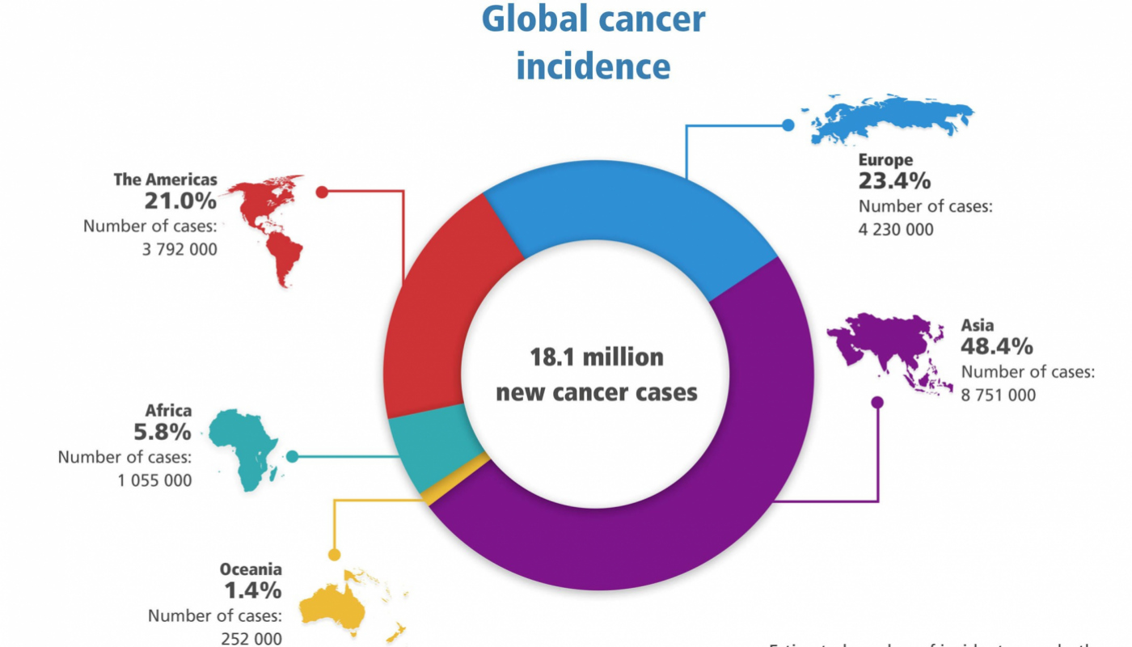

Slide 10
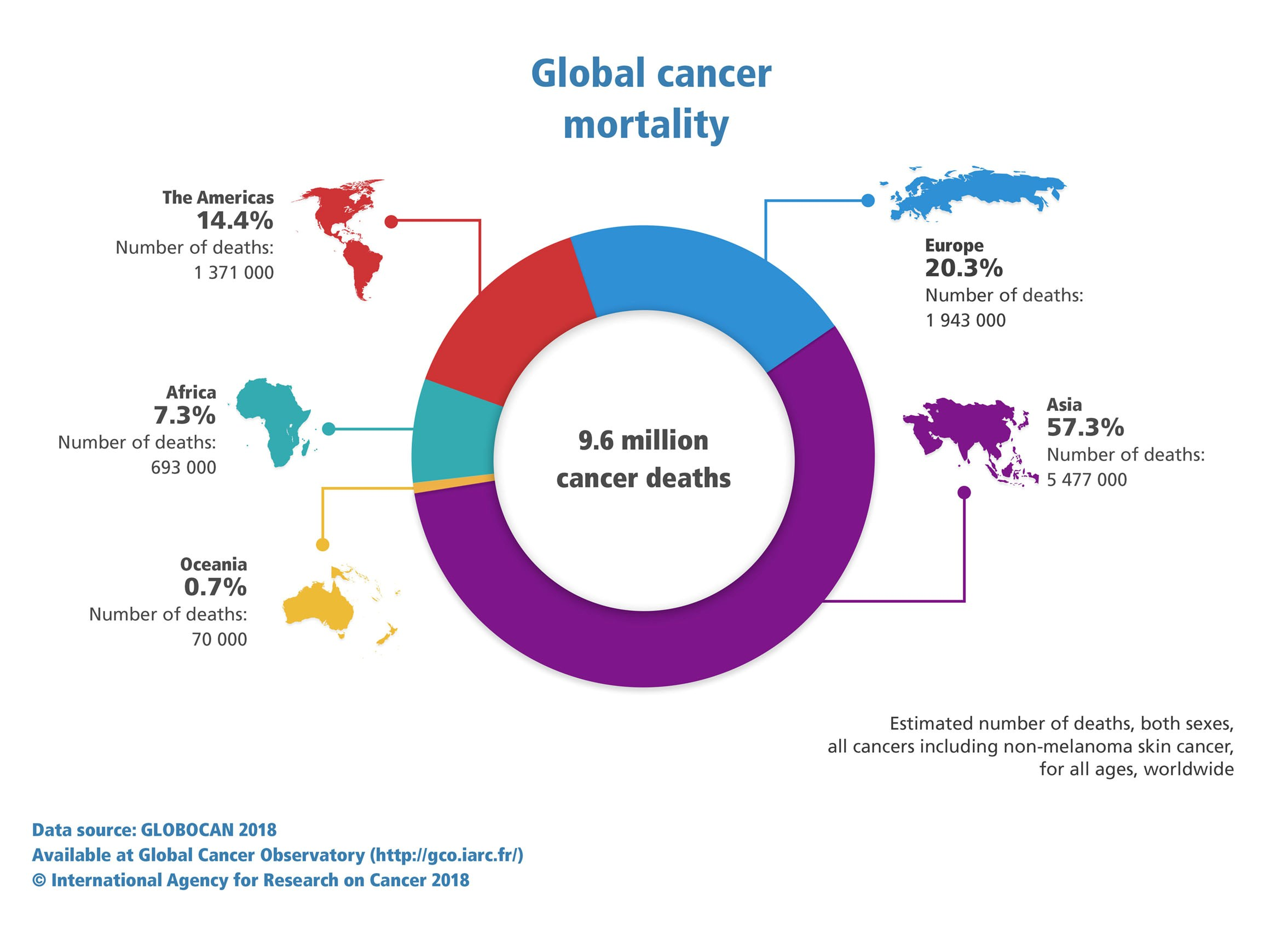

Slide 11
EPIDEMIOLOGY
Risk of developing ovarian cancer is 1-1.5% (1 in 80 women)
5th leading cause of cancer death, Leading cause of gyne cancer death
5Y overall survival: 38%
30% of neoplasm in PM♀ are malignant
7% of neoplasms in premopausal ♀ are malignant
If <20 YO, 70% germ cell & 1/3 malignant
2nd most common gynecologic cancer
7th most common cancer

Slide 12
Highest rates of ovarian cancer occur in North America, Scandinavia and Northern Europe
US data: -
accounts for 3% of all incident cancers
1/70 lifetime risk of developing ovarian cancer
Leading cause of gynaecologic cancer deaths
East Africa:-
Rates of ovarian cancer in East Africa are among the lowest in the world
In contrast to North America, ovarian cancer is not the leading cause of gynaecologic cancer death in EA
Cervical cancer causes far more deaths annually

Slide 13
Risk factors for ovarian Cancer:
Nulliparity
Infertility
Early menarche/late menopause
Endometriosis
PM estrogen therapy (HRT- E2)
Familial: BRCA1 (28-44%), smaller portion asst with BRCA2 (27%)
Hereditary nonpolyposis colorectal cancer (HNPCC) or Lynch syndrome Family Hx
Talc
Smoking
Diet
Obesity

Slide 14
PROTECTIVE FACTORS
Use of Oral Contraceptives x 5yr reduces risk by 50%
Bilateral Salpingo Ophorectomy
Tubal Ligation
Breast feeding
Multiparity
Progesterone

Slide 15
Clinical presentation

Slide 16
Clinical presentation
Asymptomatic in early stages
Symptoms secondary to pressure and tumour toxin
Vague abdominal discomfort, dyspesia and indigestion( suspicious in any woman over 40 years and warrants investigation)
Gross abdominal distension
Abdominal mass
Abdominal pain
Ascitis and pleural effusion

Slide 17
Clinical presentation …
Persistent ovarian mass enlargement is suspicious
Size of tumour not equivalent to disease severity e.g benign mucinous cysts
Consider DDx: adnexal mass( misreported on imaging as fibroid,tubo-ovarian abscess, cecal tumour, pelvic kidney), ascitis with abdominal mass( TB peritonitis)
Gross appearance at laparotomy: suggestive morphology surface/intracystic papillae, solid, bilateral, adhesions, ascitis, destructive invasion,necrosis, peritoneal implants, raptured capsule)

Slide 18
Screening for pre-cancer
No definite method
Frequent pelvic examination
Aspiration of POD for cytology
Ultrasonography and other imaging methods
CA-125

Slide 19
DEFINITIVE Diagnosis
The only way to make a diagnosis is by tissue histopathology
All cases where cancer of the ovary is suspected must undergo laparotomy, for staging, biopsy and debulking

Slide 20
Other diagnostic work ups
Tumor markers: CA125, CA 19-9
Radiological: abdominopelvic ultrasound, MRI
Features suggestive of malignancy
Thick and multi septation
Papillation
Surface irregularity
Solid components
Bilateral
High vascularity with low velocity
Necrosis
Hemorrhage
Ascitis
Metastasis to eg liver

Slide 21
Recap | complete workup for cancer of the ovary
History
Physical examination
Pelvic examination and pap smear
Proctosigmoidoscopy
CBC and urinalysis
Blood chemistries, including CA-125
Chest X-Ray
IVU
Barium enema or CT scan with contrast
Abdominopelvic ultrasound
CA 125, CA 19-9

Slide 22
Staging

Slide 23
OVARIAN CANCER
I – limited to ovaries
A – one ovary, capsule intact, no surface, neg washings
B – 2 ovaries, same as above
C1: 1 or both ovaries, with surgical spill
C2: 1 or both ovaries with capsule rupture prior to OR or ovarian surface involvement
C3: 1 or both ovaries, with positive washings tumor on surface
II – pelvic extension
A – uterus, tubes
B – other pelvic tissues
C - as A or B with tumor on surface, capsule ruptured, or ascities/washings +
III – outside pelvis
A1: positive retroperitoneal lymph nodes (IIIA1i: <10mm; IIIA1ii: >10mm
A2: microscopic extrapelvic peritoneal involvement +/- positive retroperitoneal nodes
B – macroscopic extrapelvic mets <2cm
C – macroscopic extrapelvic mets >2cm
IV
A: pleural effusion with positive cytology
B: liver or splenic parenchymal mets, inguinal nodal mets, or mets outside the abdomen
Survival
I - 75-90%
II – 60-75%
III – 25-40%
IV – 10%
Age < 50 yrs – 40%
Age > 50 yrs – 15%

Slide 24
Recap: Staging at laparotomy
Stage I: Growth limited to the ovaries
Stage II: Growth involving one or both ovaries with pelvic extension
Stage III: Tumour involving one or both ovaries with peritoneal implants outside the true pelvis and or positive retroperitoneal or inguinal nodes, superficial liver metastasis
Stage IV: Distant metastasis.

Slide 25
Guidelines for staging in Epithelial Ovarian Cancers
4 peritoneal washings (diaphragm, right and left abdomen, pelvis)
Careful inspection and palpation and inspection of all peritoneal surfaces
Biopsy or smear from undersurface of right hemidiaphragm
Biopsy of all suspicious lesions
Infracolic omentectomy
Biopsy or resection of any adhesions
Random biopsy of normal peritoneum bladder reflection, POD, right and left paracolic recesses, and both pelvic side walls(in the absence of obvious implants)
Selected lymphadenectomy of pelvic and paraaortic nodes
TAH.BSO and excision of all masses where possible

Slide 26
Management

Slide 27
Surgical Treatment in Ovarian Cancer
1. Peritoneal cytologic examination
2. Determination of extent of the disease
Pelvis
Peritoneal surfaces
Diaphragms
Omentum
Lymphnodes
3. Remove all tumour possible
Total abdominal hysterectomy and bilateral salphingoophorectomy
Plus
Node sampling and omentectomy

Slide 28
Chemotherapy
Chemotherapy
Taxol(Paclitaxel)
Cisplatin
Carboplatin
Melphalan
Cyclophosphamide
Some of these drugs are highly emetogenic
Premedication with
Dexamethason
Diphenhydramine
Cimetidine or ranitidine
ondansetron

Slide 29
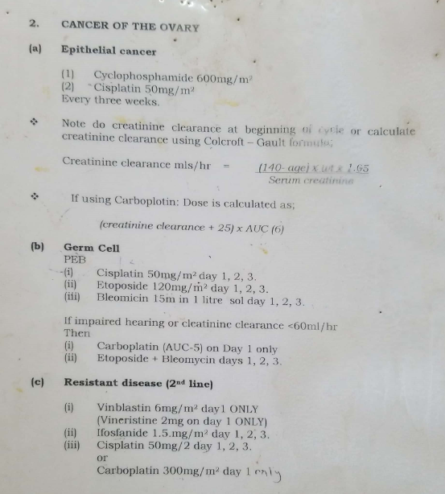

Slide 30
Chemotherapy: Drug Toxicity
Mainly on rapidly deviding cells
Haematological
Gastrointestinal
Skin
Hepatic
Lungs eg.Interstitial pneumonitis
Cardiac
Genitourinary
Neurological
Gonadol dysfunction

Slide 31
Radiotherapy
Some ovarian cancer can respond to radiotherapy eg.Dysgeminomas
Radiotherapy in ovarian cancer is limited by large area to be treated, which may lead to serious complications
Special Problems
Limits of spread often unknown
Variability of radio sensitivity
Total burden often very large
Free mobility of tumor cells within the abdominal cavity
Radiation doses restricted by neighboring organs
Infrequent detection of early disease

Slide 32
Radiotherapy…
Dose Restrictions, a challange
Tolerance of small intestines
Limited tolerance of kidneys
Bone marrow depression
Radiation enteritis caused by large volume of intestine irradiated
Adhesive peritonitis

Slide 33
Supportive treatment
Multidisciplinary approach
Pain relief
Nutritional therapy
Blood therapy
Counselling, the patient and relatives

Slide 34
Five-year Survival
Stage 1a: 84%
Stage 1b: 79%
Stage 1c : 73%
Stage 11a: 65%
Stage 11b: 54%
Stage 11c: 61%
Stage 111a: 52%
Stage 111b: 29%
Stage 111c: 18%
Stage 1V: 14%

Slide 35
Thank you

