Slide 1
Cancer of the vulva
Dr Rose Kosgei

Slide 2
Vulvar Cancer| Introduction
Fourth most common gynecologic cancer
5% percent of malignancies of the female genital tract
About 90% of all vulvar tumors is a squamous cell carcinoma
The incidence is higher among elderly women, thus, a disease of elderly women
She's just reading….so ☺

Slide 3
Epidemiology
Most frequently in postmenopausal women
Mean age at diagnosis is 65, but may be falling
Risk factors
Young age at first sexual intercourse
Multiple sexual partners
Low socio-cultural status
Infection by human papilloma virus (HPV)
Smoking
Vulvar dystrophy (eg, lichen sclerosus)
Vulvar or cervical intraepithelial neoplasia
Immunodeficiency syndromes
A prior history of cervical cancer
Two independent pathways of vulvar carcinogenesis:
Mucosal HPV infection
Chronic inflammatory (vulvar dystrophy) or autoimmune processes

Slide 4
History
Most patients present with a vulvar lump or mass, although there is often a long history of pruritus, usually associated with a vulvar dystrophy, in Kenya ulcers
Less common presenting symptoms
vulvar bleeding
Discharge
Dysuria
Pruritus
Enlarged lymph node in the groin (less common)
Occasionally a large metastatic mass in the groin may be the initial presenting symptom, although this is much less common than in the past because women are now more likely to present with earlier-stage disease.

Slide 5
Physical examination
Usually- raised lesions
May be fleshy, ulcerated, leukoplakic, or warty in appearance
Warty lesions are often initially diagnosed as condylomata acuminate
Hence need for biopsy
Most squamous carcinomas of the vulva occur on the labia majora, but the labia minora, clitoris, and perineum also may be primary sites
As part of the clinical assessment, the groin lymph nodes should be evaluated carefully and a complete pelvic examination performed
A pap smear +/- colposcopy biopsy should be performed, because of common association with other squamous cell neoplasms of the lower genitalia

Slide 6
DIAGNOSIS

Slide 7
Principles of diagnosis of cancer of the vulva
Biopsy is the mainstay of diagnosis, however, the evaluation of the patient with vulvar cancer must take into consideration:
the clinical extent of disease, the anticipated treatment plan, and the presence of coexisting medical illnesses
Initial evaluation should include a detailed physical examination with measurements of the primary tumor, assessment for extension to adjacent mucosal or bony structures, and possible involvement of the inguinal lymph nodes
Women with small cancers and clinically negative groin nodes require few diagnostic studies other than those for preoperative clearance
Additional radiographic and endoscopic studies should be considered for those with large primary tumors or suspected metastases. Potentially useful studies include barium enema, proctosigmoidoscopy, cystourethroscopy, computed tomography (CT) scan, and intravenous pyelography. Fine needle aspiration biopsy from sites of suspected metastases may eliminate the need for surgical exploration in some patients with advanced tumors
Because neoplasia of the female genital tract is often multifocal, evaluation of the vagina and cervix—including cervical cytologic screening—should always be performed in women with vulvar neoplasms

Slide 8
Biopsy
Excisional biopsy for small lesions because its curative if not a malignant lesion
If wedge biopsy, the biopsy specimen must include some underlying dermis and connective tissue so that the pathologist can adequately evaluate the depth and nature of the stromal invasion
For large lesions, it is preferable to leave the primary lesion in situ, if possible, to allow the treating surgeon to fashion adequate surgical margins
Physician delay is a common problem in the diagnosis of vulvar cancer, particularly if the lesion has a warty appearance. Although isolated condylomata do not require histologic confirmation for diagnosis, any confluent warty lesion should be biopsied adequately before medical or ablative therapy is initiated

Slide 9
Reasons for delay in diagnosis
Patient related -Ignorance , stigma , sociocultural, fear,
Health system -Distance to facility, lack of diagnostics
Doctor related – misdiagnosis
Question: discuss reasons for delay in treatment of cancer vulva

Slide 10
Histological types
Squamous Cell Carcinoma
Verrucous carcinoma
Melanoma
Basal Cell Carcinoma
Sarcoma
Paget Disease
Bartholin gland adenocarcinoma

Slide 11
Squamous Cell Carcinoma
Over 90 percent of vulvar malignancies are squamous cell carcinomas
2 subtypes
The keratinizing, differentiated, or simplex type is more common
occurs in older women
not related to HPV infection
Associated with vulvar dystrophies such as lichen sclerosus and, in developing countries, chronic venereal granulomatous disease
The classic, warty, or Bowenoid type
Associated with HPV 16, 18, and 33
Found in younger women

Slide 12
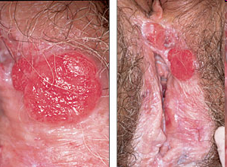

Slide 13
Verrucous carcinoma
Cauliflower-like in appearance
Differentiated from squamous cell carcinoma with a verrucous configuration by biopsy of the lesion base, which shows papillary fronds without the central connective tissue core typical of condylomata acuminata
Grows slowly and rarely metastasizes to lymph nodes, but it may be locally destructive.

Slide 14
Melanoma
5 to 10 percent of primary vulvar neoplasms
Postmenopausal white non-Hispanic women
Median age of 68 years
Vulvar melanoma is usually a pigmented lesion, but amelanotic lesions also occur
Most arise on the clitoris or labia minora, but can also develop within preexisting junctional or compound nevi

Slide 15
Basal Cell Carcinoma
2 percent of vulvar cancers are basal cell cancers and 2 percent of basal cell cancers occur on the vulva
Postmenopausal Caucasian women
"rodent" ulcer with rolled edges and central ulceration; the lesion may be pigmented or pearly and gray
Often asymptomatic, but pruritus, bleeding, or pain may occur

Slide 16
Sarcoma
1 to 2 percent of vulvar malignancies.
Prognosis is generally poor

Slide 17
Paget Disease
< 1 percent of all vulvar malignancies
60s and 70s and Caucasian
Pruritus is the most common symptom
Eczematoid appearance
Well-demarcated and has slightly raised edges and a red background, often dotted with small, pale islands
multifocal and may occur anywhere on the vulva, mons, perineum/perianal area, or inner thigh.
Invasive adenocarcinomas may be present within or beneath the surface lesion
Women with Paget disease of the vulva should also be evaluated for the possibility of synchronous neoplasms, as approximately 20 to 30 percent of these patients have a noncontiguous carcinoma (eg, involving breast, rectum, bladder, urethra, cervix, or ovary)

Slide 18
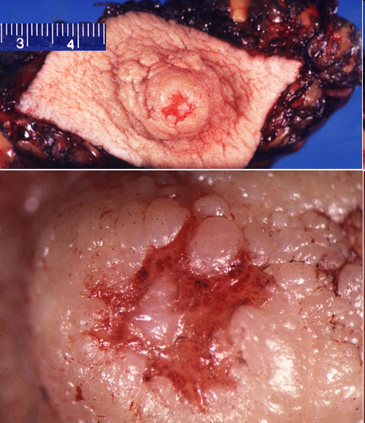

Slide 19
Bartholin gland adenocarcinoma
Rare malignancy
Cancers arising in Bartholin gland are most often adenocarcinomas or squamous cell carcinomas,
The median age at diagnosis of Bartholin gland cancer is 57
Solid and infiltrate deep into the vulva
Enlargement of the Bartholin gland in a postmenopausal woman is worrisome
Metastatic disease is common because of the rich vascular and lymphatic network

Slide 20
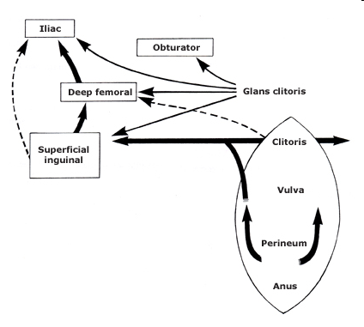
Modes of spread
Direct extension to adjacent structures (eg, vagina, urethra, clitoris, anus).
Lymphatic embolization to regional lymph nodes
Hematogenous dissemination
occurs late in the course of the disease is rare in patients without inguinofemoral lymph node involvement

Slide 21
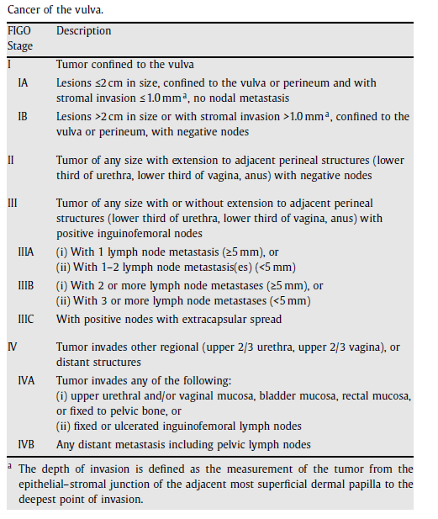
Staging

Slide 22
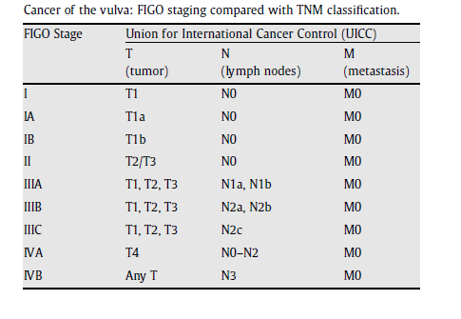

Slide 23
Treatment
Surgery
Radiation

Slide 24
Stage 0
Recurrences are common at perianal skin, presacral area, and clitoral hood
Wide local excision
Laser
Skinning vulvectomy with or without grafting
5% fluorouracil cream
Response rate of 50%-60%
Not a reliable first choice for treatment

Slide 25
Stage IA & IB (T1a & T1b, N0) and II (T2, N0)
1) Wide local excision alone (2cm margin)
Only for T1a (≤2cm with <1mm invasion)
2) Radical local excision with complete unilateral lymphadenectomy
For well lateralized T1b (<5mm invasion, no LV invasion, cN0)
Local control 90-95% (similar to radical vulvectomy)
3) Radical vulvectomy with bilateral inguinal and femoral node dissection
Separate groin incisions to decrease morbidity
Superficial lymphadenectomy for select early lesions
Groin radiotherapy instead of dissection for unfit or those who refuse Sx (randomized study was poorly done; retrospective shows equivalence)
Adjuvant radiotherapy for:
Margins <8mm on the primary tumor
Lymphovascular space invasion
Thickness >5mm
LN+ (>1 or >2 microscopic or 1 with extracapsular spread)
4) Radical radiotherapy
If unable to tolerate or unsuitable for Sx because of site or extent of disease
EBRT (45Gy/25#) & brachy boost (total dose 90-100Gy with LDR)
EBRT (45Gy/25#) & conformal boost (total dose 54-64.8Gy)

Slide 26
Stage III (T3 or N1-unilateral) and IVA (T4 or N2-bilateral)
Radiotherapy improves overall survival in comparison with pelvic node dissection (in N+, >1LN)
Modified radical vulvectomy with bilateral inguino-femoral node dissection
Radical vulvectomy and pelvic exenteration for more advanced lesions
Post-op RT is used for:
Margins <8mm on the primary tumor
lymphovascular space invasion
Thickness >5mm or bone invasion
LN+ (>1 or >2 microscopic)
2) Preoperative radiation therapy
To improve operability and to decrease the extent of surgery
45-50Gy +/- 5-FU/cisplatin concomitantly
3) Radical RT
May be combined with concomitant 5-FU +/- cisplatin
45Gy/25# pelvis and boost GTV to a total 54-64.8Gy (LDR is higher)
CR rate 50-90%
3-y DFS 50-80%
Residual disease may need local resection

Slide 27
Recurrent disease
5-y survival ~50% with radical treatment of localized disease (M0)
1) Wide local excision +/- radiotherapy
2) Radical vulvectomy and pelvic exenteration
3) Synchronous radiation and cytotoxic chemotherapy with or without surgery
4) No standard chemotherapy or other systemic treatment for metastatic disease

Slide 28
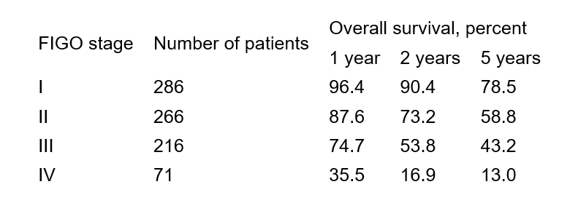
Survival

