Slide 1
MEDICAL ETHICS AND HARMFUL TRADITIONAL PRACTICES IN RH
Professor Joseph G. Karanja
Dept Obs /Gynae,
University of Nairobi

Slide 2
Outline
Definitions of ethics, bioethics
Contributing disciplines
Bioethics in Reproductive Health
Principles of Bioethics
Management of Infertility
Contraception, sex selection, abortion
Privacy and confidentiality
Doctor-patient Relationship
Research: genetic, stem cell, cloning
Euthanasia: “mercy killing”

Slide 3
Definition of ETHICS
A discipline of moral principles that include values and judgments applicable to medical practice
Ethics and law are different but they often may interact
Law addresses what must be done, may be done, must not be done
Legal choices are often guided by ethical considerations

Slide 4
Bioethics
Combines “bio” = biological knowledge or science of living systems and “ethics” = knowledge of human value systems
A multidisplinary field of enquiry both academic and professional that addresses ethical issues in clinical practice and health care, biomedical research involving humans and animals, health policy and environment

Slide 5
Ethics is multidiscipline or interdiscipline
Has contributions from:
Philosophy
Biology
Medicine
Nursing
Health care science
Law
Human rights
Religious studies

Slide 6
Bioethics in Reproductive Health
Reproductive health care often presents medical, ethical and bioethical issues in particularly challenging forms:
Confidentiality and privacy
Contraception
Abortion
Assisted Reproductive Technology: AID (H/D); IVF-ET; selective embryo reduction, surrogacy
Treating minors for sensitive conditions; Informed consent; involving parents or guardians

Slide 7
Principles of Bioethics
Respect for persons
Autonomy of capable persons
Protection of persons incapable of autonomy- vulnerable groups such as children, ppl with disability
Beneficence
Non-Maleficence
Justice

Slide 8
Protection of Autonomy
Protection of autonomy of capable persons:
Informed choices offered
Voluntary Informed consent – without undue pressure or inducement
Protection of autonomy of incapable persons:
against harm or distress in children; however reasonable pressure acceptable eg to allow vaccination, FGM not acceptable

Slide 9
Beneficence
Do good; maximize good
Make health care available, accessible and affordable for all
Maternal-foetal conflict
Special precaution and considerations for medical research on pregnant women to develop therapies beneficial to women
Adequate information to help women make decision

Slide 10
Non-Maleficence
Do no harm
Distinguish between harms and wrongs
Harms: injury, pain, disability, or distress, damaged self-esteem, causing people to feel used, exploited, treated disrespectfully.
Wrongs: eg causing injury, pain, disability, or distress, damaged self-esteem, causing people to feel used, exploited, treated disrespectfully.
“Harmless wrong” is unethical

Slide 11
Justice
Law and courts are concerned with punitive, compensatory justice
Bioethics is concerned with distributive justice
Fairness, all people receive the rights for which they are entitled
Gender equity but recognition of biological differences, therefore:
Women should have access to contraception, safe abortion services, antenatal intrapartum and postpartum care

Slide 12
Management of infertility
Health care providers need to differentiate their personal and professional responsibilities; conscientious objection
Assisted reproductive technology (ART)
Artificial insemination by husband or donor
In vitro fertilization and embryo-transfer IVF-ET; selective embryo reduction
Surrogacy: “renting womb” with husband or donor sperm

Slide 13
Abortion
Definitions: TOP (termination of pregnancy), abortion, spontaneous, induced, safe abortion, unsafe abortion
Medical ethics/rationale of providing safe abortion services- save the mother over the fetus
Only 3 countries in the world prohibit abortion all together
All other countries permit for one or more of indications: emergency, life, health, fetal congenital abnormalities, sexual violence, socioeconomic if they cant bring up the next child, on request

Slide 14
Unsafe abortion
WHO defines unsafe abortion as “a procedure for terminating an unwanted pregnancy either by persons lacking the necessary skills or in an environment lacking the minimal medical standards or both.”
Unsafe abortion is one of the BIG FIVE CAUSES of maternal death

Slide 15
Unsafe abortion is a preventable problem
Unsafe Abortion is “ ......... an important cause of maternal death that can, and should, be prevented through the promotion of sexuality education, family planning, safe abortion services to the full extent of the law, and post-abortion care in all cases”
Safe Abortion - Technical and Policy Guidance for Health Systems (WHO, 2012)

Slide 16
Legal Framework for TOP
Article 26 (4) of Constitution of Kenya 2010 allows abortion in the following circumstances:
In an emergency situation
When pregnancy threatens the life of the woman
When pregnancy threatens the health of the woman
If allowed by any other written law eg the Health Act 2017
University of Nairobi ISO 9001:2008 16 Certified http://www.uonbi.ac.ke

Slide 17
Abortion debate unendingg …
“Abortion is an ancient and controversial issue that will remain with us as long as women continue to conceive. It includes the tragedy of parental anguish and the death of a living embryo. As a result it has become a highly charged issue, a political football associated with half truths, distorted truths and vitriolic accusations”
Milton D. Heifetz, a noted neurosurgeon, and author of Ethics in Medicine
Notes:
author Milton D. Heifetz
17

Slide 18
Principles of Good Medical Practice
Make the care of your patient your first concern
Treat every patient politely and considerately
Respect patients’ dignity and privacy
Listen to patients and respect their views
Give patients information in a way they can understand
Respect the right of patients to be fully involved in decisions about their care
Keep your professional knowledge and skills up to date

Slide 19
Good Professional practice, cont …
8. Recognize the limits of your professional competence
9. Be honest and trustworthy
10. Respect and protect confidential information
11. Make sure your professional beliefs do not prejudice your patients care
12. Act quickly to protect patients from risk if you have good reason to believe that you or a colleague may not be fit to practice

Slide 20
Good Professional practice, cont …
13. Avoid abusing your position as a health professional
14. Work with colleagues in ways that best serve patients interests
Adapted from British Medical Council

Slide 21
Beneficial Cultural Practices in RH
Encouraging abstinence till marriage
Discouraging teenage marriages and extramarital sex
Avoiding harmful applications on umbilical cord
Encouraging breast feeding for 1-2 years
Encouraging education and training for girls and boys
Encouraging gender equality and equity

Slide 22
Harmful cultural practices
FGM
Child marriages
Forced marriage
Sexual and gender based violence
Incest, defilement, sexual slavery
Food taboos
Wife inheritance
Gender discrimination
Others???

Slide 23
Female Genital Mutilation

Slide 24
REASONS FOR FGM
Reasons given to Justify FGM may include:
custom and tradition
social acceptance, especially for marriage
family honor
a sense of belonging to the group and conversely the fear of social exclusion
cultural identity – a tribal initiation into adulthood
religion, in the mistaken belief that it is a religious requirement
preserving virginity / chastity
hygiene and cleanliness
enhancing fertility

Slide 25
WHO IS AT RISK OF FGM
it is estimated 2 million girls around the world every year are affected
mainly girls from Africa and the Middle East, but also some girls in the immigrant population of Europe, America and Australia
girls aged between 4 and 14 are most at risk but older or younger girls could also be at risk

Slide 26
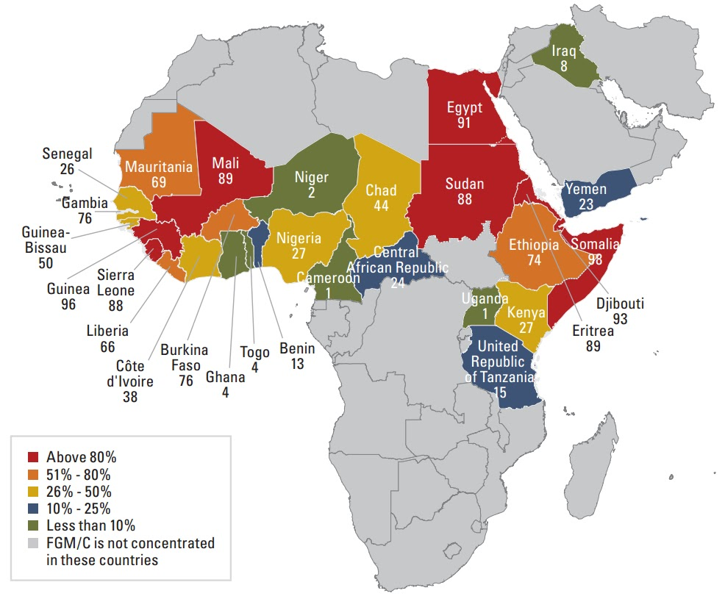
Pevalence of in Africa and ME

Slide 27
Complications fgm
Haemorrhage
Infection
Trauma to genital organs and surrounding organs
Difficulties in labour and delivery
Dyspareunia,,
Urinary retention
Haematocolpos. Haematometra, haematosalpinges
Haemoperitoneum,
Infertility
Tetanus

Slide 28
Resources for further reading: Bioethical Declarations
The Nuremberg Code 1947
The Geneva Declaration (modern version of Hippocratic Oath)
International Code of Medical Ethics, 1949
Declaration of Helsinki on human experimentation, 5th amendment, October 2000
Code of Professional Conduct and Discipline, Kenya MPDB, 6th edition, 2012
On FGM : Prohbition of fgm Act {of Kenya)

Slide 29
THE END
THANK YOU

