Slide 1
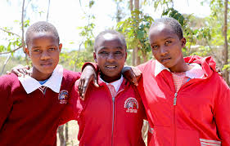
ADOLESCENT REPRODUCTIVE HEALTH
DR MAUREEN OWITI
MEDICAL SPECIALIST KNH
HONORARY LECTURER UON
I didn’t pay attention…. YOLO

Slide 2
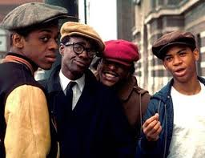
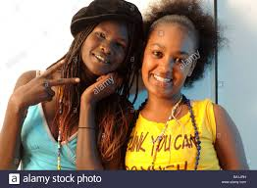
ADOLESCENT
ANY PERSON AGED BETWEWN 10-19 YEARS
24% of Kenyan population are aged between 10-19 years, so a huge chunk of the population are adolescents. 2009 Kenya Population and Housing Census

Slide 3
Reproductive health
Reproductive Health: This is a state of complete physical, mental and social well-being, and not merely the absence of disease or infirmity, in all matters relating to the reproductive system, its functions and processes.

Slide 4
Sexual, Reproductive Health and Rights:
The exercise of control over one’s sexual and reproductive health linked to human rights and includes the right to:
Reproductive health as a component of overall health, throughout life cycle, for both men and women;
Reproductive health decision-making, including voluntary choice in marriage, family formation, determination of the number, timing and spacing of one’s children, right to access information and means needed to exercise voluntary choice;
Equality and equity for men and women, to enable individuals to make free and informed choices in all spheres of life, free from discrimination based on gender; and
Sexual and reproductive health security, including freedom from sexual violence and coercion, and the right to privacy.

Slide 5
Sexual health:
A state of physical, emotional, mental and social well-being in relation to sexuality; it is not merely the absence of disease, dysfunction or infirmity. Sexual health requires a positive and respectful approach to sexuality and sexual relationships, as well as the possibility of having pleasurable and safe sexual experiences, free of coercion, discrimination and violence. For sexual health to be attained and maintained, the sexual rights of all persons must be respected, protected and fulfilled.

Slide 6
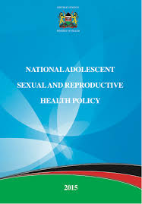
Kenya national adolescent reproductive health policy
First policy made in 2003
Current policy made in 2015
The aim of the ASRH Policy is to enhance the SRH status of adolescents in Kenya and contribute towards realization of their full potential in national development. The Policy intends to bring Adolescent Sexual and Reproductive Health and Rights issues into the mainstream of health and development.

Slide 7
Broad objective of the policy:
Promote an enabling legal and socio-cultural environment for provision of SRH information and services for adolescents;
Enhance equitable access to high quality, efficient and effective adolescent friendly ASRH information and services;
Increase gender equity and equality in SRH amongst adolescents;
Strengthen inter-sectoral coordination and networking, partnership and community participation in adolescent SRH;
Support adolescent participation and leadership in SRH planning and programming at all levels; and
Strengthen collection, analysis, and utilization of age and sex disaggregated data on adolescents.

Slide 8
Specific objectives of the policy:
Promote adolescent sexual reproductive health and rights;
Contribute to increased access to ASRH information and age appropriate comprehensive sexuality education (AACSE);
Contribute to reduction of STIs burden, including HPV and HIV as well as improvement of appropriate response for infected adolescents;
Reduce early and unintended pregnancies;
Reduction of harmful traditional practices;
Reduce drug and substance abuse;
Reduce Sexual and Gender-Based Violence (SGBV) incidences amongst adolescents to improve response; and
Address the special SRHR-related needs of marginalized and vulnerable adolescents.

Slide 9
Sexual Debut, Contraception:
The median age at first sexual intercourse in Kenya was 18.2 years for women and 17.6 years for men (KDHS 2008-2009)
12% of girls and 22% of boys reported to have had sex by the age of 15.
37% of girls and 44% of boys aged 15 to 19 years have had sex.
Among married adolescent women aged 15-19, 40% were currently using any method of contraception and 37 percent were using a modern method.
Notably, contraceptive use among adolescents varies by region, residence, education, household wealth and marital status.
One in three adolescent married girls (30%) had an unmet need for family planning.

Slide 10
FERTILITY
The Age Specific Fertility Rate (ASFR) for women in Kenya aged 15-19 is 96 births per 1,000 women and most recently it is estimated to have increased to 121 births per 1,000 women.
Even though the ASFR for adolescents has declined over the years, the contribution of a large pool of young women to total fertility rate is significant and increasing because of their absolute numbers, early child bearing, marriage at a young age an unfortunately sexual abuse.

Slide 11
PREGNANCY:
Adolescents face greater adverse complications during pregnancy because they are not fully physiologically and biologically prepared for pregnancy due to among other factors gynecological immaturity and incomplete pelvic growth. Other underlying factors include smoking, substance abuse, anemia, malaria, HIV and AIDS as well as other sexually transmitted infections.

Slide 12
Pregnancy cont.:
Adolescents may be disadvantaged in maintaining a healthy pregnancy due to poor health education, inadequate access to antenatal care and skilled birth attendance among other healthcare services, or the inability to afford costs of pregnancy and childbirth.
Adolescent pregnancy, whether intended or unintended, increases the risk of maternal mortality and morbidities including complications of unsafe abortion, prolonged labor, delivery and post-natal period.

Slide 13
Consequences unintended pregnancy in adolescents
Pregnancy and delivery complications, including unsafe abortion, are the second leading causes of death for girls below 20 years.
58 percent to 80 percent of women with obstetric fistula are under the age of 20.
Approximately 13,000 girls drop out of school annually in Kenya due to early and unintended pregnancy

Slide 14
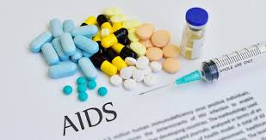
Stis, HIV and AIDS:
HIV prevalence has decreased significantly among young people aged 15 to 19 years, declining from about 3.0 percent in 2003 to 1.1 percent in 2012.
The HIV prevalence rate for adolescents aged 15-19 was almost similar for young women (1.1%) and young men (0.9%), while adolescents living in urban areas had higher HIV prevalence rates (2.2%) compared to their rural counterparts (0.5%).
For those who reported first sex before 15 years, HIV prevalence was 5.3 percent among young women and 0.3 percent among young men.
Key populations of adolescents such as men who have sex with men, injecting drug users and sex workers are at an increased risk of HIV infection.
An estimated 20-40% of female sex workers began commercial sex work before the age of 18 and a recent study in Kenya found a baseline HIV prevalence of 40% among young MSM who sell sex in Nairobi.

Slide 15
Harmful practices:
A number of social and cultural practices, some rooted in traditional attitudes and others evolving around modern times, have a direct impact on reproductive health activities and status of adolescents and young people. Among those of most urgent concern to the Policy are Female Genital Mutilation (FGM), sexual abuse and violence, drug and substance abuse as well as child marriage.

Slide 16
Sexual abuse and violence
According to a national study by UNICEF (2012) on violence against children in Kenya, adolescent girls aged 13-17 were more likely to have experienced sexual violence in the previous 12 months (10.7%) compared with similar age group of boys (4.2%).
Nearly half of both adolescent girls and boys reported experiencing physical violence in the 12 months preceding the survey.
Adolescents who suffer sexual abuse are more likely to be exposed to unintended pregnancy, unsafe abortion and STIs including HIV.

Slide 17
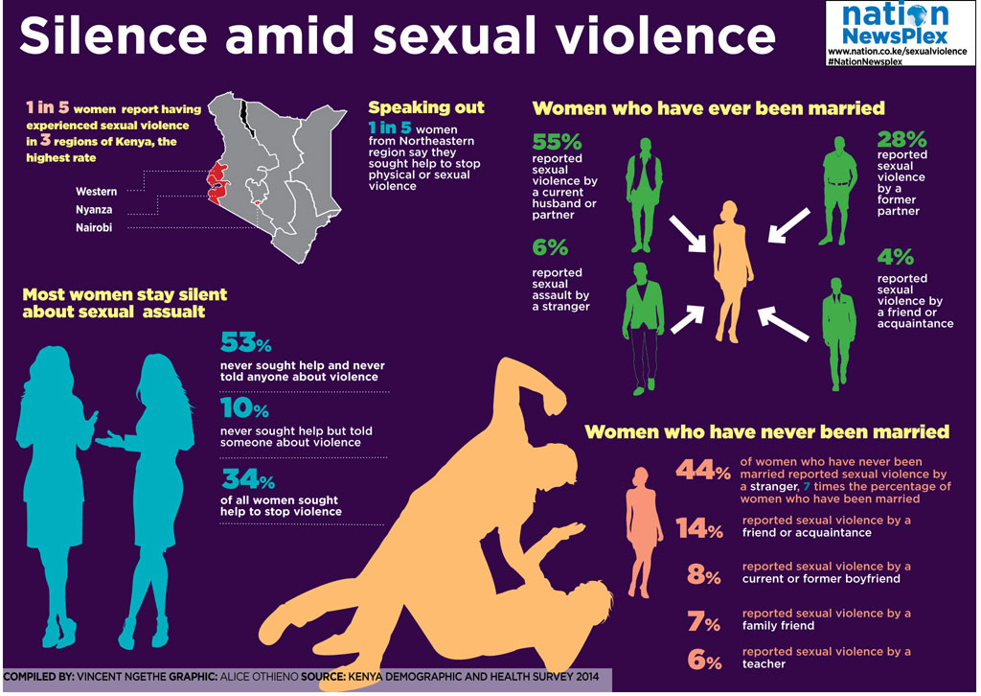

Slide 18
Drug and substance abuse
According to a 2012 rapid assessment of drugs and substance use in Kenya, about 18% of adolescents aged 15-17 reported ever using any drug or substance, including tobacco, Khat (Miraa), narcotics and inhalants.
Specifically, about 2% of females and 4% of males aged 10-14 and about 11% of 15-17 year olds reported ever using alcohol.
Despite the need for services to address substance abuse, very few drug rehabilitation programs and counseling centers are available for adolescents in Kenya and these tend to be urban-based.
For adolescents, substance use and abuse is associated with increased risk for early sexual debut, multiple sexual partners and early childbearing.

Slide 20
Female genital cut/mutilation (fgc/fgm):
Female Genital Mutilation (FGM) is a deeply rooted cultural practice that remains prevalent in Kenya despite being outlawed in 2001 by the Children’s Act and Prohibition of FGM Act 2011, and being a violation of rights.
Female Genital Mutilation is associated with immediate and long term social, physical, psychological and health consequence.
Among young girls aged 15-19, FGM declined from 15% in 2008 to 11% in 2014, however in some communities the practice is nearly universal, for example, the North Eastern region (98%).
Girls who have undergone FGM as a rite of passage are likely to drop out of school, experience child marriage and early child bearing.

Slide 21
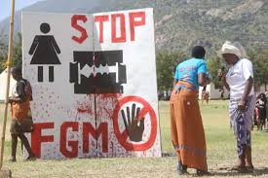

Slide 22
Child marriage:
According to KDHS 2008-2009, 6% of females were married by age 15 and 26% by age 18.
Estimates of child marriage in Kenya generally vary by place of residence and region, with higher prevalence in rural areas (31%) relative to urban areas (16%). It is highest in North Eastern (56%) and Coast (41%); and lowest in Nairobi (7%).
Child marriage is associated with termination of education (dropping out of school), low labor force participation, increased risk of HIV infection, heightened risk of gender-based violence (GBV), early childbearing as well as high fertility rates. There is also a risk of high infant mortality as well as maternal morbidity and mortality.

Slide 24
MARGINALIZED AND Vulnerable adolescents:
Adolescents living in informal settlements:
Adolescents in the labor market
Adolescents with disabilities
Adolescents living with HIV
Married adolescents
Orphaned adolescents
Adolescents in humanitarian/emergency situations:

Slide 25
Adolescents living in informal settlements
31% of Kenyan population live in informal settlements or slums. Heightened poverty and limited opportunities, expose young people to risky sexual behaviors including early sexual debut, low contraceptive use, transactional sex, sexual coercion/abuse, high burden of unintended pregnancies, and drug and alcohol abuse.

Slide 26
Adolescents in the labour market
Child labor is internationally considered work undertaken by children between the ages of five and 17 years that prevents them from attending school, is exploitative, hazardous or inappropriate for their age.
In the International Labor Convention No. 182, the worst forms of child labor are defined as trafficking, prostitution, pornography, recruitment of children for armed conflicts and use of children for illicit activities.
In Kenya, the law recognizes the age of employment as 16 years and above (GoK Employment Act, 2007).
According to the Kenya Integrated Household and Budget Survey 2005-2006, approximately one million children aged between five and 17 years were working. More than half of the working children were boys (53%) and the majority (90%) were found in rural areas.

Slide 27
Adolescents with disabilities
Adolescents with disabilities: The declaration of an African Decade of Persons with Disabilities (1999-2009) recognizes that disability severely affects chances of gaining an education. In addition people with disabilities cannot easily access health services, and this has implications on their sexual and reproductive health.
The prevalence of disability among adolescents 10-19 years in Kenya is estimated at about four percent with one out of six reporting their first pregnancy by age 20.
While in Kenya data is not available specifically for adolescents with disability, estimates for youth (15-24 years) show that about 87 percent were married or in a relationship but only 12 percent were using a modern contraceptive method.

Slide 28
Adloescents living with hiv
Adolescents living with HIV face unique challenges as they transition to adulthood because they are less likely to be in school, more likely to be orphaned, lack appropriate services and are often unable to negotiate contraceptive use or even access contraceptive methods.
Of the approximately 1.6 million Kenyans living with HIV in 2013, about 16 percent were children and adolescents (0-19 years).
About half of adolescents (15-19 years) had ever been tested and only a quarter of those knew their HIV status (24%).
Among sexually active HIV positive adolescents, only a quarter reported using condoms at their first sexual intercourse.

Slide 29
Married adolescents
Married adolescents experience sexual intercourse more frequently compared with girls who are not married, with very limited condom use despite a higher risk of HIV.
Evidence suggests that the age gap between married adolescents and their partners tends to be large, while marriage to peers is often a coping mechanism usually in the context of an unintended pregnancy.
Partly due to limited education, married adolescents have less access to SRH information and services, while power imbalance within relationships increases their odds to intimate partner violence.

Slide 31
Orphaned adolescents
According to KAIS 2012, there are about 1.8 million orphans aged zero to 17 years in Kenya, with a higher proportion among 10 to 17 year olds (66%). Estimates range from about 30 percent in Nyanza to about four percent in Nairobi.
Nearly half of the estimated number of orphans in Kenya is as a result of the HIV and AIDS epidemic.
Orphans tend to lack guidance and support which is associated with increased vulnerability to risky behaviors among children.

Slide 32
Adolescents in humanitarian/emergency situations:
In 2012, the number of internally displaced persons (IDPs) in Kenya was estimated at between 250,000 and 300,000 people.
Kenya also hosts one of the largest refugee populations in Sub-Saharan Africa, with an estimated 580,111 registered refugees and asylum seekers resident in the country.
Evidence shows that displaced women and more so adolescents face particularly high levels of maternal mortality, unmet need for family planning, complications following unsafe abortion and increased gender-based violence as well as sexually transmitted infections, including HIV.

Slide 33
Adolescents in humanitarian/emergency situations:

Slide 34
Menstrual hygiene
Menstrual hygiene not covered in policy however cause for many young girls not attending school for several days.
Huge campaigns on providing sanitary towels
Need for implementation of newer more cost effective technologies e.g. menstrual cap – need for access to safe water

Slide 35
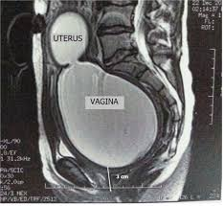
IMPERFORATE HYMEN
Common causes of in-patient management of adolescent girls
Debilitating leading to lost school/work hours
Requires surgical intervention

Slide 36
Reproductive tract cancers
Teratomas and ovarian malignancies
Cervical cancer
Cancer of the vulva
Choriocarcinoma

Slide 37
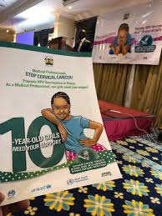
Cervical cancer prevention

Slide 38
THANK YOU!!!

