Slide 1
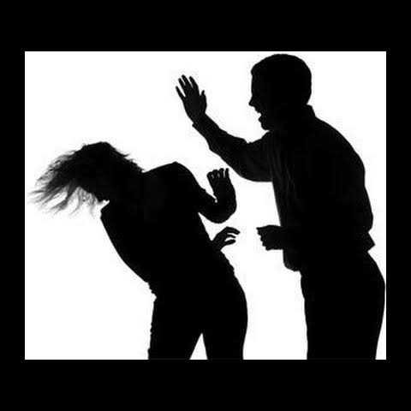
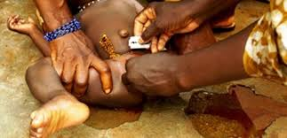
Gender based violence(IPV) the pentavalent jeopardy for the victim/ survivor
By Dr Kihara Anne B
President of AFOG and EMR
President Emeritus KOGS
Senior Lecturer UON, Dept. Obs/ Gyn
Consultant Obs/ Gyn

Slide 2
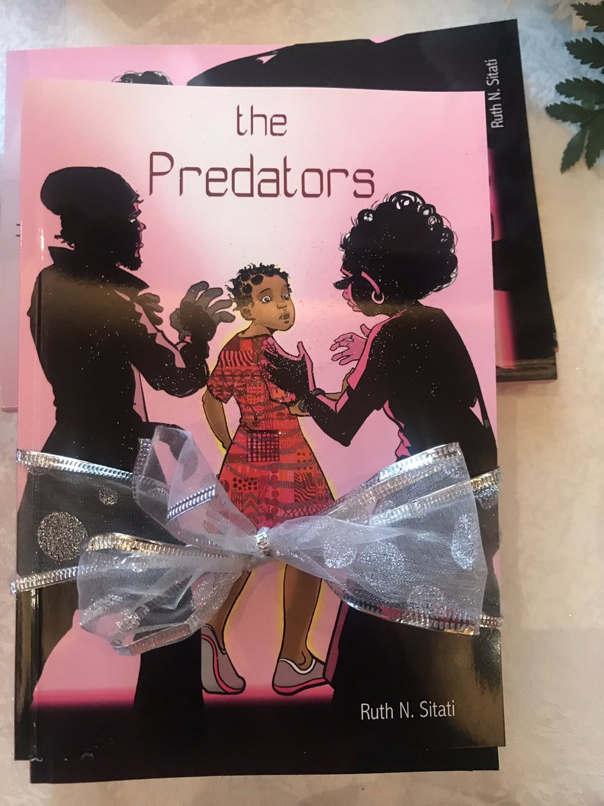
Launched in December 2019
Author Lady Justice Ruth Sitati .
Great insights of on-goings in Kenya from the lens inside and outside of the courtroom

Slide 3
Gender based violence
GBV is rooted in power and gender inequalities and inequities. The causes of GBV are multi-dimensional and deeply rooted in unequal power relations with structural and cultural determinants.
This is the most pervasive violation of human right with effects on public, social and economic development.
Gender-based violence undermines the health and well – being, dignity, security and autonomy of its survivors and unfortunately some die.

Slide 4
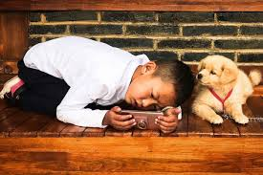
Gender based violence cont…
The forms are many and diverse and occurs even in consensual relationships. It is on the increase and does respect public, social, economics or borders!
The abuse includes:
Verbal
Psychological
Physical
Sexual
Emotional
Trafficking
Homicide
Sexting and pornography against children
Violence in humanitarian crisis
Harmful practices- FGM, child marriages , teenage pregnancies
Social media violation

Slide 5
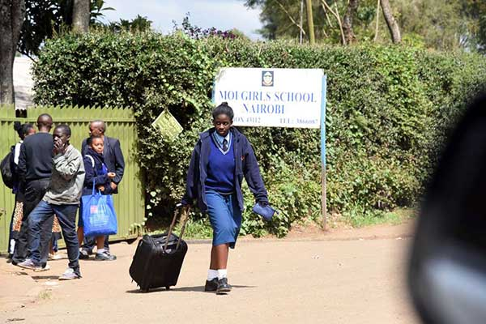
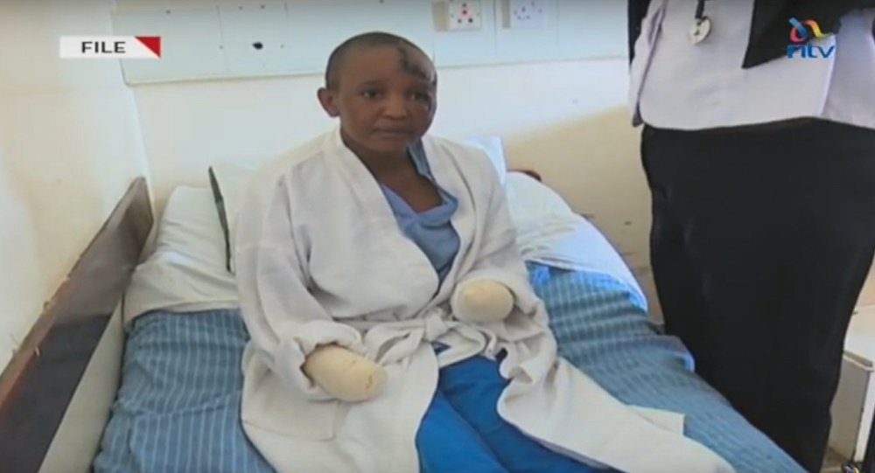
GBV is a Public Health Issue
Fatal Outcomes | Non-fatal Outcomes
Femicide Suicide AIDS-related mortality Maternal mortality | Physical | Sexual & Reproductive | Psychological & Behavioral
 | Fractures Chronic pain syndromes Fibromyalgia Permanent disability Gastro-intestinal disorders | Sexually-transmitted infections, including HIV Unwanted pregnancy Pregnancy complications traumatic gynecologic fistula Unsafe abortion | Depression and anxiety Eating and sleep disorders Drug and alcohol abuse Poor self-esteem Post-traumatic stress disorder Self harm
Source: Adapted from Bott, Morrison and Ellsberg, 2005.
Notes:
5
Suggested Narrative:
GBV has been linked to many serious health problems, both immediate and long-term. More often than recognized, gender-based violence can be fatal, as in the case of femicide or killing of women, usually after escalating bouts of violence. Other nonfatal problems include injury, chronic pain syndromes, and gastrointestinal disorders; and a range of mental health problems, including anxiety and depression. The often chronic nature of gender-based violence also increases a variety of negative behaviors, such as smoking and alcohol and drug abuse.

Slide 6
Gender based violence is a manifestation of pentavalent problem
Systems thinking
Society
Community
Relationship
Individual
Society
norms and social capital
notions of masculinity
gender roles
Social determinants
Lack of legislation and policies
Risk mitigation- changing environments to prevent , manage and overcome risks
maleness
witnessing marital violence as child
Persons with disability
being abused as child
alcohol and drug abuse
considered a socio- cultural norm
poverty
unemployment
family isolation
poor support systems
marital conflict
Interpersonal relationships
male control of wealth
male control of decision making in family
Communicable diseases
Distorted care giving
Modified WHO Ecological Model adapted to risks of GBV
Notes:
6
Social protection is concerned with preventing, managing, and overcoming situations that adversely affect people's well being.
Ministry of labour and social protection – community services; inua jamii, child protection , registry

Slide 7
Epidemiology of GBV
World Health Organization, approximately one in three women worldwide have experienced violence in their lifetime. Intimate partner violence is the most common form of violence.
Kenya has robust policies and laws that seek to prevent and respond to GBV and is also a signatory to international and regional human rights frameworks that aim to prevent and respond to GBV.
However, Country data shows that 45 percent of women and 44 percent of men age 15-49 have experienced physical violence, and 14 percent of Kenyan women age 15-49 have experienced sexual violence.
Child abuse is reported nationally to have 22% undergoing FGM; 23% with child marriages and rampant in 22 counties

Slide 8
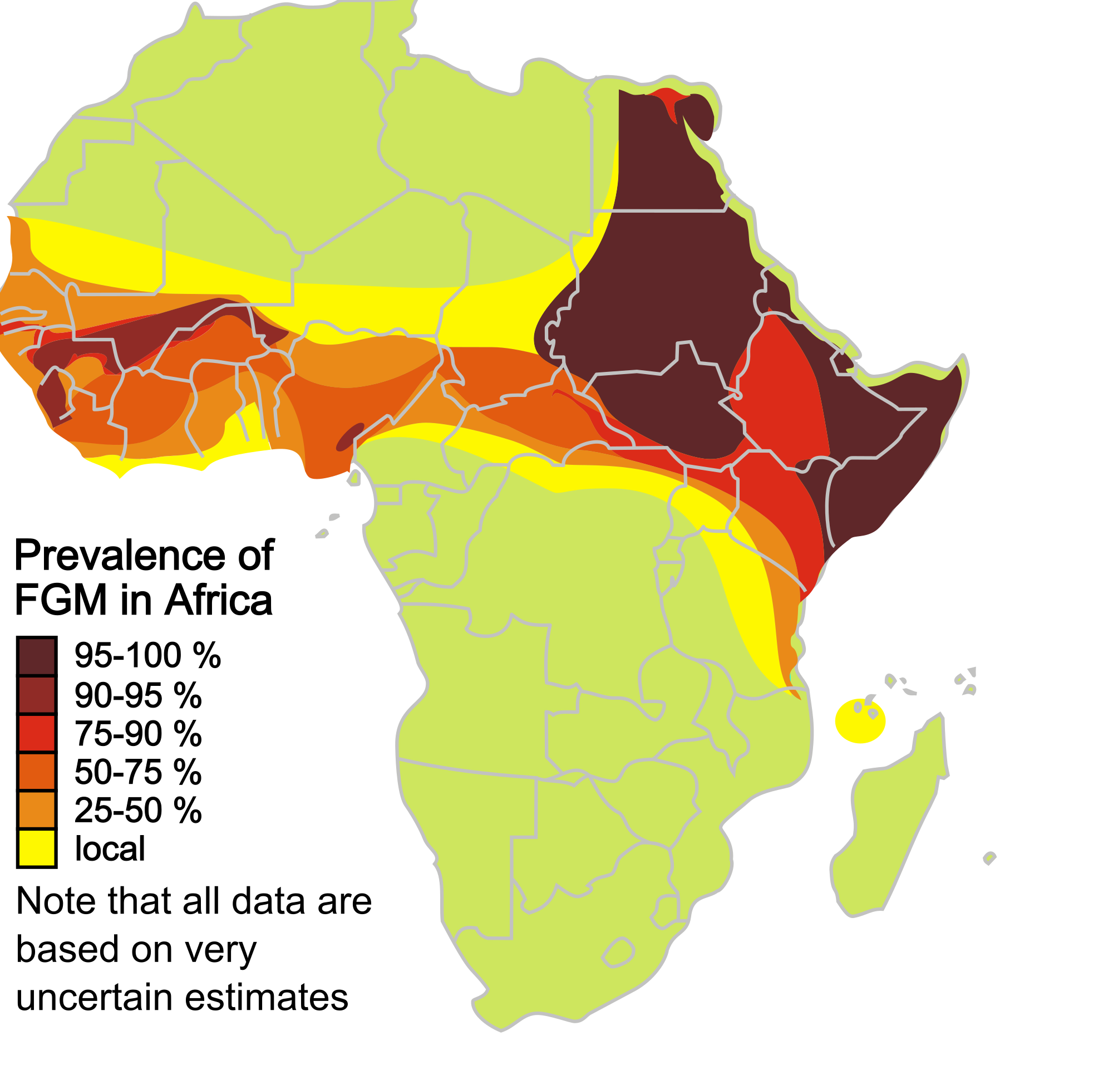
FGM/C
More than 200 million girls and women alive today have been cut in 30 countries in Africa, the Middle East and Asia where FGM is concentrated( WHO,2018).
There are an estimated 3 million girls at risk of undergoing female genital mutilation every year.
FGM is mostly carried out on young girls between infancy and age 15.
FGM is a violation of the human rights of girls and women

Slide 9
Education
Achieving gender equality in and through education is central to meeting the targets of the 2030 Agenda for Sustainable Development
Achieving gender parity in primary and secondary education enrolment and completion is an essential first step in achieving gender equality in education
Achieving gender parity can also support a more transformative role for education in tackling the unequal power relations, social norms and systems of belief that underpin gender inequality in societies.

Slide 10
Percentage distribution of girls who have undergone FGM

Slide 11
Other health consequences of GBV
Unplanned pregnancies and sequelae thereof
Unsafe motherhood
STI/ HIV
Psycho-social delinquency
Mental illness that can result to suicide
Socially unprotected; insecure, not empowered or gainfully participating in socio- economic development

Slide 12
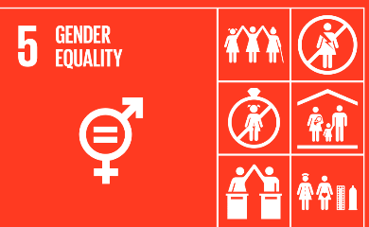
GBV its the inequities and unattained demographic dividends and SDG 5
Notes:
End all forms of discrimination against all women and girls everywhere.
Eliminate all forms of violence against all women and girls in the public and private spheres, including trafficking and sexual and other types of exploitation.
12

Slide 13
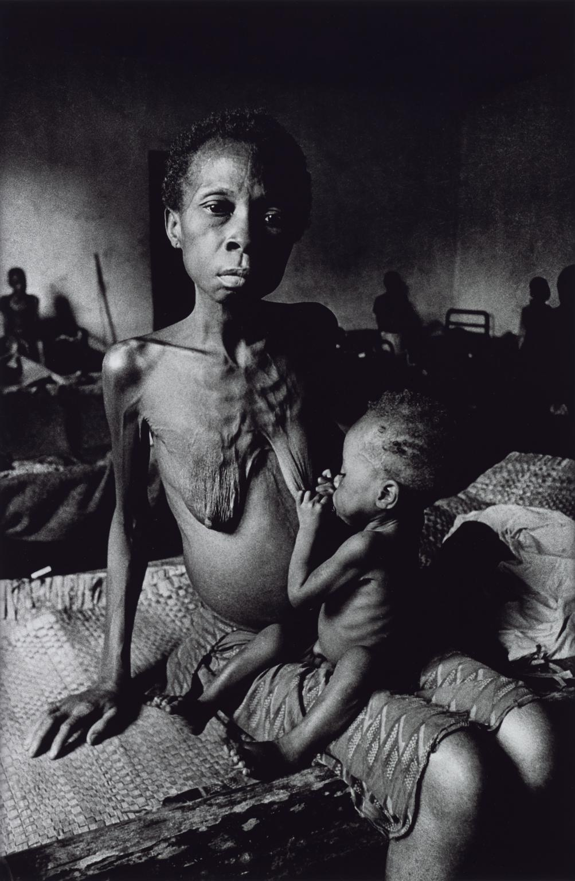
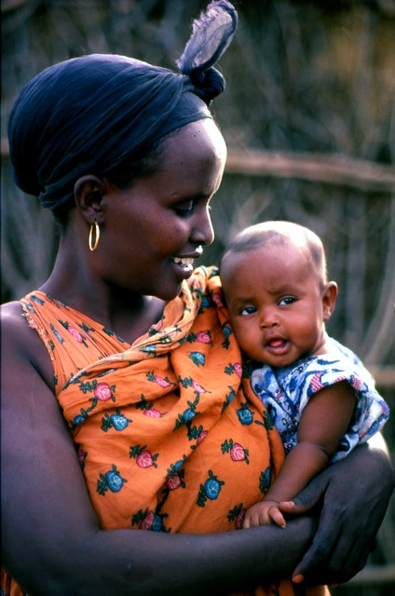
Economic empowerment
Economic empowerment increases women’s access to economic resources and opportunities including jobs, financial services, property and other productive assets, skills development and job markets.
Notes:
Women’s economic empowerment https://www.oecd.org/dac/gender-development/womenseconomicempowerment.htm
13

Slide 15
Case management with GBV
All patient MUST be treated empathetically, respectful and dignified care
The patient MUST feel safe in the clinical environment . Note amongst children the perpetrator may be known or even accompany the victim . Be on high alert and attentive to detail!
Multidisciplinary approach : medical . Psychosocial, legal , forensic personnel
HX, P/E, Documentation and forensic workup critical to the survivor legal case

Slide 16
General considerations for medical management
Introduce yourself to the survivor
Obtain written informed consent
Obtain medical history
Examine the survivor from head to toe, including genito- anal examination
Take both medical and forensic specimens at the same time
Record your findings in the PRC form
Reassure the survivor that he/she is in a safe place now
Explain the steps of the procedures you are about to undertake

Slide 17
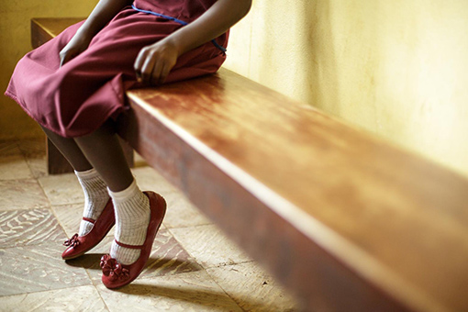
Guiding principles for interviewing children survivors of violence( VAC)
Be nurturing, comforting, and supportive.
Reassure the child.
Do no harm: Be careful not to traumatize the child further.
Speak so the child understands.
Help the child feel safe.
Tell the child why you are talking with him/her.
Use appropriate people.
Use nonverbal communication and pay attention to body language.
Respect the child’s opinions, beliefs, and thoughts.
Empower the child.

Slide 18
Perform investigations
Urinalysis – microscopy, for epithelial cells
Pregnancy test
Blood
HIV Test
Haemoglobin level
Liver Function Tests
VDRL
High vaginal swab for evidence of spermatozoa
Nail bed specimen collection

Slide 19
Post traumatic vaccination with tetanus toxoid and address soft tissue injuries appropriately
Provide analgesics to relieve the survivor of physical pain. May also need to give an anxiolytic

Slide 20
Post exposure prophylaxis
Post Exposure Prophylaxis (PEP) for HIV is the administration of a combination of antiretroviral drugs (ARV’s) for 28 days after the exposure to HIV that has to be started within 72 hours after the assault.
Drugs for PEP for HIV: These guidelines make recommendations for the use of duo therapy (i.e. two ARV drugs) for 28 days. PEP is recommended for men, women, girls and boys at risk of HIV infection. Significant risk involves oral, vaginal and/or anal penetration
The efficacy of PEP decreases with the length of time from exposure to the first dose, therefore administering the first dose is a priority. People presenting later than 72 hours after assault should be offered all other aspects of post rape care, but not PEP.

Slide 21
Emergency contraception
EC can be given up to 120 hours after rape or defilement;
EC should be given to all females with secondary sexual characteristics or who have started menstruation;
EC should be available 24 hours a day;
EC does not harm an early pregnancy;
EC is not a form of abortion.
Progestin only pills | Postinor 2 | 1-tabs 12 hours apart (total 2 tabs) or 2-tabs at a go
Combined oral contraceptive pills with high dose of oestrogen (50µg) | Oral | 2-tabs 12 hours apart (total 4 tabs)
Combined oral contraceptive pills with low dose of oestrogen (30µg) | Nordette | 4-tabs 12 hours apart (total 8 tabs)

Slide 22
Emergency contraception cont….
IUD insertion within 5 days of the sexual assault and can be continued as a family planning method
Antiprogestins
Mifepristone ( RU 486) 10 mg within72 -120 hours
Ulipristal acetate 30mg within 120 hours

Slide 23
Prophylaxis of Sexually Transmitted Infections
It should preferably be prescribed for the survivor and given for uptake within 24hours.
Non-pregnant adults male or female | Norfloxacin 800 mg Stat Doxycycline 100mg BD one week
Pregnant woman | Spectinomycin 2g Stat Amoxycillin 3g stat + Probenicid 1g Stat Erythromycin 500mg QDS one week
Children | Amoxycillin 15mg/kg TDS one week Erythromycin 10mg/kg QDS one week

Slide 24
Hepatitis B vaccination
Dosing Schedule | Administration Schedule | Duration of Immunity Conferred
1st Hep B dose | At first contact | Nil
2nd Hep B dose | 1 month after 1st Hep B dose | 1-3 years
3rd Hep B dose | 5 months after 2nd Hep B dose | 10 years

Slide 25
Psychosocial support
Survivors react differently following violence . There are the short term and long term consequences and the need to have follow up
Trauma Counselling
Counselling relate to the possibility of a pregnancy
Counselling related to possibility of STIs including HIV infection
Follow up psycho social counseling

Slide 26
Forensic management
The following practices must be followed when handling an exhibit
Protect the exhibit from weather and contamination
Use clean instruments and containers
Wear gloves and the protective gear when appropriate
Package, transport and store exhibit safely and securely
Take special care with fragile and perishable exhibits
Call on an expert if you lack adequate training to handle a particular type of exhibit.
Adequate documentation and Reporting including filling of the post rape care form and the Kenya police medical examination (p3) form
Notes:
26

Slide 27
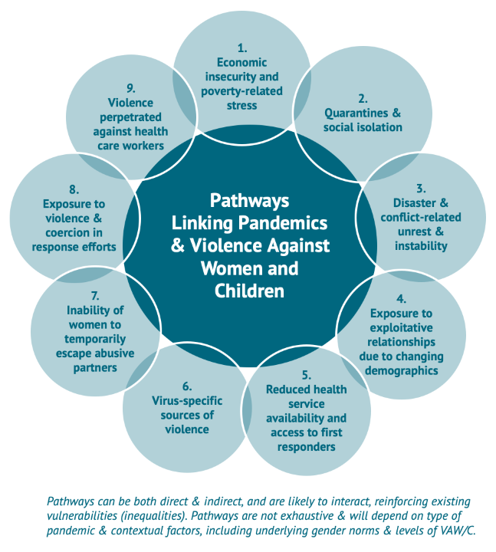

Slide 28
Potential areas towards home grow solutions
Safe spaces
Healthy recreation( protective social mechanisms and norms regulating behaviour , no room for exploitation)
Coordination of inter-sectoral referral, legislative, health and communities engagement
The Gender Inequality Index is a composite measure reflecting inequality between women and men in three different dimensions: reproductive health (maternal mortality ratio and adolescent birth rate), empowerment (share of parliamentary seats held by women and share of population with at least some secondary education), and labour market participation (labour force participation rate). Source: United Nations Development Programme, Human Development Report 2016
Social safety nets
Indigenous cultural knowledge system and providing value propositions
Leveraging on the role of the different social actors collectively
Digital science in case management and survivor care and follow up
Conducting Implementation research

Slide 29
Legal reform and policy change
Specific legislation on family, domestic or sexual violence
Training of judges on violence legislation
Training of police on GBV response
Legal aid services for victims
Reform of medico-legal system to improve forensic evidence collection and preservation
Notes:
29
Frame discussion around specific legal reform and policy change necessary in your country.

Slide 30
Programmatic Response
NGO legal aid services
Specialized healthcare services
Domestic violence refuge shelters
Media campaigns
Programs for men aimed at promoting gender equitable relationships
Notes:
30
Suggested Narrative: Current interventions to address GBV in [fill in country] include those we see here. [Read from slide.] These are for the most part small-scale, underfunded initiatives that are present in select institutions/cities. [Adapt according to the most pressing and relevant gaps emphasized in the slide.]

Slide 31
GBV hotlines

Slide 32
We need to prevent, manage and overcome situations that adversely affect health and well- being to ensure that all Kenyans live in dignity and exploit their human capabilities for their own and our collective development.

