Slide 1
Normal Puerperium and its management & Lactation Dr. Kihara Anne– Beatrice Senior Lecturer, UON Dept. Obs/ Gyn

Slide 2
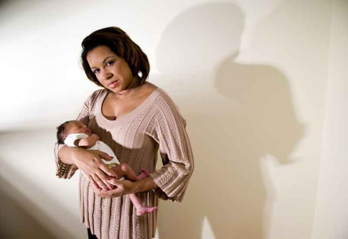
Outline of presentation
Definition of puerperium
Anatomical and Physiological changes in the puerperium
Clinical care of normal puerperium
Breastfeeding
Contraception

Slide 3
Definition of Puerperium
Period of 6 weeks following childbirth during which the maternal organs, especially reproductive organs return to the non pregnant- INVOLUTION
Breasts are an exception: undergo - mammogenesis , galactogenesis, galactopoesis and galactokinesis

Slide 4
Physiology
Involution : normalization in the size of pelvic organ
Involution of uterus
Involution of other pelvic organs
Pelvic musculature
Changes in non reproductive organs
Return to menstruation, ovulation
Initiation and maintenance of Breast feeding

Slide 5
Involution of uterus
Decrease in size (usually size of rugby ball)
Reduction in size of muscle fibers: removal of excess of cellular cytoplasm by intracellular, autolytic,proteolytic enzymes in form of peptones-blood stream-excreted by kidneys
Reduction in vascularity: thrombosis & degeneration of uterine vessels
Regeneration of endometrium: glandular remnants, interglandular stroma , completed in 4-6wks

Slide 6
Involution of uterus
Discharge emanating from uterus: Lochia(not menses)
Vaginal discharge in first 2 weeks of puerperium, fishy odor, alkaline
Lochia: sloughing decidual lining of uterus, secretions from uterine cavity, cervix & vagina
Lochia rubra: <7 days
Lochia serosa: 7-10 days
Lochia alba :10-14 days (should resolve, shouldn’t have foul smell)

Slide 7
Lochia
Lochia rubra:
color is red
Blood, leucocytes, sloughed decidua, mucus
Lochia serosa: progressively pale, blood tinged ,thinner in consistency has an abundance of white blood cells
Lochia alba:
yellowish white in color, scanty
Mucus, serous exudates, epithelia cells, leucocytes
Clinical significance: odour(peuperal sepsis), duration and pattern of change

Slide 8
Involution of other pelvic organs
Cervix: it’s a pin hole usually but after birth tube like
loose ,flabby, thrown into folds after delivery
Contracts ,thickens feels tubular but remain patulous, by 6 weeks involution is complete
Vagina:
soft, dusky, engorged, stretchable(rugae)
diminishes in size, caliber, never to prepregnant state

Slide 9
Questions
What is involution in puerperium?
Which structure does not involute in puerperium? breast

Slide 10
Urinary tract changes
Renal pelvicalyceal dilatation: Normal in 8wks,may persist 12 weeks postpartum (due to pressure during pregnancy)
Obstructed labour leads sloughing leading to vesical vaginal fistula so advice to regular micturition
Increased renal plasma flow, GFR, creatinine clearance: normal by 6 wks
Bladder:
During labor: edematous, hyperemic
trauma to bladder innervations: instrumental, difficult vaginal delivery: relatively insensitive, retention of urine, infection

Slide 11
Bowel changes
Constipation episotomy, check bowel sounds
Intestinal paresis following delivery BECAUSE WE USE ABDOMINAL MUSCLES SO IMAGINE CS WHAT HAPPENS
Altered tone of perineal muscles following delivery
Painful perineal lesion or perineal tear
Early ambulation, increased fluids, high fibre diet HELPS WITH CONSTIPATON

Slide 12
Case 1
Patient developed difficulty in breathing, convulsions immediately after delivery of the newborn, followed by unconsciousness? Provide at least three differential diagnosis ccf, pulmonary congestion, meningitis, malaria, eclampsia
Triage revealed
BP- 160/110mmHg, PR-86/min, RR- 30/min, PO2- 83%, RBS- 5.7mmol/l, BGA – showed respiratory acidosis, urine output –minimal
eclampsia due to high bp

Slide 13
Case 2
Primigravida had ben draining liquor for 2 days at a gestation of 37 weeks following GBV. Upon admission a diagnosis of ???? term rupture of membrane Was made. Augmentation of labour done delivered a MSB female bwt. 2.9Kg
Triage the following day patient with temp 39c, uterus subinvoluted at 24 weeks , tender , foul smelling rubra lochia and urine output in past 24 hours 100mls aki secondary to sepsis
What is her diagnosis peuperal sepsis with endometriasis

Slide 14
Anatomical and physiological changes MUST BE MONITORED
Metabolic changes: reversal of changes (hyperlipidemia , raised blood sugar) Pregnancy is diabetogenic and after delivery the insulin requirement drops the hormones with pregnancy disappear
Circulation:
CO increases by 70% following delivery: pre-labor values by 1 hr PP & pre-pregnant levels by 4wks
Increase in peripheral resistance (loss of progesterone effect)
Normal total circulating blood volume by 3-6 wks
Respiratory changes: rapid normalization of residual volume, FRC

Slide 15
Menstruation& ovulation
Onset of menstruation: lactating/non lactating
Lactation: increased prolactin levels- bond with baby leads to release prl and oxytocin
inhibit ovulation so have ammenorheas
inhibits ovarian response to FSH(less follicular growth),no menstruation
Suppresses release of LH, no LH surge, no ovulation
In many of the exclusive breast feeding mothers they have lactational amenorrhea a form of contraception termed as LAM
With return of menses include progesterone for contraception
also mothers that don’t bf regularly it leads to menstruation so menses return by 6 weeks

Slide 16
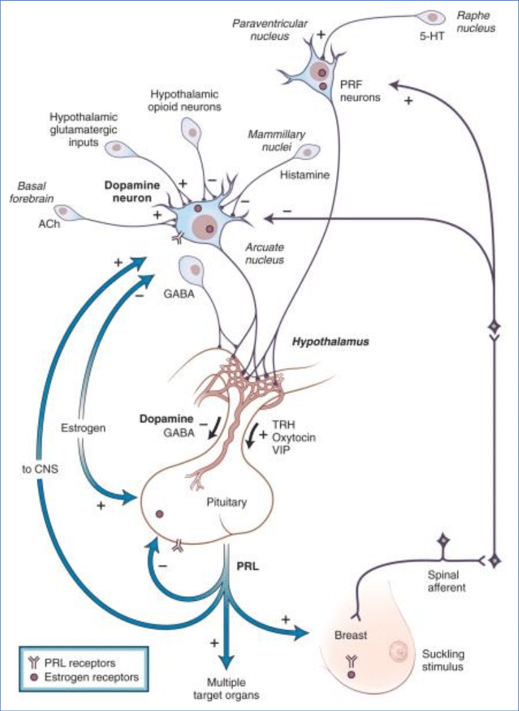

Slide 17
 | menstruation | ovulation
Non lactating women | By 6th wk(40%) By 12 th wk(80%) | 4wks
Lactating women | By 12 wks(70%) 6 months | 10wks

Slide 18
Question
What are the natural ways to enhance or stop milk production?
Enhance- motilium, oxy, dil seed, warm compression,
Stop- cold compression(wear bra), bromocriptine, carbegolin
Provide the pharmacological agents that can increase breast milk production?
Production of the drugs that can be used to prohibit breast milk production with IUFD or early neonatal death?

Slide 19
Management of normal puerperium: objectives
Restoration of health to pre-pregnancy state
Promotion of lactation
Prevent infection – puerperal sepsis
Management of co- morbidities e.g. AKI, HIV , DM
Care of the infant some don’t want to bond with baby
Advice on immunization
Advice on discharge- once baby passes meconium?
normally- discharge ideally after 48 hours to prevent pph
cs- minimum of 3 days

Slide 20
Immediate care
Examine vital parameters : PR,BP to monitor shock due to pph
P/A: uterus well retracted
L/E: amount of bleeding, perineal wound( if any) dressing by antiseptic, dry, application of sterile pad
Encouraged to pass urine- prevent pph
Meet relatives, baby put to breast feed
Allowed drinks, food- adjust accordingly e.g dm patients
Shifted to room/ward- acute phase

Slide 21
Changes in post delivery period
Pulse : tachycardia, settles in a day
Blood pressure: normal/raised: increased venous return, normalizes in 24 hrs
Temperature: transient rise(38C)
Urine output: diuresis following delivery
Emotional instability: anxiety, unfamiliar to newborn, change in lifestyle, newer demands cause psychological stress, puerperal blues can lead to puerperal psychosis

Slide 22
Care during puerperium
Rest & ambulation: adequate rest, no specified period
1.59 and labour and marathon
but also ambulate
Early ambulation encouraged:
Restores self confidence
Accelerates recovery, encourages drainage of lochia, involution
Lessens venous thrombosis-embolism
Hospital stay: 48 hrs (normal delivery)
5-7 days (cesarean delivery) 3days

Slide 23
Care during puerperium
Diet: lots of fluid, easy to digest diet(milk, green leafy vegetables, fresh fruits) ideally high protein diet
Care of breasts- nipple retraction, cracking, mastitis, hygeine
Care of bowel & bladder: encouraged to pass urine frequently, having more roughage, fluids in diet corrects constipation
Care of perineum: kept clean, dry after every act of urination/defecation sitz bath with salt and water
broke episiotomy due to sexual contact
ideally when most comfortable

Slide 24
Baby Friendly Hospital Initiative Rooming –in
Allowing mother & her baby to stay together after birth - if mother and baby stable to be done within 30 minutes
Advantages:
mother responds to her baby whenever is hungry
helps bonding & breast feeding
Confident about breast feeding, feeds on demand
Better understanding of mother about baby

Slide 25
Baby friendly Hospital Initiative( WHO)

Slide 26
Baby friendly Community Initiative
Have a written Maternal Infant and Young Child Nutrition (MIYCN) policy summary statement consistently communicated to health care providers, community health workers and community members;
Train health care providers and community health volunteers on MIYCN policy, in order to equip them with necessary skills to implement the policy;
Promote and support optimal maternal nutrition among women and their families;
Educate all pregnant women and lactating women and their families on benefits of breastfeeding to all parties and risks associated with artificial feeding;
Help mothers to initiate breastfeeding their children soon after delivery; within 1 h of birth and support them to maintain exclusive breastfeeding for 6 months. Address any problems related to breastfeeding;
Encourage mothers to continue breastfeeding their children up to 2 years or beyond, in conjunction with the appropriate, adequate and safe complementary feeding while providing holistic care and stimulation of the child;
Provide a friendly environment, supportive of breastfeeding families;
Promote collaboration among healthcare staff, community mother-support groups, mother-to-mother support groups and the members of the local community.

Slide 27
Immunization
at birth- bcg and oral polio
FOR MUM
Non immunized Rh negative mothers: fetal cord blood- anti D immuno-prophylaxis(300µg) IM ,within 72 hrs of birth
Tetanus toxoid: booster dose, if not given during pregnancy
Rubella vaccine

Slide 28
Management of ailments
After pains: infrequent, spasmodic lower pain abdomen after delivery it’s the commonest complain so resuarrance
Pain on the perineum(edema, perineal tear, hematoma formation): analgesics, sitz baths, examination to rule out vulvovaginal hematomas
Correction of anemia: iron(oral/parenteral) supplementation
Treatment of BP CAN BE HIGH OR LOW

Slide 29
Daily progress chart
Pulse, Respiration, BP :twice a day
Examination of breasts
Measuring height of uterus above pubic symphysis
Character of lochia
Bowel, bladder function
Details of baby: feeding, bowel, bladder , exam of umbilical stump (chlorhexidine 4%),skin color (nnj)

Slide 30
Involution of uterus
1st day at umbilicus
Immediately following delivery: at umbilicus
Rate of involution: 1cm /day
Becomes pelvic organ by 10-12 days and certainly not palpable t 6 weeks

Slide 31
Postpartum FP services
Immediate postpartum methods (48HOURS)
LAM i.e. bfeeding
PPIUD (after delivery of placenta <10 mins ; 10-48 hours immediate placement of IUD)- ???? Progesterone
Implant
Condoms
Intra-caeserian section BTL

Slide 32
Postpartum FP services cont….
At 6 weeks:
Barrier methods
IUCD ( interval insertion)
Oral pills ( progesterone only pills)
Injectables (DMPA)
Sterilization (BTL, Vasectomy)
LAM( Lactational amenorrhea method) but this may need to be complimented with progesterone FP if menses have resumed

Slide 33
Postpartum exercises
To tone up the pelvic floor muscles
Contract pelvic muscles (withhold act of urination/defecation) & relax
kegal exercise to prevent prolapses
To tone up the abdominal muscles
Dorsal, knees bent, contract & relax abdominal muscles alternatively
To tone up the back muscles
Prone, arms by side, head & shoulders are slowly moved up & down
change in cog

Slide 34
Postpartum exercises
When to start: as soon as the pt appears to be fit
Initially: deep breathing, leg movements
Adv:
improves muscle tone
Minimizes risk of DVT
Prevent gynecological complications: prolapse
Continued for 3 months

Slide 35
Discharge
Thorough checkup of mother & baby
Measures to improve general health of mother: diet, hematinics, bonding of mother – neonate pair and with immediate relatives
Postnatal exercises
Breast feeding & care of newborn, immunization
Family planning advice

Slide 36
Postnatal checkup /care
Minimum of three checkups
First <48hrs of delivery
Second within 7-14 days cs scar
Third at 6th week

Slide 37
Objective during subsequent visits
Assess health status of mother
Reassess ,detect & treat any medical/gynecological complication
Assess progress of baby
Immunization of baby
Impart family planning options to mother

Slide 38
Postnatal checkup
Examination of mother : general, breasts, local examination if required
Examination of baby: well baby clinic
Advice
General: health, feeding, immunization
Postnatal exercises
Impart family planning methods

Slide 39
Any questions? Invest in Mothers and new-borns to have healthy outcomes

Slide 40
Thank you We need to protect our posterity!

