Slide 1
MALPRESENTATIONS AND MALPOSITIONS
DR. ESIROMO M.

Slide 2
MALPRESENTATIONS
Presentation: the lowest pole of the fetus that presents to the lower uterine segment/cervix.
Malpresentation: when the presentation is other than the vertex.
The vertex is diamond-shaped area defined by the parietal imminences, anterior fontanelle and posterior fontanel

Slide 3
Types of Malpresentations
Breech presentation
Face presentation
Brow presentation
Cord presentation
Transverse lie with shoulder/arm presentation
Compound presentation

Slide 4
1) Breech Presentation

Slide 5
Introduction
It is the commonest malpresentation
3-4 % of term pregnancies
20% incidence at 28 weeks
In breech presentation, the lie is longitudinal and the podalic pole presents at the pelvic brim.

Slide 6
Risk Factors for breech
(i)Fetal anomalies
Head: anencephaly, hydrocephalus
Spina bifida
Chromosomal anomalies: autosomal trisomies
Multiple anomaly syndromes
(ii) Prematurity
(iii)Uterine factors
Uterine anomalies: bicornuate, unicornuate, septate

Slide 7
Uterine fibroids
Low-lying placenta
(iv) Multiple gestation
(v) Polyhyramnios
(vi) Oligohydramnios
(vii) High parity with lax abdominal and uterine musculature
(viii) Contracted pelvis
(ix) Previous breech delivery (recurrent)
(x) In many cases, there is no obvious risk factor

Slide 8
Types of breech
(i)Complete (flexed) breech - Hips flexed, knees flexed
(ii)Frank breech (extended)- Hips flexed, knees extended
(iii)Footling breech- One or both hips extended, foot presenting

Slide 10
diagnosis of breech
1) Clinically;
(i) Abdominal exam:,
Leopold 1: will identify the fetal head in the fundus (head is globular, hard, ballotable)
L3: reveals the softer breech over the pelvic inlet (breech is broader, softer)
Auscultation of fetal heart tones found in the upper quadrants of the uterus (not strictly true)
(ii)On VE: anal orifice may be identified, with genitals and the bony prominences of the ischial tuberosities. Foot will be palpated in footling breech
2) Ultrasound

Slide 11
Complications of breech delivery
Perinatal mortality is higher in breech (inherent problems in fetus)
Trauma to the head: unlike in vertex presentation, where the head has been in the pelvis for a duration to allow moulding to occur, the after-coming head of the breech must come through the pelvis more rapidly.
The fetal body may deliver through an incompletely dilated cervix, which then entraps the head
Damage to fetal muscles, soft tissues and viscera may occur during breech extraction if not handled well
Nerve injury and trauma to the spinal cord
Umbilical cord prolapse (especially with footling breech)
Maternal: Increased Cesarean delivery, genital tract injuries

Slide 12
Antenatal management
before 36 weeks gestation should be managed expectantly
Those that persists into the late third trimester should be evaluated by an US examination for congenital anomalies
ECV should then be offered and performed when indicated

Slide 13
external cephalic version (ECV)
The transabdominal manual rotation of the fetus into a cephalic presentation.
Offered after 36+ weeks as the chance of spontaneous version of breech to cephalic version after 37 weeks is low
The mother needs adequate counselling (success rates and complications)
ECV should only be performed in a setting where urgent CS is possible should there be evidence of any complications.
It is done in the delivery room after confirming by a scan that the fetus is still in breech presentation and after making a note of the side of the fetal back, type of breech presentation, fetal attitude, position of the placenta and the quantity of amniotic fluid.

Slide 14
ECV Procedure
A cardiotocograph (CTG) for 20 minutes is done
Uterine relaxation with short-acting tocolytic
ECV is accomplished by manipulation of the fetal head toward the pelvis while the breech is brought up toward the fundus. Attempt a forward roll first and then a backward roll.
Following an ECV attempt, whether successful or not, repeat the non-stress test (biophysical profile if needed) prior to discharge.
Administer Rh immune globulin to women who are Rh-negative.

Slide 15
ECV complications
precipitation of labor or premature rupture of membranes,
Uterine rupture
abruptio placentae,
fetomaternal hemorrhage
cord entanglement
Intrauterine infection such HIV (vertical transmission)
Fracture of fetal bones
transient slowing of the fetal heart rate
Spontaneous reversion to breech presentation

Slide 16
ECV contraindications
Absolute CI for ECV include;
multiple gestations with a breech presenting fetus,
contraindications to vaginal delivery
Non-reassuring fetal heart rate tracing.
Relative contraindications include;
polyhydramnios or oligohydramnios,
fetal growth restriction,
uterine malformation, and fetal anomaly.
Controversial candidates;
Women with prior uterine incisions
During labour

Slide 17
Vaginal breech delivery
Due to recognized risks associated with breech delivery, literature recommends cesarean delivery.
However, the clinician needs to be well versed with assisted vaginal breech delivery especially for cases where delivery is imminent.
These skills are also useful in cesarean delivery of a breech fetus.

Slide 18
Types of vaginal breech delivery
Spontaneous: expulsion of fetus occurs with very little assistance
Assisted breech: delivery of fetus is by assistance
Breech extraction: entire body of fetus is extracted e.g. in cases of second twin after internal podalic version , fetal distress

Slide 29
2) Face Presentation

Slide 30
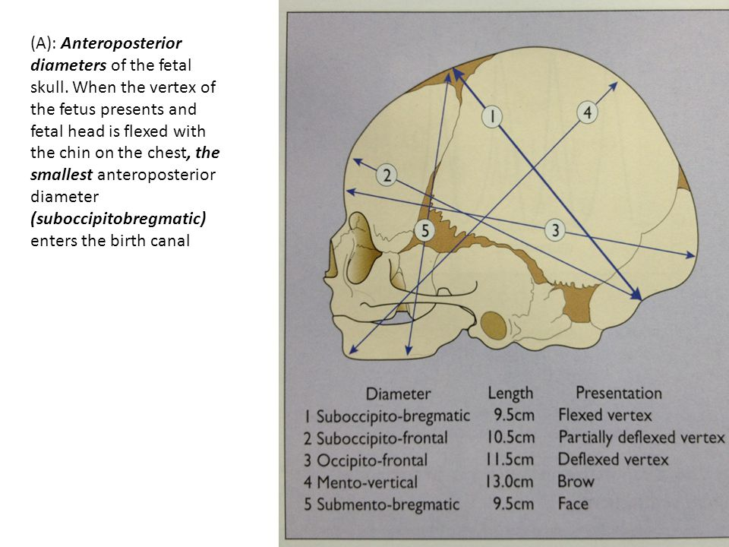

Slide 31
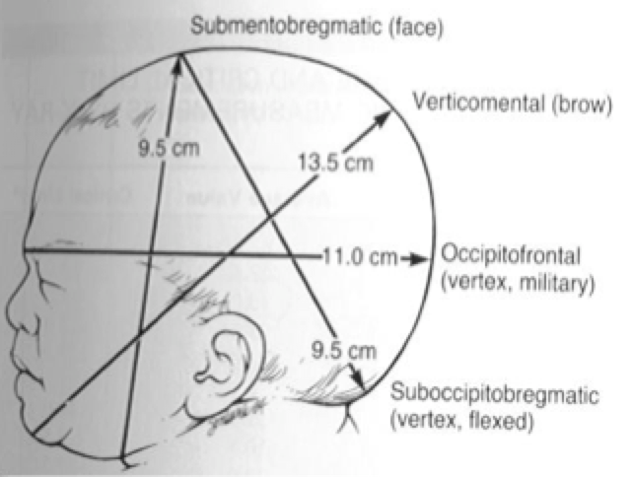

Slide 32
Face presentation occurs whereby there is complete extension of the head so that the occiput is in contact with the back.
Causes include:
Multiparity with pendulous abdomen
Contracted pelvis
Anencephaly
Congenital goitre
Twist of cord several times around the neck
Increased tone of extensor muscles of the neck

Slide 33
During labour, vaginal examination shows identifying features for face: supra-orbital ridges, malar processes, nose, mouth with had areolar ridges, and the chin.
Late in labour, the face becomes oedematous so it may be misdiagnosed as breech (the cheeks are mistaken for buttocks and the mouth for anus, and malar processes with ischial tuberosities.
The mechanism of labour has some similarity to that of the vertex. The denominator is the mentum.

Slide 34
Mento-anterior
In the vast majority face rotates forwards to mento-anterior position with the chin behind the symphysis pubis.
The presenting lateral (biparietal – 9.5 cm) and antero-posterior (submentobregmatic– 9.5 cm) diameters are conducive for vaginal delivery
Descent is possible posteriorly in the pelvis when the position is mento-anterior because of large space in the sacral area.
The head is born with the chin emerging under the pubic arch followed by the forehead over the perineum.

Slide 36
Mento-posterior
If the face rotates to a mento-posterior position, although the diameters are the same as mento-anterior, the lateral dimensions of the frontal bones are large and do not permit descent behind the narrow retropubic arch.
Deliver by emergency CS.
Complications of face presentation:
Oedema and trauma to face
Neonatal infection
Increased operative delivery and vaginal manipulation

Slide 38
3) Brow presentation

Slide 39
Brow presentation is rarest variety of cephalic presentation. The head lies between full flexion and full extension.
Commonly unstable, and converts to either face or vertex.
Causes are similar to those for face presentation.
Diagnosis is made on vaginal examination during labour; palpating supra-orbital ridges and anterior fontanelle.
The presenting diameter is mento-vertical (14cm), so if it persists, obstructed labour occurs.

Slide 40
4) Cord presentation and Cord prolapse

Slide 41
In both conditions, a loop of the cord is below the presenting part
In cord presentation: cord lies between the presenting part and the cervix. Membranes are not ruptured.
In prolapse: membranes have ruptured, and the cord has prolapsed into vagina or out of vagina
In cord prolapse, the fetal perinatal mortality is 25-50% from asphyxia due to;
(i) mechanical compression of the cord between presenting part and bony pelvis
(ii) spasm of the cord vessels when exposed to cold or manipulations DELIVER FAST

Slide 42
Predisposing factors for cord prolapse
Especially when presenting part does not fit well in lower uterine segment
1) Fetal causes;
Malpresentations eg footling breech, tranverse lie
Prematurity
Anencephaly
Multiple pregnancy
Polyhydramnios
2) Maternal;
Contracted pelvis
Pelvic tumors
Placenta previa
Sudden rupture of membranes

Slide 43
Diagnosis
Diagnosed by vaginal examination DURING LABOUR.
If the cord is prolapsed it is necessary to detect whether it is pulsating or not, and to auscultate the fetal heart sounds
Fetal heart tone and tracing; variable decelarations

Slide 45
Management
Confirm whether fetus is live or dead(ALLOW TO PROGRESS NORMALLY)
Immediate delivery if fetus is live; usually by cesarean section (unless cervix is fully dilated and assisted vaginal delivery would be faster)
During preparation for theatre, minimize risk to fetus(PROTECT THE CORD) by
Putting patient in steep trendelenburg or knee-chest position
Manual displacement of presenting part higher up
If cord protrudes from vulva, handle it gently and cover with warm moist pack
Fill bladder with 500mls saline FILL WITH CATHETER
Give oxygen to the mother
DO ALL THIS FOR EMERGENCY CS
If fetus is dead, allow labour to progress.

Slide 47
5.Compound presentation
An extremity, usually a hand, presents alongside the main presenting part, usually the head.
More common with premature infants and when the fetal presenting part does not completely occlude the pelvic inlet.
Diagnosis is made on vaginal exam
As long as labour is progressing normally, no intervention is necessary. Most commonly, the limb will retract spontaneously or when stimulated.

Slide 48
MALPOSITIONS

Slide 49
DEFINITIONS
Position is the relationship of the denominator of the presenting part to fixed points of the maternal pelvis.
The fixed points of the pelvis are;
(i) the sacrum posteriorly
(ii) the symphysis pubis anteriorly
(iii) the sacro-iliac joint postero-laterally
(iv) the ileo-pectineal eminences antero-laterally
The denominator is the most definable peripheral point in the presenting part e.g. occiput in vertex, mentum in face, sacrum in breech.

Slide 50
Malposition is more applicable to cases of vertex presentation.
DOESN’T APPLY IN MALPRESENTATION?
The normal position with ideal mechanism of labour is occipito- anterior position.

Slide 51
Occipito-posterior position
In vertex presentation where the occiput is placed posteriorly over the sacro-iliac joint or directly over the sacrum, it is called occipito-posterior position.
The position may be present before or after labour occurs.
In majority of cases (90%) , anterior rotation of occiput occurs .

Slide 53
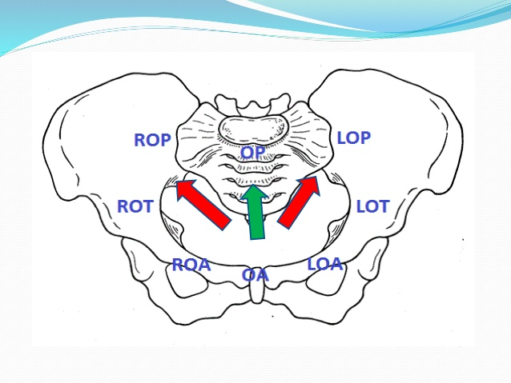

Slide 55
Causes
Shape of pelvis-android and anthropoid due to narrow fore-pelvis
Anterior placenta
Marked deflection of fetal head HEAD NOT WELL FLEXED
Abnormal uterine contractions

Slide 56
Incidence
At the onset of labour, the incidence of O-P is about 10%, and is much less in late second stage of labour
Right O-P is 5 times more common than left O-P. Presence of sigmoid colon on the left, and dextro-rotation of the uterus favors ROP.

Slide 57
Diagnosis
Abdominal examination:
Abdomen looks flat below the umbilicus NO ROUND BUMP
On pelvic grip, there is delayed engagement of head
Cephalic prominence (sinciput) is not felt so prominent as found in well flexed occipito-anterior.
Fetal heart tones are best heard towards mother’s flank (in direct O-P, or ROP)

Slide 58
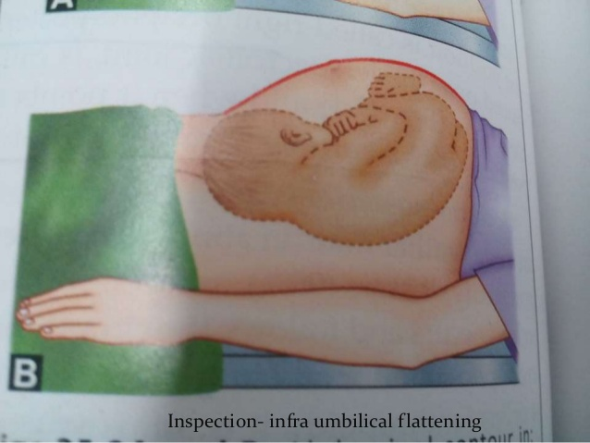

Slide 59
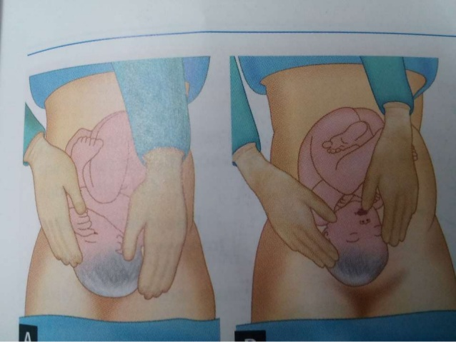

Slide 60
Vaginal examination:
Finding depends upon degree of flexion of head
Confirmation is made during 2nd stage of labour:-
the sagittal suture occupies any of the oblique diameters of the pelvis
the posterior fontanelle is felt near the sacro-iliac joint
the anterior fontanelle is felt near ilio-pectineal eminence

Slide 61
Sometimes the position is not recognized until there is a delay in second stage of labour.
The diagnosis by vaginal examination may be difficult due to the formation of caput succedaneum over the presenting part.
In this case the fingers may be passed higher to feel the free margin of the ear which will point to the occiput.
Back pain or “back labour” is a clinical hallmark of OP position

Slide 62
Mechanisms of labour
The head engages on right or left oblique diameter
In favourable cases (90%)
Long anterior rotation
Good uterine contractions results in good flexion of the head. Normal descent occurs up to the pelvic floor
Occiput rotates 3/8ths of a circle (135 degrees) anteriorly to lie behind the symphysis pubis. The shoulders rotate 2/8ths of a circle to occupy oblique diameter
The rest of the mechanism continues as occiput anterior

Slide 64
(B) In 5-10% of cases, spontaneous rotation fails to occur
Short posterior rotation
Sinciput touches the pelvic floor first resulting in anterior rotation of sinciput 1/8th of circle putting occiput to sacral hollow
Persistent occiput posterior position
Spontaneous delivery occurs with “face to pubis”

Slide 65
(iii) Non-rotation or short anterior rotation
Spontaneous vaginal delivery highly unlikely
May progress to prolonged or obstructed labour
Deep transverse arrest or oblique posterior arrest

Slide 66
Management of labour
Early diagnosis
Strict vigilance with watchful expectancy for progress: augmentation if poor contractions, use of partogram
Judicious and timely interference when indicated: manual assisted rotation, Cesarean section.

Slide 67
Complications
Labour in OP is prolonged (on average by 1 hour in parous, 2 hours in nulliparous)
Obstructed labour
Perineal lacerations and extension of episiotomies
Post-partum haemorrhage
Increased operative deliveries

Slide 68
Deep Transverse arrest
Arrest of descent when the fetal head has descended to the level of the ischial spines and the sagittal suture lies in the transverse diameter of the pelvis.
The occiput lies on one side of the pelvis and the sinciput on the other side and the head is badly flexed.
It is only diagnosed in 2nd stage of labour
If the head is firmly fixed in transverse position, then obstructed labour will occur

Slide 69
THANK-YOU

