Slide 1
MULTIPLE PREGNANCY
Alfred Osoti (MBChB MMed MPH PhD) Department of Obstetrics and Gynecology University of Nairobi
MBChB V
February 2020

Slide 2
Objectives
Outline the epidemiology of twin pregnancy
Understand zygosity and chorionicity
Highlight maternal adaptations to twin pregnancy
Appraise the maternal and fetal complications of twin pregnancy
Describe the principles of antenatal care, intrapartum care and postpartum care

Slide 3
Epidemiology
Twin pregnancy represents 2 to 3% of all pregnancies.
Depend on
  Hereditary → mother important than father
  Age → peak at 37 years of age
  Parity → increase more than six times
  Race: Nigeria- 54/1000, UK- 12/1000, Japan 4/1000
  Ovulation and assisted reproduction 25% of twins, 50–60% of triplets, and 75% of quadruplets
  Zygosity
    Monozygotic (MZ): constant at 3-4/1000
    Dizygotic (DZ) varies, in US 1:90 white vs 1:20 African

Slide 4
Zygosity and chorionicity
Zygosity refers to the genetic makeup of the twin pregnancy-monozygotic (MZ) or dizygotic (DZ).
  DZ: fertilization of two separate ova
  MZ: single fertilized ovum that subsequently divides
Chorionicity
  indicates placental composition- monochorionic or dichorionic
  determined by the mechanism of twinning and, in MZ twins by the timing of embryo division.
  Early determination of chorionicity is vital because it is a major factor in determining obstetrical risks, management and outcomes.

Slide 5
Zygosity and chorionicity
DZ
  result from the fertilization of more than one egg by more than one sperm.
  always dichorionic (separate placenta), diamniotic placentation because each blastocyst generates its own placenta-which may be separate or fused.
  Most common, represents 2/3 of cases.
  Non identical ,may be of different sex.
MZ
  result from fertilization of one egg by one sperm and then subsequent spontaneous cleavage of the fertilized ovum.
  Type of placentation is determined by the timing of this cleavage. Earlier clevage leads to separate placenta i.e. More likely
  Constant incidence of 1:250 births, constitutes 1/3 of twins.
  Not affected by heredity, induction of ovulation

Slide 6
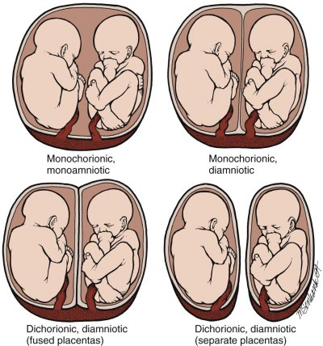
Monochorionicity
Timing of cleavage | Placentation | Prevalence (MZ twins)
<72 hrr | Diamniotic, dichorionic | 25%-30%
Days 4-7 | Diamniotic, monochorionic | 70%-75%
Days 8-12 | Monoamniotic, monochorionic | 1%-2%
≥Day 13 | Conjoined | Very rare

Slide 7
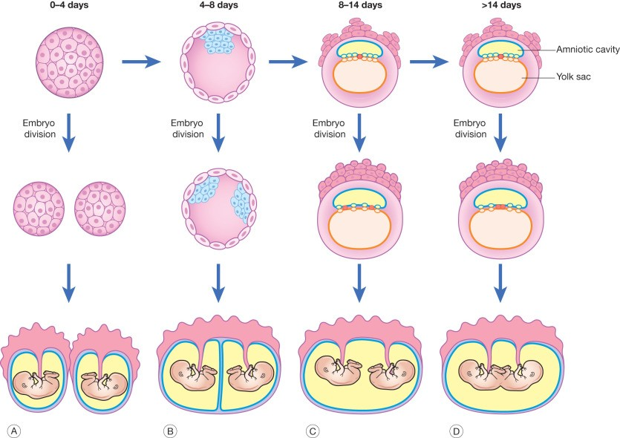
Monochorionicity

Slide 8
Zygosity-causes
DZ
  much better understood vs MZ twinning
  from multiple ovulation, associated with higher maternal follicle-stimulating hormone (FSH) levels.
  FSH levels, and therefore rates of DZ twinning, vary with season, geography, maternal age, and body habitus
  Increases in DZ twins in summer months, locations with more daylight hours, and taller, heavier, and older mothers.

Slide 9
Zygosity-causes
MZ
  less clear and thought to be a teratogenic event.
  Theories include fertilization of an “old” ovum with a more fragile zona pellucida or inadequate cytoplasm and with damage to the inner cell mass leading to two separate points of regrowth and splitting of the fertilized ovum.
  rates are constant across all variables, except for assisted reproduction-IVF and ovulation induction 10-fold higher
-injury to the zona pellucida may increase risk of
iatrogenic zygote splitting.

Slide 10
Determination of zygosity and chorionicity
Very important as most of the complications occur in monochorionic monozygotic twins
During pregnancy by Ultrasound
  Very accurate in the first trimester, two sacs, presence of thick chorion(suggestive of dichorionicity) between amniotic memb.
  Less accurate in the second trimester the chorion become thin and fuse with the amniotic memb.
Chorionicity is a major determinant of pregnancy outcome and management including selective reduction

Slide 11
Determination of zygosity and chorionicity
Ultrasound features early in the first trimester
  number of chorions = number of gestational sacs
  thick band of chorion separating two gestational sacs= dichorionic
  single gestational sac= monochorionic
  thin intervening amnion= monochorionic diamniotic, less clear < 8 wks. OR number of yolk sacs = number of amnions
  cord entanglement = monoamniotic gestation

Slide 12
Determination of zygosity and chorionicity
Ultrasound after 10-14 weeks’ gestation in dichorionic
  number of placental masses, 2 separate placentas suggest dichorionicity (NB: 1 may be single fused)
  thickness of the membrane dividing the sacs- thick dividing membrane—generally ≥2 mm, four layers—two amnion and two chorion —supports dichorionicity
  the twin peak (lambda or delta) sign-dichorionic(unique)
    appears as a triangular projection of placental tissue extending a short distance between the dividing membrane

Slide 13
Determination of zygosity and chorionicity
Ultrasound after 10-14 weeks’ gestation in monochorionic
  monochorionic thin (generally <2 mm) dividing membrane may not be seen until the second trimester.
  The relationship between the membranes and placenta without apparent extension of placenta between the dividing membranes is called the T sign
  Lack of a dividing membrane =monochorionic monoamnionic
  fetal gender –
    different gender-dichorionic (and dizygotic) except for heterokaryotypic monochorionic
    same gender, additional measures are necessary.

Slide 14
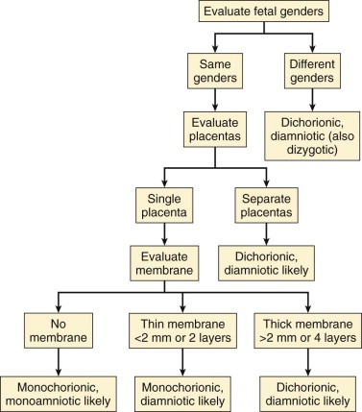
Determination of zygosity, chorionicity and amnionicity in 2nd and 3rd trimester

Slide 15
Monochorionic diamniotic
Dichorionic diamniotic
dichorionic
Lambda or twin peak sign

Slide 16
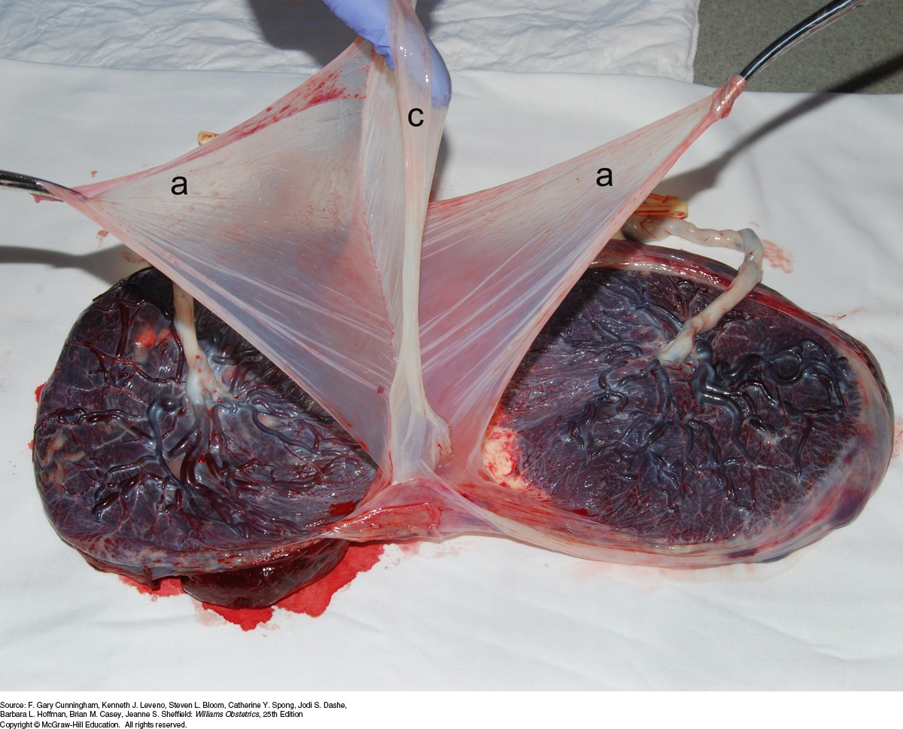
Postnatal determination of zygosity
Examination of
  membrane
  Placenta
  sex
  blood group
  DNA or HLA in selected cases
  Done postpartum

Slide 17
Maternal Physiological Adaptation
Exaggerated degree of maternal physiologic adaptation multiple
vs single gestation
Changes more pronounced between twins and singletons than
between twins and higher order
Elevated serum levels of progesterone, estradiol, estriol, hPL,
hCG, AFP in multiple vs singleton
Increase in
  blood volume and cardiac output
  demand for iron and folic acid
  maternal respiratory difficulty
  excess fluid retention and edema
  supine hypotension [syndrome-complains dizziness ]
  hyperemesis gravidarum [uncotrollable with medications]
  edema
  GDM

Slide 18
Maternal Morbidity and Mortality
Every pregnancy complication increased except postterm &
macrosomia vs singletons
Morbidities more likely to be severe vs singletons
  Acute fatty liver
  Anemia.
  Abnormal placentation
  Amniotic fluid volume abnormalities
  Operative vaginal delivery and C-section
  Premature rupture of membrane
  Postpartum hemorrhage
Other significant considerations
  Increased hospitalization ≥ 6 times
  Hospital costs ≥ 40%

Slide 19
Maternal Morbidity and Mortality
Complication | Relative Risk Ref: singleton | 95% Confidence Interval
Hyperemesis | 3.0 | 2.1 to 4.1
Threatened spontaneous abortion | 1.4 | 1.3 to 1.6
Anemia | 1.7 | 1.5 to 1.9
Abruption | 2.0 | 1.2 to 3.3
Gestational hypertension | 1.3 | 1.2 to 1.5
Preeclampsia | 3.7 | 3.3 to 4.3
Eclampsia | 3.4 | 1.2 to 9.4
Antepartum thromboembolism | 3.3 | 1.3 to 8.1
Manual placental extraction | 2.7 | 2.2 to 3.2
Evacuation of retained products | 3.1 | 2.0 to 4.8
Primary PPH (>1000 mL) | 3.4 | 2.9 to 4.1
Secondary PPH | 2.6 | 1.8 to 4.6
Postpartum thromboembolism | 2.6 | 1.1 to 5.9

Slide 20
Perinatal Morbidity and Mortality
Low birthweight (LBW)[increased incidence], VLBW from FGR, PTB
neonatal & infant death[preterm delivery]
cerebral palsy[higher order pregnancy]
anatomic /structural anomalies-2-fold increase vs singleton
earlier gest age at delivery
  57% of twins @ 35 wks
  92% of triplets @32 wks
  all quadruplets @29–30 wks
Fetal loss and early GA at delivery by chorionicity
 | Dichorionic | Monochorionic
Fetal loss < 24 weeks | 1.8% | 12.2%
Fetal loss after 24 weeks | 1.6% | 2.8%
Delivery < 32 weeks | 5.5% | 9.2%
MC-shared placental has several vascular anastomoses btw fetal-placental circulations; thus the well-being of each twin is directly dependent on the well-being of the other. number and nature of these vascular connections associated with increased perinatal morbidity and mortality

Slide 21
Perinatal Morbidity and Mortality
Spontaneous abortion-more than 3 to almost 7 times vs
singleton. In vanishing twin syndrome-one twin
spontaneously lost before 2nd trimester
Discordance (difference in estimated fetal weight of greater than 20%-25% between twin A and twin B)
  DZ: different genetic growth potential or one placenta has suboptimal implantation site
  MZ: placental vascular anastomoses that cause hemodynamic
imbalance and growth between the twins, unequal placental sharing, discordant structural anomalies.[A matter of concern-twin twin transfusion syndrome]
Umbilical cord prolapse/entanglement or anomalies
Conjoined twins. Rare 1:70,000 deliveries.
  Anterior (thoracopagus-majority), Posterior (pygopagus), Cephalic (craniopagus), Caudal (ischopagus)
Birth trauma-2nd twin is affected 4X more than 1st

Slide 22
Perinatal Morbidity and Mortality
Characteristic | Twins | Triplets | Quadruplets
Average Bwt | 2,347g | 1,687g | 1,309g
Average GA at delivery | 35.3wk | 32.2wk | 29.9wk
FGR % | 14-25 | 50-60 | 50-60
Admission to NICU % | 25 | 75 | 100
Average stay in NICU | 18days | 30days | 58days
Major handicap % | - | 20 | 50
Cerebral palsy | 4X more vs | 17 X more vs | -
 | singletons | singletons
Death by age 1 year | 7X higher vs | 20 X higher vs | -
 | singletons | singletons

Slide 23
Morbidity Specific to Monochorionic
Twin-Twin transfusion syndrome
  Results from vascular anastomosis between twins' vessels at the placenta.
  In 15% of monochorionic
  Can be acute or chronic
  Early onset associated with poorer prognosis
  Usually arterio (donor) venous (recipient)
  The net effect of blood flow imbalance result:
    donor-small, hypoperfused, anemic-pale, oligohydraminos
    recipient-large, hyperperfused, polycythemic, polyhydraminos

Slide 24
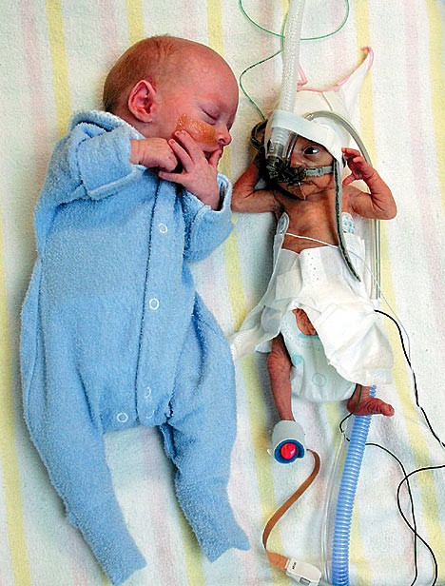
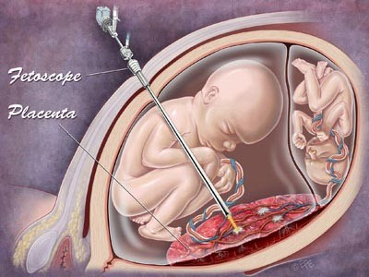
Twin-Twin transfusion syndrome
Staging (US-Quintero)
  I—discordant AFV[amnionitic fluid vol] but urine is still visible within the donor bladder
II—as I, but urine is not visible within the donor
bladder
III—criteria of stage II and abnormal Doppler
studies of the umbilical artery, ductus venosus, or umbilical vein[Evidence of compromise is seen]
IV—ascites or frank hydrops in either twin[severe anemia]
Treatment
  Repeated amniocentesis from recipient[due to overload]
  Fetoscopy and laser ablation of communicating vessels [not done in kenya]
  Selective feticide with umbilical cord/vein occlusion
Untreated
  Death occurs in 80-100% of cases.

Slide 25
Morbidity Specific to Monochorionic
Twin Anemia Polycythemia Sequence (TAPS)
  chronic fetofetal transfusion characterized by significant hemoglobin differences between donor and recipient twins.
  lacks the discrepancies in AFV typical of TTTS [twin twin transfusion syndrome]
  Diagnosed by MCA peak systolic velocity (PSV) >1.5 multiples of the median (MoM) the donor and <1.0 MoM in the recipient twin
  Abnormal doppler studies seen

Slide 26
Morbidity Specific to Monochorionic
Twin Reversed Arterial Perfusion (TRAP) Sequence
  Rare -1 case in 35,000 births, but serious
  Also known as an acardiac twin
  Result from a large artery-to-artery placental shunt, often also accompanied by a vein-to-vein shunt
  Outcome: normally formed donor twin with heart failure and a recipient twin that lacks a heart (acardius) and other structures

Slide 27
Morbidity Specific to Monochorionic
Twin Reversed Arterial Perfusion (TRAP) Sequence
  The arterial perfusion pressure of the donor twin exceeds that in the recipient twin
  The recipient twin receives reverse blood flow containing deoxygenated arterial blood from its cotwin through its umbilical arteries and preferentially goes to its iliac vessels.
  Only the lower body is perfused, and therefore disrupted growth and development of the upper body results.
  Cardiac failure seen

Slide 28
Morbidity Specific to Monochorionic
Hydatidiform Mole with Coexisting Normal Fetus [MONITOR CLOSELY]
Fetal demise
  Vanishing twin (first trimester)-the risk of death after the first trimester is not increased for the survivor, conservative management no termination due to dic just monitor
  Second trimester or later
    Complicates 4–8% of twin, 11–17% of triplet pregnancies
    Increased PTB [Preterm birth]of the live fetus
    Increased risk of neurological sequelae and mortality, maternal DIC, thrombosis of live fetus just monitor
    Previable 22weeks-terminate pregnancy
    Viable-consider GA, underlying cause, fetal and maternal condition

Slide 29
Management-antepartum
Primary goals
  prevent or interdict complications as they develop.
prevent preterm delivery of markedly immature neonates-prolong
gestation age, increase fetal weight
Reduce PNM and morbidity.
Decrease maternal complications
Components
  US-anomaly scan 18 to 20 weeks, serial us for growth
  2 weekly F/Up from 22 weeks TWIN PREG HAVE MORE VISITS
  Iron and folic acid and diet
  Assess for risk of PTB-cervical length dilated cervix and sufficiency
  Fetal Surveillance
    Monthly US- from 24 weeks to assess fetal growth and weight.
    BPP, NST from ≥28 weeks

Slide 30
Management-mode of delivery
Consider -gestational age, fetal presentations, EFW, and the experience and skill of the obstetrician
Vertex- Vertex (50%)
  Vaginal delivery, interval between twins not to exceed 30 minutes.
Vertex- Breech (20%)
  Vaginal delivery by senior obstetrician not competent don’t offer
Breech- Vertex( 20%)
  CS to avoid the rare interlocking twins( 1:1000 twins ).
Breech-Breech( 10%)
  Usually by CS.

Slide 31
Diagnosis of multiple pregnancy
• +ve family history (maternal )
• +ve history of ovulation induction
Exaggerated symptoms of pregnancy like hyperemesis gravidarum
Marked edema of lower limb
Discrepancy between date and uterine size
Palpation of multiple fetal parts/poles
Auscultation of two fetal heart beats at two different sites with a difference of 10 beats

Slide 32
Differential diagnosis for FH larger than dates
Multiple fetuses.
Inaccurate menstrual history.
Hydramnios.
Hydatidiform mole.
Elevation of the uterus by distended bladder.
Uterine myomas.
A closely attached adnexal mass.
Fetal macrosomia (late in pregnancy)

Slide 33
Timing of delivery
Monochorionic:
  elective birth from 36+0 administer prophylactic ACS
Dichorionic
  elective birth from 37+0
Triplets
  elective between 35 and 36 weeks

Slide 34
Other considerations
Asynchronous delivery, or delayed-interval delivery
  delivery of one fetus in a multiple gestation that is not followed promptly by birth of the remaining fetus or fetuses
  Management if extremely preterm for conservative management at specialized centers
    Admit and evaluate-CBC, US
    high ligation of the umbilical cord of the first fetus after delivery chlorhexidine vaginal washing
    Tocolysis and corticosteriods
    antibiotics (as dictated by cervical culture results)
    Mgso4 prevents intercranial hemmorhage
    ACS

Slide 35
Other considerations
Higher order pregnancies
  Spontaneous triplets 1:8000 births.
  Spontaneous quadruplets 1:700,000 births.
  The main risk is severe prematurity .
  CS is the usual and safe mode of delivery.

Slide 36
Other considerations
Superfetation:
  if an interval as long as or longer than a menstrual cycle intervenes between fertilizations
  requires ovulation & fertilization during the course of an established pregnancy-theoretically possible until uterine cavity is obliterated by fusion of the decidua capsularis to the decidua parietalis.
  In mares, not known to occur spontaneously in man
Superfecundation
  fertilization of two ova within the same menstrual cycle but not at the same coitus, and not necessarily by sperm from the same male.

Slide 37
Other considerations
First-Trimester Multifetal Pregnancy Reduction
  In ART[assisted reproductive technology] for three or more fetuses to reducee the risk for pregnancy loss, preterm delivery, and long-term physical and neurodevelopmental morbidity
  injection of potassium chloride into the thorax of one or more of the fetuses, transabdominally under real-time sonographic guidance

Slide 38
G1 P0 conceived dichorionic twins via intrauterine insemination with her husband’s semen. She is O-negative. One neonate is A-positive and the other is O-negative. Her husband is A-positive. This finding can be explained to the parents by describing which of the following phenomena?
  Superfetation
  Superfecundation
  Not atypical for dichorionic twins
  Infidelity or poor technique by her reproductive endocrinologist’s office
  None of the above

Slide 39
Regarding US for chorionicity
  Dichorionic intervening membrane may not be easily seen prior to 10 weeks
  Accuracy improves with advancing gestation
  Risk for misclassification decreases by 1% for each additional week from 15 to 20 weeks
  Accuracy is 98% in the first trimester and diminishes with advancing gestational age.
  All of the above

Slide 40
Objectives
Which of the following statements about zygosity is most correct?
The rate of zygotic splitting is increased following all ART procedures
Early zygotic splitting will always result in conjoined twins
The highest risk for perinatal morbidity and mortality occurs in dizygotic as opposed to monozygotic twins
Monozygotic twins will always have a monochorionic placenta
None of the above

Slide 41
Monochorionicity in a twin pregnancy can be suspected by the presence of all of the following ultrasound features except:
Separate placental disks
T-shaped junction of amnion into chorion
Fetuses of the same gender
Very thin intertwin membrane
All of the above

Slide 42
Maternal complications that are increased in multifetal gestations include all of the following except:
Hyperemesis gravidarum
Preeclampsia
Cholestasis of pregnancy
Uterine rupture
Gestational diabetes

Slide 43
Fetal demise:
Complicates 4–8% of twin pregnancies
Complicates 11–17% of triplet pregnancies
Is associated with an increased risk of preterm delivery in the survivor
Is seen at least twice the rate in monozygotic twins as in dizygotic twins
All of the above

