Slide 1
ANTEPARTUM HEMMORRHAGE(APH)
DR MICHOMA
Late pregnancy bleeding.

Slide 2
Objectives
Deﬁnition of APH
Know the important causes of APH.
Appreciate that vaginal bleeding in pregnancy is potentially life threatening.
Giving attention to maternal hemodynamic stability priority.

Slide 3
Deﬁnition
Obstetrics is "bloody business."
The term antepartum hemorrhage refers to uterine bleeding after 28 weeks of gestation before delivery of fetus that is unrelated to labor and delivery. Some places i.e. developed world is 20 weeks
The bleeding can be from a site above or below the cervix.
Uterine bleeding from a site above the cervix before delivery is cause for concern…. Bcz not so sure where exactly the bleeding is from is hard to tell as one cannot see.

Slide 4
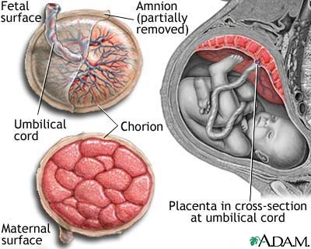
Vessels branch and stop at a point… but sometimes the vessels continue to the chorioamniontic membrane this is vasa previa
Appreciate the 2 different surfaces of the placenta

Slide 5
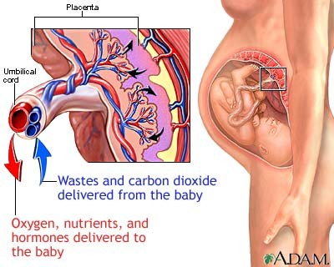
Idk what he said, voice issues…. 8am sucks

Slide 6
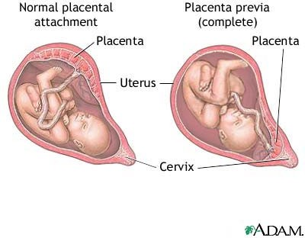
Low lying placenta is placenta previa
Placenta abruption is????

Slide 7
Causes of APH
Placenta previa (20 percent)
Abruptio placenta (30 percent)
Uterine rupture (rare)
Vasa previa (rare)…. The diagram on slide 4
Cervical Lesions
Vaginal lesions
Unidentiﬁed causes

Slide 8
Obstetric is an Emergency
Death from hemorrhage still remains a leading cause of maternal mortality.
In countries with fewer resources, the contribution of hemorrhage to maternal mortality is even more striking

Slide 9
Contribution of hemorrhage to maternal mortality
Haemorrhage
24.8%
Sepsis
14.9%
Indirect causes
19.8%
Hypertensive disorders
Obstructed labour
6.9%
12.9%
Other direct causes
7.9%
Unsafe abortion
12.9%
Source: Safe Motherhood Fact Sheet on Maternal Mortality, 1998.

Slide 10
Digital Vaginal Examination
In contrast to bleeding in the ﬁrst half of pregnancy, digital examination of the cervix SHOULD BE AVOIDED in women presenting with bleeding in the second half of pregnancy until placenta previa has been excluded.
Only do vaginal examinations after verifying wit u/s location of placenta
Digital examination of a placenta previa can cause immediate, severe and life threatening hemorrhage.
Do speculum examination- do this instead of vaginal examination

Slide 11
A) PLACENTA PRAEVIA
When the placenta is implanted partially or completely in the lower uterine segment.
Placent abnormally close to the internal os within zone of trauma(coitus or digital VE), cervical eﬀacement and dilatation.

Slide 12
TYPES OF PLACENTA PRAEVIA
TYPE I-­‐Placenta encroaches lower segment, does not reach internal os.
TYPE II(marginal)-­‐ placenta reaches margin of internal os but does not cover it.
TYPE III(partial)-­‐ placenta partially covers the internal os.
TYPE IV(complete)-­‐ placenta completely covers the internal os, cervix can not dilate.

Slide 13
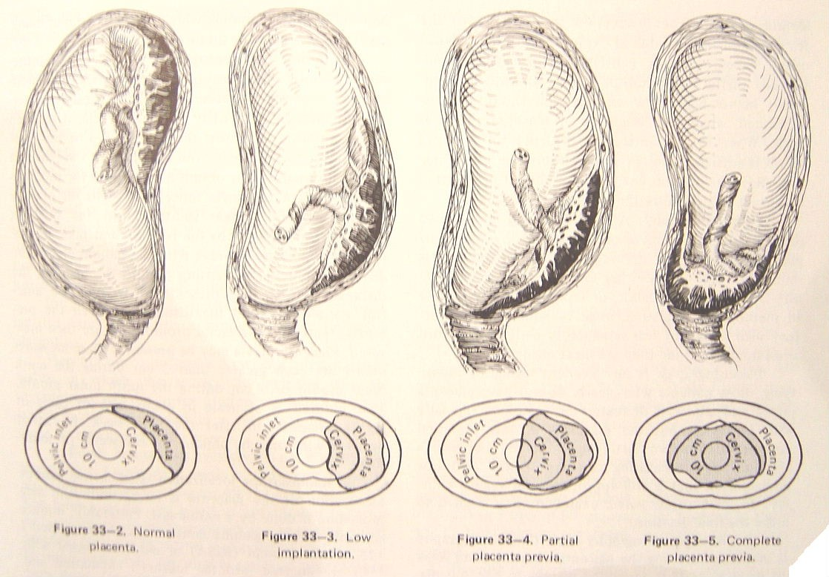
classiﬁcation
normal
Type 1
Type 3
Type 4

Slide 14
CLINICAL PRESENTATION
PREVIA OFTEN BEGINS WITH PAINLESS VAGINAL BLEEDING!- most common is par vaginal bleeding which is painless and sudden in onset, can be triggered during coitus.. Or any physical activity
The characteristic clinical presentation of placenta praevia is painless vaginal bleeding after 20 weeks of gestation; this occurs in 70 to 80 percent of patients who have low lying placenta.
Ten percent of women with praevia reach term without bleeding (incidentally detected by ultrasound examination and remain asymptomatic )
Bleeding can range from only spotting to massive life threatening haemorrhage.

Slide 15
Bleeding
Can start as spotting in 1st trimester.
1/3 initial bleeding in < 30 weeks associated with transfusion , pre-­term delivery and high perinatal mortality
1/3 bleed between 30-­‐36 weeks
1/3 bleed after 36 weeks
10% reach term without bleeding
Bleeding more in third trimester- mostly after 36 weeks

Slide 16
Risk factors
Endometrial scarring. Risk factors associated with endometrial scarring include:
Increasing number of prior cesarean
Increasing parity
Increasing maternal age
Increasing number of prior curettages for spontaneous or induced abortions

Slide 17
Risk Factors
The need for increased placental surface to increase fetal oxygenation:
✓Maternal smoking
✓Residence at higher altitudes- due to low O2 tension, though more anecdotal rather than scientific but just check
✓Multiple gestation

Slide 18
Conditions associated with placenta praevia
Placenta acreta- attach more deeply and firmly to the wall
Fetal malpresentation
Premature rupture of membranes(PROM)
Intrauterine growth restriction
Premature labor and premature delivery.

Slide 19
EVALUATION
Any pregnant woman beyond 1st Trimester presenting with PV bleeding requires a sterile speculum examination, followed by a diagnostic ultrasound scan unless previous documentation conﬁrms placenta praevia!
Give attention to patient’s hemodynamic status.

Slide 20
DIAGNOSIS
Ultrasound provides the simplest, most precise and safest method of placental location.
Double set-­‐up examination -­‐ less used these days. Done in theatre with readiness to perform emergency C/S incase life threatening bleeding is provoked by the digital vaginal examination.

Slide 21
MANAGEMENT
Depends on three case scenarios below:
 Asymptomatic mothers discovered by routine scan
Actively bleeding mothers
Mothers who are stable after one or more episodes of active bleeding
Always give priority to ABCs/ maternal hemodynamic stabilization in acute states.

Slide 22
Acute care/ emergency situation
Vaginal bleeding reqires admission till it stops.
IV. line /crystalloids
Maintain haemodynamic stability and adequate urine output 30ml / hour
GXM blood group and antibody screen
Transfusion when need be.
Changes in haemodynamic parameters and rate of bleeding should be noted.
(BP, maternal/ fetal heart rates, peripheral perfusion, urine out put)

Slide 23
Management of acute case ct
➢➢ Coagulation screen if co-­‐existing abruptio placenta or massive transfusion.
➢➢ Fetal monitoring
➢➢ Maternal monitoring
-­‐Bp, heart rate, Foleys catheter, vaginal blood loss
➢➢ Tocolysis-­‐ No tocolysis to actively bleeding women Consider if conservative management is the way forward.
➢➢ Emergency delivery by C/S if continues to bleed regardless of fetal maturity.

Slide 24
Asymptomatic PP>20wks
Sonographic follow up. Serial 4 weeks interval after 28 weeks
Avoidance of coitus or vaginal exam
Exercise restriction ( less physical activity.)
Counselling
Can be managed as outpatient with clear instructions to present to hospital immediately incase of repeat bleeding.

Slide 25
Conservative management
Give steroids to mature lungs in anticipation of premature delivery if gestation age 28 to 34 weeks…dexamethasone just in case the bleeding re occurs after prior stabilization
Hospitalization versus outpatient case base analysis.
-­‐patient return to hospital quickly
-­‐adult companion 24hours
-­‐reliable and able to maintain bed rest understand the risk

Slide 26
Indication for delivery
Non reassuring fetal status
Life threatening refractory maternal haemorrhage
Signiﬁcant vaginal bleeding after 34 weeks.
Elective delivery at 37 completed weeks.

Slide 27
Delivery
Elective C/S delivery at 37 completed wks
Caesarian section and or vaginal delivery depending on type and condition of mother.
Type I and II (anterior) vaginal delivery.
Type II(posterior), III and IV C/S.
Prepare for blood loss during or after delivery, always have blood ready (Group,cross-­‐match and save)

Slide 28
B) ABRUPTIO PLACENTA
Premature separation of a normally implanted placenta prior to delivery of the fetus.
The immediate cause of the placental separation is either due to the rupture of defective maternal vessels in the decidua basalis, where it interfaces with the anchoring villi in the placenta or the result of a mechanical force (eg, blunt trauma to the abdomen or rapid uterine decompression)

Slide 29
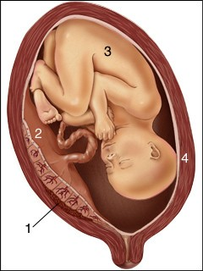
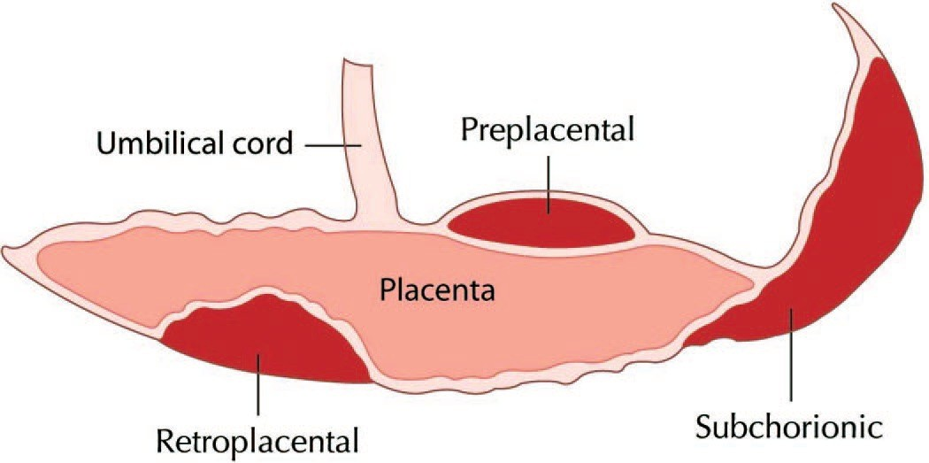
SITES OF PLACENTAL BLEEDING
Placenta is on posterior wall..
1. Blood clot.. Retroplacental bleeding

Slide 31
TWO PRESENTING TYPES
Revealed Bleeding-­‐ clinical abruption classically presents with vaginal bleeding, abdominal and/or back pain, and uterine contractions.
Is present in 80-­‐90% of abruptio cases
Concealed abruptio -­‐ Occasionally, a woman with placental abruption will present with only preterm labor, and no vaginal bleeding.
Will have profound shock disproportionate to any bleeding.
Only 10% of abruptio

Slide 32
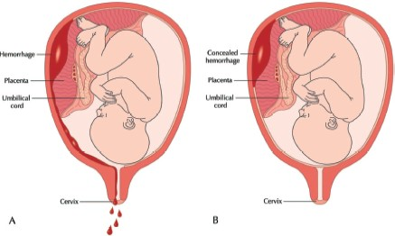

Slide 33
Risk Factors
Previous abruption -­‐ (RR 10)
Hypertension – (2.1 -­‐ 4.0)
HTN with pre-­eclampsia – ( 7 -­‐ 8)
pPROM – (2.4 -­‐ 5.0)
Tobacco – (1.4 – 2.0)
Cocaine – (many fold)
Twins – (2 fold)
Chorioamnionitis – (2 – 2.5)
Others: trauma, ﬁbroids, thrombophilias, circumvallate,
polyhydramnios
33
These 2 are the most common causes
yamu75p@yahoo.com

Slide 34
Clinical manifestation
Varies widely depending on site, extent, type….
Vaginal bleeding
Abdominal pain
78% -­‐ 84%
62% -­‐ 66%
Uterine tenderness
Uterine Hypertonus
Backache – especially with posterior placenta
Acute fetal distress
Fetal demise(IUFD)
Preterm labour
Hypovolemic shock

Slide 35
COMPLICATIONS OF ABRUPTIO
Maternal
Hypovolemia related to blood loss
Need for blood transfusion
Disseminated intravascular coagulopathy(DIC)
Renal failure
Adult Respiratory Distress Syndrome
Multisystem organ failure Death
Postpartum hemorrhage-­couvelaire uterus… check what it is

Slide 36
COMPLICATIONS OF ABRUPTIO
Fetal
Growth restriction (with chronic abruption)
Fetal hypoxemia or asphyxia
Preterm birth
Perinatal mortality

Slide 37
ABRUPTIO AND DIC
Fetus and placenta in-­‐utero so uterus unable to contract to stop bleeding. So coagulation cascade continually activated leading to exhausting of coagulation factors (consumptive coagulopathy).
Fulminant DIC occurs in:
  1 – 2% of abruption
  30% of Abruption with IUFD
Associated with high maternal mortally.

Slide 38
Grading of Abruption
Grade 0:
  Asymptomatic – Retroplacental clot(RPC) seen aNer placental delivery as only feature of abruptio.
Grade I:
  Vaginal bleeding & uterine tenderness
  Visible RPC aNer delivery
  No coagulopathy
  Maternal vitals normal
  No fetal distress
38
yamu75p@yahoo.com

Slide 39
Grade II:
  Maternal tachycardia
  Fetal compromise
  Severe uterine tenderness
  Hypoﬁbrinogenemia
  Large RPC
Grade III
  Uterine tetany
  Hypovolemia and shock
  Severe uterine tenderness
  Mostly IUFD
  Hypoﬁbrinogenemia
  30% have DIC (IIIB)
  70% do not have DIC (IIIA)
39
yamu75p@yahoo.com

Slide 40
Diagnosis
High index of suspicion.
Ultrasound: -­‐ good for concealed variety, but not for revealed type.
  Poor sensitivity: 24%-­‐40%
  Good speciﬁcity: 85%-­‐96%
  Good PPV: 88%
  Poor NPV: 53%

Slide 41
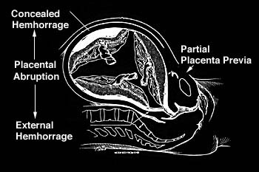
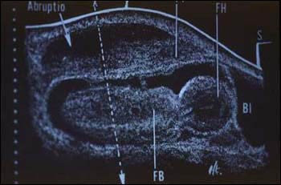

Slide 42
Management
Placental abruption is an obstetrical emergency.
All patients with suspected abruption should undergo rapid initial evaluation of the fetus and mother.
The mother should have large bore intravenous lines placed and she should be evaluated for blood loss (hypovolemia) and coagulopathy.

Slide 43
Management
After initial evaluation and stabilization, the management of pregnancies complicated by abruption depends on whether the fetus is alive or dead, the gestational age, and maternal/fetal status.
When there is partial placental separation, total abruption may occur suddenly and without warning.

Slide 44
Management
For pregnancies with abruption at or near term with a live fetus, do expeditious delivery
Cesarean delivery is indicated if there is fetal distress, there is ongoing major blood loss or other serious maternal complications, or when vaginal delivery is contraindicated…. Apparently he changed his mind and he said do vaginal delivery unless CS is indicated like breech presentation, previous CS
Otherwise, vaginal delivery may be attempted. Artiﬁcial rupture of membranes with syntocinone augumentation is followed by rapid labor due to tonus uterus.

Slide 45
Abruptio with DIC
For women with coagulopathy, transfusion of blood products should preferably occur prior to surgery. If this is not possible, blood, fresh frozen plasma, cryoprecipitate, and platelets, as required, should be aggressively administered early in the surgery.
Expect signiﬁcant blood loss especially if C/S.

Slide 46
Abruptio Remote from Term
For pregnancies with abruption remote from term with reassuring fetal and maternal status, delaying delivery to gain further fetal maturation .
Administer a course of glucocorticoids (Dexamethasone or Betamethasone) to women with pregnancies between 24 and 34 weeks of gestation to accelerate lung maturation.

Slide 47
If Fetus is Dead(IUFD)
When fetal death has occurred, the mode of delivery should minimize the risk of maternal morbidity or mortality.
Vaginal delivery is preferable unless urgent delivery is needed to enable stabilization of the mother, or there are obstetrical contraindications to vaginal birth.

Slide 48
Conclusion
Any active vaginal bleeding of a pregnant woman is a potential obstetrical emergency.
Women with active bleeding should be hospitalized for close maternal and fetal monitoring and supportive care.
Always ﬁrst give attention to hemodynamic stabilization-­‐ I.V line, GXM, Oxygen, ABC.
Be Decisive and act fast.

Slide 49
Conclusion
Placenta Praevia
Mode of delivery depends on type of praevia… imp!!
Be ready for premature delivery-­‐ give steroids btn 28-­‐34 weeks.
If life threatening rebleeding occurs, deliver without regard to fetal maturity.
Abruptio Placenta
The risks of abruption for the fetus depend on its severity and gestational age at which it occurs, whereas for the mother, the risks depend entirely on its severity.
The risk of recurrence is 5 to 15 percent, compared to a baseline incidence of 0.4 to
1.3 pre cent.

