Slide 1
Post Partum Hemorrhage
ZAHIDA QURESHI
2020

Slide 2
Classification/definition
Traditional Definition
blood loss of > 500 mL following vaginal delivery [normal bleeding]
blood loss of > 1000 mL following cesarean delivery
IN 2017 The American College of Obstetricians and Gynecologists’ (ACOG) reVITALize program defines postpartum hemorrhage as cumulative blood loss greater than or equal to 1,000 mL or blood loss accompanied by signs or symptoms of hypovolemia within 24 hours after the birth process (includes intrapartum loss) regardless of route of delivery
Functional Definition
any blood loss that has the potential to produce or produces hemodynamic instability any anemic symptoms
Functional definition –change in haemotocrit, rapidity of blood loss, volume deificit
Notes:
Functional definition –change in haemotocrit, rapidity of blood loss, volume deificit

Slide 3
Definition –time related
Primary PPH -that bleeding that occurs after delivery of the baby up to the first 24 hours most common
Most common cause is uterine atony utereus must contract to close venous sinuses
Secondary-any bleeding after 24 hours up to the end of 6 weeks of puerperium
usually due to sepsis

Slide 4
Background
Severe bleeding is the single most significant cause of maternal death worldwide.
More than half of all maternal deaths occur within 24 hours of delivery, most commonly from excessive bleeding. It is estimated that, worldwide,140,000 women die of postpartum hemorrhage each year—one every 4 Minutes-In Kenya of all Maternal deaths about 34 % are due to PPH
In addition to death, serious morbidity may follow postpartum hemorrhage. aki, shock, pituitary necrosis

Slide 5
Background
Sequelae include adult respiratory distress syndrome, coagulopathy, shock, loss of fertility, and pituitary necrosis (Sheehan syndrome).
Although many risk factors have been associated with postpartum hemorrhage it often occurs without warning.
All obstetric units and practitioners must have the facilities, personnel, and equipment in place to manage this emergency properly.
Clinical drills to enhance the management of maternal hemorrhage are recommended

Slide 6
anonymous data

Slide 7
PPH

Slide 8
Time from onset of complication to death
PPH 2 h
APH 12 h
Ruptured uterus 1 d
Eclampsia 2 d
Obstructed labour 3 d
Sepsis 6 d
if you don’t do the right thing, most common is pph as shown by 2hours
pph is a quick killer compared to the other common causes of maternal death. embolism is perhaps the only condition where death may be quicker. a healthy woman can be dead within 2 h of pph if appropriate and timely interventions are not instituted to save her life
Notes:
PPH is a quick killer compared to the other common causes of maternal death. Embolism is perhaps the only condition where death may be quicker. A healthy woman can be dead within 2 h of PPH if appropriate and timely interventions are not instituted to save her life

Slide 9
THE GOLDEN HOUR
As more time elapses between the point of severe shock and the start of resuscitation, the percentage of surviving patients decreases
as bleeding continues there can be mild to moderate shock which has to be identified
The “Golden Hour” is the time in which resuscitation must begin to achieve maximum survival

Slide 11
WHO recommendations for the Prevention of Postpartum Haemorrhage
WHO recommendations on Treatment of PPH and retained placenta
2017 recommendation on use of Tranexamic acid
2018 prevention of PPH –uterotonics

Slide 12
WHO recommendations on the use of uterotonics for the prevention of postpartum haemorrhage (PPH
Context | Recommendation | Category of recommendation
Efficacy and safety of uterotonics for PPH prevention | 1. The use of an efective uterotonic for the prevention of PPH during the third stage of labour is recommended for all births. To effectively prevent PPH, only one of the following uterotonics should be used: " oxytocin(Recommendation1.1) " carbetocin(Recommendation1.2) " misoprostol(Recommendation1.3) " ergometrine/methylergometrine(Recommendation1.4) " oxytocin and ergometrine fixed-dose combination (Recommendation 1.5). | Recommended
 | 1.1 The use of oxytocin (10 IU, IM/IV) is recommended for the prevention of PPH for all births. | Recommended
 | 1.2 The use of carbetocin (100 μg, IM/IV) is recommended for the prevention of PPH for all births in contexts where its cost is comparable to other effective uterotonics. | Context-specific recommendation
 | 1.3 The use of misoprostol (either 400 μg or 600 μg, PO) is recommended for the prevention of PPH for all births. | Recommended
 | 1.4 The use of ergometrine/methylergometrine (200 μg, IM/IV) is recommended for the prevention of PPH in contexts where hypertensive disorders can be safely excluded prior to its use. | Context-specific recommendation
 | 1.5 The use of a fixed-dose combination of oxytocin and ergometrine (5 IU/500 μg, IM) is recommended for the prevention of PPH in contexts where hypertensive disorders can be safely excluded prior to its use. | Context-specific recommendation
 | 1.6 Injectable prostaglandins (carboprost or sulprostone) are not recommended for the prevention of PPH. | Not recommended
Choice of uterotonics for PPH prevention | 2. In settings where multiple uterotonic options are available, oxytocin (10 IU, IM/IV) is the recommended uterotonic agent for the prevention of PPH for all births | Recommended
 | 3. In settings where oxytocin is unavailable (or its quality cannot be guaranteed), the use of other injectable uterotonics (carbetocin, or if appropriate ergometrine/methylergometrine, or oxytocin and ergometrine fixed-dose combination) or oral misoprostol is recommended for the prevention of PPH. | Recommended
 | 4. In settings where skilled health personnel are not present to administer injectable uterotonics, the administration of misoprostol (400 μg or 600 μg, PO) by community health workers and lay health workers is recommended for the prevention of PPH. | Recommended

Slide 13
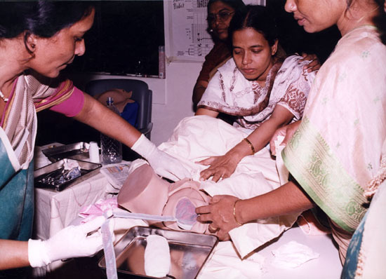
Procedure for Active Management FOR 3RD STAGE OF LABOUR
provide to every woman regardless
Within 1 minute of birth, give Oxytocin 10 IU IM OR 5 UNITS IV slowly
Clamp and cut the cord 2-3 minutes after delivery
Await a strong uterine contraction (2-3 minutes)
Apply controlled cord traction while applying counter traction above pubic bone
If placenta does not descend, stop traction and await next contraction
After placental delivery, rub uterus fundus gently to ascertain it is contracted
2 to 3 contraction leads to placental delivery
Notes:
WHO recommends giving oxytocin within 2 minutes to give provider time to give injection
Continuous gentle traction
Uterine massage every 15 minutes for 2 hours

Slide 14
Etiology of Postpartum haemorrhage
Tone - uterine atony (70%)
Tissue - retained tissue/clots(20%)
Trauma - laceration (perineal,vaginal uteral tears), rupture, inversion (10%)
Thrombopathy – coagulopathy (1%) thrombophilia, dic

Slide 15
Diagnosis - Is this a PPH?
observe vaginal loss
express blood from vagina following C/S massage uterus
REMEMBER
blood loss is consistently underestimated
ongoing trickling can lead to significant blood loss
blood loss is generally well tolerated to a point
Practically pour 500ml on towel that’s the maximum allowed

Slide 16
Management
Every woman can have pph.. It is just assumed… so avoid thinking about risk factors
Emergency preparedness-recognition, response, defined roles, multidisciplinary approach
Equipment –in labour room/theatre
Protocols
Skills
Drills
scenarios

Slide 17
Diagnosis and management of PPH
Shout (call) for help IMMEDIATELY
Wide bore branula x2
I/v fluids –Ringers lactate or Normal saline (and not dextran) COLLAPSE OF VEINS OTHERWISE,
ALSO TRY TAKE HISTORY
Empty bladder to allow uterus contraction so put catheter
Abdominal aortic compression to prevent blood to uterus
Massage uterus
Start uterotonics to manage uterus atony
Look for cause of bleeding tear, placental inspection

Slide 18
Assessment of severity of hemorrhage
Class I hemorrhage-blood volume loss of up to 15%. Heart rate is minimally elevated or normal, and no change in blood pressure, pulse pressure, or respiratory rate.
Class II hemorrhage-15-30% blood volume loss, tachycardia (100-120 bpm), tachypnea (RR of 20-24), and a decreased pulse pressure, minimal changes if at all in systolic BP. The skin may be cool and clammy, and capillary refill may be delayed.
A patient with increasing maternal heart rate and tachypnea with stable systolic BP has compensated shock and prompt investigation and institution of a PPH protocol is needed, even if only light vaginal bleeding is observed.
Notes:
Nonpregnant populations

Slide 19
Assessment of severity of hemorrhage
3. Class III -30 to 40% blood volume loss, significant drop in BP and changes in mental status. Any hypotension (SBP <90 mmHg) or drop in BP>20 to 30% of the measurement at presentation must be assumed as due to hemorrhage. Heart rate (≥120 and "thread") and markedly elevated RR, decreased urine output with delayed capillary refill.
4. Class IV->40% blood volume loss, significant depression in BPand mental status. The patients are hypotensive (SBP<90 mmHg) with narrow pulse pressure (≤25 mmHg) and marked tachycardia (>120). Minimal or absent urine output is minimal. Cold and pale skin, and delayed capillary refill.

Slide 20
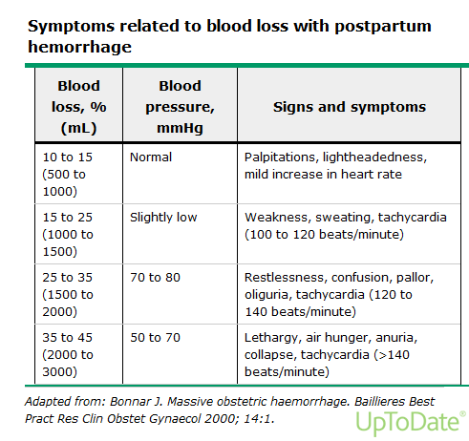

Slide 21
Clinical presentation and diagnosis
 | Degree of Shock
 | Compensation | Mild shock | Moderate shock | Severe shock
Blood loss | 500- 1000ml 10-15% | 1000-1500ml 15-25% | 1500-2000ml 25-35% | 2000-3000ml 35-45%
Blood Pressure Change (systolic pressure) | None | Slight fall (80-100mmHg) | Marked fall (70-80mmHg) | Profound fall (50-70mmHg)
Signs and symptoms | Palpitations Dizziness Tachycardia | Weakness, Sweating, Tachycardia | Restlessness, Pallor, Oliguria. | Collapse, Air Hunger, Anuria

Slide 22
USE OF OXYTOCIC DRUGS FOR PPH TREATMENT
 | Oxytocin prevent and tx | Ergometrine/ Methyl-ergometrine tetanic contraction usually extra blood goes to heart very quickly | 15-methyl Prostaglandin F_{2α} _{CARBOPLAST} | Misprostol
Dose and route | IV: Infuse 20 units in 1 L IV fluids at 60 drops per minute IM: 10 units | IM or IV (slowly): 0.2 mg | IM: 0.25 mg | 600 ugms Orally or Rectally
Continuing dose | IV: Infuse 20 units in 1 L IV fluids at 40 drops per minute | Repeat 0.2 mg IM after 15 minutes If required, give 0.2 mg IM or IV (slowly) every 4 hours | 0.25 mg every 15 minutes
Maximum dose | Not more than 3 L of IV fluids containing oxytocin | 5 doses (Total 1.0 mg) | 8 doses (Total 2 mg)
Precautions/ Contraindications | Do not give as an IV bolus | Pre-eclampsia, hypertension, heart disease | Asthma
Notes:
CARBOPLAST =(15 METHYL PGF 2a) –this is an analog of PGF2a ( dinoprost)-can also be used intramyometrial
Dinoporost
Dinoprostone or Prostin can be used Per Rectal 2 mg 2 hourly

Slide 23
Management of uterine atony
Aortic artery compression
Massage of uterus
Bimanual compression OF THE UTERUS
Continuing uterotonics
Tamponade(condom balloon)
EUA/ laparotomy examination under anesthesia
-B-Lynch suture
Artery ligation
Hysterectomy –sub or total.

Slide 24
Retained placenta and tears
Uterotonics –not ergometrine (causes tetanic contractions)
CCT
Intra-umbilical injection of oxytocin
Manual removal of placenta
Repair of tears –method of examination and repair
Abnormal placentation (accreta, percreta, increta)

Slide 25
Cont….
Uterine inversion –reduction theatre due to shock
Coagulopathy –blood
FFP
Cryoprecipitate
For atony –continue massage, uterotonics, balloon tamponade examination in theatre, etc

Slide 26
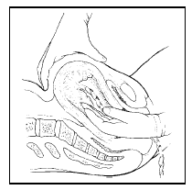
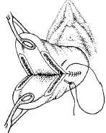
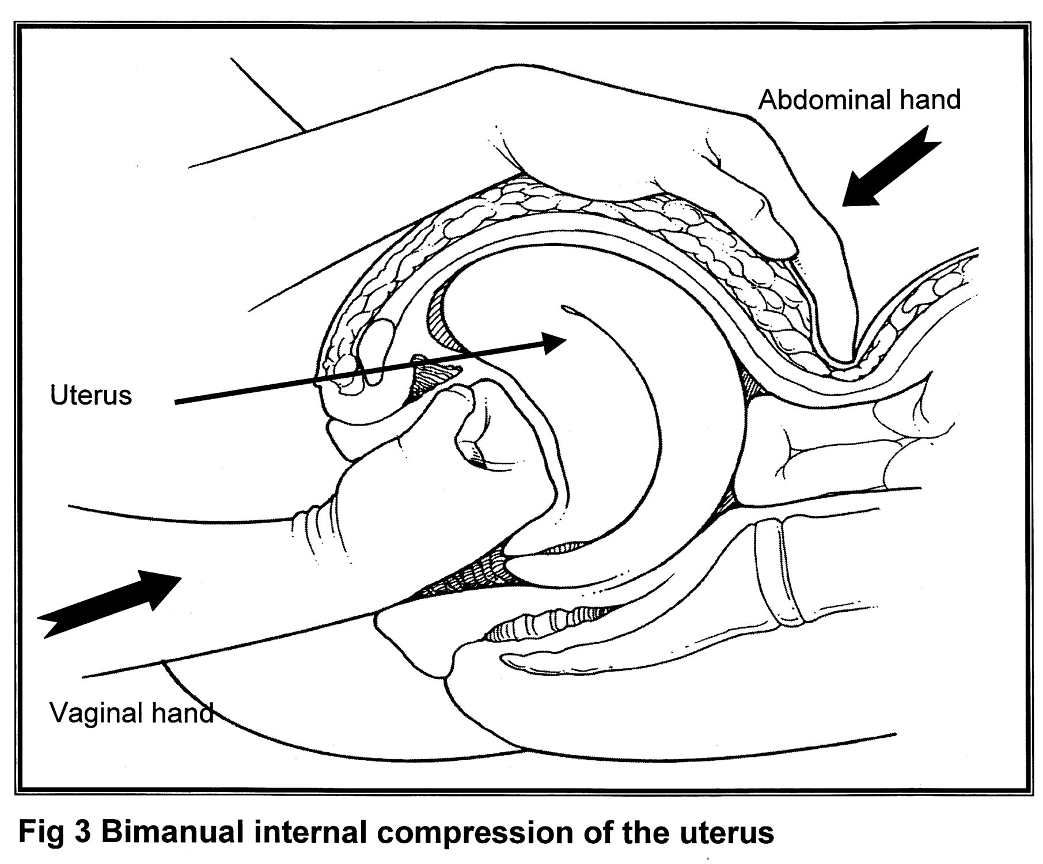
PROCEDURES
This is a pulled out cervix whereby they repair the cervical tear by suturing. It is suspected if uterotonics don’t stop bleeding.
If the placenta is still attached one may have to do a manual placental removal. A retained placenta can stay in for approximately 30 mins. If there is no bleeding no need for alarm to remove placenta but if there is bleeding then remove placenta manually
bimanual compression as shown. may have to leave hands in for several minutes

Slide 27
Press the abd aorta mostly on the left side by making a fist and applying a lot of pressure so as to prevent blood going to lower segment of the body. Confirm how well its done by feeling for femoral pulse which should be absent. This is usually an initial measure

Slide 29
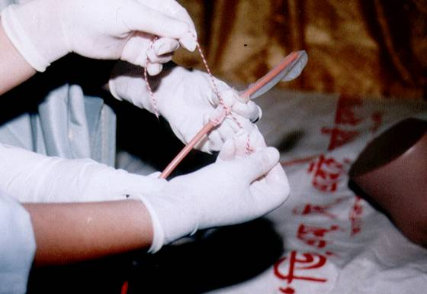
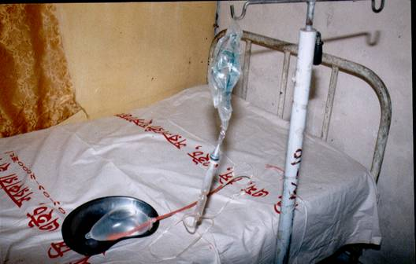
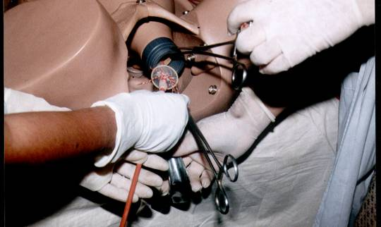
Procedure
A condom attached to a rubber catheter is introduced into the uterus under aseptic conditions
Condom is inflated between 250 to 500ml normal saline
When bleeding is reduced, stop further inflation and fold and tie outer end of the catheter to maintain pressure
Continue oxytocin infusion for 24 hours
Keep condom in uterine cavity for 24 hours, then deflate gradually over 2 hours and remove
Syeba Akhtar 2004
Notes:
Cases of primary and secondary PPH in whom medical and basic surgical approaches failed to control PPH
Recruited over 18 months at Dhaka Medical College Hospital
Total number of cases of PPH: 152
Medical and minor surgical management : 109
Major surgical (B Lynch) 20
Condom tamponade 23
All 23 had cessation of bleeding within 15 minutes

Slide 30
PPH - Aggressive Surgery
Systolic BP < 70 mm Hg especially if there is no diastolic component
Cold pale extremities/ pale conjunctiva
Failure to raise BP despite infusion with crystalloids and blood
Continuous blood loss despite medication
Confused, coma, airhunger, ECG changes. Poor urinary output (takes time to establish)

Slide 31
B-LYNCH PROCEDURE
The sutures are usually absorbable.

Slide 32
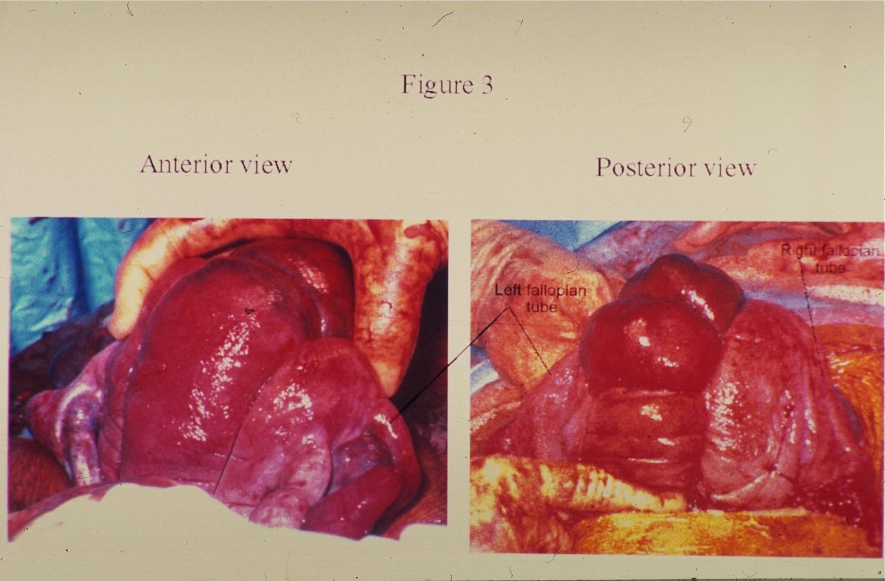
B-LYNCH PROCEDURE
ANTERIOR VIEW
POSTERIOR VIEW

Slide 33
Surgical
Techniques

Slide 34
Non-pneumatic Anti-Shock Garment (NASG)
Conversion of military trousers into a garment
To treat shock, resuscitate, and stabilize
Important to consider for transport from remote areas; little skill needed to put a mother into it

Slide 36
BEGIN APPLICATION OF NASG WITH SEGMENT 1, AT THE ANKLES

Slide 37
Criteria for Removal: Hgb 7.5 and Vital Signs Stable x 2 hours
START AT ANKLES
Wait 15 minutes between removing each segment,
Check Vital Signs
Do not continue REMOVAL if
BP decreases by 20 mm HG OR
Pulse increase by 20 BPM

Slide 39
Heat stable Carbetocin versus oxytocin for preventing hemorrhage after vaginal birth: World Health Organization CHAMPION trial
Ten countries app 30,000 participants– Kenya 4818
Comparison of Oxytocin 10 units i/m vs 100ugs Carbetocin – heat stable at delivery in vaginal births
Comparisons was outcomes of blood loss of more than 500mls and 1000mls
Carbetocin is non-inferior which means it is as good as Oxytocin and has the added advantage of being heat stable so does not requires refrigeration.
It will be made available to LMIC at the cost of oxytocin.

Slide 40
Updated WHO Recommendation on Tranexamic Acid for the Treatment of Postpartum Haemorrhage Highlights and Key Messages from the World Health Organization’s 2017 Global Recommendation
Key Messages
• The World Health Organization (WHO) recommends early use of intravenous tranexamic acid (TXA) within 3 hours of birth in addition to standard care for women with clinically diagnosed postpartum haemorrhage (PPH) following vaginal birth or caesarean section.
• Administration of TXA should be considered as part of the standard PPH treatment package and be administered as soon as possible after onset of bleeding and within 3 hours of birth. TXA for PPH treatment should not be initiated more than 3 hours after birth.
• TXA should be used in all cases of PPH, regardless of whether the bleeding is due to genital tract trauma or other causes.
• TXA should be administered at a fixed dose of 1 g in 10 mL (100 mg/mL) IV at 1 mL per minute (i.e., administered over 10 minutes), with a second dose of 1 g IV if bleeding continues after 30 minutes.
• TXA should be administered via an IV route only for treatment of PPH. Research on other routes of TXA administration is a priority

Slide 41
Summary –what have we learnt?
Introduction/Background
Definition
Prevention –Active Management of Third Stage of Labour
Causes
Medical management
Surgical management
Emergency preparedness

Slide 42
Conclusion
be prepared
practice prevention
assess the loss
assess maternal status
resuscitate vigorously and appropriately
diagnose the cause
treat the cause-medically/surgically

