Slide 1
Maternal fetal medicine

Slide 2
Dispropositionate foetal growth
Prof. Omondi-Ogutu
2020

Slide 3
Learning objectives
Historical aspects MFM
Definitions of terminologies
Types of disproposionate foetal growths
Aetiology
Influence on Maternal foetal morbidity and mortality
Some principles of management

Slide 4
terminology
Small for gestational age smaller than expected i.e. lesser than 10th percentile
Large for gestational age i.e. greater than 90th percentile
Both denotes a problem in the foetal growth
Need to understand the associated factors
The etiological factors are many

Slide 5
history
The history of perinatal [7days] medicine is long from the 18th C [nursing job]
Important landmarks are
Use of oxygen in resuscitation of the Newborn at the turn of c 20th
Development of the incubators [vulnerable babies, controlled temp there is baby growth]
Establishment of specialities/ perinataology [7days]/neonatology[28days]/ MFM [maternal fetal medicine]

Slide 6
Normality
Defining normal and abnormal fetal growth has been a long-standing challenge in clinical practice and research
Set standards that conform to the norms
35 weeks approx. 2.5kg
After 35 weeks genetics plays a role on growth

Slide 7
What is normal?
Normal fetal growth is a critical component of a healthy pregnancy
It influences the long-term health of the offspring.
Parameters such as-Fetal weight, mothers weight, normal fetal heart, basically normal ultrasound[biophysical profile]

Slide 8
normal fetal
Influenced significantly by
race/ethnicity, eg Asian community babies are smaller in size, Scandinavia have bigger baby
Sex [male 5% bigger than female], parity,
maternal size, [small mum so small baby]
genetic and physiological factors.
Environmental factors
Nutrition-

Slide 9
Determinants of foetal growth
fetal size
the status of placental health measured by
maternal [chronic diseases, tumors, multiple gestation, operative procedure on uterus that is injurious]/ genetics [familial history]
fetal Doppler velocimetry [fetal flow affected by poor placental bflow]
and biomarkers [check for PreE],
Biophysical findings and genetics
Notes:
‹#›

Slide 10
Fetal Growth
Normal fetal growth is determined by the genetically predetermined growth potential and further modulated by maternal, fetal, placental, and external factors.
Fetal growth restriction (FGR) is a failure to reach this potential [intrauterine growth restriction]

Slide 11
FOETAL GROWTH RESTRICTION (FGR)

Slide 12
Fetal Growth Restriction
“Intrauterine growth restriction is one of the most common and complex problems in modern obstetrics. Diagnosis and management are complicated by the use of ambiguous terminology and a lack of uniform diagnostic criteria…… Size alone is not an indication of a complication.
As a result of this confusion, under intervention and over intervention can occur.”
ACOG

Slide 13
Population Vs Standard reference
Use of a population reference will yield a relative fetal size in relation to the total population,
while a standard will assess a fetal size in comparison to normally-grown fetuses. Thus, a standard may have more clinical utility than a population reference.
[different standards for different countries]

Slide 14
The balance of risks and the need for the availability of services mean that the involvement of neonatologists in FGR management is vital
It is multidisciplinary.. Scenarios can be different inside vs. outside uterus

Slide 15
An Ideal Definition Of FGR
FGR should take into account the
growth potential of the fetus,
current fetal size, [fetal fat padding]
fetal and placental health,
if available, fetal growth velocity [not commonly done]
You must determine the correct gestational age….. Compare GA(know the methods) and fundal height

Slide 16
definitions
Abnormal foetal growth is now defined according to percentiles.
Previous terminologies :
Intra uterine growth restricted pregnancy (IUGR) are in the 10th percentile or below.
Large for gestational age are in the 90th percentile or above.
The new terminology fetal growth resuscitation(FGR)

Slide 17
FGR
Small for dates.- infants
Symmetrical FGR [started before 28 weeks of gestation, brain is spared]
Asymmetrical FGR [after 28 weeks, starts storing food in liver ie glycogen???]

Slide 18
FGR
Fetal growth restriction (FGR) is challenging because of the difficulties in reaching a definitive diagnosis of the cause and planning management.
FGR is associated not only with a marked increased risk in perinatal mortality and morbidity but also with long-term outcome risks.

Slide 19
features
Altered weight distribution
Normally the brain is spared

Slide 20
causes
MATERNAL
FOETAL

Slide 21
Foetal

Slide 22
Aetiology-foetal
Genetic disorders
Congenital infections
Placental disorders
Multiple gestation

Slide 23
Genetic disorders
Responsible for 10-15% of cases usually most end up in fetal death
Monosomy
Trisomy ,Downs syndrome, Edwards, Trisomy 13
Turners syndrome
Achondroplasia
Osteogenic imperfect- cognitive is spared

Slide 24
Infections
Contributes to 5-10% of cases
CMV
Rubella
Toxoplasmosis
Herpes
HIV- not such a big issue
Mostly affect CNS

Slide 25
Placental factors
Placental infarction- Placental hypo perfusion leads to compromised fetus [placental clots]
Placenta preavia
Premature placental separation
Placental malformation
Circumvallate placentae?? Point insertion is not there apparently??
Twin to twin transfusion- check on mx
Placental haemangioma.

Slide 26
Multiple gestation
Responsible for 20-30% of cases of FGR
Increased in Twin to Twin transfusion,

Slide 27
maternal

Slide 28
Aetiology-maternal
Maternal diseases: Hypertension, anaemia, renal disease, malnutrition, metabolic disorders. Compromise placental function
Substance abuse, Drugs, alcohol, cigarettes[nicotine], heroin…
Small maternal stature compare mum and baby size.
Sex of the foetus, males are 5% heavier than the females

Slide 29
Hypertension
Effect on the placenta leads to the following
1. Reduced perfusion
2. Reduced oxygenation
3. Placental infarction

Slide 30
Drugs
Alcohol
Cigarette smoking- (critical 16 weeks.)… some study that showed that u can smoke until 16 weeks and baby will still be okay…of course it was a lie…
Heroin
Medications- like warfarin

Slide 31
Nutrition
Malnutrition and malabsorption
Ulcerative colitis.
Pancreatitis
Intestinal parasites- salads
Reduced nutrients to baby

Slide 32
Maternal feature
Small stature
Ponderal index
PI = birth weight x 1000
( crow-heel length)3
PI at 28 wks. 1.8, increases by 02 every 4 wks. to 2.4 at 40 weeks.
How increase in weights occurs

Slide 33
Sex
Females are 5% smaller and 2% shorter than boys.

Slide 34
diagnosis
History- accurate dating of the pregnancy
Investigations
Obstetric ultrasound
For infections
Maternal serum AFP levels.

Slide 35
Complications
Premature labour
Pre eclampsia- non reassuring fetal status??
Meconium aspiration syndrome
Sepsis
Convulsions
Foetal demise

Slide 36
prevention
Change in social behaviour
Malaria prophylaxisis
Balanced nutrition
Correction of anaemia
Treatment of identifiable maternal diseases.

Slide 37
treatment
Bed rest Is it beneficial? Apparently doesn’t help
Use of low dose Aspirin ?
Regular ANC visits apparently with corona back to 4 weeks
Caesarean delivery

Slide 38
Large for gestational age

Slide 39
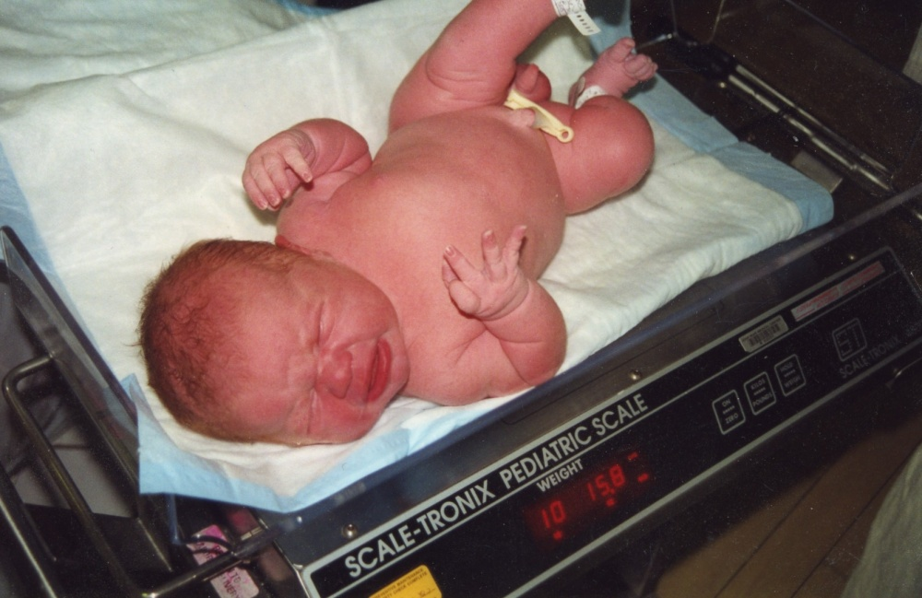

Slide 40
Definition
A birth weight above the 90th percentile of weight for any specific gestational age
Macrosomia, babies of birth weights of >4500g. Commonly due to hyperglycaemia

Slide 41
causes

Slide 42
Maternal
Diabetes mostly gestational.
Obesity increases the prevalence by 3-4 fold but not diabetic
Postdatism
Multiparty
Advanced maternal age [overprotect themselves and the over eat apparently], Genetic
Previous Large for gestational age delivery
Large maternal stature. Height more important than the weight.

Slide 43
foetal
Sex usually males
Genetic causes
Malformations

Slide 44
complications

Slide 45
maternal
Caesarean delivery- CPD
Post partum haemorrhage-PPH
Shoulder dystocia -6-24%
Genital/Perineal injuries
Operative vaginal deliveries
Vacuum extraction
Forceps delivery
Destructive operations

Slide 46
foetal
Still births/PeriNatalDeath
Shoulder dystocia/ foetal injuries
Congenital anomalies

Slide 47
Neonatal
Hypoglycaemia- feed immediately as glucose can even be at 1
Birth trauma
Polcytheamia-
Jaundice

Slide 48
infants
Obesity
Type II diabetes

Slide 49
Sknaht thanks

Slide 50
Copa cabana

Slide 51
Notes:
‹#›

