Slide 1
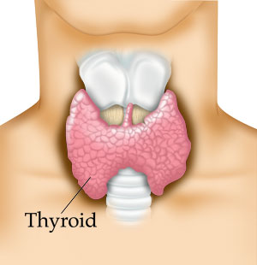
THYROID DISEASE IN PREGNANCY
DR. Rose J. Kosgei
MBChB, MMED, MSc

Slide 2
Goals for this lecture
At the end of the lecture you should be able to:
Describe the anatomy of thyroid gland
Describe the formation and secretion of thyroid hormones
Describe the regulation of thyroid hormones
Discuss thyroid gland physiology: non-pregnant and pregnant state
Discuss thyroid disease in pregnancy: hyper and hypothyroidism

Slide 3
Introduction
Thyroid disorders are common in young women
Incidence of thyroid disorders overall in pregnancy is 1%
The impact of pregnancy on thyroid physiology is substantial:
  Changes in structure and function of the gland sometimes cause confusion in diagnosis of thyroid abnormalities
    Causing delay in diagnosis
There is an intimate relationship between maternal and fetal thyroid function
  The fetus depend on maternal thyroxine
  Drugs that affect the maternal thyroid affect the fetal gland

Slide 4
Introduction
......Therefore
The diagnosis of thyroid disease during pregnancy requires an understanding of the changes in:
  thyroid physiology and
  thyroid function tests that accompany normal pregnancy

Slide 5
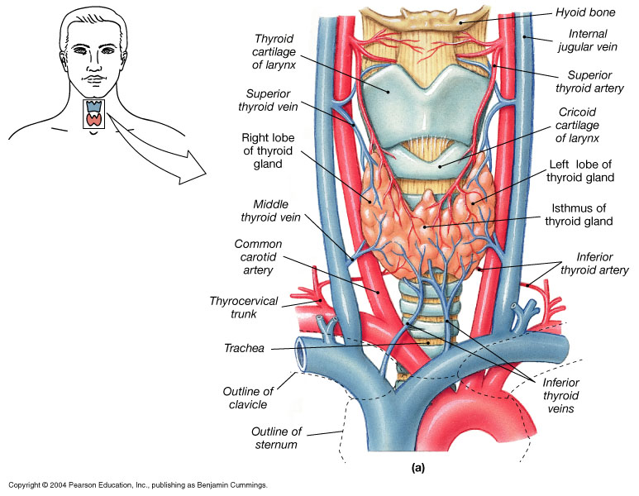
Thyroid gland anatomy
Embryology
Gross
Histology

Slide 6
Thyroid gland- Embrology
Originates from an evagination of the floor of the pharynx
  A thyroglossal duct marking the path of the thyroid from the tongue to the neck sometimes persists in the adult
Fetal thyroid :
  7-9 weeks: Formation of thyroid gland
  10 weeks: Thyroid stimulating hormone (TSH) and Thyroxine detectable
  17 weeks: Maturation of the gland
  >18weeks: Response to TSH stimulation

Slide 7
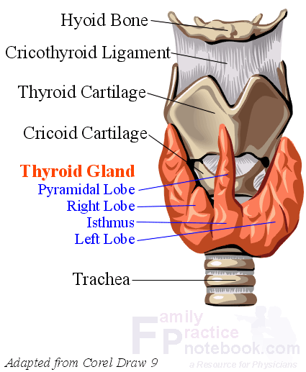
Thyroid gland-Gross anatomy
2 lobes connected by thyroid isthmus
Can have additional lobe –pyramidal lobe
Well vascularized

Slide 8
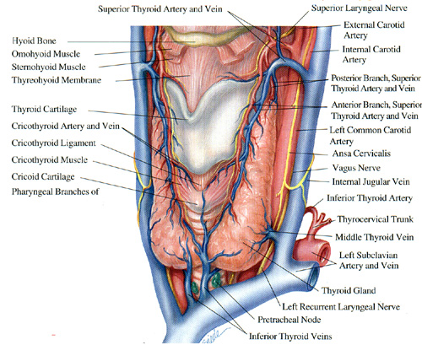

Slide 9
Thyroid gland- Histology
Made up of multiple acini (follicles)
Each follicle is surrounded by a single layer of cells filled with pink staining proteinceous material called colloid
Between follicles are clear parafollicular cells, which produce calcitonin
When the gland is inactive:
  the colloid is abundant, the follicles large and cells lining them flat
When gland is active:
  the colloid is little, follicles small, cells lining them cuboid or columnar and the edge of the colloid is scalloped, forming many small re-absorption lacunae

Slide 10
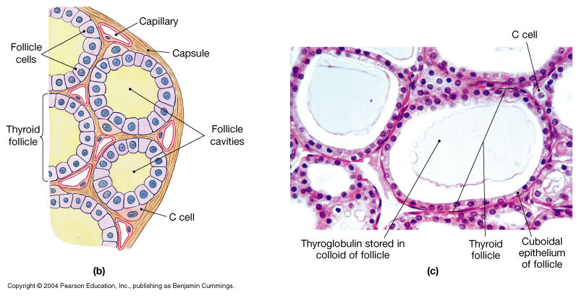
The Thyroid Gland – Histology
Gland is composed of hollow spheres, called colloid follicles.
Squamous epithelial cells, cuboidal cells (follicle cells)
Colloid fills the follicle cavities
I
Follicle cells produce thyroglobulin ----→ TH

Slide 11
Formation and secretion of thyroid hormones
Principal hormones secreted:
  Thyroxine (T4) and triidothyronine (T3)
  T3 is also formed in the peripheral tissues by deiodination of T4
  Small amounts of reverse triidothyronine RT3
T3 is more active than T4, whereas RT3 is inactive
Thyroid binding globulin (TBG) is the major transport protein for thyroid hormone

Slide 12
Iodine Metabolism
Dietary iodine is absorbed in the GI tract, then taken up by the thyroid gland (or removed from the body by the kidneys).
The transport of iodide into follicular cells is dependent upon a Na⁺/I⁻ cotransport system.
Iodide taken up by the thyroid gland is oxidized by peroxide in the lumen of the follicle:
Oxidized iodine can then be used in production of thyroid hormones.
peroxidase
I⁻ I⁺

Slide 13
The Next Step: Production of Thyroglobulin
Pituitary produces TSH, which binds to follicle cell receptors.
The follicle cells of the thyroid produce thyroglobulin.
Thyroglobulin is a very large glycoprotein.
Thyroglobulin is released into the colloid space, where it’s tyrosine residues are iodinated by I⁺.
This results in tyrosine residues which have one or two iodines attached (monoiodotyrosine or diiodotyrosine).

Slide 14
Transport of Thyroid Hormones
Thyroid hormones are not very soluble in water (but are lipid-soluble).
Thus, they are found in the circulation associated with binding proteins:
- Thyroid Hormone-Binding Globulin (~70% of hormone)
- Pre-albumin (transthyretin), (~15%)
- Albumin (~15%)
Less than 1% of thyroid hormone is found free in the circulation.
Only free and albumin-bound thyroid hormone is biologically available to tissues.

Slide 15
Conversion of T4 to T3
T3 has much greater biological activity than T4.
A large amount of T4 (25%) is converted to T3 in peripheral tissues.
This conversion takes place mainly in the liver and kidneys. The T3 formed is then released to the blood stream.
In addition to T3, an equal amount of “reverse T3” may also be formed. This has no biological activity.

Slide 16
One Major Advantage of this System
The thyroid gland is capable of storing many weeks worth of thyroid hormone (coupled to thyroglobulin).
If no iodine is available for this period, thyroid hormone secretion will be maintained.

Slide 17
Regulation of Thyroid Hormone Levels
Thyroid hormone synthesis and secretion is regulated by two main mechanisms:
  an “autoregulation” mechanism, which reflects the available levels of iodine
  regulation by the hypothalamus and anterior pituitary

Slide 18
Autoregulation of Thyroid Hormone Production
The rate of iodine uptake and incorporation into thyroglobulin is influenced by the amount of iodide available:
  low iodide levels increase iodine transport into follicular cells
  high iodide levels decrease iodine transport into follicular cells
Thus, there is negative feedback regulation of iodide transport by iodide.

Slide 19
Neuroendocrine Regulation of Thyroid
Hypothalamic-pituitary-thyroid axis
Thyrotropin-releasing hormone (TRH)
  Produced in a tonic fashion in the paraventricular nucleus of the hypothalamus to the pituitary gland
TRH stimulates the anterior pituitary to produce thyroid stimulating hormone (TSH)
  TSH has an α and β subunit;β subunit confers specificity
  TSH secretion regulated by negative feedback from circulating thyroid hormone, dopamine, and somatostatin
TSH then stimulates the thyroid gland to produce, as well as secrete, thyroxine(T4) and triiodothyronine (T3)

Slide 20
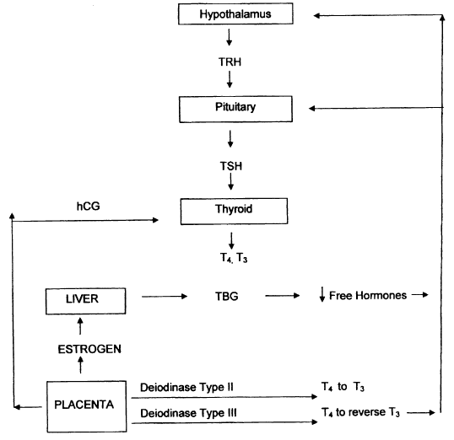

Slide 21
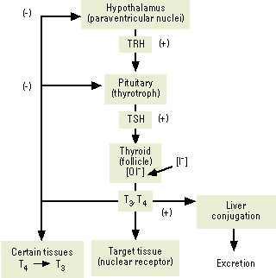

Slide 22
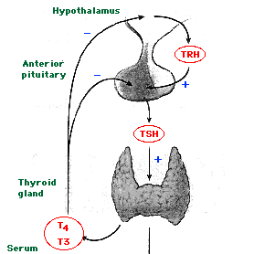

Slide 23
Other factors regulating thyroid hormones
Diet: a high carbohydrate diet increases T3 levels, resulting in increased metabolic rate (diet-induced thermogenesis).
Low carbohydrate diets decrease T3 levels, resulting in decreased metabolic rate.
Cold Stress: increases T3 levels in other animals, but not in humans.
Any condition that increases body energy requirements (e.g., pregnancy, prolonged cold) stimulates hypothalamus → TRH → TSH (Pit)

Slide 24
Thyroid gland -physiology
The thyroid gland maintains the level of metabolism in the tissues that is optimum for their normal function
  Thyroid stimulate the oxygen consumption cells
  Regulate lipid and carbohydrate metabolism
To meet the increased metabolic needs during a normal pregnancy, there are changes in thyroid physiology that are reflected in altered thyroid function tests. There is an increase in:
  Estrogen-mediated increase in circulating levels of TBG
    Major transport protein for thyroid hormone
  stimulation of the thyrotropin (TSH) receptor by human chorionic gonadotropin (hCG)

Slide 25
Stimulation of TSH by hCG
How does it occur?
Human chorionic gonadotropin (hCG) is one of a family of glycoprotein hormones that include:
  Thyrotropin (TSH)
  TSH and hCG have a common alpha-subunit and a unique beta-subunit
    However, there is considerable homology between the beta-subunits of hCG and TSH
  As a result, hCG has weak thyroid-stimulating activity
Serum hCG concentrations increase soon after fertilization and peak at 10 to 12 weeks
  During this peak, total serum T4 and T3 concentrations increase

Slide 26
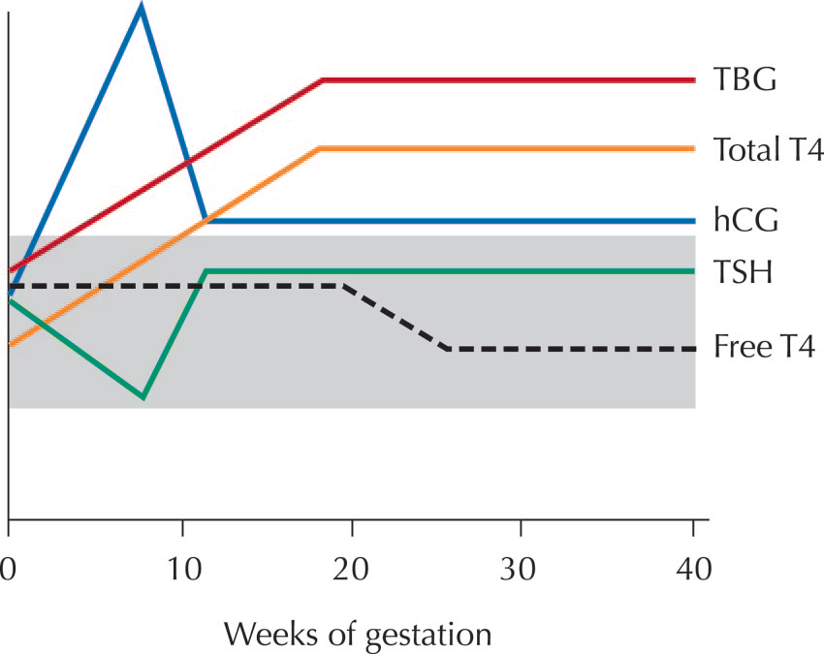
Hormonal Changes in Pregnancy
The pattern of changes in serum concentrations of thyroid function studies and hCG according to gestational age
The shaded area represents the normal range in the non pregnant woman
These changes should be factored in interpretation of thyroid function in pregnancy

Slide 27
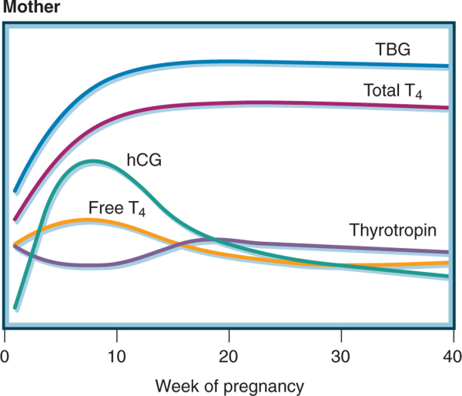

Slide 28
Fetal thyroid physiology
The fetal thyroid gland begins concentrating iodine and synthesizing thyroid hormone after 10- 12 weeks of gestation
Little hormone synthesis occurs until the 18-20th week, when fetal thyroid secretion increases gradually
Any requirement for thyroid hormones before this time (20 weeks) is supplied by the mother, and it is during this time that maternal thyroid hormones are most important to fetal brain development

Slide 29
Iodine requirements in pregnancy
Iodine requirements are higher in pregnant state
  Due to an increase in maternal T4 production required to maintain maternal euthyroidism
  Increased renal iodine clearance
Severe maternal iodine deficiency results in:
  Reduction in maternal thyroxine production
  Inadequate placental transfer of maternal thyroxine
  Impairment of fetal neurologic development.
WHO, recommends 250 mcg of iodine daily during pregnancy and lactation

Slide 30
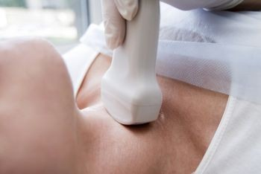
THYROID DISEASE IN PREGNANCY

Slide 31
Thyroid disease in pregnancy
Hyperthyroidism
Hypothyroidism

Slide 32
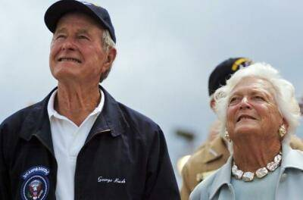
Hyperthyroidism

Slide 33
Hyperthyroidism Complicating Pregnancy
In overt hyperthyroidism there is
  Elevated free T4 and/or T3
  Suppressed TSH
  Occurs in 0.1 to 0.4 percent of all pregnancies
Hyperthyroidism from any cause can complicate pregnancy but the common causes are:
  Graves' disease
  hCG-mediated hyperthyroidism
Symptoms of hyperthroidism mimic pregnancy changes:
  Delaying initiation or optimization of treatment

Slide 34
Causes of hyperthyroidism
Thyroid over activity
Extra-thyroid
Graves disease
Solitary toxic adenoma
Toxic multinodular goiter
Hashimoto’s thyroiditis
TSH-secreting pituitary tumour
Mutations causing constitutive activation of TSH receptor (rare)
Transient hyperthyroidism during pregnancy & gestational transient thyrotoxicity (GET)- mole pregnancies
Trophoblastic hyperthyroidism
Sub-acute thyroidiitis
Tumors of the pituitary gland or ovary (struma ovarii)
Administration of T3 or T4
  Iatrogenic
Ectopic thyroid tissue
We will also discuss thyroid storm

Slide 35
Signs and symptoms of hyperthyroidism
Nervousness
Weight loss
Hyperphagia
Heat intolerance
Increased pulse pressure
Fine tremor of the outstretched fingers
Warm soft skin
Sweating
+/- enlargement of thyroid gland

Slide 36
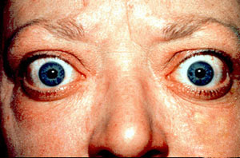
We will discuss a few of the causes of hyperthyroidism
Assignment
Read the chapter on the thyroid gland in
Review of medical physiology by William F. Ganong

Slide 37
Graves disease
Causes 95% of hyperthyroidism in pregnancy
Its an autoimmune disease in which antibodies to the TSH receptor stimulate the receptor
  This produces marked T4 and T3 secretion and enlargement of the thyroid gland (goiter)
  Due to the feedback mechanism of T4 and T3, plasma TSH is low
Clinical scenarios
  Stable Graves’ disease receiving thionamide therapy with exacerbation during early pregnancy.
  In remission with a relapse of disease.
  Without prior history diagnosed with Graves’ disease de novo during pregnancy.

Slide 38
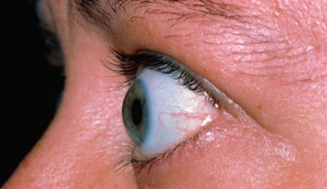
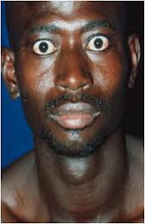
Graves disease symptoms and Signs
Symptoms and signs of hyperthyroidism
  Discussed
Hallmark of Graves:
  Swelling of the tissues in the orbit producing protrusion of the eye balls (exophthalmos)

Slide 39
Graves disease-diagnosis
Diagnosis
  Challenge :hypermetabolic symptoms in normal pregnancy mimic hyperthyroidism
  Thyroid examination: goiter (with or without bruit)
  Suppressed serum TSH level and usually elevated free and total T4 and T3 serum concentrations.
  TSH receptor antibodies
Autoantibodies mimic TSH can cross the placenta and cause neonatal Graves’ disease

Slide 40
Adverse effects of Graves disease in pregnancy
Maternal
Neonatal
Preterm labor
  Untreated :88%
  Partially treated: 25%
  Adequately treated :8%
Spontaneous abortion
Preeclampsia
Heart failure
Thyroid storm
Prematurity
Stillbirth
  Untreated: 50%
  Partially treated: 16%
  Adequately treated: 0%
Small for gestational age
Congenital malformations
Neonatal Graves disease
  Autoantibodies can cross the placenta
  1% infants

Slide 41
Transient hyperthyroidism during pregnancy & gestational transient thyrotoxicity (GET)
Believed to be related to hCG stimulation of the thyroid gland
  Normalization of T4 levels by midgestation
  Resolution of symptoms parallels the decline in hCG levels
Characterized by:
Hyperemesis gravidarum
  Severe nausea and vomiting leading to a 5% loss of body weight, dehydration, and ketosis.
Absence of goiter and ophthalmopathy, and absence of the common symptoms and signs of hyperthyroidism
Higher serum hCG and estradiol concentrations
Treatment is supportive care

Slide 42
Trophoblastic hyperthyroidism
Hydatidiform mole & choriocarcinoma.
  high serum hCG concentrations and abnormal hCG isoforms
55 to 60% had clinically evident hyperthyroidism
Normal thyroid gland and few symptoms of thyroid hormone excess
Some findings of hyperthyroidism and a diffuse goiter
  ophthalmopathy is not present
Nausea and vomiting may predominate

Slide 43
Thyroid storm
Thyroid storm is a rare, life-threatening condition characterized by severe clinical manifestations of thyrotoxicosis
Usually precipitated by an acute event such as thyroid or non-thyroidal surgery, trauma, infection, an acute iodine load, or child birth
Aetiology not known but hypothesized to be a rapid rate of increase in serum thyroid hormone levels, increased responsiveness to catecholamines, or enhanced cellular responses to thyroid hormone

Slide 44
Thyroid storm
Symptoms
Exaggeration of the usual symptoms of hyperthyroidism
Tachycardia to rates that can exceed 140 beats/minute
Congestive heart failure
Hypotension, cardiac arrhythmia, and death from cardiovascular collapse may occur
Agitation, anxiety, delirium, psychosis, stupor, or coma are also common and are considered by many to be essential to the diagnosis
Physical examination may reveal goiter, ophthalmopathy, lid lag, hand tremor, and warm and moist skin.
Treatment
The therapeutic options for thyroid storm are the same as those for uncomplicated hyperthyroidism, except that the drugs are given in higher doses and more frequently.
In addition, full support of the patient in an intensive care unit is essential, since the mortality rate of thyroid storm is substantial (10 to 30 percent)

Slide 45
Diagnosis of hyperthyroidism in pregnancy
Signs and symptoms of hyperthyroidism
Laboratory investigations
  Suppressed Serum TSH (<0.1 mU/L) or undetectable serum TSH (<0.01)
  Elevated thyroid hormone levels (T3 and T4) that exceed the normal range for pregnancy

Slide 46
Assignment
Management of maternal hyperthyroidism in pregnancy

Slide 47

Hypothyroidism

Slide 48
Hypothyroidism in pregnancy
Characterized by elevated serum TSH concentration and low T3 and T4
Women with hypothyroidism are infertile
  Majority on thyroxine prior to pregnancy
Incidence 3-5/1000 pregnant women
Less common because:
  Some hypothyroid women are anovulatory and have difficulty conceiving
  New or inadequately treated hypothyroidism complicating pregnancy is associated with a high rate of first trimester spontaneous abortion

Slide 49
Causes of hypothyroidism
Primary (thyroid dysfunction)
Secondary (pituitary dysfunction)
Hashimoto thyroiditis
  Iodine sufficient areas
  Autoimmune destruction of thyroid (thyroid peroxidase and thyroglobulin antibodies)
  Antithyroid antibodies are found in approximately 10% of women in second trimester
Endemic iodine deficiency
  Central Africa, South America, northern Asia
History of ablative radioiodine therapy or thyroidectomy.
Sheehan’s syndrome
Lymphocytic hypophysitis
History of a hypophysectomy.

Slide 50
Signs and symptoms of hypothyroidism
Similar to symptoms of pregnancy; Vague and nonspecific
Myxedema is the syndrome of adult hypothyroidism
Fatigue
Constipation
Cold intolerance
Muscle cramps
Insomnia,
Weight gain
Carpal tunnel syndrome
Slow mentation and poor memory
  Myxedema madness in severe cases
Hair loss
Coarse hair
Voice changes
Husky slow voice
Intellectual slowness
+/- goiter
Periorbital edema
Dry skin
Prolonged DTR relaxation phase

Slide 51
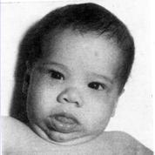
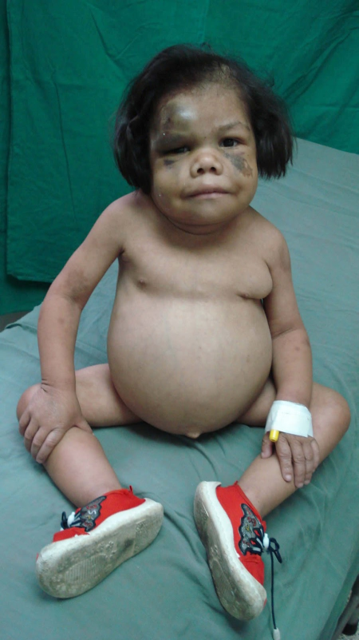
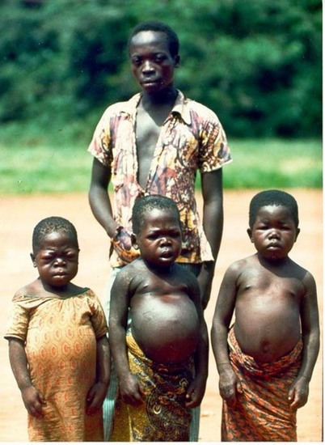
Cretinism
Children who are hypothyroid from birth or before birth are called cretins
They are:
  Dwarfed
  Mentally retarded
  Have potbellies
  Protruding tongues
Congenital hypothyroidism is one of the preventable mental retardation
Causes of congenital hypothyroidism
  Maternal iodine deficiency
  Fetal thyroid dysgenesis
  inborn errors of thyroid hormone synthesis
  Maternal antithyroid antibodies that cross placenta
  Fetal hypopitutary hypothyroidism

Slide 52
Untreated maternal hypothyroidism
Associated with increased risk of
Maternal
Newborn
Preeclampsia
Gestational hypertension
Placental abruption
NRFHT
Preterm delivery, very preterm delivery (<32 weeks)
Increased rate of caesarean section
Postpartum hemorrhage
Increased operative delivery
Preterm birth
Low birth weight
Perinatal morbidity and mortality
Increased NICU admission
Neuropsychological and cognitive impairment:
  Congenital cretinism – growth restriction, deafness, neuropsych impairment from severe Iodine deficiency or untreated congenital hypothyroidism

Slide 53
Hypothyroidism in pregnancy
Diagnosis
Symptoms masked by the hyper-metabolic state of pregnancy.
20% to 30% patients with overt hypothyroidism develop symptoms
  Discussed earlier slides
Elevated serum TSH concentration
Central hypothyroidism (hypothalamic and pituitary) do not manifest an elevated serum TSH level
Hypothalamic and pituitary hypothyroidism the thyroid responds to a test dose of TSH
Low serum T3 and T4

Slide 54
Assignment
Management of maternal hypothyroidism during pregnancy

Slide 55

Questions

Slide 56


