Slide 1
IMAGING IN GYNECOLOGY.
DR.A.AYWAK
i don't have the class notes these were the old ish and also different

Slide 2
Gynae organs

Slide 3
Pelvic Anatomy

Slide 4
Pelvic Pathology
Given the many organs and structures in the pelvis, it can be a tough task to confidently locate which organ or structure is the cause of illness
For instant iliac fossa pain can due to appendictis, ectopic gestation,diverticulitis, pedunculated fibroid or ectopic kidney among other hence need for evidence based patient management

Slide 5
Leaning objectives
Recognize the role of diagnostic imaging in reproductive health
Identify commonly used imaging modalities in reproductive health and their appropriate indications
Recognize importance of selecting optimum imaging test in given clinical setting and how findings will affect/direct management decisions.
Appreciate that imaging cannot replace appropriate history taking and thorough physical examination

Slide 6
Role of diagnostic imaging in reproductive health
Diagnostic imaging plays a major role in management of reproductive health conditions not only in assisting in making appropriate diagnosis but also ;
Assessing disease extent and thus influence choice of management
In guiding interventional procedures such as aspirations and biopsies and invitro fertilization procedures.
And follow up to track disease recurrence or metastases

Slide 7
Imaging in Gynaecology
Imaging is invaluable in the management of patients with gynaecological conditions.
In addition to identifying/excluding common gynaecological disease processes imaging can demonstrate normal anatomy as well as congenital structural anomalies.

Slide 8
Imaging modalities in Gynaecology.
The following are commonly used imaging modalities in order of preference.
Ultrasound :transabdominal and transvaginal.
Hysterosalngography
Sonohysterography
MRI
Computerised Tomography.
Intravenous urography
Micturating cystourethrography

Slide 9
Ultrasound.
Has revolutionised practice of OB/GY
Advantages are manifold and include, non-invasive nature, ability to image in multiple scan planes, no ionizing irradiation, relatively cheap compared to similar cross-sectional imaging techniques.
Transvaginal approach has greatly improved diagnostic and imaging potential.

Slide 10
Pelvic sonography
There are two main approaches
Trans abdominal sonography
Transvaginal sonography
The two approaches are complimentary
Trans perineal ,transrectal and translabial can also be done

Slide 11
TRANS ABDOMINAL
Advantages
limitations
Can asses large pelvic masses
Superiorly placed ovaries can be evaluated
Nodal involvement- iliac , paraaortic
Associated Hydronephrosis can be documented
Limited characterization of the internal structure of pelvic masses
Patients unable to fill their bladder
Obese patients and
Retroverted uterus difficult to assess

Slide 12
At ultrasound the following can be demonstrated: Normal anatomy,
Abnormal uterus: enlargement, , abnormal masses as well as Congenital anomalies.
Ovarian abnormalities
Fallopian tube abnormalitiies
Pelvic masses and their organs of origin
Ectopic gestation.
IUCD localization.

Slide 13
The Uterus
The size and shape of the normal uterus varies throughout life and are related to hormonal status.
The infantile (prepubertal) ranges from 2.8x0.80)cm with cervix accounting for two thirds.It has an inverse pear-shaped appearance.
The neonatal uterus is slightly larger due to residual maternal hormones.

Slide 14
The adult uterus varies in size.
Maximal dimensions of nulliparous uterus are (8x5x4)cm
Parity increases the normal size by 1-2cm in each dimension
After menopause the uterus atrophies and decreases in size
In patients over 65yrs the uterine size ranges from 3.5-6.5in length,1.2-1.8in AP

Slide 15
Normal uterus sagital plane
Normal post menarche
Infantile uterus
Normal uterus: transabdominal sagittal

Slide 16
Bicornuate uterus

Slide 17
Uterine Enlargement.
Normal uterus
Adenomyosis

Slide 19
Normal
Subserous fibroid

Slide 20
Uterine cervix mass

Slide 21
Ultrasound uterine mass
CT scan uterine mass

Slide 22
Large uterine cervix fibroid

Slide 23
TransVaginal Sonography
Advantages
Limitations
Uses high frequency transducer therefore better characterisation of pelvic masses
Better evaluation of the adnexa
Better delineation of the endometrium
Good evaluation of retroverted uterus
Evaluation of obese patients
Patients who are unable to fill there bladder
Limited evaluation of large pelvic masses extending beyond the focal zone of the transducer
Cannot be used in virginal patients

Slide 24
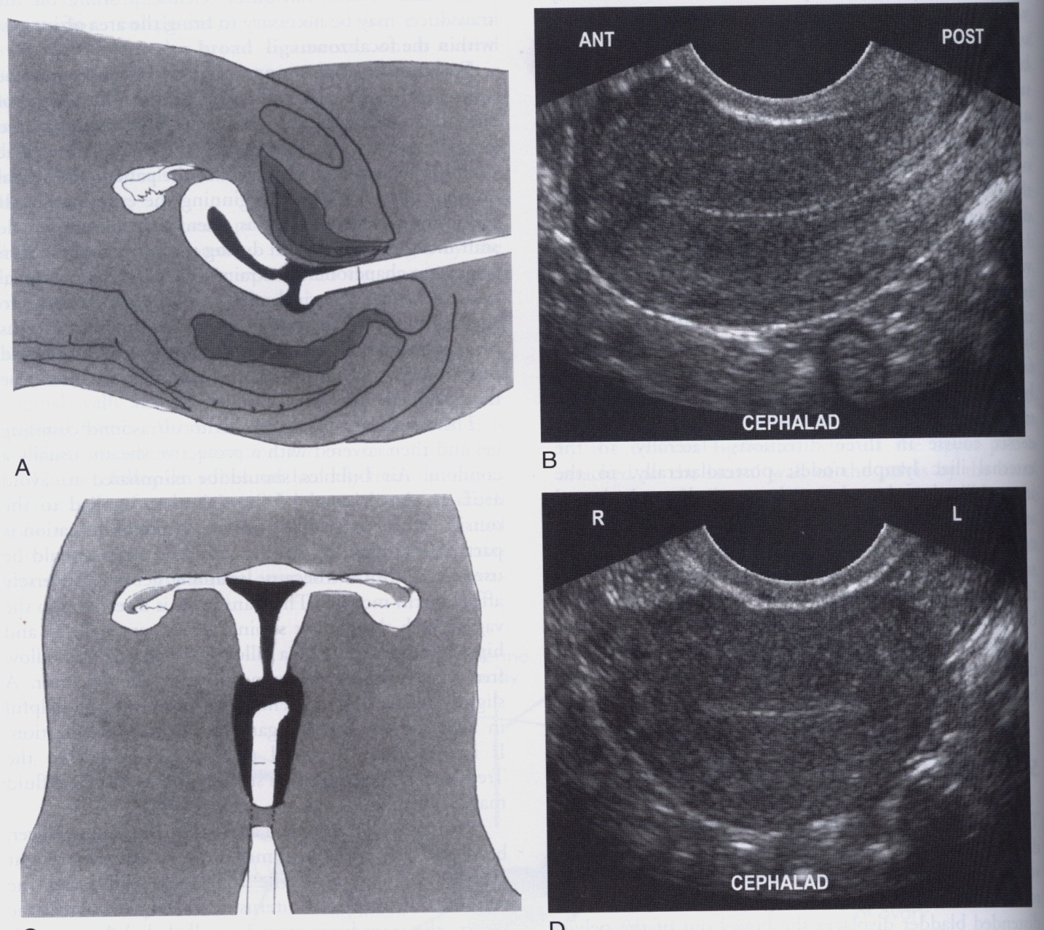
TVS

Slide 25
Localization of IUCD
Ultrasound is the examination of first choice in evaluation of position of IUCD

Slide 26
IUCDS

Slide 30
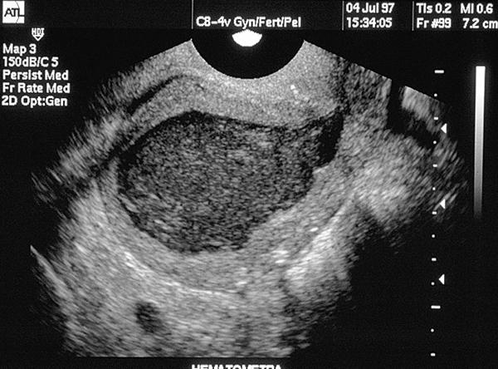
HAEMATOCOLPOS

Slide 31
TVS RETROVERTED UTERUS
TRANSABDOMINAL RETROVERTED UTERUS

Slide 32
Endometrium.
normal trilaminar endometrium

Slide 33
Endometrium changes with menstral cycle -

Slide 36
Hydrosalpinx.

Slide 37
PID-hydro/pyosalpinx

Slide 38
Sonohysterography
Ideal technique for assessing endometrial masses
Normal saline is introduced into the endometrial cavity through a catheter. TVS is then done
Can differentiate between ;diffuse endometrial hyperplasia ,endometrial polyp and submucosal fibroid.
Can assess treatment of uterine synechiae

Slide 39
Sonohysterograohy.

Slide 40
Sonohysterography
Polyp with cyst
Polyp
Submucosal fibroid

Slide 41
Adenomyosis
Condition characterized pathologically by presence of endometrial glands and stroma in the myometrium.Usually more extensive on posterior wall
Can occur in diffuse or nodular forms
Diffuse form appears as scattered foci while nodular form is composed of circumscribed nodules.
Clinical presentation is non specific consisting of uterine enlargement, pelvic pain and dysmenorrhea

Slide 42
Adenomyosis

Slide 43
Ultrasound evaluation of adnexa
Polycystic ovary disease- TVS
Ovarian cyst-simple,haemorrhagic-TAS,TVS
Ovarian torsion-TVS+doppler
Dermoid-TAS,TVS
Endometriosis
Ovarian neoplasm

Slide 44
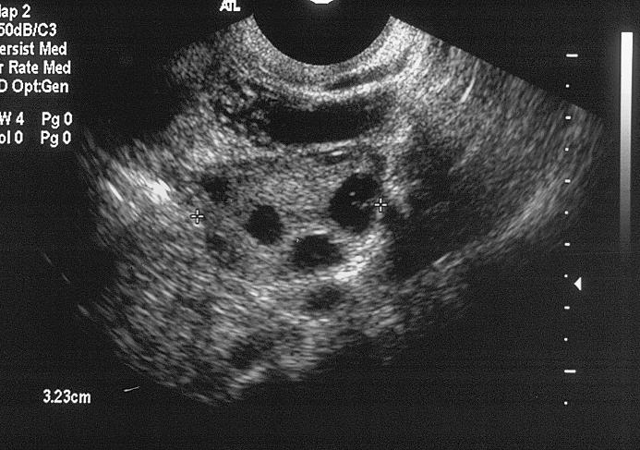
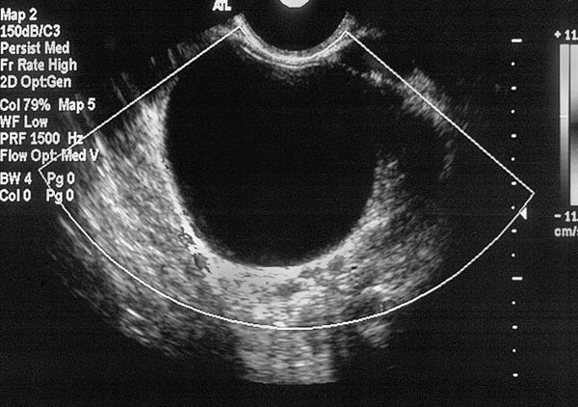
Ovaries
Follicular cyst
Normal ovary
Haemoragic cyst

Slide 45
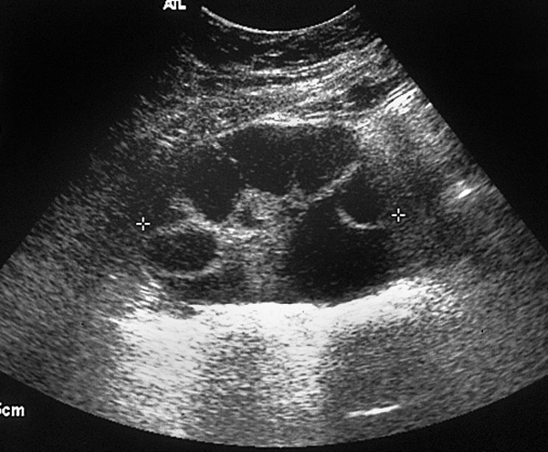
Ovarian hyperstimulation
Multiple cysts
Ascites

Slide 46
Polycystic ovaries

Slide 50
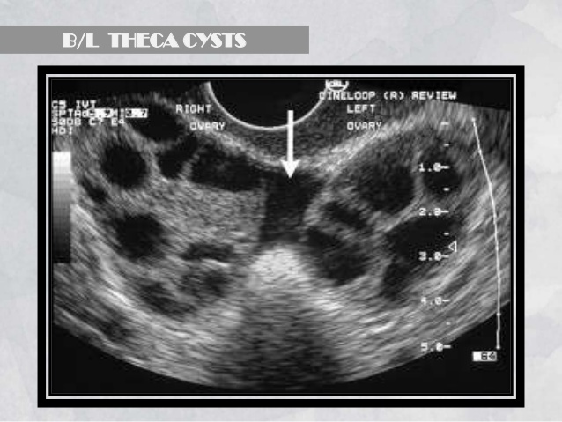

Slide 51
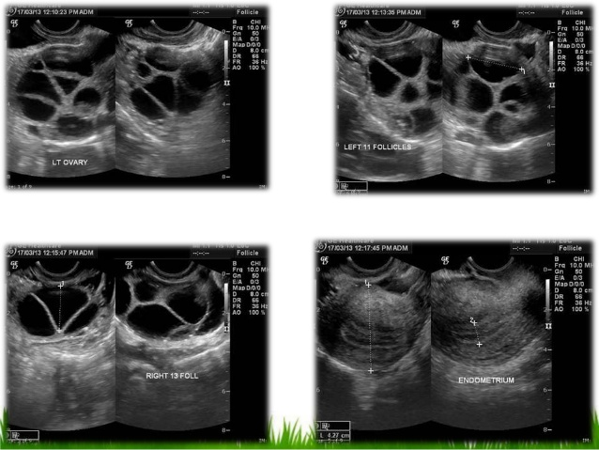
Ovarian hyperstimulation

Slide 52
Ovarian neoplasm
Mucinou cys adenoma
Serous cystadenoma

Slide 53
Plain radiography
Plain abdomen
Supine position
Empty bladder
Limited applications- pelvic mass lesion especially dermoid. Calcifications, bone involvement, IUCD

Slide 54
Plain film
IUCD localization

Slide 55
MRI.
Not frequently used due to expense may not be cost effective in most cases.
Helpful in cases where ultrasound is inconclusive, and staging of malignancies.
No ionizing radiation used hence safe

Slide 56
Indications for MRI
MRI is helpful in both benign and malignant conditions when ultrasound is inconclusive
Benign Lesions
Congenital anomalies
Leiomyomas
Adenomyosis
Adnexal masses
Cervical lesions
Ovarian lesions
Uterine malignancies

Slide 57
Congenital Anomalies
As regards congenital anomalies, MRI can provide enough information for:
Precise diagnostic classification for obstetric counselling and treatment options
Pre-surgical planning
Evaluation of complications associated with Mullerian duct syndromes

Slide 58
Leiomyomas
In suspected leiomyomas MRI will provide the following
Precise delineation of number, size and location
Help with selection of type of surgery: myomectomy or hysterectomy
Differentiate between leiomyomas and adenomyosis
Assess uterus before or after hormonal treatment or uterine artery embolisation adequately

Slide 59
Adenomyosis
MRI is definitive modality when ultrasound is inconclusive.
MRI can effectively differentiate adenomyosis from leiomyomas.

Slide 60
Adnexal Masses (when ultrasound is limited)
Detection
Characterisation
- attempts benign vs malignant
Differentiate cystic teratomas from endometriomas.

Slide 61
Pelvic Malignancy
MRI is primary modality in tumour staging of
- endometrial carcinoma
- cervical carcinoma
- vaginal carcinoma
It is a problem solving tool in carcinoma of the ovary in conjunction with CT
Helps in detection of disease recurrence
Can identify Secondary malignancies

Slide 62
Sagittal MRI Image:Pelvis

Slide 65
Uterine and Vaginal Agenesis

Slide 66
Unicornuate uterus
Bicornuate uterus

Slide 67
UTERINE DIDELPHIS MRI T2

Slide 68
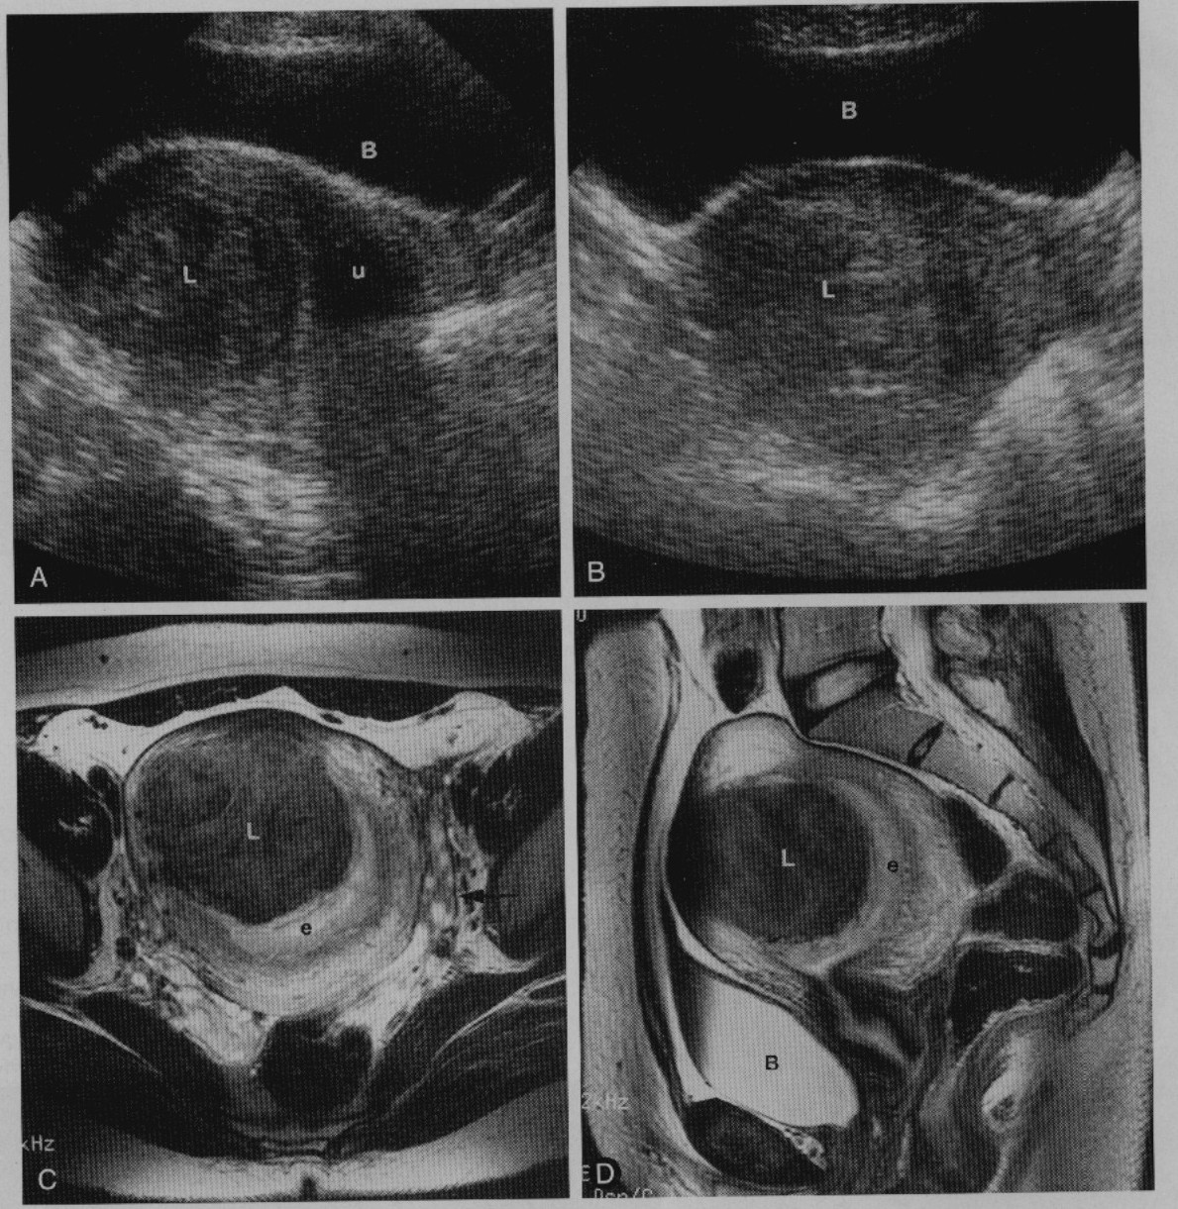
Intramural Leiomyoma

Slide 69
Leiomyoma

Slide 70
ADENOMYOSIS TRANSABDOMINAL ULTRASOUND
ADENOMYOSIS TRANSVAGINAL ULTRASOUND

Slide 71
MRIT2
DIFFUSE ADENOMYOSIS
FOCAL ADENOMYOSIS

Slide 72
Carcinoma of the Cervix

Slide 73
Ovarian Masses
Mucinous cystadenoma

Slide 74
PCOD

Slide 75
Computerised Tomography.
Like MRI used when ultrasound is inconclusive in assessing pelvic masses.

Slide 76
Hysterosalpingograpy (HSG).
Hsg is the examination of the uterine cavity and the fallopian tube. The indications include:
Infertility.
Recurrent abortions.
Monitor effects of tubal surgery.

Slide 77
Contraindications.
The contraindications include:
Active pelvic sepsis.
Sensitivity to contrast material
Pregnancy
Recent D/C.
Inappropriate menstrual stage preferred time is about the 10day of menses.

Slide 78
Normal HSG.

Slide 79
Congenital Uterine Anomalies.

Slide 80
Uterus Didelphys.

Slide 81
Bicornuate Uterus.

Slide 82
Unicornuate Uterus.

Slide 83
Arcuate Uterus.

Slide 84
Filling defect (Fibroid).

Slide 85
Intramural Fibroid.

Slide 87
Hydrosalpinx.

Slide 89
Clip Sterilization.

Slide 90
Venous Intravasation.

Slide 91
INTRAVENOUS VENOGRAPHY
IVU is functional examination of the upper urinary tract.
Usually indicated to demonstrate effect of pelvic masses on the ureters.
Displays precise anatomical position of kidneys ureters and bladder

Slide 92
normal exam
IVU KUB

Slide 93
Mass displacing ureters

Slide 94
MICTURATING CYSTOURETHROGRAM(MCU)
The MCU in a contrast examination of the bladder and urethra.
Indications include:
Suspected outflow obstruction
Incontinence
Demonstration of vesico-vaginal fistulae
Recurrent lower urinary tract infections
Assessment of vesical diverticula
Demonstration of ability of bladder to contract
Suspected vesicoureteric reflux
Assessment of anatomical anomalies of bladder neck and urethra

Slide 95
MALE
FEMALE

Slide 96
MCU Vesico-Vaginal Reflux

Slide 98
PELVIC ARTERIOGRAPHY
Indications:
Localise site and cause of heavy uterine bleeding,e.g AVM, by pelvic arteriography.
Interventional procedures eg
Transcatheter embolization of the anterior division of the internal iliac artery in the treatment of haemorrhage from advanced or recurrent carcinoma of the cervix.
Transcatheter selective embolisation of the uterine artery as alternative to hysterectomy in selected patients with leiomyomas.
The first report was published on its application as a primary treatment for symptomatic uterine fibroids in 1995
Clinical studies have documented that uterine artery embolization alleviates symptoms of menorrhagia in 79-93% of treated women.

Slide 99
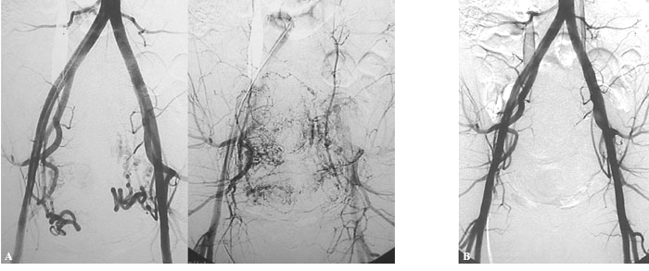
Angiographic AppearanceA) Pre-embolization
B) Post-embolization

Slide 100
THANK YOU

