Slide 1
ECTOPIC PREGNANCY
BY
DR D.K. ONDIEKI

Slide 2
“TRY”REWATCH… I DON’T REMEMBER ISH

Slide 3
Outline
Definition
Incidence
Aetiology
Sites of ectopic pregnancy
Clinical presentation
Diagnosis
Management

Slide 4
Definition
Any pregnancy where the fertilized ovum gets implanted & develops in a site other than normal uterine cavity.
Leading cause of maternal death in first trimester.

Slide 5
Incidence
>1 in 100 pregnancies.
Recent evidence indicates that the incidence of ectopic pregnancy has been rising in many countries.
USA – 5 fold
UK – 2 fold
France – 15/1000 pregnancies
India – 1 in 100 deliveries
Recurrence rate
15% after 1st ectopic
25% after 2 ectopics

Slide 6
Aetiology
Any factor that causes delayed transport of the fertilized ovum in the fallopian tube favours implantation in the tubal mucosa, thus giving rise to a tubal ectopic pregnancy.
These factors may be congenital or acquired.

Slide 7
Congenital causes
Tubal Hypoplasia
Tortuosity
Congenital diverticuli
Accessory ostia
Partial stenosis

Slide 8
Acquired causes
Inflammatory: PID, Septic Abortion, Puerperal Sepsis, lntraluminal adhesion
Surgical Tubal reconstructive surgery, Recanalisation of tubes
Neoplastic Broad ligament myoma, Ovarian tumour
Miscellaneous Causes IUCD , Endometriosis, ART (IVF GIFT), Previous ectopic

Slide 9
Sites of ectopic pregnancy

Slide 10
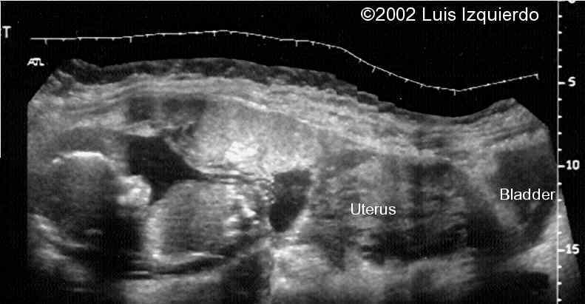
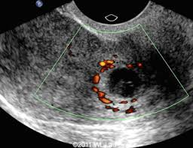
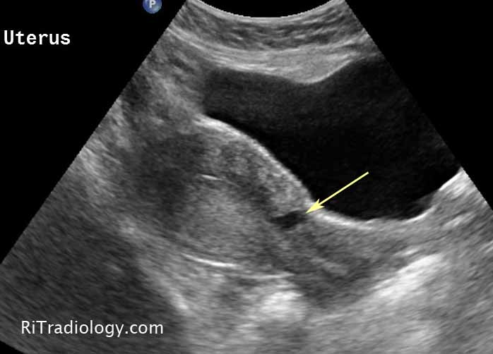
EXTRAUTERINE
-Tubal 95%-
70% -ampullary
12% -isthmic
11% -infundibulum / fimbrial
2% -Interstitial & cornual
-Ovarian -3%
-Abdominal(rare-1%)
* intraperitoneal *extra-peritoneal *broad ligament (intraligamentous)
UTERINE(rare >1%)
Cervical
Caesarian scar/ intramural
HETEROTOPIC PREGNANCY
Tubal pregnancy + intrauterine pregnancy

Slide 12
Clinical presentation
Ectopic pregnancy remains asymptomatic until it ruptures when it can present in two variations -
Acute
Chronic
SYMPTOMS-
Amenorrhea
Abdominal Pain
Syncope
Vaginal Bleeding
Pelvic Mass

Slide 13
Diagnosis
In recent years, inspite of an increase in the incidence of ectopic pregnancy there has been a fall in the case fatality rate.
This is due to the widespread introduction of diagnostic tests and an increased awareness of the serious nature of this disease.
This has resulted in early diagnosis and effective treatment.
Now the rate of tubal rupture is as low as 20%.

Slide 14
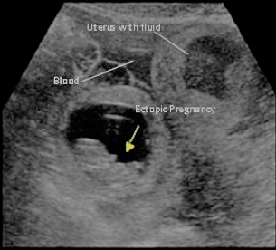
Methods of early diagnosis
Enzyme immunoassay test for beta HCG hormone using monoclonal antibodies
Ultrasound scanning – transabdominal, transvaginal including colour doppler
Laparoscopy
A combination of these methods may have to be employed.

Slide 15
Methods of early diagnosis
At 4-5 weeks-
TVS can visualise a gestational sac as early as 4-5 weeks from LMP.
During this time the lowest serum beta HCG is 2000 IU/L.
When beta HCG level is greater than this and there is an empty uterine cavity on TVS, ectopic pregnancy can be suspected.
In such a situation, when the value of beta HCG does not double in 48 hours ectopic pregnancy will be confirmed.

Slide 16
Methods of early diagnosis
The USG features of ectopic pregnancy after 5 weeks can be any of the following-
Demonstration of the gestational sac with or without a live embryo (Bagel sign) - The GS appears as an intact well defined tubal ring by 6 weeks when it measures 5 mm in diameter. Afterwards it can be seen as a complete sonolucent sac with the yolk sac and the embryonic pole with or without heart activity inside.
Poorly defined tubal ring possibly containing echogenic structure and POD typically containing fluid or blood.
Ruptured ectopic with fluid in the POD and an empty uterus.
In Colour Doppler, the vascular colour in a characteristic placental shape, the so-called fire pattern, can be seen outside the uterine cavity while the uterine cavity is cold in respect to blood flow.
Notes:
Tubal ring sign, also referred to as bagel sign or blob sign, one of the ultrasound signs of a tubal ectopic. It comprises of an echogenic ring which surrounds an unruptured ectopic pregnancy. It is said to have a 95% positive predictive value (PPV) for ectopic pregnancy.

Slide 17
Management
An acute abdomen in a female patient of reproductive age is considered an ectopic pregnancy until ruled otherwise.

Slide 18
Management
Depends on the stage of the disease and the condition of the patient at diagnosis.
Options-
Surgery Laparoscopy / Laparotomy
Medical Administration of drugs at the site / systemically
Expectant Observation

Slide 19
Management of acute ectopic pregnancy
Hospitalisation
Resuscitation -
Treatment of shock
Lie flat with the leg end raised
Analgesics
Blood transfusion
Culdocentesis -
Most helpful in emergent situations to confirm diagnosis
Highly specific if performed and interpreted correctly - presence of free-flowing, NON-Clotting Blood
Negative Tap Inconclusive
Remains Controversial
Investigations
BHcG, ultrasound
Laparotomy should be done at the earliest.
Salpingectomy is the definitive treatment.
No benefit of removing Ovary along with the tube
If blood is not available, auto-transfusion can be done.

Slide 20
Management of chronic ectopic pregnancy
TREATMENT IS ALWAYS SURGICAL.
Salpingectomy of the offending tube.
If pelvic haematocele is infected, posterior colpotomy is to be done to drain the pelvic abscess
Salpingo-oophorectomy

Slide 21
Management of unruptured ectopic pregnancy
Surgical
Surgically administered medical (SAM) treatment
Medical treatment
Expectant management

Slide 22
Surgical treatment of ectopic pregnancy
Carried out either by Laparoscopy / Laparotomy.
The procedures are -
Salpingectomy / Cornual resection / Excision
Conservative surgery (in cases of Infertility desire for pregnancy)
Linear salpingostomy
Linear salpingotomy
(the creation of a new tubal opening (os) by surgery is a salpingostomy, while the incision into the tube to remove an ectopic is a salpingotomy). The 2 terms can be used interchangeably.
Segmental resection and anastomosis
Milking of the tube

Slide 23
Surgical treatment of ectopic pregnancy
The debate
LAPAROTOMY?
VS.
LAPAROSCOPY?
SALPINGECTOMY?
VS
SALPINGOSTOMY / SALPINGOTOMY?

Slide 24
Surgical treatment of ectopic pregnancy

Slide 25
Surgical treatment of ectopic pregnancy
SALPINGECTOMY VS SALPINGOSTOMY / SALPINGOTOMY
All tubal pregnancies can be treated by partial or total Salpingectomy
Salpingostomy / Salpingotomy is only indicated when
The patient desires to conserve her fertility
Patient is haemodynamically stable
Tubal pregnancy is accessible
Unruptured and < 5cm in size
Contralateral tube is absent or damaged

Slide 26
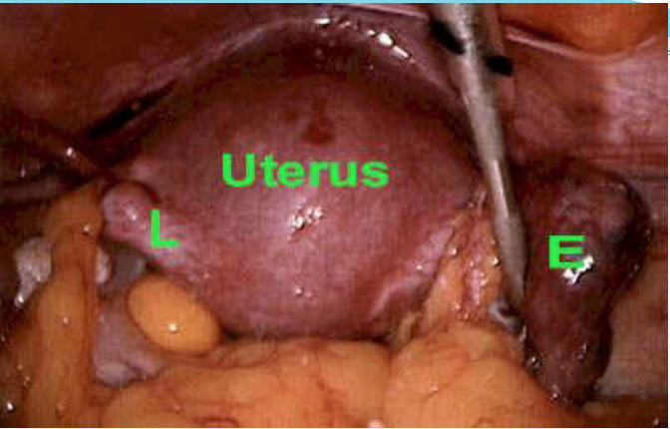
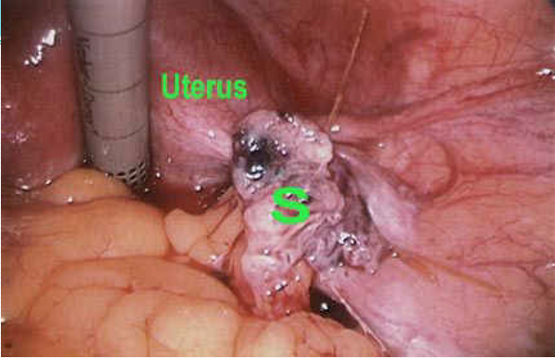
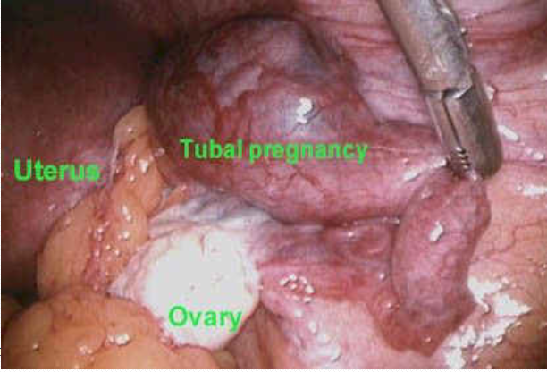
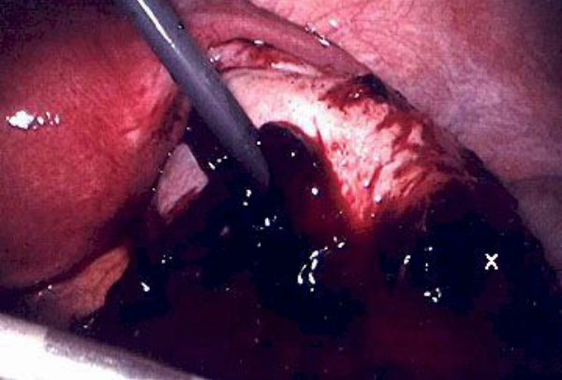
Surgical treatment of ectopic pregnancy
LAPAROSCOPIC SALPINGECTOMY - It is carried out by laparoscopic scissors and diathermy or Endo-loop.
LAPAROSCOPIC SALPINGOTOMY – an incision is made and the tubal pregnancy is then evacuated by suction irrigation.

Slide 27
SAM treatment
Aim- trophoblastic destruction without systemic side effects
Technique- Injection of trophotoxic substance into the ectopic pregnancy sac or into the affected tube by-
Laparoscopy or
Ultrasonographically guided
Transabdominal (Porreco, 1992)
Transvaginal (Feichtingar, 1987)

Slide 28
Medical trophotoxic agents include:
Methotrexate (Pansky, 1989)
Potassium Chloride (Robertson, 1987)
Mifepristone (RU 486)
PGF2α (Limblom, 1987)
Hyper osmolar glucose solution
Actinomycin D

Slide 29
Medical treatment with methotrexate
Resolution of tubal pregnancy by systemic administration of Methotrexate was first described by Tanaka et al (1982)
Mostly used for early resolution of placental tissue in abdominal pregnancy. Can be used for tubal pregnancy as well
Mechanism of action- Interferes with the DNA synthesis by inhibiting the synthesis of pyrimidines leading to trophoblastic cell death. Auto enzymes and maternal tissues then absorb the trophoblast.

Slide 30
Medical treatment with methotrexate
Ectopic pregnancy size should be < 3.5 cm.
Can be given IV/IM/Oral, usually along with Folinic acid.
Recent concept is to give Methotrexate IM in a single dose of 50mg/m2 without Folinic acid. If serum HCG does not fall to 15 within 4-7 days, then a second dose of Methotrexate is given and resolution confirmed by HCG estimation.

Slide 31
Medical treatment with methotrexate
Advantages
Minimal Hospitalisation. Usually outpatient treatment
Quick recovery
90% success if cases are properly selected
Disadvantages-
Side effects like GI and skin reactions
Monitoring is essential- Total blood count, LFT serum HCG once weekly till it becomes negative

Slide 32
Expectant treatment
Tubal Pregnancies are known to abort /resolve
Before the advent of salpingectomy in 1884, ectopic pregnancies were being treated expectantly with 70% mortality.
Today only selected cases are managed expectantly, screened and identified by high resolution ultrasound scanner and monitored by serial serum HCG assay.
Spontaneous resolution occurs in 72%,while 28% will need laparoscopic salpingostomy.

Slide 33
SUMMARY
Incidence of ectopic pregnancy is rising while maternal mortality from it is falling.
Early diagnosis is the key to management of these patients.

Slide 34
THE END

