Slide 1
Infertility
Dr. Kireki Omanwa M.D., Ph.D.
Lecturer University of Nairobi.
Consultant Obstetrician and Gynaecologist.
Fertility Specialist
Rak Szyjki Macicy: Profilaktyka, diagnostyka I leczenie; Google Images- Cx cancer

Slide 2
Infertility
1978

Slide 3
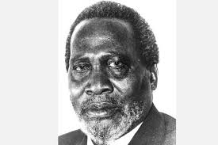

Slide 4
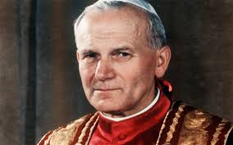
Notes:
Non Italian pope

Slide 5
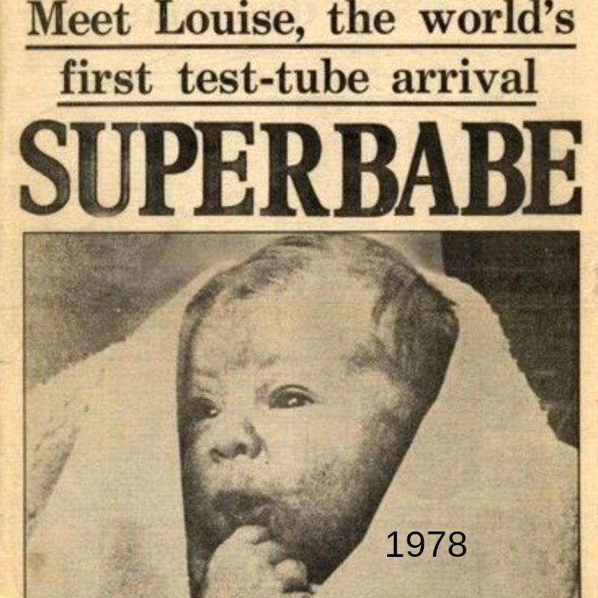

Slide 6
“Her birth made headlines around the globe as a turning point in human reproduction and gave new hope to countless infertile couples.” New York Times

Slide 7
“Her birth attracted controversy, with religious leaders expressing concern about the use of artificial intervention and some raising fears that science was creating “Frankenbabies”
— Felicity Thistlethwaite, Express

Slide 8
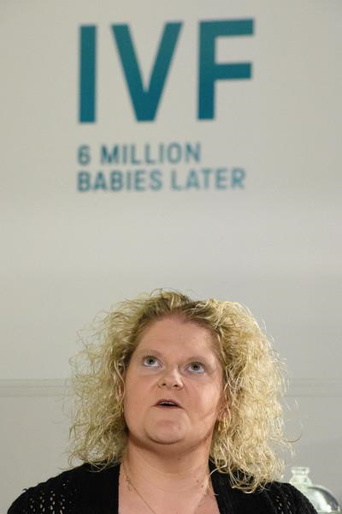

Slide 9
And God blessed them, and God said unto them , Be fruitful and multiply, and replenish the earth and subdue it… Genesis1:28

Slide 10
INFERTILITY IN THE BIBLE
Genesis 15:2 Sarai , Abram’s wife
Genesis 25:21 Rebekah Isaac’s wife
Genesis 29:31 Rachel Jacob’s wife
I Samuel 1:2 Hannah Elkanah’s wife
II Kings 4:14 Shunamite woman

Slide 11
There are three things that are satisfied, yea four things say not it is enough. The grave , the barren womb, the earth that is not filled with water and the fire that saith not, it is enough.
Proverbs 30:15-16 (KJV)

Slide 12
TYPES OF INFERTILITY
Primary Infertility- never conceived before
Secondary Infertility- conceived before,
Get the definitions plus caveats!!!

Slide 13
EPIDEMIOLOGY
Infertility affects 8 - 9% of the developed world population.
5th highest serious global disability
Kenya – approximately 15-20 % of the population is infertile– 7 to 9 million
Infertility belt in Africa

Slide 14
Epidemiology
Social
Apparently the one that hasn’t given birth feels left out
Husband stealing concept
Medical
Fallopian tube
Intercourse issues
Sperm issues
There is no pain as a manifestation
Cultural problem
Position in society depends on whether you have children or not.
Having sons vs daughters
All myths and ish like that

Slide 15
POSSIBLE CAUSES OF INFERTILITY - MEN
Chronic diseases- diabetes, hypertension- not the biggest problem, drugs used for treatment lead to low libido
Lifestyle- smoking, excessive alcohol intake, high BMI, usage of drugs (muguka can lead to ED), stress.
Infectious diseases- mumps affecting adults is of concern, orchitis, blocked tubes
Genetic diseases - cystic fibrosis, hormonal imbalances (Fsh Levels)

Slide 16
POSSIBLE CAUSES OF INFERTILITY - MEN
ED – Erectile Dysfunction
Problems with ejaculation – anejaculation, retrograde ejaculation.
Others – medications, radiotherapy(freeze semen), hernia repair, undescended or twisted testes/testicles, trauma, testicular cancer, “kun’gowa transformer”!
Other reason- varicocele, hydrocele, vasectomy

Slide 17
POSSIBLE CAUSES OF INFERTILITY - WOMEN
Age- age of 35 and above increases risk of infertility, issues with number of eggs… apparently women loose 700 eggs/month. Older we become poorer the genetic material so increased chromosomal defects.
Hormonal imbalance – ovulatory problems e.g. Premature Ovarian Failure- irregular periods, fsh level, e2 levels are low… check on investigations, relate to genetics and family history, also some immune problems
STI – Sexually Transmitted Infections - N. gonorrhea, C. trachomatis (asymoptomatic as well), T. palladium damage to Fallopian tubes- adhesions in the pelvis that affect tubal functions
TB also affects the tubes and uterus which can leave scars

Slide 18
Surgical complications – adhesions, blocked tubes, removal of tubes – post ectopic pregnancies- can be due to STI that lead ectopic pregnancies which can lead to dysfunctional tubes after “milking tubes” but solution can be Ivf
Post abortion related complications- Pragmatism? Death due to abortion or post abortion.. How come? The concept of ‘not well done’ abortions lead to aki, sepsis, liver failure
Conditions affecting the uterus- fibroids, endometrial polyps, septi, lack of a uterus-
diff type of fibroids and the locations matter the most like submucosal fibroids affect implantation, intramural can indent within the uterus
Endometrial polyps can look like fibroids
Septi can be complete or partial that affects cavitation of the womb that can lead to premature babies
Lack of uterus is rare but from history they say never had a period

Slide 19
POSSIBLE CAUSES OF INFERTILITY -WOMEN
Endometriosis- 10% of women in this part of the world… ectopic places such as ovary, tubes, adenomyosis, intestines as time goes on, also in brain, lungs(case reports)… his pt who had cyclical shoulder pain and has a history of endometriosis. Patients present with pre menstrual pain in the ectopic areas. Most of these pts have pain during intercourse as well.
PCOS-Poly Cystic Ovarian Syndrome- 15 to 20%, spectrum of different symptoms like jumping of periods aka irregularity, hirsutism is common, overweight, low libido… high androgen levels maybe, also issues with insulin sensitivity… IVF can have high level of eggs on stimulation and poor quality of eggs
Medical conditions – diabetes, dysfunctional thyroid, immune system… he just said studies have shown

Slide 20
Lifestyle – High/low BMI, smoking, alcohol… women are also adapting to high consumption of alcohol and smoking
Combination of factors
Lack of sexual intercourse… the husbands can be away and all… lack of intimacy. Men and women with low sex drive

Slide 21
CONSEQUENCES OF INFERTILITY
Stigma… apparently you can be called a witch if you don’t have children, sad that there are so many myths around this
Social isolation and feeling rejected
Low self esteem – not feeling complete– loosing something intangible
Psychological stress – denial, depression, suicide- pressure from society,
Breakdown of relationships – violence both physical and emotional, divorce mostly men(of course)- 34% of children are brought up by fathers who aren’t even theirs..
Polygamy- men passed the law… I mean why not?

Slide 22
CONSEQUENCES OF INFERTILITY
Burden - to family, community and society
Stealing of children
Socially accepted promiscuity- Maa community apparently men age mates can assist with reproduction… okay
Women “marrying” other women to bear children for them (NOT LESBIANISM
Inheritance… where will the wealth go?

Slide 23
IMPROVING CHANCES OF GETTING PREGNANT
Eat healthily – “You are what you eat”
Regular exercise → release of endorphins→ ↓stress, ↓BMI
Use alcohol sparingly (Central Province!!).. Cheap alcohol can cause dysfunction
Avoid some medications, stop drug abuse
Quit smoking
Keep “crown jewels cool”
Folic acid - ♀ 400mcg /daily
Avoid stress
HFEA.gov.uk

Slide 24
DIAGNOSIS OF INFERTILITY
Comprehensive medical history – couple, men are reluctant to come in
♂ - Semen analysis, hormone analysis, Urologist evaluation, general medical evaluation… Check components of a semen analysis, done after 3 months
♀- Ultrasound scan (Pelvis), hormone analysis, HSG, HSC, diagnostic laparoscopy, dye studies

Slide 25
TREATMENT OF INFERTILITY
Medical:
Clomid,
Letrozole,
GnRH analogues
Progestins
Multivitamins - adjunctive

Slide 26
TREATMENT OF INFERTILITY
Surgical
Reversal of vasectomy,
Treatment of varicocoele (semen sample gets better with time)
Undescended/twisted testes,
Preservation of sperm prior to radio/chemotherapy,
SSR – TESA – surgical sperm retrieval for ICSI

Slide 27
TREATMENT OF INFERTILITY
Surgical
Myomectomy – remove fibroids(small vs big)
Uterine septi- divide or remove septi
Polypectomy
Endometriosis- surgery
Adhesions
Cystectomy
Preservation of ovarian tissue/eggs prior to radio/chemotherapy

Slide 28
TREATMENT OF INFERTILITY
ART – Assisted Reproductive Techniques
IUI – Intra Uterine Insemination
IVF- In Vitro Fertilisation – good sperm quality is a requirement
ICSI – Intra Cystoplasmic Sperm Injection- quality of sperm doesn’t matter
Egg donation- ovarian reserve test
Sperm donation
Surrogacy
Embryo freezing
Egg freezing
Sperm freezing

Slide 29
TREATMENT OF INFERTILITY
PGS – Pre implantation Genetic Screening
PGD – Pre implantation Genetic Diagnosis
Done in Kenya e.g is sickle cell

Slide 30
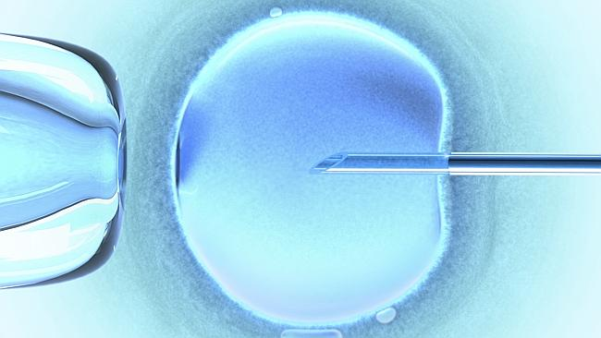

Slide 31
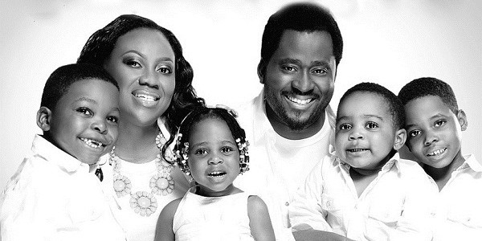

Slide 32
INFERTILITY SUPPORT GROUP
Dr Kireki Omanwa.
Please join and like:
Kenya Infertility Support Group

Slide 33
THANK YOU

Slide 34
ACKNOWLEDGEMENTS
Merck Pharmaceutical Company
Replenish
SISI Pharmaceuticals
The Nairobi Hospital Convention Centre

