Slide 1
Assisted reproduction Technique-update
Dr. Wanyoike Gichuhi
Senior Lecturer

Slide 2
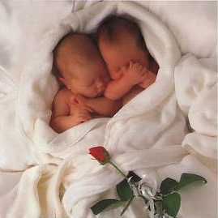
A baby is God's opinion that the world should go on.-- Carl Sandburg

Slide 4
Humans are the only animals that have children on purpose with the exception of guppies, who like to eat theirs.--P.J. O'Rourke

Slide 5
Diagram page 209
Notes:
regulation

Slide 6
THE MENSTRUAL CYCLE
The menstrual cycle spans, an average of, 28 days.
Manipulate cycle
Increase fsh, stimulate follicles, reduce lh

Slide 7
Techniques
1. Intra uterine insemination
a). Husband (39 million normal- this case is 5 million)
b). Donor (husband is azoospermic)
In Vitro Fertilization Embryo Transfer
Intracytoplasmic sperm injection very low sperms i.e. 1 million

Slide 8
Intrauterine insemination indication
A. IUI – Husband
- Oligospermia
- Asthenospermia
- Teratozoospermia
B. IUI – Donor
- Azoospermia

Slide 9
IVF
Edward and Streptoe
Baby Brown 1978
Germany - 1st IVF baby 1982.
Prof. Mettler University Women Hospital, Kiel.

Slide 10
IVF - ET
Concept
Tubalfactor- blockage chlymidia and gonorhhea
Oligospermia
Asthenosperma- poor swimmer
Tetratosospermia- abnormal sperm
Multipleovulation
Oocyte retrieval
Multiple embryo transfer
Lutel phase support
Cryopreservation- 35% success freezing off eggs, sperms, embryos

Slide 11
Intra cytoplasmic sperm injection
Injection of one oocyte into the ovum.
Azoospermia
Sperm retrieval in azoospermia
1.PESA –Percutaneous epididymal sperm aspiration
2. TESA –Testicular sperm aspiration
3. TESE – Testicular sperm extraction
4. MESA –Micro-epididymal sperm aspiration

Slide 12
Ovulation induction
Clomiphine citrate
Atromatase inhibitors
Insulin synsitizes –metformin- pcos
Gonadotrophins- normally fsh given
Gonadotrophins – releasing hormone analogs
Gonadotrophin antagonist
Recombinant Gonadtrophin

Slide 13
Ovarian reserve
DEF: ability of the ovary to produce mature follicle capable of conception.
Ovarian Reserve assessment
Anti mullerian Hormone- older so amount reduces- most important way to assess
FSH- higher doses in low eggs
Inhibin- expensive
Estrodiol (E2)
Ultrasonography – Antral follicle count

Slide 14
Gonadotrophins
Human Menopausal Gonadrotrophin FSH 7UIU, LH 75IU, Pergonal.
Purified follicle – stimulating Hormone – decreased LH activity.
MetrocordinRecombinant gonadotrophins
Human chorionic Gonadotrophin.

Slide 15
Therapy for ovulation induction
Age < 30yrs - FSH 150
31-34 - FSH 150/225
35-39 - FSH 225
> 40yrs - FSH 300
(FSH upto 450 – 300FSH + 150LH)
Dose reduction – previous OHSS & PCO
Increase in dosage – BMI> 25

Slide 16
GnRh Agonist
Menstrual function requires GnRH pulsatile secretion in a ctritical range of frequency and amplitude.
Initial agonistic action “ Flare effect”
Desensitization and down regulation of the pituitary leads produce hypogonadotropic , hypogonad state – loss of receptors
Hypoestrogenism

Slide 17
Gonadrophin – Release Hormone Agonist and Antagonist
Prolonged use of GnRH agonist leads to down regulation of GnRH receptors
Antagonist of GnRH have a direct inhibitory reversible suppressive effect on gonadrophin
Effect: avoid premature untimed single ovulation
HCG – Timed Multiple Ovulation.

Slide 18
Ultrasound – Monitoring
From day 6 of cycle alternates day.
Dosage increases or decreased of gonadotrophins
Then given hcg, then retrieve… blah blah.. Know the bigger picture he said

Slide 19
Oocyte Retrieval
Transvaginal guided procedure done under seddation or general anasthesia
IVF Theatre performed
Oocyte ovum preparation done in the labatatory
Sperm preparation
Combination of oocyte and sperms for fertilization

Slide 20
INCUBATOR
Controlled temperature
CO2 – 5% Oxygen 20%
3-5 day –Embryo has formed
Confirmed by Embryologist
Completely sterile

Slide 21
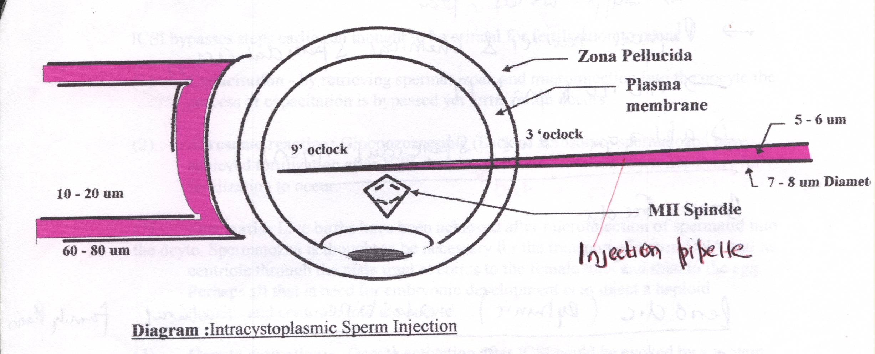
Intracystoplasmic sperm injection(ICSI) most exciting microassisted and fertilization technique developed this far ‘jewel in the crown’

Slide 22
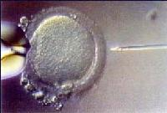
Intracytoplasmic sperm injection (ICSI)

Slide 23
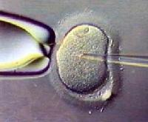
ICSI

Slide 24
Micromanipulator in University women Hospital , Kiel. Germany.

Slide 25
Intrauterine Insemination Embryo
Transfer (AIH, AID, ET)
C) ET
Same as AIH, but straight dressing forceps (no tweezers); before: information number and maturity of oocytes, fertilized and frozen oocytes, number and quality of embryos (number of blastomeres);
After: information OHSS, follow up visit in 3-5 days; if E2>3000 or number of oocytes> 10, follow up immediately if discomfort increases; progesterone (utrogest) 3x2 tablets per day (600mg) vaginally; pregnancy test in 2 weeks; letter to gynaecologist.

Slide 26
Oocyte retrieval o development

Slide 27
Embryo grading

Slide 28
Embyro Grading

Slide 29
Quality of Embryo
Temperature: 37º
PH: 7.2 – 7.4
Role of 5% carbondioxide – regulate PH
If PH is abnormal, change of culture media.

Slide 30
Embryo transfer
2-4 Embryo transferred- not more than 3 apparently
Transcervical transfer with an IVF Canular
Done in theatre while the patient is conscious

Slide 31
Embryo transfer
2-4 Embryo
Transcervical transfer with an IVF Canular
Done in theatre while the patient is conscious

Slide 32
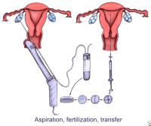
OOCYTES FOR ICSI-ET

Slide 33
Luteal Phase Support
Progesterone
Estrogens
Low dose Aspirin
Up to 12 weeks
Pregnancy managed normally

Slide 34
8. Early Pregnancy (US)
8.1. Pregnancy test - ET +2Weeks

Slide 35
8. Early pregnancy (US)
8.5.
Suspicion of abortion or ectopic pregnancy. Gynaecologic investigation, maybe second opinion.
HCG doubling every 2 days
first ultrasound - ET + 3 Weeks
2nd Ultrasound: ET + 5 Weeks - heartbeats

Slide 36
Hyperstimulation (US)
Ovarian HyperStimulation Syndrome 2⁰
Diagnosis: Ovary 5-10cm, moderate ascitis in Douglas (>3cm), moderate abdominal discomfort (shirt or trousers do not fit) hematocrit > 40.
Therapy: information (course of disease, pregnancy chance, risk of thrombosis); if hematocrit > 40: fragnub P; drink 3 I/d; controls daily until decline of symptoms.

Slide 37
Hyperstimulation (US)
OHSS 3⁰
Diagnosis: Ovary ≥10cm or strong subjective or objective discomfort (slow walking, difficulty in breathing)
Risk of thrombosis.
Therapy: information (x3); admission to hospital.

Slide 38
Crypreservation
Embryo
sperm

Slide 39
Embryo freezing
1. Slow freezing – good survival rate.
Temp from 37 C to minus 190 involves 3 reagents – which remove water out of the cell.
2. Vitrification
First – high survival rate.

Slide 40
aneuploidy
Situation in which an abnormal number of chromosomes is present in the cell, is extremely common in human oocytes and embryosis
Development arrest and failure to implant
Pre implantation genetic diagnosis.

Slide 41
IVF training Women University hospital, Kiel, Grrmany

Slide 42
IVF Success Rates
28% per cycle depending on Age, Weight, Smoking.
60-70% after 4 cycles.
RISKS
OHSS (Ovarian hyperstimulation Synd) – 3%
Multiple gestation – 20% per pregnancy
Malformation risks – 9% vs 7% (general population)
Chances decrease after 6 cycles.

Slide 43
Artificial Gametes
Normal cells or stem cells from body tissue.
Pluripontent or Multipontent
Sperm and oocytes from normal body tissue – skin
Creation of “female” sperm or “Male” eggs.
Complementary gametes-Fertilize themselves
“ same sex couple –own child”
Strain on regulatory framework which is already strained

Slide 44
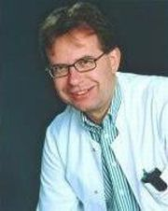
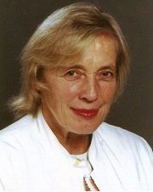
The International School of Medicine was founded in 2008. It is managed by Dr.med. Andreas Schmutzler, a German gynaecologist and lawyer, head of the Kiel University IVF programme, and Dr.med. Monica Tobler, a Swiss-Thai gynaecologist, founder of the private IVF Center Göttingen.
Dr. med. Monica Tobler
Dr. med. Andreas Schmutzler
Prof. Dr. med. Liselotte Mettler
The Kiel School of Gynaecological Endoscopy and Reproductive Medicine, founded by Prof. Liselotte Mettler, has a more than two decade history in international teaching. Together they offer an International Intensive Training Course in Reproductive Medicine and Embryology.

Slide 45
Pioneer of modern endoscopy, University women Hospital, Kiel Germany “ The magician of Kiel”

Slide 46
Director, University Hospital, Kiel. Germany.Women

Slide 47
Strousburg, France Lap. trainingin
1.Camera navigation-keep central, correct zoom
2.Hand eye coordination; orientation of instruments, synchronization of both hands.
3.Suturing and knotting : Loading needle, passing needle through tissue, rotation movement, knotting technique

Slide 48
Bragging Rights

Slide 49
Thanks for listening to me
“We are what we repeatedly do, Excellence, then, is not an act, but a habit.” Aristotle

