Slide 9
Check benefits of using carbon dioxide for laparascopy-safe gas as is easily absorbed, it is inert so no fires with the currents used
Cardiac Disease- one should have adequate cvs to get rid of this excess CO2.
Also this CO2 puts pressure on the diaphragm so pulmonary disease is an issue in this case as it compromises the normal functioning
Severe perotinitis… injuring the gut is a risk
IO- when using the probe somethingggg idk what

Slide 11
Most oncology surgeries use laparascopy…

Slide 21
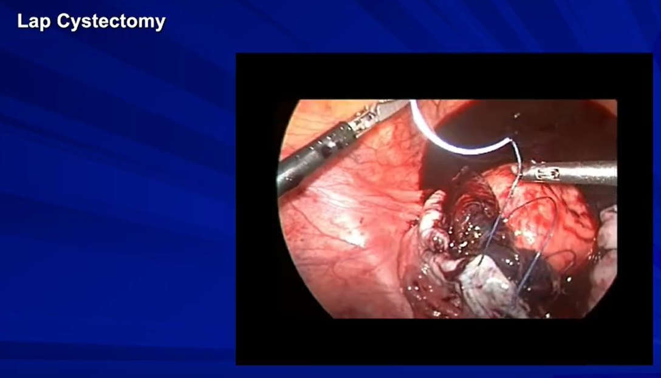

Slide 26
Use Normal Saline instead of Carbon Dioxide

