Slide 1
Urinary tract infection in pregnancy
Alfred Osoti MBChB MMed MPH

Slide 2
Objectives
Define and classify UTI in pregnancy
Understand the urinary tract changes in pregnancy that increase the risk of UTI
Identify the risk factors and causes of UTI in pregnancy
Rationalize the diagnosis and management of UTI in pregnancy
Outline the maternal and neonatal complications of UTI in pregnancy

Slide 3
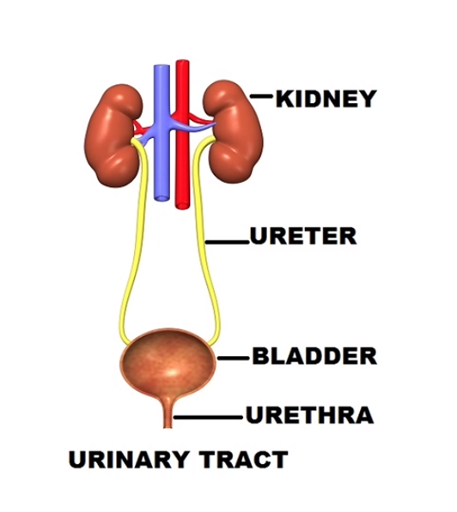

Slide 4
UTI IN PREGNANCY
Definition
presence ≥ 100,000 organisms/mL of urine in asymptomatic or > 100 organisms/mL of urine with pyuria (>7 WBC/mL) in symptomatic patient.
Classification
Upper (pyelonephritis) Vs lower (cystitis and urethritis) (always specify what type)
Asymptomatic (asymptomatic bacteriuria) found in routine screening maybe using dip stick vs Symptomatic (acute urethritis, cystitis and pyelonephritis)

Slide 6
URINARY TRACT CHANGES THAT INCREASE RISK OF UTI
The renal pelvis and ureters - hydroureter and hydronephrosis
progesterone- reduce ureteral tone, peristalsis, and contraction pressure
Hypertrophy of Waldeyer's sheath (the connective tissue that surrounds the ureters within the true pelvis) may prevent hormone-induced dilatation below the pelvic brim
mechanical compression of the ureters at the pelvic brim- by enlarged vessels in the suspensory ligament of the ovary

Slide 7
Urinary tract changes that increase risk of UTI
Hydroureter and hydronephrosis
more prominent on the right than the left-
right ureter affected by dextrorotation of the uterus by the sigmoid colon
kinking of the ureter as it crosses the right iliac artery, and/or proximity to the right ovarian vein
the resulting urinary stasis can serve as a reservoir for bacteria

Slide 8
Urinary tract changes that increase risk of UTI
Bladder
edematous and hyperemic mucosa
Progesterone induces bladder wall relaxation and increased capacity but the enlarging uterus displaces the bladder superiorly, anteriorly, and flattens it, which can decrease capacity
increased incidence of microhematuria
Intermittent vesicoureteral reflux
incompetence of the vesicoureteral valve from bladder flaccidity infection ascends
increased intra vesical pressure
decreased intraureteral pressure cz of hydroureter

Slide 9
Urinary tract changes that increase risk of UTI
Postpartum changes from trauma during labor and delivery
Mucosal congestion and submucosal hemorrhage blood is a good culture medium
Decreased bladder sensitivity/sensation so increase in retention of urine
Detrusor atony, increased post voidal residual urine, bladder over distention, and urinary retention
Impaired tubular function
Reduced fractional reabsorption of glucose, amino acids, and beta microglobulin results in higher rates of urinary excretion-hence glucosuria and aminoaciduria

Slide 10
Increased risk of UTI in women vs men
Shorter urethra what is the length in men compared to women 3-5cm vs 20cm??
Lower third of the urethra is continually contaminated with pathogens from the vagina and the rectum
Incomplete bladder emptying
Intercourse-expose urogenital system to bacteria during intercourse

Slide 11
Urinary tract changes that mimic UTI
Do not use symptoms alone for pregnancy. Use lab tests
Urinary frequency (voiding >7 X per day)
Due to changes in bladder function and increase in urine output
Nocturia (voiding ≥2 X at night)
Due to excretion of larger amounts of sodium and water during the night than non pregnant women and nocturnal mobilization of edema later in pregnancy
Urgency and stress incontinence
Uterine pressure on the bladder
Hormonal effects on the suspensory ligaments of the urethra
Altered neuromuscular function of the urethral striated sphincter

Slide 12
Etiology
Two main sources
Escherichia coli and other coliforms: enterobacteriacea
normal vaginal and perineal flora introduced into the urethra during intercourse/wiping after bowel movement
Neisseria gonorrhoeae and chlamydia trachomatis
sexually transmitted

Slide 13
Etiology
E coli: 80-90% as ascending infection from periurethral fecal flora
Urea-splitting bacteria e.g. Proteus (7%), Klebsiella (5%) Pseudomonas, and coagulase-negative staphylococcus, alkalinize the urine, may be associated with struvite stones.
Enterobacter species (3%)
Staphylococcus saprophyticus (2%), aggressive community acquired likely to be persistent/recurrent
Group B beta-hemolytic Streptococcus (GBS; 1%) leads to neonatal sepsis and death give mother prophylaxis to prevent this
Gram-positive: Enterococcus faecalis
Chlamydia causes sterile pyuria and up to 30% of atypical pathogens.

Slide 14
Asymptomatic Bacteriuria (ASB)
Definition
persistent, actively multiplying bacteria within the urinary tract without urinary symptoms
defined by >100,000 CFU of a single organism not multiple
Prevalence in pregnancy no higher than non-pregnant population (2-7%)
Significance
if untreated increases the risk of symptomatic UTI (20-50%) as acute cystitis/ pyelonephritis

Slide 15
ASB-RISK FACTORS
Age (1% increase/decade of life)
Multi parity-repeated changes in pregnancy which may persist
Sexual activity
Chlamydia infection
Lower socioeconomic status- hygiene, access to info
UTI prior to prenatal care
History of recurrent UTI
DM
Sickle cell disease (renal damage),
Anatomic or functional GU abnormalities e.g. Diversion
Preeclampsia
Cesarean delivery/catheterization – don’t put indwelling catheter

Slide 16
ASB-SCREENING
Urine culture by clean catch at initial visit- gold standard
clean the vulvar from front to back to avoid contamination of the urine sample. what is used to clean? Just use plain water so u don’t kill the bacteria with antiseptic
collect MSSU mid stream specimen of urine
Dipslide (semi-quantitative dip inoculum method)- used in research
a special agar-coated dipstick first placed in urine and then used as culture plate
Urinalysis and urine dipstick- done in KNH
PH- range 4.5 to 8 but normally is slightly acidic (5.5 to 6.5), alkaline urine suggests urea-splitting organism
leukocyte esterase and nitrite-inadequate, lower sensitivity, and high specificity
Many gram-negative and some gram-positive organisms reduce urinary nitrates to nitrites
false-negative results from non-nitrate–reducing organisms and low-nitrate diet
Leucocyte esterase produced by neutrophils and may signal pyuria from UTI

Slide 17
2. ACUTE URETHRITIS/ACUTE URETHRAL SYNDROME
Causes:
Escherichia coli and other coliforms
Neisseria gonorrhoeae, and Chlamydia trachomatis
Symptoms
frequency, urgency, and dysuria, hesitancy, dribbling, mucopurulent urethral discharge
Investigations
Urine microscopy: white blood cells, bacteria
Urine culture: low colony counts of coliforms-100
Culture urethral discharge: for gonorrhea and chlamydia
A rapid diagnostic test e.g. NAAT preferred for gonorrhea and chlamydia

Slide 19
UTI: treatment
Asymptomatic Bacteriuria
Coliforms
Empiric
PO antimicrobials
3-7 days preferred over single day course: amoxicillin, cephalosporin, nitrofurantoin
Treatment failures: nitrofurantoin for 21 days is usually very nauseating
Persistence or recurrence: suppress, nitrofurantoin at bedtime until delivery

Slide 20
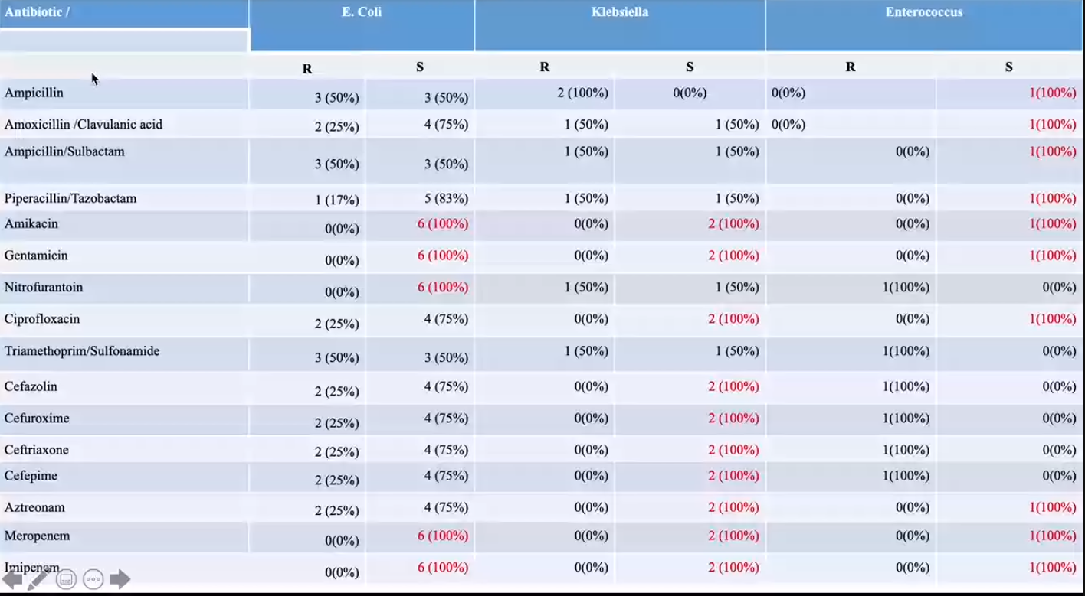

Slide 21
TREATMENT: GONOCOCCAL
Dual therapy preferred
Ceftriaxone 250 mg IM single dose PLUS azithromycin 1 g PO as a single dose
Cefixime 400 mg orally as a single dose PLUS azithromycin 1 g PO as a single dose
Single therapy -use local resistance data for susceptibility
E.G. Spectinomycin 2 g IM
Higher dosages for recurrence

Slide 22
TREATMENT: CHLAMYDIA
Azithromycin 1 g PO as a single dose/doxycycline 100 mg PO twice a day for 7 days
OR
tetracycline 500 mg orally four times a day for 7 days
erythromycin 500 mg orally twice a day for 7 days
ofloxacin 200–400 mg orally twice a day for 7 days.
Avoid tetracyclines and quinolones in pregnancy
Pregnancy
azithromycin preferred over erythromycin or amoxicillin,
amoxicillin preferred over erythromycin.
Higher dosages for recurrence

Slide 23
ACUTE CYSTITIS
Inflammation of the bladder from bacterial or nonbacterial causes (e.g. radiation or viral infection)
Prevalence :1-2%
Symptoms and signs
Suprapubic discomfort
Dysuria, urgency, nocturia and frequency
Pyuria and bacteriuria
Microscopic hematuria and occasionally gross hematuria from hemorrhagic cystitis
Significance
Precede 40 % of pregnant women with acute pyelonephritis
Treatment
3-7 days and not single-dose therapy needed as for ASB

Slide 24
Treatment: acute cystitis
Antibiotic choice depends on
Sensitivity patterns
Ampicillin, amoxicillin, cephalexin, amoxicillin-clavulanic acid affect normal bowel and vaginal flora to cause diarrhea or monilial vulvovaginitis cause vaginal yeast infections
Nitrofurantoin has minimal effect on vaginal and bowel flora, and effective against the common uropathogens, except Proteus species
Amoxicillin-clavulanic acid and trimethoprim sulfamethoxazole best for resistant pathogen
Amoxicillin-clavulanic acid concern about neonatal necrotizing enterocolitis
Sulfonamides not used in the first trimester due to teratogenicity, and immediately prior to delivery due to displacement of bilirubin from protein binding sites and resultant neonatal jaundice

Slide 25
ACUTE PYELONEPHRITIS
The most common serious medical complication of pregnancy
About 10 to 20% of women with pyelonephritis have bacteremia so maybe having sepsis
Prevalence: 1-2 % and most common in the 2nd and 3rd trimesters
Location: right (75%-80%), left (10% -15%) or bilateral
Symptoms and signs
urinary symptoms-frequency, and dysuria
fever, flank pain, nausea, vomiting, shaking chills
CVA/renal angle tenderness-salient feature so do it routinely if you suspect a UTI
signs of preterm labor, septic shock, and ARDS
Labs:
Bacteriuria- 1–2 per HPF in unspun urine or >20 in centrifuged urine
Pyuria
WBC casts
Leukocytosis
Blood cultures –septicemia in 10–20%

Slide 26
ACUTE PYELONEPHRITIS: GENERAL MANAGEMENT
Admit to monitor for septic shock
Intravenous hydration to ensure adequate urinary output
Antipyretics/cooling blanket. Hyperthermia in early pregnancy is teratogenic and can lead to early labor or fetal compromise/NRFS-non reassuring fetal status
Closely monitor urinary output, BP, PR, Temp, and oxygen saturation.
Investigations: CBC, UEC, urine culture anemia is a risk factor for uti, low platelets in infection
Renal US for failed/persistent or complicated infections: can identify obstruction/perinephric abscess
In selected cases
plain abdominal radiograph will identify nearly 90% of radiopaque calculi
modified one-shot intravenous pyelogram—a single radiograph 30 minutes after contrast; CT urogram; MRI if no response to RX
cystoscopy and retrograde pyelography

Slide 27
Acute pyelonephritis: specific management
Parenteral antibiotics until defervescence and culture obtained within 48-72 hours
Then oral antibiotics for a total of 10 to 14 days
Options:
cefazolin +/-gentamicin
cefuroxime
ceftriaxone

Slide 29
UTI: prevention
Primary prevention: screening for and treating ASB
Secondary prevention, suppressive therapy indicated for
ASB: no response to initial and subsequent 7-10 day therapy
Recurrent bacteriuria after initial clearance of ASB
≥2 symptomatic UTIs
Acute pyelonephritis
Options-bedtime antibiotic dose
Nitrofurantoin 100 mg
Cephalexin 250 mg
Amoxicillin 250 mg

Slide 31
UTI: maternal complications
Fever
Bacterial endotoxemia, endotoxic shock, sepsis
Transient renal insufficiency
Anemia
Leukocytosis
Thrombocytopenia
Elevated fibrin split product levels
Postpartum endometritis
Pulmonary dysfunction
minimal (mild cough and slight pulmonary infiltrate)
severe ADRS

Slide 32
Complications: ARDS
bacterial endotoxins increase alveolar permeability leading to pulmonary edema.
Increased risk in the presence of: tachycardia, tachypnea, blood transfusion, Temp>103 degrees, tocolytics, excessive IV fluids
Awareness, prompt and aggressive management needed
Intensive care may be needed

Slide 34
UTI: Fetal/neonatal complications
preterm labor and prematurity
Fetal death
IUGR
Low birth weight

Slide 35
UTI: recurrence
Recurrence occurs in 30 to 40 %
Relapse
recurrent infection from the same species and type-specific strain present before treatment; a treatment failure.
occur <2 weeks after completion of RX
Reinfection
recurrent infection due to a different strain of bacteria after successful treatment of the initial infection
occurring >3 weeks after completion of RX

Slide 36
UTI: differential diagnosis
Labour
Chorioamniontis
Appendicitis
Placental abruption
Degeneration of leiomyomas
Musculoskeletal pain
Costochondritis

Slide 37
Objectives
Define and classify UTI in pregnancy
Understand the urinary tract changes that increase the risk of UTI in pregnancy
Identify the risk factors and causes of UTI in pregnancy
Rationalize the diagnosis and management of UTI in pregnancy
Outline the maternal and neonatal complications of UTI in pregnancy

Slide 38
