Slide 1
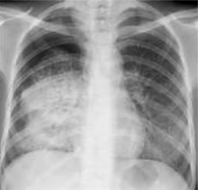
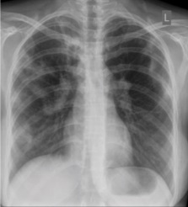
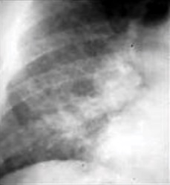
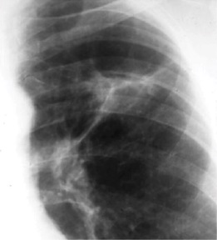
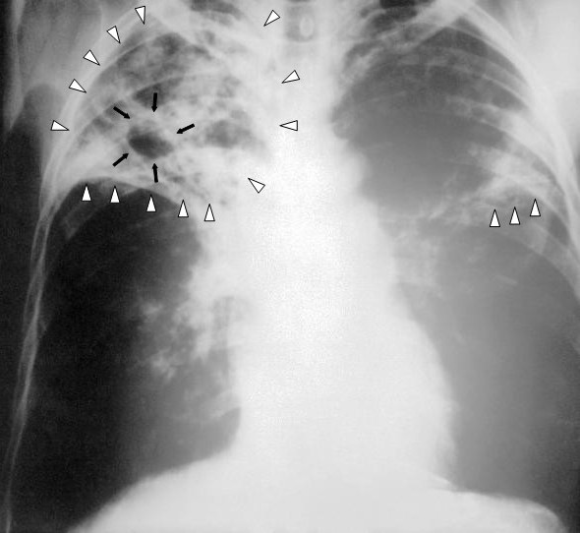
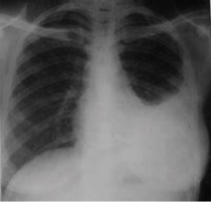
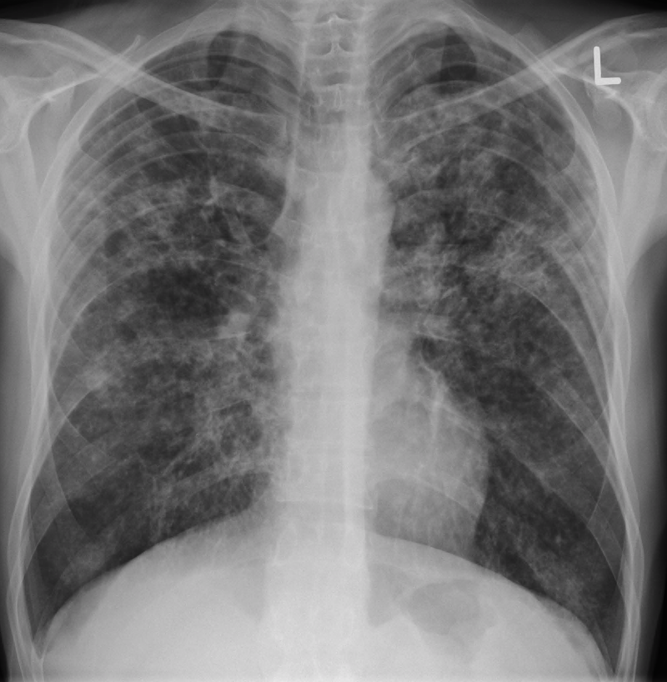
Tuberculosis in pregnancy
By Dr Kihara Anne B
Senior Lecturer, UON DEPT Of obs / Gyn
TB a global public health emergency

Slide 2
Outline of presentation
At the end of this module the learner will be able to address the:
Historical background
Epidemiology and global policy
Public implication why this disease is important
Clinical presentation
Screening and diagnosis
Management
Prevention

Slide 3
Historical background
N 1882, WHEN Robert Koch discovered Mycobacterium tuberculosis
Tuberculosis (TB) is believed to be nearly as old as human history. Traces of it in Egyptian mummies date back to about 7000 years ago, when it was described as phthisis by Hippocrates.
Mycobacterium Tuberculosis was discovered by Robert Kochs in 1882
It was declared a public health emergency in the African Region in 2005.
About 9.4 million new cases of tuberculosis were diagnosed in 2009 alone and 1.7 million people reportedly died from the disease in the same year, translating to about 4700 deaths per day!

Slide 4
Epidemiology
Global burden
In 2018, an estimated 10 million people fell ill with tuberculosis(TB) worldwide. 5.7 million men, 3.2 million women and 1.1 million children. There were cases in all countries and age groups.
In 2018, 1.1 million children fell ill with TB globally, and there were 205 000 child deaths due to TB (including among children with HIV). Child, adolescent and pregnancy TB is often overlooked by health providers and can be difficult to diagnose and treat.
A total of 1.5 million people died from TB in 2018 (including 251 000 people with HIV). Worldwide, TB is one of the top 10 causes of death and the leading cause from a single infectious agent.
However, it is preventable and curable.

Slide 5
Epidemiology cont…
In 2018, the 30 high TB burden countries accounted for 87% of new TB cases. Eight countries account for two thirds of the total, with India leading the count, followed by, China, Indonesia, the Philippines, Pakistan, Nigeria, Bangladesh and South Africa.
New TB cases occurred in the South-East Asian region, with 44% of new cases, followed by the African region, with 24% of new cases and the Western Pacific with 18%.
Multidrug-resistant TB (MDR-TB) remains a public health crisis and a health security threat. WHO estimates that there were 484 000 new cases with resistance to rifampicin – the most effective first-line drug, of which 78% had MDR-TB.
Globally, TB incidence is falling at about 2% per year. This needs to accelerate to 4–5% annual decline to reach the 2020 milestones of the End TB Strategy.
An estimated 58 million lives were saved through TB diagnosis and treatment between 2000 and 2018.
Ending the TB epidemic by 2030 is among the health targets of the Sustainable Development Goals

Slide 6
25% of the global population has latent TB
People infected with TB bacteria have a 5–15% lifetime risk of falling ill with TB. Persons with compromised immune systems, such as people living with HIV(x19), malnutrition(x3) or diabetes, or people who abuse alcohol (x3.3) use tobacco(x1.6) , have a higher risk of falling ill.
People with active TB can infect 5–15 other people through close contact over the course of a year. Without proper treatment, 45% of HIV-negative people with TB and nearly all HIV-positive people with TB will die.

Slide 7
TB in pregnancy
The exact incidence of tuberculosis in pregnancy is not readily available in many countries due to a lot of confounding factors.
Schaefer reported a new case rate of 18–29/100,000 in pregnancy, which was similar to the 19–39/100,000 reported for the city of New York in 1970’s
A recent United Kingdom study, however, quoted an incidence of 4.2 per 100,000 maternities, which may be a reflection the current global fall in the incidence of the disease by 2010.
Paucity of local despite the guideline that states routine screening for TB in pregnancy be conducted
Can you provide an explanation for this ??????
Notes:
Schaefer G, Zervoudakis IA, Fuchs FF, David S. Pregnancy and pulmonary tuberculosis. Obstetrics and Gynecology. 1975;46(6):706–715
Knight M, Kurinczuk JJ, Nelson-Piercy C. Tuberculosis in pregnancy in the UK. BJOG. 2009;116(4):584–588
2010/2011 tuberculosis global fact; World Health Organisation. www.who.int/tb/data, Nov. 2010.
Overpopulation, HIV infection, increasing poverty, and the increasing incidence of antibiotic-resistant isolates are increasing the burden of tuberculosis on women and society
LCK OF HELATH EDUCATION
Failure t have contact tracing and management
7

Slide 8
Public health importance of TB in pregnancy
There is an impact of pregnancy on TB and TB on the pregnancy
Challenges with diagnosis and treatment in pregnancy as may mimic other pathophysiology e.g. pulmonary oedema associated with severe PE, Asthma, AKI, hyoerwmesis gravidarum. Fever ad chills , night sweats
Can exist with other co- morbidities such as gestational diabetes, HIV
Pulmonary TB is a communicable disease an therefore can be contracted and also spread
Development of Drug resistant TB due to inappropriate prescriptions , poor drug quality and non – compliance to treatment Risk of Congenital tuberculosis
Major cause of indirect maternal and perinatal mortality needs prompt diagnosis and treatment in pregnancy for healthier maternal and neonatal outcomes
MDR-TB and XDR-TB increasingly very costly to the health system ad should be avoided at all cost( good quality treatment of TB and ensuring adherence to anti-TB medications) and aggressive management when resistant TB detected

Slide 9
Stop TB strategy
Government commitment, diagnosis through microscopy, standardised and supervised treatment, uninterrupted drug supply, and regular monitoring, which together constitute DOTS—the WHO recommended tuberculosis control strategy
Notes:
Ref : WHO STOP TB strategy https://www.thelancet.com/journals/lancet/article/PIIS0140-6736(06)68392-X/fulltext Volume 367, ISSUE 9514, P952-955, March 18, 2006
9

Slide 16
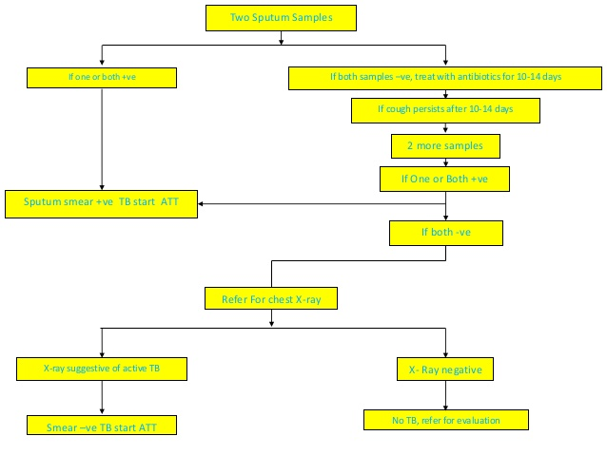

Slide 17
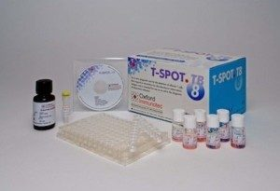
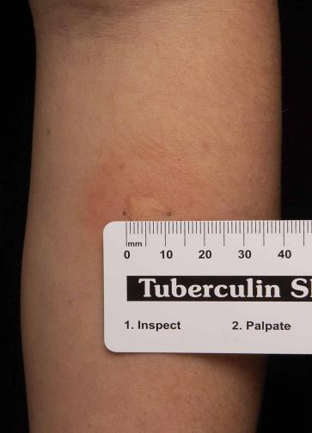
Other Screening and diagnostic tests
Mantoux test and read within 48-72 hours
Microscopy and culture of M. Tuberculosis
Microscopy with Staining for AFB is also done, using the Ziehl-Neelsen, fluorescent, Auramine-Rhodamine, and the Kinyoun techniques; Light-emitting diode (LED) fluorescent microscopy has recently been introduced to improve diagnosis,
and culture on Lowenstein-Jensen's medium may take 4–6 weeks to obtain a result.
Newer diagnostic tools including the liquid Bactec culture medium, which has been endorsed by WHO. Other culture media that could be used include the modified Lowenstein's medium, Petragnani medium, Trudeau Committee medium, Peizer's medium, Dubos Middlebrook media, Tarshis blood agar, Middlebrook's 7-H3, Middlebrook's 7-H9, and Middlebrook's 7H-10 media. Liquidisation and decontamination with N-Acetytl-L-Cysteine in 1% Sodium Hydroxide solution before inoculation may enhance sensitivity.
Molecular Line Probe Assay (LPA) as well as the use of polymerase chain reaction (PCR) are presently facilitating the specific identification of the tubercle bacilli
Notes:
RefPathways to Better Diagnostics for Tuberculosis; A Blueprint for Development of TB Diagnostics. Geneva, Switzerland: World Health Organization; 2009.
17

Slide 18
Screening and Diagnosis of TB
Microscopy detects only half the number of TB cases and cannot detect drug-resistance.
The use of the rapid test Xpert MTB/RIF® has expanded substantially since 2010, when WHO first recommended its use. The test simultaneously detects TB and resistance to rifampicin, the most important TB medicine. Diagnosis can be made within 2 hours and the test is now recommended by WHO as the gold standard test in all persons with signs and symptoms of TB.
Diagnosing multidrug-resistant and extensively drug-resistant TB (see Multidrug-resistant TB section below) as well as HIV-associated TB can be complex and expensive. In 2016, 4 new diagnostic tests were recommended by WHO – the rapid molecular test to detect TB at peripheral health centres where Xpert MTB/RIF cannot be used, and 3 tests to detect resistance to first- and second-line TB medicines.

Slide 20
WHO GUIDELINE FOR TUBERCULOSIS TREATMENT
All forms of PTB and EPTB except TB meningitis and osteo-articular TB
Intensive phase: 2months Rifampicin, Isoniazid, Ethambutol and Pyrazinamide
Continuation phase: 4 months of Rifampicin and Isoniazid
TB meningitis and Osteoarticular TB
Intensive: 2 months Rifampicin, Isoniazid, Ethambutol and Pyrazinamide
Continuation: 10 months of Rifampicin and Isoniazid
Retreatment
Intensive: 2months Rifampicin, Isoniazid, Ethambutol and Pyrazinamide
Continuation: 5 Rifampicin, Isoniazid, Ethambutol
NOT :in the intensive phase in both category I and category II can be extended for an extra one month if sputum still positive after 2 months of treatment.
Steroids can be used as adjunct therapy inpatients with TB pericarditis and TB meningitis administered initially in high dose and tapered in 6-8 weeks

Slide 21
Treatment in pregnancy
Pregnancy should be avoided during anti-TB treatment. However, when it occurs, termination of pregnancy is not recommended
Anti-TB drugs have not been specifically studied in pregnancy. There is always some risk of teratogenicity with any drugs especially if given in the first trimester. There have been no significant reports that anti-TB drugs pose a greater than usual risk of teratogenicity and therefore all pregnant women with active TB should be treated with a full complement of anti-TB drugs.
Rifampicin, isoniazid, ethambutol and pyrazinamide are classified under FDA category C meaning their risk cannot be ruled out in pregnancy.
Pyridoxine should be given together with isoniazid to avoid neurological congenital malformations in the fetus
Streptomycin is ototoxic and should not be used in pregnancy as it may cause deafness in the infant.
In drug resistant TB, the amino glycosides (Kanamycin, Amikacin and Capreomycin) and the thioamides (Ethionamide and Prothionamide) should not be used in pregnancy because of associated ototoxity.

Slide 22
Management of the neonate of mother with TB
In the absence of evidence of congenital tuberculosis, isoniazid (10 mg/kg/day) should be commenced at birth and continued for six months.
Clinical or radiological features of active tuberculosis and a positive tuberculin skin test are indications for a full course of anti-tuberculous treatment.
The tuberculin skin test and chest X-rays are done at 6 weeks, 12 weeks, and 6 months. The baby is vaccinated with BCG at 6 months if these tests are negative.
The baby is, however, changed to multiple drug therapy if any of these tests turn positive during the period of monitoring.

Slide 23
WHO-recommended collaborative TB/HIV activities
Establish and strengthen the mechanisms for delivering integrated TB and HIV services
1.Set up and strengthen a coordinating body for collaborative TB/HIV activities functional at all levels 2. Determine HIV prevalence among TB patients and TB prevalence among people living with HIV. 3. Carry out joint TB/HIV planning to integrate the delivery of TB and HIV services
4. Monitor and evaluate collaborative TB/HIV activities

Slide 24
Reduce the burden of TB in people living with HIV and initiate early antiretroviral therapy (the Three I’s for HIV/TB)
5. Intensify TB case-finding and ensure high quality anti-tuberculosis treatment 6. Initiate TB prevention with Isoniazid preventive therapy and early antiretroviral therapy 7.Infection control of TB Infection in health-care facilities and congregate settings

Slide 25
Reduce the burden of HIV in patients with presumptive and diagnosed TB
8. Provide HIV testing and counselling to patients with presumptive and diagnosed TB 9. Provide HIV prevention interventions for patients with presumptive and diagnosed TB 10. Provide co-trimoxazole preventive therapy for TB patients living with HIV 11. Ensure HIV prevention interventions, treatment and care for TB patients living with HIV 12. Provide antiretroviral therapy for TB patients living with HIV

Slide 26
Breastfeeding practices with TB and in TB / HIV co-infection
Anti-tuberculous drugs are excreted into breast milk, though the dose is less compared with the therapeutic dose for infants.. No toxicity has been reported from this small concentration in breast milk
Pyridoxine deficiency may cause seizures in the newborn. Supplemental pyridoxine should, therefore, be administered to infants on INH or whose mother is taking the drug.
Breastfeeding may be discouraged in women who are yet to commence TB treatment at the time of delivery and those who are still actively excreting the bacillus while coughing. In mothers who are also HIV breastfeeding exclusively for 6 months, HAART for life OR an alternate to BF observe the AFASS Criteria
Notes:
Olabisi M. Loto * and Ibraheem Awowole Tuberculosis in Pregnancy: A Review J Pregnancy. 2012; 2012: 379271.
Published online 2011 Nov 1. doi: 10.1155/2012/379271
J. N. Oliwa,^{1,2,5} J. Maina,¹ P. Ayieko,¹ D. Gathara,¹ I. A. Kathure,³ E. Masini,^{3,4} A. H. van’t Hoog,^{5,6} M. B. van Hensbroek,^{5,6} and M. English Variability in distribution and use of tuberculosis diagnostic tests in Kenya: a cross-sectional survey BMC Infect Dis. 2018; 18: 328.
Published online 2018 Jul 16. doi: 10.1186/s12879-018-3237-z
26

Slide 27
Notes:
IRIS SYNDROME
27

Slide 28
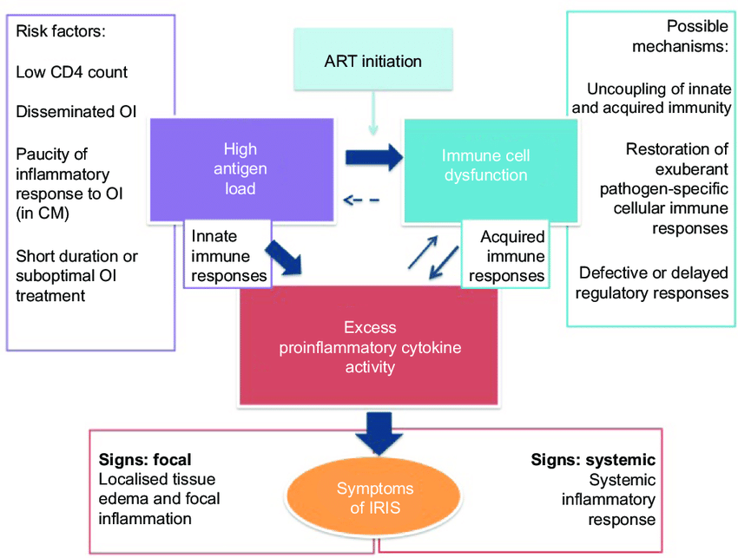
Notes:
IRIS– Immune reconstitution inflammatory syndrome associated with TB , Crytococcal, CMV retinitis and Karposis sarcoma syndrome associated with initiation or change of ART
28

Slide 30
Notes:
MDR develops due to inappropriate prescriptions , poor quality of drugs and failure of adherence by the patient
30

Slide 42
Conclusion
Control of TB demands improved living conditions, public enlightenment, primary prevention of HIV/AIDS and BCG vaccination.
Counselling, reassurance, supervision for adherence and long term follow up are key to successful treatment

Slide 43
References
Global Tuberculosis Report 2018; ISBN 978-92-4-156564-6, © World Health Organization 2018
Newton, E, Glob. libr. women's med. (ISSN: 1756-2228) 2008; DOI 10.3843/GLOWM.10186
Screening for tuberculosis in pregnancy: do we need more than a symptom screen? Experience from western Kenya: R. J. Kosgei, D. Szkwarko, S. Callens, P. Gichangi, M. Temmerman, A-B. Kihara, J. J. Sitienei, E. J. Cheserem, P. M. Ndavi, A. J. Reid, E. J. Carter
Guidelines for Management of Tuberculosis and Leprosy in Kenya. July 2013 edition
WHO treatment guidelines 2013

