Slide 1
PARASITIC DISAESES
The Next next slides….. Ooops!!!

Slide 2
MAIN ONES
MALARIA
INTESTINAL NEMATODES
ENTAMOEBA
TRICHOMONIASIS
LEISHMANIASIS
TREMATODES/CESTODES
TRYPANMOSOMIASIS ETC

Slide 3
EFFECTS ON PREGNANCY
.BLOOD LOSS—HOOKWORM,PLASMODIA,SCHISTOSOMA
.ANAEMIA OF CHRONIC DISEASE
MALABSORPTION-NEMATODES
ELEPHANTIASI/LYMPHOEDEMA
PLACENTAL INFECTION-CRYPTOSPORIDIUM,TOXOPLASMOSIS,TRYPANOSOMIASIS
PRETERM BIRTH

Slide 4
PREGNANCY COMPLICATIONS
ANAEMIA,---PLACENTA PRAEVIA
./ IUGR
PRECLAMPSIA
LOWBIRTHWEIGHT BABIES
IUFD
POSTPARTIUM HAEMORRHAGE

Slide 5
CONTD
MALABSORPTION
------ANAEMIA
IUGR
IUFD
APH/PPH
PREECLAMPSIA
LOWBIRTH WEIGHT BABIES

Slide 6
DYSENTRY—DEHYDRATION—PREGNANCY LOSS

Slide 7
Protozoa
Life Stages –
Trophozoite -vegetative; feeding, mostly motile
Cyst – dormant; protective thick wall
Most are free living in water and soil
Classified by motility & life cycle
Subdivided by location in human host (GI, blood, GU)
Sarcodina- Amoeba - move by pseudopods
Ciliophora - Ciliates - move by cilia
Mastigophora - Flagellates - move by flagella
Apicomplexan - Sporozoa – complex life cycle

Slide 8
50% PREVALENCE IN POOR SANITATION

Slide 9
Amoeba
Entamoeba histolytica
Amoebic dysentery
Naegleria
primary amoebic meningoencephalitis
Acanthamoeba
contact lens contaminant
Figure 12.18a

Slide 10
Entamoeba histolytica
Carried asymptomatically in the digestive tracts of humansTen per cent of the world population, including 2–5% in the United States and up to 80% in some tropical countries, is infected with the intestinal protozoan Entamoeba histolytica.²⁹ The primary habitat of the parasite is the ileum and colon
No animal reservoir exists
Infection usually occurs by drinking water contaminated with feces that contain cysts
Trophozoites migrate to the large intestine where they multiply

Slide 11
Entamoeba histolytica
Carried asymptomatically in the digestive tracts of humans
No animal reservoir exists
Infection usually occurs by drinking water contaminated with feces that contain cysts
Trophozoites migrate to the large intestine where they multiply

Slide 12
Entamoeba histolytica
Three types of amebiasis can result from infection
Luminal amebiasis
Least severe form that is asymptomatic
Invasive amebic dysentery
More common form of infection
Characterized by bloody, mucus-containing stools and pain
Invasive extraintestinal amebiasis
Trophozoites carried via the bloodstream throughout the body
Maintaining clean water is important in prevention

Slide 13
Acanthamoeba and Naegleria
Cause rare and usually fatal brain infections
Common inhabitants of natural waterways as well as artificial water systems
Contact lenses wearers who use tap water to wash their lenses can become infected
Acanthamoeba diseases
Infection occurs through cuts or scrapes, the conjunctiva, or through inhalation
Acanthamoeba keratitis results from conjunctival inoculation
Amebic encephalitis is the more common disease

Slide 14
treatment
Metronidazole 400mgs 8 hourly for seven days
Paromomycin
Iodoquinol
Fluid replacement

Slide 15
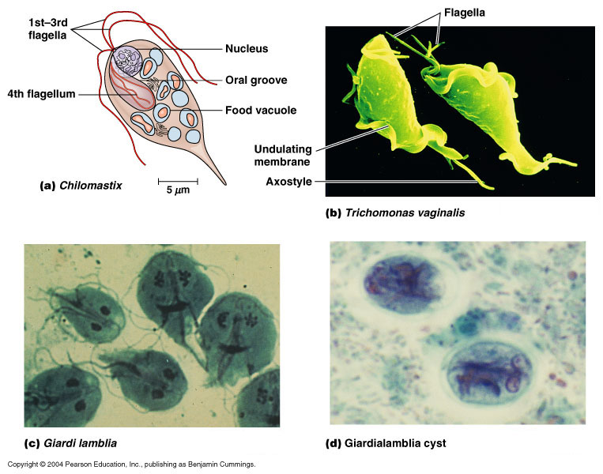
Flagellate
Trichomonas vaginalis
no cyst stage
Trichomoniasis - STI
Giardia lamblia
intestinal malabsorption
Traveler's diarrhea, day care centers, hikers
Figure 12.17b-d

Slide 16
Trichomonas—vaginitis and non gonoccocal urethritis in males
Bartholinitis,urethritis
Malodrous yellow greenish discharge
Treatment
Metronidazole,tinidazole

Slide 17
Hemoflagellates
Trypanosoma
African sleeping sickness or Chagas disease
Transmitted by tsetse flies or reduviid bugs
Leishmania
leishmaniasis – “Baghdad Boil”- Desert Storm
Transmitted by sand fly vector

Slide 18
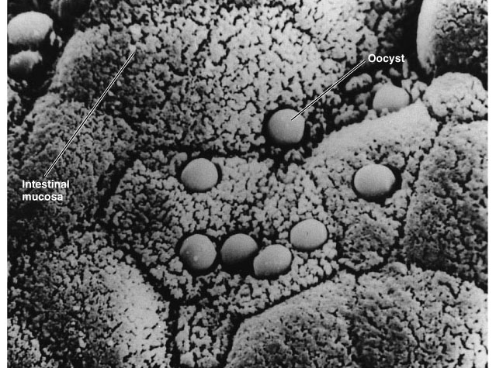
Cryptosporidium parvum
Waterborne
Found in cattle
Attach to intestinal lining
Cause watery diarrhea
Acid-fast Oocysts
Resistant to chlorine
Figure 25.19

Slide 19
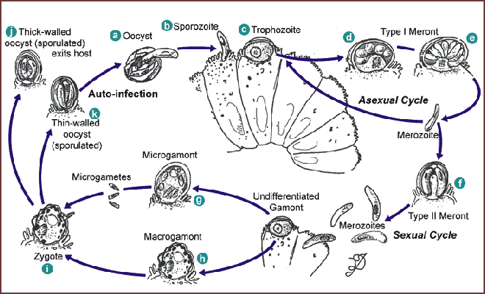
Cryptosporidium life cycle

Slide 20
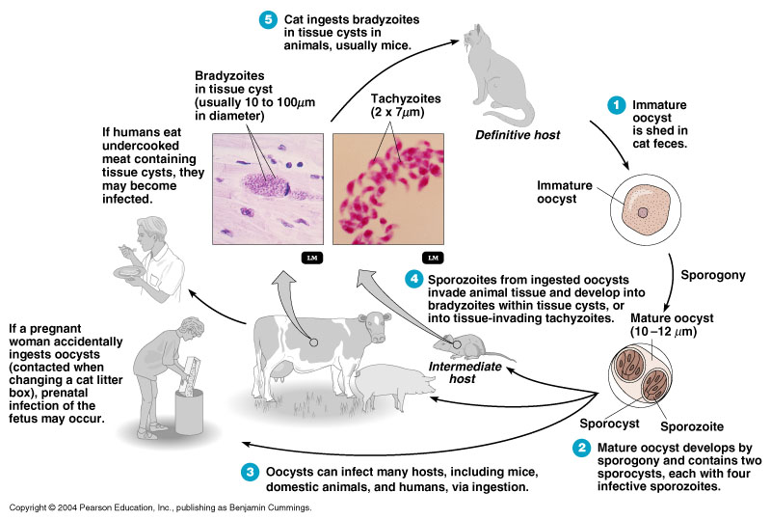
Toxoplasma gondii

Slide 21
Helminths - worms
Life Stages
egg, larva, adult; complex life cycles
infective stage: egg or larva
definitive host: harbors adult stage
intermediate hosts: may be more than one
Classifications:
Nematodes - roundworms
Platyhelminthes - flatworms
Trematodes - flukes- nonsegmented
Cestodes - tapeworms- segmented

Slide 22
Nematodes- Roundworms
Intestinal roundworms:
Ascaris (Giant intestinal roundworm)
Enterobius (Pinworm)
Necator / Ancylostoma (Hookworm)
Tissue roundworms
Trichinella spiralis - trichinosis

Slide 23
Nematodes - roundworms
Ascaris lumbricoides- adult stage

Slide 24
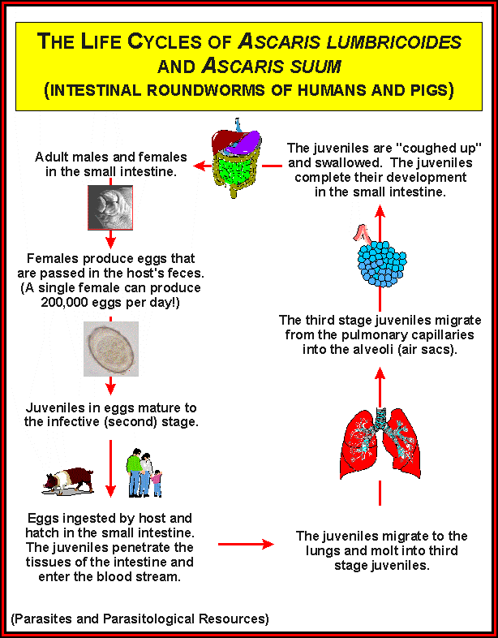

Slide 25
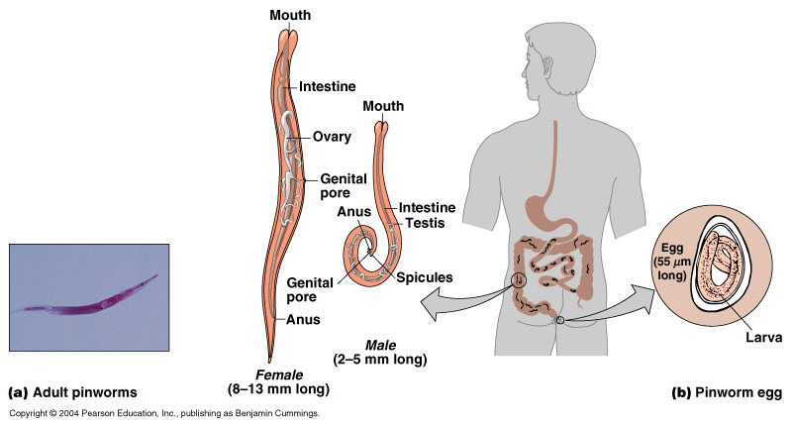
Enterobius - Pinworm
Figure 12.29

Slide 26
Hookworm—1cm long, n.americanus—0.003mls daily,diuodenale—0.2mls of blood per day
Can be present in their thousands

Slide 27
Necator or Ancylostoma - Hookworm

Slide 28
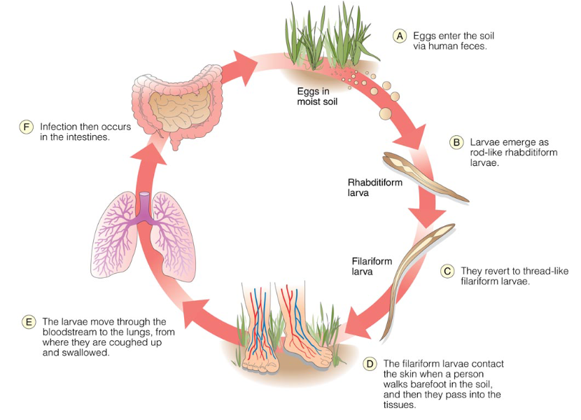
The Life Cycle of the Hookworms Ancylostoma duodenale and Necatur americanus

Slide 29
Platyhelminthes - Flatworms
Trematodes – Flukes - nonsegmented
Schistosoma - blood fluke; Swimmer’s itch
Cestodes – Tapeworms - segmented
Taenia – beef or pork tapeworm
Echinococcus – wild dog tapeworm

Slide 30
trypanosomiasis
Trypanosoma species
T,gambiese,rhodesiansiae,cruzi
Causes lymphadenitis—cervical nodes—winterbottom sign,fever,joint pains and muscle pain
Severe palm pains due to pressure on the ulnar nerve—kerandels sign
Encephelatitis and meningoencephalitis.
Chagas –fever , lyphadenopathy,edema of eyelids—romanes signs
Rx--suramin

