Slide 1
BASIC OBSTETRICS & GYNECOLOGY SKILLS
MBChB V
Prof Eunice Cheserem
&
Dr Alfred Osoti
&
Dr Rose J. Kosgei

Slide 2

Two days of just skills
The following are objectives of the two day skills day
Impact skills and competencies for selected obstetric and gynecology procedures
Prepare students for clinical procedures in the clinical areas
Prepare students for the end of year clinical exam
  Objective Structured Clinical Exam (OSCE)

Slide 3
Mode of delivery of the skill day
Students are required to have read about the skills before the skills day
There are 10 Obstetric and Gynecology skill stations each (20 total)
Each station will be facilitated by a Resident under the guidance of Faculty
MBChB V students will be divided into 10 groups (group 1 to 10)
Each group will take 30 minutes per station with a 30 minute tea break and one hour lunch break
For each skill, the log book will be signed off when the facilitator is satisfied that the student is able to perform the skill

Slide 4

10 Obstetrics Skill Stations
Counseling in Obstetrics-1 Previous Scar
Fetal heart rate tracing interpretation – normal and abnormal tracings
Normal vaginal delivery
Breech Vaginal Delivery
Assisted vaginal delivery-vacuum extraction
Shoulder dystocia
Sterile speculum examination
Digital vaginal examination
PPH evaluation and management
Perineal tear & episiotomy repair

Slide 5

10 Gynecology skill stations
Manual Vacuum aspiration
Pap smear collection
VIA/VILI
Counselling for abnormal cervical screen result
Implant insertion/removal
IUCD insertion/removal
Scrubbing/Gowning/Gloving, Abdominal draping and incisions
Ectopic Pregnancy, catheterization & IV access
High vagina swab & endocervical swab
Bimanual examination for pelvic mass/adnexal mass

Slide 6
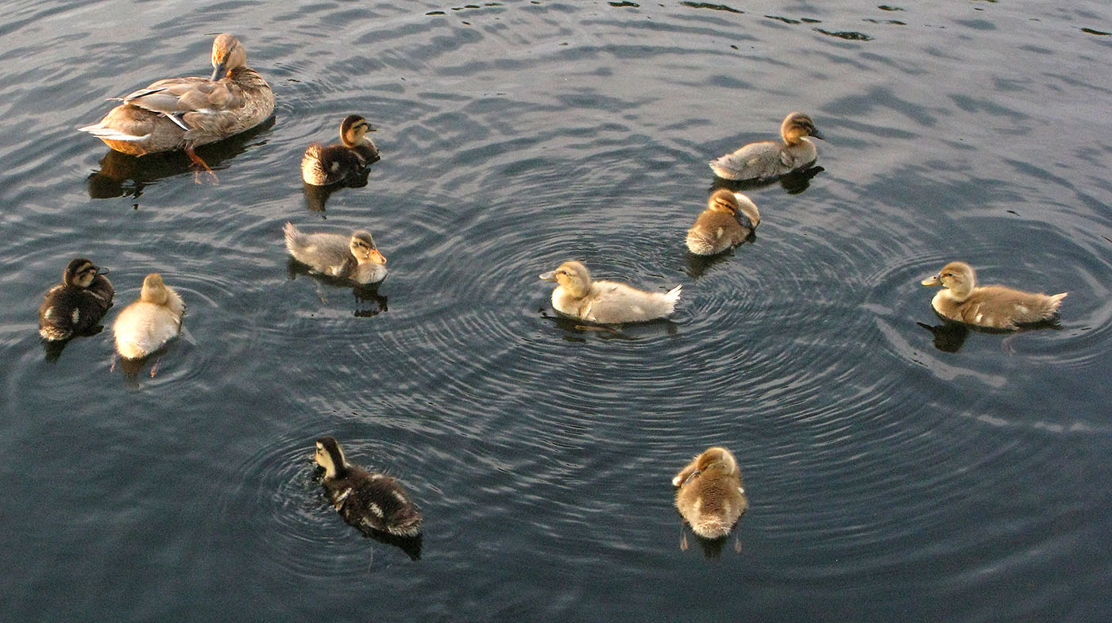
10 Obstetrics Skill Stations

Slide 7

Counseling in Obstetrics-1 Previous Scar
Greet patient, Introduce self, Sit squarely, Open Posture, Lean Forward, Eye Contact, Relax
Demonstrate understanding of the underlying condition and management
  Explain the diagnosis-1 previous scar
  Elective delivery options-elective repeat cesarean delivery vs TOLAC/VBAC
    TOLAC/VBAC
      Review previous scar- Indications as non-recurrent, outcome, complications
      Current pregnancy-confirm no contraindication to TOLAC/VBAC
      TOLAC/VBAC -Success rate
      Potential maternal/neonatal complications
    Elective Repeat Cesarean Delivery (ERCD)
      Timing-at 39 weeks
      Risks versus benefits
      Potential maternal and neonatal complications
      Preoperative and postoperative care
  Emergency repeat cesarean delivery if early onset of labor or failed TOLAC/VBAC
Appreciates/acknowledge patients time

Slide 8
Counseling in Obstetrics-1 Previous Scar
ACRONYMS
  TOLAC-Trial Of Labor After Previous Cesarean Delivery
  VBAC-Vaginal Birth After Cesarean Delivery
  ERCD-Elective Repeat Cesarean Delivery
Antepartum predictors of success
  Indication for prior cesarean delivery
  Fetal malpresentation (75%)
  non-reassuring fetal heart rate pattern (60%)
  Failure to progress or CPD if non-recurrent cause (54%)
  History of prior vaginal delivery
  Before or after previous CS (OR prior vaginal delivery 3.90; prior VBAC 4.76)
  Demographic factors
  Hispanic, African American, and Asian women more likely to pursue TOLAC, but are less likely to have a successful VBAC versus non-Hispanic and white women
Demographics ctd
  Increasing maternal age, single marital status, and less than 12 years of education have reduced likelihood
  Age >35 less likely to have a successful VBAC and more likely to experience complications
  Success increases with increasing maternal height
  Success lower in obese women
Interpregnancy interval of less than six months risk factor for uterine rupture and maternal morbidity
Maternal medical disease
  hypertension, diabetes, asthma, renal disease, and heart disease may reduce likelihood
Intrapartum factors
  Admission labor status:
    spontaneous labor or high bishop score more likely to succeed than induced labor or low Bishop score
  Fetal macrosomia
    Wt. > 3.5 kg reduces likelihood

Slide 9
TOLAC vs ERCD: Risks and Benefits
Maternal benefits: TOLAC
Avoid risks of repeat CD
Immediate benefits
  shorter hospital stay
  fewer postpartum complications
  quicker return to normal activities
  lower maternal morbidity and mortality.
Long-term:
  avoid the potential complications of multiple CD-hysterectomy; bowel or bladder injury, transfusion, infection, abnormal placentation eg previa, accreta
Maternal benefits: ERCD
  scheduling convenience
  TL at delivery
  Avoid risks of failed TOLAC
Perinatal risks
Mortality: higher perinatal mortality and neonatal mortality rates in TOLAC vs ERCD ( PMR 0.13 versus %; NMR: 0.11 versus 0.06%)
Hypoxic ischemic encephalopathy —higher risk HIE in TOLAC vs ERCD (46 /100,000 TOLAC VS 0 at term)
Respiratory problems — TTN slightly higher with ERCD

Slide 10
Appropriate candidates for TOLAC
Contraindications to TOLAC
One prior low transverse uterine incision
  success rate of TOLAC 60 - 70 %
  uterine rupture rate of about 0.7 %
  Success rates are higher if prior vaginal delivery
Clinically adequate pelvis
Appropriate fetal weight < 3.5 kg
No other uterine scars or previous rupture
Interpregnancy interval of >18 months
Physicians and facility immediately available throughout active labor capable of monitoring labor and performing an emergency cesarean delivery
High risk for uterine rupture
  Previous classical or J or T-shaped incision, or extensive transfundal uterine surgery or myoma resections
  Previous uterine rupture
  ≥2 previous scars
Medical complications that preclude vaginal delivery
Obstetric indications of cesarean delivery e.g. placenta previa, footling breech presentation
Lack of an appropriate facility — surgical, anesthesia, nursing, pediatric staff and laboratory resources to provide multiple transfusions

Slide 11

Fetal Heart Rate Tracing Interpretation
Goal of fetal heart rate monitoring is to improve perinatal outcome, specifically by decreasing stillbirth and long term neurologic impairments such as injury to the fetal CNS
Fetal hypoxia and acidosis precedes fetal injury and death
Principle: fetus whose oxygenation in utero is challenged will respond with a series of detectable physiologic adaptive or decompensatory signs as hypoxemia or frank metabolic acidemia.
CTG- Cardiotocograph,
  graphical display of FHR with or without contractions
  NST- Non stress test, CTG without contractions
  CST-contraction stress test, CTG with contractions
  FHR interpretation: Baseline rate, Variability, Acceleration, Deceleration, Sinusoidal pattern
NST
  Reactive/Reassuring
  Non-reactive/Non-reassuring
CST
  Negative/Positive/Equivocal/Unsatisfactory
Intrapartum FHR monitoring:
  Grade I/II/III

Slide 12
CTG PATTERNS-USE PAGE 48 TO EXPLAIN
Pattern | Definition
Baseline FHR | Mean FHR rounded to increments of 5 beats/min during a 10-min segment Must be for a minimum of 2 minutes in any 10-minute segment Normal: 110–160 beats per minute Tachycardia: > 160 beats/min Bradycardia: < 110 beats/min The decrease or increase in heart rate that lasts for longer than 10 minutes is a baseline change
Baseline variability | Fluctuations in the baseline FHR that are irregular in amplitude and frequency Variability is visually quantitated as the amplitude of peak-to-trough in beats per minute. Absent—no amplitude range Minimal—amplitude range ≤ 5 beats/min Moderate (normal)—amplitude range 6–25 beats/min Marked—amplitude range > 25 beats/min

Slide 13
Acceleration
Definition
Definition: Abrupt increase in FHR (onset to peak < 30 sec) ≥ 32 Weeks GA: Peak of 15 beats/min or more above baseline Duration ≥15 sec but < 2 minutes from onset to return. < 32 weeks GA Peak of ≥ 10 beats/min above baseline Duration ≥ 10 sec but < 2 minutes from onset to return. Prolonged acceleration: lasts ≥ 2 minutes but < 10 minutes in duration Baseline change: an acceleration lasting ≥10 minutes

Slide 14
CTG- INTERPRETATION PAGES 124, 142
Pattern | Definition
Early deceleration | Symmetrical gradual decrease and return of the FHR associated with a uterine contraction Onset, nadir, and recovery coincident with beginning, peak, and end of contraction, respectively Gradual FHR decrease from the onset to the FHR nadir of ≥30 sec
Late deceleration | Symmetrical gradual decrease and return of the FHR associated with a uterine contraction Nadir after the peak of the contraction. Onset, nadir, and recovery occur after beginning, peak, and end of contraction respectively Gradual FHR decrease from the onset to the FHR nadir of ≥30 sec

Slide 15
CTG PAGE 160, 182, 102
Pattern | Definition
Variable deceleration | Abrupt decrease in FHR Abrupt FHR decrease from the onset to FHR nadir of ≤ 30 sec Decrease ≥ 15 beats per min, lasting ≥15 sec, <2 min in duration
Prolonged deceleration | Decrease ≥15 beats per min, lasting ≥2 minutes < 10 min Deceleration ≥10 min is a baseline change
Sinusoidal | Smooth, sine wave-like undulating pattern, a cycle frequency of 3–5 per minute persists for ≥ 20 minutes

Slide 16
NST INTERPRETATION
 | Reactive | Non-reactive
Baseline | 110–160 bpm | Bradycardia <110 bpm Tachycardia > 160 bpm Erratic or rising baseline
Variability | 6–25 bpm | <5 (absent or minimal) in >40 min >25bpm >10min Sinusoidal
Accelerations | 2 accelerations in < 40 min | < 2 accelerations in ≥40 min
Decelerations | None or occasional variable < 30 sec | Variable decelerations ≥30 sec Prolonged decelerations

Slide 17
CST-INTERPRETATION
Negative: no late or significant variable decelerations Positive: late decelerations after ≥50% of contractions Equivocal suspicious: intermittent late decelerations or significant variable decelerations FHR decelerations in the presence of contractions more frequent than every 2 minutes or lasting longer than 90 seconds Unsatisfactory: fewer than three contractions in 10 minutes or an uninterpretable tracing

Slide 18
INTRAPARTUM FHR MONITORING
Three-Tiered Intrapartum Fetal Heart Rate Interpretation System
Category I
Baseline rate: 110–160 bpm
Baseline FHR variability: moderate
No Late or variable decelerations
Early decelerations present or absent
Accelerations: present or absent
Category II: FHR tracings not categorized as Category I or Category III
Category III: Absent baseline FHR variability and any of:
Recurrent late decelerations
Recurrent variable decelerations
Bradycardia
Sinusoidal pattern

Slide 19

Normal Vaginal Delivery
Describe the three/four stages of labor
Describe the steps of a normal vaginal delivery
Describe the cardinal movements of labor
Describe the various types of fetal position
Properly assess fetal station and position
Deliver the fetal head utilizing appropriate attention to the pelvic curve
Assess for nuchal cord
Deliver the remainder of the body
Deliver the placenta
Identify cervical and/or perineal lacerations
Properly document the delivery procedure

Slide 20
Normal Vaginal Delivery
Assess
  Fetal lie – longitudinal axis of the fetus in relation to the long axis of the maternal uterus-longitudinal, oblique and transverse
  Fetal presentation – fetal body part presenting at the maternal pelvic inlet
    e.g. in LONGITUDINAL lie can be CEPHALIC or BREECH presentation.
    In CEPHALIC presentation, the VERTEX, or occipital area of the fetal skull is presenting.
    Any other presentations are MALPRESENTATIONS e.g. fetal face, brow, breech, and compound presentations.
  Position –relationship of the fetal head to the maternal pelvis
    assessed by digital vaginal examination when the cervix is dilated.
    The fetal occiput is the reference point
    The most common is OA (occiput anterior). Others are OP (occiput posterior), and OT (occiput transverse), and can be ROP-right OP, LOA – left OP etc
  Station – how far bony presenting part of the fetus has descended into the maternal pelvis
    estimated in centimeters (cm), ranging from -5 through 0 to +5.
    0 is at the ischial spines, (-) above and (+) below the ischial spines, +5 being at introitus.
    Equivalent is descent, how may fifths above the pelvic brim

Slide 21
Engagement
  widest diameter of the fetal presenting part (usually BPD) passes below the plane of the maternal pelvic inlet.
  Generally occurs at 0 station, when the BPD is at the ischial spines
Descent
  fetal presenting part descends through the maternal pelvis.
Flexion
  Of fetal head onto the fetal chest when the head meets resistance from maternal pelvic soft tissues.
  Allows for the smallest diameter of the fetal head (suboccipitobregmatic) to pass through the pelvis rather than the largest diameter (BPD)

Slide 22
Internal rotation –
  fetal head rotates from transverse position when it entered the pelvis to OA/OP
Extension
  Once the fetal head is at the maternal introitus, it is rotated upward, extending around the maternal symphysis pubis.
External rotation/restitution
  the fetal head returns to its transverse position in relation to the fetal body.
  Eg fetal torso is directed toward the maternal left thigh and the fetal head turns toward the maternal left thigh.

Slide 23

Breech Vaginal Delivery
TERM BREECH TRIAL (Lancet, 2000) planned CS is associated with improved neonatal outcomes compared to planned vaginal birth (poor neonatal outcomes of 1.6% -v- .5.0%). However patients may present in second stage necessitating vaginal breech delivery
Procedure
  Confirm diagnosis and no contraindications to vaginal delivery
  Call consultant/staff experienced in breech delivery
  Consider episiotomy
  “Hands off” – do not assist in the delivery of the baby until maternal efforts have resulted in expulsion of the fetus at least to the scapulae
  Pull down a small loop of cord to prevent traction on the cord
  Wrap body in a towel to allow for support and grip
  Gentle rotation will allow delivery of arms. If not use the Lovsett’s maneuver. Follow humerus down and rotate each arm across the chest and out.
  The aftercoming head may deliver spontaneously. If not, use the Mariceau-smellie-veit maneuver. The trunk of the baby lies on the operator’s right forearm. The head is flexed by applying pressure to the cheek bones and upper lip while gentle traction is applied on the shoulders with the left hand.
  If the head is entrapped, uterine relaxation in theatre with GA (halothane) may allow delivery.
Complications
  Cord prolapse
  Birth trauma as a result of extended arm or head, incomplete dilatation of the cervix or CPD
  Asphyxia from cord prolapse, cord compression, placental detachment or arrested head
  Damage to abdominal organs
  Broken neck
Documentation: detailed, clear, comprehensive include counseling and the identity of caretakers involved in the procedures.

Slide 24
BREECH DELIVERY
Basic skills in physical examination essential for diagnosis
The Leopold maneuvers are the backbone of the physical exam
Leopold maneuvers
  Identify fetal pole in the fundus. Breech gives sensation of large nodular mass.
  Palms on the sides of abdomen. Identify (hard smooth) back on one side and irregular mobile parts on the other side
  Using thumb and fingers grasp presenting part (diagnose whether engagement has occurred)
  Facing mothers feet, use fingertips to palpate presenting parts.

Slide 25
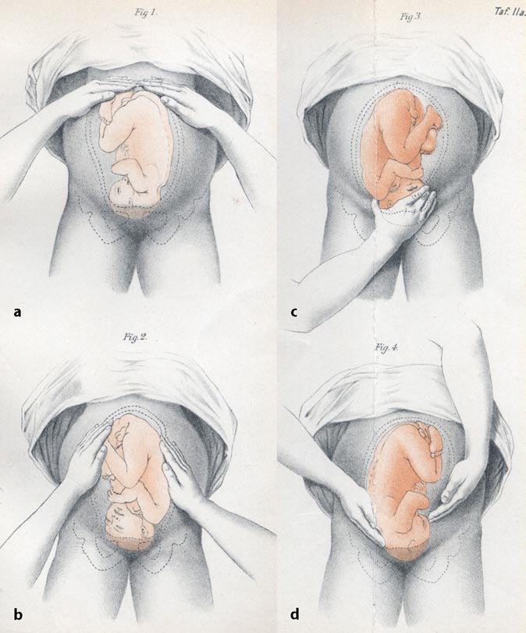
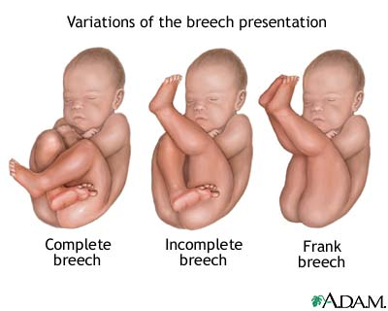

Slide 26
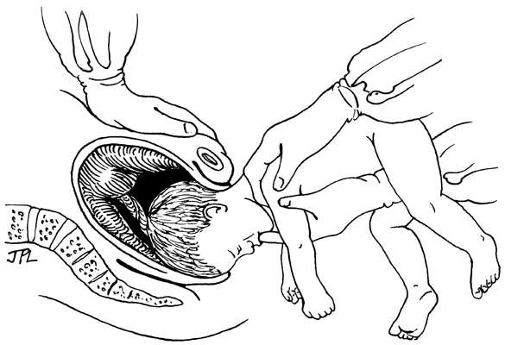
Mariceau-smellie-veit maneuver
Correct position of the hand on the cheek and not the mouth

Slide 27

Assisted Vaginal Delivery-Vacuum Extraction
Prerequisites: ≥ 36 weeks, cephalic, vertex, full cervical dilation, station 0, descent not more than 1/5, mother conscious & cooperative
Procedure:
  verbal informed consent, sterile gown and sterile gloves, test if equipment is working
  mother in semi-lithotomy, empty bladder, confirm full cervical dilation, identify posterior fontanel, identify sagittal suture, assess for episiotomy
  Place center of cup 2 cm anterior to the posterior fontanel/flexion point on the sagittal suture
  Stabilize the suction cup with two fingers
  Check and free maternal tissues
  Create vacuum of 0.2kg/sq.cm (yellow)
  To pull increase vacuum pressure to 0.8kg/sq.cm (green)
  Apply traction during uterine contraction only perpendicular to the cup
NOTE: When to abandon procedure/Complications/Documentation
Notes:
Abandon: a)Fetal head does not advance with each pull b) No descend to pelvic floor after 3 contractions/pulls c) Cup slips off the head 3 times at proper direction of pull with maximum negative pressure
Fetal –Cephalo-haematoma, localized scalp oedema scalp abrasions and lacerations Neonatal jaundice, Intracranial haemorrhage
Maternal – lower genital tract injuries

Slide 28
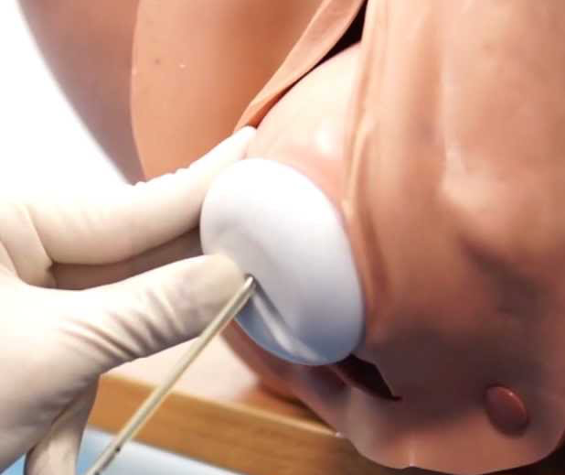
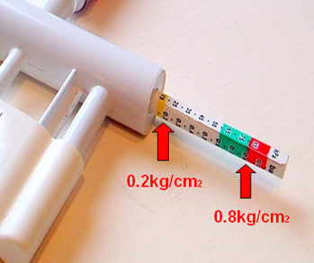

Slide 29

Shoulder Dystocia
Definition: need for additional obstetric maneuvers to effect delivery of fetal shoulders during vaginal delivery
Pathophysiology: impaction of anterior fetal shoulder on maternal pubic bone causes delay in delivery of the shoulder after head has been delivered
Risk Factors: Mainly due to increased fetal birth weight: Maternal: High BMI, Multiparity, Advanced Maternal Age, Diabetes, Postterm Pregnancy, Previous macrosomic infant, excessive weight gain in pregnancy, Maternal birth weight over 4000 g.
Warning Signs: -prolonged second stage, “turtling” (head retracts into perineum after delivery)
Management: goal → release anterior shoulder from entrapment, prevent fetal asphyxia and permanent Erb's palsy, Avoid physical injury (eg, bone fractures, maternal trauma).
HELPERR (pneumonic):
  Call for HELP-team
  Evaluate for EPISiOTOMY
  LEGS – McRoberts Manuver –knee chest position
  External PRESSURE (suprapubic)-to dislodge the anterior shoulder
  ENTER – Rotational manuvers, Wood’s Screw: push on posterior aspect of anterior shoulder and on anterior aspect of posterior shoulder and try to rotate shoulders to oblique, Reverse Wood’s Screw: push on anterior aspect of posterior shoulder and try to rotate shoulders to oblique
  REMOVE Posterior arm - grasp foetal elbow, not shoulder
  ROLL the patient to her hands and knee, Others: Replacement of fetal head, Abdominal Rescue, Intentional fracture of the clavicle
Complications: Maternal: PPH, cervical/vaginal lacerations, Fetal:clavicle/humerus fractures, brachial plexus injuries, birth asphyxia, death

Slide 30
Call for HELP
  Nursing, anesthesia, obstetric, and pediatric/neonatal
  Give instructions in a clear and calm manner to gravida and personnel
  No pushing while preparations are made and maneuvers are undertaken to reposition the fetus
  Position patient positioned with her buttocks flush with the edge of the bed to provide optimal access
  Empty bladder
Evaluate for EPISOTOMY
LEGS – McRoberts Maneuver
  Cephalad rotation of the symphysis pubisfrees the impacted shoulder and flattens lumbar lordosis/sacrum
  Relieves majority of cases
External PRESSURE (Rubin I, suprapubic presure)
  Pressure on the anterior shoulder downward and toward the baby's face or sternum
  Mechanism: Adducts or bring the shoulder into an oblique plane
  Performed in conjunction with McRoberts maneuver
  Useful in mild cases or impacted anterior shoulder

Slide 31
ENTER – Rotational maneuvers
Rubin II
  Hand on anterior shoulder and rotated towards the fetal face
  Mechanism: Adduction of the fetal shoulder so that the shoulders are displaced from the anteroposterior diameter of the inlet, allowing the posterior arm to enter the pelvis
Rubin II, and Woods screw maneuver
  Rotates the fetus by exerting pressure on the anterior, clavicular surface of the posterior shoulder to turn the fetus until the anterior shoulder emerges from behind the maternal symphysis
  Reverse Wood Screw
REMOVE posterior arm
  Posterior arm identified and pulled out of the vagina
  Brings the posterior shoulder into the pelvis and reduces the shoulder diameter by 2-3 cm

Slide 32
ROLL the patient to her hands and knees, Gaskin all- fours
  Places the mother on her hands and knees, OR racing start or ‘sprinter’ position NOT knee-chest position
  Delivery achieved by gentle downward traction on the posterior shoulder (the shoulder against the maternal sacrum) or upward traction on the anterior shoulder (the shoulder against the maternal symphysis)
Zavanelli maneuver: Tocolytics, rotate the head back to an occiput anterior position (reversal of restitution), Flex head, cesarean delivery

Slide 33
Abdominal rescue:
  A low transverse hysterotomy, transabdominal manual rotation of the anterior shoulder to the oblique diameter fetus delivered vaginally
Intentional clavicular fracture:
  shortens the biacromial diameter by pulling the anterior clavicle outward
Documentation:
  Clear and complete documentation including personnel

Slide 34
Pathophysiology
Normal:
  The fetal biacromial diameter enters the pelvis at an oblique angle with the posterior shoulder ahead of the anterior one, rotating to the anterior-posterior position at the pelvic outlet with external rotation of the fetal head.
  The anterior shoulder can then slide under the symphysis pubis for delivery
Abnormal/shoulder dystocia:
  The fetal shoulders remain in an anterior-posterior position during descent OR descend simultaneously rather than sequentially into the pelvic inlet
  THE anterior shoulder becomes impacted behind the symphysis pubis
  AND the sacral promontory may obstruct the posterior shoulder.

Slide 35
Maneuvers
LEGS – McRoberts Manuver
  Hyperflexion and abduction of the hips causing cephalad rotation of the symphysis pubis and flattening of the lumbar lordosis that frees the impacted shoulder
  Two assistants, each grasps a maternal leg and sharply flexes the thigh back against the abdomen
  Relieves shoulder dystocia via
    Marked cephalad rotation of the symphysis pubis and subsequent flattening of the sacrum, thus removing the sacral promontory as an obstruction site
    By bringing the pelvic inlet into the plane perpendicular to the maximum expulsive force, pushing efficiency improves significantly
  NO change in diameter, McRoberts maneuver does not change the actual dimensions of the maternal pelvis
External PRESSURE (suprapubic)
  An assistant applies pressure suprapubically with the palm or fist, directing the pressure on the anterior shoulder both downward (to below the pubic bone) and laterally (toward the baby's face or sternum)
  Performed in conjunction with McRoberts maneuver
  Adducts the shoulders or bring them into an oblique plane, the oblique diameter is the widest diameter of the maternal pelvis
  Useful in mild cases and those from impacted anterior shoulder

Slide 36
ENTER – Rotational maneuvers
REMOVE Posterior arm
  Introduce a hand into the vagina to locate the posterior shoulder and arm : If the fetal abdomen faces the maternal right, the operator's left hand should be used; if the fetal abdomen faces the maternal left, the right hand is used.
  The posterior arm should be identified and followed to the elbow. If the elbow is flexed, the operator can grasp the forearm and hand and pull out the arm. If it is extended, pressure is applied in the antecubital fossa. This flexes the elbow across the fetal chest and allows the forearm or hand to be grasped.
  The arm is then pulled out of the vagina, which brings the posterior shoulder into the pelvis and reduces the shoulder diameter by 2 to 3 cm
  If the anterior shoulder cannot be delivered at this point, the fetus can be rotated and the procedure repeated for the anterior (now posterior) arm.

Slide 37
Rubin maneuver
  Adducts fetal shoulder so that the shoulders are displaced from the anteroposterior diameter of the inlet, thereby allowing the posterior arm to enter the pelvis
  Requires adequate anesthesia
    One hand placed in the vagina and on the back surface of the posterior fetal shoulder, and then rotate it anteriorly (towards the fetal face). If the fetal spine is on the maternal left, the operator's right hand is used; the left hand is used if the fetal spine is on the maternal right
    Alternatively, hand placed on the back surface of the anterior fetal shoulder, if it is more accessible.
Woods screw maneuver
    Rotates the fetus by exerting pressure on the anterior, clavicular surface of the posterior fetal shoulder to turn the fetus until the anterior shoulder emerges from behind the maternal symphysis
    If the fetal spine is on the maternal left, the operator uses the left hand to push on the clavicle of the posterior arm and rotate the baby 180 degrees in a counterclockwise direction

Slide 38
ROLL the patient to her hands and knees, Gaskin all-fours
  Places the mother on her hands and knees, OR racing start or ‘sprinter’ position NOT knee-chest position
  Delivery achieved by gentle downward traction on the posterior shoulder (the shoulder against the maternal sacrum) or upward traction on the anterior shoulder (the shoulder against the maternal symphysis)
Zavanelli/Gunn-Zavanelli-O'Leary maneuver
Replacement of the fetal head in the pelvis, then cesarean delivery
  Administer tocolytic eg terbutaline (0.25 mg SC/nifedipine/nitroglycerin)
  Rotate the head back to an occiput anterior position (reversal of restitution)
  Flex head from its extended position and push it as far cephalad as possible using firm pressure with palm of one hand.
  The other hand may be used to depress the perineum
  Proceed with cesarean delivery.

Slide 39
Rotation of posterior shoulder-Wood screw

Slide 40
Manual removal of posterior shoulder
Gaskin

Slide 41
Rubin
Zavanelli

Slide 42
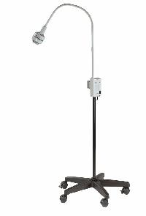
Sterile Speculum Examination
Review indications-e.g. preterm premature rupture of fetal membranes
Thoroughly explain the procedure to the patient
Sterile gloving
Report findings on inspection of external genitalia
Swabs vulva -5 swab technique
Application of sterile towels
Lubricates speculum
Separates the labia and exposes introitus with non non-dominant hand and introduces lubricated speculum with dominant hand
Position speculum to asses cervix
Report on status of vaginal walls, Cervix (dilatation, position, defects, inflammation)
May report on cord, colour of liquor, pooling on valsalva , any other discharge/blood

Slide 43
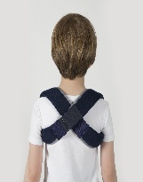
Digital Vaginal Examination
Thoroughly explain the procedure to the patient
Assess the patient between contractions when most relaxed
Sterile technique: 5 sterile gloves, lubricates the first two fingers of the dominant hand
Use the non‐dominant hand to spread the labia minora and the dominant hand to assess the cervix
Assess cervical dilation, effacement, consistency, position
Identify the presenting part, palpate for fontanelles and sutures
Rule out common malpresentations: breech, shoulder, brow, face, compound
Assess for the presence of a prolapsed umbilical cord
Dispose the contaminated equipment
Document on a partograph
Institute appropriate management

Slide 44

PPH Evaluation and Management
Establish Diagnosis, Primary, Secondary, Determine cause from the 4Ts
Call for HELP, PPH BOX
Resuscitation-2 large-bore IV needles, Oxygen by mask, Monitor VS & Urine output, samples CBC/GXM/UEC/Coagulation profile
Empty bladder
Uterine massage
Repeat uterotonics (Oxytocin i/m or ergometrine-if no contraindication)
Infuse oxytocin 40 units in 1 litre to run at 60 drops per minute
Inspect placenta for completeness
Inspect vulva, vagina for tears
Administer misoprostol 600 mcg PO, tranexamic 1 gram IV slow
Aortic compression
Bimanual uterine compression
Once bleeding controlled and all observations normal, observe every 15 mins until stable
Others: Balloon tamponade, B- Lynch, Ligation of Uterine vessels /Internal iliac artery/hysterectomy/UAE

Slide 45
THE CONDOM TAMPONADE
UTERUS
Water/NS
Inflate Condom with water till no further bleeding is occuring (usually about 300-500 mls )
syringe
Condom
Giving set
OR
String
Foleys Catheter
Clean
water
Apply clamp to keep water within
Condom after inflation

Slide 46
Steps
1. Place condom over balloon end of Foleys catheter 2. Tie lower end of condom snugly below level of the balloon using suture / string. Tie should be tight enough to prevent leakage of water but should not strangulate catheter and prevent inflow of water into condom. Check for leakage by inflating ballon with about 20cc water. 3. Aseptically place the condom end high into uterine cavity by digital manipulation or with aid of speculum and forceps 4. Inflate CT by connecting open/outlet end of catheter to giving set connected to infusion bag or use clean water with aid of large syringe. (cut the giving set at level of rubber to enable it fit into catheter) | Inflate condom with water or saline to about 300- 500 mls (or to amount at which no further bleeding is observed). Clamp catheter when desired volume is achieved and bleeding is controlled. Maintain In-situ for 24 hours if bleeding controlled and patient is stable. Give Broad spectrum antibiotic cover 9. Monitor patient closely, resuscitate and/or treat complications e.g. shock, coagulopathy

Slide 47
10. When patient is stable (after 24 hours) slowly deflate condom by letting out 50 mls of water/saline every hour. 11. Re-inflate to previous level if bleeding reoccurs whilst deflating. 13. If Bleeding is not controlled within 15 mins of initial insertion of CT abandon procedure and seek surgical intervention immediately.

Slide 48
Steps
1. Place condom over balloon end of Foleys catheter 2. Tie lower end of condom snugly below level of the balloon using suture / string. Tie should be tight enough to prevent leakage of water but should not strangulate catheter and prevent inflow of water into condom. Check for leakage by inflating ballon with about 20cc water. 3. Aseptically place the condom end high into uterine cavity by digital manipulation or with aid of speculum and forceps 4. Inflate CT by connecting open/outlet end of catheter to giving set connected to infusion bag or use clean water with aid of large syringe. (cut the giving set at level of rubber to enable it fit into catheter) | Inflate condom with water or saline to about 300- 500 mls (or to amount at which no further bleeding is observed). Clamp catheter when desired volume is achieved and bleeding is controlled. Maintain In-situ for 24 hours if bleeding controlled and patient is stable. Give Broad spectrum antibiotic cover 9. Monitor patient closely, resuscitate and/or treat complications e.g. shock, coagulopathy

Slide 49
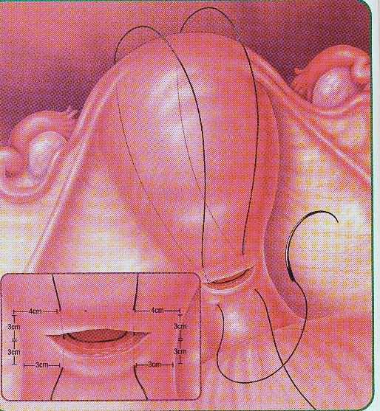
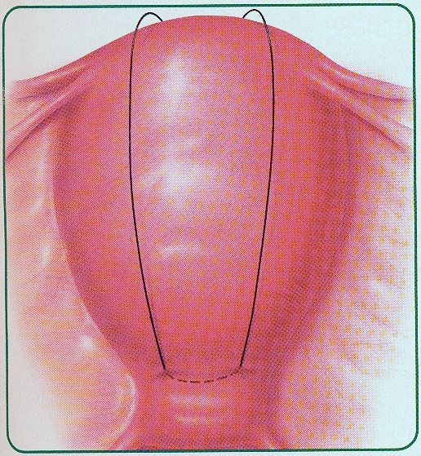
The B-Lynch Suture
Step 1: Using Absorbale large suture.
In-out-over…In-out-over…In-out-tie
B-Lynch Suture #2
Courtesy: Lynch BC, Coker A, Laval AH et al. The B_Lynch technique for control of Masive PPH,
An Alternative to Hysterectomy. Five Cases Reported. Br. J. Obstet Gynecol 1997, 104 327-376

Slide 50
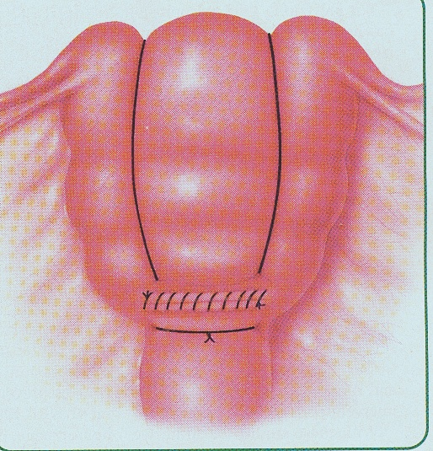
B-Lynch Suture #3

Slide 51

Perineal Tear & Episiotomy Repair
Episiotomy
  is a surgical incision of the perineum performed to widen the vaginal opening to facilitate the delivery of an infant
  May be associated with increased risk of extension to severe perineal lacerations, dyspareunia, and future pelvic floor dysfunction: Types: Midline and mediolateral
Tears
  Are spontaneous perineal lacerations arising from perineal trauma at delivery. Degrees 1-4
Repair in layers
Postoperative care
  pain control, perineal hygiene, sitz baths

Slide 52
Perineal Tear & Episiotomy Repair

Slide 53
Technique
Place an anchor stitch above the wound apex
  Close the vaginal mucosa and submucosa with continuous interlocking stitches to close the vaginal incision and reapproximate the cut margins of the hymenal ring using an absorbable 2–0 or 3–0 suture
Close the fascia and muscles to restore the perineal body using a continuous absorbable 2–0 or 3–0 suture
Carry the continuous suture upward as a subcuticular stitch
Tie the final knot proximal to the hymenal ring.

Slide 54
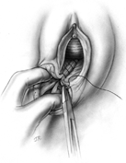

Slide 55
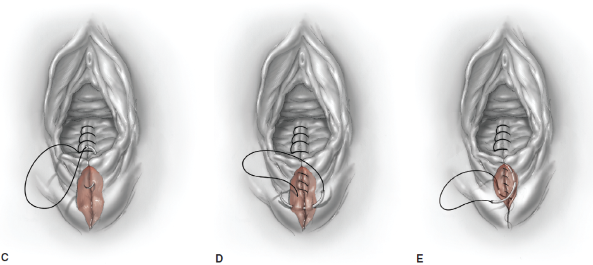

Slide 56
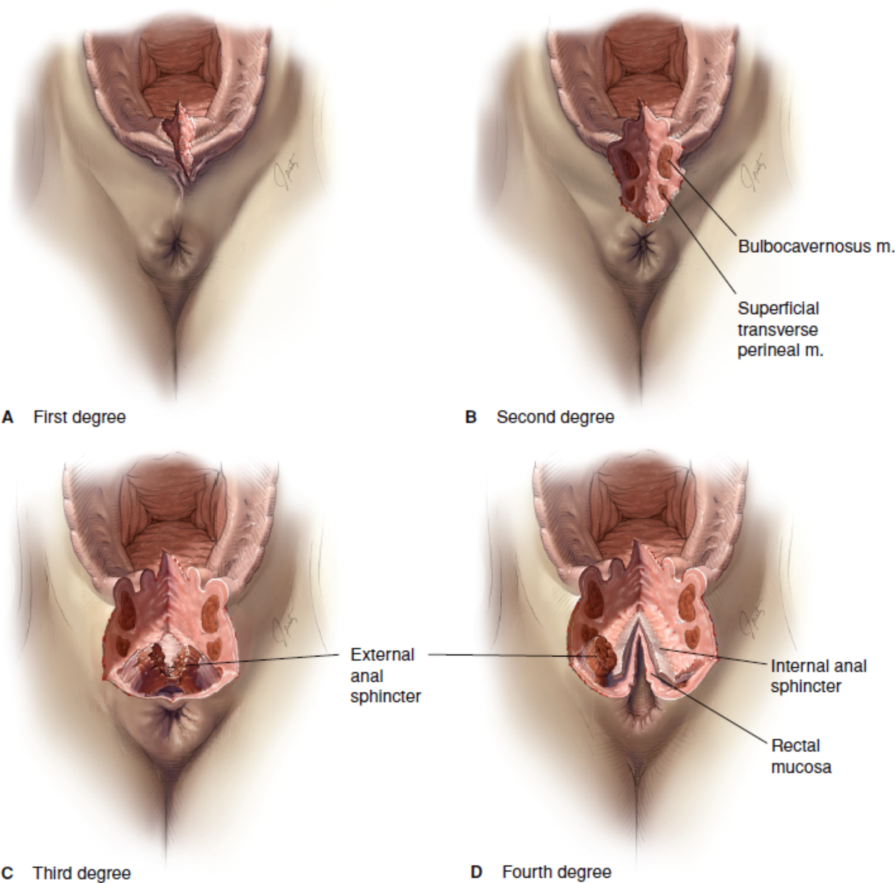
Perineal lacerations/tears
A. First-degree: involve the fourchette, perineal skin, and vaginal mucous membrane but not the underlying fascia and muscle.
B. Second-degree : in addition, the fascia and muscles of the perineal body but not the anal sphincter.
C. Third-degree: extend farther to involve the external anal sphincter.
D. Fourth-degree: extend completely through the rectal mucosa to expose its lumen and thus involves disruption of both the external and internal anal sphincters

Slide 57
Obs OSCE dry Run (Five minutes)
SCENARIO
  You are provided with a model and equipment. (pelvic model and a Kiwi vacuum extractor)
Question
  Using the model provided, demonstrate the correct placement of the cup
End

Slide 58

Questions?
Notes:
58

Slide 59

10 Gynecology skill stations

Slide 60

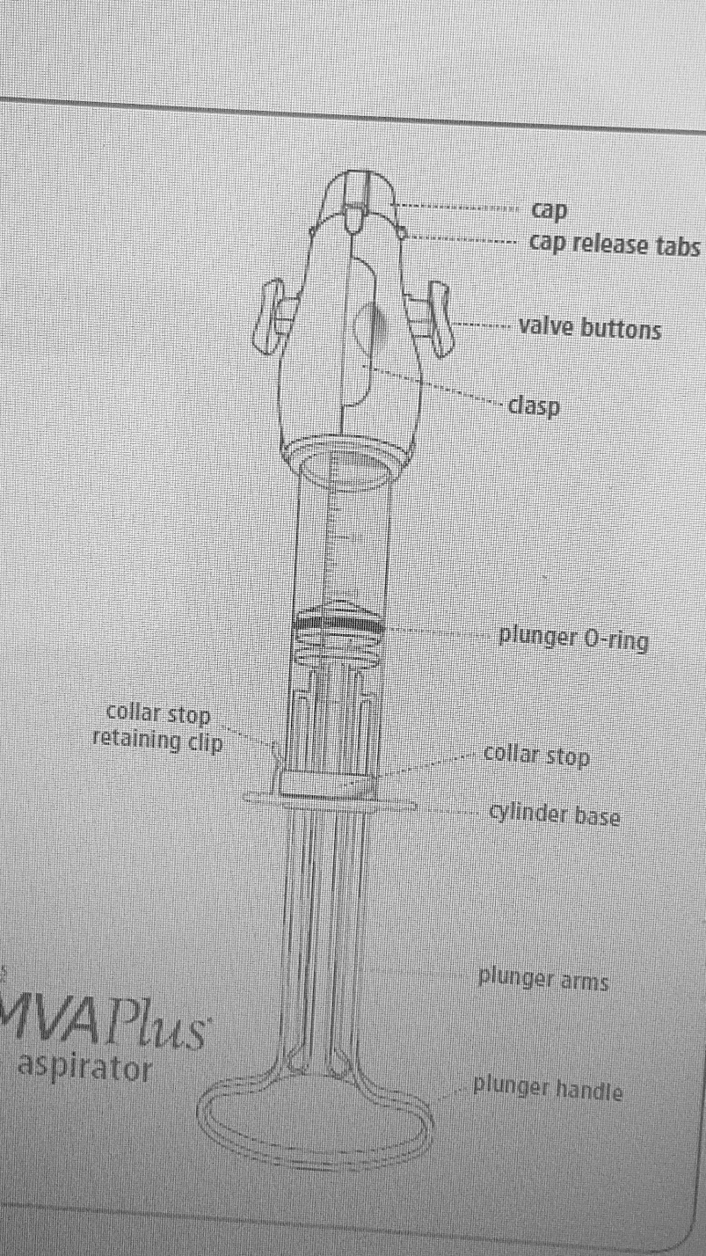
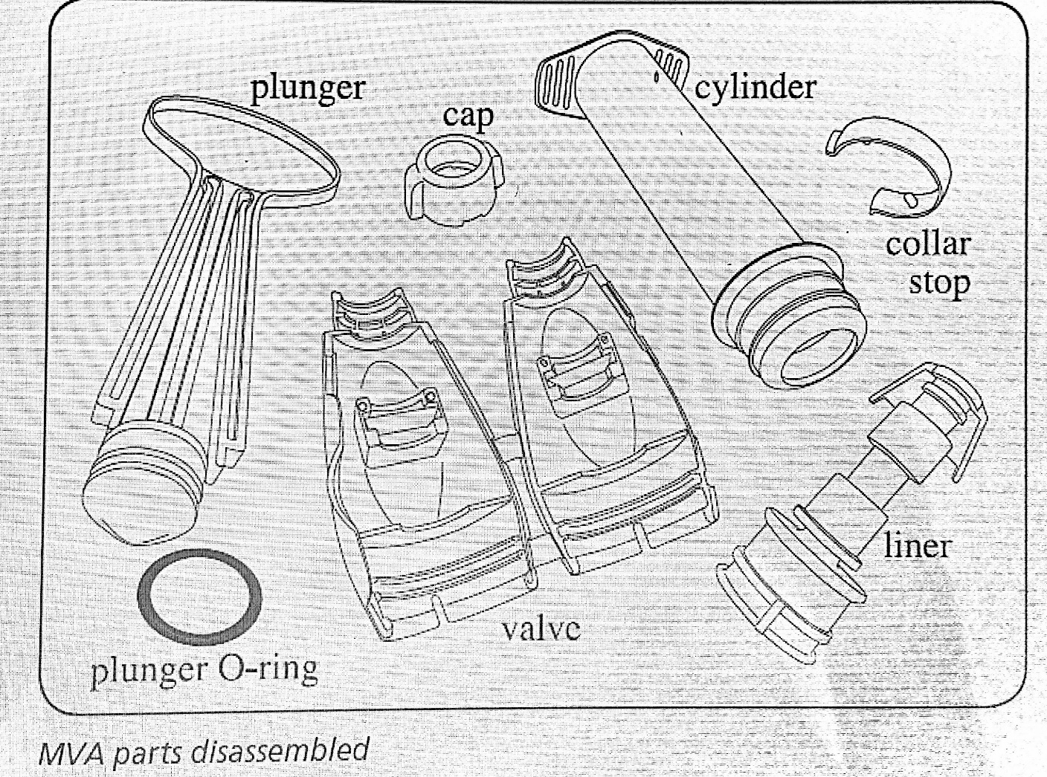
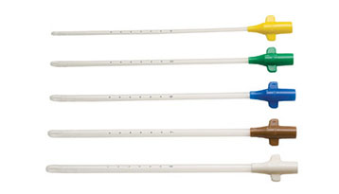
Manual Vacuum aspiration- MVA Kit
MVA parts assembled
MVA-KIT
Plunger
O-rings
Cap
Valve set
Cylinder
Liner
Collar stop
Cannula
Cannula
MVA parts disassembled

Slide 61
Manual Vacuum aspiration –Procedure
Prepare aspirator/ requirements
  Aspirator:
    Position the plunger into the cylinder
    Put collar stop in place with tabs in the cylinder holes
    Push valve buttons down and forward until they lock
    Create vacuum-pull plunger back until arms snap outward and catch on cylinder base
  Other requirements
    Drapes, antiseptic
    Sterile gauze
    Ovum/sponge holding forceps
    Tenaculum
    Dilators
    Kidney dish
    Infection prevention supplies: sharps container, buckets,
    Large bore IV cannula
    Specimen bottles
    Cervical block requirements: 1% lidocaine, paracervical needle (or gauge 21 green needle), 10ml syringe
    Gyn bed
    Light source
    Resuscitation tray
    Sanitary pads
    Contraceptive methods
Prepare patient
    Counsel for procedure
    Confirm gestation <12 weeks
    Confirm diagnosis of incomplete abortion
    IM diclofenac 75 mg start 30 minutes before the proceedure
    Prophylactic antibiotics or for treatment if indicated
    Empty bladder
    Fix large bore intravenous cannula and assess for IVF or blood
    Chaperon needed
  General and abdominal exam
  Position patient in lithotomy position, clean &drape
  Sterile pelvic and bimanual exam

Slide 62
Manual Vacuum aspiration –Procedure
Insert speculum, visualize the cervical os & check for signs of infection
Remove any visible products of conception with ovum forceps
Attach tenaculum, at 12 o'clock to steady the cervix and straighten the canal.
  Spray 0.5 cc of lidnocain and inject 1% lidocaine before applying the tenaculum at 12 o’clock
Para cervical block: 1% lidocain at 8, 10, 2 and 4 o'clock. Avoid 3 and 9 o'clock –blood vessels
  Inject 2-3 ml at each point just below mucus membrane slowly with aspiration to avoid intravascular injection
Applying traction to tenaculum insert the correct size of cannula, dilate if necessary to allow insertion of cannula. Do not insert cannula forcefully
Insert cannula to fundus
Create vacuum with syringe
Suction uterine contents by releasing vacuum and by gently and slowly rotating the cannula 180° in each direction, using an in-and-out motion
Expel syringe contents into dish to inspect tissue and measure amount
Continue curettage until uterus feels empty: red/pink foaming, gritty feeling, uterus contracts
Remove tenaculum, cannula and speculum
Reposition patient, reassess for shock
Counsel and offer contraception
Take specimen for histology if spontaneous, optional for induced and if the patient does not consent
Process instruments observing infection prevention principals

Slide 63

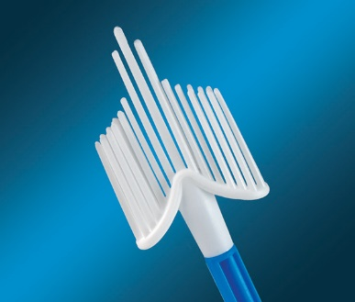
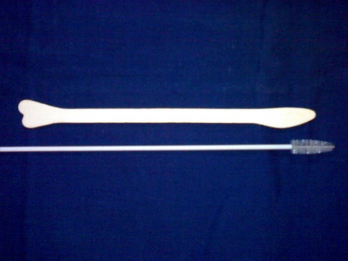
Pap smear collection-procedure
Prepare requirements
  Examining light
  Bivalve speculum
  Endocervical broom or Ayre spatula/ endocervical brush
  Glass slide
  Fixation solution
  Pathology request form
Prepare patient
  Counsel for procedure
  LMP
  Empty bladder
  Ask patient to lie on couch in lithotomy position
  Chaperon needed
Introduce the speculum and expose the cervical os
Obtaining cells from the squamo-columnar junction of the cervical os
  For endocervical broom, the central bristles are inserted into the endocervix while the outer will be in contact with the ectocervix. Rotate the broom in the same direction for five times
  For spatula and endocervical brush , start with the spatula to scrape the ectocervix, rotate the spatula 360⁰ once. Then insert the endocervical brush into the endocervix so that the bristles nearest the examiner are inserted to the level of the external cervical os, rotate the brush 180 degrees
  Spatula followed by brush minimizes blood in the sample
Quickly spread the scrapings evenly on the glass slide and fix by dropping, a drop of the fixative solution or spray evenly allow to air dry
  Speed is key to prevent drying of cells
Discard spatula/brush in waste bin
Remove speculum and reposition patient
Complete pathology form for Pap smear cytology
Counsel and offer contraception
Thank client
Give return date for cytology result
Endocervical broom
Spatula and endocervical brush

Slide 64
POSSIBLE PAP SMEAR CYTOLOGY RESULT AND ACTION
THE BETHESDA SYSTEM-RESULT | ACTION
Normal | Repeat yearly for 3 years, then 5 yearly For HIV + annual screens
Low grade squamous intraepithelial lesion (LSIL) | Repeat Pap smear in 6 months
High grade squamous intraepithelial lesion (HSIL) Recurrent LSIL Atypical squamous cells of undetermined significance (ASC-US) Atypical squamous cells – cannot exclude HSIL (ASC-H) Atypical glandular cells of undetermined significance (AGUS) Carcinoma in situ | Colposcopy biopsy followed by possible cervical excision procedure by LEEP or cold knife cone
? Invasive cancer | Investigations to confirm diagnosis
Please Note: CIN classification is for cervical histology NOT cytology

Slide 65

Visual inspection with acetic acid and lugols iodine (VIA/VILI)
Prepare requirements
  Examining light
  Instrument tray/surface
  2 gallipots
  3-5% acetic acid
  Lugols iodine in tightly stoppered brown bottle – light destroys lugols
  Cotton swabs mounted in an applicator sticks
  Bivalve speculum
  K-Y gel
  Clean gloves
  Infection prevention: Bucket with 0.5% chlorine solution and container lined with plastic bag
  Documentation form
Prepare patient
  Counsel for procedure
  LMP
  Empty bladder
  Change to examination gown
  Ask patient to lie on couch in lithotomy position
  Chaperon needed
Apply K-y gel to the speculum, introduce to the vagina gently to expose the cervical os
Start by doing the VIA procedure
  Apply 3-5% acetic acid liberally
  Wait for 1-3 minutes and interpret the result (review cervicograms)
    VIA Negative (Pink)
    VIA Positive (Acetowhite) - acetic acid coagulates protein in abnormal cells, making them opaque
    Suspicious for cancer
Followed by the VILI procedures
  Use a fresh lugols iodine for each patient-light destroys lugols
  Apply lugols iodine liberally
  Interpret the result (review cervicograms)
    VILI Negative (Mahogany black): Normal cell have glycogen that stain black with lugols
    VILI Positive (Banana Yellow) – abnormal cell have no glycogen hence does not stain with lugols
    Suspicious for cancer
Remove the speculum gently
Reposition patient make her comfortable
Counsel the client on the result
The following are the actions for each result
  Normal: repeat after 3-5 years, yearly for HIV positive
  Positive: Cryotherapy or colposcopy
  Suspicious for cancer: Investigate for invasive cancer
Counsel and offer contraception
Thank client
Give a return date

Slide 66
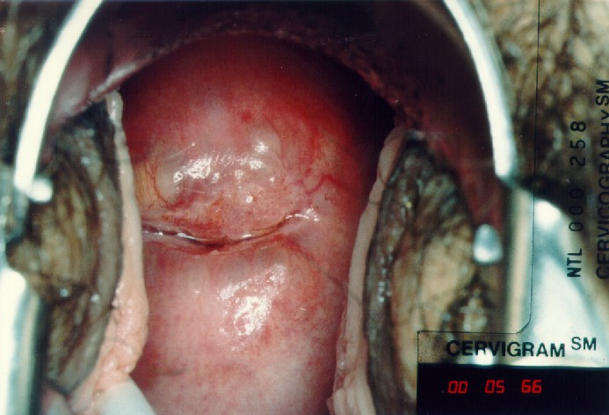
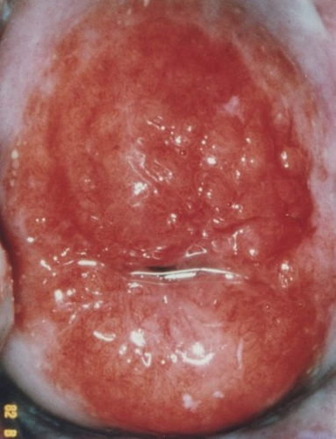
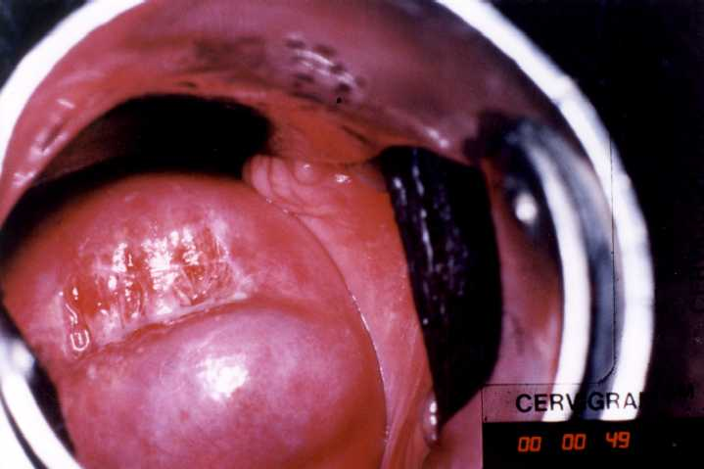
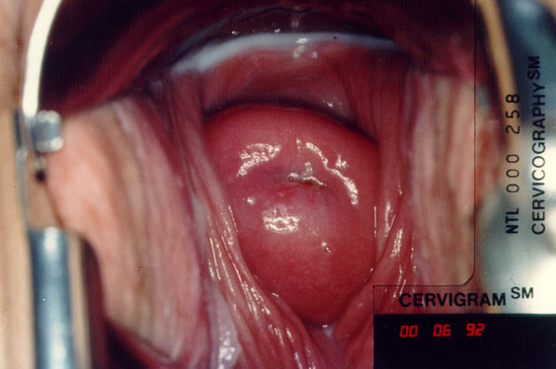
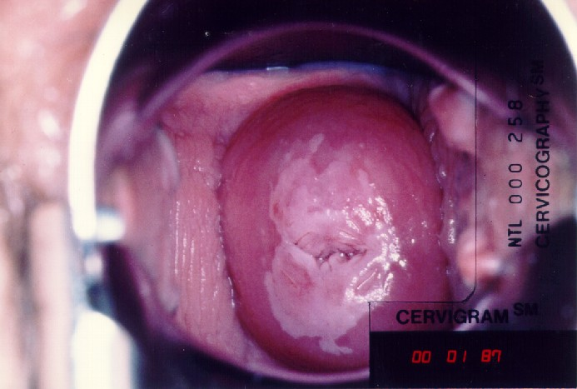
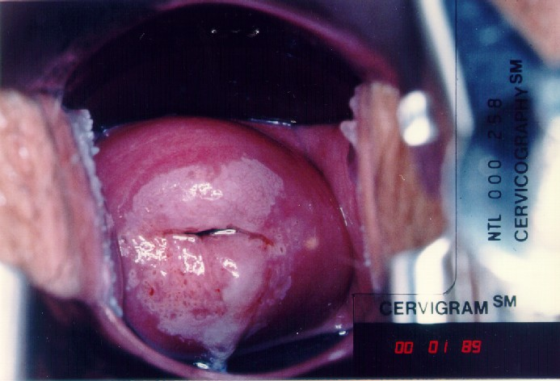
VIA Negative- Parous Os
VIA Negative-Nabothian Cyst
VIA Negative-Ectopy
VIA Negative- Nulliparous Os
VIA Positive
VIA Positive

Slide 67
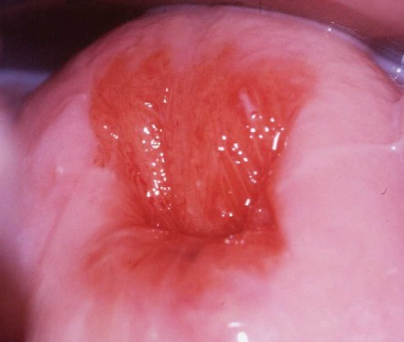
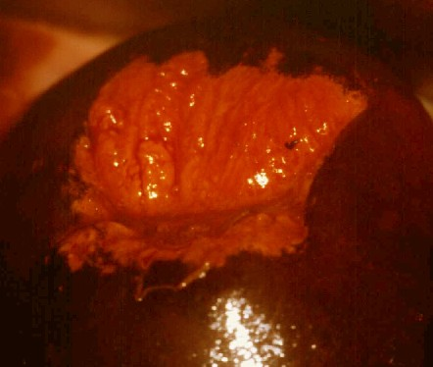
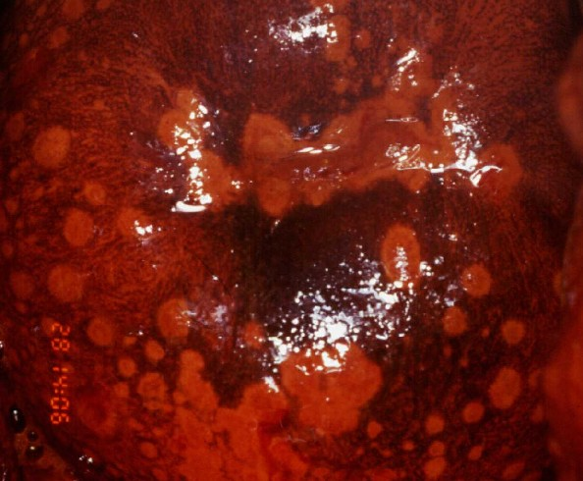
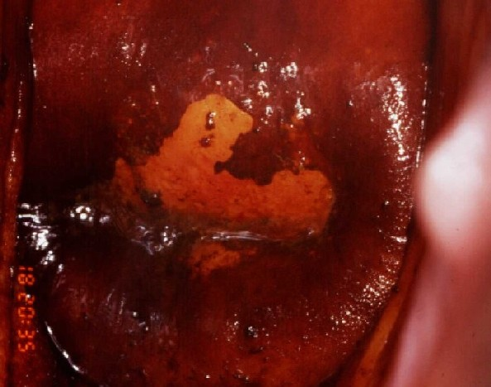
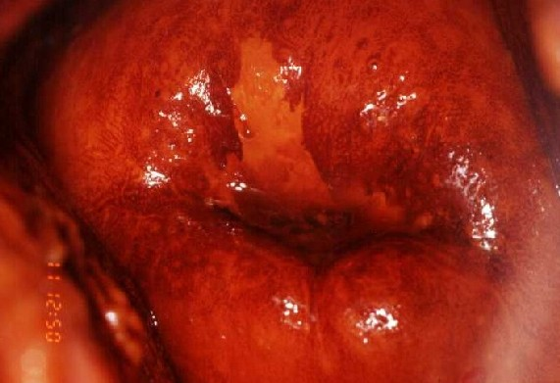
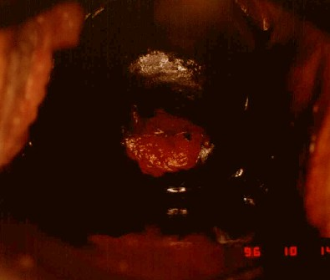
Normal cervix-ectopy
After lugols- VILI Negative-ectopy
VILI Negative – cervicitis (leopard skin)
VILI Negative-columnar epithelium has no gycogen
VILI Positive
VILI Positive

Slide 68
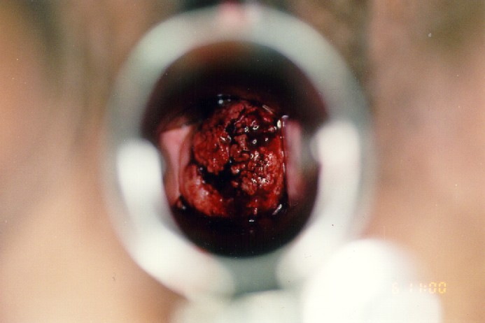
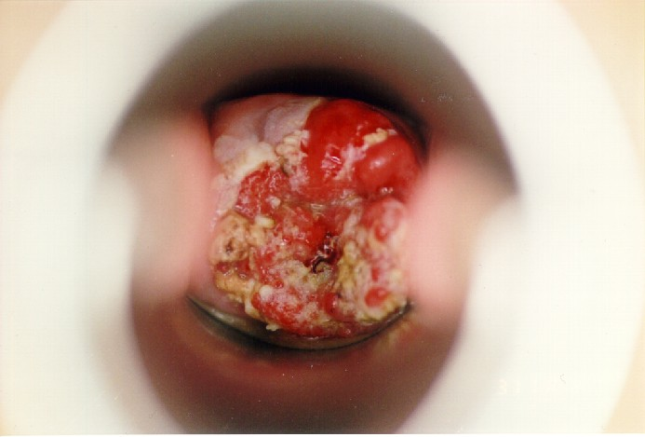
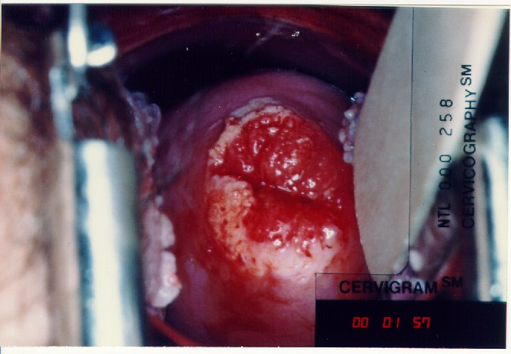
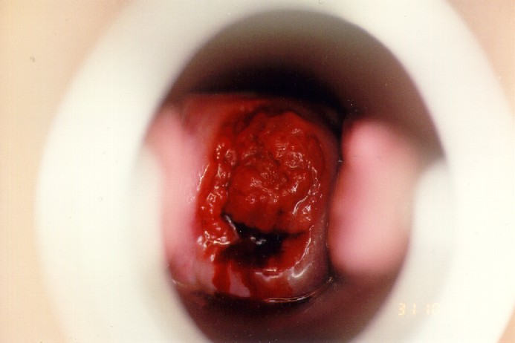
Suspicious for Cancer

Slide 69
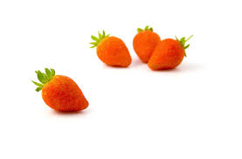
Counselling for Abnormal Cervical Screen Result
Greet patient, introduce self, sit squarely, open posture, leans forward, eye contact, relax and explain the following to the patient in lay language
Cancer of the cervix is caused by HPV
Cancer of the cervix is presided by a pre-cancer stage, with cell abnormalities. Counselling depends on test
Pap smear results is reported as normal, mild cell abnormalities (LSIL), severe cell abnormalities (HSIL, ASCUS, ASC-H, AGUS) or suspicion for invasive cancer
  Normal results means there were no abnormal cells seen
  Mild and severe cell abnormalities are precancerous stages and not cancer
  Suspicious for invasive cancer means cancer of the cervix is likely
  If normal another Pap smear test will be done after 1 year for 3 years, if all 3 will be normal then Pap smear will be done after 5 years
  If mild cell abnormalities, a repeat Pap smear will be done after 6 months
  If severe cell abnormalities treatment will be offered: i) excision of abnormal cells (LEEP or Cold knife cone) or ii) simple hysterectomy. Counselling on the two options will be done to enable you make a choice
  If suspicious for invasive cancer more diagnostic test will be performed to confirm diagnosis
  Allow patient to ask questions
  Thank patient for their time
VIA/VILI results is reported as negative, positive and suspicious for invasive cancer
Normal means there are no abnormal cells
A positive result is a precancerous stage and not cancer
  Suspicious for cancer means cancer of the cervix is likely
If normal a repeat VIA/VILI will be done in 3-5 years
For positive result treatment can be done by freezing the abnormal cell (cryotherapy) or doing colposcopy biopsy (using a microscope to visualize abnormal cells and take small tissue for investigations), if biopsy shows abnormal cells treatment will be offered depending on result
  If suspicious for cancer more diagnostic test will be performed to confirm diagnosis
  Allow patient to ask questions
  Thank patient for their time

Slide 70

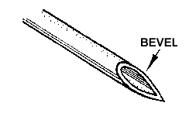
Implant insertion- Jadelle levonorgestrel subdermal implant
UP
Prepare requirements: Table for the patient to lie on and rest for her arm, Sterile drape with fenestration and sterile tray for the equipment, Sterile gloves, Sterile Gauze, Antiseptic solution for the skin, Local anaesthetic -1% lidocaine, Needle gauge 21 and 5 ml syringe, Jadelle, diposable trocar and cannula , Elastoplast
Prepare patient: Counsel client for the method, Explain the procedure, Explain that the implant will be inserted in the less dominant arm , Ask client to lie on her back so that implant arm is turned outwards and bent at the elbow and is well supported, insertion area is in the inner aspect of the upper arm, between the muscles, about 6–8 cm above the fold in the elbow (measure using your four palm fingers- to be demonstrated)
Prepare clean instrument tray, open sterile instrument pack, open jadelle pouch and drop the rods
Wear sterile gloves, clean the insertion area and drape aseptically
Infiltrate the local anesthetic under the skin slowly withdrawing to avoid intravascular infiltration. Start by infiltrating the needle entry point to form a small wheal
Introduce the trocar under the skin up to the 1st mark with bevel facing up
Advance the trocar horizontally under the skin (subdermally) until the 2nd mark
Remove cannula
Insert 1st rod into the trocar and load it with the cannula by holding the cannula steady and pulling the trocar out up to the level of the 1st mark on the cannula
Repeat above and insert 2nd rod in a narrow V shape
Remove trocar and cannula
Press edges of insertion together and dress with Elastoplast and compress with wrap gauze
Check the two rods by cautious palpation, ask the patient to palpate too
Answer any questions the client may have, give a return date and thank them

Slide 71

Implant removal- Jadelle
Push each implant with your fingers gently towards the incision. When the tip is visible in the incision, grasp it with the curved mosquito forceps. Use a scalpel to very gently open the tissue capsule around the implant.
Grasp the end of the implant with the second straight forceps
Remove the implant gently
Repeat the procedure for the second implant
Measure the length of the removed implants- the length should be 43 mm
After the procedure is completed, close the incision and bandage it as after insertion
Show the patient the implants
Offer another contraceptive if needed, if jadell reinsert into the same location
The arm should be kept dry for about 3 days
Answer any questions the client may have, give a return date and thank them
Prepare requirements: Table for the patient to lie on and rest for her arm, Sterile drape with fenestration and sterile tray for the equipment, Sterile gloves, Sterile Gauze, Antiseptic solution for the skin, Local anaesthetic -1% lidocaine, Needle and 5 ml syringe, 2 mosquito forceps-curved and straight, scalpel 22 mm Elastoplast
Prepare patient: counsel on removal, find out if needs the same method or another method or desires to get pregnant, ask client to lie on her back so that implant arm is turned outwards and bent at the elbow and locate the implants
Prepare clean instrument tray, open sterile instrument pack
Wear sterile gloves, clean the insertion area and drape aseptically
Infiltrate the local anesthetic under the implants
Make a 4-mm incision with the scalpel close to the ends of the implants. Keep the incision small.

Slide 72

IUCD Insertion
Remove the loaded IUCD from the package, keeping it level
Insert IUD to the uterine cavity:
  Gently grasp the tenaculum (still in place from sounding the uterus) and apply gentle traction
  Insert the loaded IUCD, without touching vaginal walls or speculum blades, keeping the horizontal plane
  Gently advance the loaded IUCD into the uterine cavity
  STOP when the depth-gauge comes in contact with the cervix or light resistance is felt
  Hold the tenaculum and white plunger rod stationary, while partially withdrawing the insertion tube - this releases the arms of the IUCD
  Gently push the insertion tube until you feel a slight resistance - this step ensures placement high in the uterus
  Remove the white plunger rod, while holding the insertion tube stationary
  Gently and slowly withdraw the inserter tube from the cervical canal until strings can be seen protruding from the cervical opening
  Use sharp Mayo scissors to cut the IUCD strings at 3–4 cm from the cervical opening
  Completely withdraw insertion tube with cut ends of strings inside
Gently remove the tenaculum
Observe the cervix for bleeding and remove speculum
Reposition patient and make her comfortable
Counsel woman on checking of strings, complications and give return date
Thank her for her time
Prepare requirements: examining light, copper T IUCD, bivalve speculum, tenaculum, uterine sound, sponge holding forceps, scissors, sterile gauze, sterile gloves, sterile drapes, K-Y gel and antiseptic solution
Prepare patient: counsel for the procedure, LMP, empty bladder, lithotomy position, chaperon needed
Conduct bimanual and speculum pelvic examination to: Screen for eligibility and determine the position of the uterus, rule out infection
Sound the uterus:
  Clean the cervix with an antiseptic solution
  Apply a tenaculum to the cervix at 12 o'clock
  Gently pull the tenaculum to align the uterus and cervical opening
  Insert the uterine sound into the cervical opening
  Advance the sound into the uterine cavity until a slight resistance is felt, mark length with sponge holding forceps
  Slowly withdraw the sound and assess the uterine length
Load the IUCD:
  Load the IUCD by folding its arms and placing them inside the insertion tube
  Set the depth-gauge to reflect the uterine length as measured by the uterine sound
  Align the depth-gauge and the folded arms of the T so that they are both in a horizontal plane

Slide 73

IUCD Removal
Prepare requirements: examining light, bivalve speculum, sponge holding forceps, sterile gauze, sterile gloves, sterile drapes, K-Y gel and antiseptic solution
Prepare patient: counsel for the procedure, LMP, empty bladder, lithotomy position, chaperon needed
Conduct bimanual pelvic exam
Insert the speculum : Look for the length and position of strings
Swab cervix and vagina with antiseptic
Grasp strings close to the cervix and pull gently but firmly to remove IUCD
Refer difficult removals
Insert a new IUD immediately following removal (if desired) or offer another method
Remove speculum
Reposition patient
Thank the patient

Slide 74

7a
Gowning:
First covering of sterile gown opened by circulating nurse
Surgical gowns are folded with the inside facing the scrub person
Pick up gown without touching the outside surface with one hand
Unfold the gown. Hold the gown away from you, at chest level to facilitate safe handling without break in asepsis
Grasp the inside shoulder seams and open the gown with the armholes facing you
Slide your arms part way in to the sleeves of the gown, keeping your hands at shoulder level away from the body
Hold your hands high so gown does not touch the floor
When the fingertips are even with the proximal edge of the cuff, grasp the inside seam at the juncture of gown sleeve and cuff using your thumb and index finger.
Be careful that no part of your hand protrudes from the sleeve cuff
Circulating nurse will help secure the gown
Proceed with sterile gloving
Sterile Gloving:
After gowning, carefully open the sterile glove wrapper
Remove one glove from wrapper by lifting it with one hand without the inside of the glove wrapper
Hold the glove by the folded back cuff and slip the hand into the glove, using a smooth upward motion
Pick the other glove with the sterile gloved hand
Slip fingers of the gloved hand under the cuff of the sterile glove and adjust the glove to fit without touching skin with gloved hand
Adjust gloves as necessary by slipping gloved fingers under the sterile fold of the cuff to slide up
(check next page)
Scrubbing:
Wear surgical cap and mask (eye protection optional)
Put on disposable plastic apron
Turn on water and get antiseptic
Lather hands and arms with scrubbing solution, keeping hands up, wash both palms, between fingers, each finger separately, back of hands X 3
Close tap using elbow
Dry hands and arms: pick sterile towel, unfold towel, place 1/3 over right hand and 2/3 will be hanging toward left hand then dry left hand and arm. Transfer dry end of towel to left hand, place 1/3 over left hand and 2/3 toward right hand then dry right hand and arm
Drop towel to collecting bin

Slide 75
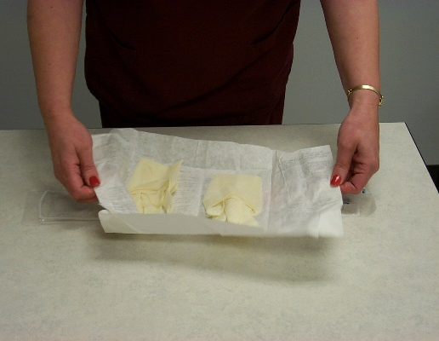
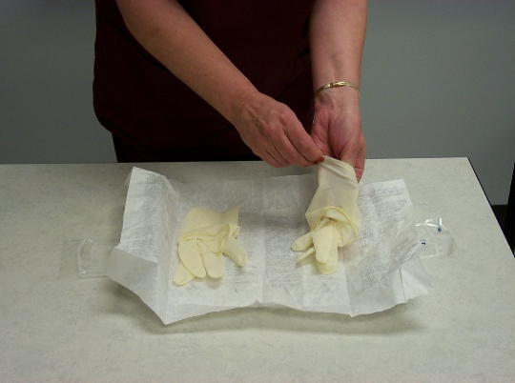
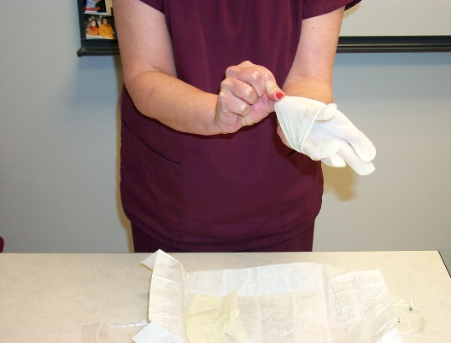
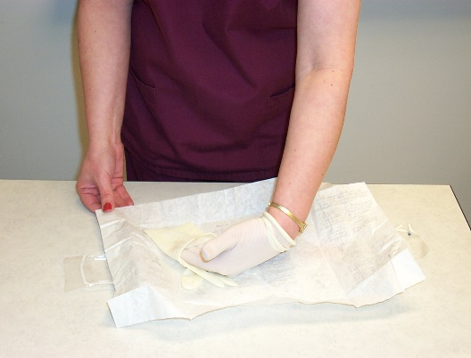
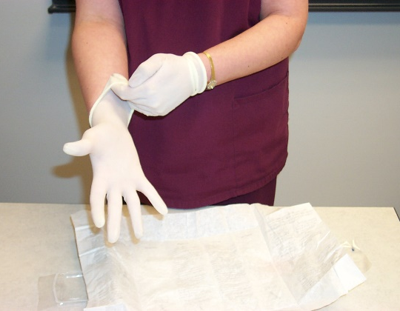
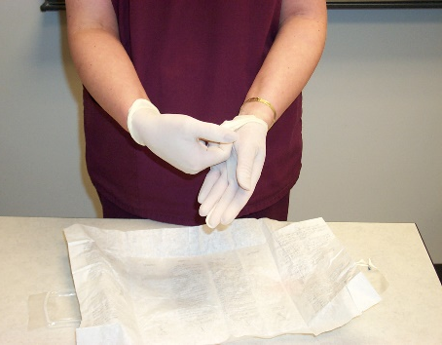
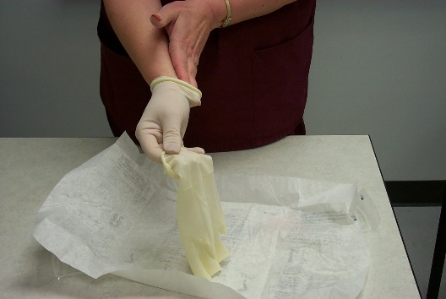
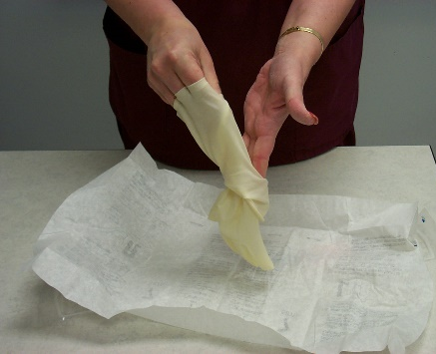
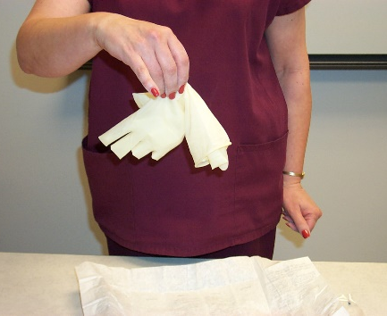
Sterile gloving
1
2
3
4
5
Technique of removing gloves
Insert fingers of one gloved hand under the cuff of the other glove and roll glove off the hand. (glove to glove technique
Insert fingers of the bare hand between the cuff of the glove and the wrist to roll glove off hand. (skin to skin technique)
Touch only the inside of the gloves during removal
1
2
3
4

Slide 76

7b: Abdominal Draping
Depends on the incision site
Scrub the abdomen commencing from your incision site work your way outwards with a semi-arc manner
  Antiseptic solution X 3
  Dry Swab
  Povidon iodine x 1
Place a plastic drape from the pubic symphysis to the thighs
Four small towels:
  1st is placed from the pubic symphysis to the thighs
  2nd is placed from the xiphysternum upwards to cever chest
  3rd and 4th placed loin area outwards
  Place 4 towel clips to secure
Place the half sheet on top of the first small towel to cover to the foot of the operating table
Place the laparotomy sheet (full sheet) with the fenestration at the intended incision site

Slide 77

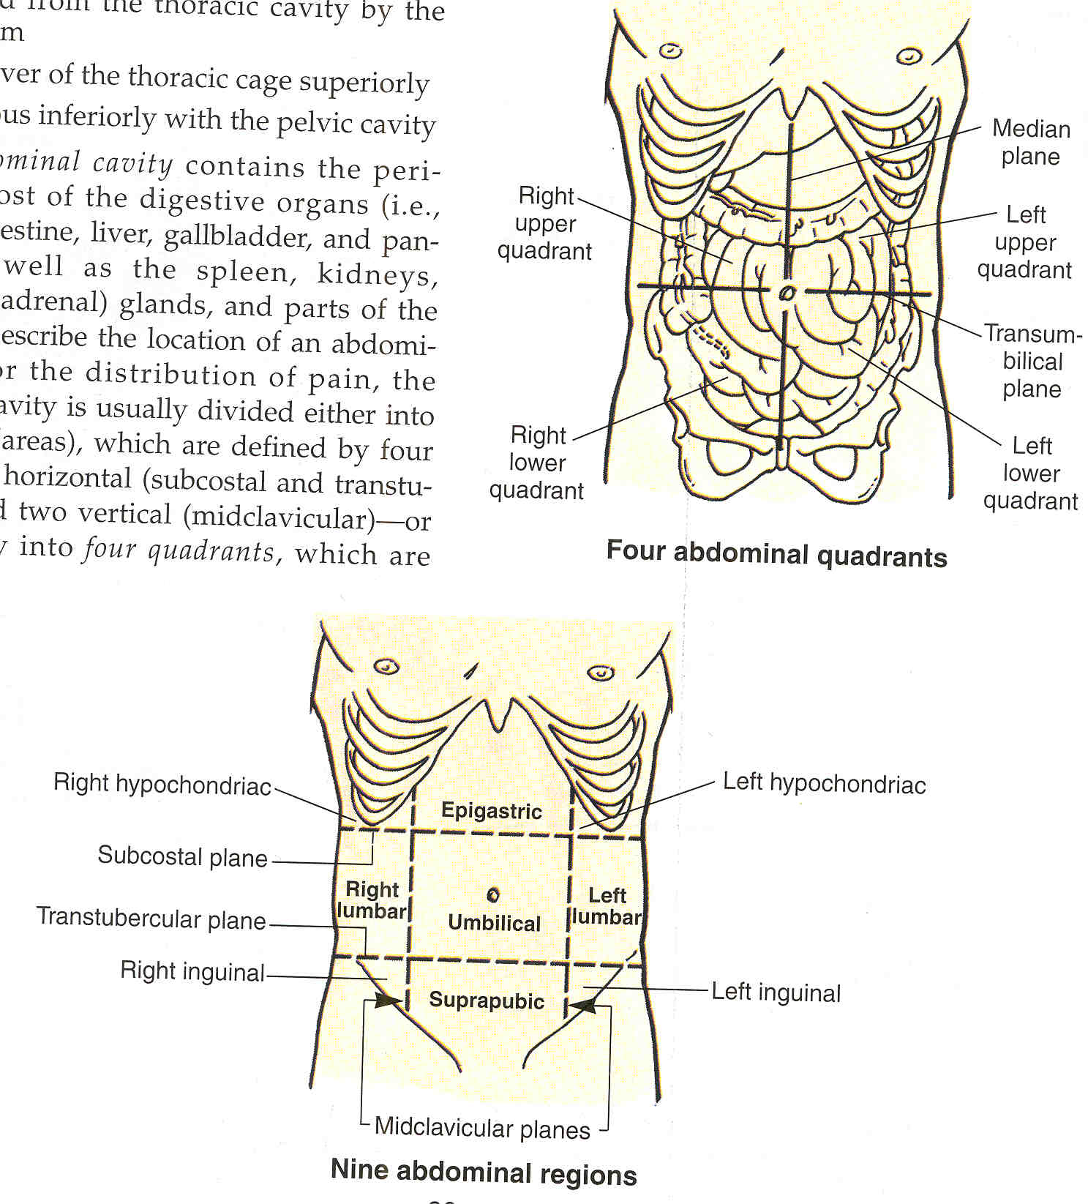
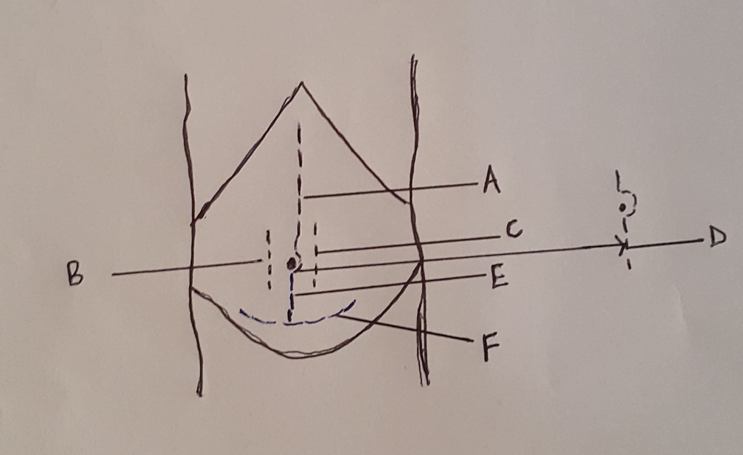
7 c: Anterior abdominal wall incisions
Abdominal incision
Midline
Right paramedian
Left paramedian
Extended subumbilical midline
Subumbilical midline
Pfannenstiel
Choice of incision is determined by:
Need for rapid entry
Certainty of the diagnosis- location and size of pathology
Body habitus
Location of previous scars
Potential for significant bleeding
Cosmetic outcome

Slide 78

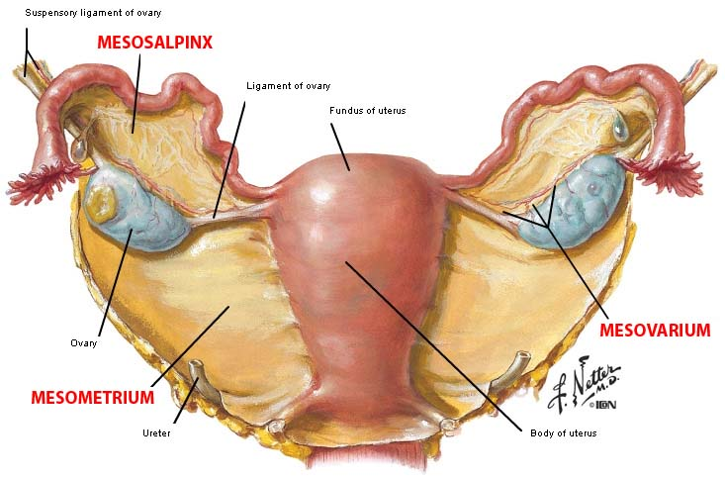
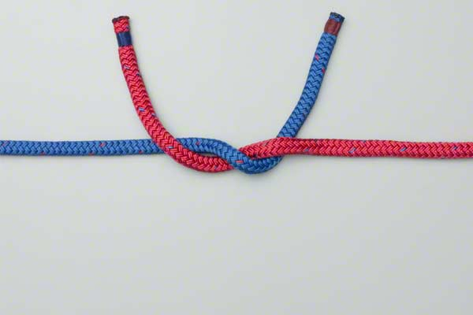
8a): Ruptured Ectopic Pregnancy –salpingectomy
A laparotomy is performed through a midline or Pfannenstiel incision
The uterus and the fallopian tube with the ectopic pregnancy is identified
The ligation of the ovarian pedicle will be demonstrated in this station
Place two long curved artery forceps below the ectopic at the level of mesosalpinx making a loop
Place a straight artery above the two long curved arteries leaving enough pedicle
Using a knife, remove the ectopic by cutting between the straight artery and upper end of the second curved artery
Using 2-0 or 3-0 vicryl absorbable suture ligate the pedicle
    Anchor the suture and make a reef knot , while the assistant is removing the 1st curved forceps (most distal), as you tighten the knot
    Once tight enough, the assistant can remove the second curved artery forceps, knot is tied completely
Check to ensure hemostasis is achieved

Slide 79

8b) Female urethral Catheterization
Place the kidney dish between the patients legs
If you are right handed, with your left hand part the labia
Using SALINE soaked cotton balls, gently clean the urethral meatus with single downward movement with each cotton ball X5
with the labia still parted apply K-Y gel at the tip of the foleys and insert it into the urethral meatus (do not touch the tip of the foleys)
Advance the foleys until urine begins to flow, then inflate the balloon using 10ml of saline
Attach the urine bag
Gently pull on the catheter until resistance is felt to ensure that the balloon is resting on the urethral opening of the bladder
Dispose wastes observing infection prevention
Reposition the patient and ensure she is comfortable
Thank the patient
Prepare requirements
  Catheterization pack: kidney dish, gallipot, sterile towel, cotton balls
  Foleys catheter size 12-14
  Urine bag
  Saline
  Sterile gloves
  K-Y gel
  10ml saline filled syringe
Prepare patient
  Greet
  Explain procedure
  Verbal consent
  Chaperon needed
  Position the patient on her back, ask her to put her ankles together and let her knees fall apart
Using aseptic technique open the catheterization
Wash/dry hands and put on the sterile gloves
Using a the towel drape the tigh nearest to you
Pour antiseptic to the gallipot

Slide 80

8c) IV Access: Branula insertion
Stretch the skin distally and the tell the patient to expect a sharp pain prick
Insert the needle with bevel upwards at about 30⁰
Advance the needle until a flush back of blood is seen in the hub at the back of cannula
Once this is seen withdraw the needle slightly and advance the cannula further into the vein completely
  Release the tourniquet
Apply pressure to the vein at the tip of cannula
Remove the needle
Flush with saline and check for patency: if pain, localize tissue swelling or resistance remove the cannula and restart the procedure with a new vein
Remove the cap on the needle and cork it at the end of cannula
Dispose needle and other wastes
Apply plaster to secure the cannula in place and label the date of insertion (Should not be on more than 72 hours)
Thank the patient
Requirement:
  Alcohol swab
  Gloves
  Disposable tourniquet
  IV cannula
  Plaster
  Syringe
  Normal saline
  Sharps disposal
  Alcohol sanitizer for hand washing
Patient preparation
  Greet the patient and explain the procedure
  Make the patient lie or sit down comfortably
Sanitize your hands
Position the arms of the patient and identify a vein
Apply the tourniquet and recheck the vein
Put on your gloves
Clean patient’ skin with alcohol wipe and let it dry
Remove the cannula from its packaging and remove the needle cover ensuring not to touch the needle
UP

Slide 81

High Vagina Swab & Endocervical Swab
For high vaginal swab- if right handed:
  Using the right hand, pick up the swab’s sample tube and place in your left hand (also holding the speculum) and remove the lid
  Take the swab with your right hand
  Circle the swab once from lateral fornix to posterior fornix to the other lateral fornix
  Insert the swab back to the sample tube and close it
For endocervical swab
  Steps 1 and 2 same as for high vaginal swab
  Place the swab in the endocervical canal and do a full 360⁰ sweep
  Insert the swab back to the sample tube and close it
Remove speculum
Wipe patients perineum
Reposition patient and make her comfortable
Complete the laboratory request form and label specimen
Give return date
Thank the patient
Prepare requirements
  Sterile gloves
  K-Y gel
  Sterile bivalve speculum
  Swabs
  Examining light
Prepare patient
  Greet patient and introduce self
  Explain procedure
  Chaperon needed
  Ask patient to empty bladder
  Position patient in lithotomy position
Wear sterile gloves
Lubricate the speculum and let the patient know the procedure is about to start
Advance the speculum to expose the cervix and secure it

Slide 82

Bimanual Pelvic Examination
Palpate the vaginal walls as you advance the fingers for obvious abnormalities
Using finger tips palpate the cervix: feel for size, shape, mobility and observe for tenderness
Bimanually palpate the uterus by pressing it between the right and middle index fingers on the cervix and with your left hand placed on the lower abdomen. At this point feel for any masses
Bimanually Palpate the left and right adnexa: note masses and tenderness
  Note uterine masses will move the cervix during bimanual exam while adnexal masses wont
Remove fingers, check glove for discharge/blood
Wipe the patient’s perineum
Remove gloves and dispose gloves
Reposition patient and make her comfortable
Thank the patient
Prepare Requirements
  Gloves
  K-Y gel
  Gauze or tissue paper
Prepare patient:
  Great and introduce self to patient
  Explain the procedure
  Ask her to empty bladder
  Chaperon required
  Positon the patient in lithotomy position and expose from waist downwards
Put on gloves
If right handed: lubricate index finger and middle fingers of right hand, and explain to the patient that you are about to start the procedure
Using the thumb and index finger of the left hand, separate the labia majora then insert the index finger followed by the middle finger into the introitus and advance to the cervix

Slide 83
Gyn OSCE dry run (Five minutes)
SCENARIO
  During your clinical rotation in the family planning clinic, you were asked to demonstrate insertion of the family planning method label Q
QUESTIONS
  What is the name of family planning method Q (Q is Copper T IUCD)
  Using the pelvic model provided, uterine sound, tenaculum , demonstrate how to:
    Sound the uterus
    Loading of Q
End

Slide 84
Questions?
Notes:
84

