Slide 1
BASIC OBSTETRICS SKILLS MBChB IV
Dr. Gwako
Adapted from Prof Eunice Cheserem, Dr Alfred Osoti
& Dr Rose J. Kosgei 2015 presentation

Slide 2
Instructions
Students are required to have read about the skills before the skills day
There are 10 Obstetric skill stations
Each station will be facilitated by a Resident under the guidance of Faculty
MBChB IV students will be divided into 10 groups
Each group will take 40 minutes per station with a 30 minute tea break and one hour lunch break
For each skill, the log book will be signed off when the facilitator is satisfied that the student is able to perform the skill
Students are required to perfect their skills in the Skills Lab after the seminar (these will be signed off in the log book as well)

Slide 3
10 Obstetrics Skill Stations
Counseling in Obstetrics-1 Previous Scar
Fetal heart rate tracing interpretation – normal and abnormal tracings
Normal vaginal delivery
Breech Vaginal Delivery
Assisted vaginal delivery-vacuum extraction
Shoulder dystocia
Sterile speculum examination
Digital vaginal examination
PPH evaluation and management
Perineal tear & episiotomy repair

Slide 4
1. Counseling in Obstetrics-1 Previous Scar
Greet patient, Introduces self, Sits squarely, Open Posture, Leans Forward, Eye Contact, Relax
Demonstrate understanding of the underlying condition and management
Explain the diagnosis-1 previous scar
Elective delivery options-elective repeat cesarean delivery vs TOLAC/VBAC
TOLAC/VBAC
Review previous scar- Indications as non-recurrent, outcome, complications
Current pregnancy-confirm no contraindication to TOLAC/VBAC
TOLAC/VBAC -Success rate
Potential maternal/neonatal complications
Elective Repeat Cesarean Delivery (ERCD)
Timing-at 39 weeks
Preoperative and postoperative care
Risks versus benefits
Potential maternal and neonatal complications
Emergency repeat cesarean delivery if early onset of labor or failed TOLAC/VBAC
Appreciates/acknowledge patients time

Slide 5
Counseling in Obstetrics-1 Previous Scar
ACRONYMS
TOLAC-Trial Of Labor After Previous Cesarean Delivery
VBAC-Vaginal Birth After Cesarean Delivery
ERCD-Elective Repeat Cesarean Delivery
Antepartum predictors of success
Indication for prior cesarean delivery
Fetal malpresentation (75%)
non-reassuring fetal heart rate pattern (60%)
Failure to progress or CPD if non-recurrent cause (54%)
History of prior vaginal delivery
Before or after previous CS (OR prior vaginal delivery 3.90; prior VBAC 4.76)
Demographic factors
Hispanic, African American, and Asian women more likely to pursue TOLAC, but are less likely to have a successful VBAC versus non-Hispanic and white women
Demographics ctd
Increasing maternal age, single marital status, and less than 12 years of education have reduced likelihood
Age >35 less likely to have a successful VBAC and more likely to experience complications
Success increases with increasing maternal height
Success lower in obese women
Interpregnancy interval of less than six months risk factor for uterine rupture and maternal morbidity
Maternal medical disease
hypertension, diabetes, asthma, renal disease, and heart disease may reduce likelihood
Intrapartum factors
Admission labor status:
spontaneous labor or high bishop score more likely to succeed than induced labor or low Bishop score
Fetal macrosomia
Wt. > 3.5 kg reduces likelihood

Slide 6
TOLAC versus ERCD: Risks And Benefits
Maternal benefits: TOLAC
Avoid risks of repeat CD
Immediate benefits
shorter hospital stay
fewer postpartum complications
quicker return to normal activities
lower maternal morbidity and mortality.
Long-term:
avoid the potential complications of multiple CD-hysterectomy; bowel or bladder injury, transfusion, infection, abnormal placentation eg previa, accreta
Maternal benefits: ERCD
scheduling convenience
TL at delivery
Avoida risks of failed TOLAC
Perinatal risks :TOLAC
Mortality — higher perinatal mortality and neonatal mortality rates compared with ERCD ( PMR 0.13 versus %; NMR: 0.11 versus 0.06%)
Hypoxic ischemic encephalopathy —higher risk HIE than ERCD (46 per 100,000 TOLAC VS 0 cases at term)
Respiratory problems — TTN is slightly higher with ERCD

Slide 7
Appropriate candidates for TOLAC
Contraindications to TOLAC
One prior low transverse uterine incision
success rate of TOLAC 60 - 70 %
uterine rupture rate of about 0.7 %
Success rates are higher if prior vaginal delivery
Clinically adequate pelvis
Appropriate fetal weight < 3.5 kg
No other uterine scars or previous rupture
Interpregnancy interval of >18 months
Physicians and facility immediately available throughout active labor capable of monitoring labor and performing an emergency cesarean delivery
High risk for uterine rupture
Previous classical or J or T-shaped incision, or extensive transfundal uterine surgery or myoma resections
Previous uterine rupture
≥2 previous scars
Medical complications that preclude vaginal delivery
Obstetric indications of cesarean delivery e.g. placenta previa, footling breech presentation
Lack of an appropriate facility — surgical, anesthesia, nursing, pediatric staff and laboratory resources to provide multiple transfusions

Slide 8
2. Fetal Heart Rate Tracing Interpretation
Goal of fetal heart rate monitoring is to improve perinatal outcome, specifically by decreasing stillbirth and longer term neurologic impairments such as injury to the fetal central nervous system
Fetal hypoxia and acidosis precedes fetal injury and death
Principle: fetus whose oxygenation in utero is challenged will respond with a series of detectable physiologic adaptive or decompensatory signs as hypoxemia or frank metabolic acidemia.
CTG- Cardiotocograph,
graphical display of FHR with or without contractions
NST- Non stress test, CTG without contractions
CST-contraction stress test, CTG with contractions
FHR Patterns: Baseline rate, Variability, Acceleration, Deceleration, Sinusoidal
NST
Reactive/Reassuring
Non-reactive/Non-reassuring
CST
Negative/Positive/Equivocal/Unsatisfactory
Intrapartum FHR monitoring:
Grade I/II/III

Slide 9
CTG PATTERNS
Pattern | Definition
Baseline FHR | Mean FHR rounded to increments of 5 beats/min during a 10-min segment Must be for a minimum of 2 minutes in any 10-minute segment Normal: 110–160 beats per minute Tachycardia: > 160 beats/min Bradycardia: < 110 beats/min The decrease or increase in heart rate lasts for longer than 10 minutes it’s a baseline change
Baseline variability | Fluctuations in the baseline FHR that are irregular in amplitude and frequency Variability is visually quantitated as the amplitude of peak-to-trough in beats per minute. Absent—no amplitude range Minimal—amplitude range ≤ 5 beats/min Moderate (normal)—amplitude range 6–25 beats/min Marked—amplitude range > 25 beats/min

Slide 10
Pattern | Definition
Acceleration | Definition: Abrupt increase in FHR (onset to peak < 30 sec) ≥ 32 Weeks GA Peak of 15 beats/min or more above baseline, Duration ≥15 sec but < 2 minutes from onset to return. < 32 weeks GA Peak of ≥ 10 beats/min above baseline Duration ≥ 10 sec but < 2 minutes from onset to return. • Prolonged acceleration: lasts ≥ 2 minutes but < 10 minutes in duration Baseline change: an acceleration lasting ≥10 minutes

Slide 11
CTG- INTERPRETATION
Pattern | Definition
Early deceleration | Symmetrical gradual decrease and return of the FHR associated with a uterine contraction Gradual FHR decrease from the onset to the FHR nadir of ≥30 sec Onset, nadir, and recovery coincident with beginning, peak, and end of contraction, respectively.
Late deceleration | Symmetrical gradual decrease and return of the FHR associated with a uterine contraction Gradual FHR decrease from the onset to the FHR nadir of ≥30 sec Nadir after the peak of the contraction. Onset, nadir, and recovery occur after beginning, peak, and end of contraction respectively

Slide 12
Pattern | Definition
Variable deceleration | Abrupt decrease in FHR Abrupt FHR decrease from the onset to FHR nadir of ≤ 30 sec Decrease ≥ 15 beats per min, lasting ≥15 sec, <2 min in duration
Prolonged deceleration | Decrease ≥15 beats per min, lasting ≥2 minutes < 10 min Deceleration ≥10 min is a baseline change
Sinusoidal | Smooth, sine wave-like undulating pattern, a cycle frequency of 3–5 per minute persists for ≥ 20 minutes

Slide 13
NST INTERPRETATION
 | Reactive | Non-reactive
Baseline | 110–170 bpm | Bradycardia <110 bpm Tachycardia > 170 bpm Erratic or rising baseline
Variability | 6–25 bpm | ≤ 5 (absent or minimal) >40 min >25bpm >10min. Sinusoidal
Accelerations | ≥2 accelerations in < 40 min | < 2 accelerations in ≥40 min
Decelerations | None or occasional variable < 30 sec | Variable decelerations ≥30 sec Prolonged decelerations

Slide 14
CST-INTERPRETATION
Negative: no late or significant variable decelerations Positive: late decelerations after ≥50% of contractions Equivocal–suspicious: intermittent late decelerations or significant variable decelerations Equivocal: FHR decelerations in the presence of contractions more frequent than every 2 minutes or lasting longer than 90 seconds Unsatisfactory: fewer than three contractions in 10 minutes or an uninterpretable tracing

Slide 15
INTRAPARTUM FHR MONITORING
Three-Tiered Intrapartum Fetal Heart Rate Interpretation System
Category I
Baseline rate: 110–160 bpm
Baseline FHR variability: moderate
No Late or variable decelerations
Early decelerations present or absent
Accelerations: present or absent
Category II: FHR tracings not categorized as Category I or Category III
Category III:
Absent baseline FHR variability and any of:
Recurrent late decelerations
Recurrent variable decelerations
Bradycardia
Sinusoidal pattern

Slide 16
3. Normal Vaginal Delivery
Describe the three stages of labor
Describe the cardinal movements of labor
Describe the various types of fetal position
Describe the steps of a normal vaginal delivery
Properly assess fetal station and position
Deliver the fetal head utilizing appropriate attention to the pelvic curve
Assess for nuchal cord
Deliver the remainder of the body
Deliver the placenta
Identify cervical and/or perineal lacerations
Properly document the delivery procedure

Slide 17
4. Breech Vaginal Delivery
TERM BREECH TRIAL (Lancet, 2000) planned CS is associated with improved neonatal outcomes compared to planned vaginal birth (poor neonatal outcomes of 1.6% -v- .5.0%). However patients may present in second stage necessitating vaginal breech delivery
Procedure
Confirm diagnosis and no contraindications to vaginal delivery
Call Consultant/staff experienced in Breech Delivery
Consider episiotomy
“Hands off” – do not assist in the delivery of the baby until maternal efforts have resulted in expulsion of the fetus at least to the scapulae
Pull down a small loop of cord to prevent traction on the cord
Wrap body in a towel to allow for support and grip
Gentle rotation will usually allow delivery of arms. If not use the Lovsett’s maneuver. Follow humerus down and rotate each arm across the chest and out.
The aftercoming head may deliver spontaneously. If not, use the Mariceau-smellie-veit maneuver. The trunk of the baby lies on the operator’s right forearm. The head is flexed by applying pressure to the cheek bones and upper lip while gentle traction is applied on the shoulders with the left hand.
If the head is entrapped, uterine relaxation in theatre with GA (halothane) may allow delivery.
Complications
Cord prolapse
Birth trauma as a result of extended arm or head, incomplete dilatation of the cervix or CPD
Asphyxia from cord prolapse, cord compression, placental detachment or arrested head
Damage to abdominal organs
Broken neck
Documentation: detailed, clear and comprehensive including details of counseling and the identity of all those involved in the procedures.

Slide 18
BREECH DELIVERY
Basic skills in physical examination essential for diagnosis
The Leopold maneuvers are the backbone of the physical exam
Leopold maneuvers
Identify fetal pole in the fundus. Breech gives sensation of large nodular mass.
Palms on the sides of abdomen. Identify (hard smooth) back on one side and irregular mobile parts on the other side
Using thumb and fingers grasp presenting part (diagnose whether engagement has occurred)
Facing mothers feet, use fingertips to palpate presenting parts.

Slide 20
Mariceau-smellie-veit maneuver
Correct position of the hand on the cheek and not the mouth

Slide 21
5. Assisted Vaginal Delivery-Vacuum Extraction
Prerequisites: ≥ 36 weeks, Cephalic, Vertex, Full cervical dilation, Fetal head at station 0, Descent not more than 1/5, Mother conscious & cooperative
Procedure:
Obtain verbal informed consent, Put on sterile gown and sterile gloves, Confirm equipment is working
Position the mother in semi-lithotomy, Empty bladder, Confirm full cervical dilation, Identify posterior fontanel, Identify sagittal suture, Assess for episiotomy
Place center of cup 2 cm anterior to the posterior fontanel/flexion point on the sagittal suture
Stabilize the suction cup with two fingers
Check and free maternal tissues
Create vacuum of 0.2kg/sq.cm (yellow)
To pull increase vacuum pressure to 0.8kg/sq.cm (green)
Apply traction during uterine contraction only perpendicular to the cup
Also: When to abandon procedure/Complications/Documentation
Notes:
Abandon: a)Fetal head does not advance with each pull b) No descend to pelvic floor after 3 contractions/pulls c) Cup slips off the head 3 times at proper direction of pull with maximum negative pressure
Fetal –Cephalo-haematoma, localized scalp oedema scalp abrasions and lacerations Neonatal jaundice, Intracranial haemorrhage
Maternal – lower genital tract injuries

Slide 23
6. Shoulder Dystocia
Definition: need for additional obstetric maneuvers to effect delivery of fetal shoulders at the time of vaginal delivery
Pathophysiology: impaction of anterior fetal shoulder on maternal pubic bone causing delay in delivery of the shoulder after head has been delivered
Risk Factors: Mainly due to increased fetal birth weight: Maternal: High BMI, Multiparity, Advanced Maternal Age, Diabetes, Postterm Pregnancy, Previous macrosomic infant, excessive weight gain in pregnancy, Maternal birth weight over 4000 g.
Warning Signs: -prolonged second stage, “turtling” (head retracts into perineum after delivery)
Management: goal 🡪 release anterior shoulder from entrapment, Prevent fetal asphyxia and permanent Erb's palsy, Avoid physical injury (eg, bone fractures, maternal trauma).
HELPERR (pneumonic):
Call for HELP-team
Evaluate for EPISOTOMY
LEGS – McRoberts Manuver –knee chest position
External PRESSURE (suprapubic)-to dislodge the anterior shoulder
ENTER – Rotational manuvers, Wood’s Screw: push on posterior aspect of anterior shoulder and on anterior aspect of posterior shoulder and try to rotate shoulders to oblique, Reverse Wood’s Screw: push on anterior aspect of posterior shoulder and try to rotate shoulders to oblique
REMOVE Posterior arm - grasp foetal elbow, not shoulder
ROLL the patient to her hands and knee, Others: Replacement of fetal head, Abdominal Rescue, Intentional fracture of the clavicle
Complications: Maternal: PPH, cervical/vaginal lacerations, Fetal:clavicle/humerus fractures, brachial plexus injuries, birth asphyxia, death

Slide 24
Pathophysiology
Normal:
The fetal biacromial diameter enters the pelvis at an oblique angle with the posterior shoulder ahead of the anterior one, rotating to the anterior-posterior position at the pelvic outlet with external rotation of the fetal head.
The anterior shoulder can then slide under the symphysis pubis for delivery
Abnormal/shoulder dystocia:
The fetal shoulders remain in an anterior-posterior position during descent OR descend simultaneously rather than sequentially into the pelvic inlet
THE anterior shoulder becomes impacted behind the symphysis pubis
AND the sacral promontory may obstruct the posterior shoulder.

Slide 25
Call for HELP AND PREPARE
Nursing, anesthesia, obstetric, and pediatric staff should be called to the room to provide assistance as needed
Instructions given in a clear and calm manner to gravida and personnel
No pushing while preparations are made and maneuvers are undertaken to reposition the fetus
Patient positioned with her buttocks flush with the edge of the bed to provide optimal access for executing maneuvers to affect delivery
Empty bladder
Evaluate for EPISIOTOMY

Slide 26
Maneuvers
LEGS – McRoberts Manuver
Hyperflexion and abduction of the hips causing cephalad rotation of the symphysis pubis and flattening of the lumbar lordosis that frees the impacted shoulder
Two assistants, each grasps a maternal leg and sharply flexes the thigh back against the abdomen
Relieves shoulder dystocia via
Marked cephalad rotation of the symphysis pubis and subsequent flattening of the sacrum, thus removing the sacral promontory as an obstruction site
By bringing the pelvic inlet into the plane perpendicular to the maximum expulsive force, pushing efficiency improves significantly
NO change in diameter, McRoberts maneuver does not change the actual dimensions of the maternal pelvis
External PRESSURE (suprapubic)
An assistant applies pressure suprapubically with the palm or fist, directing the pressure on the anterior shoulder both downward (to below the pubic bone) and laterally (toward the baby's face or sternum)
Performed in conjunction with McRoberts maneuver
Adducts the shoulders or bring them into an oblique plane, the oblique diameter is the widest diameter of the maternal pelvis
Useful in mild cases and those from impacted anterior shoulder

Slide 27
ENTER – Rotational maneuvers
REMOVE Posterior arm
Introduce a hand into the vagina to locate the posterior shoulder and arm : If the fetal abdomen faces the maternal right, the operator's left hand should be used; if the fetal abdomen faces the maternal left, the right hand is used.
The posterior arm should be identified and followed to the elbow. If the elbow is flexed, the operator can grasp the forearm and hand and pull out the arm. If it is extended, pressure is applied in the antecubital fossa. This flexes the elbow across the fetal chest and allows the forearm or hand to be grasped.
The arm is then pulled out of the vagina, which brings the posterior shoulder into the pelvis and reduces the shoulder diameter by 2 to 3 cm
If the anterior shoulder cannot be delivered at this point, the fetus can be rotated and the procedure repeated for the anterior (now posterior) arm.

Slide 28
Rubin maneuver
Adducts fetal shoulder so that the shoulders are displaced from the anteroposterior diameter of the inlet, thereby allowing the posterior arm to enter the pelvis
Requires adequate anesthesia
One hand placed in the vagina and on the back surface of the posterior fetal shoulder, and then rotate it anteriorly (towards the fetal face). If the fetal spine is on the maternal left, the operator's right hand is used; the left hand is used if the fetal spine is on the maternal right
Alternatively, hand placed on the back surface of the anterior fetal shoulder, if it is more accessible.
Woods screw maneuver
Rotates the fetus by exerting pressure on the anterior, clavicular surface of the posterior fetal shoulder to turn the fetus until the anterior shoulder emerges from behind the maternal symphysis
If the fetal spine is on the maternal left, the operator uses the left hand to push on the clavicle of the posterior arm and rotate the baby 180 degrees in a counterclockwise direction

Slide 29
ROLL the patient to her hands and knees, Gaskin all-fours
Places the mother on her hands and knees, OR racing start or ‘sprinter’ position NOT knee-chest position
Delivery achieved by gentle downward traction on the posterior shoulder (the shoulder against the maternal sacrum) or upward traction on the anterior shoulder (the shoulder against the maternal symphysis)
Zavanelli/Gunn-Zavanelli-O'Leary maneuver
Replacement of the fetal head in the pelvis, then cesarean delivery
Administer tocolytic eg terbutaline (0.25 mg SC/nifedipine/nitroglycerin)
Rotate the head back to an occiput anterior position (reversal of restitution)
Flex head from its extended position and push it as far cephalad as possible using firm pressure with palm of one hand.
The other hand may be used to depress the perineum
Proceed with cesarean delivery.

Slide 30
Others
Abdominal rescue
A low transverse hysterotomy, then transabdominal manual rotation of the anterior shoulder to the oblique diameter fetus delivered vaginally
Intentional clavicular fracture
Intentional-to shorten the biacromial diameter by pulling the anterior clavicle outward
Difficult; can lead to injury of underlying vascular and pulmonary structures
Documentation : Clear and complete documentation in the medical record is critical

Slide 31
Rotation of posterior shoulder-Wood screw

Slide 32
Manual removal of posterior shoulder
Gaskin

Slide 33
Rubin
Zavanelli

Slide 34
7. Sterile Speculum Examination
Review indications-e.g. preterm premature rupture of fetal membranes
Thoroughly explain the procedure to the patient
Sterile gloving
Report findings on inspection of external genitalia
Swabs vulva -5 swab technique
Application of sterile towels
Lubricates speculum
Separates the labia and exposes introitus with non non-dominant hand and introduces lubricated speculum with dominant hand
Position speculum to asses cervix
Report on status of vaginal walls, Cervix (dilatation, position, defects, inflammation)
May report on cord, colour of liquor, pooling on valsalva , any other discharge/blood

Slide 35
8. Digital Vaginal Examination
Thoroughly explain the procedure to the patient
Assess the patient between contractions when most relaxed
Sterile technique: 5 sterile gloves, lubricates the first two fingers of the dominant hand
Use the non‐dominant hand to spread the labia minora and the dominant hand to assess the cervix
Assess cervical dilation, effacement, consistency, position
Identify the presenting part, palpate for fontanelles and sutures
Rule out common malpresentations: breech, shoulder, brow, face, compound
Assess for the presence of a prolapsed umbilical cord
Dispose the contaminated equipment
Document on a partograph
Institute appropriate management

Slide 36
9. PPH Evaluation and Management
Establish Diagnosis, Primary, Secondary, Determine cause from the 4Ts
Call for HELP, PPH BOX
Resuscitation-2 large-bore IV needles, Oxygen by mask, Monitor VS & Urine output, samples CBC/GXM/UEC/Coagulation profile
Empty bladder
Uterine massage
Repeat uterotonics (Oxytocin i/m or ergometrine-if no contraindication)
Infuse oxytocin 40 units in 1 litre to run at 60 drops per minute
Inspect placenta for completeness
Inspect vulva, vagina for tears
Consider misoprostol 600 mcg PO, tranexamic 1 gram IV slow
Consider aortic compression, bimanual uterine compression
Once bleeding controlled and all observations normal, observe every 15 mins until stable
Others: Balloon tamponade, B- Lynch, Ligation of Uterine vessels /Internal iliac artery/hysterectomy

Slide 37
THE CONDOM TAMPONADE
UTERUS
Water/NS
Inflate Condom with water till no further bleeding is occuring (usually about 300-500 mls )
syringe
Condom
Giving set
OR
String
Foleys Catheter
Clean
water
Apply clamp to keep water within
Condom after inflation

Slide 38
Steps
1. Place condom over balloon end of Foleys catheter 2. Tie lower end of condom snugly below level of the balloon using suture / string. Tie should be tight enough to prevent leakage of water but should not strangulate catheter and prevent inflow of water into condom. Check for leakage by inflating ballon with about 20cc water. 3. Aseptically place the condom end high into uterine cavity by digital manipulation or with aid of speculum and forceps 4. Inflate CT by connecting open/outlet end of catheter to giving set connected to infusion bag or use clean water with aid of large syringe. (cut the giving set at level of rubber to enable it fit into catheter) | Inflate condom with water or saline to about 300- 500 mls (or to amount at which no further bleeding is observed). Clamp catheter when desired volume is achieved and bleeding is controlled. Maintain In-situ for 24 hours if bleeding controlled and patient is stable. Give Broad spectrum antibiotic cover 9. Monitor patient closely, resuscitate and/or treat complications e.g. shock, coagulopathy

Slide 39
10. When patient is stable (after 24 hours) slowly deflate condom by letting out 50 mls of water/saline every hour. 11. Re-inflate to previous level if bleeding reoccurs whilst deflating. 13. If Bleeding is not controlled within 15 mins of initial insertion of CT abandon procedure and seek surgical intervention immediately.

Slide 40
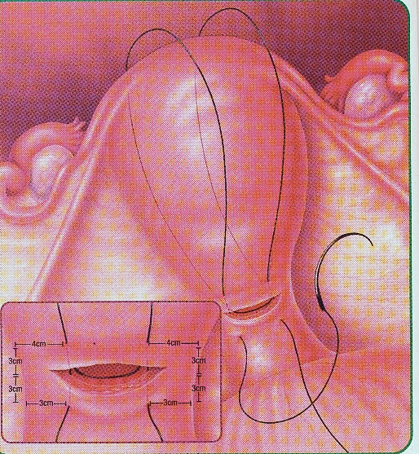
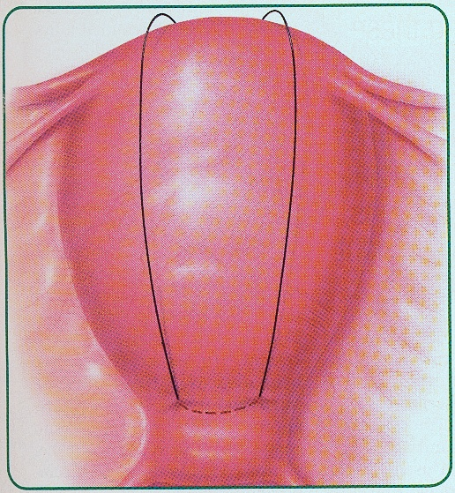
The B-Lynch Suture
Step 1: Using Absorbale large suture.
In-out-over…In-out-over…In-out-tie
B-Lynch Suture #2
Courtesy: Lynch BC, Coker A, Laval AH et al. The B_Lynch technique for control of Masive PPH,
An Alternative to Hysterectomy. Five Cases Reported. Br. J. Obstet Gynecol 1997, 104 327-376

Slide 41
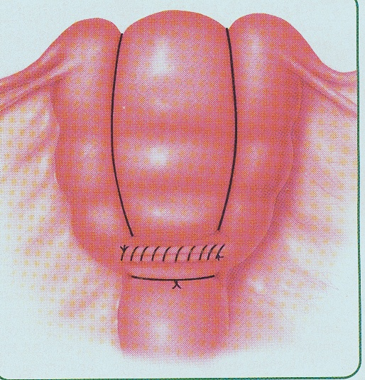
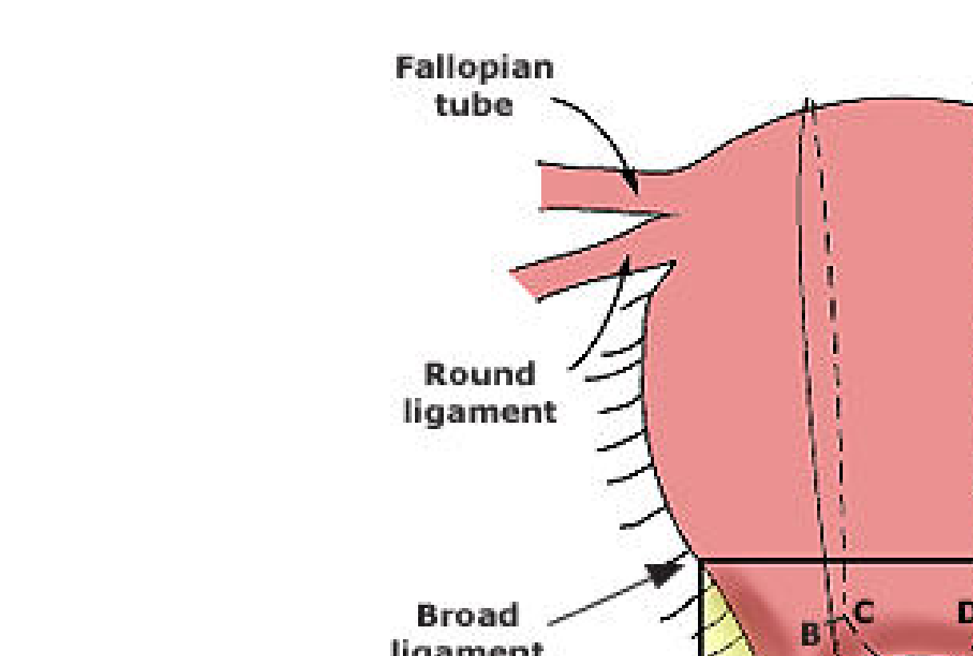
B-Lynch Suture #3

Slide 42
10. Perineal Tear & Episiotomy Repair
Episiotomy
is a surgical incision of the perineum performed to widen the vaginal opening to facilitate the delivery of an infant
May be associated with increased risk of extension to severe perineal lacerations, dyspareunia, and future pelvic floor dysfunction: Types: Midline and mediolateral
Tears
Are spontaneous perineal lacerations arising from perineal trauma at delivery. Degrees 1-4
Repair in layers
Postoperative care
pain control, perineal hygiene, sitz baths

Slide 43
Technique
Place an anchor stitch above the wound apex
Close the vaginal mucosa and submucosa with continuous interlocking stitches to close the vaginal incision and reapproximate the cut margins of the hymenal ring using an absorbable 2–0 or 3–0 suture
Close the fascia and muscles to restore the perineal body using a continuous absorbable 2–0 or 3–0 suture
Carry the continuous suture upward as a subcuticular stitch
Tie the final knot proximal to the hymenal ring.

Slide 46
Perineal lacerations/tears
A. First-degree: involve the fourchette, perineal skin, and vaginal mucous membrane but not the underlying fascia and muscle.
B. Second-degree : in addition, the fascia and muscles of the perineal body but not the anal sphincter.
C. Third-degree: extend farther to involve the external anal sphincter.
D. Fourth-degree: extend completely through the rectal mucosa to expose its lumen and thus involves disruption of both the external and internal anal sphincters

Slide 47
NORMAL DELIVERY
https://www.youtube.com/watch?v=ulWDfErwYGA
https://www.youtube.com/watch?v=VHcej771Afg
https://www.youtube.com/watch?v=ulWDfErwYGA&t=5s

Slide 48
VACUUM DELIVERY
https://www.youtube.com/watch?v=dnDiRrQqRJA
https://www.youtube.com/watch?v=GthnX-jYT5s
https://www.youtube.com/watch?v=GthnX-jYT5s
https://youtu.be/QeB3M6vpCk4

Slide 49
BREECH DELIVERY
https://www.youtube.com/watch?v=EWjKswZ3Mm8&feature=youtu.be
https://www.youtube.com/watch?v=ZbkDHDxKWrw
https://www.youtube.com/watch?v=xOqWT06qVS8

Slide 50
SHOULDER DYSTOCIA
https://www.youtube.com/watch?v=UTz2eIiZOL8&feature=youtu.be
https://www.youtube.com/watch?v=joTTDjRCCug&feature=youtu.be

Slide 51
Perineal tear repair
https://www.youtube.com/watch?v=m5Vm8ZT24HM
https://www.youtube.com/watch?v=oZW2KSuD800
https://www.youtube.com/watch?v=qXzZUqXFPDE

Slide 52
PPH
Videos already shared(uterine massage, aortic artery compression, bimanual compression, UBT insertion, B-Lynch suture insertion)

