Slide 1
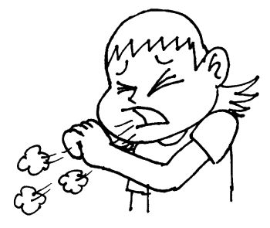
Tuberculosis in pregnancy
Dr Rose J. Kosgei
MBChB, MMED, MSc

Slide 2
Outline
Introduction
Epidemiology
TB, HIV and pregnancy
Clinical features
Management

Slide 3
Introduction
Tuberculosis (TB) chronic bacterial infection caused by Mycobacterium tuberculosis.
formation of granuloma in infected tissues and florid cell- mediated hypersensitivity.
usual site of disease is the lung but all other organs may be affected
M. Tuberclusis leads to:
TB infection (latent TB)
TB disease (with symptoms of TB)- reactivation of latent infection
Tuberculosis is a contagious disease; only people that are sick with TB in their lungs are infectious (PTB)
TB bacilli is propelled into the air when contagious people cough, sneeze, talk, or spit

Slide 4
Epidemiology 1
Every second, someone in the world is newly infected with TB bacilli
Globally, it is estimated that 8.4 million people develop TB each year, and nearly 2 million deaths result from the disease
Overall, 1/3 of the world’s population is currently infected with the TB bacillus and over 95% of global cases occur in developing countries

Slide 5
Epidemiology 2
TB kills more youth and adults than any other infectious disease
TB causes more maternal deaths than any other single cause of maternal mortality, estimated to be in the order of more than 1 million women per year
TB affects women mainly in their active economic and reproductive years and thus the impact of the disease is also strongly felt by their children and families

Slide 6
Epidemiology 3
Left untreated, each person with active TB will infect on average of 10 to 15 people per year
People infected with TB bacilli will not necessarily become sick with the disease: the TB bacilli that can lie dormant for years
When someone’s immune system is weakened, the chances of becoming sick are greater. Poor nutrition, smoking, and alcohol abuse may result in decreased immunity

Slide 7
Tuberculosis and Pregnancy
Diagnosis of PTB in pregnancy poses unique challenges:
The non-specific nature of early pregnancy symptoms (such as frequency of malaise and fatigue) that can mimic early symptoms of TB
Other diagnostics not readily available
Fear of use of chest radiography in pregnancy due to concerns regarding radiation-induced teratogenicity

Slide 8
TB and HIV
HIV has led to rapid increases in the incidence of TB
HIV increases the likelihood of dying from TB
TB is a leading cause of death among people who are HIV-positive accounting for about 13% of AIDS deaths worldwide
HIV and TB form a lethal combination. Someone who is HIV- positive and infected with TB bacilli is many times more likely to develop tuberculosis. TB contribute to the rapid progression of HIV/AIDS
TB treatment is effective in HIV-infected people

Slide 9
Tuberculosis and HIV infection in pregnancy
PTB common opportunistic infection in HIV-infected patients
Screening for PTB is not routinely or systematically done in PMTCT programs
Both TB and HIV independently increase maternal and perinatal morbidity and mortality
Risk of Immune Reconstitution Inflammatory Syndrome (IRIS) when ART for PMTCT is given on undiagnosed active TB
ART for PMTCT starts from pregnancy diagnosis for life
Ruling out active TB is important in the design of Isoniazid Preventive Therapy (IPT) in PMTCT programs
the nature of PTB disease in HIV-infected people which often renders sputum smear microscopy negative (the most commonly available diagnostic tool in resource limited settings)

Slide 10
Effects of TB on pregnancy
Pregnancy does not alter the course of active TB.
TB increases the risk of poor pregnancy outcomes: prematurity, neonatal low birth weight, and perinatal deaths
Woman with a late diagnosis of pulmonary TB have an increased risk of obstetric morbidity and a higher risk of miscarriage, eclampsia, and intrapartum complications.
70% of deaths due to TB occur during the childbearing years

Slide 11
Effect of Tb to pregnancy Depends on
Type
Site and Extent
Stage of pregnancy
Nutritional status of mother
Presence of concomitant disease
Immune status and co-existence with HIV
Availability of facilities for early diagnosis and treatment

Slide 12
Effects of Tb to pregnancy outcomes
Neonatal
Perinatal mortality
Intrauterine growth retardation
Low birth weight infant
congenital Tb:
Transplacental
aspiration and ingestion of infected amniotic fluid
Mother
May lead to rapid progression of HIV
Pill burden and non adherence to medication
Abortion
Increased obstetric morbidities
Death

Slide 13
Effects of pregnancy to TB
Theoretically, may cause a flare-up of the disease due to immune compromise and poor nutritional status.
No firm evidence that pregnancy has an effect on the progression of TB

Slide 14
Case 1.
Amry J. presents to the antenatal clinic for the first time and following history was recorded:
Para 3 + 0 at 26 weeks of gestation
Perceives fetal movements
No drainage of liqour or per vaginal bleeding
She however complaints of productive cough, night sweats and chest pains
The medical officer reassured her that it could the growing baby and prescribes prenatal vitamins

Slide 15
What more history is needed in this patients?

Slide 16
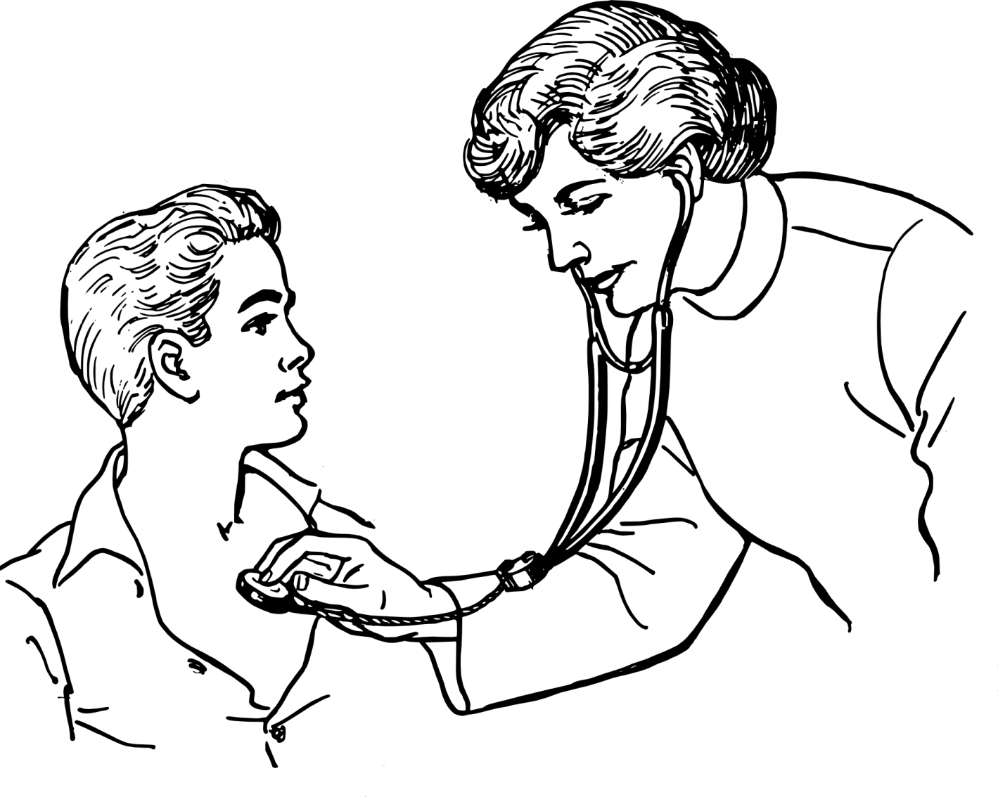
What systems will you examine and why?

Slide 17
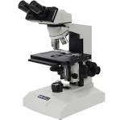
What investigations would you do?

Slide 18
What is the possible diagnosis?

Slide 19
What gaps did the medical officer have in his management?

Slide 20
Clinical features
Persistent cough, fever, and weight loss
Chest pain and hemoptysis may also be present
Women with TB do not present with “typical” symptoms - prolonged cough with expectoration – this can delay the diagnosis
Other opportunistic infections due to HIV may mask the signs and symptoms of TB

Slide 21
Symptoms
Symptomatology depends on organs affected
Pulmonary, Brain, Eye, Intestines, Bone, breasts, genito-urinary system skin)
Include:
Weight loss
Night sweats
Nocturnal pyrexia
Productive cough
Haemoptysis
Dyspnoea
Tachypnoea
Anaemia
Lassitude
enlarged lymph nodes
abdominal pain and swelling
Symptoms of TB mimic symptoms of pregnancy

Slide 22
Main findings
38 (20%) were symptom screen-positive
None had positive sputums for M. tuberculosis
10 had presumtpive TB on CXR: caviations, infiltrates and milliary pattern

Slide 23
Diagnosis
Medical History
Physical Examination
TB skin test (Mantoux
Not useful in Kenya and other developing countries where TB is endemic and most people have TB infection
SPUTUM for microscopy and culture
CXR(+ Lead shield)
New technology: Gene expert

Slide 24
Management principals
Multidisciplinary approach
Early diagnosis and prompt treatment
Screening for other concomitant diseases like HIV mandatory

Slide 25
Treatment 1
DOTS (Directly Observed Treatment, Short Course)
6 – 8 months of drugs for treatment
Kenya now 6 months
2 months induction
4 months continuation
Produces cure rates of up to 95%
Prevents new infections by curing infectious patients
Prevents the development of drug resistance by ensuring that the full course of treatments followed

Slide 26
Treatment 2
Sputum smear testing is repeated after 2 months to check progress, and again at the end of treatment
A negative sputum confirms the cure
When the person is co-infected with TB, HIV treatment must also be provided

Slide 27
Anti-TB treatment
First line drugs:
Isoniazid (INH)
Side effects: Hepatotoxicity, peripheral neuropathy
RIFAMPICIN
Side effects: Hypoprothrombinaemia in mother and child, hepatotoxicity
ETHAMBUTOL
Side effects: Optic neuritis
PYRAZINAMIDE
Side effects: Possible teratogenic effect, use with caution

Slide 28
Supportive treatment
Directly observed therapy where feasible
pyridoxine prophylaxis while on INH
Vitamin K prophylaxis to neonate to prevent haemorrhagic disease of newborn
If MDR TB:
Separate baby from mother if less than 2 weeks on treatment or usage of masks by mother
GiveINHresistant BCG to baby till mother is sputum negative.
Expressed breast milk if no mastitis
If HIV treatment replace Nevirapine with Efavirenz with another class or change rifamipicin to rifambutin
Trace contacts of infected mother and treat if positive
Interventions-pleural tap, chest tube drainage ascitic tap when indicated
Nutritional support (haematinics protein supplements)+bed rest

Slide 29
Breastfeeding considerations
High risk of transmission to infant in the course of active pulmonary TB without recognition
If mother is newly diagnosed with active pulmonary TB and not on treatment should be separate with infant till
Treatment commences and sputums negative
All first line TB medications are safe for use during breast feeding
Infant on INH prophylaxis

Slide 30
Conclusion
Diagnosis of TB in pregnancy warrants a high index of suspicion. Offering early diagnosis and prompt treatment ensures better maternal and neonatal outcomes.

