Slide 1
ANATOMY OF THE FEMALE PELVIS AND THE FETAL SKULL
By Dr. P. K. Koigi
MB, ChB, M. Med O/G

Slide 2
PRESENTATION OBJECTIVES
Parts of the pelvis
Various types of pelvis
Differences between the male and female pelvis
Parts of the fetal skull
Relationship of the fetal skull to the maternal pelvis in labor
Pelvic issues and their significance

Slide 3
INTRODUCTION
The relationship of the fetal skull to the maternal pelvis is the single most important prognostic determinant of the progress of labour.
There is a need to appreciate the structure of the pelvis and the structure of the fetal skull in order to appreciate their relationship in labor

Slide 4
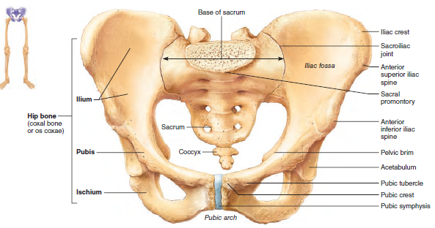
THE PELVIS
Made of 8 bones:
Ilium (2): upper flattened part of the hip bone; joined to the sacrum by synovial sacro-iliac joint
Ischium (2): the inferior and posterior part of the hip bone
Pubis (2): The anterior most portion of the hip bone; articulates with its counterpart at the Fibrocartilaginous Symphysis pubis
Sacrum
Coccyx
The pelvis has an Inlet, Mid-cavity and outlet

Slide 5
PELVIC INLET
Homework: Look up the difference among diagonal, obstetric and true conjugates
Has 4 boundaries:
Horizontal ramii of pubic bones and pubic symphysis anteriorly.
Alae of the sacrum
Sacral promonitory
Two ileo-pectineal lines
The smallest diameter of the pelvic inlet is between the symphysis pubis and the sacral promontory.

Slide 6
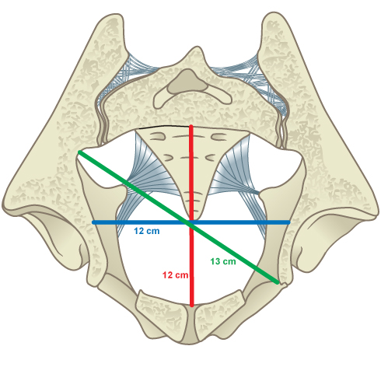
PELVIC MID-CAVITY
Boundaries include:
Middle of public symphysis anteriorly
2 pubic bones
Obturator fascia
Ischial bones(inner surface)
2nd and 3rd sacral junction
The ischial spines lie slightly below
The interspinous diameter (~10cm) is usually the smallest diameter of the pelvis.

Slide 7
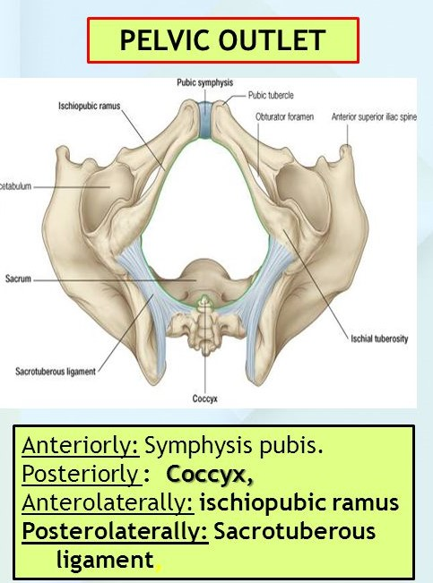
PELVIC OUTLET
Is diamond shaped and bound by:
Lower margin of the pubic symphysis
Descending rami of pubic bones
Ischial tuberosities
Sacro-tuberous ligaments
5th sacral bone
The smallest diameter in the pelvic outlet is the inter-tuberal diameter

Slide 8
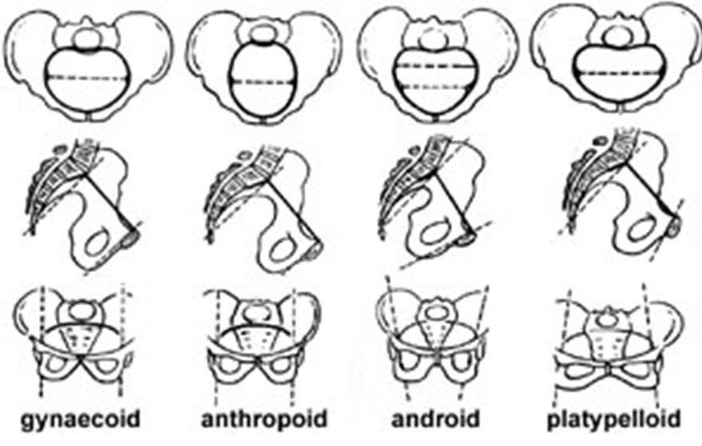
CLASSIFICATION OF TYPES OF PELVIS
4 types of pelvis are known:
Android
Gynaecoid
Anthropoid
Platypelloid

Slide 9
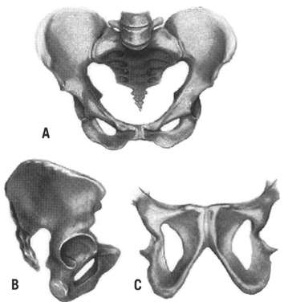
ANDROID PELVIS
Typical male pelvis
Wedge-shaped inlet
Narrow anterior segment (retropubic angle)
Flat and wide posterior segment
Narrow sacrosciatic notch
Forward sacral inclination
A narrow wedge-shaped (‘Gothic’) suprapubic arch
Converging side walls, narrow interspinous and intertuberous diameters
Bones ranging from medium to heavy in structure

Slide 10
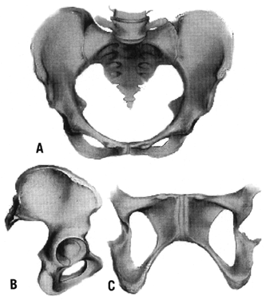
GYNECOID PELVIS
Typical Female Pelvis
Spacious and well rounded posterior segment
Inlet has an ovoid shape
Wide and well rounded anterior segment
Sacrosciatic notch of medium size
An average sacral inclination and curvature
A wide suprapubic arch [which reduces the waste space of Morris]
Wide interspinous and intertuberous diameters
Bones ranging from medium to delicate in structure

Slide 11
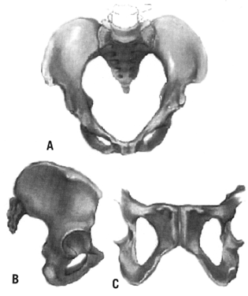
ANTHROPOID PELVIS
Long and narrow, oval shaped inlet
Long, narrow, well rounded anterior segment
Long, narrow posterior segment
Very wide and shallow sacrosciatic notch
Long narrow sacrum with average inclination and curvature
Slightly narrow suprapubic arch
Straight side walls with below average interspinous and intertuberous diameters
Medium to delicate bones

Slide 12
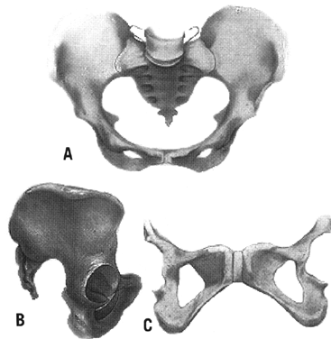
PLATYPELOID PELVIS
A transverse oval shaped inlet
A very wide, round, retropubic angle
A very wide and flat posterior segment
A narrow sacrosciatic notch
Average sacral inclination
A very wide suprapubic arch
Straight side walls with very wide interspinous and intertuberous diameters
Bones range from medium to delicate in structure

Slide 13
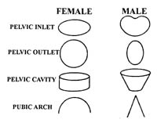
MALE PELVIS VS FEMALE PELVIS

Slide 14
MALE PELVIS VS FEMALE PELVIS

Slide 15
MALE PELVIS VS FEMALE PELVIS

Slide 16
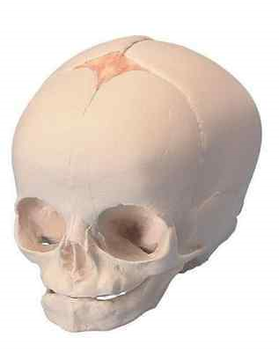
ANATOMY OF THE FETAL SKULL
The foetal skull is made up of the cranium (vault and base) & the face.
The vault consists of two parietal bones, two frontal bones, two temporal and one occipital bone.
The vault bones are not fused at birth to allow moulding of the foetal head during labour.

Slide 17
Key landmarks of the fetal skull
BREGMA – at the anterior fontanalle
VERTEX – area between parietal eminences, posterior and anterior fontanalle
LAMBDA – at the posterior fontanelle
GLABELLA – the root of the nose
MENTUM – the chin

Slide 18
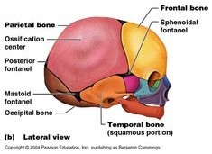
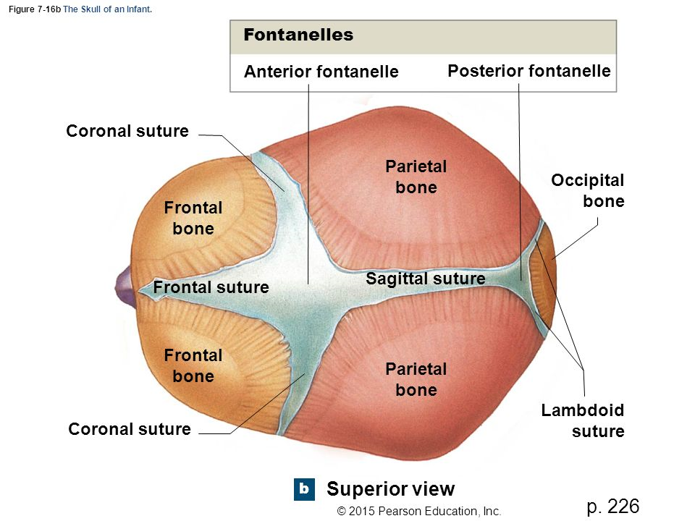

Slide 19
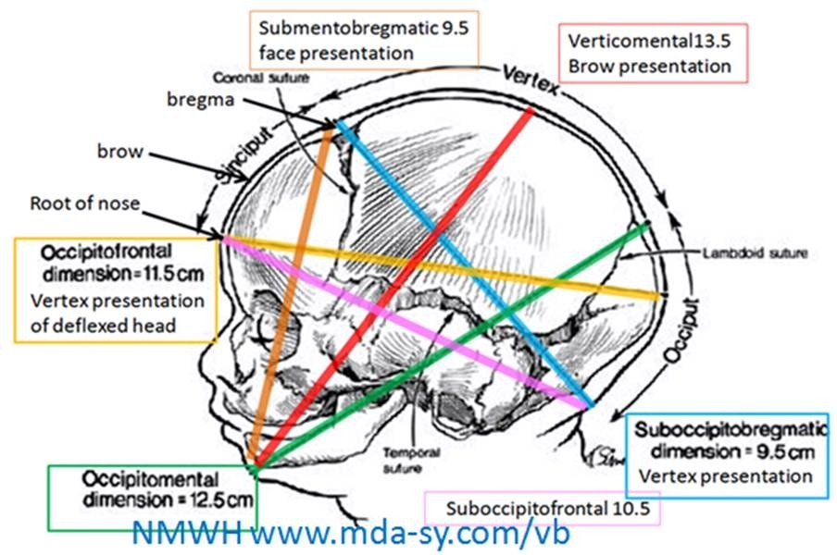
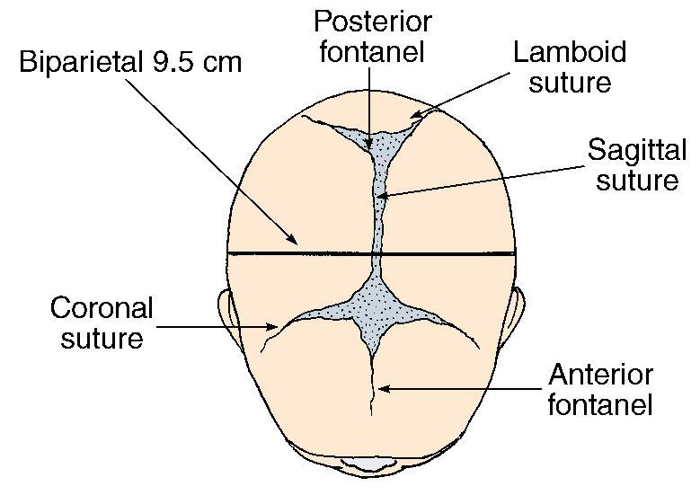
DIAMETERS OF THE FETAL HEAD

Slide 20
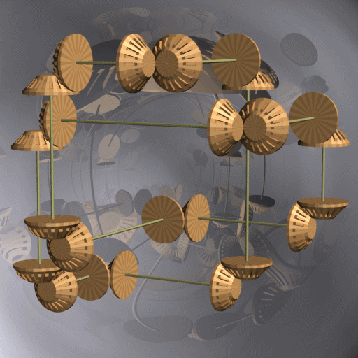
THE RELATIONSHIP
At the onset of labor, the relationship of the fetus with respect to the maternal pelvis is critical to the route of delivery.
This relationship is determined by the foetal lie, presentation, attitude and position.

Slide 21
THE RELATIONSHIP…
Foetal Lie: the position of the long axis of the baby in relation to the long axis of the mother.
Presentation: the part of the fetus that is closest to the pelvic inlet
Fetal attitude: the posture of the fetus in labor (normally the fetal head is flexed)
Fetal Position: the location of an arbitrarily chosen point of the presenting foetal part in relation to the left or right side of the maternal pelvis e.g. Vertex → occiput; face→ mentum; breech → sacrum

Slide 22
ABNORMALITIES OF THE PELVIS
Developmental abnormalities may lead to:
Contracted pelvis (childhood malnutrition); High assimilation (6 sacral vertebrae); Naegle’s oblique pelvis (one-sided fusion of the ischium & ilium); Robert’s contracted pelvis (bilateral fusion of the ilium & ischium); simple flat pelvis
Diseases & injury may lead to difficulties in delivering vaginally:
Rickets (rachitic flat pelvis); poliomyelitis; Malunion of pelvic fractures
Abnormalities of the hip joint, spine & lower limbs may make vaginal delivery impossible:
Kyphosis; Spondylolisthesis; Congenital dislocation of the hip

Slide 23
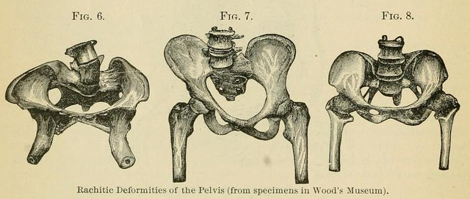
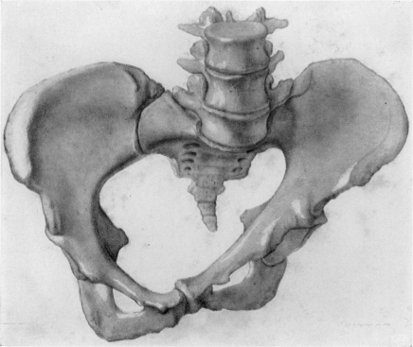
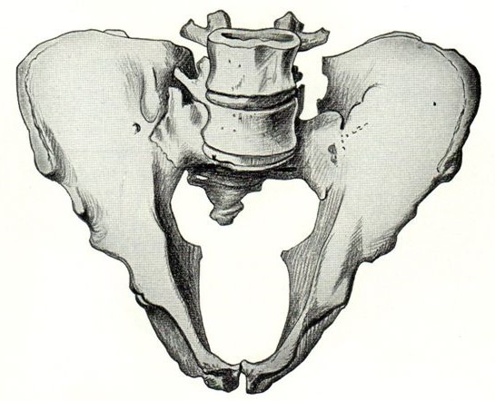
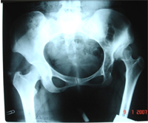
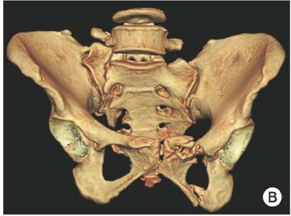
Rachitic deformities of the pelvis; Naegle’s oblique pelvis; Robert’s contracted pelvis; X-ray of the pelvis of a polio patient; Malunion of pelvic fractures

Slide 24
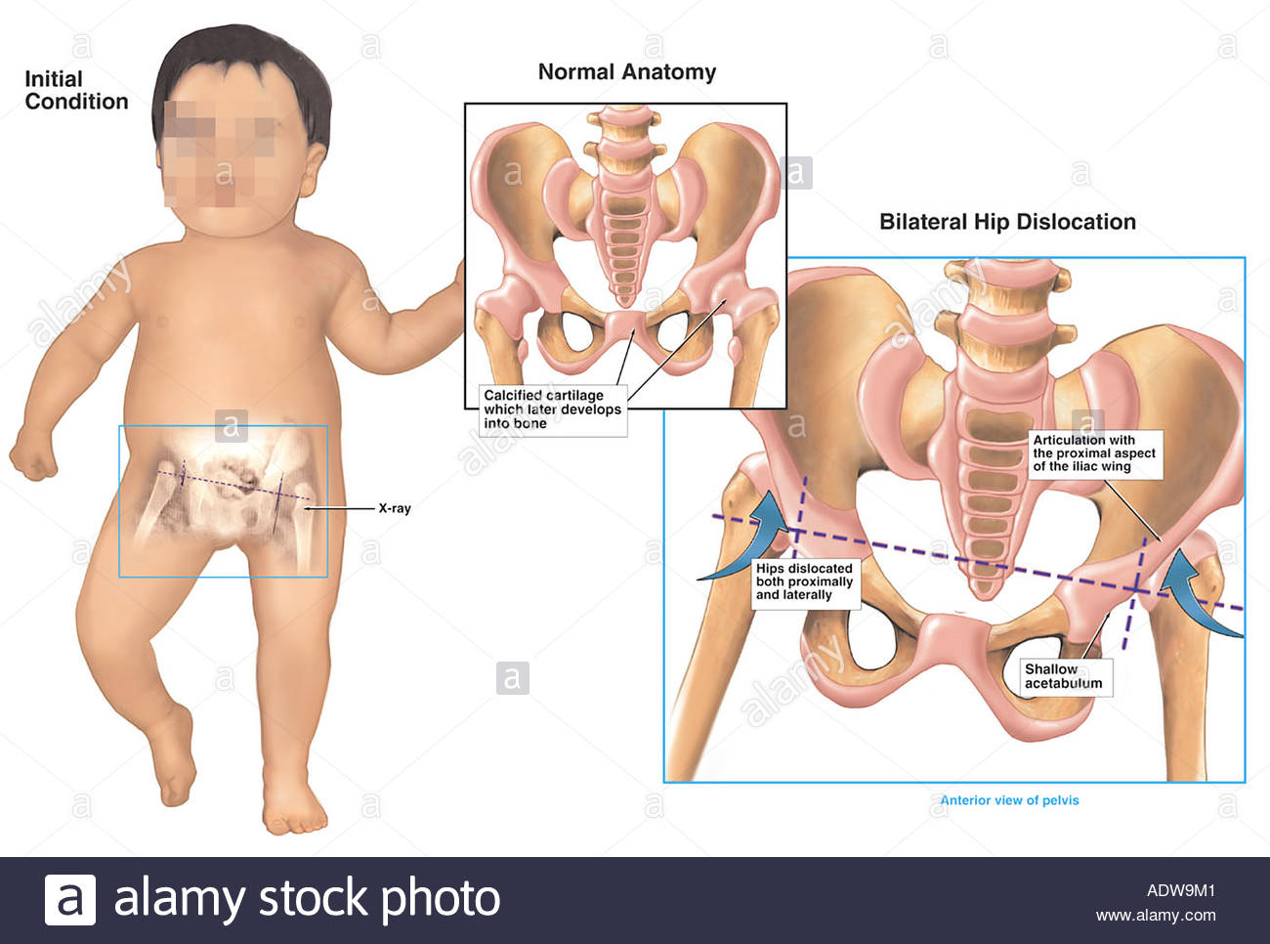
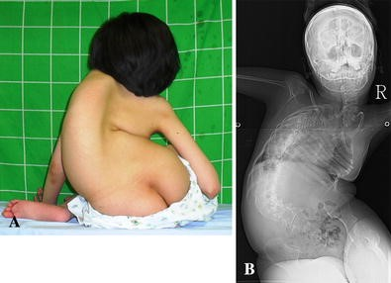
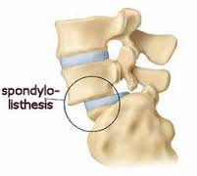
Congenital hip dysplasia; Kyphoscoliosis; Spondylolisthesis

Slide 25
CONCLUSION
The relationship between the maternal pelvis and the fetal skull is of critical importance in labour
The maternal Pelvis (Passage) and the fetal skull (Passenger) are 2 of the “3 P’s” that affect the process (mechanisms) of labor and therefore the outcome of labour
A narrow passage cannot allow a large passenger to pass – this is the basis for predicting and understanding cephalopelvic dysproportion

Slide 26
THANK YOU

