Slide 1
Lactation and breastfeeding
Prof Zahida Qureshi
May 2017

Slide 2
Lactation/Breastfeeding
Session objectives
To be able to describe the
  Ministry guidelines
  Anatomy of the breast
  Physiology of lactation
  Constituents of breast milk
  Advantages of breast feeding
  Proper b’feeding technique

Slide 3
Lactation/Breastfeeding
Session objectives
  Complications of b’feeding and their management
  B’feeding in special circumstances
  Nutrition during the breastfeeding period
  Drugs contraindicated in b’feeding
  Contraception during the b’feeding period.

Slide 4
Ministry of Health Guidelines
Seventeen steps
Baby Friendly Hospital Initiative

Slide 5
Infants who receive only breast milk are considered exclusively breastfed.
Exclusive breastfeeding is recommended for the first 6 months of life.

Slide 6
KDHS 2008-9
Exclusive breastfeeding has increased to 31%
97% children b’fed at some time is high
58% b’fed within 1 hr and 86%within 1 day
% of women b’feeding within 1 hour is highest in northeastern province and lowest in Western at 34%
34% of children are given something before b’feed(pre-lacteal feeds)
More common male children, rural 44% and urban 35% and influenced by education

Slide 7
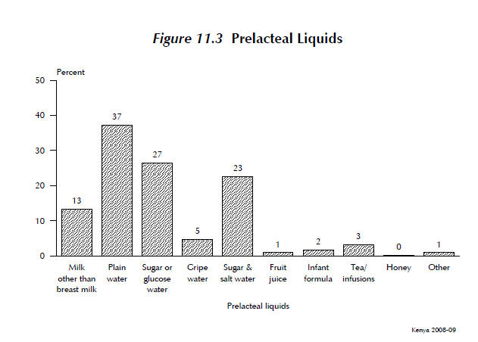

Slide 8
Embryology
Stage Mammary | Age of embryo (days) | Crown-rump length of embryo (mm)
band | 35 | 6
streak | 36 | 8
Line | 37 | 10
crest | 40 | 13
hillock | 42 | 13
bud | 49 | 20

Slide 9
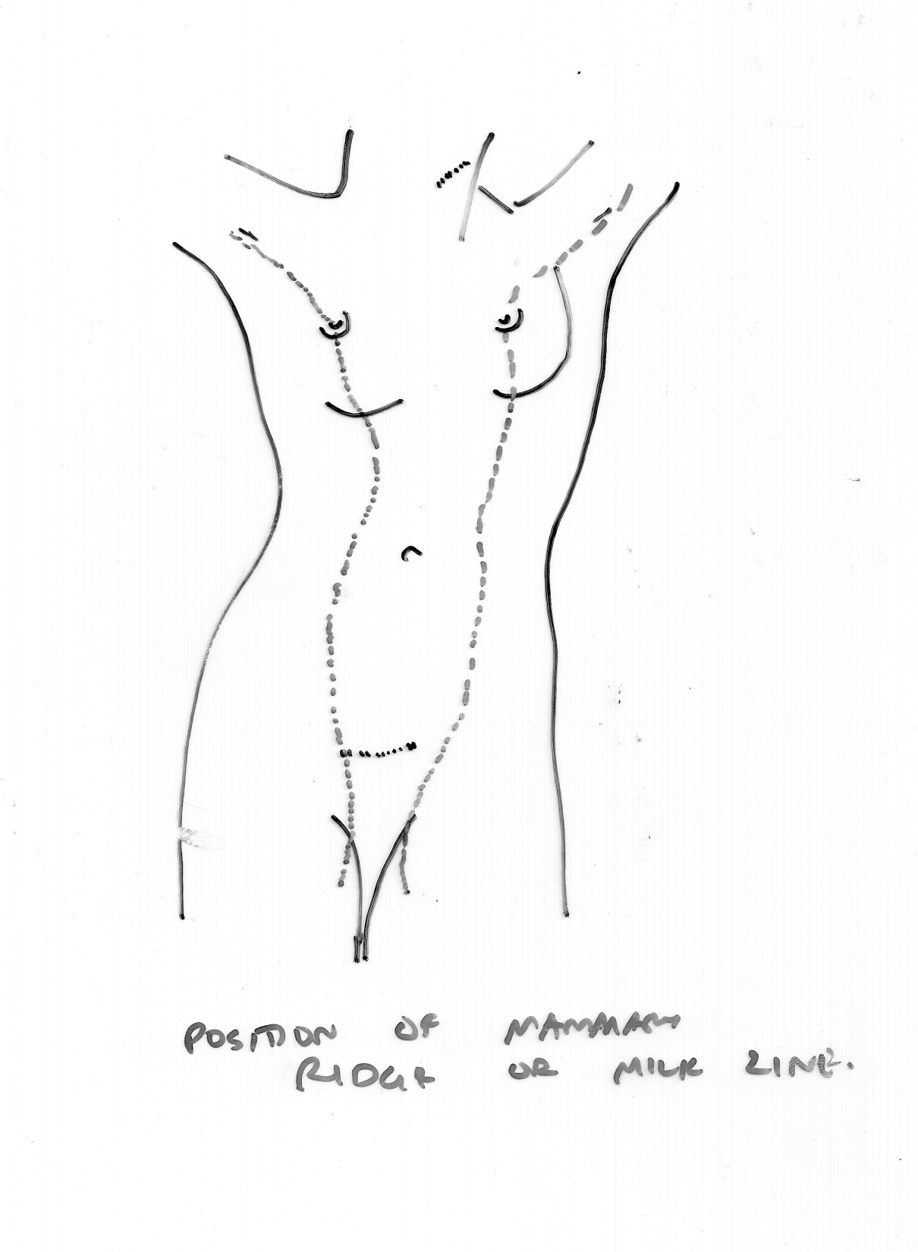
Position of Mammary Ridge
or Milk Line

Slide 10
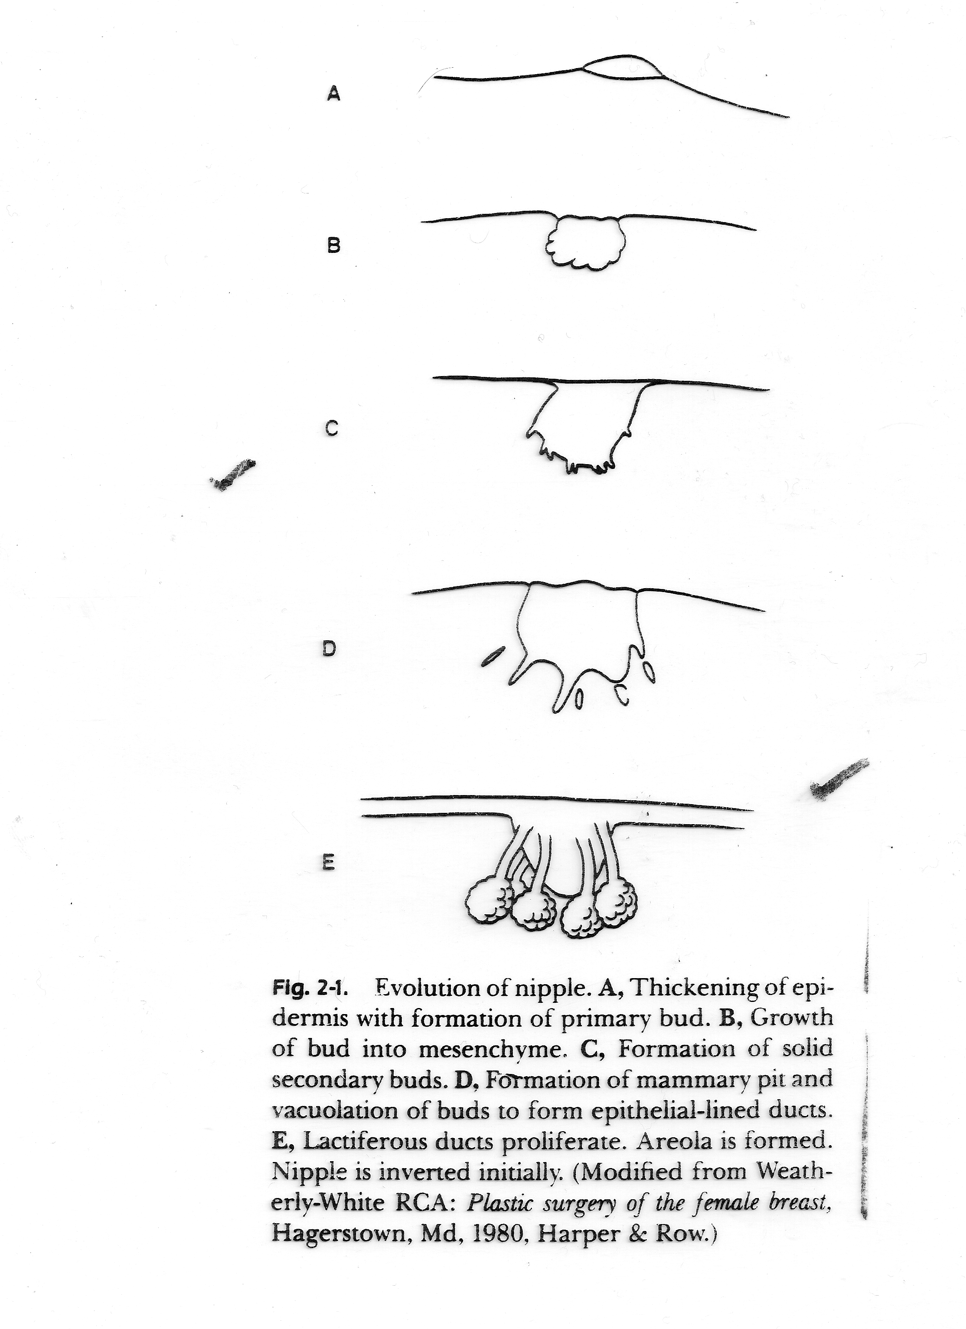
Evolution of the nipple

Slide 11
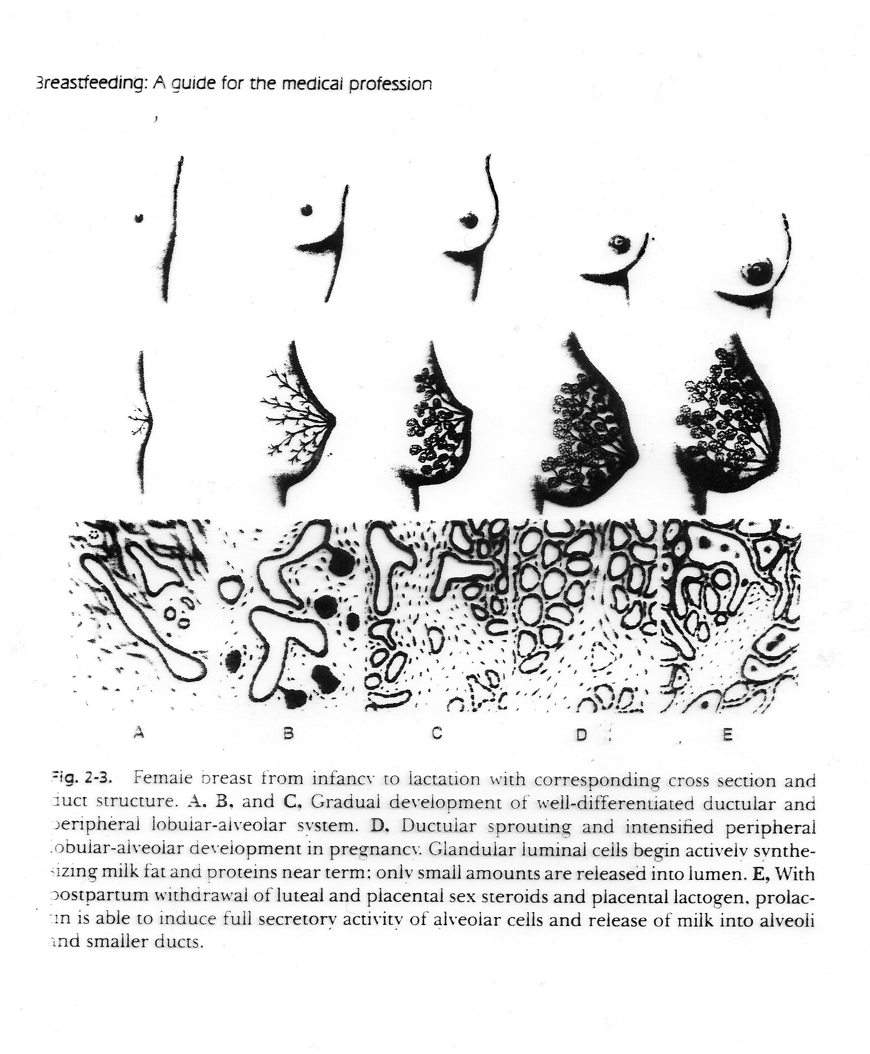
Tanner stage development of the breast
STAGE 1 STAGE 2 STAGE 3 STAGE 4 STAGE 5

Slide 12
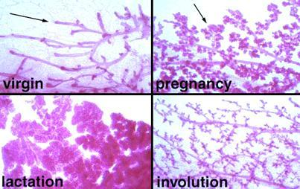

Slide 13
MAMMARY GLAND
PAIR – MODIFIED GLANDS
SUPERFICIAL SURFACE CONVEX
2ND – 6TH RIB 10-12 DIAMETER
5-7 CMS CENTRAL THICKNESS
UPPER OUTER QUADRANT – AXILLARY TAIL
ARTERIES- Br’s of intercostals and Internal Thoracic and Internal Mammary
Venous drainage-Axillary, Internal Thoracic and intercostal veins

Slide 14
MAMMARY GLAND
NON PREGNANT 200 GMS
NEAR TERM 400 - 600 GMS
LACTATION 600 – 800 GMS
GLANDULAR TISSUE – PARENCHYMA
CONNECTIVE TISSUE – STROMA (SUPPORTING)

Slide 15
EPITHELIAL COMPONENTS LOBES 15 - 25
LACTIFEROUS DUCTS
LOBE SUBDIVED INTO 20-40 LOBULES WHICH INTURN ARE COMPOSED OR 20-100 ALVEOLI
ALVEOLUS SINGLE LAYER
SECRETORY EPITHELIUM

Slide 16
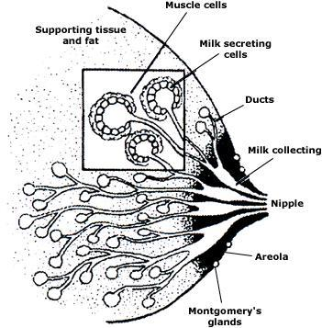
Anatomy of the breast

Slide 17
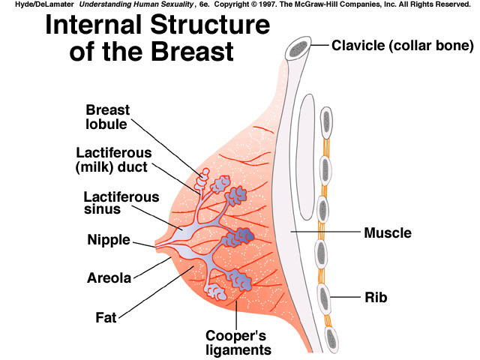

Slide 18
Definitions
Lactation: the secretion of milk from the mammary glands of the breast.
Breastfeeding: the feeding of an infant at the mother's breast; nursing.
There are four stages of lactation:
Mammogenesis (growth of the breasts)
Lactogenesis (the functional change of the breasts so that they can secrete milk)
Galactopoiesis (maintaining the production of milk)
Involution (the termination of milk production).

Slide 19
The important hormones involved in lactation are:
prolactin
oestrogens
progesterone
adrenal corticoids (cortisol)
insulin
growth hormone

Slide 20
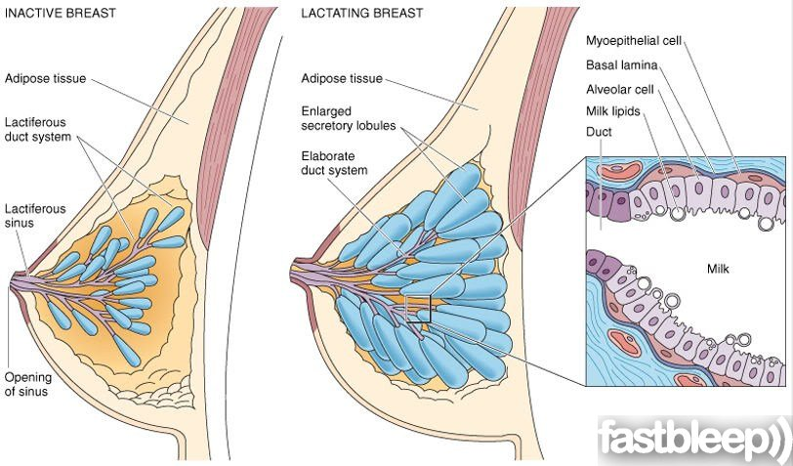
Mammogenesis (growth of the breasts)

Slide 21
The inactive breast is mainly made up of adipose tissue; however the lactating breast has a greater proportion of glandular tissue.
During pregnancy the breasts enlarge; the nipple pigment darkens; the skin becomes thinner and the veins in the breast become more prominent.
In mammogenesis the ductal system grows and branches; the amount of connective tissue and supporting cells increases and fat is laid down in the breast. This is stimulated by the oestrogens, growth hormone, prolactin, insulin and the adrenal corticoids.
Progesterone is involved in the last stages of mammogenesis after the ductal system has grown. It acts with the other hormones to develop the breast lobules and alveoli, and adapts the alveoli to have secretory properties.

Slide 22
Lactogenesis (the functional change of the breasts so that they can secrete milk)
Lactogenesis I: the ability of the mammary glands to secrete milk from mid-pregnancy to late pregnancy.
  starts from mid-pregnancy till 2 days after birth. It involves the differentiation of alveolar epithelial cells and the stimulation of milk synthesis by prolactin.
Lactogenesis II: the formation of large amounts of milk after parturition.
  starts from day 3 postpartum to day 8. It is triggered by the reduction of progesterone. The breast become full and warm and produce large amounts of milk.

Slide 23
Galactopoiesis (maintaining the production of milk)
starts around 9 days after birth and finishes at the beginning of involution. It is the maintenance of milk secretion controlled by hormones. Breast size starts to diminish between 6 to 9 months after birth. The rate of milk formation normally decreases after 7-9 months; however milk production can continue for years if the child continues to suckle.
Involution (the termination of milk production).
Involution is the loss of secretory function of milk, due to the accumulation of inhibiting peptides. It normally starts 40 days after the last breastfeed. The epithelial cells no longer require their secretory properties so they are removed by the process of apoptosis and replaced by adipocytes.

Slide 24
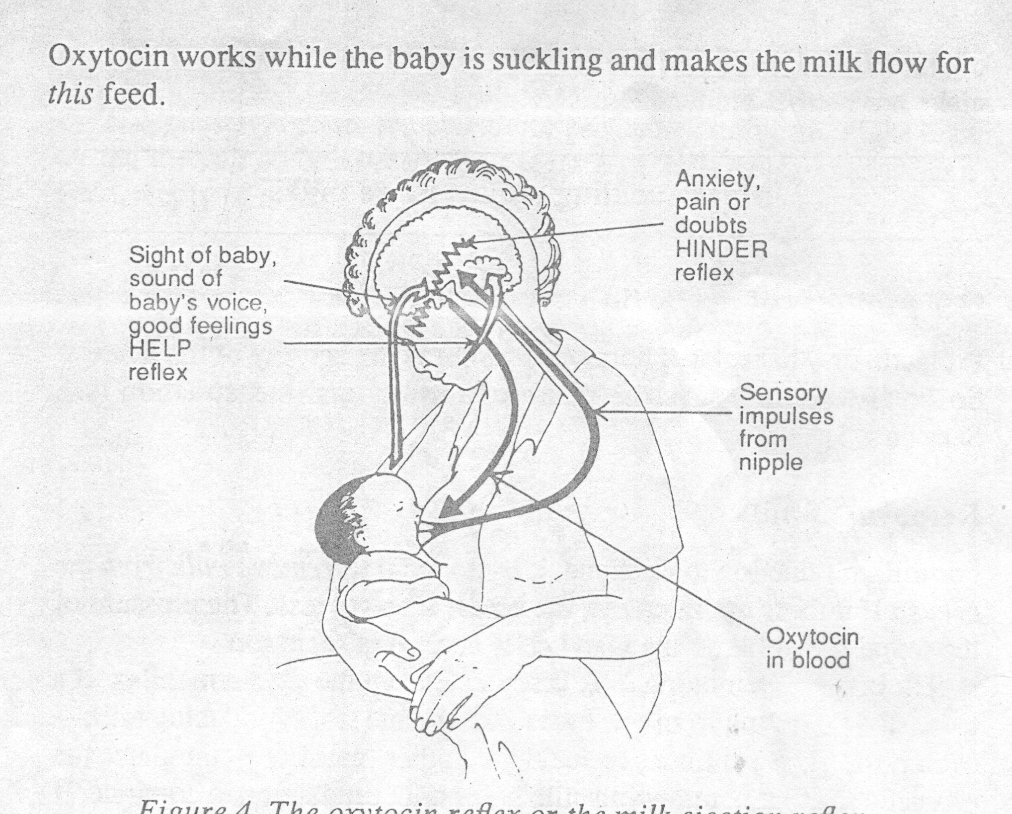
The oxytocin or milk ejection reflex

Slide 25
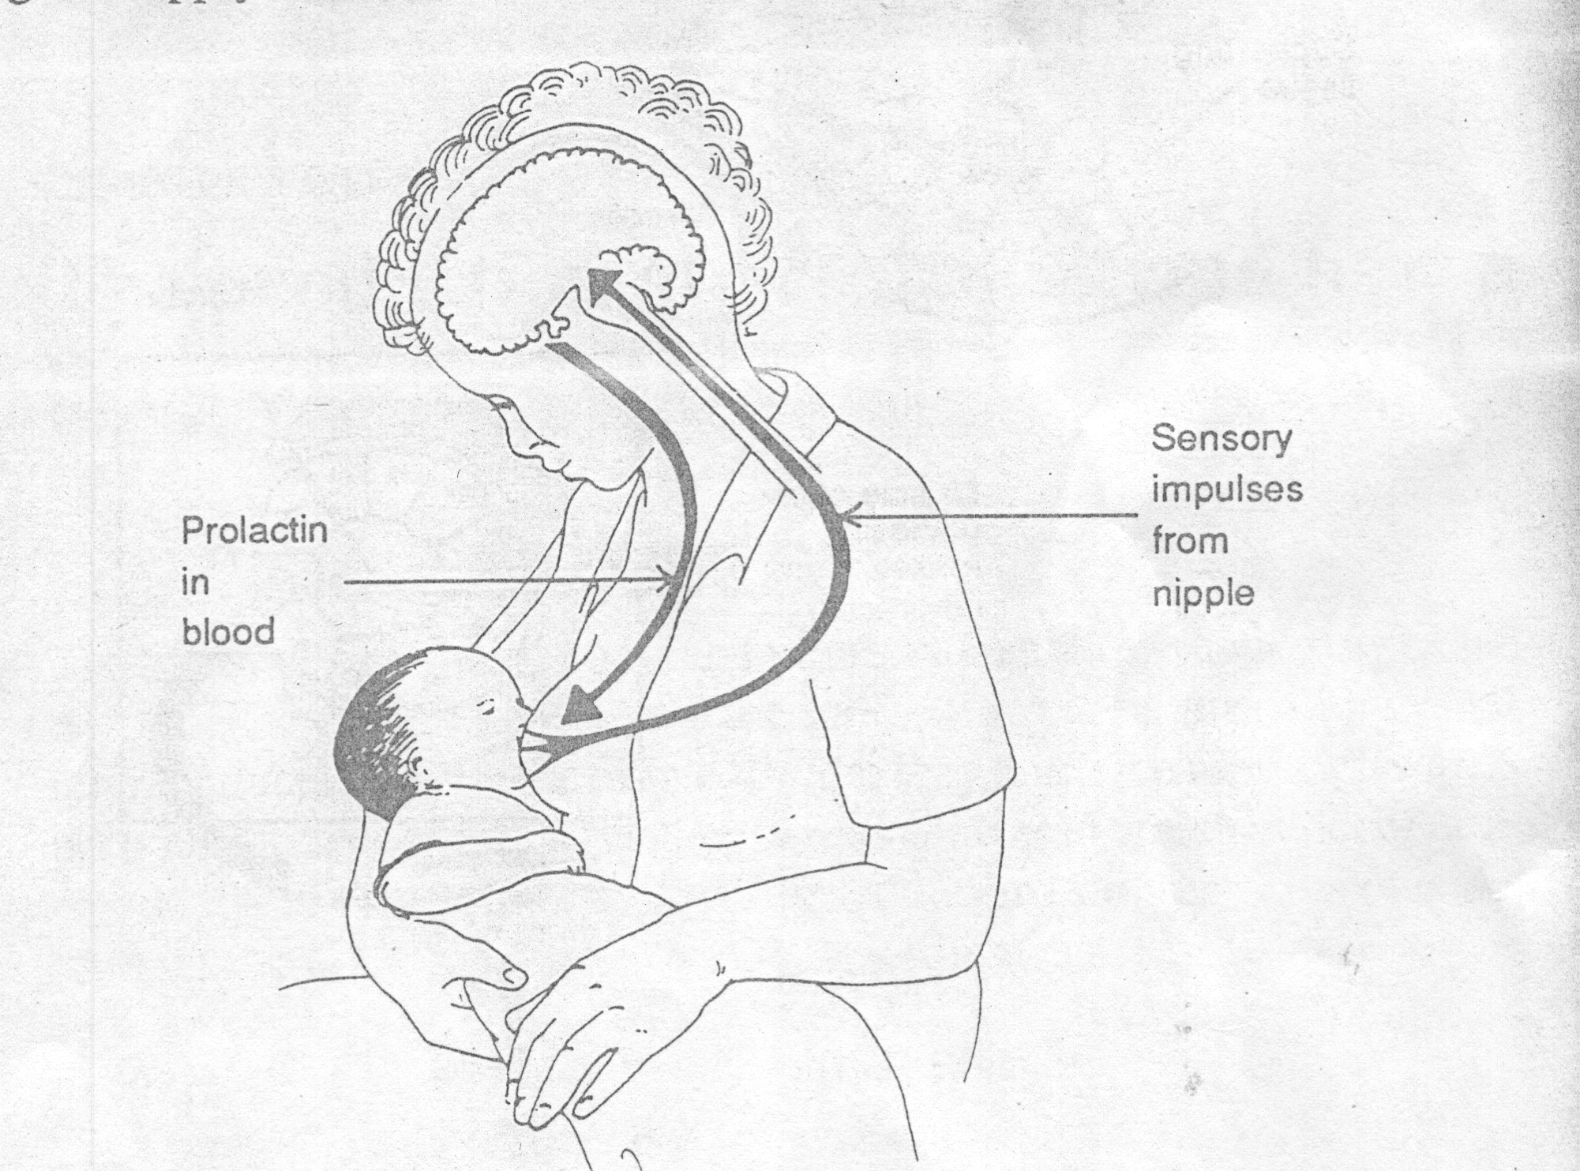
The prolactin or milk secretion reflex

Slide 26
COLOSTRUM
PRE MILK SECRETION
YELLOWISH
1ST 2-3 DAYS AFTER DELIVERY
HIGHER SP.GR (1.040 – 1.06)
& NA + CL CONTENT, LOWER CHO+O, K AND FAT CONTENT THAN MATURE MILK.
NORMAL LAXATIVE ACTION

Slide 27
COLOSTRUM
NATURAL STARTER FOOD
- HELPS BABY PASS MECONIUM
FORE MILK
GREY WATERY – RICH IN PROTEINS LACTOSE, VITAMINS, MINERALS + WATER
HIND MILK - END OF FEED
WHITER THAN FORE MILK – CONTAINS MORE FAT
BOTH NEEDED!

Slide 28
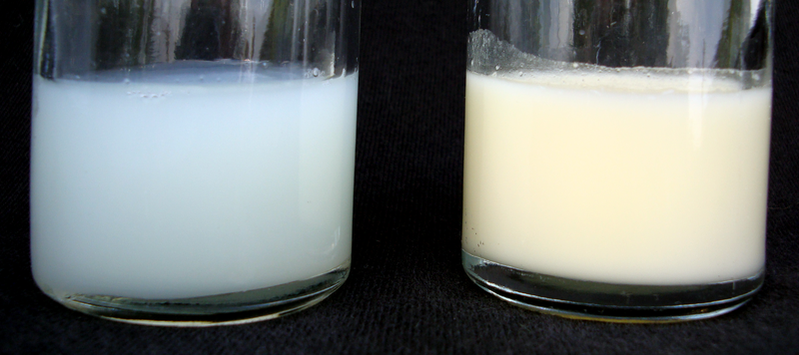
FORE MILK AND HIND MILK
The left hand sample is Foremilk, the first milk coming from a full breast. Foremilk has a higher water content and a lower fat content to satisfy thirst.
The right hand sample is Hindmilk, the last milk coming from a nearly empty breast. Hindmilk has a lower water content and a higher fat content to satisfy hunger. As breastmilk is made continuously including during the feed itself, the milk can switch between Foremilk and Hindmilk until the baby has had enough.

Slide 29
Factors
Secretory IgA and other immunolgobulins
Bifidus factor
Antistaphlococcal factor
lysozymes
lactoferrin
leucocytes
interferon
lactoperoxidase
Prostaglandins

Slide 30
Anti-infective properties of breast milk
Factor | Function
Secretory IgA and other immunolgobulins | Coat intestinal mucosa and protect from bacteria and viruses: high levels in colostrum –gradually disappears
Bifidus factor | Creates inhospitable conditions for enteropathic bacteria through presence of L.Bifius and resulting acidity
Antistaphlococcal factor | Resists staphlococci, especially S. Aureus
lysozymes | Attack bacterial cell wall by cellular lysis, levels increase for 6 months after delivery
lactoferrin | Inhibits growth of bacteria by chelating iron
leucocytes | Destroy pathogens by phagocytosis, produce lysozyme, lactoferrin, IgA and interferon
interferon | Protects against viral infections
lactoperoxidase | Kills streptococci
Prostaglandins | Act as cytoprotectors, full effect still unknown

Slide 31
Distribution of Immunolglobulins and other soluble substances in colostrum and milk delivered to the breastfed infant during a 24 hrs period
Concentration in mg/day weekly after delivery
Soluble Product | <1 | 1-2 | 3-4 | >4
Immunoglobulin
I gG | 50 | 25 | 25 | 10
I g A | 5000 | 1000 | 1000 | 1000
Ig M | 70 | 30 | 15 | 10
Lysozyme | 50 | 60 | 60 | 100
Lactoferrin | 1500 | 2000 | 2000 | 1200

Slide 32
Constituents of human and cow milk
 | HUMAN | COW’S
ENERGY (Kcal/ml | 75 | 66
LACTOSE (g/100ml | 6.8 | 4.9
PROTEIN (g/100ml) | 1.1 | 3.5
FAT (g/100ml) | 4.5 | 3.7
SODIUM (mmo11l) | 7 | 22
WATER(ml/100ml) | 87.1 | 87.3

Slide 33
ADVANTAGES OF BREASTFEEDING
F-resh
E-motionally bonding
E-asily digested
D-iarrhea reduced
I-mmediately available
N-utritious
G-astroenteritis reduced
B-est for baby
R-educes allergy
E-conomical
A-ntibodies
S-tool inoffensive
T-emp always right

Slide 34
Health Benefits for Breastfeeding Women
Postpartum Benefits Helps to expel the placenta Reduces blood loss Speeds uterine involution Helps body weight return to normal | Reduces Cancer Risks Epithelial Ovarian Cancer Breast Cancer | Bone Health Greater bone density among women who have ever breastfed Lower risk of hip fracture later in life
Notes:
Postpartum benefits:
These benefits occur because oxytocin, a hormone released in the body when a woman breastfeeds, stimulates uterine contractions. The contractions help to expel the placenta and decrease postpartum blood loss. Study findings on weight loss are mixed.
Reducing Cancer Risks:
One large study found a reduced risk of breast cancer averaging 14% among women who ever breastfed compared with women who never breastfed. Among premenopausal women, the longer the total durations of breastfeeding over a lifetime, the more protection that breastfeeding appears to provide.
Bone Health:
Breastfeeding may be associated with better bone health later in life. While studies consistently find a temporary bone loss during breastfeeding, this loss is fully recovered after weaning or once menses resume.

Slide 35
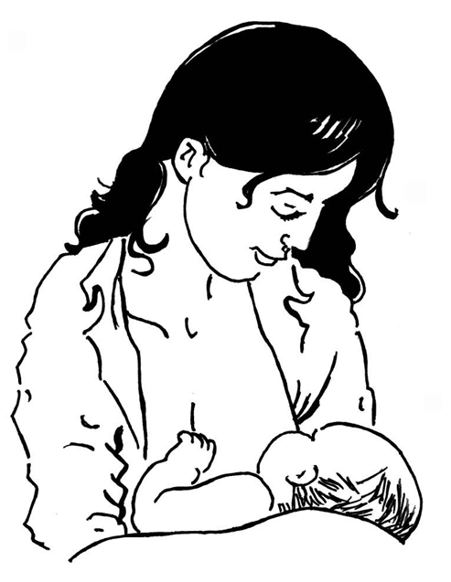
Proper breastfeeding technique
Positions
Entire areola in mouth

Slide 36
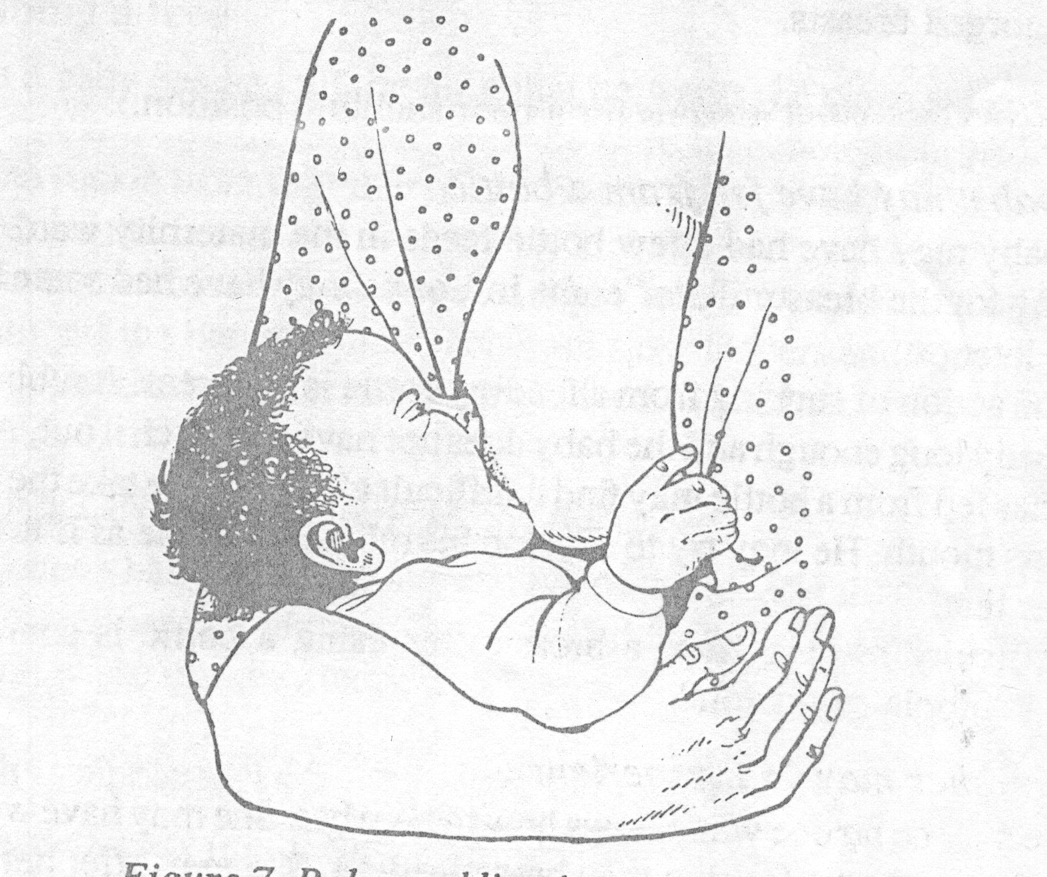
Baby suckling in a good position

Slide 37
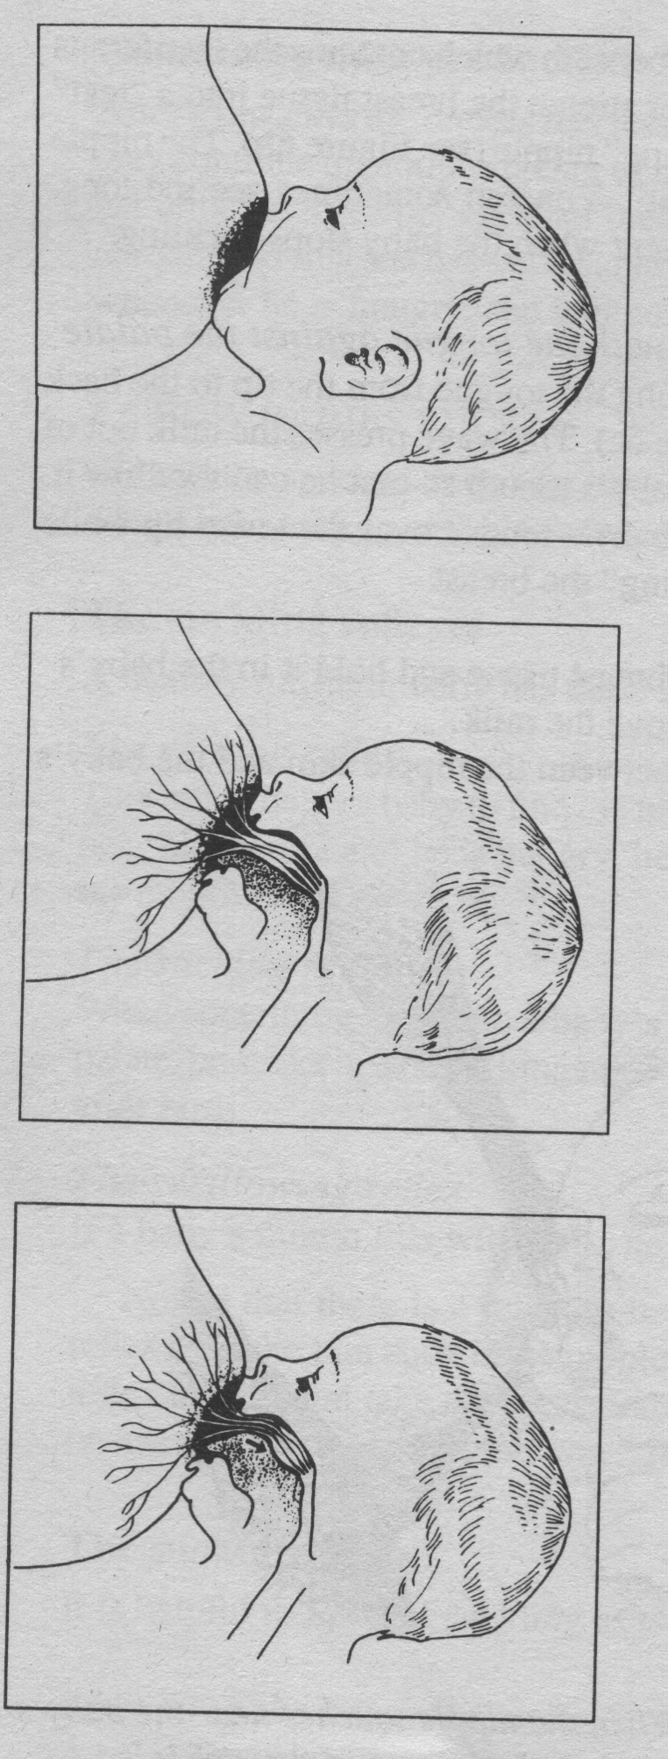
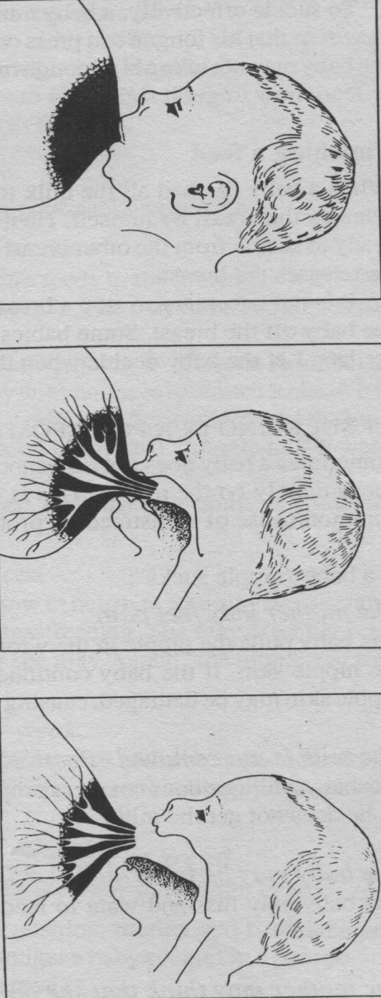
CORRECT
INCORRECT

Slide 38
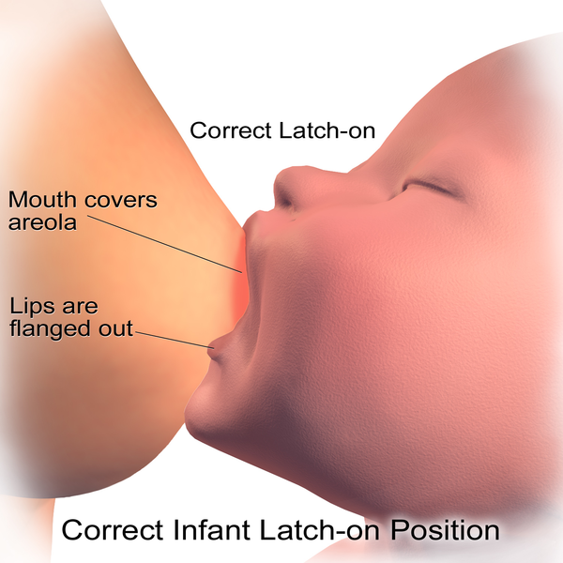

Slide 39
Breastfeeding in special circumstance
Preterm
Sick mother/baby
Cleft palate/lip
Working mother
Twins/triplets

Slide 40
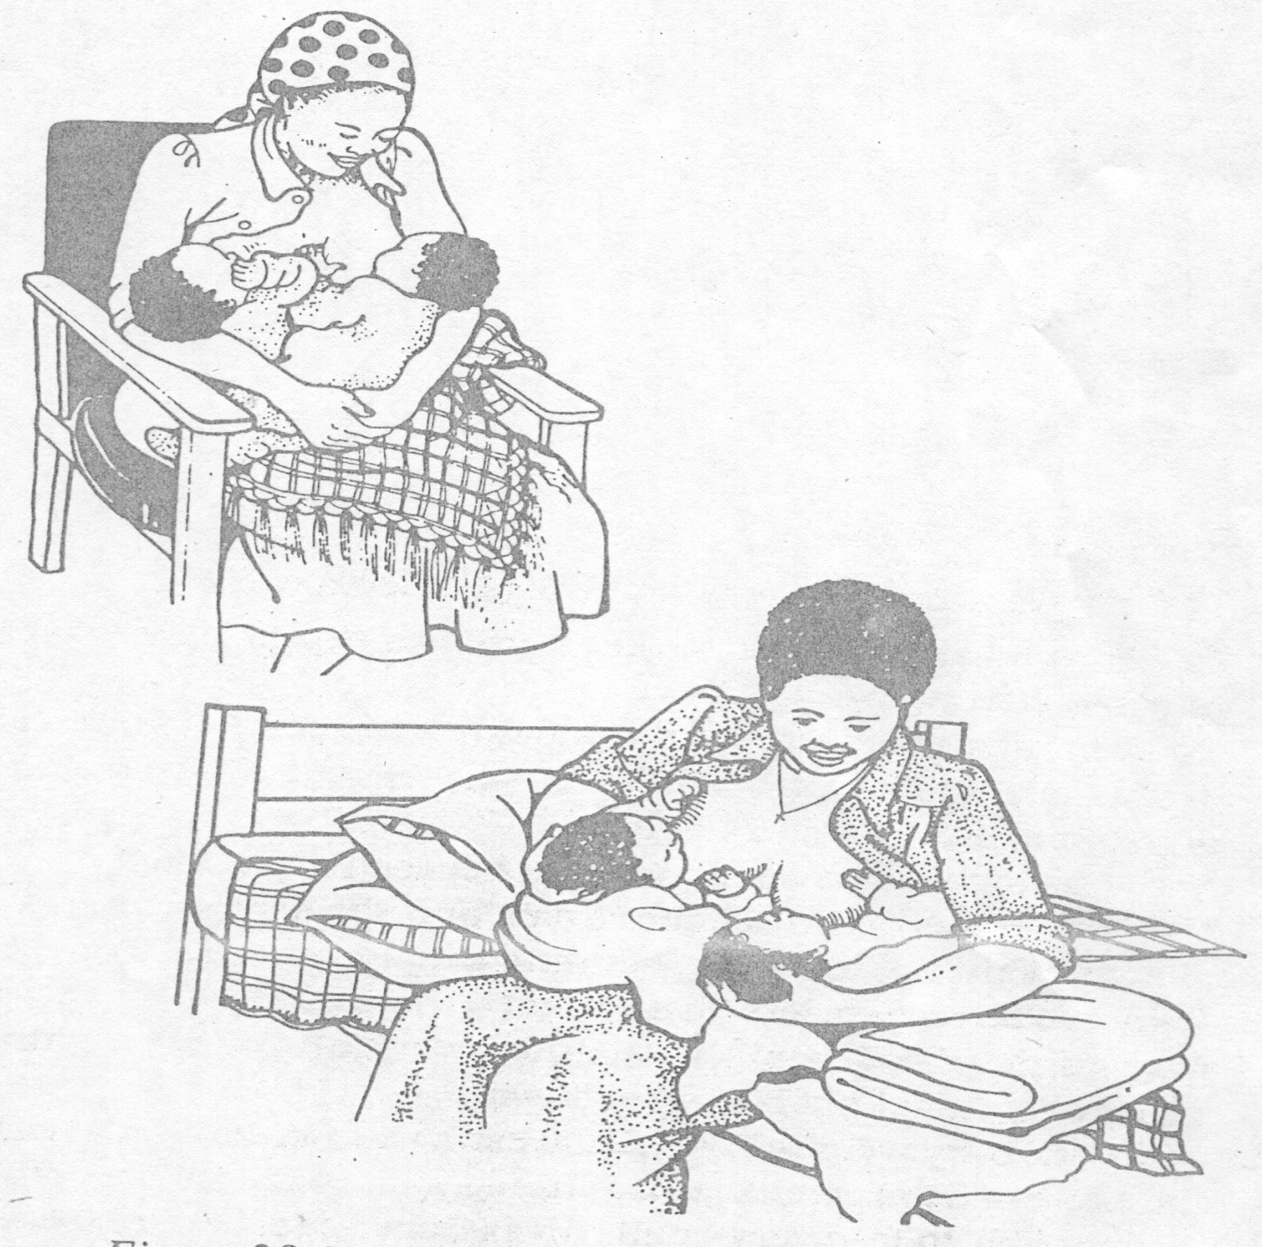
Breastfeeding Twins

Slide 41

Can Employed Women
Use LAM?
Women who are able to keep their infants with them at the work site or nearby and are able to breastfeed frequently can rely on LAM as long as they meet the three criteria for LAM.
Women who are separated from their infants by work or for other reasons can use LAM if the separation is less than four to five hours at a time.
Expressing breastmilk may not signal the mother’s hypothalamus to stimulate milk production as well as suckling.
Photo ID:2005-695
Notes:
Pregnancy rates may be higher for women who are separated from their infants. The one study that assessed use of LAM among working women estimated a risk of pregnancy of 5% during the first six months postpartum. In this study each woman was asked to express her breastmilk while away from her infant—at least as often as the feeding pattern at home and never less than every four hours. Expressing breastmilk may not signal the mother’s hypothalamus to stimulate milk production as well as suckling.
An employed woman may want to use LAM but worry that her job will prevent it. Health care providers can encourage the woman to breastfeed more often when she is with her baby. This may ensure enough suckling to maintain the contraceptive effectiveness of LAM. Providers also can advise the woman that full and frequent breastfeeding provides immediate health benefits for the infant whether or not she can practice LAM.

Slide 42
Complications of b’feeding and management
Cracked nipple
Engorgement
Mastitis
Abscess
Too much milk
Too little milk

Slide 43
Balancing the Risks
A mother living with HIV faces a difficult decision—whether to breastfeed, in order to give her infant important nutrients and protection from potentially deadly diseases, or not to breastfeed, to avoid the risk of transmitting HIV through breastmilk.
HIV Transmission
Risk of Other Diseases
Notes:
HIV also can be transmitted from an infected mother to her child during pregnancy or delivery. Among 100 children born to HIV-positive mothers who do not receive antiretroviral treatment, an estimated 15 to 25 children will become infected with HIV during the mother’s pregnancy and delivery. If HIV-positive mothers breastfeed their infants up to six months of age, an additional 5 to 10 of these 100 children would become infected. If breastfeeding lasts between 18 and 24 months, 15 to 20 children would be infected through breastmilk.
One study found that in areas of poverty and poor hygiene—as in much of sub-Saharan Africa—compared with replacement feeding, any breastfeeding by HIV-infected mothers during the first six months would result in 68 HIV infections but 100 fewer deaths from other causes per 1,000 live births.
In the countries most affected by AIDS, an estimated 10% of pregnant women are currently offered services of proven effectiveness to prevent HIV transmission during pregnancy and childbirth.
Ultimately, every HIV-positive mother’s decision whether to breastfeed or not is her individual decision. She should make her decision with full information on the various choices and their possible consequences and with help and support from her health care provider and her family.

Slide 44
What Do Experts Advise?
WHO and other UN agencies advise that HIV-positive mothers
avoid breastfeeding if replacement feeding meets five essential
criteria:
- Affordable
- Feasible
- Acceptable
- Sustainable
- Safe
Otherwise, HIV-positive mothers should breastfeed exclusively for their infants’ first months of life and stop breastfeeding if replacement feeding can meet the five criteria or when breastmilk alone is no longer adequate.
Notes:
The greater risk of early mixed feeding means that infants of mothers with HIV need to stop breastfeeding all at once, rather than gradually, when they switch to replacement feeding.

Slide 45
Infant feeding Guidelines 2009
  Longer periods of breastfeeding ARV’s
  More information will be provided during the PMTCT seminar

Slide 46
Drugs and breastfeeding
Absolute contraindications
  Chemotherapeutic agents
  Lithium etc

Slide 47
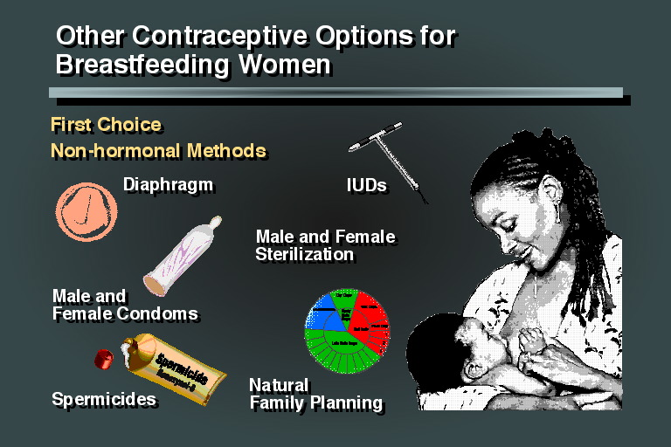

Slide 48
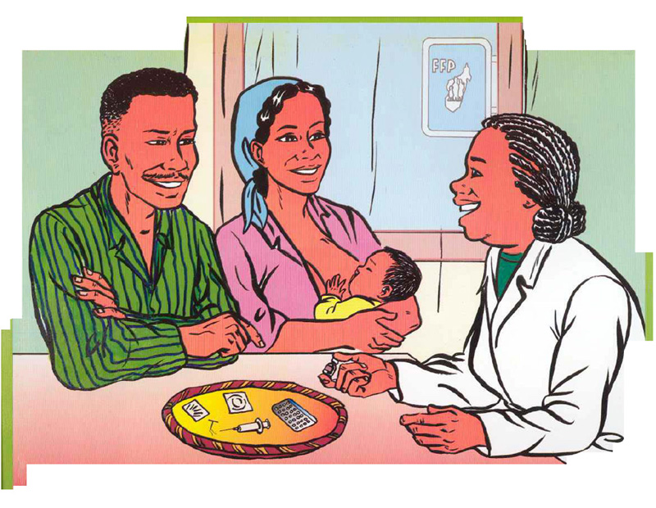
Breastfeeding Increases Women’s Contraceptive Options
Mothers who breastfeed fully or nearly fully can rely on the lactational amenorrhea method (LAM) to delay their next pregnancy.
Notes:
LAM takes advantage of the natural infertility that results from frequent breastfeeding, which can last for six months postpartum, or longer, if a woman’s menses have not resumed.
Nonhormonal contraceptive methods and progestin-only hormonal methods also can be appropriate for nursing Mothers and do not affect breastmilk production or infant health.

Slide 49
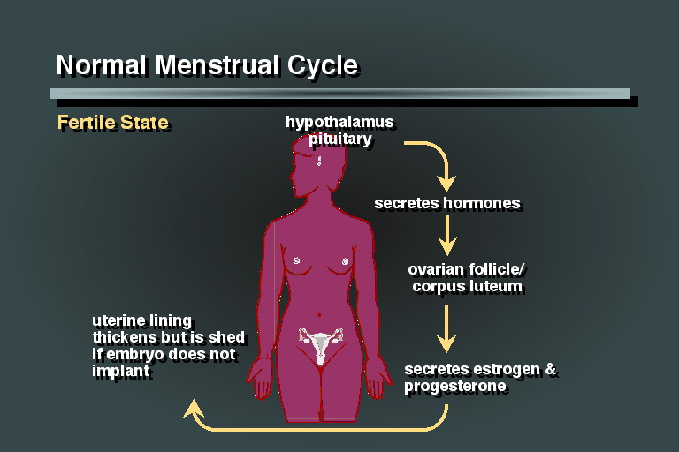

Slide 50
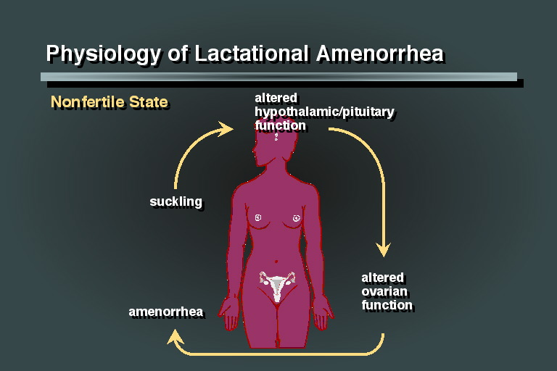

Slide 51
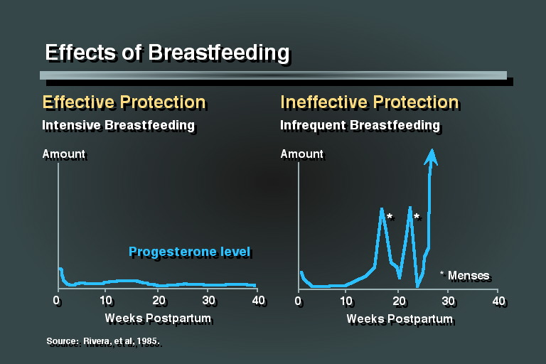

Slide 52
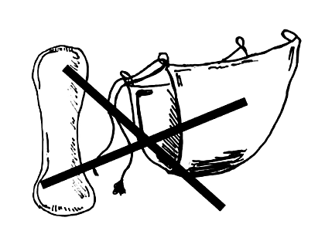

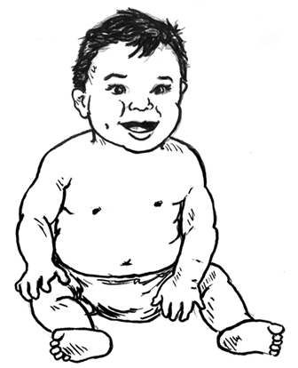
When Can a Woman Use LAM?
1
Have your menses returned?
If the answer to all these questions is NO she can use LAM.
2
Are you regularly giving the baby other food besides breastmilk, or allowing long periods without breastfeeding, either day or night?
If the answer to any ONE of these questions is YES her chances of pregnancy increase.
3
Is your baby more than 6 months old?
Notes:
LAM has 3 criteria, all of which must be met for breastfeeding to provide effective temporary protection from another pregnancy:
1. The mother’s menstrual periods have not returned.
Following childbirth and while breastfeeding, a woman is less likely to ovulate and menstruate. The return of a woman’s menses is an important indicator that her postpartum infertility is at an end. It indicates that ovulation has resumed or may soon resume.
2. The baby is fully or nearly fully breastfed, and frequently, day and night.
Active suckling causes the biological actions necessary to suppress ovulation. A baby’s suckling stimulates the nipple, which signals the mother’s brain to release the hormone prolactin. Prolactin stimulates milk production and blocks the release of the gonadotropin-releasing hormone (GnRH), which promotes ovulation. When the baby’s suckling falls below a certain frequency and intensity, GnRH and other hormones that promote ovulation are no longer blocked, leading to the resumption of the menstrual cycles, and thus fertility.
3. The baby is less than 6 months old.
A woman can begin LAM anytime during the first six months after childbirth, as long as she has been fully or nearly fully breastfeeding her baby since birth and her menstrual periods have not returned.

Slide 53
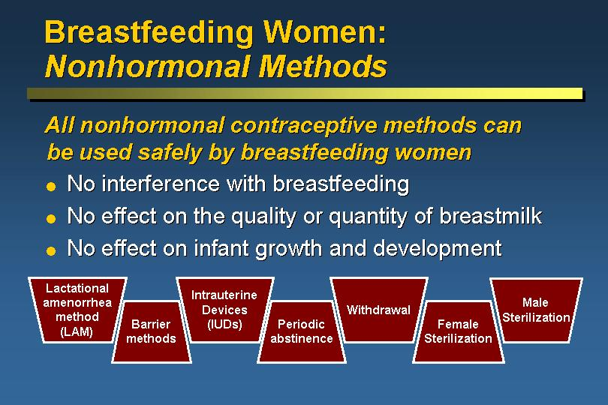

Slide 54
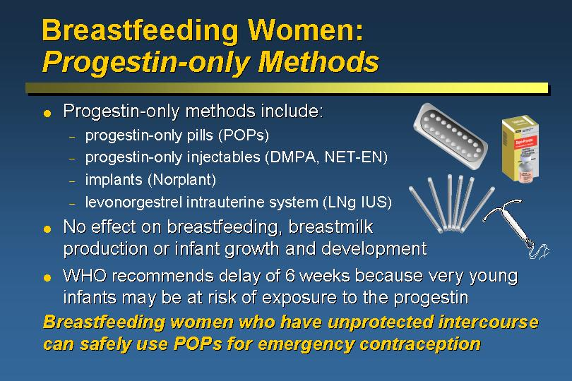

Slide 55
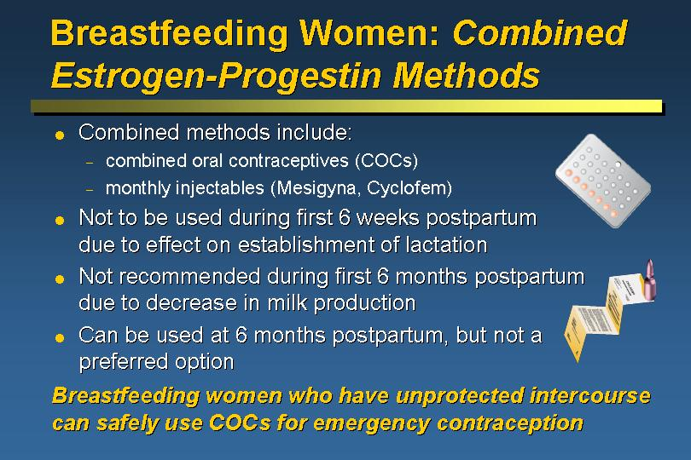

Slide 56
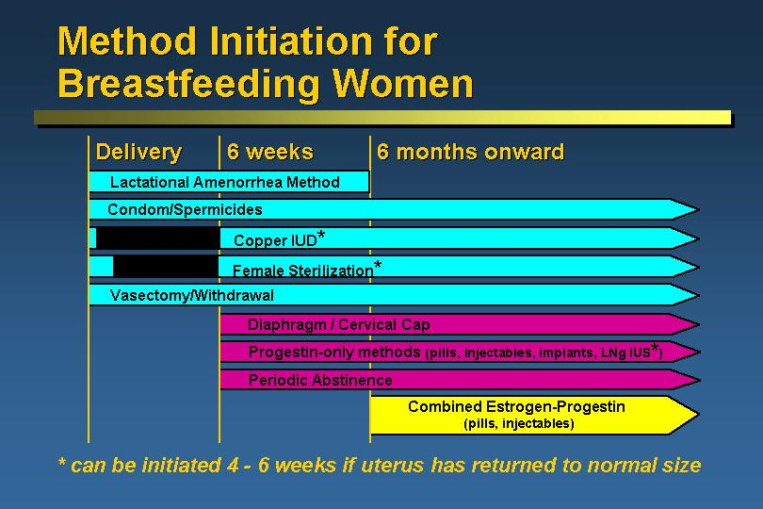

Slide 57
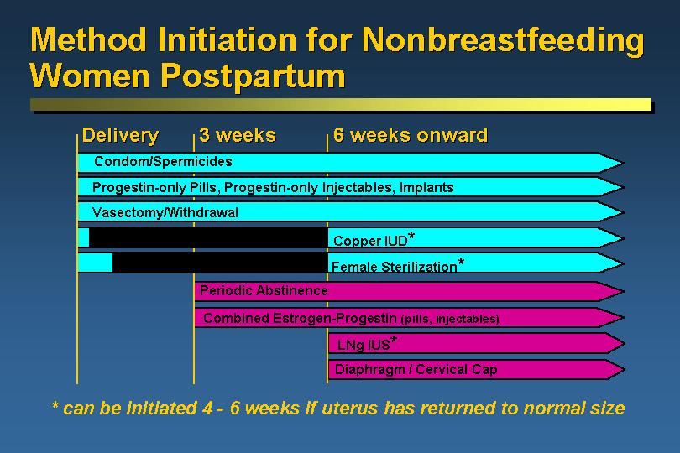

Slide 58


Slide 59


