Slide 1
SURGICAL CONTRACEPTION
By Dr. Kamau Koigi,
MB, ChB, M.MED O/G

Slide 2
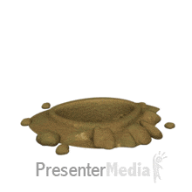
PRESENTATION OUTLINE
INTRODUCTION
SURGICAL CONTRACEPTIVE TECHNIQUES:
FEMALE
MALE
CONCLUSION

Slide 3
INTRODUCTION
Simply put, contraception is the prevention of pregnancy
Historically, numerous methods had been attempted, such as use of Kahun papyrus for vaginal plugs, or a mix of crocodile dung and fermented dough or acidic mixtures of fruits, nuts and wool as spermicides
Effective control of reproduction is essential to a woman’s well-being and to her ability to achieve her individual goals, especially if she has completed her family size or if pregnancy presents a significant risk to her health

Slide 5
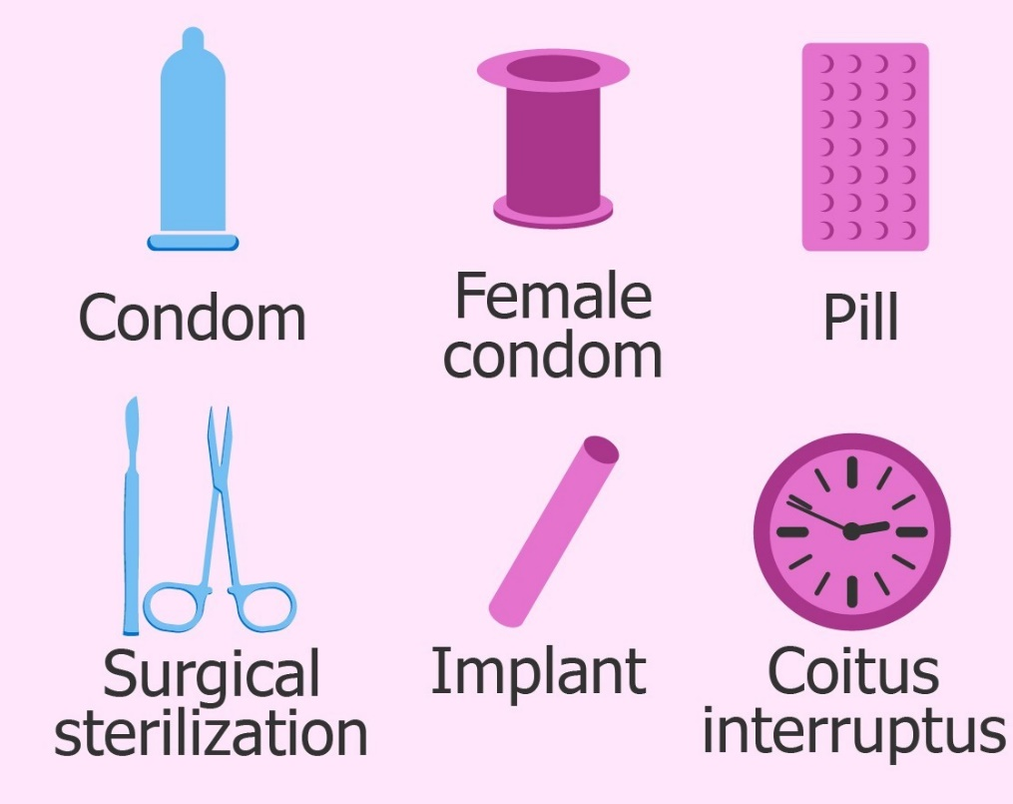
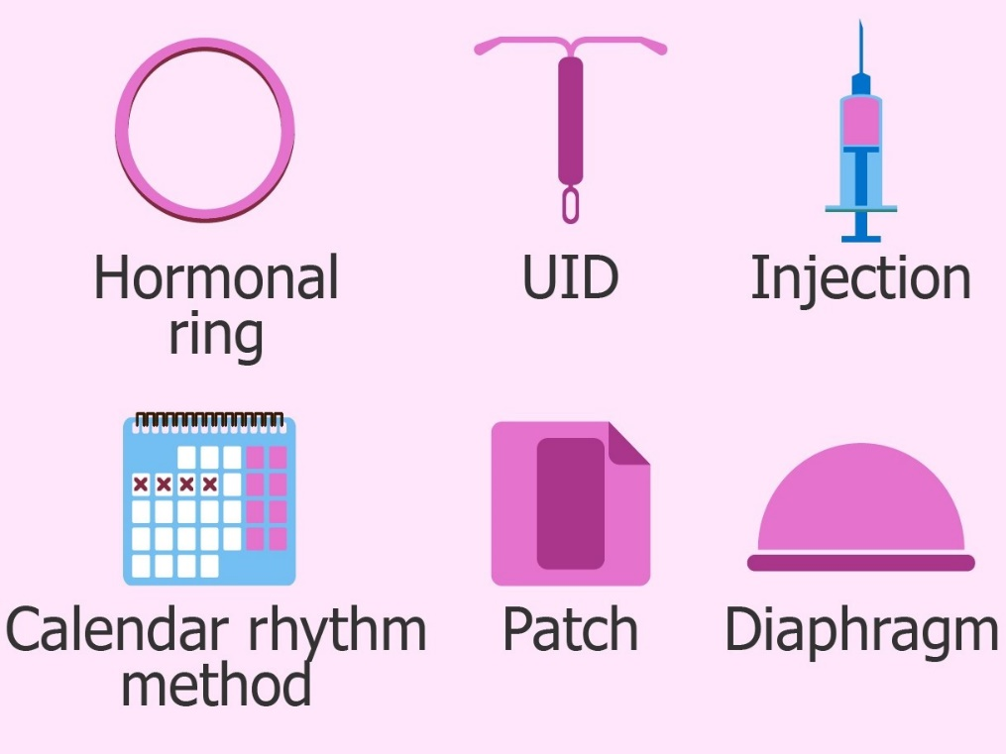
Methods currently available:
Natural methods: coitus interruptus, lactational amenorrhoea, natural family planning
Mechanical barriers: male condom, female condom, diaphragm, cervical cap – work best with spermicidal agents
Hormonal contraceptives: implants, injectable, progestin-only pills, combined contraceptives, combination patch, contraceptive vaginal ring
Intrauterine devices: Copper T380A, Mirena, Skula
Surgical methods/ Sterilization: Female (tubal ligation); Male (Vasectomy)
[Emergency (post-coital) contraception is also possible]

Slide 6
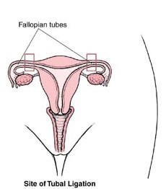
FEMALE STERILIZATION
This refers to the elective permanent prevention of fertilization by the interruption of the integrity of the fallopian tubes

Slide 7
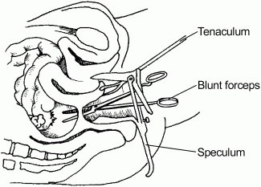
Based on timing, it may be classified as:
Post-partum: done through a small, transverse infra-umbilical incision
Interval: can be done via laparotomy, laparoscopy or colpotomy
-----------------------------------------------------------------------------------------
Based on the mode of access, it may be classified as:
Laparotomic – abdominal incision - open
Laparoscopic – minimal access technique
Colpotomy – Vaginal access technique

Slide 8
Female Sterilization techniques
Based on the surgical technique applied, tubal sterilization may be classified as:
Occlusive methods using Falope rings, clips or bands
Segmental destruction with electrocoagulation
Suture ligation with partial salpingectomy: Pomeroy, Uchida and Irving methods; fimbriectomy
Microinsertion technique: done via hysteroscopy – Essure insertion

Slide 9
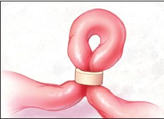
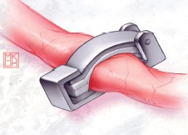
Occlusive methods

Slide 10
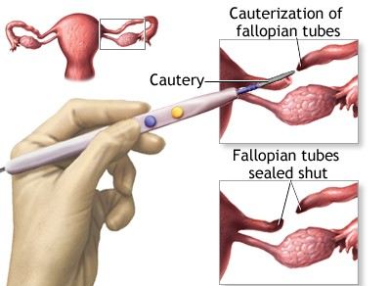
Segmental destruction – electrocautery

Slide 11
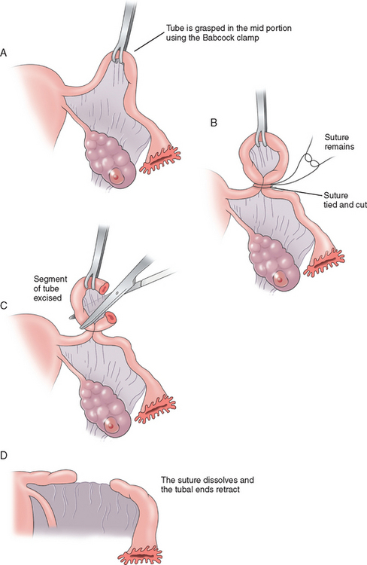
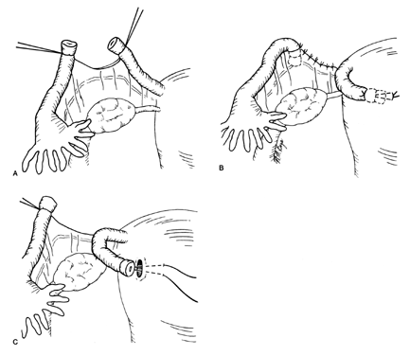
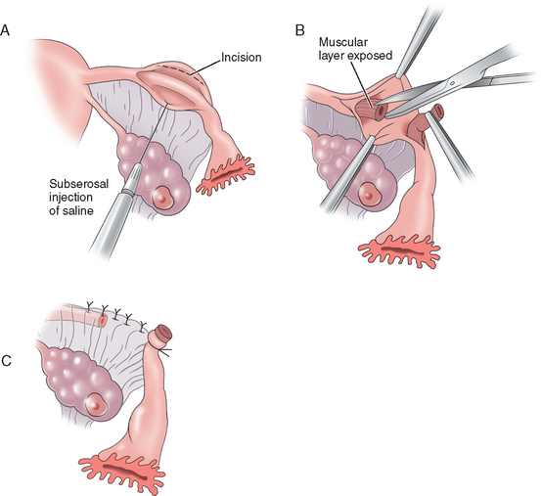
Suture ligation + Partial salpingectomy

Slide 12
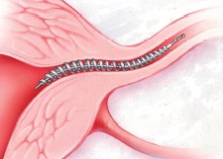
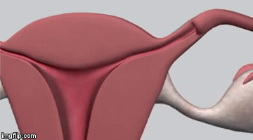
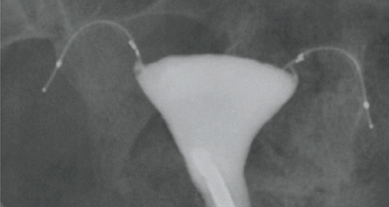
Essure micro-insertion technique

Slide 13
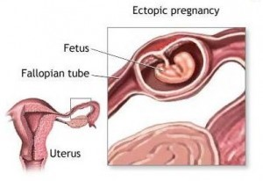
Complications
Regret of permanency, therefore requesting reversal – up to 6%
Failure: unwanted intrauterine pregnancy (0.1 – 0.8%) or an ectopic pregnancy; may be due to failure to correctly identify the fallopian tube during TL
Pain – chest and shoulder pain due to trapped gas (if done laparoscopically)
Infection & haemorrhage – more common with mini-laparotomy and colpotomy approaches
Visceral injuries – bowel, bladder, ureters
Mortality – more likely to be due to complications associated with anaesthesia – hypoventilation and cardiopulmonary arrest

Slide 14
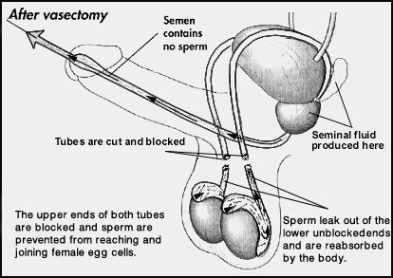
MALE STERILIZATION
There is only one method of male sterilization – vasectomy
This is the elective ligation of the vas deferens through a small incision in the upper outer aspect of the scrotum
The procedure is only considered successful after documentation of azoospermia – usually after semenalysis after 3 months
Failure rate very low 0.2%

Slide 15
CONCLUSION
Sterilization, being a permanent method of prevention of pregnancy, has the potential to enhance the sexual experience of a couple
However, it should be undertaken only after careful discussion and consideration in order to avoid having unnecessary regrets and conflict

