Slide 1
CANCER OF THE CERVIX
DR.MEDHAT M.AMIN
CYNECOLOGIC ONCOLOGIST

Slide 2
Anatomy
-Portio vaginalis & Supravaginal cervix
-Ectocervix & endocervix
-External & Internal os
-Histology
Estrogen dependent tissue, glycogen deposition into the superficial layer (Schiller,s + ve test)
Ectocervix ; st.sq.epth. –basal layer –Mitosis
--parabasal layer
--intermediate layer
--superficial layer
Endocervix ; single cylindrical cells ,branching folds
Stroma ;C.T. ,stratified ms ,collagen ,and bl.v.
-Gross anatomy ; see figure

Slide 3
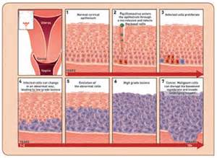
St.Squamous cell & CIN

Slide 4
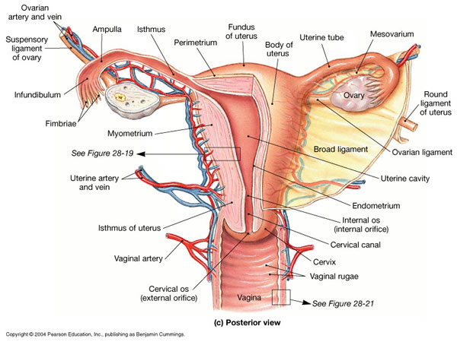

Slide 5
Epidemiology
-The 2nd most common wide world cancer
- incidence 530 .000 new cases ,280.000 deaths annually ,most of which in subsaharian Africa
-Reduced mortalities due to screening, and improving treatment skills
-incidence reduced 15 to 4.6 to 3.4/100000
-High association with human papilloma virus shows a causative relation than association
-Risk factors
Young age of sexual activities
Multiple sexual partners & unprotected sex
Cigarette smoking ,multiparity ,1st child at age >20
Low social class ,Backs

Slide 6
Vaccination againist Human Papilloma Virus
-GARDASIL ;quadravalent vaccine (HPV 6,11,16,18) against HPV of cx ,vag. , anogenital region
-CERVACIX ; bivalent vaccine ( HPV 16 ,18 ) against HPV of cx , vag
-Vaccination ; 98% effective
-Intent to treat ; 44% improvement
-Age of vaccination 9-26 years ( before sexual activities)
-Vaccination 0 , 1-2 , 6 months

Slide 7
Histological Classification
-EPITHELIAL
I Ectocervix ; Non-glandular squamous .c. – verrucous –warty, papil sq c – lymphoid like epith - sarcomatoid
II Endocevtx ;Glandular
Adencarcinoma –mucous –clear c
- endomerioid –adenoma magnum –mesenephr. Signet ring – colloid –intest-like
III Others ; Adeno-squamous – Glassy –small c
-NON-EPITHELIAL
Mesenchymal , Germ c , Miscellaneous

Slide 8
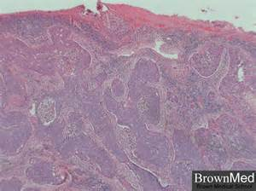
SQUAMOUS CELL CARCINOMA CX

Slide 9
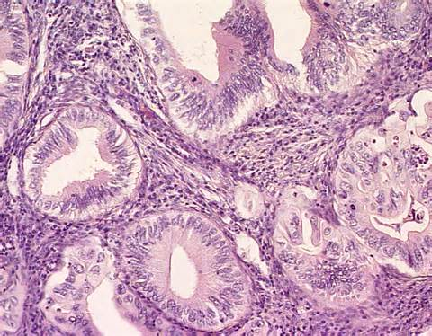
WELL DIFFERENTIATED ADENOCARCINOMA CX

Slide 10
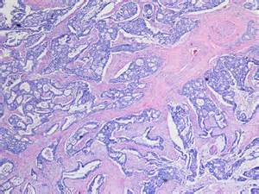
POORLY DIFFERENTIATED ADENOCARCINOMA CX

Slide 11
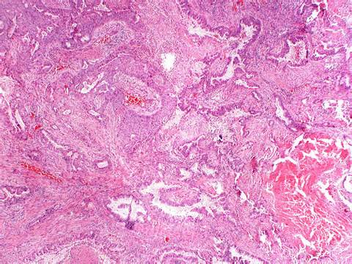
ADENOSQUAMOUA CA CX

Slide 12
Clinical Profile
I Symptoms ;
-Watery vaginal discharge ,blood stained
-Bleeding (mainly) ;spotting ,profuse ,contact ,intermenstrual
-Infection
-45-55 years ,multiparaty ,early age of childbirth
-Advanced ; ureteric involvement symp. ,GIT symp. ,lungs ,liver etc
II Gross appearance
-Exophytic , size? ,friable? ,polypoidal ,bleeding
-Endophytic ,barrel shaped
-Ulcer
-Infilterating ,no obvious lesion (stoney hard)

Slide 13
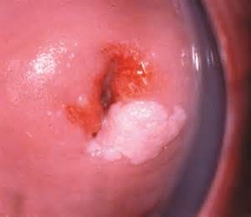
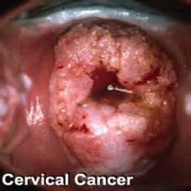
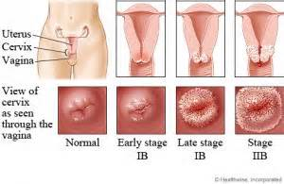

Slide 14
Routes of spread of Ca Cx
-Direct
>Vagina
>Parametrium
>Bladder
>Rectum
>Ureters
>pelvic wall
-Lymphatics
-Hematogenous ;distal metastases

Slide 15
Lymphatic Spread in Ca Cx
-Primary group
Parametrium
Paracervical or Ureteral
Hypogastric (int. iliac)
External iliac ;6-8
Obturator
Sacral group
-Secondary group
Common iliac
Inguinal groups (deep and superficial L N )
Periaortic group

Slide 16
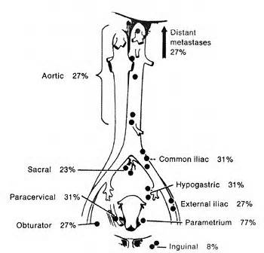

Slide 17
International Federation of Gynecology and Obstetrics
International classification of cancer of cervix according to the International Federation of Gynecology and Obstetrics (FIGO) was recently revised in 2009
Stage 0 Carcinoma in situ, intraepithelial carcinoma
Stage I The carcinoma is strictly confined to the cervix (extension to the corpus should be disregarded)
Stage Ia Invasive cancer identified only microscopically; all gross lesions even with superficial invasion are stage Ib cancers. Invasion is limited to measured stromal invasion with maximum depth of 5 mm and no wider than 7 mm
Stage Ia1 Measured invasion of stroma no greater than 3 mm in depth and no wider than 7 mm
Stage Ia2 Measured invasion of stroma greater than 3 mm and no greater than 5 mm and no wider than 7 mm

Slide 18
The depth of invasion should not be more than 5 mm taken from the base of the epithelium, surface or glandular, from which it originates. Vascular space involvement, venous or lymphatic, should not alter the staging
Stage Ib Clinical lesions confined to the cervix or pre-clinical lesions greater than stage Ia
Stage Ib1 Clinical lesions no greater than 4 cm
Stage Ib2 Clinical lesions greater than 4 cm
Stage II Involvement of the vagina but not the lower third, or infiltration of the parametria but not out to the sidewall
Stagen IIa Involvement of the vagina but no evidence of parametrial involvement
Stage IIa1 Clinically visible lesion greater than 4 cm in greatest dimension
Stage IIa2 Clinically visible lesion greater than 4 cm in greatest dimension
Stage IIb Infiltration of the parametrial but not out to the sidewall

Slide 19
Stage III Involvement of the lower third of the vagina or extension to the pelvic sidewall; all cases with a hydronephrosis or nonfunctioning kidney should be included, unless they are known to be attributable to other causes
Stage IIIa Involvement of the lower third of the vagina but not out to the pelvic sidewall if the parametria are involved
Stage IIIb Extension onto the pelvic sidewall or hydronephrosis or nonfunctional kidney
Stage IV Extension outside the reproductive tract
Stage IVa Involvement of the mucosa of the bladder or rectum
Stage IVb Distant metastasis or disease outside the true pelvis

Slide 20
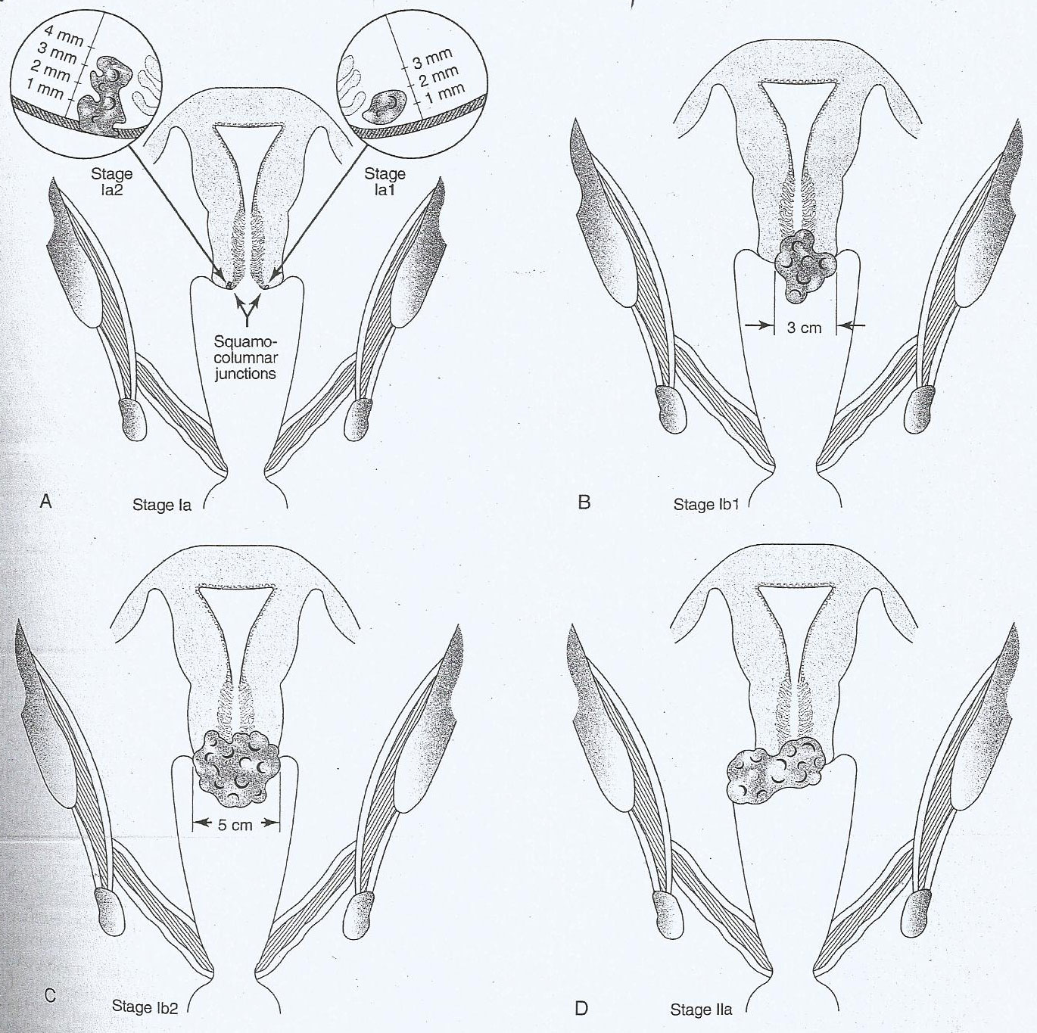

Slide 23
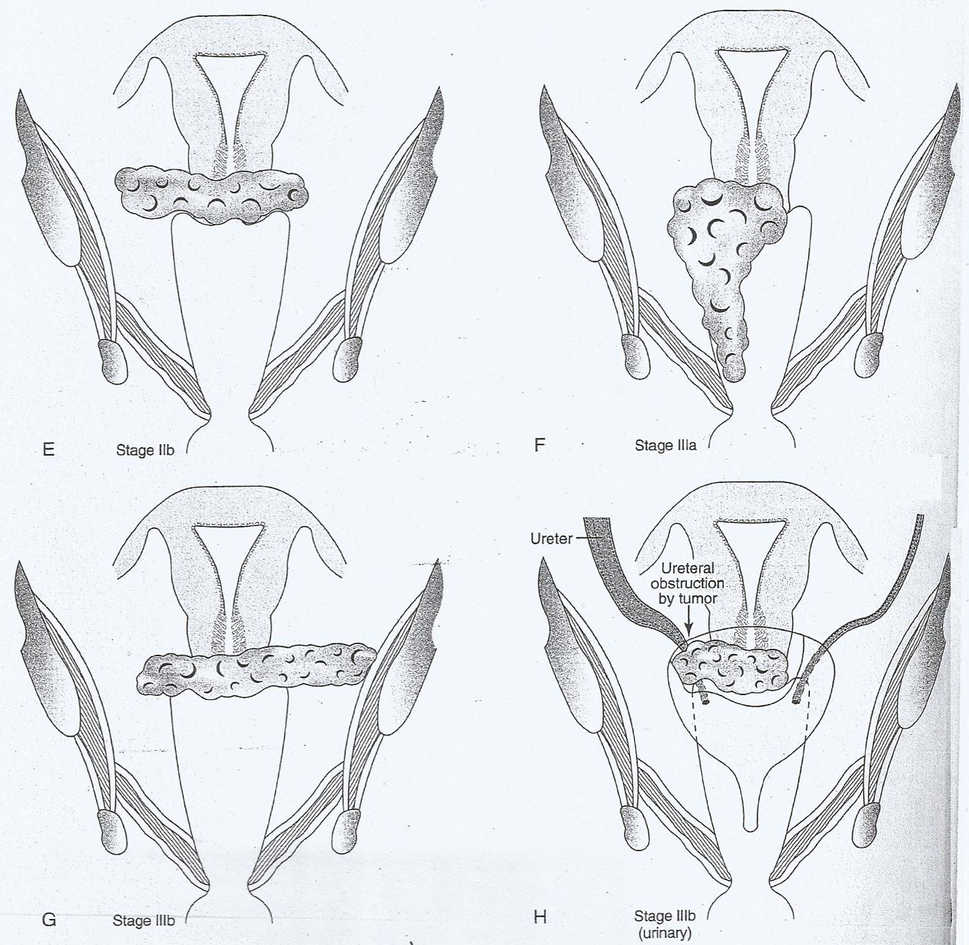

Slide 26
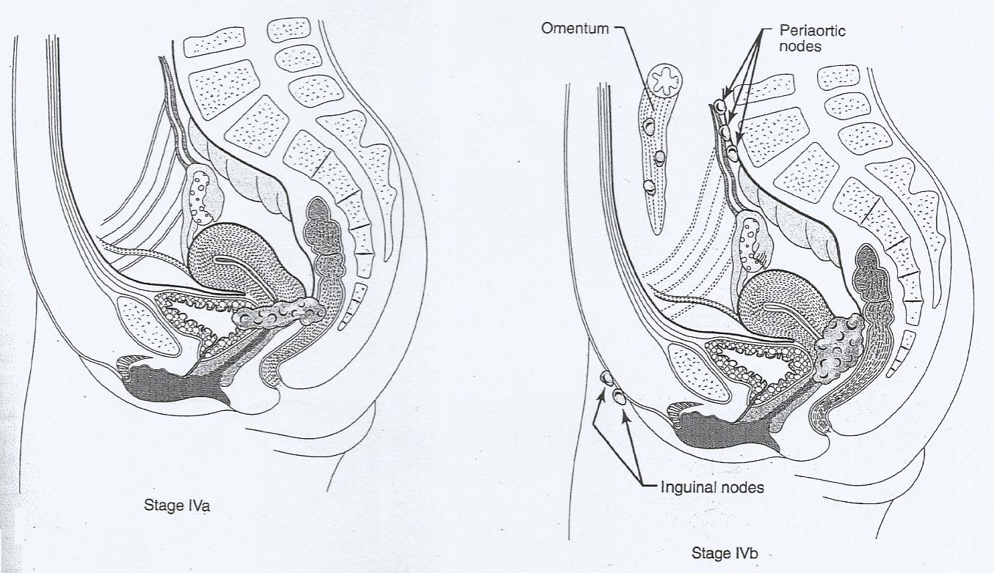

Slide 27
Factors influencing lymphatic spread
Stage
-Stage Ia Ia1 1% / +LVSI 2-3% ,,, Ia2 6.3%
-Stage Ib Pelvic L N 18% Periaortic L N 6%
-Stage II Pelvic L N 29% Periaotic L N 16%
-Stage III Pelvic L N 47% Periaotic L N 9% Tumor Size
-Stage Ib
< 1cm 18% ----2-3cm 22% ---4-5cm 35% ----
>6cm 50%
Cell Differentiation
Histological Type

Slide 28
Assessment of Patient with Ca Cx

Slide 29
History Review of systems General Physical Examination
Risk factors (STDs, smoking, OCPs, HIV), Abnormal vaginal bleeding or discharge; pelvic Peripheral lymphadenopathy Prior abnormal Pap test, previous pain. Flank pain, sciatica, hematuria, rectal Dysplasia and treatment bleeding, anorexia, weight loss, bone pain Evaluation Common procedures (FIGO) Alternative procedures Invasive cancer Cervical biopsy Histologic diagnosis required Endocervical curettage Cervical conization Tumor size; involvement of the vagina, Pelvic examination under anesthesia MRI pelvis preferred over CT bladder, rectum and parametria Anemia Complete blood count __ Renal failure Serum chemistries __ Hematuria Urinalysis __ Bladder involvement Cytoscopy with biopsy and urine cytology CT, MRI pelvis Rectal infiltration Proctoscopy with biopsy CT, MRI pelvis; barium enema Hydronephrosis Intravenous pyelogram Renal ultrasound; CT abdomen Pulmonary metastases Chest radiograph CT chest; PET scan Retroperitoneal lymphadenopathy __ Lymphangiogram, CT, MRI, PET scan

Slide 30
Management

Slide 31
Fertility Preservation
-Stage Ia1 SCCA (no LVSI) > Cone biopsy
-Stage Ia + LVSI >Cone biopsy + Lapar.lymph.
-Stage Ia2 to IIa> Radical Trachelectomy + Pelvic Lymphadenectomy ( Lapar. , Abdo. . Vag. ) + tailored adjuvant therapy
Standerd Terapy
-Stage Ia1 SCCA (no LVSI) > Extrafascial hysterectomy
-Stage Ia1 + LVSI > Extrafascial hysterectomy +/- Lymphadenectomy
-Stage Ia2 –Ib1 > Modified Radical hysterectomy +
Lymphadenectomy (Lapar.,Abd.) +adjuvent therapy
-Stage Ib1-IIa > Radical hysterectomy + adjuvent therapy

Slide 32
-Stage Ib2 – IIa > Radiochemotherapy
-Stage Ib2 – IV a > Radiochemotherapy HDR brachytherapy (pretreatment laparoscopic Lymphadenectomy as indicated )
Central Recurrence (isolated)
-No prior Radio > Radiochemotherapy
-Prior Radiotherapy > Pelvic exentration with urinary divertion (If no hydronephrosis ,negative paraortic lymph nodes)
Stage IVb ,Persistent and/or non central recurrence
-Cisplatin+ Paclitaxil OR
-GOG Protocol 240 ; Cisplatin +Pclitaxil +/- Bevacizumab
Vs Toptocan +Paclitaxil +/ - Bevacizumab
-Palliative Care ;e.g. Radiation for PV bleeding /bone metastasis ,,, Percutaneous nephrostomy /ureteric stent

Slide 33
Surgical Management of Ca Cx

Slide 34
Cone biopsy , cold knife ,Co2 LASER ,
LEEP are acceptable management for stage Ia1 (no LVSI or AIS Ia)
-In AIS Ia1 cone biopsy has 2.6% recurrence rate in free margin specimen , and 19% in margin involvement

Slide 35
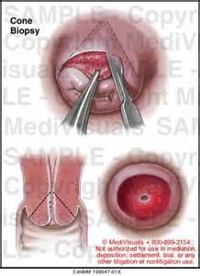
Cone biopsy

Slide 36
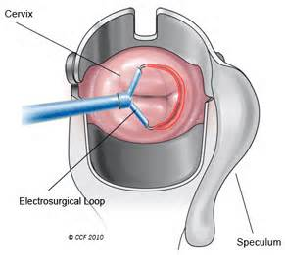
LEEP

Slide 37
Radical trachelectomy ( vag. & abd. )
VRT & ART
-For stage Ia2 ; recurrence rate 4.5% ,mort.2.5%
-Risk for failure ; bigger size (not suitable in >2cm) , LVSI
-Neuroendocrine tumor RT is not suitable treat.
-Subsequent pregnancy rate 62% of which 65% proceed to term
-Indications of ART
Vag. distortion
Clear c. ca of up vag.
Cervical stump ca
1st half of pregnancy
-ART has better parametrium clearance

Slide 38
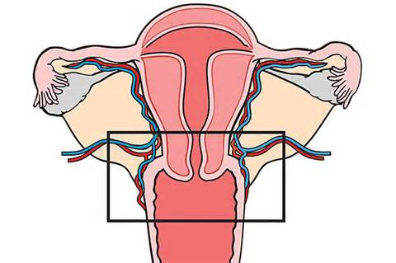

Slide 39
Radical Hysterectomy

Slide 40
Class Description Indication
I Extrafacial hysterectomy; pubocervical CIN, early stromal invasion ligament is incised, allowing letaral deflection of the ureter II Removal of the medial half of the cardinal and Microcarcinoma postirradiation uterosacral ligaments; upper third of the vagina removed III Removal of the entire cardinal and uterosacral Stages Ib and IIa lesions ligaments; upper third of the vagina removed IV Removal of all periureteral tissue, superior Anteriorly occuring central recurrences vesical artery, and three fourth of the vagina where preservation of the bladder is still possible V Removal of portions of the distal ureter and Central recurrent cancer involving bladder portions of the distal ureter or bladder

Slide 41
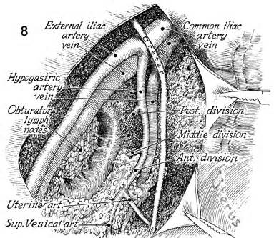

Slide 42
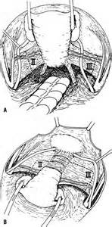

Slide 43
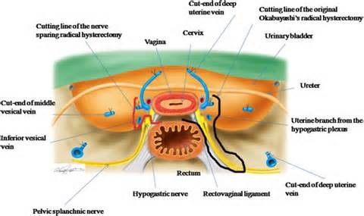

Slide 44
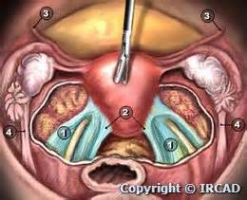

Slide 45
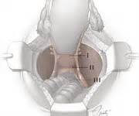

Slide 46
Complications of Radical Surgery
-Bladder dysfunction ; 4% more in class III ,motor & sensory n. damage . Loss of sense of urgency and complete emptying .up to 30 days catheterization or self catheterization
-Lymphocyst formation ;3% ,less incidence without peritonization ,need to repeat aspiration if >4cm , resolves sponteousely in 2 months
-Ureteral fistula 0-3% ,Vesico-uterine fistula 1%
-Intestinal obstruction 1% ,
-occult ov.mets 1%
-Need for neoadjuvent therapy ; >30% in class III
, >60% in class II

Slide 47
Nerve Sparing Radical Hysterectomy
-Pelvic nerve supply
Sympathetic supply T11-L2 >sup.hypogastric
Parasymp. supply L2-4 > Pelvic splanchnic n.
-Symp &Parasymp > merge >Inf. Hypogasric plexus >supply uterus ,vagina ,and bladder
-Nerve Sparing ;
Hypogasric n.—loose tissue sheath underneath ureter lat.to uterosacral lig
Inf.hypogastric plaxus –parametium lateralization during dissection
Separation &isolation of deep ut.vein from the pelvic splanchnic n.
Distal part of inf.hypogasric plexus below the the post.part of vesicouterine lig.
-Bladder & rectal dysfunction ,emptying ,storage
-Nerve sparing proceedure is associated with less bl.loss ,operative time
-Neuronavigation system in Robotic surgery is under study

Slide 48
Sentinel Lymph Node Identification
-To avoid lymphadenectomy with its subsequent complications as lymphoedema ,lymphcyst
-Using blue dye & colloid isotopes
-Detection rate 87-100% , false negative rate 0-20%

Slide 49
Laparoscopic Radical Hysterectomy
-Improved visualization by magnifications &light
-Better cosmatic ,reduced bi.loss 50-250 cc , hosp. stay ,morbididty ,adhesion
-Average operative time 162-189 mins
-Complications 10% Vs 5% for convensional surg.
-Port site mets ; floating cells ,direct spread
-Multi-channels single incision

Slide 50
Robotic Laparoscopic Rad. Hyst.
-high definition , 3D ,abolishing tremors and faster suturing
-High dexterity
-Operative time 272 min Vs 200 min laparotomy
-Cost benefits ?
-steep Trendlenberg position

Slide 51
Ovarian Transposition
-Radiotherapy result in 28-50% ovarian failure
-Dose of scattered radiation affecting the ovaries is 30 cGy
-Follow up of ovarian function using FSH &LH

Slide 52
Radiotherapy for Treatment of
Ca Cx

Slide 53
-Total dose used in ca cx is usually 7000 cGy
-External beam 4500 cGy is 25 fractions
-Brachytherapy 1000-1500 Gy applied in three techniques Stockholm , Paris and Manchister
-ca tissues are more sensitive than normal tissues to ionized radiation
-Normal tissues have high recuperate abilities
-Maximum effect of ionized radiotherapy needs good intact circulation with optimum oxygenation , so Hb of > 10 gm /dl is needed before start on radiotherapy
-Radiation sources ;
Radium half life 1620 y
Caesium half life 30 y

Slide 54
-radiation tolerance is inversely related to the organ volume (size and distribution of the cancer tissues rather than the tumor stage)
-Tissues radiation dose tolerability
Vag. mucosa 20000-25000 cGy
Rectovaginal septum 6000 cGy
Bladder mucosa 7000 cGy
Colon & Rectum 5500 cGy
Small Bowel 4200 cGy
WAR 2500 cGy
-Normal Vag. & Cervical tissues are potentially radioresistant

Slide 55
Brachytherapy
-Brachytherapy delivers 1500-2000 cGy
-Three techniques are used
Stockholm technique
Paris technique
Manchester technique
-Intra-cavitary make accessibility to radiate the cervical canal and portio vaginalis
-Before treatment evaluate the lesion and the pelvic geometry
-Paris technique
Intra-uterine tanedum & vag.colpostat (hallow corks) with afterload (Fletch-suit)
Use 66.66 mg ( 1/2 vag. hallow cork & 1/2 cx )
12 -24 hours for 5-7 days

Slide 56
-Stockholm technique
Plaque , No tanedum 12-36 h.--- 2-3 applications
-Manchester technique
Iso-dose pattern
7000 cGy -- paracervical region
Point A ;2cm lat. To midline and 2cm above lat. vag. fornix
Point B ;3cm lat. to point A
Points A&B represent important points on a curve describing the dose gradient
4000 cGy -- rectum
5000-7000 cGy bladder
-Migavoltage machine ;cobalt ,linear accelerator , betatron --- No skin damage by energy this passage
-Orthovoltage ; causes skin damage

Slide 57
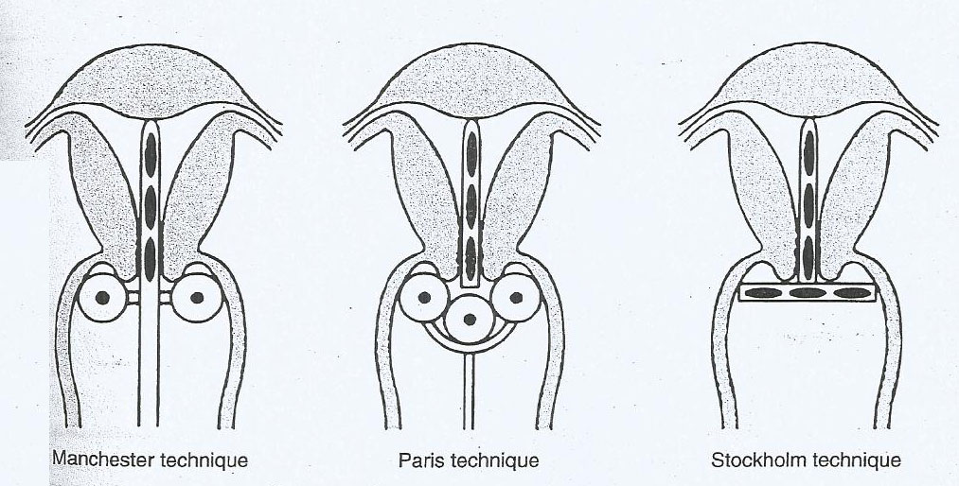
Three techniques of intracavitary brachytherapy

Slide 58
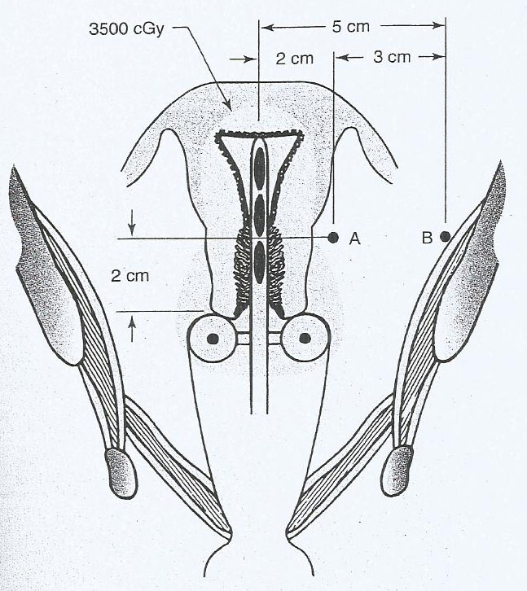
Pear-shaped distribution of radiation

Slide 59
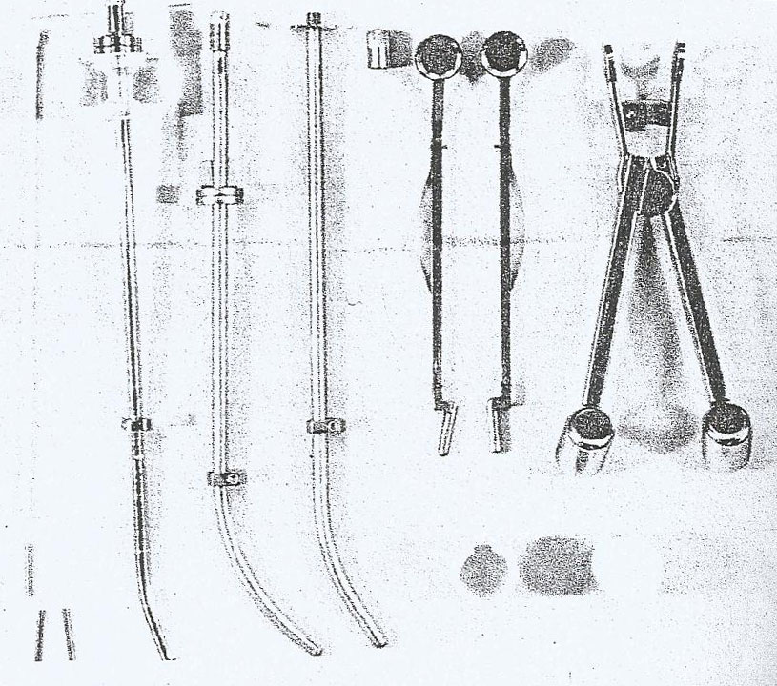
Fletcher-Suit radium applicators

Slide 60
Interstitial Therapy
-For advanced stages of ca cx and/or obliterated vaginal fornices
-Transperitoneal &Transvaginal implants
(transvaginal interstitial colpostat )

Slide 61
Pear-shaped distribution of radiation

Slide 62
Extended field radiotherapy
-Value and field of irradiation in advanced disease is not clear
-In bloc lymphadenectomy from the dome of the diaphragm to the obturator foramen
-Periaortic region (8-10cm) dose is 4500 cGy
(150-180 cGy /day ) x 30 days
-Complications of extended radiotherapy
Segmoiditis
Small bowel obstruction
Rectal & Uretheral stricture
-Prognosis of extended field radiotherapy
30% die from complications ,45% recurrence , 25% survive
-Although retroperitoneal lymphadenctomy is preferred for transperitoneal ,less adhesion &fibrosis
,the role of lymphadenectomy is questioned
-In barrel-shaped cx pre-operative radiotherapy will reduce recurrence rate from 19% to 2%

Slide 63
Chemoradiation
-Chemotherapy effect is formation of DNA-platinum adducts
-Mechanism of action of chemo is
Sublethal damage repair , reduce tumor volume
> increase oxygenation > increase response toDXT
>reduce recurrence by 50%
-Used agents cisplatin , 5-F U , hydroxyurea
-Cisplatin dose 40-20 mg/m2 /weekly
-Toxicities are GIT , myelosupression and leukemia but no cystitis ,no proctitis
-Chemoradiation is used mainly in bulky & advanced tumor
-Radiohyperthermia has significant improvement in prognosis

Slide 64
Neoadjuvant Chemotherapy
-Imrpove result in stage Ib2
-Adviced for cases with lymph nodes & parametrium involvement

Slide 65
Suboptimum Management
-Cancer of Stump of the cx
Brachytherapy ;challenges of use due to adherent bladder and rectum
Surgery ; is preferred , Trachelectomy
-Simple Hysterectomy in ca cx ; surgerical lymphadenectomy and parametrium excision with proper surgical staging

Slide 66
Neuroendocrine (small cells) ca cx
-Incidence <5% ,with early nodal & distant mets
-Non keratinized st. sq. ep.
-Similar to Oat cell tumor of the lungs
-Poorest diagnosis ;29% OS
-80% of tumor staining ,synaptophysin ,chromogranin .CD 56 ( neural cell adhesion molecules
-Treatment options ; surgery , chemo-radiotherapy

Slide 67
Glassy cell carcinoma ,Carcinosarcoma
,Lymphoma
-Glassy cell ( Adeno-squamous ca ) with survival rate of 50% for stage I
-Carcinosarcoma ; Ifosfamide based regimen is to be used
-Lymphoma ; extranodal type has worse prognosis than nodal type
-Melanoma is rare

Slide 68
Prognostic factors for early ca cx & locally advanced disease
-Depth of the stroma invasion is the most single prognostic factor
-Bl.v. invasion 30% OS vs 70% for non-invasion
-Tumor size can be reflected on LN involvement
-In intraperitoneal involvement OS is the same regardless the tumor stage
-LN +ve intraperitoneal involvement is 25% Vs only 6% for LN –ve
-Age factor ; worse survival at 15-39y for stage II
& 30-49y for stage IV

Slide 69
Recurrent & Persistent ca cx
-35% of ca cx either persist or recur
-Central recurrence ; stages I 15% , II b 5% ,
IIIa 7.5% , 17%
-Pap smear is invalid after radiotherapy (malig’ cells with reproductive death) >punch&needle biospy is indicated
-Most of recurrence in 1st 2 years ,variable presentations ; serosangineous vag discharge& pelvic ,sciatic or thigh pain & leg oedema &prog.uretral obst.& supraclavecular LN &general symp.
(wt.loss &cough hemoptysis ,pain)
-CT ,MRI ,PET-CT ,CXR ,hemogram ,UECs,liver f.test
IVU

Slide 70
-Mets in untreated pt.; liver 25% ,lungs 14% , vertebrae 8% ,large bowel 7%
-Mets in treated pt.; liver 16% ,lungs 14% , vertebrae 9% ,large bowel 7%
-Recurrence after DXT 12.7% ; 43% parametrium
& pelvic side wall , 16% distant
-Ureteral obstruction 95% due tumor prog.& 5% due to DXT fibrosis >diversion &retrograde stent
-Definition of healing after DXT; smooth vault (epithelialization) ,rectovag.,ex cx no nodularity
-Definition of persistence ca cx ; evidence of persistence of portion of cx or develop of new growth

Slide 71
-After surgery ; recurrence after proved free margins of specimen and persistence is evidence of growth within one year of treatment
-The triad ;Leg edema ,Wt loss ,Pelvic pain ,,is an ominous finding
-Leg edema ;lymphatic obs. ,or vascular tumor growth ,unilateral
-Pain ;thigh ant-medial ,post---buttocks ,sciatic
-Vag bleeding or watery discharge suggest recur.
-Lung mets symp.;cough ,hemoptysis ,pain
-Supraclavicular needle biopsy is indicated
-Bone mets ;2% ,bone survey , develop within 30 m ,96% die in 18m
-Of mortalities 50% 1st year,25% 2nd y ,3rd y 15%
-Follow up ex ,rectovag.ex ;horse-shoe due to parametrium fibrosis

Slide 72
-Periaortic LN involvement ,extended field radiation
- Isolated lung mets may be treated by lobectomy
-Roles of brachytherapy and super voltage extended radiation
-Bowel irradiation > bowel radiation changes including acute & chronic presentation
-Bowel obstruction may be due to radiotherapy or tumor, surgical repair may be needed

Slide 73
Prognosis
-Persistent & recurrent ca cx has overall survival rate of 10-15%
-Most are unlikely to be candidate for curative therapy and palliative care are the likely needed measure

Slide 74
Radical Hysterectomy for previously radiotherapy
-Usually class II & III
-Complications 42% ,of which 28% urinary tract injuries
-In a successful surgery 90% 5 years survival rates if the lesion is <2cm and 63% >2cm
-Omental pedicle placement into the pelvis may provide pelvic bl.supply and improve circulation

Slide 75
Pelvic Exentration
-Acceptable and respectable mode of treatment in indicated cases
-Can improve mortalities & morbidities
-Total exentric involves resection of both bladder and rectoegmoid
-Rehabilitation assistance will help to improve the healthy existence
-Illial conduit & rectal bladder ,proximal colostomy are various urinary diversion measures
-Electrolytes imbalance ,ut infection (pyelonephritis)
& hypochloraemic acidosis
-Stapling device can improve surgical facilities with reservoir dry continence

Slide 76
Patient selection
-Unilateral leg edema ,ureteric obstruction and sciatic pain are signs of unresectability
-Pt.with distant mets is unsuitable for exentration procedure
-Intra-operatively ; lower periaotic LN sampling and examination if no mets exentration could be done

Slide 77
Morbidity & Mortality
-Most within 18 m
-Pul.embolism ,edema ,cererbrovascular accidents ,bleeding and sepsis
-Small bowel obstruction due to denuded pelvic floor leads to adhesion ,omental mobilization and peritonization ,,,,mortality 50%
-Urinary deviation , UT infection , and hydronephrosis has to be treated promptly

Slide 78
Radiation
-For recurrence outside the initial field of treatment ,the dose is 3000 cGy over 2-3 weeks
-Insertion of a guide tubes for brachytherapy into deposits or growth
-Re-irradiation of a previously treated pt. is controversial with unfavorable complications as fistulae and necrosis

Slide 79
Chemotherapy
-Recurrent tumor is essentially platinum resistant as in platinum based agents is a part of recent chemoradiation
-Regimens are ;Ifosfamide+bleomycin+platinum b
Topotocan +platinum b
Paclitaxil+platinum b
-Cisplatinum is more effective than carboplatin
-Bevacizumab 15mg/kg as used in breast & colorectal recurrence
-Proposed regimen;
Carboplatin 2 AUC /days 1-8-15
Paclitaxil 80mg /m2 weekly
Bevacizumab days 1-8-15

Slide 80
Targeted Therapy
Angiogenesis inhibitor
-Retarding tumor growth ,and even eliminating small-volume tumor residues
-Tumor Microvessel Density (MVD); it is a significant prognostic factor and its presence is associated with poor locoregional control and overall survival
-MVD >20 HPF survival 90% <20 63%
-Pazopanib is oral tyrosinkinase inhibitor and anti-angiogenetic activities

Slide 81
Therapeutic HPV Vaccination
-

