Slide 1
PARASITIC DISAESES

Slide 2
MAIN ONES
MALARIA
INTESTINAL NEMATODES
ENTAMOEBA
TRICHOMONIASIS
LEISHMANIASIS
TREMATODES/CESTODES
TRYPANMOSOMIASIS ETC

Slide 3
EFFECTS ON PREGNANCY
.BLOOD LOSS—HOOKWORM,PLASMODIA,SCHISTOSOMA
.ANAEMIA OF CHRONIC DISEASE
MALABSORPTION-NEMATODES,ENTAMOEBA
ELEPHANTIASI/LYMPHOEDEMA IN LeSIHMANIASIS
PLACENTAL INFECTION-CRYPTOSPORIDIUM,TOXOPLASMOSIS,TRYPANOSOMIASIS,MALARIA—CONGENITAL ANOMALIES,IUFD
PRETERM BIRTH

Slide 4
PREGNANCY COMPLICATIONS
ANAEMIA,---PLACENTA PRAEVIA
./ IUGR
PRECLAMPSIA
LOWBIRTHWEIGHT BABIES
IUFD
POSTPARTIUM HAEMORRHAGE

Slide 5
CONTD
MALABSORPTION
------ANAEMIA
IUGR
IUFD
APH/PPH
PREECLAMPSIA
LOWBIRTH WEIGHT BABIES

Slide 6
DYSENTRY—DEHYDRATION—PREGNANCY LOSS
DIARRHEA DISEASE,--FLUID ELECTROLYTE IMBALANCE
PRETERM LABOUR/IUFD
RENAL INJURY—HYPOVOLUMIC SHOCK

Slide 7
Protozoa
Life Stages –
  Trophozoite -vegetative; feeding, mostly motile
  Cyst – dormant; protective thick wall
Most are free living in water and soil
Classified by motility & life cycle
Subdivided by location in human host (GI, blood, GU)
Sarcodina- Amoeba - move by pseudopods
Ciliophora - Ciliates - move by cilia
Mastigophora - Flagellates - move by flagella
Apicomplexan - Sporozoa – complex life cycle

Slide 8
50% PREVALENCE IN POOR SANITATION

Slide 9
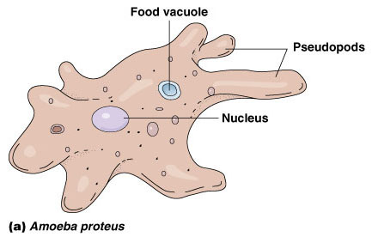
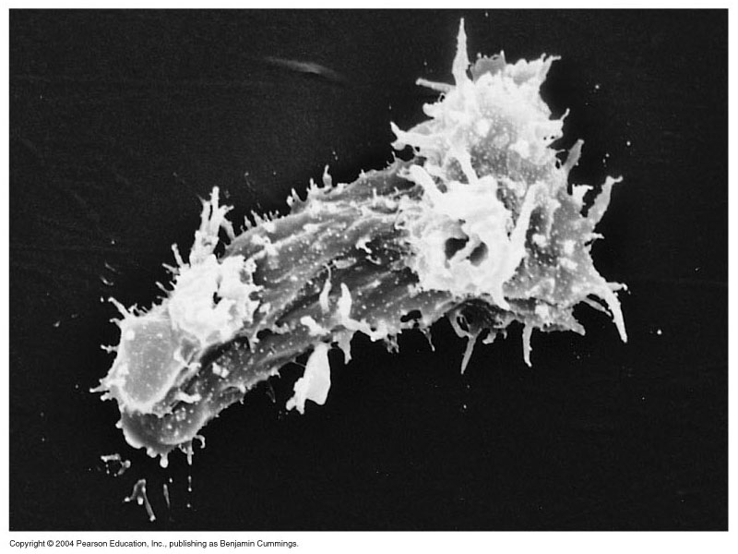
Amoeba
Entamoeba histolytica
  Amoebic dysentery
Naegleria
  primary amoebic meningoencephalitis
Acanthamoeba
  contact lens contaminant
Figure 12.18a

Slide 11
Entamoeba histolytica
Carried asymptomatically in the digestive tracts of humans
No animal reservoir exists
Infection usually occurs by drinking water contaminated with feces that contain cysts
Trophozoites migrate to the large intestine where they multiply

Slide 12
SYMPTOMS
COLICKY LOWER ABDOMIAL PAINS
DYSENTRY—BLOODY MUCOID STOOLfluid loss
Hepatic abscess

Slide 13
Entamoeba histolytica
Carried asymptomatically in the digestive tracts of humans
No animal reservoir exists
Infection usually occurs by drinking water contaminated with feces that contain cysts
Trophozoites migrate to the large intestine where they multiply

Slide 15
Entamoeba histolytica
Three types of amebiasis can result from infection
  Luminal amebiasis
    Least severe form that is asymptomatic
  Invasive amebic dysentery
    More common form of infection
    Characterized by bloody, mucus-containing stools and pain
  Invasive extraintestinal amebiasis
    Trophozoites carried via the bloodstream throughout the body
Maintaining clean water is important in prevention

Slide 17
Acanthamoeba and Naegleria
Cause rare and usually fatal brain infections
Common inhabitants of natural waterways as well as artificial water systems
Contact lenses wearers who use tap water to wash their lenses can become infected
Acanthamoeba diseases
  Infection occurs through cuts or scrapes, the conjunctiva, or through inhalation
  Acanthamoeba keratitis results from conjunctival inoculation
  Amebic encephalitis is the more common disease

Slide 18
treatment
Metronidazole 400mgs 8 hourly for seven days
Paromomycin
Iodoquinol
Fluid replacement

Slide 19
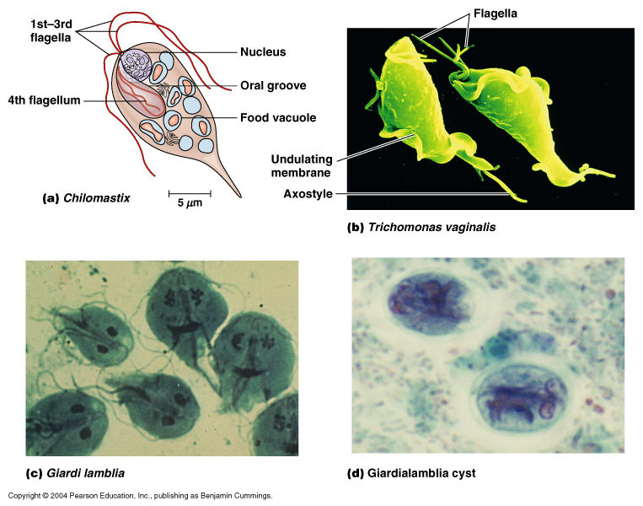
Flagellate
Trichomonas vaginalis
  no cyst stage
  Trichomoniasis - STI
Giardia lamblia
  intestinal malabsorption
  Traveler's diarrhea, day care centers, hikers
Figure 12.17b-d

Slide 20
Trichomonas—vaginitis and non gonoccocal urethritis in males
Bartholinitis,urethritis
Malodrous yellow greenish discharge
Treatment
Metronidazole,tinidazole

Slide 21
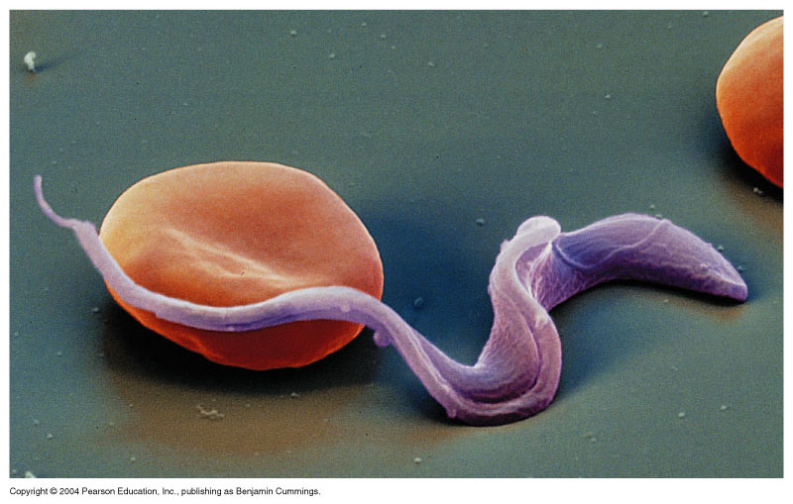
Hemoflagellates
  Trypanosoma
    African sleeping sickness or Chagas disease
    Transmitted by tsetse flies or reduviid bugs
  Leishmania
    leishmaniasis – “Baghdad Boil”- Desert Storm
    Transmitted by sand fly vector

Slide 23
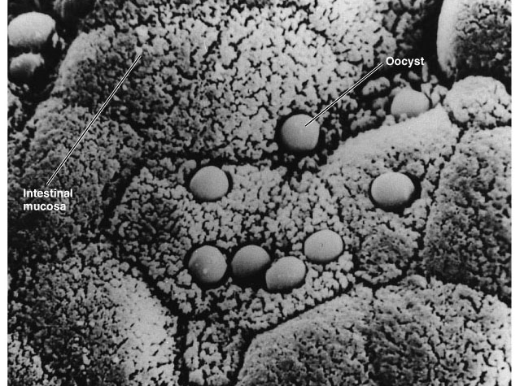

Cryptosporidium parvum
Waterborne
Found in cattle
Attach to intestinal lining
Cause watery diarrhea
Acid-fast Oocysts
Resistant to chlorine
Figure 25.19

Slide 25
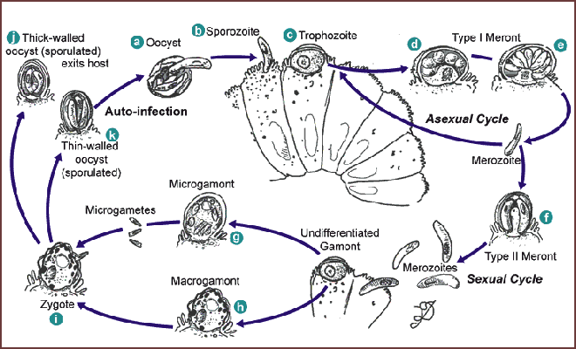
Cryptosporidium life cycle

Slide 27
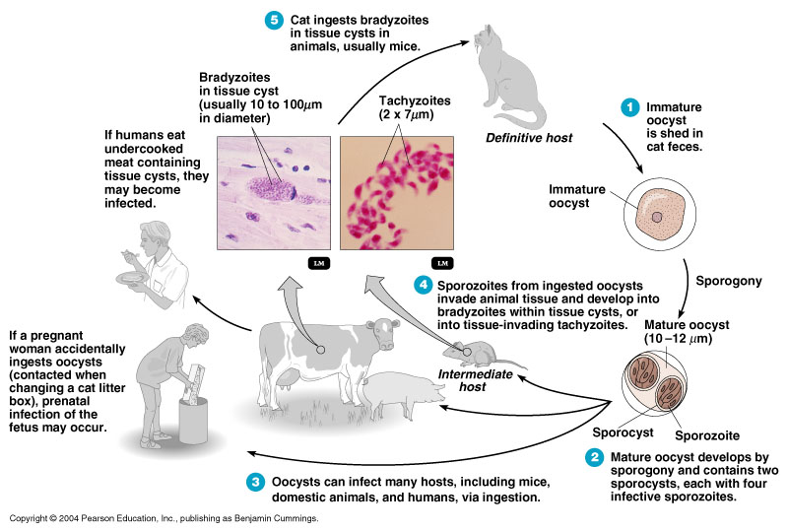
Toxoplasma gondii

Slide 29
Helminths - worms
Life Stages
  egg, larva, adult; complex life cycles
  infective stage: egg or larva
  definitive host: harbors adult stage
  intermediate hosts: may be more than one
Classifications:
Nematodes - roundworms
Platyhelminthes - flatworms
  Trematodes - flukes- nonsegmented
  Cestodes - tapeworms- segmented

Slide 31
Nematodes- Roundworms
Intestinal roundworms:
  Ascaris (Giant intestinal roundworm)
  Enterobius (Pinworm)
  Necator / Ancylostoma (Hookworm)
Tissue roundworms
  Trichinella spiralis - trichinosis

Slide 33
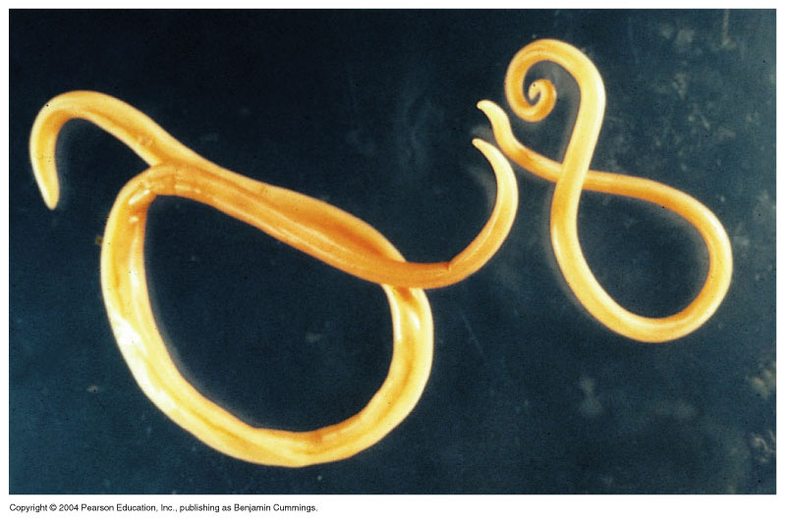
Nematodes - roundworms
Ascaris lumbricoides- adult stage

Slide 35
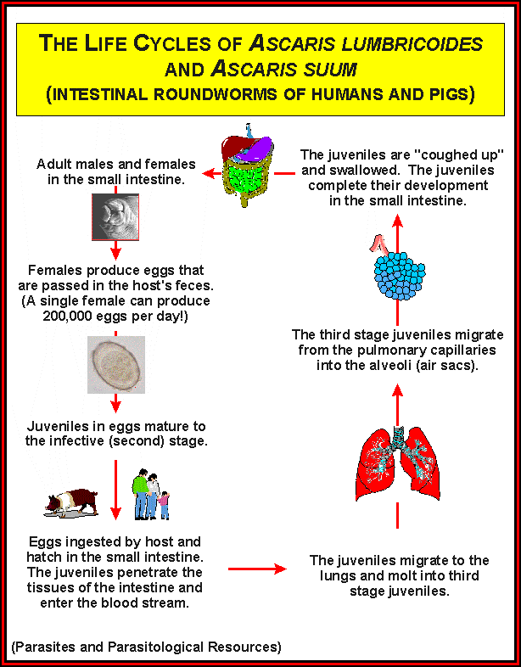

Slide 37
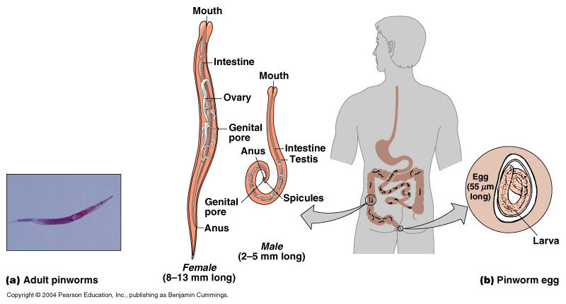
Enterobius - Pinworm
Figure 12.29

Slide 38
Hookworm—1cm long, n.americanus—0.003mls daily,diuodenale—0.2mls of blood per day
Can be present in their thousands

Slide 39
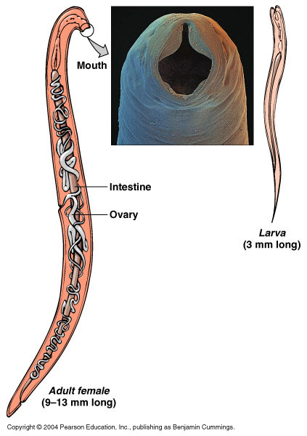
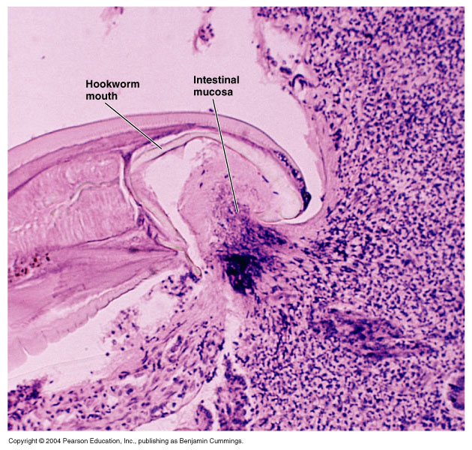
Necator or Ancylostoma - Hookworm

Slide 41
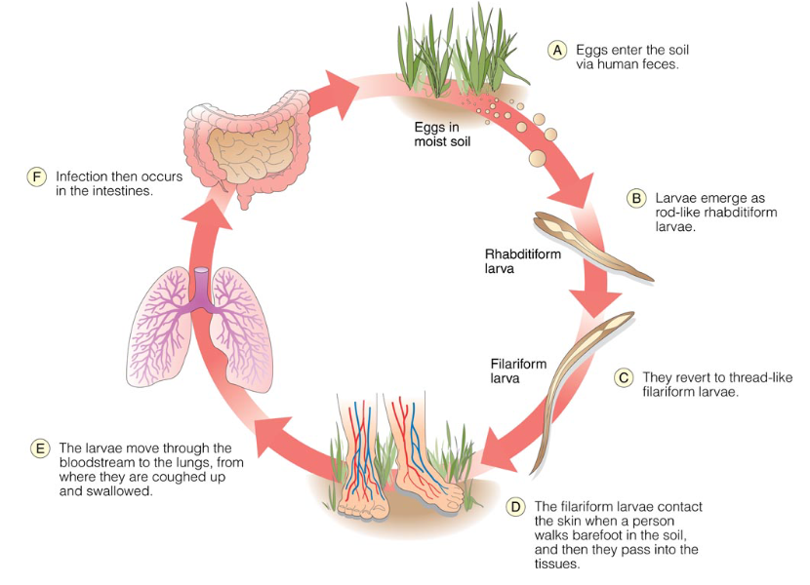
The Life Cycle of the Hookworms Ancylostoma duodenale and Necatur americanus

Slide 43
Platyhelminthes - Flatworms
Trematodes – Flukes - nonsegmented
  Schistosoma - blood fluke; Swimmer’s itch
Cestodes – Tapeworms - segmented
  Taenia – beef or pork tapeworm
  Echinococcus – wild dog tapeworm

Slide 44
trypanosomiasis
Trypanosoma species
T,gambiese,rhodesiansiae,cruzi
Causes lymphadenitis—cervical nodes—winterbottom sign,fever,joint pains and muscle pain
Severe palm pains due to pressure on the ulnar nerve—kerandels sign
Encephelatitis and meningoencephalitis.
Chagas –fever , lyphadenopathy,edema of eyelids—romanes signs
Rx--suramin

