Slide 1
CAESAREAN SECTION
By Diana Ondieki

Slide 2
Introduction
It is the most frequently performed procedure in Obs/Gyn.
Definition – It is the delivery of a fetus, placenta and membranes through an incision in the anterior abdominal and uterine walls.
Hysterotomy

Slide 3
Incidence
Rate is rising worldwide
  1970 C-section rate: 5.5% (US)
  1988 C-section rate: 24.7% (US)
  2000 C-section rate 22.9% (US)
  KNH – 17% (1980), 20% (1991)
  UK – current rate 15-20%
  Brazil – 35-51%

Slide 4
Reasons for Increase in Frequency
Reduced parity, over 50% of pregnant women are nulliparous
Older women are having children
Extensive use of electronic fetal monitoring
By 1990, 83% of breech presentations
Incidence of midpelvic vaginal deliveries down
Change in lifestyle
Malpractice suits
Maternal request

Slide 5
Ideally C-section rate should not be more than 15% for nullipara and 37% for VBAC
A policy of VBAC would keep this figure low but
Fear of litigation is main reason for most cases

Slide 6
Indications for caesarean section
Maternal Indications
  Previous caesarean section
    Previous LUSCS due to a recurring condition e.g contracted pelvis, or a concomitant obstetric complication
    2 or more caesarean sections
    After a classical scar
  Severe preeclampsia, eclampsia with unfavourable cervix
  Life threatening haemorrhage (APH)
  Placenta praevia Types II posterior to IV

Slide 7
Maternal indications (ctnd)
  Contracted pelvis (CPD)
  Following repair of Obstetric fistula (VVF, RVF)
  Prolonged labour, cervical dystocia and failed induction of labour
  Pelvic tumours obstructing labour – fibroids, entrapped ovarian tumour
  Invasive cancer of the cervix
  Maternal preference
  Combination of factors which alone are not indications e.g postdatism, elderly primigravida, prior infertility, bad obstetric history, DM

Slide 8
PRIOR CAESAREAN DELIVERY
In 1916, Cragin made his famous pronouncement “once a CS always a CS”
Those were the days of classical method
Kerr popularized the transverse in 1921
1978, Merrill & Gibbs from Texas reported safe delivery in 83% of their patients with prior CS
By 1996 use of VBAC rose from 2% in 1978 to 28% in USA

Slide 9
Fetal indications for C-section
Non reassuring fetal status (used to be called fetal distress) –
  reduced fetal movements with poor biophysical score
  meconium passage
  abnormal fetal heart rate – bradycardia, tachycardia, reduced variability on CTG, late decelerations on CTG, sinusoidal pattern on CTG
Malpresentation & malposition – breech, transverse, oblique, unstable lie, face, brow, compound, POPP

Slide 10
Fetal indications (ctnd)
Cord presentation & cord prolapse
Fetal macrosomia
Multiple pregnancy – 1st noncephalic twin, retained second twin, extreme prematurity, discordant fetal growth, single amniotic sac, conjoined twins, >2 fetuses
Risk of infections – active HSV2, HPV (genital warts), HIV

Slide 11
Fetal Indications (ctnd)
Fetal anomalies – hydrocephalus, sacral tumour
IUGR
Vasapraevia

Slide 12
Recurring and nonrecurring indications

Slide 13
Types of caesarean sections
Based on timing of the operation
  Elective caesarean section
  Emergency caesarean section
Based on the uterine incision
  Transverse lower uterine segment C/S (Kerr) – not likely to give way
  Vertical lower uterine segment (Delee) – done when LUS not well formed
  Classical (Vertical upper uterine segment C/S)

Slide 14
Disadvantages of classical incision
Lots of bleeding
Extensive adhesion formation
Hard to repair (tears through muscle)
Likely to give way. Can rupture before pregnancy is term.

Slide 15
Indications for classical incision
If lower segment cannot be exposed due to scar or myoma or Ca cervix
Transverse lie with ruptured membranes and big baby
Some cases of placenta praevia anterior
Very small fetuses, breech with non formed LS
Massive obesity where only upper uterus accessible

Slide 16
Abdominal incisions when performing caesarean section
Sub-Umbilical Midline Incision (SUMI)
Pfannestiel incision
Joel cohen incision
Maryland Incision

Slide 17
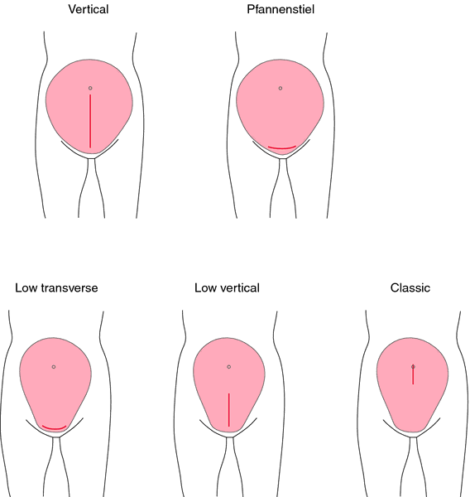
Abdominal and uterine incisions

Slide 18
Video

Slide 19
Procedure for elective caesarean section
Preoperative preparation
  Review and ascertain fetal maturity (early Anc, quickening, early U/S, amniocentesis/ surfactant test)
  Explain to the patient the procedure and obtain inform consent
  Investigations – TBC, U/E/Cs, GXM
  If anxious, can sedate with an anxiolytic the night before surgery e.g Diazepam 5mg
  Warm birth
  Preoperative observations
  Premedication

Slide 20
Intraoperative procedure
Anaesthetize
Abdominal shaving
Aseptic catheterization
Supine position with a 15 degree tilt (to prevent aortocaval compression syndrome)
Clean the abdomen with antiseptic and drape
Abdominal incision (pfannestiel, midline, subumbilical), subcutaneous tissue/fat, rectus sheath, muscle, extraperitoneal fat, peritoneum
Pack paracolic gutters & retract bladder with a doyen’s retractor

Slide 21
Intraoperative procedure (ctnd)
Reflect the visceral peritoneum
Uterine incision
Deliver fetus (oxytocin given at delivery of the anterior shoulder), placenta and membranes
Green-amytage forceps to clamp midpoint of the lower uterine incision and bleeding points
Dilate cervix (to allow lochia to flow)
Close uterus in 1 or 2 layers
Inspect adnexa and abdominal organs. Perform BTL if indicated.
Close the abdomen in layers

Slide 22
Post operative care
If patient was under GA, observe ½ hourly till fully awake, then 4 hourly
IVF 3 litres/ 24hours – normal saline alternating with 5% dextrose
Pain control – pethidine for 24 hours, then non-opioids
Antibiotics
Expose the wound on the 3rd post operative day
Check HB on the 3rd postoperative day
Discharge and advise on subsequent pregnancy
See in the clinic after 1 week
Final check – after 6 weeks at the postnatal clinic

Slide 23
Complications of C-section- Maternal
Immediate
  Anaesthetic – difficult intubation, hypotension, spinal headache
  Haemorrhage – lacerations, uterine atony, placenta praevia, or accreta
  Complications of blood transfusion
  Gastro intestinal and Urinary Tract injuries
  Death – risk 7 times more than vaginal delivery

Slide 24
Late
  General post op complications – atelectasis, pneumonia, paralytic ileus, UTI, thromboembolism
  Infection (endometritis, wound infection)
  Intestinal obstruction (due to adhesion formation esp after classical)
  Uterine scar dehiscence, rupture in subsequent pregnancy
  Chronic abdominal pain

Slide 25
Complications of C-section - fetal
Prematurity
Respiratory depression (TTN)
Intracranial haemorrhage (small incision)
Erbs palsy, fracture of long bones esp in breech extraction

Slide 26
TOLAC
These conditions must be satisfied:-
  Only 1 previous LUS C/S
  Nonrecurring indication for previous C/S – NRFS, cord prolapse, malpresentation
  No post operative sepsis after previous C/S
  Parity less than 5
  Cephalic presentation
  Estimated fetal weight <= 3500g
  Adequate pelvis – true conjugate >=10.5cm
  No other indication for C/S
  Facilities for blood transfusion available
  Ready theatre, available immediately

Slide 27
Management of a patient for TOLAC
Early ANC (1st half of pregnancy)
Review history to ensure eligibility
Pelvic assessment at 36 weeks (clinical and radiological – erect lateral xray pelvimetry)
Estimate fetal weight at 37 weeks (<=3500g)
Admit in early labour
Fix IV line, take samples for GXM, TBC, U/E/Cs
Consent for C/S
Partograph – pulse, BP, FHR, contractions, descent of the head, cervical dilatation, colour of liquor and PV bleeding

Slide 28
TOS – risk is uterine rupture
Clinically observe patient closely for
  Acute abdominal pain
  A ‘popping sensation’
  Palpation of fetal parts outside the uterus on leopold’s maneuvers
  Fetal heart rate deceleration and bradycardia
  High presenting part on vaginal examination
  Vaginal bleeding
  Take patient for immediate laparotomy.

Slide 29
PERIMORTEM CAESAREAN SECTION
C/S performed when survival of the mother is in doubt.
Perinatal outcome is directly related to
  Gestational age
  Duration since maternal collapse/ death with best results if done within 4 minutes and no survival after 25 minutes
  Availability of personnel and equipment
  Availability of perimortem ventilation and cardiac massage of mother
  Prompt delivery and effective neonatal care

Slide 30
THE END

