Slide 1

ECTOPIC PREGNANCY
BY DR. P. KAMAU KOIGI,
M.B.,Ch.B, M. MED OBS/GYN

Slide 2


PRESENTATION OBJECTIVES
DEFINITION
EPIDEMIOLOGY
CLASSIFICATION
PATHOPHYSIOLOGY
CLINICAL FEATURES
DIFFERENTIALS
DIAGNOSIS
TREATMENT
FOLLOW-UP

Slide 3

INTRODUCTION
An “Ectopic pregnancy” is one where the blastocyst implants anywhere other than the endometrial lining of the uterine cavity.

Slide 4
EPIDEMIOLOGY
Incidence: EP makes up ≈ 2% of all pregnancies.
Mortality: The leading cause of early pregnancy-related death. The case fatality rate was 35.5 per 100,000 EP’s from 1970 – 19990.
Non–Caucasian races had 3.4 times higher chances of mortality.

Slide 5

RISK FACTORS
Tubal damage: prior tubal surgery or PID (Chlamydia; Neiserria, M.tb)
Prior EP
Smoking
> 3 prior spontaneous abortions; >2 TOP’s
Previous/ current IUCD use
Infertility; Infertility treatment (ART)
In-utero exposure to Diethylstilbestrol (DES)
High number of lifetime sexual partners

Slide 6
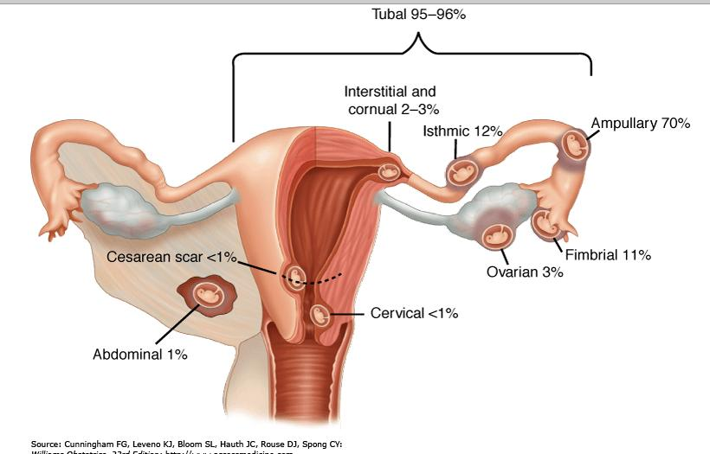
CLASSIFICATION

Slide 7
PATHOPHYSIOLOGY
Tubal Pregnancy:
The zygote burrows through the tubal epithelium into the muscular wall. Trophoblast invasion opens the maternal vessels to the developing placental tissue. The rapidly growing POC’s cause increased pressure within the tube, which may rupture spontaneously or rupture during coitus/ bimanual examination.

Slide 8
SYMPTOMS
Classical symptoms: Only seen in ~50% of patients:
Amenorrhoea
p/v bleeding
Abdominal pain
Vasomotor symptoms from Hemorrhagic hypovolemia: Vertigo & syncope,
Shoulder pain (Cause?)

Slide 9
SIGNS
VITAL SIGNS & GEN EXAM: If they are normal, they cannot rule out EP;
  If in shock: Tachycardia; Hypotension; low-volume pulse, Pallor, cold clammy skin
  Low-grade fever may be present
ABDOMINAL EXAMINATION:
  Abdominal tenderness (Generalized (45%); lower abdomen (25%); unilateral (30%); rebound tenderness may be present); absent bowel sounds
PELVIC EXAMINATION:
  Pelvic fullness; palpable adnexal mass in the cul-de-sac
  Cervical motion tenderness
  Culdocentesis – Free-flowing non-clotting blood in peritoneal cavity

Slide 10
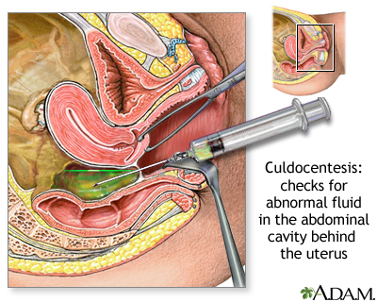

Slide 11
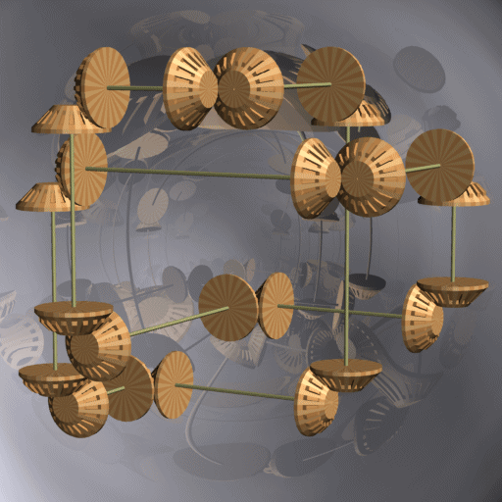

DIFFERENTIAL DIAGNOSIS
PREGNANCY-RELATED CONDITIONS: Abortion
UTERINE AND CERVICAL PATHOLOGY: Cervicitis, Endometriosis, Degenerating fibroids
ADNEXAL DISEASE: Salpingitis, Tubo-ovarian abscess, Ovarian torsion, Corpus Luteum cyst
OTHER CONDITIONS: Appendicitis, Mesenteric Lymphadenitis, Cystitis, Renal Calculi

Slide 12

LABORATORY INVESTIGATIONS
QUANTITATIVE B-hCG:
  Usually doubles every 48 – 72hrs in normal pregnancy
  In non-viable pregnancies, it increases by <50% in 48hrs or plateaus
Hb and Hct: May be reduced if acute hemorrhage is in progress
Serum Progesterone: Normal intrauterine pregnancies are associated with serum progesterone levels ≥ 25ng/ml; not much diagnostic value as it cannot differentiate intrauterine and ectopic pregnancies

Slide 13
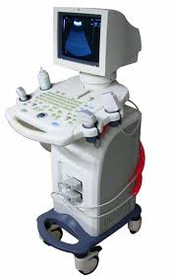
RADIOLOGICAL INVESTIGATIONS
TRANS-ABDOMINAL OR TRANS-VAGINAL ULTRASOUND:
Uterus: endometrial reaction; no gestational sac; there may be a Pseudo-gestational sac (lacking the “double ring sign”)
Adnexa: solid/ cystic Extrauterine mass/gestational sac with a yolk sac; adnexal cardiac activity may be present; Free echogenic fluid in the pelvis
Doppler studies: The shape of the placenta is seen in a “ring-of-fire pattern” outside the uterine cavity

Slide 14
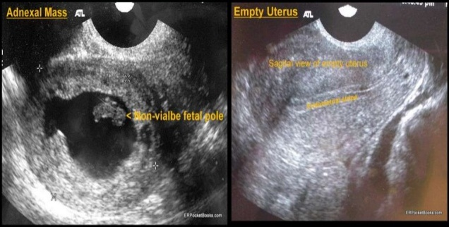

Slide 15
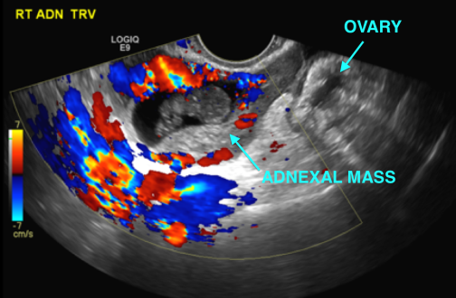

Slide 16

TREATMENT
The plan of management of the patient depends on:
The condition of the patient
Whether the ectopic gestation has ruptured or not

Slide 17

A) Ruptured Ectopic pregnancy
The patient will usually present in shock with an acute abdomen:
Fix 2 large bore IV cannulas
Take a blood sample for Blood grouping and cross-match and FBC
Begin fluid resuscitation using crystalloids
Insert Foley’s catheter for I/O monitoring
Obtain consent for surgical intervention

Slide 18
Ruptured Ectopic pregnancy…
Surgical management:
  Access Options:
    Open (Laparotomy)
    Minimal access (Laparoscopic)
  Surgical options:
    Salpingectomy (Non-conserving)
    Salpingotomy/ Salpingostomy (Conserving)
What are the indications for tubal-conserving surgery and what are its possible complications?

Slide 19
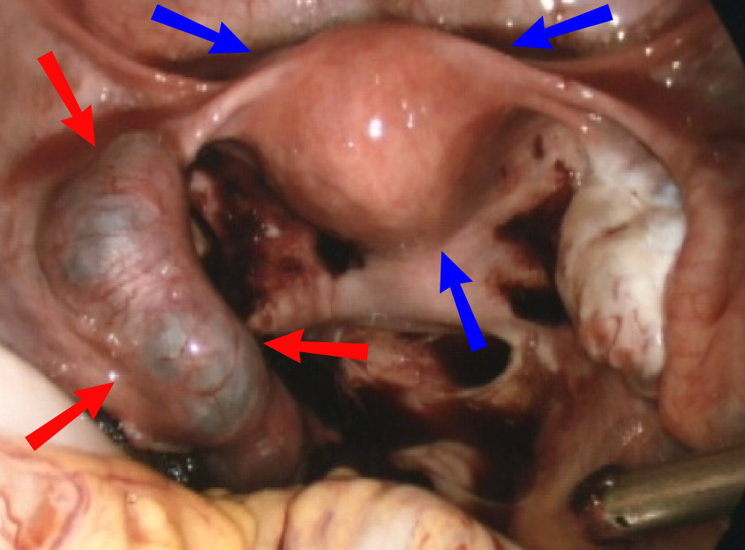
View at Laparoscopy

Slide 20

B) Unruptured Ectopic pregnancy
There are 4 options of management of an unruptured EP:
Surgical management (as above)
Surgically administered medication
Systemically administered medication
Expectant management

Slide 21
1. Surgical management
Access Options:
    Open (Laparotomy)
    Minimal access (Laparoscopic)
Surgical options:
    Salpingectomy (Non-conserving)
    Salpingotomy/ Salpingostomy (Conserving)
Post-op surveillance and treatment are crucial

Slide 22
2. Surgically administered medication
Administration of trophotoxic medications injected directly into the gestational sac (usually at laparoscopy or by ultrasound guidance):
Methotrexate
Potassium Chloride (KCl)
Hyper-osmolar glucose
Actinomycin D
Leucovorin
Mifepristone
PGF2α

Slide 23
3. Systemically administered medication
If the EP is <3.5cm in diameter, then it is acceptable to give 50mg/m2 of Methotrexate IV/ IM or orally
NOTE: Any option that involves administration of medication will require:
Baseline evaluation of hepatic and renal function prior to initiation of treatment
Surveillance after administration of treatment (serial B-hCG, clinical and sonographic assessment) to assess success of the treatment and screen for signs of persistent EP

Slide 24
4) Expectant management
Only used for selected cases that fulfill the following criteria:
Diameter of EP < 4cm
No sign of an Intrauterine pregnancy
No sign of rupture on Transvaginal sonography
Falling serum levels of B-hCG every 2 days
Resolution may occur in up to 72% of such cases if all criteria are met
If all criteria are not met, then do NOT attempt expectant management

Slide 25

FOLLOW-UP
Contraception: for 3/12 after surgical management; for up to 6/12 if trophotoxic medications were used
After 1 EP, ~ 60% of patients conceive spontaneously.
The risk of recurrence is 10 – 27% if that was the only EP; the risk is increased if there has been more than 1 EP
An early Ultrasound at the next pregnancy is necessary to pre-emptively rule out recurrent EP

Slide 26

CONCLUSION
EP is the most significant killer of women in early pregnancy
Tubal damage is the most significant risk factor for EP
Any vaginal bleeding that is not menstrual and is associated with abdominal pain should be considered as being an ectopic pregnancy until proved otherwise
A high index of suspicion and Prompt management are the keys to avoiding morbidity and mortality from EP

Slide 27


