Slide 1
PREMATURE RUPTURE OF MEMBRANES
BY DR. KOIGI P K
M.B., Ch.B, M.MED O/G

Slide 2
PRESENTATION OBJECTIVES
Introduction
Epidemiology
Pathophysiology
Clinical features
Differential diagnosis
Investigations
Treatment
Complications
Conclusion

Slide 3
INTRODUCTION - DEFINITIONS
Premature rupture of membranes: disruption of the integrity of the foetal membranes that occurs before the onset of labour
Pre-term Premature rupture of membranes (PPROM): ROM before 37/40 GBD
Prolonged PROM: > 24hrs elapse between ROM & onset of labour
Mid-trimester PROM: occurs at or before 26/40 GBD
Pre-viable PROM: ROM before 23/40 GBD (what is considered the current limit of viability in well endowed centers)
Pre-term PROM remote from term: ROM between 23 – 31/40 GBD
Pre-term PROM near term: from 32 – 36/40 GBD

Slide 4
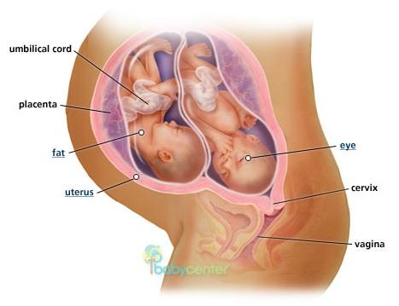
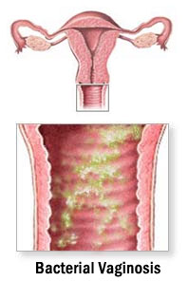
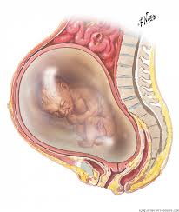
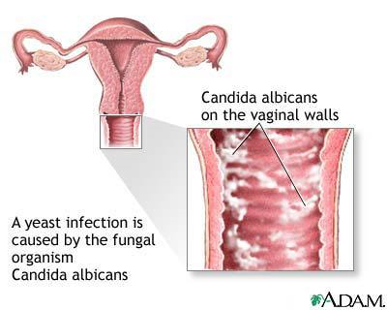
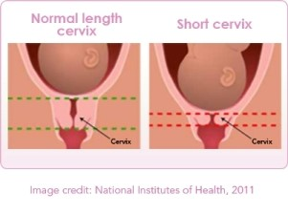
EPIDEMIOLOGY
Occurs in 8 – 10% of all pregnancies
PPROM associated with 30 – 40% of all preterm deliveries
RISK FACTORS:
History of prior PROM
Genital tract infection
Cervical insufficiency
Increased intrauterine pressure: Multiple gestation & Polyhydramnios
Cigarette smoking
Trauma: Pelvic examination; coitus

Slide 5
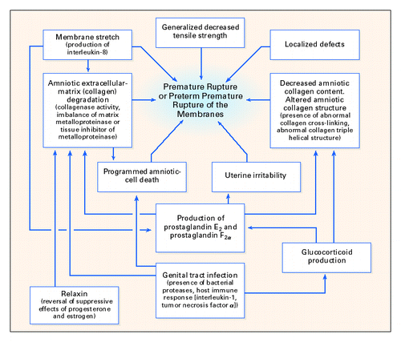
PATHOPHYSIOLOGY

Slide 6
SYMPTOMS:
Sudden gush of fluid/ continued leakage
↓ size of the uterus
She may also complain of a fever

Slide 7
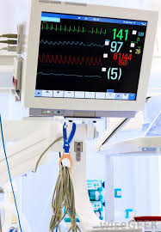
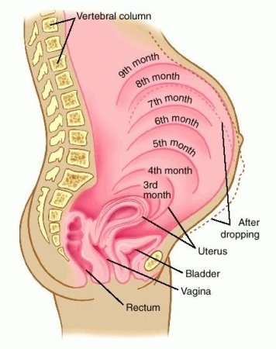
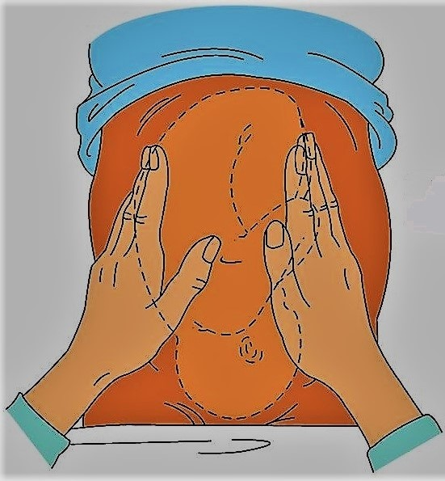
PHYSICAL FINDINGS:
General examination: look for features of infection: febrile, ↑ pulse rate, BP may ↓ if patient is overtly septic
Abdominal examination: FH < dates; increased prominence of foetal parts on palpation

Slide 8
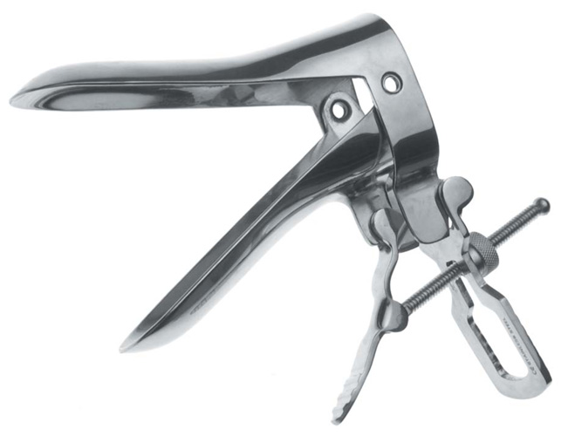
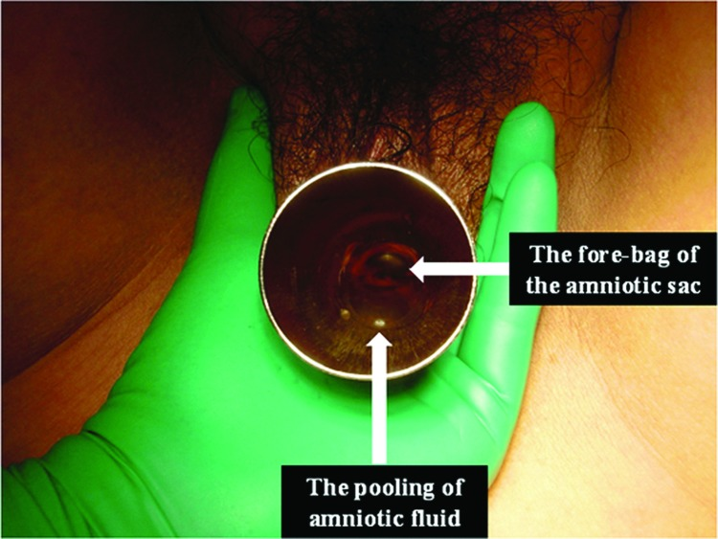
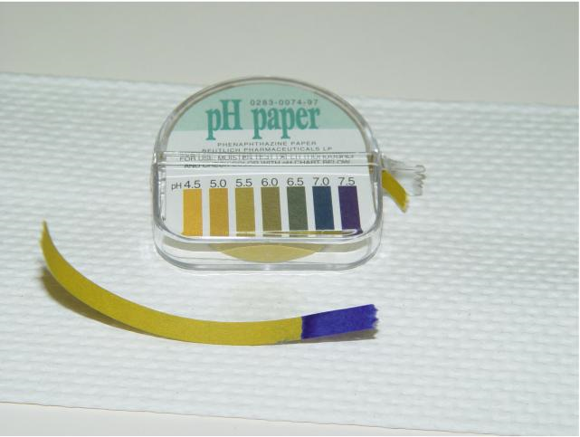
Sterile speculum examination
Pooling: collection of amniotic fluid in the posterior fornix
Nitrazine test: a sterile cotton-tipped swab is used to collect the fluid from the posterior fornix & apply it to Nitrazine (Phenaphthiazine) paper→ the nitrazine paper turns blue, revealing an alkaline pH
Ferning test: fluid from the posterior fornix is placed on a glass slide & is allowed to dry. The amniotic fluid, if present, forms a ferning pattern of crystallization.
The presence of the above 3 confirms PROM. If one of these three tests is negative, then PROM is unlikely.
Visually inspect the cervix for dilatation & effacement, rule out cord prolapse.

Slide 9
DIFFERENTIAL DIAGNOSIS
Hydrorrhoea gravidarum
Vaginitis with ↑ vaginal secretions
Urinary incontinence
Exogenous fluids: semen or douche

Slide 10
INVESTIGATIONS
Read up on Fetal lung maturity testing
Blood: FBC with WBC differentials: to determine the presence of infection.
Vaginal fluid:
Collect for foetal lung maturity testing
Collect for Gram stain & M/C/S & wet mount preparations
Cervical secretion for Gram stain, culture & sensitivity: if there is no vaginal fluid
Ultrasound: confirmation of dates & determination of amniotic fluid index
Amniocentesis: if ultrasound is inconclusive; take a sample for foetal lung maturity testing then inject Evans blue OR Indigo Carmine dye. If ROM has occurred, then the dye will be present in the vagina if a sterile speculum examination is conducted 20 minutes later; ask patient to perform valsalva manoeuvre

Slide 11
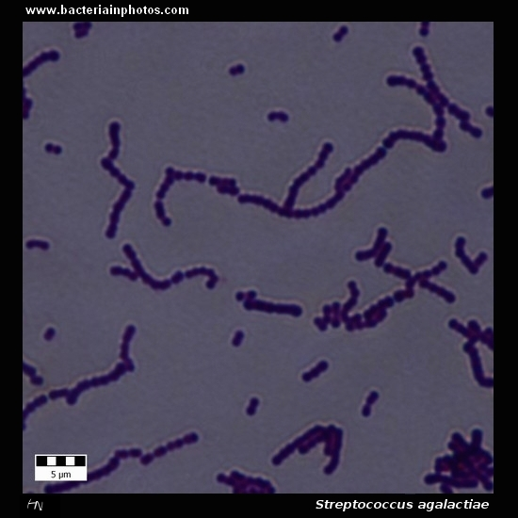
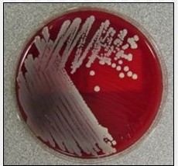
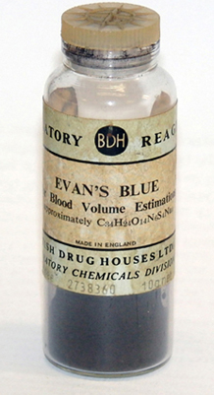
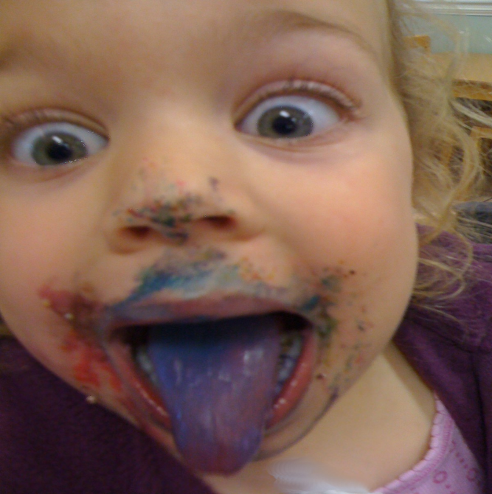
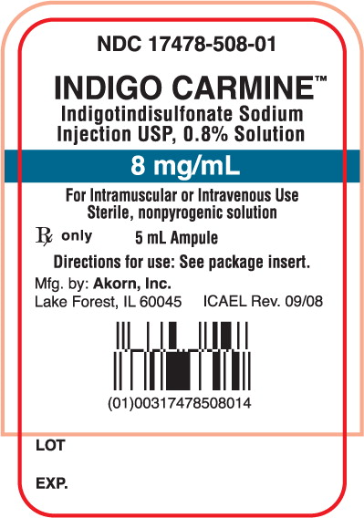
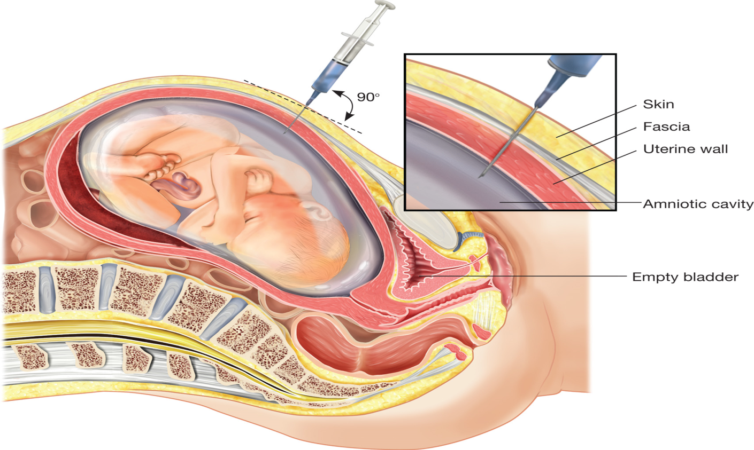

Slide 12
Bonus information – Gross examination of amniotic fluid
APPEARANCE | SIGNIFICANCE
Colorless with slight to moderate turbidity | Normal
Blood-streaked | Traumatic tap, abdominal trauma, intra-amniotic hemorrhage
Yellow | Hemolytic disease of the neonate
Dark-green | Meconium staining
Dark red-brown | Likely intrauterine fetal demise

Slide 13
TREATMENT
The course of action depends on 3 crucial factors:
Gestational age
Whether the patient goes into advanced labor or not
The presence of chorio-amnionitis

Slide 14
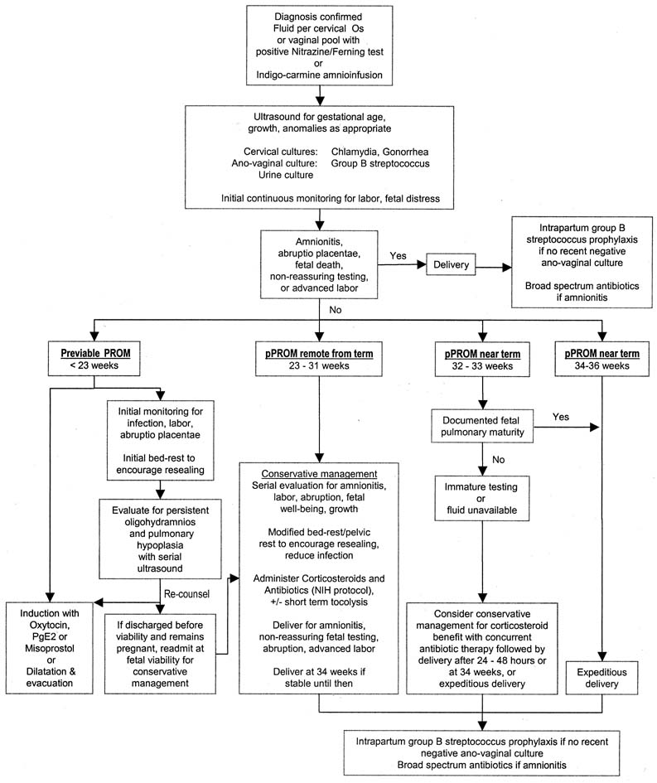

Slide 15
COMPLICATIONS
Maternal:
Chorioamnionitis
Generalized sepsis may also occur
Fetal:
Prematurity (and its attendant complications)
Cord prolapse
Malpresentation
Intrauterine & neonatal infection
Intrauterine fetal demise
Limb deformity
IMPORTANT! DIAGNOSIS OF CHORIOAMNIONITIS:
Fever: Temp. > 38ºC.
Maternal leukocytosis (with Differentials)→ ↑ WBC & NΦ; Leukocytosis is not reliable, as steroid administration & labour are associated with mild leukocytosis.
Uterine tenderness
Tachycardia:
Maternal: > 100bpm
Foetal: >160 bpm
Foul-smelling amniotic fluid

Slide 16
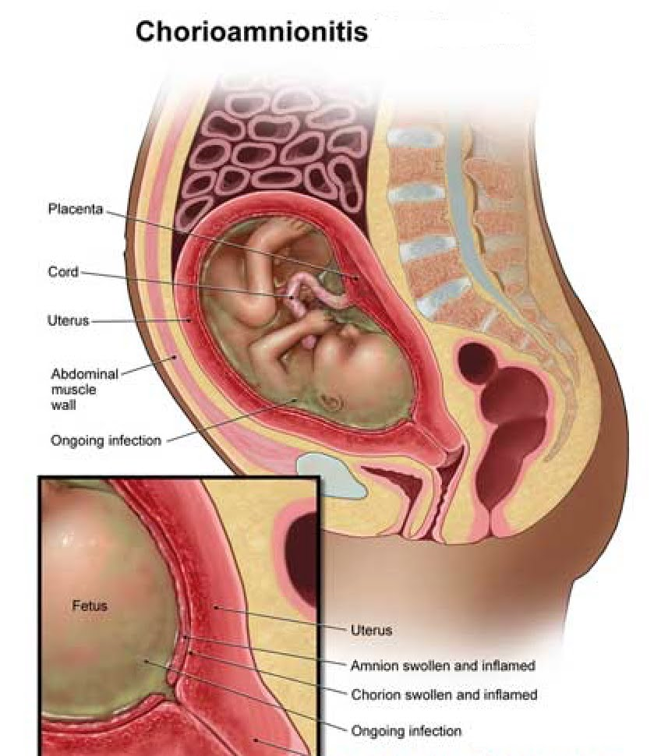
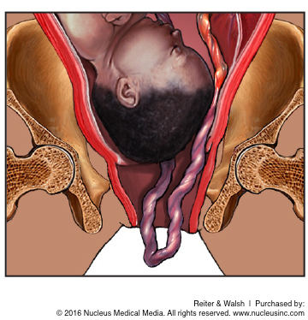
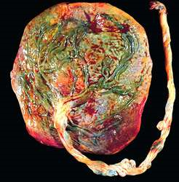

Slide 17
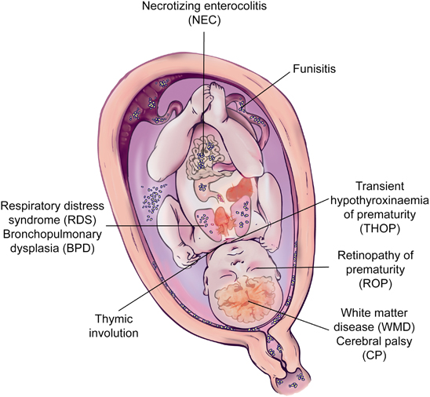
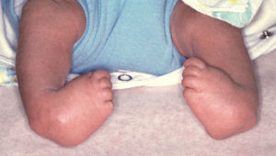

Slide 18
CONCLUSION
Premature rupture of membranes is a common condition in pregnancy
Its occurrence significantly increases the risk of adverse outcomes in the mother and the baby
Understanding its pathophysiology and managing it appropriately would enable us to reduce the risk of maternal and fetal/ perinatal morbidity and mortality

