Slide 1
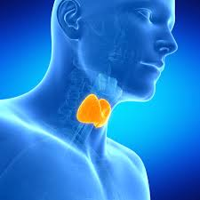
THYROID DISEASE IN PREGNANCY
BY DR. P. KAMAU KOIGI,
M.B.,Ch.B,
M.MED OBS/GYN

Slide 2
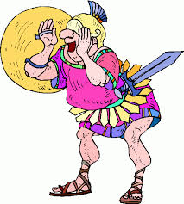
PRESENTATION OBJECTIVES
THYROID ANATOMY
THYROID PHYSIOLOGY
THYROID FUNCTION IN PREGNANCY
THYROID MALFUNCTION IN PREGNANCY
HYPOTHYROIDISM
HYPERTHYROIDISM
CONCLUSION

Slide 3
INTRODUCTION
Thyroid disorders occur more commonly in females than males (M/F ratio of 1:7); occurs in up to 1% of all pregnancies
Thyroid function has a direct impact on both reproductive potential and pregnancy outcomes
Therefore, there is a significant need to understand the functioning and malfunctioning thyroid in order to reduce the risk of maternal and fetal morbidity and mortality

Slide 4
THYROID – GROSS ANATOMY
Located in the neck anterior to the cricoid cartilage & trachea.
B supply: sup & inf thyroid arteries; thyroidea ima.
Lymphatic drainage: paralaryngeal, paratracheal, prelaryngeal (Delphian) nodes adjacent to thyroid gland
Innervation: entirely autonomic;
Sympathetic from the Superior, middle and inferior ganglia of the sympathetic trunk
Parasympathetic from the vagus nerve

Slide 5
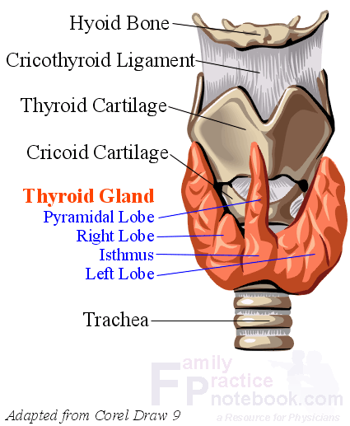

Slide 6
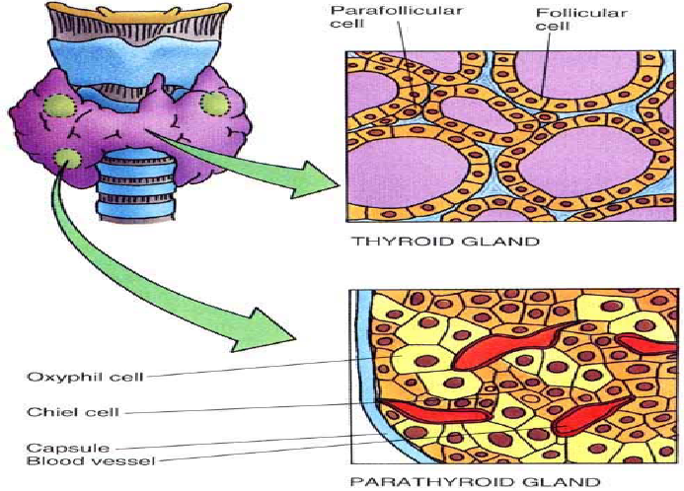
THYROID – HISTOLOGY

Slide 7
THYROID – EMBRYOLOGY
Wk 3 (day 24) of embryonic life: appears as midline vesicular structure at foramen caecum (base of tongue) from duct-like invagination of ventral pharyngeal endoderm that descends to become thyroglossal duct in neck; thyroglossal duct then atrophies
Wk 7: finishes descent along midline; 2 lateral analgens develop from 4th-5th branchial pouch, which contains ultimobranchial body; midline and lateral portions of thyroid fuse

Slide 8
Wk 9: cords and plates of follicular cells are formed
Week 10: small follicular lumina appear
Week 11-12: colloid secretion appears
Week 14: well developed follicles are lined by follicular cells and contain thyroglobulin containing colloid in lumina
Week 18: Fetal thyroid gland begins to respond to TSH stimulation

Slide 9
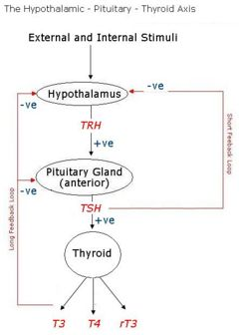
THYROID PHYSIOLOGY - Maternal
The thyroid gland produces thyroid hormone (thyroxine).
From a basic standpoint, the thyroid gland is an endocrine organ.
Its function is mostly regulated via negative feedback along the Hypothalamus-Pituitary-Thyroid axis
Assignment – Review the production of Thyroid hormone

Slide 11
Fetal Thyroid Physiology
During the first trimester of pregnancy, there is very little function of the fetal thyroid. The thyroid hormone requirements during this time are supplied by the maternal thyroid. This continues up to the 18th – 20th week.
At this point, the fetal H-P-T axis begins to function, and fetal Thyroid hormone production begins increasing gradually
Therefore, deficiency in maternal thyroid hormone production in early pregnancy is associated with impaired fetal neurologic development

Slide 12
Functions of thyroid hormone
Regulates metabolism:
Increases glucose metabolism
Increases protein synthesis
Increases Oxygen consumption (Heart Rate, BP)
Regulates tissue growth, differentiation and function:
Digestion
Reproduction
Bone growth
Muscle tone
Development of nerve cells

Slide 13
Normal adjustments in Pregnancy
During pregnancy, there are certain adjustments in maternal thyroid function that occur:
TSH levels do not change
There is increase in TBG, Total T4 and Total T3
There is a decrease in Free T4 (due to increase in TBG)
In order to facilitate normal thyroid function in pregnancy, there is an increase in Iodine requirements (RDA – 250mcg in Pregnancy)
Iodine deficiency in pregnancy impairs fetal neurological development

Slide 14
THYROID DISEASE IN PREGNANCY
Normal maternal thyroid function is known as Euthyroidism
Deviation from normal function may result in one of two scenarios:
Deficient function – HYPOTHYROIDISM
Excessive function – HYPERTHYROIDISM

Slide 15
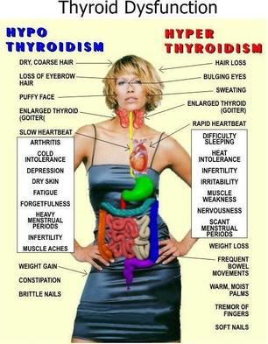

Slide 16
HYPOTHYROIDISM
Causes of Hypothyroidism:
Endemic goitre
Post- surgery – Partial or total thyroidectomy
Autoimmune: Hashimoto’s thyroiditis
Post-irradiation
Pharmacologic: Li⁺, amiodarone, antithyroid drugs
Peripheral tissue resistance: cretinism, juvenile hypothyroidism
Type 1 DM: 25% risk of developing post-partum hypothyroidism
Secondary Hypothryroidism: Sheehan syndrome, lymphocytic hypophysitis, hypophysectomy
Affects up to 1% of pregnant women

Slide 17
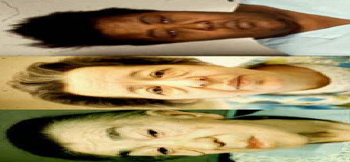
Clinical features…
Skin: cool, rough and scaly, dry yellowish colour (carotenemia);
Peripheral non- pitting oedema (myxoedema); puffy face; hoarse voice; macroglossia; ↑BMI, BP ↑ or ↓
CVS: Bradycardia,
Resp: shallow and slow respirations, impaired ventilatory response to hypercapnia; development of a frog-like husky voice

Slide 18
Clinical features
Hematological: Pallor (impaired Hb synthesis; Iron and folate deficiency; pernicious anaemia)
Renal: ↓GFR, thus impaired ability to excrete water load
MSS: paraesthesia; carpal tunnel syndrome
CNS: lethargy, inability to concentrate, depression, slow reflexes, hypersomnolence (≥12 – 14 hrs/day), myxedema madness (agitation and anxiety)

Slide 19
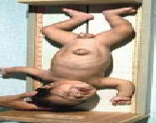
Maternal and Fetal risks
Maternal Risks: Myxedema Coma (hypothermia, bradycardia, decreased deep tendon reflexes, altered consciousness, hyponatremia, hypoglycemia, hypoxia and hypercapnia – a true medical emergency); Hypertensive disease in pregnancy
Fetal Risks: Impaired neuro-psychiratric development; Cretinism (deaf mutism, spastic motor disorder, macroglossia, hypothyroidism); Low birth weight due to Pre-term Labor
Note: the fetus is not at risk of hyperthyroidism if the mother is on T4 because the placental transfer of T4 is very poor

Slide 20
DIAGNOSIS
TFT’s: ↓ T₃, T ₄; ↑ TSH
FBC: ↓Hb, microcytic hypochromic or megaloblastic
Lipid profile: ↑ cholesterol
U/S: may show an enlarged thyroid with a diffusely hypoechogenic pattern if goiter present
ECG: bradycardia, low voltage QRS complexes, P and T waves;
Echo: cardiac enlargement, pericardial effusion; peripheral vascular disease (because of increased atherosclerosis)
EEG: low voltages, prolonged conduction time and slowed visual evoked response (VER)
Thyroid autoantibodies: may be present in Hashimoto’s thyroiditis

Slide 21
MANAGEMENT OPTIONS
Pre-pregnancy: Consider in those with subfertility/ menstrual disorders
Pre-natal:
Obtain baseline thyroid function tests; repeat every 3 months
Initiate Thyroxine therapy; adjust dose based on TFT’s
Labor and delivery:
Large maternal goiter may cause anesthetic complications
Post-partum:
Screen for post-partum depression

Slide 22
HYPERTHYROIDISM
Affects up to 0.2% of pregnant women
Causes of Hyperthyroidism:
Grave’s dx (95% of cases), toxic multinodular goitre, toxic thyroid nodule/adenoma, subacute thryoiditis, Acute thyroiditis (De Quervain’s/viral or Post-partum), Iodine treatment, Lithium therapy
2° hyperthyroidism: (↑TSH)➔ CNS dx (TSH-producing adenoma)
Rare causes: molar pregnancy, exogenous thyroid ingestion, thyroid malignancy; hyperfunctioning ovarian teratoma (struma ovarii)

Slide 23
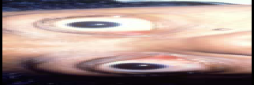
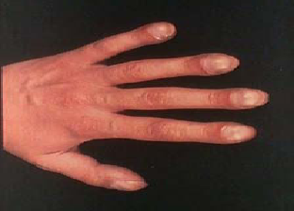
Clinical features
Symptoms/ complaints: palpitations, nervousness, easy fatigability, excessive sweating, heat intolerance, diarrhoea, oligomenorrhoea
Atypical symptoms: Periodic paralysis (2º Hypokalaemia), pruritus, AF, apathetic hyperthyroidism
Grave’s triad: Goitre + thyrotoxicosis + exophthalmos
General: Hair loss, CCF + peripheral oedema, gynecomastia, splenomegaly, onycholysis
Distal separation of the nail plate from the nail bed (Plummer’s nails)

Slide 24
Clinical Features
Neck: enlarged thyroid + bruit + tracheal deviation
Legs: pretibial myxoedema
CVS: Tachycardia; High cardiac output failure (CCF); Hypertension
Thyroid ophthalmopathy: exophthalmos, proptosis, periorbital oedema, conjunctival swelling + oedema, lid lag, ophthalmoplegia, diplopia (involvement of the extraocular muscles) keratitis (corneal involvement) & blindness.
Hypermetabolism: sweating, paradoxical wt. loss, heat intolerance, thirst, amenorrhoea.
Psychiatric: Change in sleep patterns, emotional lability, fatigue, agitation, excitability, psychoneurotic tendencies

Slide 25
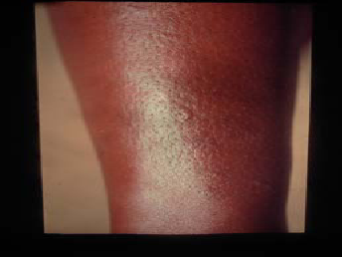
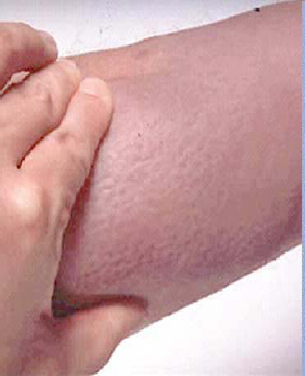
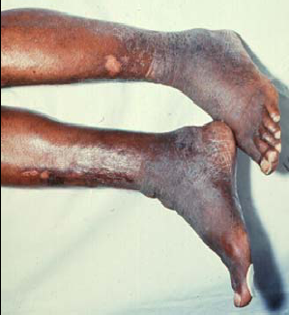
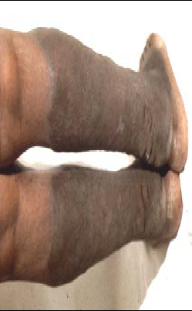
Pretibial Myxoedema and Graves Dermopathy
Localized myxoedema

Slide 26
Maternal and Fetal Risks
Maternal Risks: Heart failure and Thyroid storm (A true medical emergency); Hypertensive disease of pregnancy; Infection; Abruptio placenta; adverse effects of anti-thyroid medications (agranulocytosis; hepatitis, urticaria, nausea, vomiting and diarrhoea)
Fetal: Spontaneous abortion; Pre-term labor; intrauterine growth restriction; Fetal/ neonatal thyrotoxicosis in Grave’s disease; craniocystosis; exophthalmos; hydrops fetalis (heart failure); hepatosplenomegaly; neonatal jaundice; poor feeding; poor weight gain; irritability; hypothyroidism due to antithyroid medication; stillbirth

Slide 27
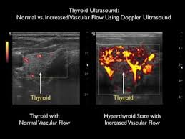
Diagnosis
TFT’s: ↓ TSH; ↑ free and total T₃ / T₄
Anti-TSH R^{I} ab’s: seen in Grave’s disease
Thyroid scan: usually shows ↑ uptake of iodine; Doppler studies may show increased vascularity
Electrolytes: hypokalaemia

Slide 28
Management options
Pre-pregnancy:
Therapy for Hyperthyroidism is best begun before pregnancy; conception is best avoided for up to 4 months after last treatment when she is preferably euthyroid; medication should be continued antenatally

Slide 29
2. Antenatally
Block and replace regimens are not suitable for pregnancy – antithyroid medications freely cross the placenta but T4 does not.
Therapeutic modalities available include:
Thionamides: Carbimazole, Methimazole, Propylthiouracil
B-Blockers: Propranolol (for palpitations, tremor, tachycardia) may be used for only up to a month (Risk of fetal growth restriction)
Iodides: only limited to pre-operative use due to ↑ fetal hypothyroidism
Radioactive Iodine (131-I) – ABSOLUTELY CONTRAINDICATED!!!
Surgery: Only for patients who do not respond to medication or those with compressive symptoms from a large goiter causing stridor, respiratory distress, dysphagia or carcinoma (Complications?)

Slide 30
3. Labor and Delivery
If treated, labor and delivery are not associated with increased risks
A large maternal goiter may cause anesthetic complications
In women with poorly controlled or untreated thyrotoxicosis, labor and delivery may precipitate THYROID STORM.

Slide 31
THYROID STORM:
Precipitants of Thyroid storm:
Diabetic Ketoacidosis; Cerebrovascular accident; Myocardial infarction;
Pulmonary Embolism; Trauma; Surgery; Infection
Childbirth; Iodine administration; Withdrawal of thyroid medication;
Ingestion of thyroxine; Idiopathic (20 – 25%)

Slide 32
THYROID STORM:
Features:
Extreme symptoms of Hyperthyroidism – Palpitations; Tachycardia >140 bpm; atrial fibrillation with rapid ventricular response; high output cardiac failure
Vital signs: Fever ≥ 40ºC; BP may be normal but there is increased pulse pressure; may present in shock;
Altered mental status: varies from restlessness & confusion to psychosis, seizures and coma)
Other symptoms: Severe diarhoea, nausea, vomiting & non-specific abdominal pain

Slide 33
THYROID STORM…
MANAGEMENT:
Propylthiouracil 300 – 400 mg 8hrly PO/NGT/PR
Potassium Iodide 2 – 5 drops PO OR Sodium Iodide (0.5 – 1.0g IV) 8hrly 1–2 hours after starting PTU
Supportive: maintain blood volume, glycemic control, temperature control and restore electrolyte balance – Propranolol 40 – 80 mg PO or 1mg/min IV to a total of 6mg
AIMS OF TREATMENT:
To decrease thyroid hormone production
To decrease the effect of circulating T3/T4
To provide supportive therapy
To treat the underlying cause

Slide 34
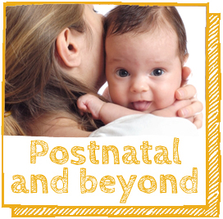
4. Post-natal
Umbilical cord TFT’s and TFT’s in the breastfeeding neonate
Observe for worsening symptoms after delivery, as Grave’s disease tends to flare post-natally as maternal antibodies rise post-partum
If medications were stopped, they can be re-introduced 2 – 3 months after delivery

Slide 35
CONCLUSION
Normal thyroid function is a significant factor in ensuring favorable maternal and fetal outcomes in pregnancy
Thyroid dysfunction therefore represents a significant risk to maternal and fetal well-being
Understanding thyroid dysfunction would thus increase the opportunity to have better maternal and fetal outcomes by reducing the risk of morbidity and mortality

