Slide 1
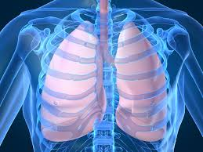
TUBERCULOSIS IN PREGNANCY
BY DR. P. KAMAU KOIGI
M.B.,Ch.B, M/MED

Slide 2
PRESENTATION OBJECTIVES
INTRODUCTION
EPIDEMIOLOGY
PATHOPHYSIOLOGY
CLINICAL ASPECTS
PREGNANCY ISSUES
DIAGNOSIS
MANAGEMENT
CONCLUSION

Slide 3
INTRODUCTION
Tuberculosis is an infection caused by Mycobacterium tuberculosis
It is an atypical acid–alcohol–fast bacillus that usually affects the lungs but can affect other systems

Slide 4
EPIDEMIOLOGY
Globally: (WHO 2010) 1/3 of world’s population is infected, with 8 million new cases and 2 million deaths annually
The leading cause of infectious mortality globally
95% of mortality from TB is in the lesser developed countries
Risk factors – Poverty; overcrowding; HIV infection
Transmission is by droplet infection – thus highly contagious
Incidence and transmission of TB are not altered by pregnancy

Slide 5
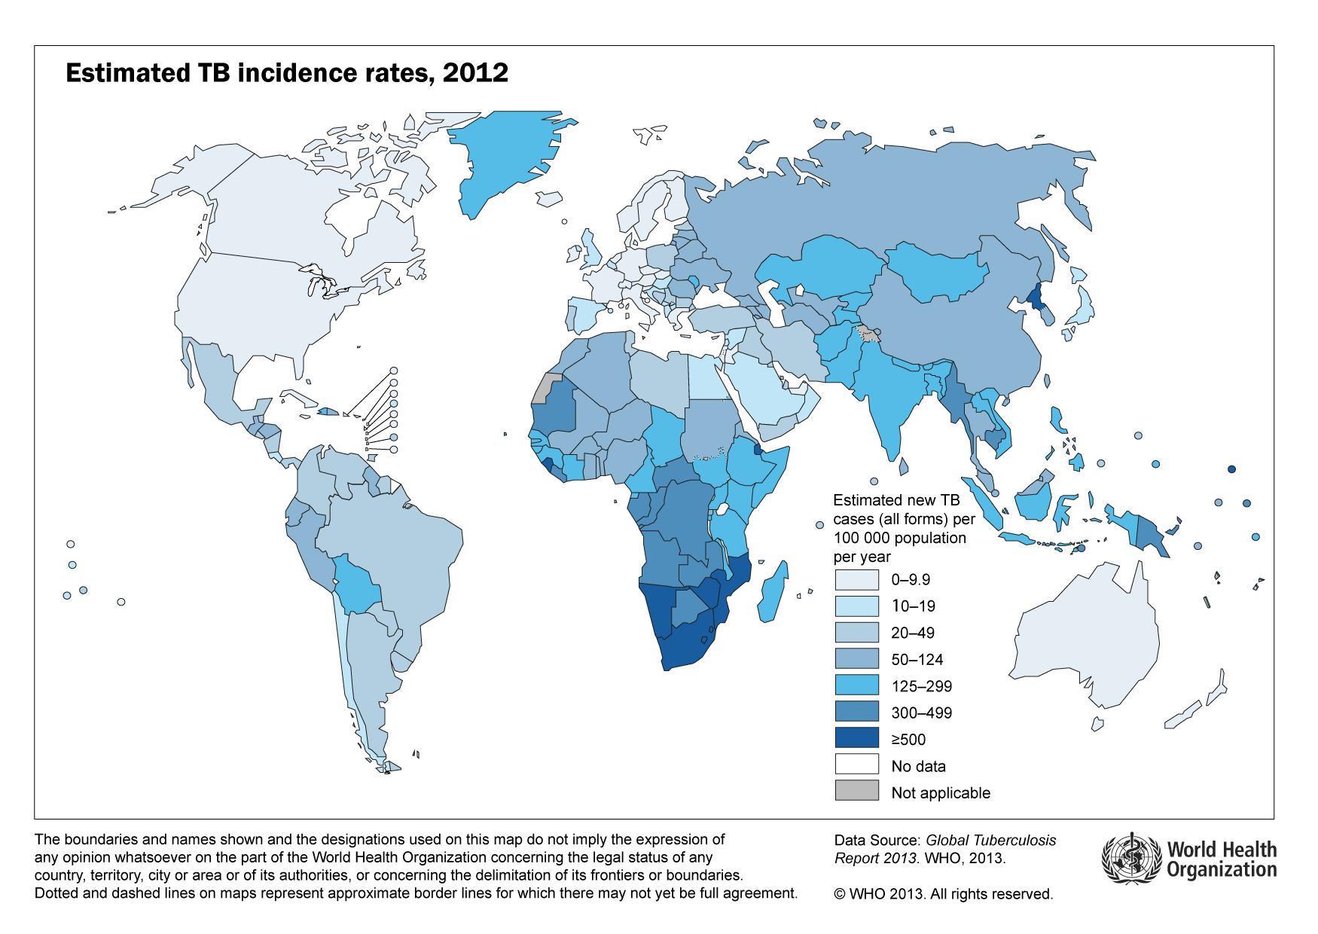

Slide 6
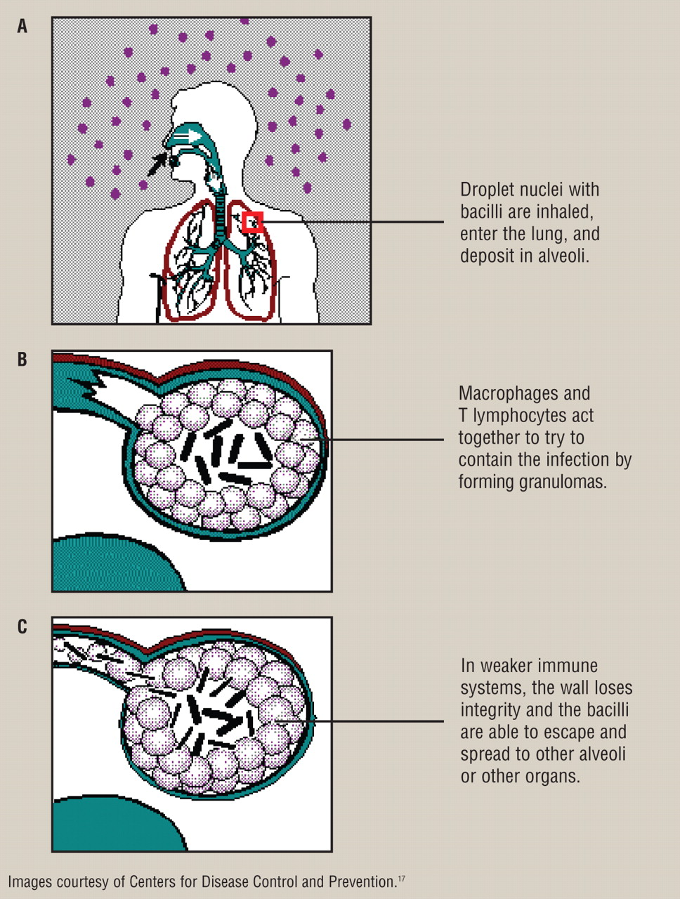
PATHOPHYSIOLOGY
The bacilli cause non-specific pneumonitis, with activation of the alveolar macrophages, which engulf the bacilli & seal them off to form a tubercle which undergoes caseous necrosis and fibrosis, thereby compromising pulmonary function
Progression is directly related to the level of immunocompetence of the infected individual

Slide 7
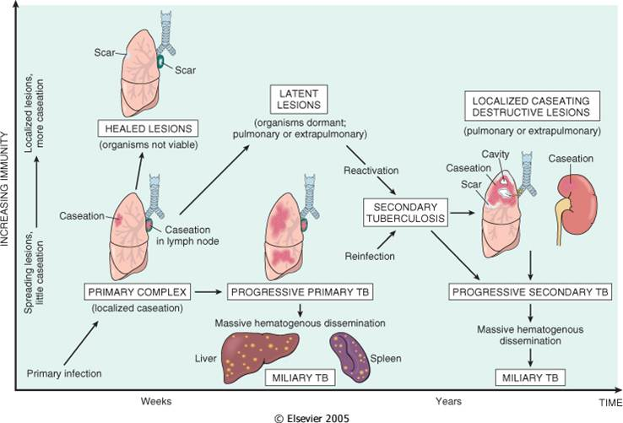

Slide 8
CLINICAL ASPECTS
SYMPTOMS:
Chronic cough (>2/52) productive of sputum;
Night sweats (drenching);
Unexplained loss of ≥ 10% body weight
Hemoptysis may be present;
Prolonged low-grade fever;
PHYSICAL SIGNS:
Digital clubbing; bronchial breath sounds; crepitations may be present; stony dullness (pleural effusion)

Slide 9
PREGNANCY ISSUES
The interaction between Tuberculosis and Pregnancy depends on several key factors:
Nutritional and immune status of mother
Presence of concomitant disease, especially HIV
Stage of pregnancy
Type: latent, primary, recurrent, secondary, miliary/ disseminated
Site: Pulmonary, Extrapulmonary
Extent of tissue damage: Derangement of function
Availability of facilities for early diagnosis and treatment

Slide 10
MATERNAL RISKS
Lower if the mother is immunocompetent
HIV co-infection significantly increases risk of progression and non-adherence to treatment – Pill burden
INH Hepatotoxicity may occur more commonly in pregnancy
Increased risk of other obstetric morbidities
Increased risk of spontaneous abortion

Slide 11
FETAL RISKS
Risk of fetal harm form Anti-TB medications (especially Streptomycin)
Fetal risks from defaulting or disseminated TB – Intrauterine growth restriction; low birth weight; Preterm labor & Delivery
Congenital infection - rare
Perinatal mortality

Slide 12
ADDITIONAL CLINICAL CONCERNS
The neonate is at risk of post-natal infection if the mother is still infectious at delivery
Though rare, congenital infection may occur due to transplacental transfer or fetal ingestion of infected amniotic fluid

Slide 13
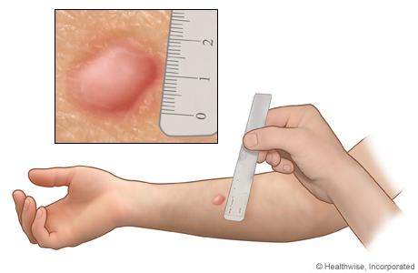
DIAGNOSIS
Mantoux Tuberculin Skin test: Not useful in Kenya due to high exposure to TB
Positive if ≥10mm (immunocompetent) and if ≥ 5mm in HIV

Slide 14
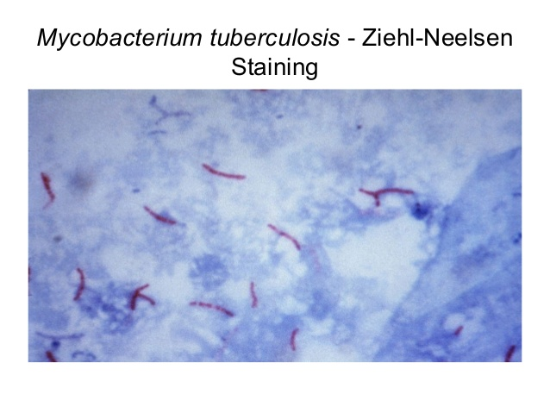
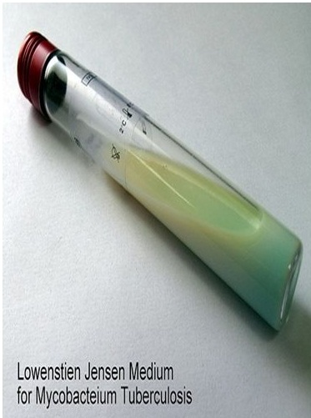
Sputum Microscopy and Culture testing:
Sputum sample obtained from early morning expectorate in a sterile container for 3 days
Microscopy:
Light microscopy (ZN staining) – Acid-alcohol-fast bacilli
Flouresence microscopy
Sputum Culture on Lowenstein-Jensen (LJ) medium or Bactec medium

Slide 15
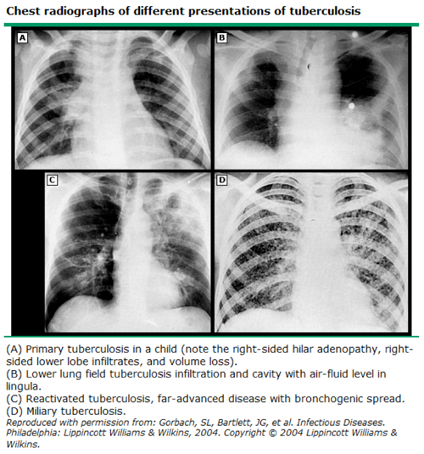
Shielded Chest X Ray:
Facilitates a clinical diagnosis in event that sputum assessment is not possible;
Shielding reduces fetal exposure

Slide 16
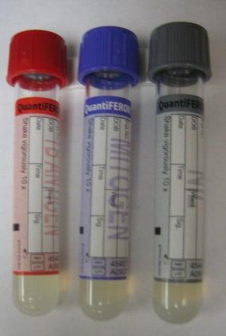
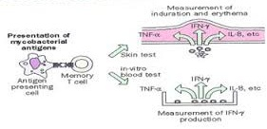
Newer Diagnostic modalities
QUANTIFERON TEST: A blood test that determines the levels of IFN- Gamma in the blood in response to TB infection – cannot differentiate latent and active TB

Slide 17
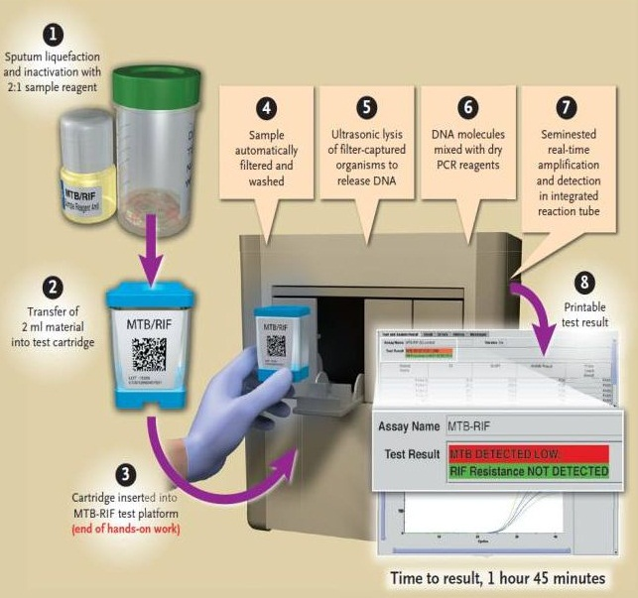
GENEXPERT: Uses sputum to detect TB DNA; also assesses for genetic mutations in TB genome that are associated with resistance to Rifampicin; Very Fast (2 hrs) and highly reliable

Slide 18
MANAGEMENT PRINCIPLES
Early diagnosis and prompt treatment (preferred)
Screening for HIV co-infection (mandatory if not already done)
Multi-disciplinary approach: Chest physician; Laboratory support; Obstetrician; HIV & TB-specific management team; Obstetrician
Supportive management: e.g. Pleural tap/ Chest tube if necessary

Slide 19
FIRST-LINE THERAPY
There are 4 key medications that are used in Kenya: (+A/E’s)
Rifampicin (R): Fever, Nausea, Hepatitis, Purpura, Orange secretions, increased metabolism of many drugs
Isoniazid (H): Hepatitis, peripheral neuropathy, cutaneous hypersensitivity
Pyazinamide (Z): Thrombocytopenia; Hepatotoxicity, Nephrotoxicity
Ethambutol (E): Retrobulbar neuritis, peripheral neuropathy

Slide 20
Phases of therapy
Treatment of TB is based on the DOTS principle – Directly Observed Therapy over a Short course
There are 2 phases of TB therapy, spread out over 6 months:
Initiation phase: RHZE for 2 months
Continuation phase: RH for 4 months

Slide 21
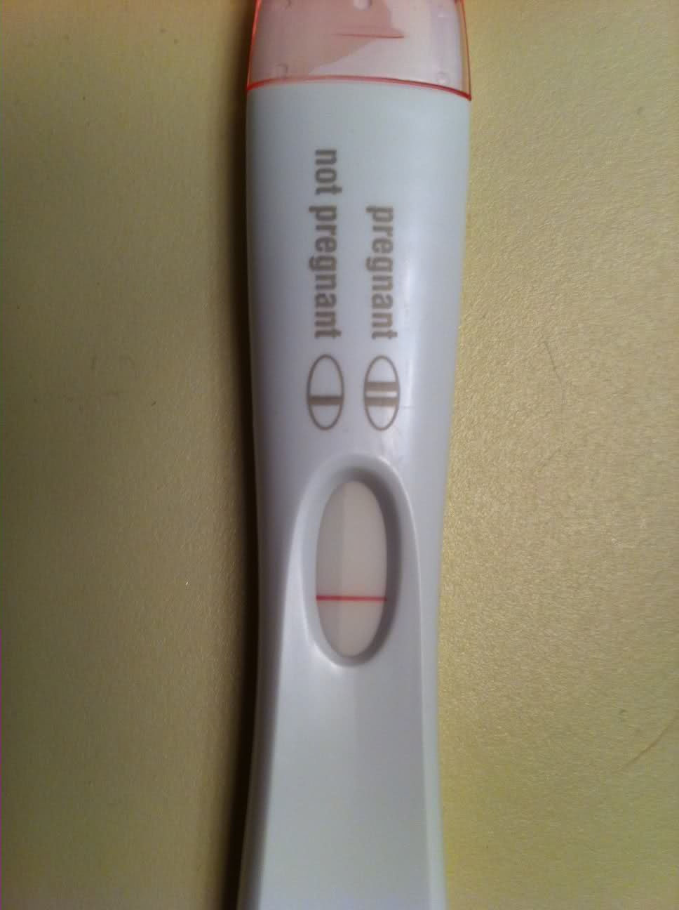
Pre-pregnancy
Screen for TB prior to pregnancy if possible
If detected, delay pregnancy until treatment is completed
Counsel regarding possible teratogenic potential of anti-TB’s

Slide 22
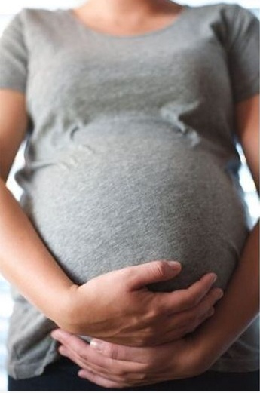
Antenatal
Screen all women from high risk populations
Perform sputum evaluation if you suspect TB
Give all diagnosed patients full course of treatment; with Pyridoxine supplementation and monthly LFT’s
If TB and HIV co-infection are confirmed, treat BOTH simultaneously

Slide 23
Labor and Delivery
The most significant concern is that appropriate infection prevention and control measures should be used if the mother is still infectious at the time of delivery
Delivery mode choice should be based on obstetric indications

Slide 24
Post-partum
Separate the baby from the mother only if she is infectious until she has completed at least 10 – 14/7 of therapy
Give INH and BCG vaccine to the baby if the mother is infectious at birth
Encourage exclusive breastfeeding

Slide 25
CONCLUSION
Globally, TB is an important cause of morbidity and mortality
There is therefore a need for early diagnosis and prompt treatment in order to reduce the risk of adverse maternal and fetal outcomes
Assignment: Read up on MDR–TB and XDR–TB

