Slide 1
Overview of Female Infertility
Ogweno G.M.
Subspecialist in Reproductive Medicine
Hon. Lecturer UON & Consultant Gynecologist

Slide 2
Historical perspective
1800s-Marion Sims-Analysed the importance of cervical secretions in affecting sperm survival.
1920-Rubin introduced clinical tests to determine tubal patency initially using Radioactive material and later through O₂ insufflation.
1935-Stein and Levanthal described a series of patients with amenorrhea, hirsutism and obesity (PCOS).

Slide 3
1950s-Solomon Berson developed RIA for detection of steroid and peptide hormones.
1960s-Introduction of fertility medications such as Clomiphene citrate, FSH and LH.
1980s-Reproductive surgery.
1990s-The IVF revolution.

Slide 4
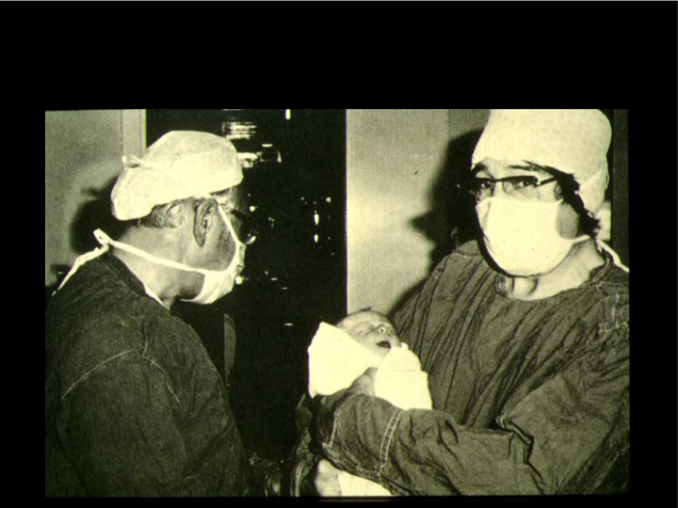
Louise Brown: First IVF baby with Steptoe and Edwards July 1978

Slide 5
Definition
Infertility is a disease, “defined by the failure to achieve a successful pregnancy after 12 months or more of regular unprotected intercourse. Earlier evaluation and treatment may be justified based on medical history and physical findings and is warranted after 6 months for women over age 35 years. (ASRM)

Slide 6
Factors affecting fertility
Maternal Age-there is reduced number and quality of eggs that occur with advancement in age.
Ovarian ageing is associated with an increase in abnormal chromosomal contingent that results from faulty meiosis leading to aneuploidies.
Reasons for delay in childbearing: wide choice of contraceptive to choose from, pursuing education and careers and hence marrying late.

Slide 7
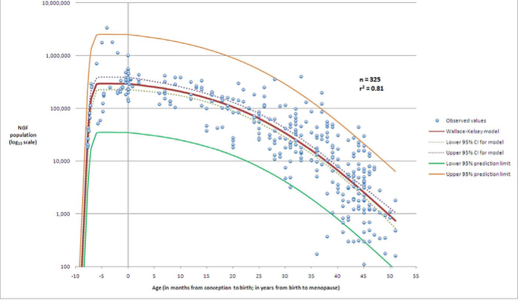
Maternal Age
Wallace and Kelsey 2010

Slide 8
Timing of Intercourse
The establishment of a successful pregnancy also depends on properly timed intercourse around the time of ovulation.
The greatest chance of conception has been associated with intercourse occurring two to three times during the six-day time frame that ended with the day of ovulation.

Slide 9
Duration of Attempting pregnancy
The monthly fecundity rate in the general population is estimated at between 15-20%, and is influenced by age.
Evaluation may be indicated sooner if there is an obvious or known cause of the infertility (i.e.; anovulation, age over 35 years, previous ectopic pregnancy, signs of endometriosis, etc.)

Slide 10
Previous Contraception
The IUD was a popular method of contraception in the 1970s in the US, in particular the Dalkon Shield which was linked with a higher risk of PID, hence increasing the chance of tubal factor infertility.

Slide 11
Occupational Hazards
Chemical exposures can result from either environmental or more likely exposure at workplace.
The Occupational Safety and Health Administration (OSHA) regulates the workplace to ensure safety of all employees.
Most spermatotoxins are encountered in men working with pesticides.

Slide 12
Diet
Currently there is no data to show that any particular diet can impact on fertility.
Women with extremes of weight; BMI <19 or body fat content <22% are at risk for hypothalamic dysfunction, while those with BMI > 30 may have associated PCOS which can cause reduced fertility aside from its impact on ovulatory function.
Advanced BMI is associated with reduced implantation and pregnancy rates and men also are associated with altered sperm parameters and reduced fertility.

Slide 13
Lifestyle Habits
Smoking-is a reproductive toxin and is associated with decreased fertility.
Caffeine-has been associated with an increased risk of pregnancy loss, with reports linking it to decreased fertility.
Alcohol-effect on fertility has not been well studied.
Stress and Anxiety-have been show to reduce a couples success while undergoing treatment for conception.

Slide 14
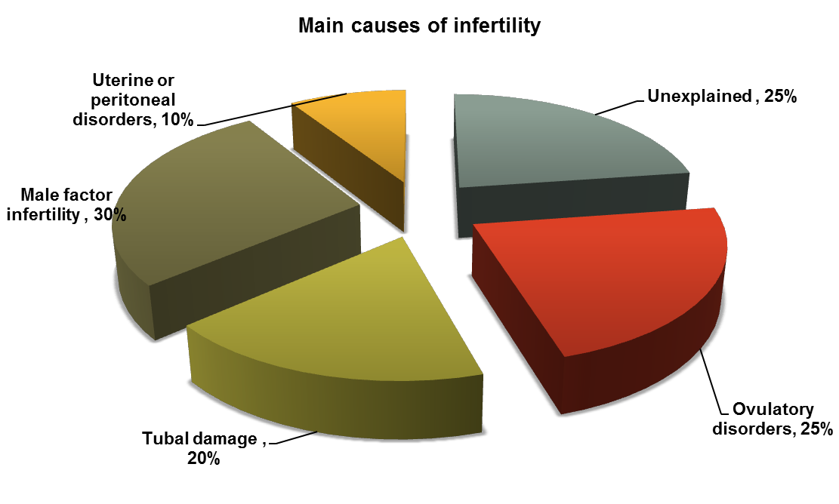
Causes of Infertility

Slide 15
Cervical factor Infertility
Impaired sperm penetration of the cervical mucus following intercourse can prevent the establishment of pregnancy.
About 5% of couples will have cervical factor as the cause of their infertility.
A history of LEEP or ablative surgery to the cervix could put a woman at risk.

Slide 16
Uterine factor fertility
Dysfunction of the uterus can prevent establishment of a pregnancy.
Evaluation of the uterine cavity should be considered for women with AUB, abnormal cavity noted on HSG or those with a history repeated miscarriages.
Evaluation of the uterine cavity can be done by diagnostic hysteroscopy or a sonohysterogram (SHG).

Slide 17
Tubal factor (TF) infertility
TF infertility is present in approximately 20% of infertile women.
Risk factors include previous ectopic pregnancy, ruptured appendix, septic abortion, previous use of IUD, or a history of PID.
HSG and laparoscopy are the standard tests for assessing tubal patency in infertile women.
Absolute contraindications to the test include: active pelvic infection and suspicion of pregnancy.

Slide 18
Ovarian Function
Determination of whether ovulation is occurring by ODKs or Day-21 progesterone level >3ng/ml.
Assessment of ovarian reserve: Cycle Day 3 Basal FSH and estradiol, AFC and AMH.
Evaluation of a woman with ovulatory dysfunction: Menstrual cycles out of the normal range (25-35), TSH, PRL.
PCOS patients should have androgen tests as well as a FBS or HBA1C to rule out glucose intolerance.

Slide 19
Premature menopause
Cessation of ovarian function before the age of 40 years
Amenorrhoea
Raised FSH (>40 iu) x 2 times
Hypo-oestrogenism
Hyp
Pit
E2
FSH
LH
Small
Follicles
in ovary

Slide 20
Premature menopause
1% women <40 years of age
0.1% women <30 years (⬇ by a factor of 10)
0.01% women <20 years (early POF)
50% experience intermittent ovarian function
5% spontaneous pregnancies
20-30% positive family history

Slide 21
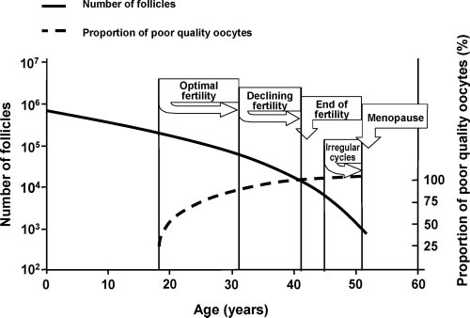
Ovarian Ageing
Progressive loss of reproductive function
Broekmans et al; 2009 Endo.reviews

Slide 22
Premature menopause: causes
Chromosomal/Genetic
Turners Syndrome
Gonadal dysgenesis
Fragile X syndrome/ FMR1 gene mutation
Deletions/ translocations in X chromosomes
Idiopathic
Autoimmune/ ? Infective (e.g. mumps, TB)
Surgical (ovarian surgery, UAE, Hysterectomy)
Chemotherapy (drug/dose/age)
Radio-therapy (20 Gy in <40yrs; 6 Gy in older)
Environmental

Slide 23
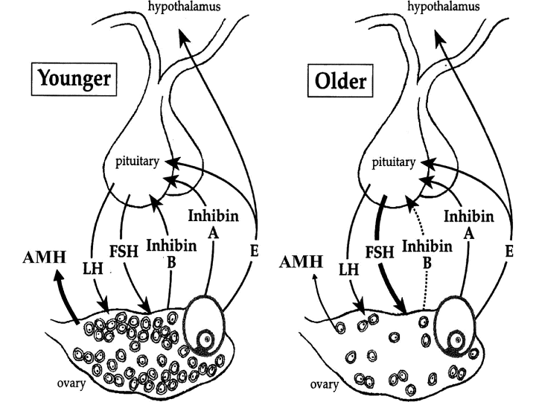
Ovarian factor and infertility

Slide 24
Endometriosis
Severe endometriosis can cause distortion of pelvic anatomy by adhesions.
Periovarian adhesions can interfere with oocyte release.
Tubal adhesions can impair transport into the uterine cavity.
Presence of ectopic endometrial implants can lead to an autoimmune response resulting in implantation failure.

