Slide 1
HIV/AIDS IN GYNAECOLOGY Overview
Kizito Lubano, MBChB, M.Med (OBGYN), MSc Research Officer
Reproductive Health Research Unit- KEMRI

Slide 2
Objectives
To review the most common gynecologic problems ( benign & malignant)
Discuss sexual transmission of HIV
Discuss contraception and HIV
Adolescent reproductive health and HIV
Notes:
The objectives of this presentation are to: explain why prevention of HIV is important; demonstrate the progress made in HIV prevention; discuss the modes of HIV transmission; and to describe the most effective interventions for reducing HIV transmission.

Slide 3
Identification of Women with HIV
Women seen for reproductive healthcare:
Sexually active
Pregnant or at risk for pregnancy
Signs or symptoms of genital tract infection
Information and counseling about HIV
Personal risk assessment
DCT, RCT,VCT~ knowledge of serostatus
Notes:
Women being seen for reproductive healthcare are generally sexually active; they may be pregnant or at risk for becoming pregnant; they may have signs or symptoms of genital tract infections. In areas of high HIV prevalence, these are women at increased risk for becoming HIV-infected. Reproductive healthcare should include information and counseling about HIV and personal risk assessment. Voluntary testing may be performed on site or clients can be referred for testing. Reproductive healthcare offers the opportunity to identify HIV infection early, often during the period of clinical latency, so that appropriate clinical care can be started at a time it is likely to be most effective, and sexual and mother-to-child transmission can be prevented.

Slide 4
Gyecologic problems in HIV-Infected Women
Most problems directly associated with HIV/AIDS or indirectly through its treatment~ drug interactions
Menstrual disorders ~ sub-fertility
Genital ulcer disease
Abnormal vaginal discharge
Pelvic inflammatory disease~ infertility
HPV, cervical dysplasia and neoplasia
Notes:
There are several gynecologic problems that are common in the setting of HIV infection, and these often occur when the woman with HIV has no other symptoms. In one study, almost one-half of HIV-infected women developed a gynecologic problem over the course of follow-up. Another study of hospitalized AIDS patients found that 83% of women had coexisting gynecologic disease. These include menstrual disorders, genital ulcer disease, abnormal vaginal discharge, pelvic inflammatory disease, and human papillomavirus infections and lower genital tract dysplasia and neoplasia. Several of these conditions are more frequent or more severe with declining immune function; others may be associated with HIV because of common risk behaviors, weight loss, or other factors.

Slide 5
Menstrual Disorders
Common, but unclear relationship to HIV-oligomenorrhoea, amenorrhoea
Must consider possibility of pregnancy
May reflect malnutrition or chronic disease
Anemia an independent predictor of HIV progression and death
Notes:
HIV-infected women frequently report menstrual disorders. However, controlled studies have given conflicting evidence regarding whether HIV or HIV-related immunesuppression exerts a clinically significant direct effect on menstrual function. In any woman with abnormal bleeding or amenorrhea, the possibility of pregnancy must be considered and ruled out. Menstrual disorders may also reflect malnutrition, wasting, or chronic disease in the HIV-positive woman. Women with increased menstrual blood loss are at risk for anemia, which is an independent predictor of HIV progression and death, and requires intervention.

Slide 6
Menstrual Disorders Interventions
Iron supplementation and/or iron-rich foods
Pregnancy testing
Antenatal care
Ectopic pregnancy precautions
Treat underlying STI
Hormonal contraception may decrease blood loss, regulate menses with ovulatory disorders
Surgical intervention may be needed with severe menorrhagia and fibroids
Notes:
What can be done for the HIV-infected woman with abnormal menstrual function? Iron supplementation, as well as iron-rich foods, can help prevent or correct anemia with increased menstrual blood loss. Pregnancy testing should be used when available in order to identify women who are pregnant and need antenatal care. Women who are pregnant and have lower abdominal pain and irregular bleeding may have an ectopic pregnancy and should be followed closely to assess the need for possible surgical intervention. Underlying STIs, particularly gonococcal or chlamydial cervicitis or endometritis, may cause irregular bleeding or spotting, and should be ruled out or treated if present. Cervical cancer may present with abnormal bleeding and in postmenopausal women with bleeding, uterine cancer must be considered. Surgical evaluation may be needed. In women with ovulatory disorders or increase in menstrual flow or duration, use of hormonal contraception can decrease blood loss and regulate menses. Ultimately however, surgical treatment may be necessary with severe menorrhagia that is secondary to uterine fibroids and unresponsive to simple measures.

Slide 7
Interactions between HIV & STIs
Impaired immunity
STIs
Increased transmission
HIV
Sexual behaviour
Type of partner/ sexual network
Lack of circumcision

Slide 8
STIs and HIV
Clinical manifestations of some STIs altered in presence of HIV.
STIs, both ulcerative and nonulcerative, facilitate HIV transmission 2-5 fold.
Disruption of epithelial barrier
Increased number of receptors per cell
Increased genital HIV viral load
Enhanced syndromic treatment of STIs resulted in 38% decrease in HIV seroconversion over 2 years (Mwanza, Tanzania).
Notes:
STIs and HIV are closely interrelated. The clinical findings of certain STIs are changed in the presence of HIV. Furthermore, STIs, both ulcerative and nonulcerative, increase the risk of HIV transmission 2-5 times. Genital ulcers disrupt the epithelial barrier, and STIs also increase the number of cells vulnerable to HIV in the genital tract, increasing susceptibility in uninfected individuals. Alternatively, HIV-infected persons with STIs have increased genital tract HIV viral load, which increases infectiousness. Treatment of these infections reduces the amount of virus in the genital tract. These findings suggest that screening and treating STIs can be another way to prevent HIV transmission. Indeed, in one clinical trial in Tanzania, enhanced syndromic management of STIs resulted in a 38% decrease in HIV seroconversion over two years.

Slide 9
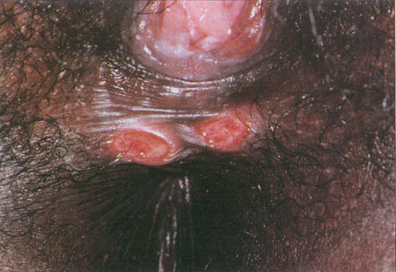
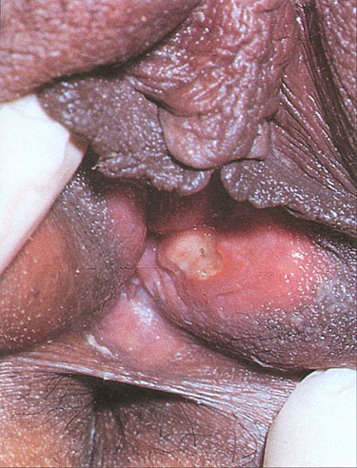
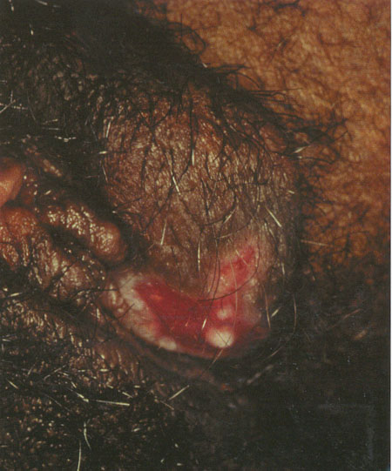
Genital Ulcer Disease
Wilkinson and Stone, 1995; Fig 8.46
J. Anderson, MD, ed.
Holmes, 1999; Plate 32
Syphilis
Chancroid
Herpes Simplex
Notes:
Genital ulcers are most commonly caused by syphilis, chancroid, or herpes simplex. These etiologies cannot be reliably distinguished from one another on clinical grounds and may coexist in the same individual. HIV-infected persons with syphilis may have abnormal serologic results, such as unusually high titers, false negatives, or delayed seroreactivity, although generally serologic tests can be interpreted in the usual manner. The clinical presentation of syphilis is variable at all stages, but atypical manifestations may be seen in the setting of HIV infection. Neurosyphilis should be considered in the differential diagnosis when HIV-infected individuals present with neurologic signs or symptoms. Therapy is not altered by the presence of HIV infection.
With chancroid, response to treatment may be diminished in the HIV-infected person; with use of single dose therapies, close follow-up is necessary since treatment failure may be more likely. Herpes simplex infections are chronic, involving relapsing infections that cannot be cured by current therapies, although infections can be controlled by suppressive or intermittent antiviral agents such as acyclovir. In the HIV-infected client with genital herpes, more frequent, prolonged, and/or severe episodes are common with progressive immunesuppression and lesions may be atypical in appearance or location.

Slide 10
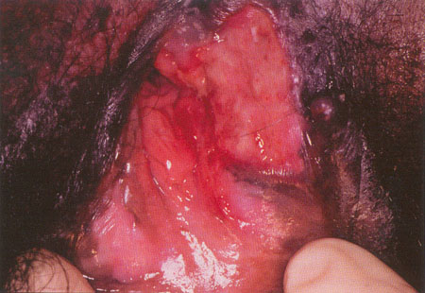
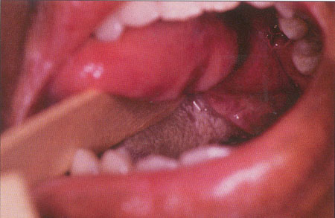
Apthous Ulcerations
J. Anderson, MD, ed.
J. Anderson, MD, ed.
Apthous Genital Ulcerations
Apthous Oral Ulcerations
Notes:
In women with late-stage AIDS, genital ulcers may develop for which no specific cause can be found. These are known as aphthous ulcers. In about one-third of cases, oral or esophageal ulcers are present as well, and one-fifth of cases are also associated with fistula formation, usually with erosion into the rectum.

Slide 11
Genital Ulcer Disease
Other Causes
Lymphogranuloma venereum
Herpes simplex 2 ( HSV2)
Granuloma inguinale (Donovanosis)
Neoplasm
Syndromic Management
Notes:
Other causes of genital ulcers include lymphogranuloma venereum and granuloma inguinale, which are caused by infections and may be more difficult to treat in individuals with HIV infection. With any genital ulcer that does not heal and does not respond to treatment, a malignant neoplasm must be considered.
In areas with limited resources for diagnosis, syndromic management is recommended and has been shown to be accurate and effective. With syndromic management, immediate treatment is given for all major causes of genital ulceration, based on local information about causes of ulcers and their drug susceptibility.

Slide 12
Abnormal Vaginal Discharge
Vaginitis
Bacterial vaginosis
Overgrowth of anaerobic/facultative anaerobic flora
Associated with increased risk of PID, preterm labor, PROM
May enhance HIV transmission
Candidiasis
May increase in frequency with progressive HIV disease
Common after antibiotic treatment
Trichomoniasis
Transmitted sexually
Sex partner treatment needed
Notes:
Another problem frequently seen in women with HIV infection is abnormal vaginal discharge. This can be caused by one or more vaginal infections, including bacterial vaginosis, candidiasis, or trichomoniasis. The first and most common type of vaginal infection, bacterial vaginosis or BV, is not caused by a single type of bacteria, but by an overgrowth of different pathogenic bacteria that alter the normal vaginal environment. BV has been associated with an increased risk of pelvic inflammatory disease and, in pregnant women, an increased risk of preterm labor and premature rupture of membranes. More recent information has shown that BV may enhance HIV transmission, both sexual transmission and mother-to-child transmission.
The second type of vaginal infection, candidiasis or yeast infection, may increase in frequency with progressive HIV disease, as the immune system becomes more suppressed. These infections are also common after antibiotic treatment in both HIV-infected and HIV-uninfected individuals. The third common type of vaginal infection is trichomoniasis, a protozoan infection that is transmitted sexually. Syndromic management of abnormal vaginal discharge, including treatment for these three types of infections, is recommended and is effective for the treatment of vaginal infections.

Slide 13
Abnormal Vaginal Discharge (2)
Cervicitis
Gonorrhea
Chlamydia
Limitations of syndromic management
Use local prevalence data, if available
Risk assessment
Additional symptoms/signs – cervical swab to assess purulence
Partner treatment
Notes:
Another major cause of abnormal vaginal discharge is infection of the cervix or cervicitis. The two most common causes of cervicitis are gonorrhea and chlamydia, both of which are sexually transmitted. Unfortunately, syndromic management for abnormal vaginal discharge is less accurate in the diagnosis and management of cervicitis. If specific testing for gonorrhea and chlamydia is not available, other information should be used to make decisions about treatment, including personal risk assessment, local information about how frequently these infections are found, and other symptoms or signs, such as a cervical swab showing a purulent discharge. Sex partners should also be treated if a diagnosis of cervicitis is made.

Slide 14
Pelvic Inflammatory Disease
Minimal criteria for diagnosis
Lower abdominal tenderness
Adnexal tenderness
Cervical motion tenderness
Simple supporting signs
Fever >38.3°C
Abnormal discharge
Rule out pregnancy
In presence of HIV infection, PID may be more common and more severe
Oral versus IV therapy
Notes:
Both gonorrhea and chlamydia are major causes of pelvic inflammatory disease or PID, which is an upper genital tract infection involving the endometrial cavity, fallopian tubes, ovaries, and the peritoneal cavity. Most women with PID present complaining of lower abdominal pain. On physical examination, the presence of lower abdominal tenderness, adnexal tenderness, and cervical motion tenderness form the basis for clinical diagnosis. The presence of other simple findings, such as fever and abnormal discharge increase the accuracy of diagnosis. If available, pregnancy testing should be performed, since ectopic pregnancy may present with similar findings. In women with HIV infection, PID may be both more common and more severe. Treatment with antibiotics to cover gonorrhea, chlamydia, and other aerobic and anaerobic bacteria is indicated. Hospitalization for intravenous therapy should be considered with severe PID and in women who have symptomatic HIV.

Slide 15
Cervical Cancer Linked to Human Papillomavirus (HPV) Infection
One or more oncogenic types of HPV found in over 99% of cases
HPV is sexually transmitted
Women usually are infected with HPV in their teens or 20s
Cervical cancer can develop up to 20 years after HPV infection
Source: Walboomers et al 1999
Notes:
We now know that the cause of cervical cancer is infection with a sexually transmitted virus called human papillomavirus or HPV. One or more cancer causing types of HPV have been found in over 99% of cases. Of the more than 100 types of HPV, however, only a small group, types 16, 18, 33 and a few others, have been shown to cause cervical cancer. The other HPV types only produce a temporary infection. Women are generally infected with HPV in their early teens, twenties or thirties when they first become sexually active. In the US and Europe, HPV is the most common STI, occurring at some point in up to 75% of sexually active women. In many women, the interval from becoming infected with the papillomavirus and developing cancer can be as long as 20 years.

Slide 16
HPV Infection and HIV
HIV-infected women have
Higher prevalence of HPV
Longer persistence of HPV
Higher likelihood of multiple HPV subtypes
Greater prevalence of oncogenic subtypes
Prevalence and persistence of HPV increase with declining immune function.
Prevalence of squamouos intraepithelial lesion (SIL) 5-6X greater in HIV +
Incidence of SIL 20% in infected Vs 5 % in uninfected
HAART reduces prevalence of SIL
Notes:
Women with HIV have higher rates of HPV infection and longer persistence of HPV, a characteristic that has been linked to greater likelihood of progression to precancerous changes or cervical dysplasia. Women with HIV are also more likely to have infection with multiple HPV types and greater frequency of oncogenic or cancer-causing HPV types. Both the likelihood of HPV infection and its persistence increase with lower CD4 cell counts and higher viral loads.

Slide 17
Cervical Dysplasia and Neoplasia in Women with HIV
Rates of cervical dysplasia 10-11x greater than those observed in HIV-negative women
Frequency and severity of cervical dysplasia increase with advancing HIV disease
Shortened time from HPV infection to dysplasia and cancer without adequate screening and treatment programs
Notes:
When cervical dysplasia does develop in the HIV-infected woman, rates of these precancerous changes are much greater than those seen in HIV-negative women. Furthermore, the likelihood and the severity of these changes increase with advancing HIV disease. Overall, there appears to be a shortened time from initial HPV infection to development of cervical dysplasia and cancer without adequate screening and treatment programs.

Slide 18
Cervical Dysplasia and Neoplasia in Women with HIV
Dysplasia associated with more extensive cervical involvement and more likely to involve other sites in the lower genital tract
Increased incidence of recurrence after treatment for cervical dysplasia
Invasive cervical cancer appears to present at more advanced stages and has poorer responses to standard therapy
Notes:
Precancerous changes caused by HPV in the woman with HIV infection often involves a larger area of the cervix and is more likely to affect other areas in the lower genital tract as well, such as the vulva, vagina, and perianal region. There is also an increased likelihood of recurrence after treatment for cervical dysplasia. In the absence of screening and treatment, invasive cervical cancer may develop. For the woman with HIV infection, cervical cancer often presents at more advanced stages and is less likely to have a good response to standard treatment.

Slide 19
Prevention of Cervical Cancer
Possible role for VIA and cryotherapy (test, treat/refer)
Careful visual inspection of vulva, vagina, perianal region
Excisional or ablative treatment – may need to treat larger areas of cervix
More frequent follow-up after treatment
Notes:
What can be done to prevent cervical cancer in limited-resource settings? There is a possible role for visual inspection of the cervix with acetic acid and treatment with cryotherapy, although this has not yet been studied in women with HIV. When treatment of the cervix with cryotherapy or with excision is performed, larger areas of the cervix may need to be treated and more frequent and careful follow-up after treatment is needed. Because the entire lower genital tract may be involved with precancerous changes, it is important to carefully inspect the vulva, vagina, and perianal region.

Slide 20
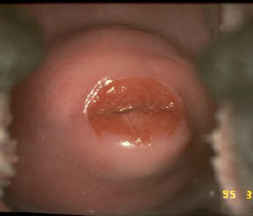
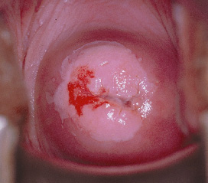
What is VIA?
Visual inspection with acetic acid
Applying dilute (3-5%) acetic acid (vinegar) to the cervix then viewing it with the naked eye to detect abnormalities
Acetic acid enhances and marks a precancerous lesion or cancer by turning it a whitish hue (acetowhite change).
Negative
Positive
Notes:
What is VIA? VIA or Visual Inspection With Acetic Acid is looking at the cervix to detect abnormalities after applying a dilute solution of acetic acid, which is the most common ingredient in household vinegar. What does the acetic acid do to cells? If immature or precancerous cells are present, the acetic acid will turn their cytoplasm cloudy. To the human eye, this reaction looks white and is referred to as an "acetowhite" change; the tissue itself is often referred to as white epithelium. Mature squamous cells and glandular cells do not react this way.

Slide 21
Sexual transmission of HIV
Sexual – most common mode of transmission globally
Risk per episode
Receptive vaginal intercourse: 0.1–0.2%
Receptive anal intercourse: 0.1–3%
Insertive vaginal intercourse: 0.1%
Insertive anal intercourse: 0.06%
Receptive oral intercourse: 0.04%
Notes:
Globally, sexual transmission, primarily heterosexual, is the most common mode of HIV transmission. The magnitude of risk varies with different types of sexual activity. The greatest risk per episode is with receptive vaginal or anal intercourse, which means that women are at greater risk for sexual transmission of HIV. Anal sex is somewhat riskier than vaginal sex. Although the risk with oral sex is low, there are now data to suggest that it may account for a significant minority of transmissions, particularly in sex between men.

Slide 22
Factors Affecting Sexual Transmission of HIV
 |  | Infectiousness | Susceptibility
Late Clinical Stage |  |  | N/A
Primary HIV Infection |  |  | N/A
Antiretroviral Therapy |  |  | ?
Genital Tract Infection
Cervical Ectopy |  | ?
Circumcision
Method of Contraception
Barrier
Hormonal |  | ?
Spermicidal |  | ?
IUD |  | ?
Menstruation
Pregnancy |  | ? | ?
Source: Royce et al 1997.
Notes:
There are several factors that increase or decrease the risk of sexual transmission of HIV. For example, individuals who are newly infected with HIV or who have AIDS are more infectious because they have higher levels of virus in their blood and genital secretions. Antiretroviral therapy lowers the amount of virus in an infected individual and therefore reduces the risk of transmission. STDs, both ulcerative and nonulcerative, increase both infectiousness and susceptibility to HIV approximately 2–5 times. Uncircumcised men appear to be at increased risk of transmitting and acquiring HIV. When a woman is menstruating, pregnant or has cervical ectopy, she may have an increased risk of HIV transmission. Barrier contraceptive methods, including the male and female condom, provide the greatest protection against both transmission and acquisition of HIV. The role of hormonal contraceptive methods in HIV transmission is inconclusive, although some data suggest that they may increase genital tract HIV shedding. Although spermicides (most of which use nonoxynol-9 as the spermicidal agent) have activity against HIV in the laboratory, a recent clinical trial conducted by UNAIDS in Africa and Thailand in sex workers who averaged over 3 partners daily found significantly increased rates of HIV seroconversion in nonoxynol-9 users as compared to placebo. Finally, the IUD was associated with increased susceptibility to HIV transmission in an Italian cross-sectional study, but not in prospective studies.

Slide 23
Intervention strategies
Mathematical model for sexual transmission:
R0 =beta*C*delta; where beta is efficiency of transmission, C is partner change rate, and delta is duration of infectiousness, when R0 exceeds 1, new secondary cases of HIV occur, so successful prevention strategies must reduce R0 to less than 1 (Anderson R et al, Infectious diseases of humans: Dynamics and control. New York, NY: Oxford science publications; 1992)
Behavioural: reduce No of partners
Biological: reduce efficiency of transmission or shorten duration of infectiousness
Comprehensive approach: multisectoral; individuals, families, communities, institutions and contextual barriers to behaviour change. Include, social, political, infrastructural and environmental factors that influence risk behaviour.

Slide 24
Behavioral Interventions
Education
Recognition of risks
Recognition of barriers to risk reduction
Motivation to change
Risk reduction plan
Notes:
Several well-designed randomized and controlled trials have been conducted to assess the effectiveness of different behavioral intervention strategies and most conclude that such interventions result in decreased sexual risk taking and, in some studies, STI and HIV incidence. Behavioral interventions to prevent HIV infection include basic education about HIV — what is HIV and AIDS; the natural history of HIV infection, including a prolonged asymptomatic phase; how HIV is transmitted; and how transmission can be prevented. However, knowledge is not enough to motivate change. Individuals must be helped to recognize their personal risks and motivated to change. Barriers to risk reduction should be identified and strategies developed to overcome them. With these variables in mind, an individualized risk reduction plan is formulated by the individual and the healthcare provider.

Slide 25
Risk Assessment
Age < 25 yrs
Single
Sexual behavior: woman or partner
More than one partner in last 3 months
Multiple partners
New or casual partner
Mobile population
Refugee
Husband in military or long-distance truck driver
STIs: woman or partner
History
Signs or symptoms
History of substance abuse
Pregnant
History of tuberculosis (TB)
Sex worker
Signs or symptoms suggesting HIV
Notes:
Risk assessment is important for two reasons. In countries where there is a low HIV prevalence, risk assessment helps determine who is most appropriate to target for counseling and testing. It is also important on an individual basis to identify specific risky behaviors in order to provide effective risk reduction counseling. The factors listed here help identify individuals who may be at increased risk for HIV infection. Young single men and women are likely to be at increased risk because of greater frequency of unprotected sexual activity and increased likelihood of multiple partners. Young women may also be more vulnerable to HIV for physiologic reasons, such as increased rates of cervical ectopy. Studies have demonstrated that women whose husbands are long-distance truck drivers or are in the military are at increased risk because their husbands are more likely to have had contact with commercial sex workers. Similarly, when a population is unstable because or war or famine, families may be separated and unsafe sexual practices are more common. Certain specific sexual behaviors, signs or symptoms or history of a sexually transmitted infection in the woman or her partner, and a current or past history of injection or noninjection drug or alcohol abuse indicate individuals at increased risk of HIV who should receive individualized counseling and be offered voluntary HIV testing. Active tuberculosis is more common in HIV-infected persons and is an indication for HIV testing. Pregnant women are a priority for counseling and voluntary testing because of greater availability of effective short-term antiretroviral therapies to reduce the risk of mother-to-child transmission. Finally, any individual who has symptoms such as unexplained weight loss, chronic diarrhea , fevers of unclear cause, or oral thrush should be offered HIV testing since these symptoms may indicate the presence of underlying HIV disease.

Slide 26
Ways to Reduce Risk of Transmission
Sexual behavior
Abstain from or delay start of intercourse
Decrease number of sexual partners
Practice monogamy
Practice non-penetrative sex
Avoid:
Anal sex
Douching
Dry sex
Sex during menses
Sex while using alcohol/drugs
Use condoms with every sexual act
Notes:
There are a number of ways to reduce the risk of sexual transmission of HIV. Delaying the start of sexual activity, lowering the number of lifetime sexual partners, practicing monogamy and abstaining from sexual activity all will help reduce the risk of both HIV infection and other sexually transmitted infections. Non-penetrative sex or mutual masturbation can be a safer and satisfying alternative to intercourse. Certain practices, such as anal sex; dry sex in which herbs or other substances are used to dry the vaginal mucosa; and douching may increase trauma and irritation to mucosal surfaces, possibly increasing infectiousness and susceptibility. Sex should be avoided during menses because it has been found to increase both infectiousness and susceptibility; Furthermore, use of alcohol or drugs increases the prevalence of unsafe sexual practices. Perhaps the best way to reduce the risk of sexual transmission is by using a condom with every act of sex.

Slide 27
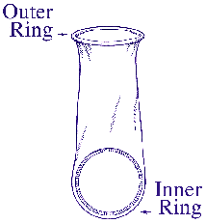
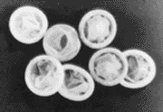
Condoms
Most effective method to prevent HIV transmission and STI acquisition (not very effective against HPV & HSV)
Male and female condoms available
Clients should be instructed in proper use
Consistent use must be emphasized
Female Condom
Male Condom
Notes:
When they are used consistently and correctly, male and female condoms are the most effective methods in preventing HIV transmission and transmission of most STIs, as well as acquisition of these infections.
Clients should be instructed in proper use. Only water-based lubricants or appropriate spermicide should be used with latex (male) condoms. Oil-based lubricants, such as petroleum jelly, cooking oils, shortening, or lotions, results in a 90% reduction in latex strength in just 60 seconds and promote breakage. For latex condoms to be effective they should be stored in a cool, dry area, out of direct sunlight to prevent deterioration. Common errors in use include delaying condom application until just prior to full penetration, failure to extend the male condom all the way to the base of the penis, insufficient application of a water-based lubricant, and failure to hold the base of the condom during withdrawal. Finally it is essential to emphasize consistent condom use, with every sexual act.

Slide 28
Comparison of Increase in Condom Use with Decline in Reported Male STIs on a National Scale, Thailand, 1989–1994
Source: UNAIDS 2001.
Notes:
In Thailand, rates of STIs in males decreased by over 90% at the same time that condom “non-use” declined by similar proportions.

Slide 29
Dual Protection
Dual protection: Protection against pregnancy, HIV and other STDs
Achieved by:
Avoidance of penetrative sex
Mutual monogamy between non-infected partners using effective contraception
Condom use alone
Dual method: Condom use in combination with other contraceptives
Used correctly and consistently with every act of sex, condoms are 98% effective in protecting against HIV and STDs and 95–97% effective in preventing pregnancy
Notes:
Dual protection is defined as protection against pregnancy as well as HIV and other sexually transmitted diseases. Dual protection can be achieved in the following ways:
- By avoiding penetrative sex
- By practicing mutual monogamy between noninfected partners using an effective method of contraception
- By using condoms alone
- Or by using condons and another method of contraception
If condoms are used correctly and consistently with every act of sex, they are very effective, providing 98% protection against HIV and STD infection and 95–97% protection against pregnancy.

Slide 30
Barriers to Prevention for Women
Stigma of HIV
Women often unaware of partner’s infection status or level of risk
Women may be unable to negotiate safer sex practices
Sexual coercion
Domestic violence
Economic vulnerability
Notes:
The information we have reviewed so far shows that prevention of HIV is possible and prevention efforts have been successful in several areas with limited-resources. There are a number of barriers to prevention however, several of which affect women disproportionately. There is still an enormous stigma associated with HIV infection because of ignorance and fear. In many areas, women may be blamed for transmitting infection to their newborns or to men through sex work. Women are often unaware of their partner’s infection status or risky behaviors and, therefore, may not realize they need to use protection during sex. Furthermore, women may be unable to negotiate safer sex practices because of sexual coercion, physical or emotional violence, or fear of abandonment because they are economically depending on their partners.

Slide 31
Contraception for Women with HIV
Condoms
Prevent HIV transmission and STI acquisition
Male and female condoms
Spermicides
Activity against GC, chlamydia
Possible increase in mucosal irritation and genital ulcers, especially with frequent use
Recent UNAIDS clinical trial in Africa and Thailand found significantly higher HIV seroconversion rates in nonoxynol-9 users
Notes:
Contraception for the woman with HIV infection must take into account the effectiveness of different methods in preventing transmission of infection, in addition to considerations of contraceptive efficacy, safety, and potential non-contraceptive benefits. Both male and female condoms effectively prevent HIV transmission and Sexually Transmitted Infection or STI acquisition when used consistently and correctly. Female condoms have the advantage of being female controlled, although they cannot be used without their partner's knowledge. Although spermicides have significant activity against gonorrhea and chlamydia and activity in the laboratory against HIV, their use, particularly if frequent, has been associated with an increase in mucosal irritation and even genital ulcers. A recent clinical trial conducted by UNAIDS in Africa and Thailand actually found significantly increased rates of HIV seroconversion in nonoxynol-9 users as compared to placebo.

Slide 32
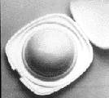
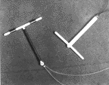
Contraception for Women with HIV
Diaphragm
Limited STI protection
No significant protection against HIV transmission
IUD
No increase in infection-related complications noted
No increase in cervical HIV shedding (measured 4 months after IUD insertion)
No STI or HIV protection
Increased menstrual flow and duration may increase transmission risk and risk of anemia
Notes:
The diaphragm has limited STI protection and no significant protection against HIV transmission. Use of the Intrauterine Device or IUD in the setting of HIV infection remains controversial. There has been no increase in infection-related complications noted in women who are IUD users and HIV-infected. There has also been no increase in cervical HIV shedding demonstrated when measured four months after IUD insertion. On the other hand, the IUD does not offer protection against either HIV transmission or STI acquisition; furthermore, there are concerns that the increased menstrual flow and duration seen in non-progesterone- and non-progestin-releasing IUDs may increase transmission risk or increase the risk of anemia, which is an independent predictor of progression in HIV disease.

Slide 33
Contraception for Women with HIV
Hormonal methods: oral contraceptive pills, DMPA, Norplant
No significant STI or HIV protection
May increase genital tract HIV shedding
Interactions with ARVs, antiTB drugs
Voluntary sterilization
No STI or HIV protection
Decreased risk of PID
Notes:
Hormonal contraceptive methods offer no significant STI protection and there is some data, although inconclusive, that they may increase genital tract HIV shedding. Voluntary sterilization, although it may reduce the risk of tubal infection or salpingitis, does not offer other STI or HIV protection.

Slide 34
Adolescent reproductive health and HIV
Period between 10-19?-24 years
Cognitive, emotional, and physical development
Exploration and adventure
Explore intimacy & sexuality ~ heightened vulnerability to HIV, STIs, Pregnancy, substance abuse
15-24 year olds represent new infections worldwide>50%

Slide 35
Heightened Vulnerability
Behavioural
Risk taking
Experimentation
Alcohol + drugs
Non-use of condoms, no access to health services
Biological
Cervix immature susceptible
Most STIs assymptomatic
Socioeconomic
Manipulation~ dependence
Inaccessible health services

Slide 36
Approaches to HIV care in adolescents
Consent policies
Confidentiality
Accessibility
Outreach
Linkage to care treatment & prevention

