Slide 2
Vaginal bleeding in pregnancy
Dr Bosire Alex Nyakundi

Slide 3
This is divided into two
    PV bleeding Before 28 weeks
    Pv bleeding after 28 weeks – APH

Slide 4
PV bleeding before 28 weeks
Frequent cause of distress among patients
Likely differential diagnosis include
  Ectopic pregnancy
  Miscarriages
  Gestational trophoblastic disease
  Infections of cervix and vagina
  Trauma

Slide 5
Management
Any patient who comes in to the hospital with PV bleeding should undergo the following
A comprehensive history and examination paying attention to parity, lnmp, presenting symptoms and signs.
Vital signs noted
Abdominal exam – noting areas of tenderness, pelvic mass
Pelvic examination – speculum is a must(rememebr to charge) – pay attention to state of cervix,type of bleeding encountered,any smell/discharge,cervical mass.

Slide 6
After examination
Consult with the senior registrar on duty/patients private consultant.
Ideal investigations – TBC,UECS,Serum Bhcg level,urinalysis
Radiology – ultrasound- TVS/TAS

Slide 7
Once results are in
Inform senior registrar/consultant/primary doctor.
If its an acute case- manage as an emergency, start on admission protocol ASAP.
Manage shock if need be.

Slide 8
Miscarraiges
Common presentation in the A&E.
PV bleeding and pain are a common combination

Slide 9
tYPES
Complete – closed cervix, No poc on scan
Threatened – closed cervix,Viable fetus
Inevitable – Open cervix, Viable fetus
Incomplete –Open cervix, POC on scan
Septic miscarriage – features of abortion with features of infection/sepsis

Slide 10
Management
Is as per type
Complete miscarriage – Bed rest,antibiotic,analgesic,reassure, book in gyn clinic
Threatened miscarriage – bed rest(in or out),analgesic,reassure, Progestins – susten/duphaston, Folic acid,Omega 3
Inevitable Miscarriage – tricky – watch and see, admit,reassure, discuss prognosis
Incomplete- antibiotics, analgesics,discuss likely mode of management – medical or surgical

Slide 11
Ectopic pregnancy
Pregnancy anywhere but in the uterine cavity
Life threatening
Category 1 emergency
If suspicious of diagnosis, activate emergency team especially if patients condition is deteriorating
Otherwise- investigate –TVS is gold standard in diagnosis(rememeber user dependence of sonography)
Any reproductive age patient with severe pelvic pain should always have a pdt and tvs done.

Slide 12
Management
Manage acute crises if need be
Inform senior registrar or consultant on duty/Private doctor
Can then move on to either medical management with MTX or surgical management with laparoscopy
Transfuse if need be

Slide 13
GTN
H.Moles, Choriocarcinoma also cme with early oregnancy bleed. A keen eye can pick out these diagnosis.
Follows the same management as for misccarriage

Slide 14
CLASSIFICATION OF HAEMORRHAGE
Understyanding the physiological responses that accompany varying degrees of volume deficit assists the clinician when caring for a patient experiencing haemorrhage
The class of haemorrhage may reflect volume deficit (may not be the sama eas volume loss)
The average 60kg pregnant woman maintains a blood volume of 6000mls by 30 weeks

Slide 15
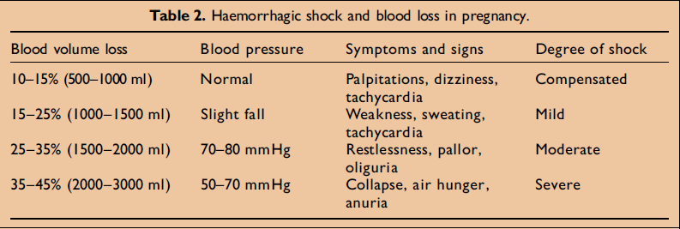
Haemorrhagic shock and table

Slide 16
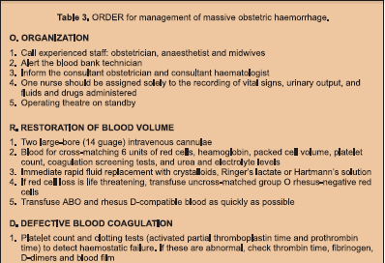
O.R.D.E.R

Slide 17
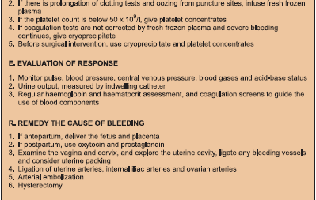
O.R.D.E.R.

Slide 18
ANTEPARTUM HAEMORRHAGE

Slide 19
OUTLINE
Introduction and Definition
Incidence
Physiological changes in preg-CVS,haem
Aetiology
Brief review of placenta
Discussion of major cause
-Abruptio
-Praevia
Principles of Management
Small mention of other causes

Slide 20
INTRODUCTION & DEFINITION
Death from h’age stil remains leading cause of maternal mortality and perinatal M & M
33.9% (Lancet 2006) in developing countries
Of these 50% ante- and 50% post (Sweit 2000)
Fatal h’age due to unavailability of prompt admin of blood or its components
All bleeding is ominous in pregnancy
DEFN: Bleeding from or into genital tract after 20/24/28wk but before labour & delivery

Slide 21
INCIDENCE
APH complicates 2-5% of pregnancy
Contributes to significant healthcare costs because of antepartum hospitalization, maternal morbidity and operative interference
To the fetus-higher rates of prematurity and perinatal death than pregnancies without bleeding
APH 20% praevia, 35% abruptio, 35% undetermined aetiology (unclassified), 5% lower genital tract.

Slide 22
AETIOLOGY
Obstetric Non-Obstetric
-Bloody show Cervicitis
-Praevia Cervical polyps
-Abruptio Cervical eversion
-Vasa praevia Cervical Ca
-Uterine rupture Vaginitis/laceration
-DIC Vulval varicosities
-Marginal Sinus bleed GIT haemorrhoids
GUS haematuria
(Major causes- placenta praevia, abruption, ruptured vasa praevia, uterine scar disruption)

Slide 23
ABRUPTIO
DEFINITION:
Premature separation of (normally
Implanted) Placenta
CLINICAL TYPES:
Concealed 20%
Revealed commonest 80%
Mixed

Slide 24
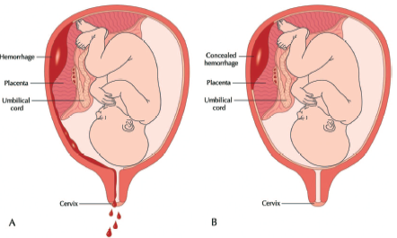
Revealed : Concealed

Slide 25
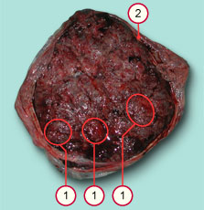
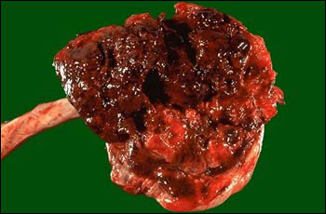
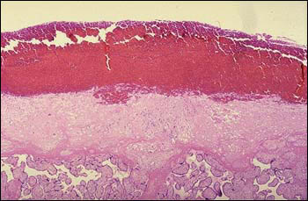
Pathology cont’d
a. Gross: Normal Placenta
b. Gross: Abruptio Placenta - Large retroplacental blood clot
c. Histology: Extensive hemorrhage at the decidual plate, with placental villi below
Histologic evidence of decidual hemorrhage has been noted in 2 to 4 percent of deliveries, but most cases are associated with preterm premature rupture of membranes or preterm labor and delivery rather than a clinical diagnosis of abruption

Slide 26
RISK FACTORS
DEMOGRAPHIC
-Advancing maternal age RR 1.3-1.5
-Multiparity >5 RR 1.3-1.5
-Poor SES
-Malnutrition
-Male infant sex RR 0.9-1.3
-Unmarried
-Race/Ethnicity commoner in African-American

Slide 27
Risk Factors Cont’d
MEDICAL
HTN disorders in pregnancy
PPROM with Chorioamnionitis
Thrombophilias
NUTRITIONAL -Folic acid deficiency causing
hyperhomocysteinemia

Slide 28
PREGNANCY-RELATED &UTERUS
Sudden Uterine Decompression
-Polyhydramnios RR 2
-PPROM
-Following delivery of 1st twin
Short Cord
Uterine myoma
Torsion of Uterus

Slide 29
Uterine malformations including septum
Prior abruption
Abnormal placentation-circumvallate
TRAUMA, SUBSTANCES OF ABUSE
Cigarette smoking
Cocaine
Trauma-forceful shearing effect

Slide 30
Clinical Features
PV bleeding Concealed vs revealed
Abdominal pain
Back pain
Uterine tenderness
High frequency contractions(tachysystole) >5/10min
Hypertonus contraction >2min
PTL assoc with abruptio in >60% of cases
NRFS
IUFD
DIC
Hypovolemic shock
80% occur before onset of labour

Slide 31
DIAGNOSIS
Primarily clinical (hx and P/E & Vital signs-Shock) with aid of USG. Inspect placenta for clots
USG done on stable patients
Good for concealed variety not for revealed
Rule out praevia, fetal status-viability
-Poor sensitivity 24%
-Good specificity 96%
-Good PPV 88%
-NPV 53%

Slide 32
SITES OF PLACENTAL BLEEDING

Slide 33
Acute haemorrhage - hyperechoic
After 1/52 - hypoechoic
After 2/52 – sonoluscent
DDx of abruptios on USG
-succenturiate lobe
-myoma
-chorioangioma
-coexisting molar pregnancy

Slide 34
Laboratory
Full haemogram ↓Hb
Blood group and Rh
GXM
Coagulation profile
-↓platelets
-↓fibrinogen levels
-↑clotting time, prolonged APTT/PT

Slide 35
DIFFERENTIAL DIAGNOSIS
Other causes of APH
Other causes of abdominal pain in 2nd and 3rd trimester including PTL, acute abdomen

Slide 36
COMPLICATIONS
MATERNAL
Haemorrhagic shock
DIC
Ischaemic necrosis of distal organs
-Renal Failure (acute tubular and acute cortical necrosis)
-Anterior pituitary gland (Sheehan’s syndrome)
-Liver
-Adrenal glands

Slide 37
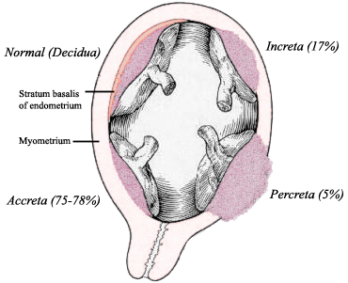
ARDS
PPROM
PPH
Sepsis
MOF
Death

Slide 38
FETAL
Hypoxia/Asphyxia
Preterm labour/delivery and all effects of prematurity
IUGR
IUFD
3-fold increase In rate of major malformations esp CNS
Long term neurodevelopmental sequelae-Cerebral palsy, SIDs,

Slide 39
PRINCIPLES OF MANAGEMENT
(ABRUPTIO)
OBSTETRIC EMERGENCY!!!
Continuous monitoring of vital signs
Continuous, high-flow, supplemental oxygen
One or 2 large-bore IV lines with normal saline (NS) or lactated Ringer (LR) solution
Continuous fetal monitoring
Monitor amount of vaginal bleeding
Monitor urine output (>30ml/hr)
Treatment of hemorrhagic shock, if needed (maintain hematocrit >30%)
Investigations=

Slide 40
Subsequent management is determined on a case to case basis depending upon the severity of abruption & ongoing bleeding, gestational age & maternal and fetal status
(1) early delivery
(2) adequate blood transfusion
(3) adequate analgesia for pain relief
(4) monitoring of maternal condition
(5) assessment of fetal condition
TOCOLYSIS is C/I in abruptio

Slide 41
PRAEVIA
DEFINITION
Presence of placental tissue over or
adjacent to the internal cervical os.
INCIDENCE
-0.4-1%; (4/1000 deliveries/term pregnancies)
-Doubled in multiple gestations
-Upto 30% in early pregnancy, 4-5% In 2nd trimester, reduces to 0.3% at term
-↑ing incidence due to ↑ C/S rate

Slide 42
TYPES
Historically but still used
-Type 1-Low lying (edge encroaching onto LUS but not upto internal os)
-Type 2-Marginal (edge at margin of internal os but does not cover it; further classified as anterior and posterior)
-Type 3-Partial (edge covers internal os partially)
-Type 4-Total (placenta completely covers os)

Slide 43
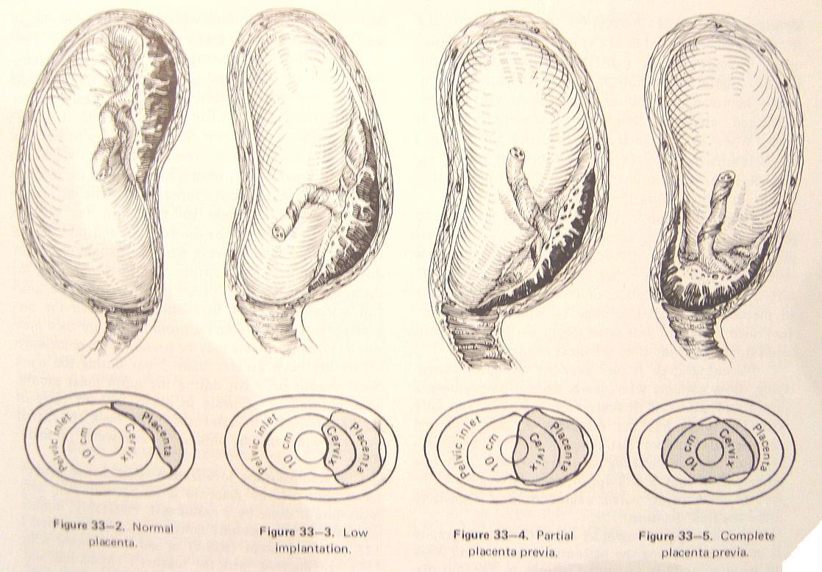
classification

Slide 44
Types cont’d
Currently with advancement in US esp in use of TAS and TVS, it is possible to determine the distance between the lower edge of placenta and internal os (which is seen as a point)
Complete Praevia-those that cover the internal os completely
Marginal Praevia (within 1-2cm)-those with edge at the os. Includes partial
Edge >2cm from internal os=not a praevia

Slide 45
PATHOGENESIS
Not well understood but several hypothesis advanced
Normally, placental implantation favours fundal location where blood supply is better.
1) Endometrial scarring in upper segment
association with
-↑no of C/S (10% after >4)
-prior currettage
-↑parity (5% in grand, 0.2%in nulliparous)
-↑maternal age (0.03 in <30yr; 0.25% in >30yr)

Slide 46
2)Increased placental surface
- Need for ↑placental SA to compensate for ↓in uteroplacental oxygen and nutrient delivery
-Smoking
-High altitudes
-Multiple gestation 3.9/1000LB; singleton 2.8/1000

Slide 47
3) Gestational Age
4-6% incidence of low-lying placentas at mid-pregnancy
“apparent placental migration” theories
a) development of LUS 0.5 cm at 20 wks, 5cm@term
- failure of differential growth may occur when LUS is scarred also contributing to a praevia

Slide 48
MATERNAL RACE
-Whites rate of praevia 3.3
-Blacks 3.0
-Others-Asian 4.5
Pathogenetic mechanism unclear

Slide 49
b)Trophotropism-unidirectional growth of trophoblast towards the fundus in a stationery uterus results in upward migration of placenta
-the worse the praevia,the less probability of migration.
-complete praevia at mid-preg, 40% persist
-marginal at mid-preg, 2.5%
4) MALE SEX
Association not explained but could reflect association of larger males with larger placentas or delayed devpt & implantation of male blastocyst

Slide 50
PATHOLOGY
Thin, large placenta, with tongue-shaped extension from the main placental mass
May be morbidly adherent
Areas of infarction and calcification
Cord insertion may be battledore or velamentous
Lower uterine segment is soft and more friable

Slide 51
CLINICAL FEATURES
1) Painless haemorrhage 70-80%
“warning” haemorrhages in 1st and 2nd tri-in 1/3; 1/3=30-36wk; 1/3=>36wks
Sudden onset
Usually no ppting event though coitus or strenuous activity may be implicated
1st episode usually not life threatening but subsequent bouts may be heavier

Slide 52
Complete praevias likely to present with PV bleeding earlier than other degrees
Asymptomatic cases are <10% detected on U/S; reach term with no bleeding esp in nulliparous because placenta is protected by uneffaced cervix
Bleeding more in 3rd trimester (formn of LUS)-shearing effect ,
Bleeding is almost always maternal
NB: initial cramping in 20%

Slide 53
2) PA exam
-Uterus soft, relaxed, no area of tenderness
-Uterine size=dates
-High presenting part
-Malpresentation 50% -breech, transverse, oblique (esp in multiple gestation)
-Fetal heart sounds present, normal NST

Slide 54
3) Speculum examination
-to see source and assess amount of
bleeding
-character of blood
-continuing or has ceased
-any local lesions

Slide 55
DIAGNOSIS
High index of suspicion
Clinical and P/E
USG
-Transabdominal
-Tranvaginal
-Translabial

Slide 56
COMPLICATIONS
Maternal
APH with shock
Malpresentation
Premature labour
PPROM, cord prolapse
PPH with shock (atony, bleeding from placental bed, retained placenta-accreta 5-10%of praevia, lower segment disruption)
↑operative interference
sepsis

Slide 57
Fetal
IUGR upto 16%
Low birth weight (chronic placental insufficiency, prematurity)
Asphyxia
IUFD
Congenital malformations

Slide 58
PRINCIPLES OF MANAGEMENT
(PRAEVIA)
Index of suspicion- avoid digital exam in APH until praevia is ruled out
U/S for localization of placenta & fetal growth
Restrict activity including coitus,avoid straining
Counsel on danger signs/labour symptoms
Supplements to avoid anaemia
Early medical attention if bleeding occurs

Slide 59
At presentation, admit for assessment- amount of bleeding, maternal condition, fetal condition
If stable and not term, delivery can be delayed
Most women with initial bleeding respnd to therapy, 50% may continue for 4 weeks
Large-bore IV, baseline labs with blood available
If <34wks give steroids
Haematinics to maintain HCt above 30%
RH immune globulin if RH–ve unsensitized

Slide 60
Tocolysis- not routine. Only if contracting, bleeding ceased, and delivery not indicated (MgSO vs betamim., Nifedipine)
Cerclage-to delay delivery. No good evidence
Out-patient management for small bleeds resolved for >7 days (cost-effective, efficacious) if pt still remote from term
Lives nearby hosp (15 mins)
Compliant pt (reliable, can rest at home)
Has 24hr emergency transport to hosp
Can verbalize understanding of condition(risks)
If >3episodes,admit till delivery

Slide 61
U/S towards term for location (esp. marginal)
Other Indications for delivery:
NRFHR unresponsive to treatment
Life threatening refractory hemorrhage
Significant vaginal bleeding after 34 weeks
Amniocentesis for fetal lung maturity at 36wks, deliver at 37 wks
C/S delivery for complete praevia (marginal may deliver vaginally) Rates of C/S depends on distance from os
In cases of marginal, can do “double set-up”

Slide 62
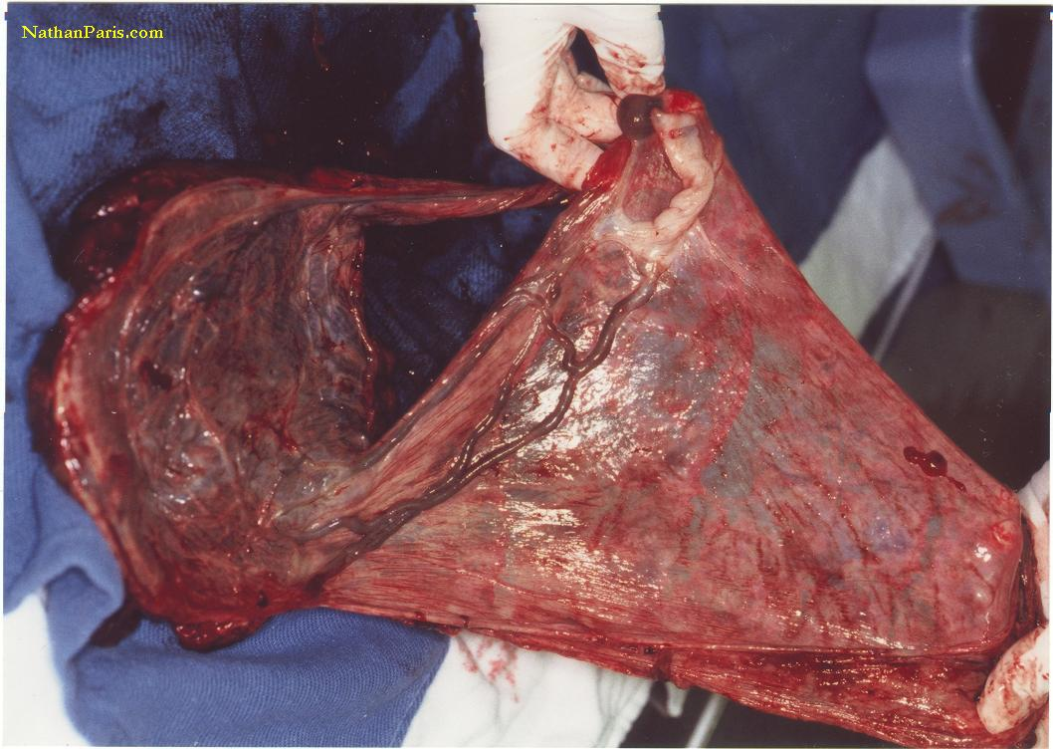

VELAMENTOUS INSERTION OF CORD

Slide 63
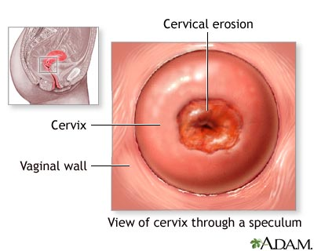
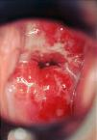
CERVICITIS CERVICAL ECTROPION

Slide 64
REMEMBER…
APH WEAKENS SO THAT PPH KILLS!!!

