Slide 1
Common Paediatric Dermatoses
GICHINA M. B
MB ChB, MMed Paeds - Nairobi, Msc derm – London.
PAEDIATRICIAN AND DERMATOLOGIST
DFMH

Slide 2
AIMS
To recognise common skin conditions in children
To know how to manage them

Slide 3
Introduction
Rare cause of mortality
Significant cause of morbidity
~20-30% paediatric primary care consultations relate to skin problems. 8% admissions

Slide 4
Common conditions
Infections
Eczema
Urticaria
Insect bites
Non Accidental Injury
Other: Manifestations systemic illnesses.

Slide 5
General approach
History
Examination
Skin – nomenclature!
Management

Slide 6
Bacterial infections

Slide 7
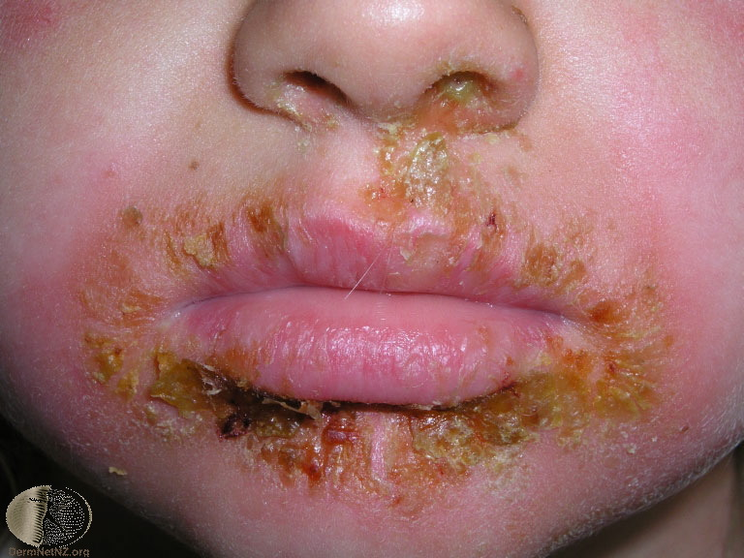
Impetigo

Slide 8
Impetigo
common bac skin infection.
Characterised by pustules and honey-coloured crusted erosions
Ulcerated impetigo is called ecthyma.
Staphylococcus aureus
GABS (Streptococcus pyogenes).
Predisposing factors
Bullous impetigo is due to staph exfoliative toxins
Cxns- SSSS, TSS, ,PSGN , RF, Cellulitis
DX..swab mcs
Rx.. Antiseptics, topicals, systemics
Px –Rx carrier sites

Slide 9
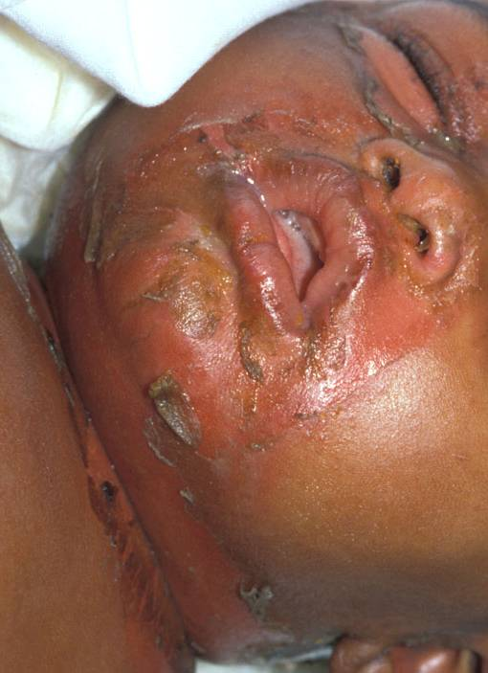
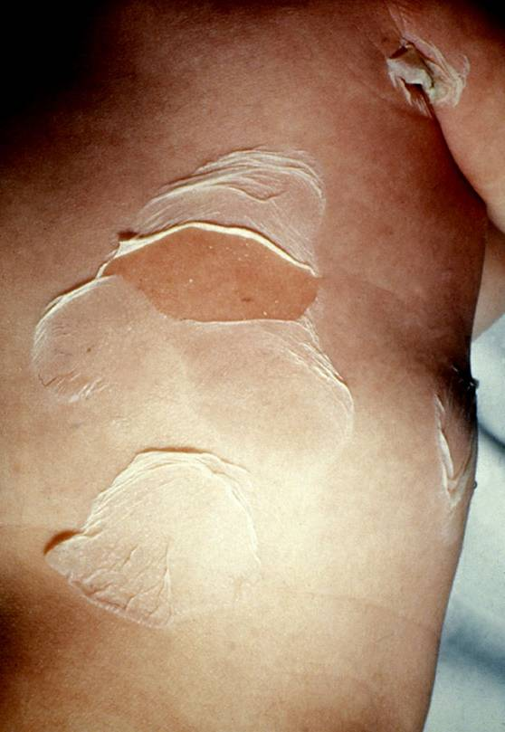

Slide 11
Staphylococcal scalded skin syndrome
Cutaneous reaction pattern to localised staph infection producing epidermolytic toxin.
Most commonly neonates (decreased excretion of toxin by immature kidneys)
The toxins cause the epidermis to split

Slide 12
Staphylococcus scalded skin syndrome (SSSS)
Clinically,
Skin erythematous
the split produces a flaccid bulla.
Sheets of desquamation
Fever, irritability
Usually heals within 7-14 days
Treatment IV (oral) Flucloxacillin

Slide 13
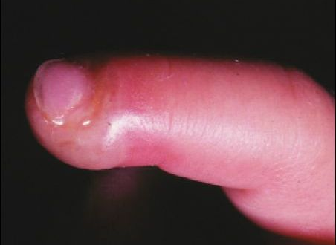
Streptococcus
Blistering Dactylitis
Bullous manifestation of GABHS usually
2-16 years
Superficial blister on erythematous base
Distal phalanx

Slide 14
Other bacterial infections..
Cellulitis
Erysipelas
Folliculitis
Abscess/ boil
Carbuncle

Slide 15
Fungal infections

Slide 16
Superficial mycoses
Dermatophytoses.
Parasitize keratin rich structures
Candida- moist skin
Malassezia- oily skin

Slide 17
T capitis

Slide 18
Tinea capitis
Most common in 6-10yrs. boys> girls
Inflammation, scaling, itching, papules/pustules, LN, alopecia
Abscess- kerion
Notes:
A vigorous host response can lead to a boggy tender plaque with pustules and overlying hair loss (kerion)

Slide 19
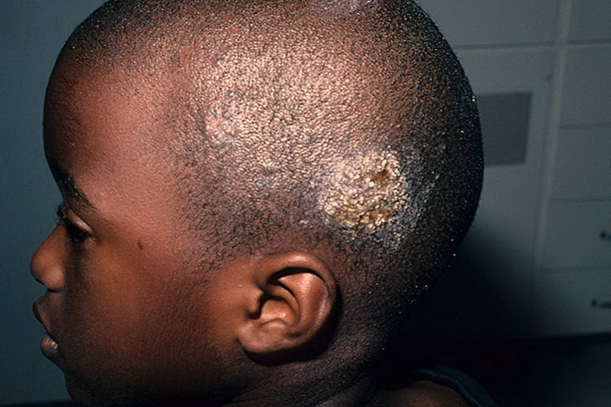
kerion

Slide 20
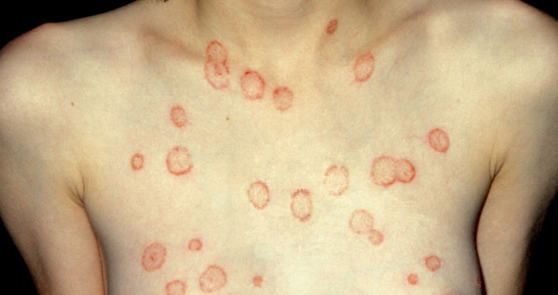
Tinia corporis
Tinea corporis

Slide 21
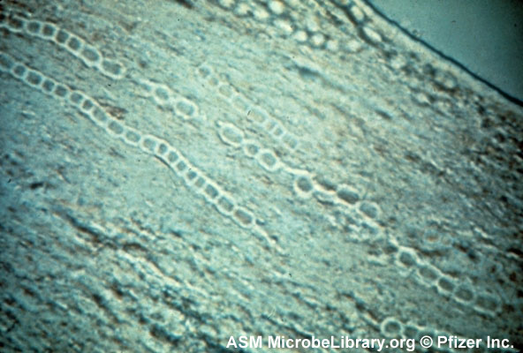
Tinea
Diagnosis
Treatment
Sample:
Scalp
Hair
Direct microscopy & culture
Topical
Systemic therapy
Griseofulvin 15-20mg/kg for 4-6-weeks
Terbinafine 3mg/kg for 2-4-weeks
Siblings/ pets

Slide 22
Candida
Oral mucosa
Napkin area
Nystatin oral suspension QDS x 1-2 weeks
Topical clotrimazole

Slide 23
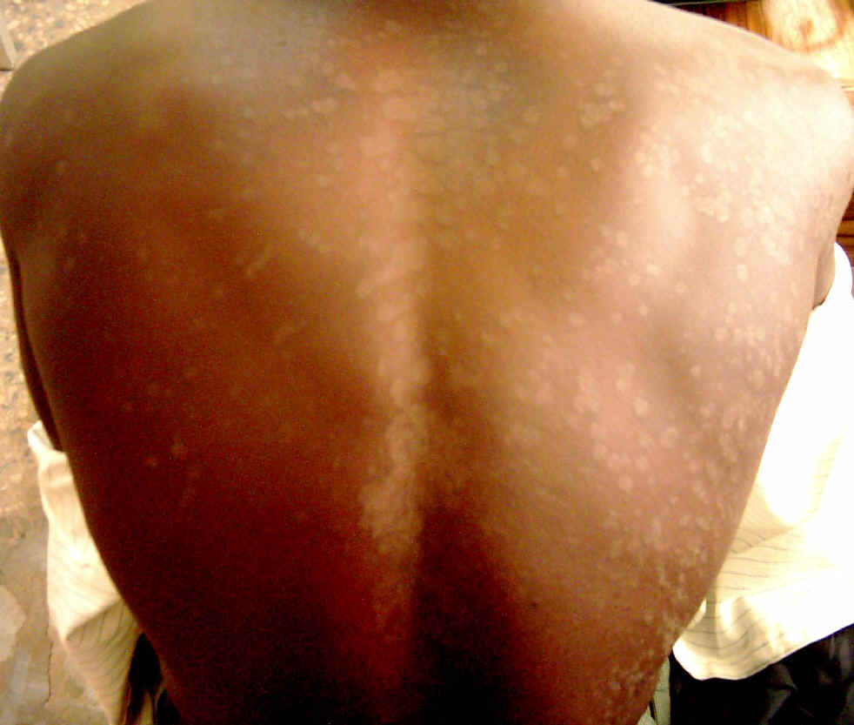
Pityriasis versicolor
White/brown scaly macules
Common. 2nd decade
Malassezia spp-yeast
Treat:
ketoconazole shampoo

Slide 24
Viral infections

Slide 25
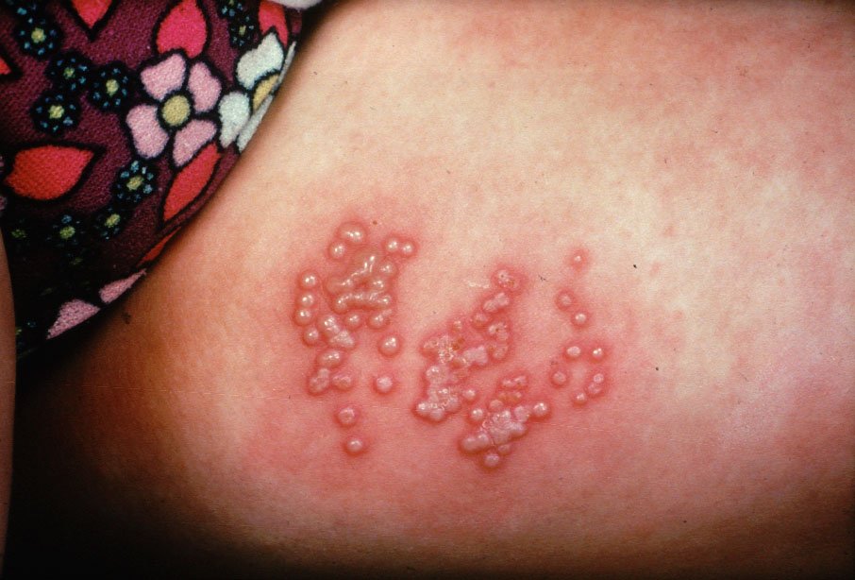
Grouped Vesicles, painful
Notes:
25

Slide 26
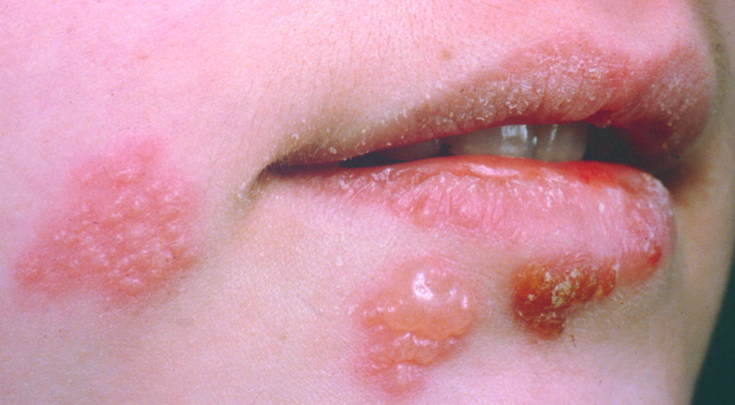
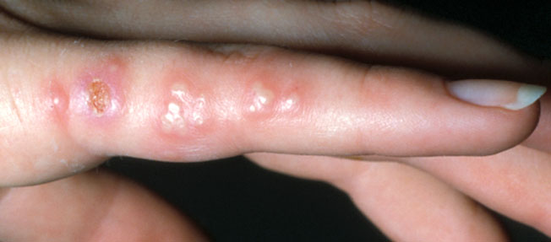

Slide 27
Eczema herpeticum

Slide 28
Herpes Simplex
Generally HSV-1 in children
Ocular HSV leading cause of recurrent keratoconjunctivitis
May lead to corneal blindness
Ophthalmology!

Slide 29
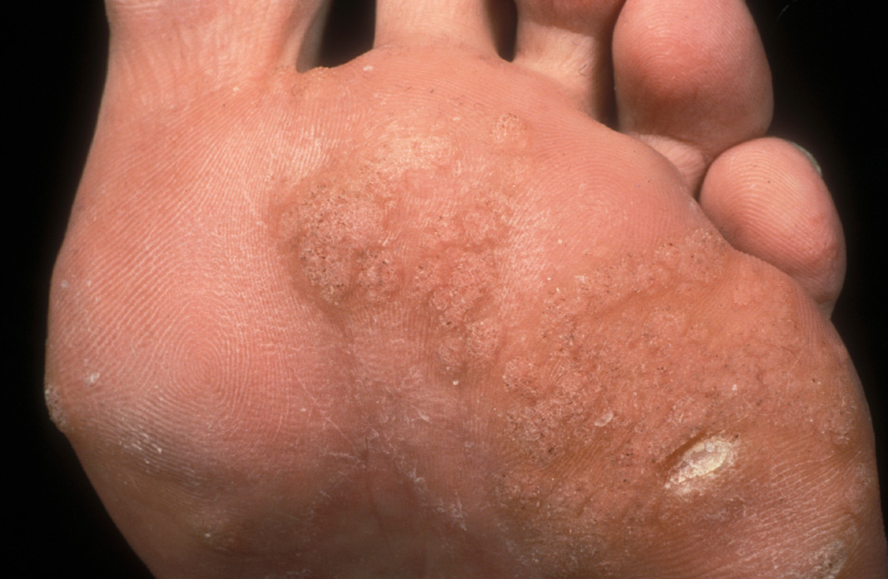

Slide 30
HPV
General
Treatment
Over 130 subtypes
HPV 1,2,4,7 associated with common warts
3,10,28,41 plantar warts
6,11 respiratory, genital and conjunctival.
1 deep plantar and palmar
16,18 – high risk Ca Cx
Watchful waiting
Topical salicylic acid
Podophylline
Silver nitrate
Imiquimod
Cryotherapy
Electrocautery
Laser
(Cimetidine)
(high dose zinc)

Slide 31
Nodular/popular firm eruptions

Slide 32
Molluscum contagiosum
General
Treatment
Member of pox virus family
Dramatic increase in incidence
Spreads more quickly with eczema
Cryotherapy,
gentle curretage,
cantharidin,
topical tretinoin,
imiquimod,
phenol,
benzyl-peroxide

Slide 33
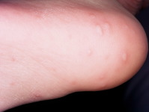
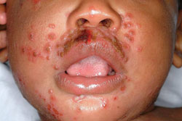
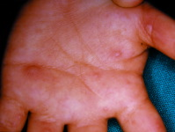
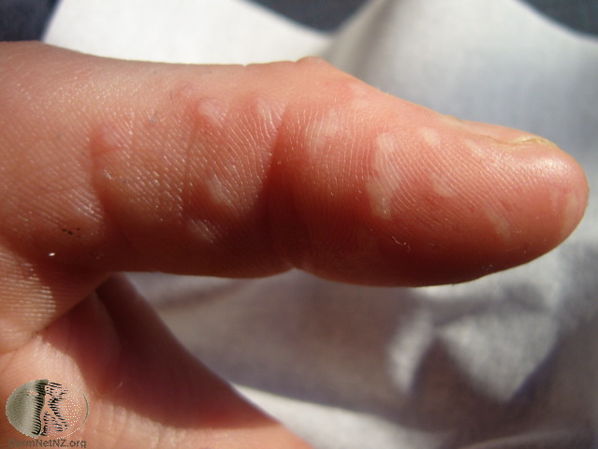

Slide 34
Hand foot and mouth disease
General
Clinical
Young children.
Very common in summer
Enterovirus (Coxsackie A16)
Very infectious.
Contact..faeces, saliva, mucous.
Incubation period 3 to 5 days
Flat small blisters on hands, feet and mouth.
Occasionally buttocks, geni
Mild fever. Pain .
Resolves 7-10 days.
Mx: analgesia, mouthwash
Complications
Fingernail and toenail loss 4-8weeks after.

Slide 35
Infestations

Slide 36
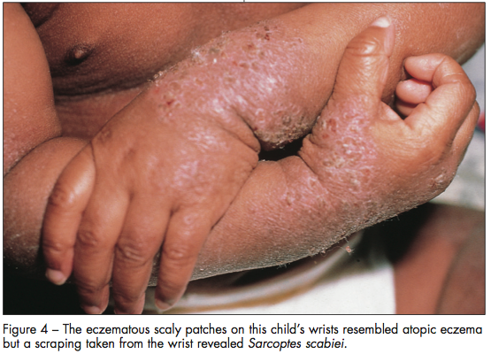
Pruritic, vessicular rash with scaling

Slide 37
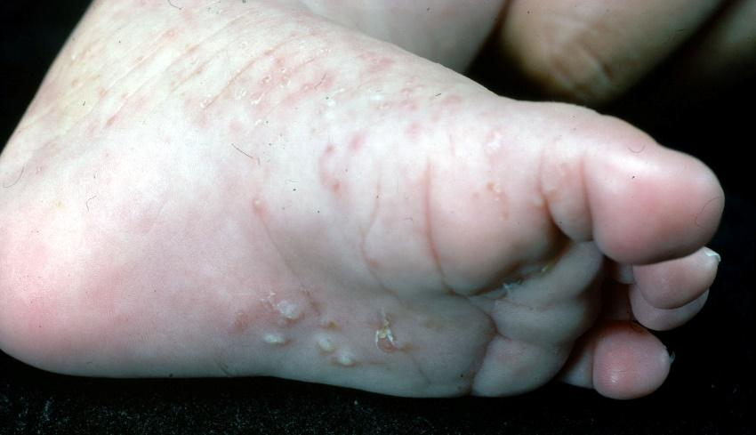
Scabies
0.1mm. Sarcoptes scabiei var hominis

Slide 38
Sarcoptes Scabies
Papules, nodules, burrows, vesiculo-pustules
Interdigital spaces, wrist, ankles, axillae, waist, groin, palms, soles, penis
Signs/symptoms may not clear for 2-6 weeks
Treat all contacts
Permethrin
Scabion (Sulphur, crotamiton)
BBE
Levamisole

Slide 39
Cutaneous larva migrans
More in those who walk bare foot; or sit on ground without a barrier.
Pruritic, serpeginous lesions
Intensely pruritic.
May get secondary bacterial infection.
Often self limiting and clear in 6-8 weeks.
Thiabendazole, ivermectin, Albendazole, may be given to hasten clearance.
Aetiology: Dog and cat hookworm larvae. (Ancylostoma braziliense ; Ancylostoma caninum )

Slide 40
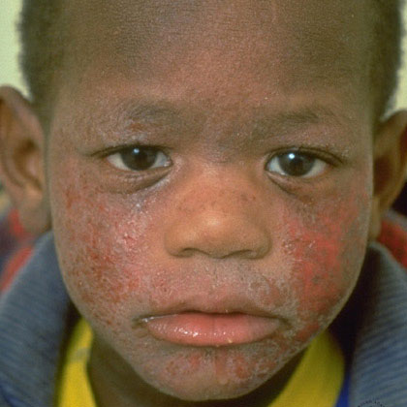
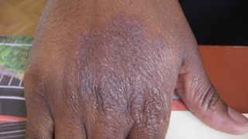
12

Slide 41
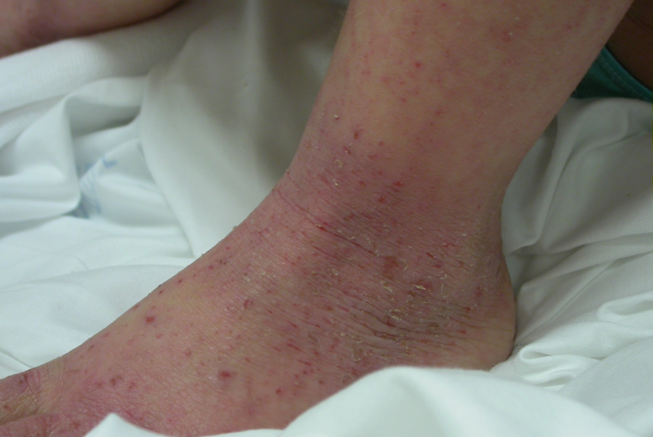
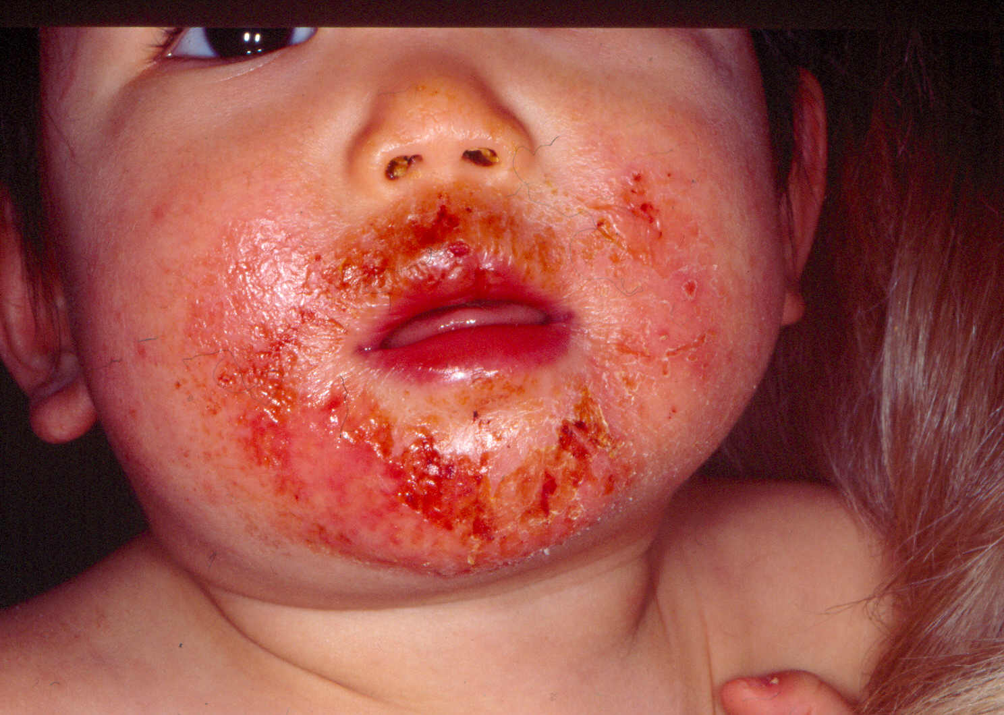
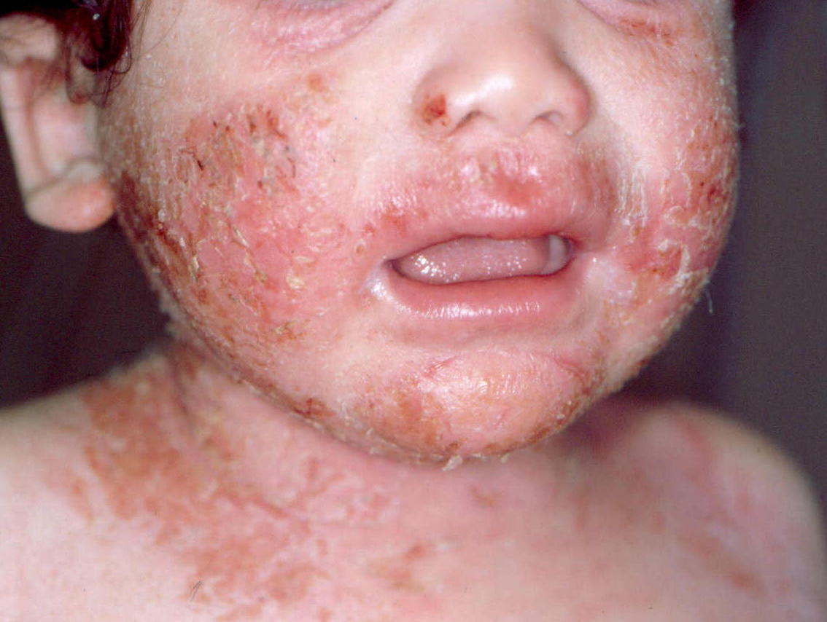
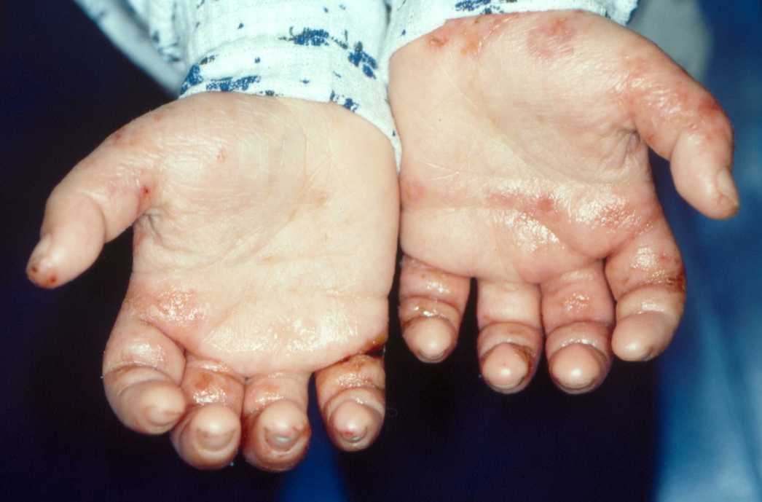
5

Slide 42
ATOPIC DERMATITIS
Clinical Presentation
Dry skin and scales
Erythema –poorly demacated
Edema
Exudation - oozing and crusting
Excoriations
Lichenification
Symmetric > asymmetric
4

Slide 43
Treatment of AD
Reduce damage from scratching.
Trigger avoidance (Allergen /irritant)
Emollients-moisturizers
Topical corticosteroids
Calcineurin inhibitors
Phototherapy
Systemic treatment: steroids, biologics.

Slide 44
Guidelines -‘stepped approach’
From NICE clinical guidance 57 – Atopic eczema in children

Slide 45
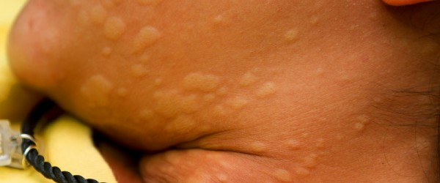
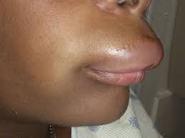
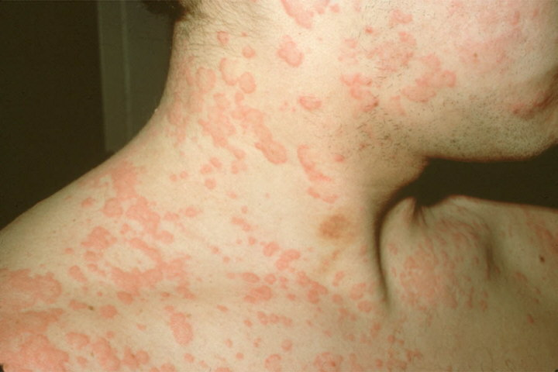
Urticaria
Notes:
45

Slide 46
Urticaria1
Type I hypersensitivity- degranulation of mast cells.
Each individual lesion lasts less than 24 hours.
Acute <6 weeks. > 6weeks chronic
80% associated with infection

Slide 47
Urticaria2
1/5 people have a lifetime episode
Drugs, food (dairy/nuts), stings
Rarely physical (dermographism, cholinergic, aquagenic, cold,heat, pressure, solar, vibratory)

Slide 48
Treatment of urticaria
Avoid trigger/ treat infections.
2nd generation antihistamines; loratadine, fexofenadine, bilastine, cetirizine..
Corticosteroids, Leukotriene antagonist, TCA, MTX, Dapsone, PhotoRx
Epinephrine- anaphylaxis

Slide 49
What is this? How will you treat?

Slide 50
DDx ‘Nappy Rash’
Candidiasis
Dermatophyte
Atopic dermatitis
Contact dermatitis
Erythrasma
Seborrhoic dermatitis
Psoriasis - inverse
NAI

Slide 51
Non-accidental injury1: Battered baby syndrome

Slide 53
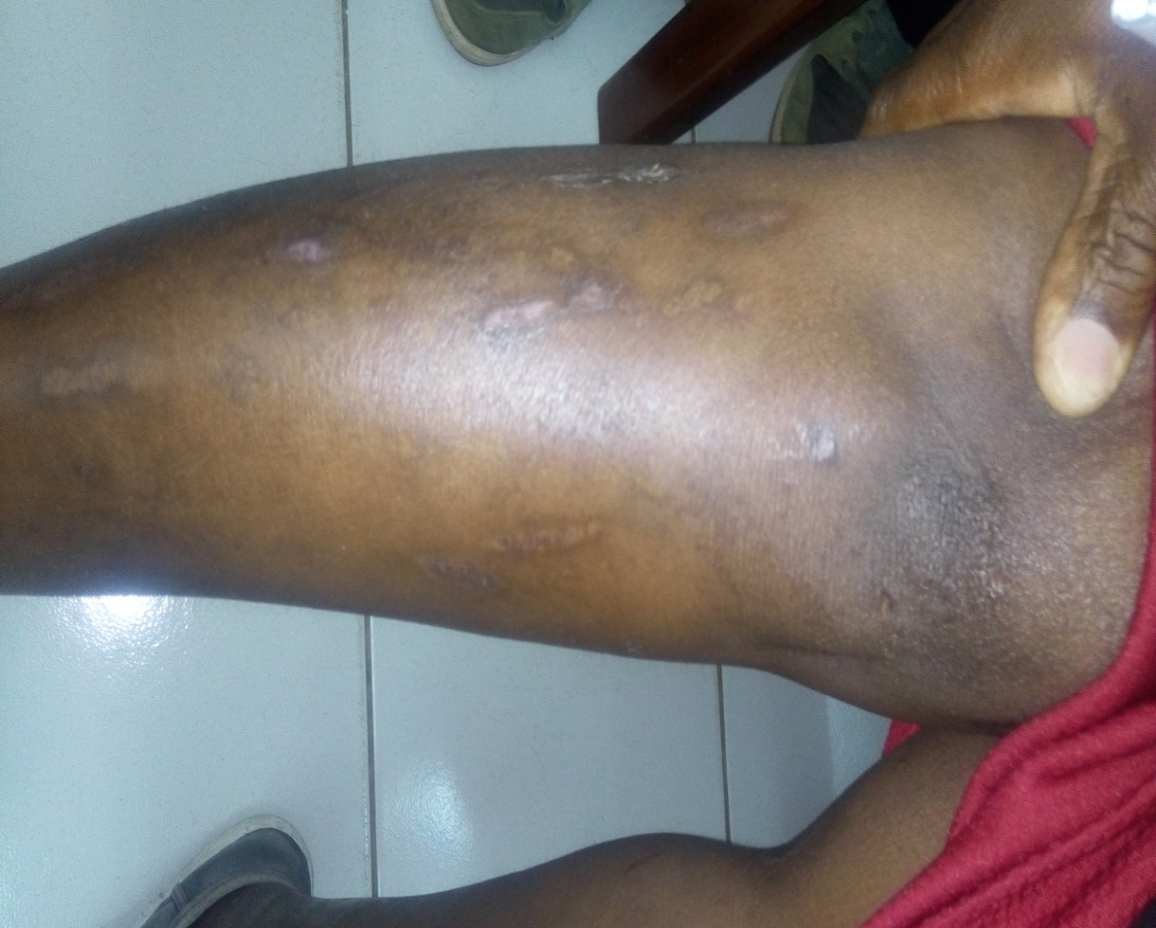
NAI2: Factitial dermatitis (artefacta)
Factitious disorder. Requires both dermatology and psychiatry evaluation.

Slide 54
AUTOIMMUNE DISEASES

Slide 55
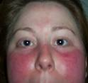
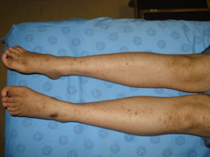
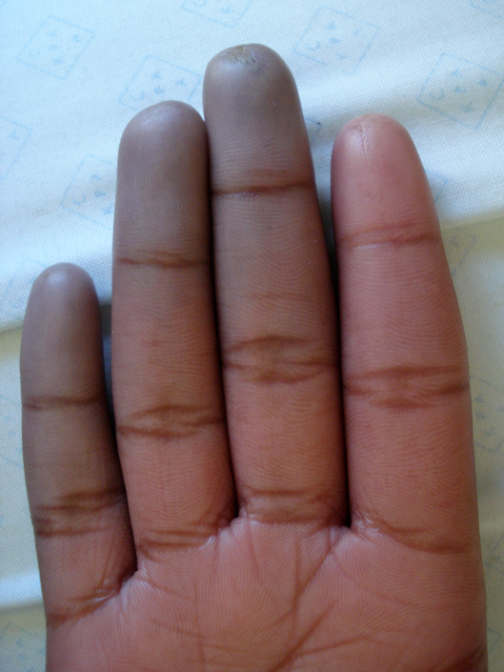
Differential CTD
SLE
Juvenile dermatomyositis
Sclerdoderma
Mixed Connective Tissue disease

Slide 56
Systemic CTD1: Systemic Lupus Erythematosus (SLE)
Autoimmune systemic disease.
Diagnosis: use EULAR/ACR criteria.
Positive ANA
1 clinical: serositis, arthritis, haemolytic anaemia, nephritis, neuropsychiatric, skin (alopecia, oral sores, malar rash, discoid rash).
1 immunological: Direct coombs test, antidsDNA, C3, C4, anti-smith, antiphospholipids (b2 glycoprotein, anticardiolipin, lupus anticoagulant)

Slide 57
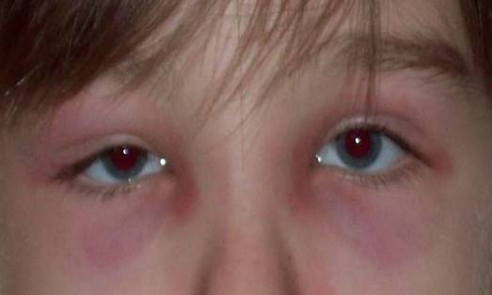
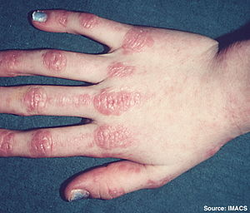
Systemic CTD2: Juvenile Dermatomyositis
Diagnosis
Muscle weakness
Skin changes
Gottrons
Heliotrope
- Increased muscle enzymes
Aldolase
Creatine kinase
LDH, ALT, AST.
Other
Calcinosis
Capillary Nailbed
Arthritis & contractures

Slide 58
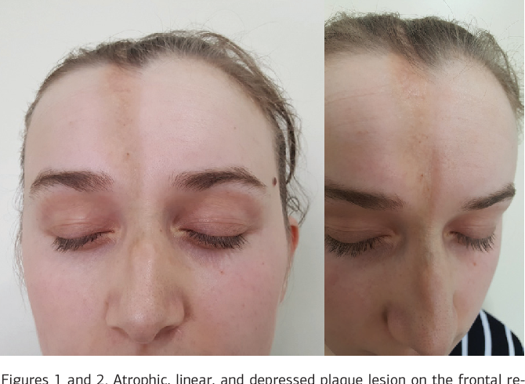
CTD3: Linear scleroderma

Slide 59
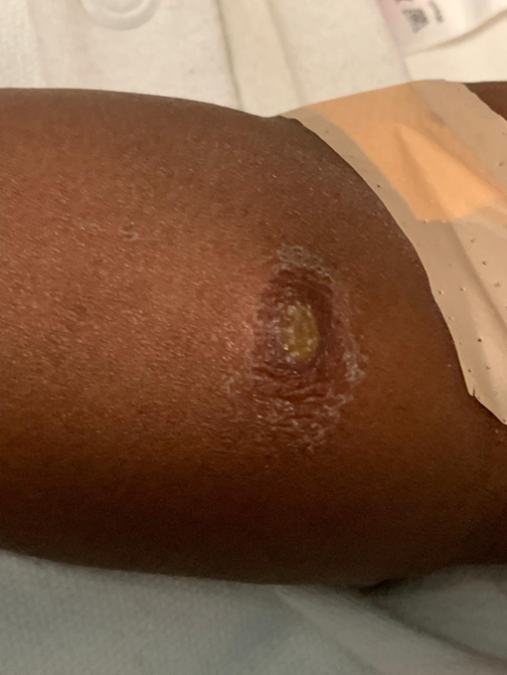
Kawasaki disease1: Oral changes and BCG scar reactivation

Slide 60
Kawasaki2: Extremity changes

Slide 61
Vaculitides2: PAN
Foot gangrene

Slide 62
Vasculitides3: IgA vasculitis (HSP)
Diagnostic criteria
Purpura of HSP
Palpable purpura and
Abdominal pain
Arthritis
Nephritis.
Biopsy: IgA

Slide 63
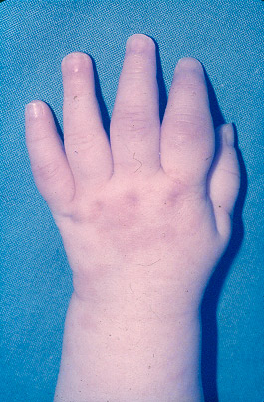
Systemic JIA
Rash: salmon coloured, evanescent
Quotidian fever, arthritis
Modified from Slide from Dr Angelo Ravelli, PRINTO, Genoa, Italy
Notes:
63
Systemic disease is the JIA subtype that is often the most difficult to manage

Slide 64
Congenital1:Epidermolysis Bullosa
Genetic defect in basement mebrane complex.

Slide 65
Congenital 2: Icthyosis

Slide 66
Congenital 3: Portwine stains

Slide 67
Malignant1: Malignant melanoma

Slide 68
Malignant2: Squamous cell carcinoma

Slide 69
CNS disease associated1: Tuberous sclerosis

Slide 70
CNS disease associated 2: Neurofibromatosis

Slide 71
CNS disease associated 3: Sturge weber

Slide 72
Other: Bonny eruptions? Think FOP

Slide 73
Conclusion
Most rashes in children mild presentation
Often resolve spontaneously
A few presentations suggestive of systemic diseases not to be missed!!!

Slide 74
And Finally……………..
…………….. From those to whom much has been given, much will be required.

