Slide 1
DEVELOPMENT
Dr Lucy Mungai

Slide 2
Questions to ask
Why are some species small and others big.
Why do some grow slowly and others fast
Why do they grow old and die
Why do some have few offsprings

Slide 3
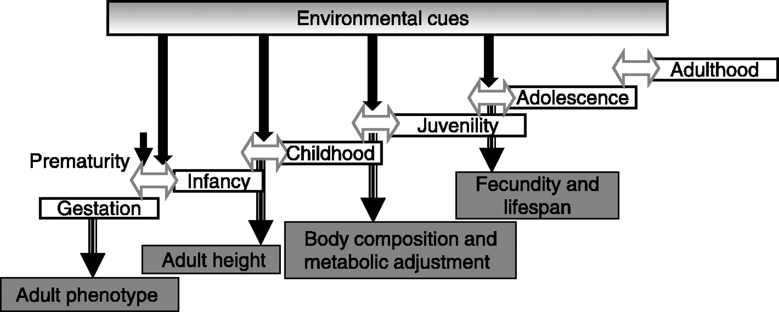

Slide 4
Principles of Growth and Development to Remember:
It’s a continuous process from conception until death
It proceeds in an orderly sequence
It happens at different rates.
It is cephalocaudal (from head to feet)
It proceeds proximodistally (from center out)
It continues from gross to fine motor skills

Slide 5
Prenatal Development
The normal gestation period for humans is 38 weeks. Several names are given to developing humans:
Zygote.....conception to 2 weeks
Embryo….2-8 weeks
Fetus……..8-38 weeks
Neonate..birth-4wks

Slide 6
1st Trimester: central
nervous system develops
2nd Trimester: muscle and
bone, fingers and toes,
reflexes develop
3rd Trimester: lots of brain growth, sight, hearing, most organs are well developed (lungs don’t fully develop until the 9th mth.

Slide 7
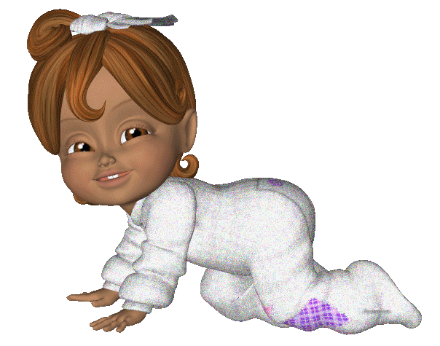
Neonatal Developmental Steps
Sit…6 Months
Creep…8 Months
Crawl…10 Months
Stand…12 Months
Walk…13-14 Months

Slide 8


Preschool Development (Ages 2-6)
The child is moving from gross motor skills to fine motor skills. (They learn to throw a ball before learning to use scissors.)
Children in this age group need much physical activity.

Slide 9

Middle Childhood Development
Ages 6-12yrs; JUVINILITY
The major growth and change during this time period is in the cognitive domain.
Physical growth is slow but steady.

Slide 10




Adolescent Development
Ages 10 or 11-18
Raging Hormones
Growth Spurt (Feet and hands grow faster than legs and arms which causes that awkward, clumsy stage)
Oil glands and sweat glands increase in production causing pimples

Slide 11
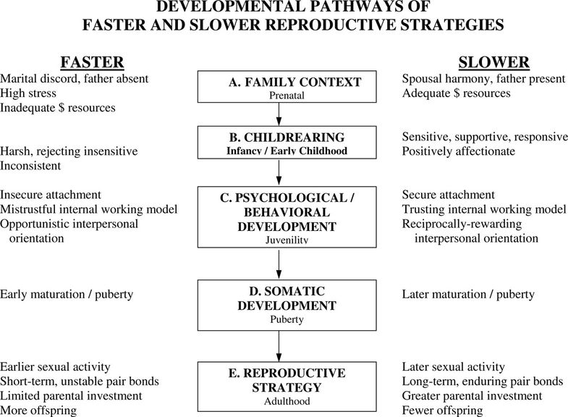

Slide 12
Table 2
Adolescence in boys and girls manifests differently with regard to their actual fertility.
Boys | Girls
Become fertile approximately 2 years after onset of growth spurt; 1 year before peak height velocity | Completed half their breast and pubic hair development by peak height velocity; menarche approximately 1 year after peak height velocity
Remain juvenile in body hair, stature, muscularity and voice | Appear feminine, while remain infertile
Muscle spurt and adult stature still four years away; approximately 18 years | Adult frequency of ovulation and adult size of birth canal; approximately age 18 years
Learn adult social roles while sexually mature, but not perceived mature by adults | Learn adult social roles while infertile, but perceived by adults as mature

Slide 13
Human Life-History
Relative to other species, human life-history strategy;
a long period of postnatal growth,
dependency to sexual maturity,
rapid adolescent growth a
delayed reproduction

Slide 14
Development History
Humans;
infancy, lasts 30 to 36 months;
childhood, 2 to 4 years;
a juvenility stage of 3 to 4 years of semi-independence,
adolescence, which lasts 3 to 5 years;
youth stage lasts an average of 4 years

Slide 15
From Childhood to Juvenility
Transition from childhood to juvenility is marked by the onset of adrenal androgen generation (adrenarche), adiposity rebound, deceleration of growth [21], and the eruption of the first molar teeth
an important role for adrenarche in human brain maturation
increased brain size and extended lifespan of humans relative to the great apes imply changes in the timing and impact of adrenarche
increases in body size leads to increase in lifespan and delayed adrenarche and reproductive maturation, and the potential role of delayed transition from childhood to adrenarche in human evolution.

Slide 16
Puberty/Adolescence
The terms puberty and adolescence are often used interchangeably and thus incorrectly
puberty refers to the activation of the neuroendocrine hypothalamic-pituitary-gonadal axis that culminates in gonadal maturation and the biological effects of sex steroids
adolescence includes
pubertal development
growth spurt,
cognitive and brain maturation,
social aspects in learning, intimacy and mutual support, intensification of pre-existing friendships, development of new relationships, and the attainment of biosocial skills needed for successful reproduction

Slide 17
Adolescence
starts before the emergence of secondary sexual characteristics in girls, and much later than the onset of genital changes in boys.
the human adolescent has striking fat deposits in the thighs, buttocks and breasts, even if she is thin overall.
These enable her to get through periods of scarcity, signal sexual maturity and facilitate sexual attraction of a mate, and allows others to continuously monitor her nutritional state

Slide 18
Transition from juvenility to adolescence
Age and size at adolescence have strong effects on an individual's fitness because they affect reproductive potential, schedule and efficiency
Accelerated pubertal development also reduces generation time, while potentially lengthening reproductive lifespan.
Alternatively, late transition into adolescence lengthens preadolescent growth and the opportunity to internalize the various resources to which the individual is exposed,
nutritional, social or psychological.
Delayed maturation prolongs the preadolescent hazard period, which may be compensated for by continuing parental care.
Ultimately, individuals face a tradeoff between maturing to reproduction young and small and maturing at large body size, since for any given growth rate earlier maturation implies smaller size at transition.

Slide 19
Developmental and maturation
It is flexible and responsive to environmental conditions in a presumptively adaptive manner.
When immature animals experience severe environmental stresses such as malnutrition or disease, maturation is often delayed until conditions improve and normal growth can resume.
when animals are raised under ideal conditions that promote rapid growth, internal checkpoints ensure that maturation does not occur until juvenile development is complete.
But when contextual stress is not so great as to challenge survival, pubertal development is accelerated, thereby increasing the likelihood of reproduction before death or disability
. Nutritional cues have clear temporal influence, including the timing of juvenility and adolescence,

Slide 20
ADULTHOOD
The collective endpoint of the adolescence package is the socially and reproductively mature adult.
To promote reproductive and parenting success in the service of reproductive fitness,
hormonal and mental maturations are intimately coupled through iterative transactions between the nervous system and endocrine systems, with the latter involving gonadal steroid hormones

Slide 21
Adoption
There is greater tendency of adopted girls to respond with pubertal onset to a changing environment with female idiopathic central precocious puberty.
Note:
it is the female who has intrinsic constraints on the number of offspring she can generate over her reproductive years, and it is females more than males who may enjoy a fitness advantage from early maturation

Slide 22
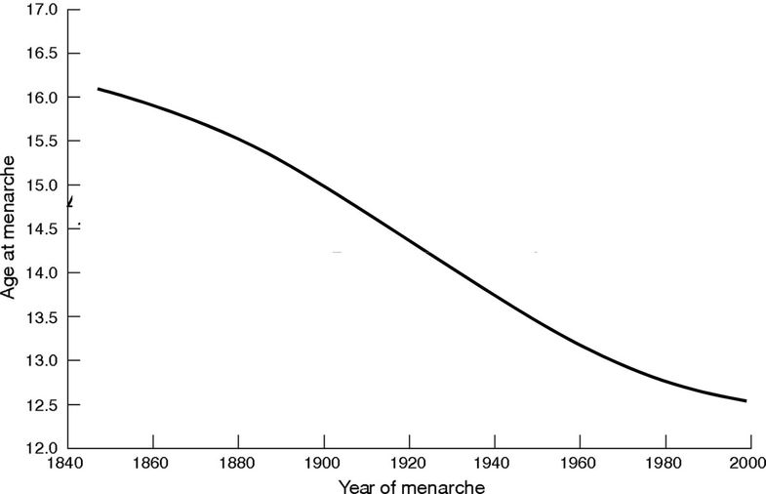
The secular trend in puberty. Declining age of menarche in Western societies from 1840 to 2000.

Slide 23
APPROACH
History
Physical exam

Slide 24
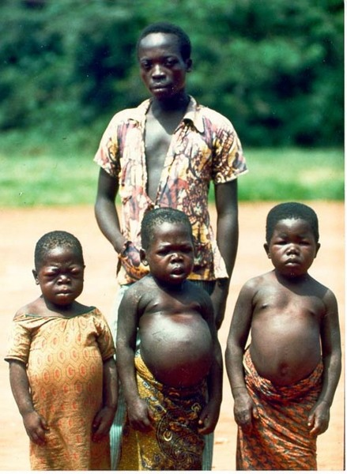
Failure to thrive

