Slide 1
DKA MANAGEMTNT
DR L N W MUNGAI
2016

Slide 2
Water and salt replacement
➠ If needed, volume expansion to restore peripheral circulation (resuscitation) should begin immediately with an isotonic solution (0.9% saline or balanced solution such as Ringer's lactate) (E)
➠ … where it is clinically indicated, the volume typically is 10-20 mL/kg over 1-2 hours, and may be repeated if necessary (E)
➠ Use crystalloid not colloid (C)
➠ Subsequent fluid management (deficit replacement) should be with 0.9% saline or a balanced salt solution such as Ringer's lactate (or acetate) for at least 4-6 hours (C,E).

Slide 3
Water and salt replacement
➠ Thereafter, deficit replacement should be with a solution that has a tonicity equal to or greater than 0.45% saline with added potassium chloride,
➠ The rate of IV fluid should be calculated to rehydrate evenly over at least 48 hours (C,E).
➠ …infuse fluid each day at a rate rarely in excess of 1.5-2 times the usual daily maintenance (E).
➠ Urinary losses should not be added to the calculation of replacement fluid (E).

Slide 4
Water and salt replacement
➠ The sodium content of the fluid may need to be increased if serum corrected sodium is low and does not rise appropriately as the plasma glucose concentration falls (C).
➠ The use of large amounts of 0.9% saline has been associated with the development of hyperchloremic metabolic acidosis (C).

Slide 5
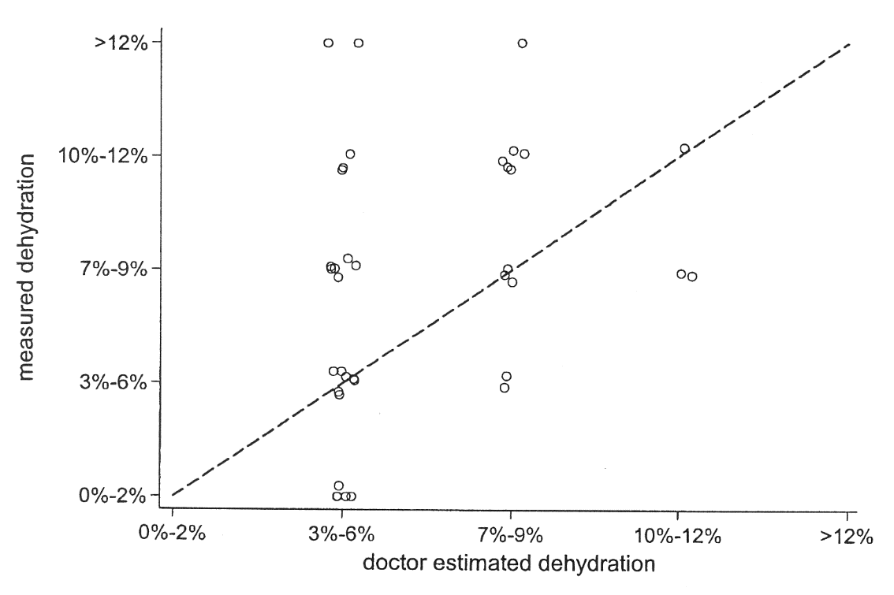
Estimated dehydration
➠ Not everyone has 10% dehydration!
In average 7.4% (1-22%) in 231 patients (10 mo.-20 y.,
25% new onset). Harris G et al. Arch Ped Adolesc Med 1994;148:1046-52.
Koves IH, Neutze J et al. Diabetes Care 2004;27:2485-7.
➠ In average 8.7% dehydration
➠ None of the usual clinical parameters were found to be good predictors of dehydration in DKA.

Slide 6
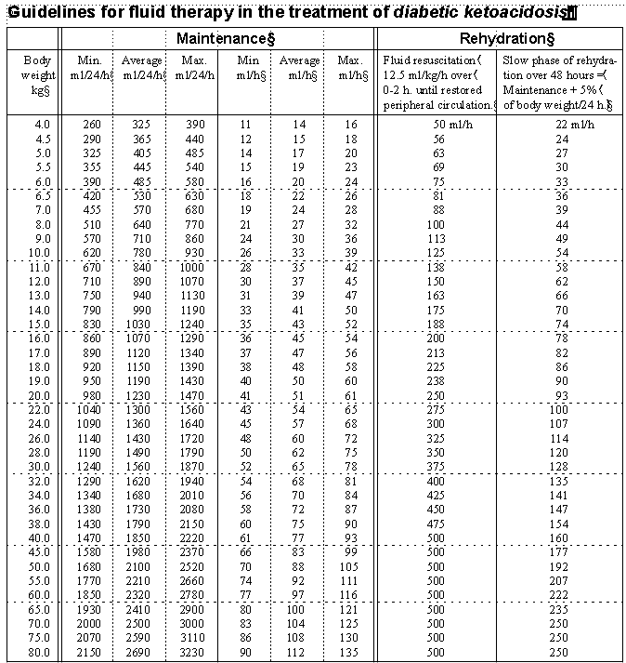
Fluid management
➠ Tables are safer than calculations in the middle of the night!
Darrow DC, Ped Clin North Am 1959 & Talbot FB, Am J Dis Child 1938

Slide 7
Fluid management – 10% dehydration
ISPAD 2000:
➠ 6 ml/kg/h
3 - 9 kg
➠ 5 ml/kh/g
10 -19 kg
➠ 4 ml/kg/h
20 – kg
Max 1.5-2 x maintenance
134
140
144
150
154
166
176
184
194
200
208
216
224
2009:
➠ Max. 1.5-2 x maintenance

Slide 8
Fluids before insulin
Mmol/l
33
22
11
Luzi L et. al Diabetes 1988;37:1470-77.
➠ If insulin was administered in the first hour the OR for cerebral oedema was 4.7 (95% CI: 1.5–13.9, p<0.007) after adjustment for age, sex, new/known diabetes and baseline acidosis. Edge J. Diabetologia 2006;49:2002-09.

Slide 9
Insulin therapy
➠ Start insulin infusion after the patient has received initial volume expansion; i.e., approximately 1-2 hours after starting fluid replacement therapy (C).
➠ 0.1 U/kg/h.
➠ Route of administration IV (A).
Mean
➠ An IV bolus (0.1 U/kg) is unnecessary,
may increase the risk of cerebral
edema, and should not be used
at the start of therapy (C).
Hours
➠ 0.1 U/kg/h at least until resolution of
DKA (pH >7.30, bicarbonate >15
mmol/L and/or closure of the anion gap).
0.25 U/kg as bolus,
then 0.1 U/kg/h
Dahlquist G et al.
Lakartidningen 1981;78:3489-92.

Slide 10
Insulin therapy
➠ 5% glucose should be added to the IV fluid when the BG falls to ~ 17 mmol/L (300 mg/dL) (B).
➠ If BG falls very rapidly (>5 mmol/L/h, 90 mg/dL/h), consider adding glucose even before plasma glucose has decreased to 17 mmol/L (E).
➠ It may be necessary to use 10% or even 12.5% dextrose to prevent hypoglycemia while continuing to infuse insulin to correct the metabolic acidosis.
➠ If the patient demonstrates marked sensitivity to insulin (e.g., some young children with DKA and patients with HHS), the dose may be decreased to 0.05 U/kg/hour, or less, provided that metabolic acidosis continues to resolve

Slide 11
Potassium replacement
➠ Replacement therapy is required regardless of the serum potassium concentration (A).
➠ If the patient is hypokalemic, start potassium replacement at the time of initial volume expansion and before starting insulin therapy with 20 mmol K/L.
➠ Otherwise, start replacing potassium after initial volume expansion and concurrent with starting insulin therapy with 40 mmol K/L.
➠ If the patient is hyperkalemic, defer potassium replacement therapy until urine output is documented (E).

Slide 12
Potassium replacement
➠ Subsequent potassium replacement therapy should be based on serum potassium measurements (E).
➠ Potassium replacement should continue throughout IV fluid therapy (E).
➠ The maximum recommended rate of intravenous potassium replacement is usually 0.5 mmol/kg/h. (E).
➠ If hypokalemia persists despite maximum rate of potassium replacement, then the rate of insulin infusion can be reduced.

Slide 13
Potassium infusion
➠ A separate K-infusion may be easier to manage in the intensive care unit
mmol K/lit. mmol/kg/h
20 ~0.1
40 ~0.2
60 ~0.3
80 ~0.4
100 0.5 (maximum!)
➠ Calculated for the fluid rate of maintenance + 10% dehydration over 48 hours

Slide 14
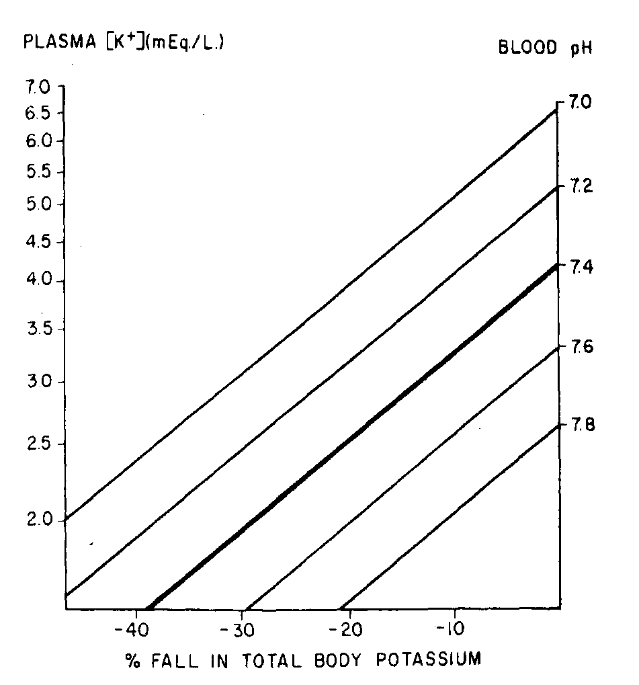
Potassium
➠ Often normal or increased at admission
But in reality there is always a deficit!
s-K increases with acidosis
x
➠ S-K ↓ during treatment due to:
① Insulin → K⁺ goes ECV → ICV
② Acidosis ↓
③ Potassium is consumed during
glycogen production
x
Example of 10 % potassium deficit:
Acidosis with pH 7.0; s-K 5.2 → 3.3
during treatment of acidosis
Sperling NA. Ped Clin North Am 1984;31: 591-610.

Slide 15
Acidosis
➠ Bicarbonate administration is not recommended for resuscitation unless the acidosis is profound and likely to affect adversely the action of adrenaline/epinephrine during resuscitation (A).
➠ There may be selected patients who may benefit from cautious alkali therapy:
➠ Severe acidemia (arterial pH < 6.9) in whom decreased cardiac contractility and peripheral vasodilatation can further impair tissue perfusion, and patients with life-threatening hyperkalemia
➠ If bicarbonate is considered necessary, cautiously give
1-2 mmol/kg over 60 minutes (E).

Slide 16
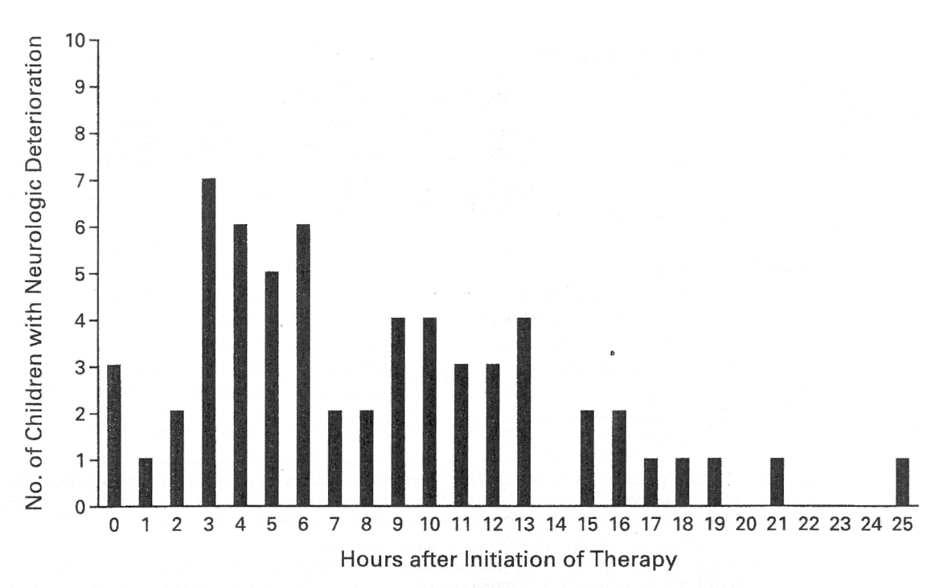
CE mortality
➠ In national population studies, the mortality rate from DKA in children is 0.15% to 0.30%
Curtis JR. Diabetes Care 2002;25:615-18, Edge JA. Arch Dis Child 1999;81:318-23.
➠ Cerebral edema accounts for 60 to 90% of all DKA deaths
Glaser N. NEJM 2001;344:264-69, Lawrence SE. J Pediatr 2005;146:688-93.
➠ CE can occur before treatment has begun or, may develop as late as 24-48 hours
Time to neurologic deterioration
Glaser N, Barnett P et al. NEJM 2001;344:264-69.

Slide 17
Cerebral edema – risk factors
➠ Younger age
➠ Presentation with new onset diabetes
➠ Longer duration of symptoms
➠ Greater hypocapnia at presentation after adjusting for degree of acidosis
➠ Increased serum urea nitrogen at presentation
➠ More severe acidosis
➠ Bicarbonate treatment for correction of acidosis
➠ An attenuated rise in measured serum sodium concentrations during therapy

Slide 18
Diagnosing cerebral edema
Diagnostic criteria
➠ Abnormal motor or verbal
response to pain
➠ Decorticate or decerebrate posture
➠ Cranial nerve palsy (especially III, IV, and VI)
➠ Abnormal neurogenic respiratory pattern (e.g., grunting, tachypnea, Cheyne-Stokes respiration, apneusis)
One diagnostic criterion for diagnsosis
(only signs that appear after the rapid fluid infusion are included)
Muir A et al. Diabetes Care 2004;27:1541–46.

Slide 19
Diagnosing cerebral edema
Major criteria
➠ Altered mentation/fluctuating
level of consciousness
➠ Sustained HR deceleration (decline more than 20 bpm) not attributable to improved intravascular volume or sleep state
Fall in HR to <70% from maximum at admission in 11/26 patients with CE
Edge J. ISPAD 2004
➠ Age-inappropriate incontinence
2 major or one major and 2 minor criteria for diagnosis
Muir A et al. Diabetes Care 2004;27:1541–46.

Slide 20
Diagnosing cerebral edema
Minor criteria
➠ Vomiting
➠ Headache – 10/44 at 2-12 hours before event Edge J. ISPAD 2004
➠ Lethargy or being not easily aroused from sleep
➠ Diastolic blood pressure >90 mmHg
➠ Age <5 years
2 major or one major and 2 minor criteria for diagnosis
➠ 92% sensitivity and 96% specificity for the recognition of CE sufficiently early for intervention.
Headache or fall in HR – mannitol may prevent CE! Edge J.
Muir A et al. Diabetes Care 2004;27:1541–46.

Slide 21
Cerebral edema – treatment
➠ Initiate treatment as soon as the condition is suspected.
(before calling doctor if profound symptoms!)
➠ Give mannitol 0.25-1 gram/kg IV over 20 minutes and repeat if there is no initial response in 30 minutes to 2 hours (C,E)
➠ Reduce the rate of fluid administration by 50%.
➠ Hypertonic saline (3%), 5-10 mL/kg over 30 minutes, may be an alternative to mannitol, especially if there is no initial response to 1 g/kg mannitol (C).
➠ Mannitol or hypertonic saline should be available at the bedside

Slide 22
Cerebral edema – treatment
➠ Elevate the head of the bed.
➠ Intubation may be necessary for the patient with impending respiratory failure, but aggressive hyperventilation (to a pCO₂ <22 mm Hg [2.9 kPa]) has been associated with poor outcome and is not recommended (C).
➠ After treatment for cerebral edema has been started, a cranial CT scan should be obtained to rule out other possible intracerebral causes of neurologic deterioration (≈10% of cases), especially thrombosis or hemorrhage, which may benefit from specific therapy.

Slide 23
Preventing DKA (after onset of diabetes)
➠ Insulin omission, either inadvertently or deliberately, is the cause in most cases (C).
➠ The most common cause of DKA in insulin pump users is failure to take extra insulin with a pen or syringe
when hyperglycemia and hyperketonemia or ketonuria occurs (E)
➠ An intercurrent infection is seldom the cause when the patient/family is properly educated and has access to a 24-hour telephone helpline (B).
➠ In countries with a high incidence of childhood diabetes, the frequency of DKA at onset is lower (16% in Sweden).

Slide 24
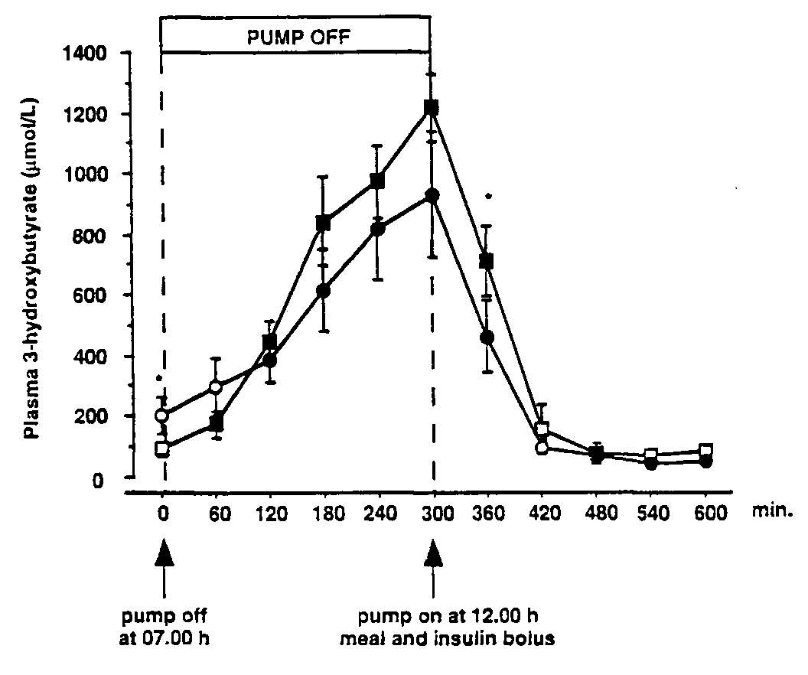
Preventing DKA - measuring ketones
➠ Blood ß-hydroxybutyrate (BOHB) concentrations may be increased to levels consistent with DKA when a urine ketone test is negative or shows only trace or small ketonuria (C).
➠ Home measurement of BOHB decreases
diabetes-related hospital visits when
compared to urine ketone testing (B).
➠ Blood BOHB measurements may be
especially valuable to prevent DKA in
patients who use a pump because
interrupted insulin delivery rapidly
leads to ketosis.
1,4
1,2
1,0
0,8
0,6
0,4
0,2
0
Humalog
Velosulin
Betahydroxy-buturate, mmol/l
Guerci B et al. J Clin Endo Met 1999;84:2673-78.

Slide 25
Recurrent DKA - psychological factors
➠ There usually is an important psychosocial reason for insulin omission:
➠ This can be an attempt to lose weight in an adolescent girl with an eating disorder, a means of escaping an intolerable or abusive home situation, or clinical depression.

Slide 26
Preventing recurrent DKA
➠ A psychiatric social worker or clinical psychologist should be consulted to identify the psychosocial reason(s) contributing to development of DKA (E).
➠ Insulin omission can be prevented by schemes that provide education, psychosocial evaluation and treatment combined with adult supervision of insulin administration (B).

Slide 27
More DKA at onset in low incidence countries
PLACE | %DKA at onset | Comments
Bangkok, Thailand | 77% | 1987-1996
Addis Abeba, Ethiopia | 65% | 1982-1988
Parma, Italy | 78%* | 1987-1991
EURODIAB | 42% (26-67%) | 2001 – 24 centres
Kuwait Oman | 49% 42% | 1992-1995 1990-93
London, UK | 41% | 1992
Birmingham, UK | 27% | 2001
Barts-Oxford, UK Denver, Colorado | 26% | 1985 & 1990 1998-2001
Manchester, UK | 27% | 1990-96
Finland | 21.6% | 1986-1989
Ontario, Canada Sweden | 18.6% 16% | 1997-2002 1999-2000
    Slide from Daneman D.

Slide 28
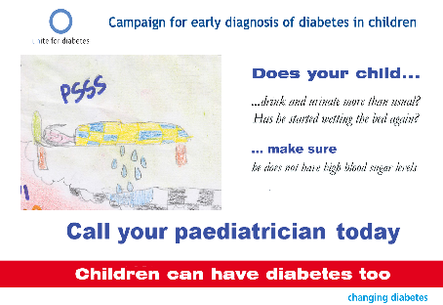

How can DKA at onset of diabetes be reduced?
➠ Posters were displayed in schools, at GP offices and pediatric centers 1991-1997
➠ DKA in the age 6-14 years ↓ from 78% to 0% after 1992
    Vanelli M. Diabetes Care 1999: 22: 7-9.

Slide 29
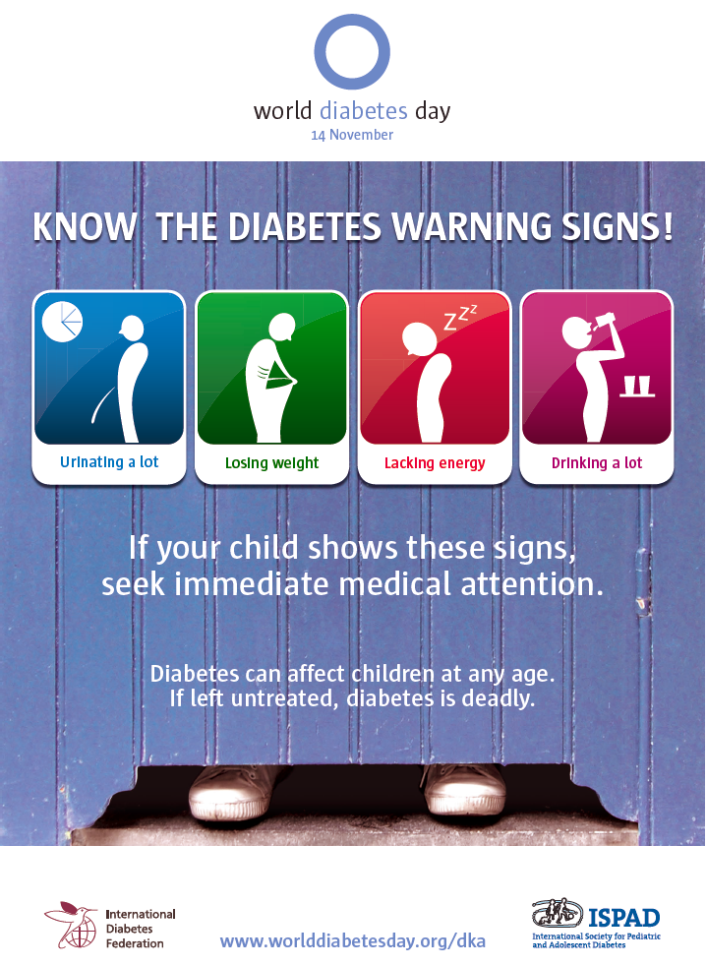
How can DKA at onset of diabetes be reduced?
➠ ISPAD organized an international campaign together with IDF in 2008
➠ Posters are available for translation at www.worlddiabetesday.org/dka
➠ Needs to be repeated!

