Slide 1

BREASTFEEDING
By
Prof Grace Irimu, PhD, Mmed (Paed)
Paediatric Nephrologist and Public Health Specialist

Slide 2
Learning outcomes
At the end of the session the learner should be able to :
Define best breastfeeding practices and infants cues for breastfeeding
Discuss the advantages of breastfeeding - infant, mother, society, employer
Describe anatomy of the breast
Describe the physiology of breastfeeding
Demonstrate the correct breastfeeding technique
      Mothers position
      Baby's position
      Holding the breast
      Latching on to the breast
Demonstrate technique of breastmilk expression by hand, explain storage of the breast milk and demonstrate cup feeding.

Slide 3
The contents on breast milk. (colostrum & mature milk)
Breastmilk contains nutrients and substances that help :
  digestion and absorption of nutrients,
  substances that enhance immunity for the immature immune system,
  substances that help in development of the brain

Slide 4
Colostrum (up to 2-3days)
Usually 50ml on 1st day – but it is enough for the baby
Colostrum (up to 5 days): LIQUID GOLD, thick, yellow in colour but may be colourless. Not unusual for mother to say ‘I have no milk’. It has a lot of white blood cells and antibodies for fighting infections (FIRST IMMUNIZATION)
It stimulates early bowel movement –reduces risk of severe jaundice
It promotes growth of a protective bacteria in the gut, that protects against invasion of harmful bacteria.
Reduces growth of harmful bacteria in the GI ( lactoferrin &lysosome)
Rich in antibodies and may provide protection against bacteria in the birth canal and those associated with other human contact
It is JUST RIGHT for the baby high protein, low fat and sugar thus easily digestible. Very rich in vitamins X 3-10 of that in mature milk.

Slide 5
Composition of breastmilk
Fats (3.5g/l) | High level fats that have a positive effect in the cognitive and behavioural development, they are vital for brain development, retinal stimulation and neurotransmission -are not found in other milks. Fat increases as the feed time prolongs
Carbohydrate | For energy and some – protect against infection
Proteins 0.9g/l | BM contains more of whey protein than casein – well digested. Cow milk contains beta lactoglobulin, this is absent in human milk, and which infants become intolerant.
Vitamins | With exception of vitamin D breast milk has enough, unless the mother is deficient eg Vit A deficiency is common Iron and zinc are low quantity but bio-availability and absorption is high. Provided maternal iron status are adequate baby is born with adequate levels except pre-terms
Anti-infective properties | Contains substances that kill germs and also prevent the attachment of these germs to the gut wall. Confers immunity against common infections that the mother has been exposed to previously
Breast milk is – 87% water
Notes:
High level of polyunsaturated fats that (docosahexaenoic acid –DHA & arachidonic acid-ARA) are not found in other milks. - . (some of these may be added in some formulas but they don’t confer any advantage over breast, and may not be as effective as those in breast milk)
Vitamin A may not be adequate if the mother is does not eat foods with Vitamin A.
Vitamin D – should expose babies to sunlight, not through the glass window, nor covered under an umbrella, dress baby lightly with upper and lower limbs exposed but a hood to cover the fontanel. 30minutes exposure best at 10am. Lack of sunlight exposure causes rickets, this is a very common problem in Kenya, yet God has given us sunlight throughout the year. By 4 weeks baby should be having planned sessions of basking- just like food.

Slide 6
Composition of milk from human, cow, got and sheep milk and the growth rate
Species | Days required to double birth weight | Content of milk (%) |  |  | mg/100ml
 |  | Fat | Protein | Lactose | Minerals | Sodium
Human | 180 | 3.8 | 0.9 | 7.0 | 200 | 15
Cow | 47 | 3.7 | 3.4 | 4.8 | 700 | 58
Goat | 19 | 4.5 | 2.9 | 4.1
Sheep | 10 | 7.4 | 5.5 | 4.8
The breast milk is easily digested and baby need to feed often. Cow’s milk takes 4-5hrs to be digested.
Notes:
Minerals and vitamins : reserves of the newborn are related to maternal diet. Vit C, Iron foetal supply is adequate and exceeds that of mom.
High level of vitamin A in colostrum X3 that of mature milk
Na in cow’s milk is 3.6 times that of human milk
Phosphorous – x6 that human milk
Calcium /phosphorous ratio is lower in cow’s milk (1:4) than in human milk (2:2)

Slide 7
Appropriate breastfeeding
Initiating breastfeeding immediately ( or within the first 5 minutes)
Exclusive breastfeeding until 6 months age
Continued breastfeeding to at least up-to 2 years of age
Breastfeeding on demand, day and night
Suboptimal breastfeeding practices contribute to 11.6% of mortality in the under 5’s globally
Notes:
exclusive breastfeeding has the single largest potential impact on child mortality of any preventive intervention strategy

Slide 8
What are the advantages of breastfeeding?
    To the infant
        Nutritional
        Immunological
        Cognitive
        Protects against NCD later in life
    (exclusive breastfeeding has the single largest potential impact on child mortality of any preventive intervention strategy)
    To the mother
    To the family and nation

Slide 9
Why early initial breastfeeding
Early initiation of breastfeeding is encouraged for a number of reasons.
  early suckling stimulates breast milk production and facilitates the release of oxytocin, which helps the contraction of the uterus and reduces postpartum blood loss.
  Early initiation of breastfeeding also fosters bonding between mother and child.
But only 56% of newborns in Kenya are breastfed within 1 hour of birth

Slide 10
Benefits of initiating breastfeeding within 1 hour
Benefits to baby
Benefits to Mum
The first breast milk contains colostrum, which is highly nutritious and has antibodies that protect the newborn from diseases.
22% reduction of neonatal deaths if breastfeeding
initiated in the first 1 hour
16% reduction if breastfeeding initiated on the first day
Maternal-infant bonding.
Prevents mothers deaths by preventing excessive bleeding

Slide 11
Benefits of appropriate breastfeeding
Reduces risk of death
Reduces risk of acute illness
Reduces risk of chronic illnesses
Reduces risk of mother developing chronic illnesses

Slide 12

Benefits of Breastfeeding (1)
Increased hospitalization in bottle fed babies
3/4 reduction in admissions due to diarrhea
Reduces admissions due to pneumonia by 50%

Slide 13
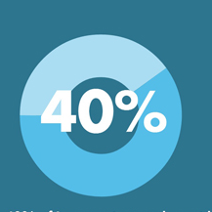
Benefits of Breastfeeding (2)
Increased hospitalization in bottle fed babies
Reduction in sudden infant deaths in high income countries
3/4 reduction in admissions due to diarrhea
Reduces admissions due to pneumonia by 50%

Slide 14

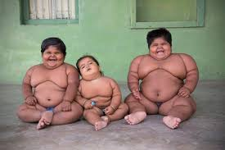

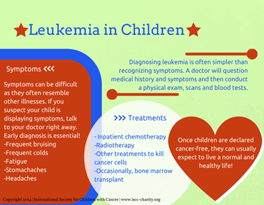
Benefits of breastfeeding (3)
Prevents illnesses
  Ear infection
  Asthma
Chronic illness

Slide 15


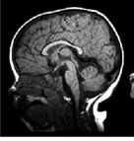
Improves brain development
Baby needs MOTHERS MILK for normal brain growth.
Breastfed babies have higher performance of IQ at 6.5 years (3.5 points higher). Higher effect in LBW (5.18 point higher)
Feeding preterm babies on breastmilk –first 28 days - have been associated with higher academic achievements, better working memory, better muscle functions, being better in mathematics by age 7 years. The higher the BM the higher the effect

Slide 16
Development of brain and breastmilk
Breastfeeding is beneficial to brain development
  Breastmilk has specific factors not found in other milk – may be added to some formulas – no added benefit over breastmilk
  Mothers who provide breast milk show greater sensitivity to the babies associated with better brain development

Slide 17
Towards achieving the SDGs
Better performance in school (33%)
Higher wages
(5 – 50% )
Likely to survive
Africa and Asia loosing 10-11% of the GDPs due to under nutrition

Slide 18
Saving cost associated with improved breastfeeding from societal perspective
Perspective | Saving
Infant and parent | FEEDS (Formula, commercial complementary feeds,) MEDICAL COST ( physician cost, prescription cost, over the counter medication) FAMILY COST – ( care of sick child- seeking care & care at home or hospital, lost wages, family disruption ) LONG TERM SEQUELE – ( decreased quality of life, reduced IQ)
Employer | Less employee absenteeism Less lost productivity Lower insurance premium Less employee turnover
State | Purchase of formula Medical cost Worker productivity Global competition

Slide 19

Benefits to the mom
1.
Breastfeeding can reduce this by 20,000 per year
2. Cancer of the ovaries
3. Excessive bleeding during child birth
4. Can help you lose pregnancy weight.

Slide 20
Helping the modern mothers achieve breastfeeding goals
Health Bill - 2016
Comprehensive lactation Programme for corporates Includes:
  Privacy for milk expression
  Flexible working hours/breaks
  Education
  Support
??Insurance policies to include breastfeeding support.

Slide 21
Benefits of lactation Programme for corporates (1)
 | Reduces medical cost and health insurance claim for the employees and their infants
 | Reduces turn over Return to work after child birth- 90%
 | Reduces number of 1day absences.
X3
X90%
X50%

Slide 22
Is there a problem?

Slide 23
Towards successful breastfeeding
Be prepared
  When
  What (moms’ feeds, baby’s feeds)
  How (Technique)

Slide 24
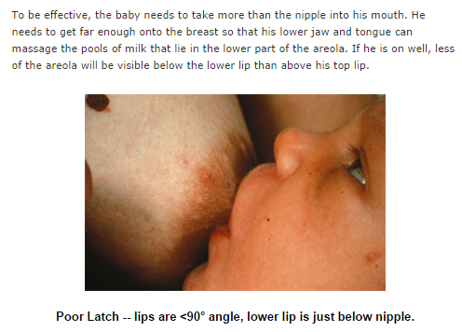
Common problems – be proactive
I don’t have sufficient breast milk
I have breast pain
I gained a lot of weight during after delivery
Baby is crying a lot- not getting enough

Slide 25
The Breast
Nipple
  contains 15-25 ducts, opening of each of the tubuloalveolar glands
  Richly innervated with sensory nerve endings
  Smooth muscle fibre
  Sebaceous and sweat glands
  Highly elastic
Tail of Spence – mammary glandular that projects to the axilla – connect to a normal ductal system
Notes:
The three major structures of the breast are skin, subcutaneous tissue, and corpus mammae.

Slide 26
Breast anatomy
Areolar :
Montgomery glands – secrete a lubricant for the nipple an the areolar
Highly elastic
Glandular tissue
Size of breast does not predict milk production

Slide 27
Breast milk
stage I : From 16 weeks – mother can express colostrum . Milk production inhibited by high level of progesterone and estrogen
Stage II: Production of copious milk at delivery - - due to drop in progesterone levels – level drop in the first 4 days postpartum. – by 5th day the mammary epithelium is transformed to produce volumes of milk
onset of stage II also marks increase
in lactose and citrate concentration in
breastmilk.
High levels of prolactin first 3-4 day
& milk production not dependent
on suckling
Next 10days composition of
milk changes to mature milk .
Stage III: mature breastmilk
Notes:
Breast prepared for full lactation from 16 weeks gestation without any active intervention from the mother

Slide 28
Physiology of breastfeeding
Oxytocin stimulated also auditory, visual

Slide 29
Essentials of Effective lactation
Suckling
Emptying of the breast (accumulation of milk in the breast inhibits milk production)
Adequate precursors of nutrients
Maternal nutrition, age, body composition and parity are secondary factors

Slide 30
Correct breastfeeding technique
Mothers position
Baby position
Holding the breast
Attaching the breast into baby’s mouth

Slide 31
Baby correct position
    baby’s nose at the level of the breast
    baby close to the mother
    head and the trunk in a straight line
    mom support child’s whole body
Notes:
Cradle-hold (Madona) Mother’s same-sided arm supports the infant at the breast on which the infant is nursing.
The infant’s head is cradled near the mother’s elbow while the arm supports the infant along the back ,facing the mother , chest-to-chest
Football - The infant’s feet and body are tucked under her arm and the infants head is held in her hand facing the breast.
It can be difficult in this position to determine whether the infant’s mouth is open wide enough and whether lower lip is flanged

Slide 32
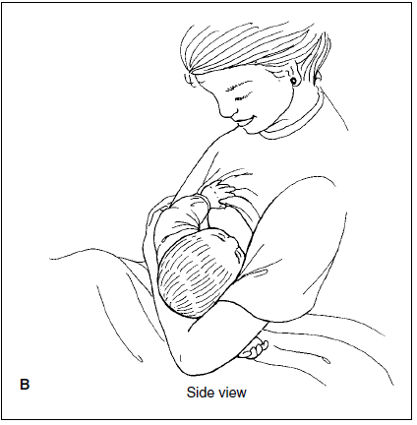
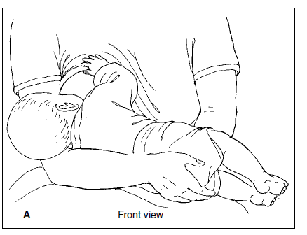
Madonna (cradle position)

Slide 33
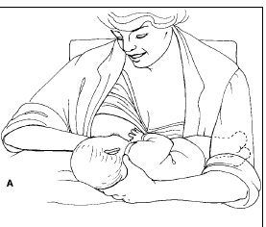
Cross-cradle or modified clutch hold
Notes:
This hold uses the opposite arm to support the infant with the back of the head(below the occiput) and neck held in the mother’s hand.
The hand closest to the breast supports and positions the breast as needed
Ideal for early breastfeeding
Excellent support and the ability to present the breast in a moulded fashion with a free hand.
Easier to assess a wide gap of the mouth and appropriate lip flange

Slide 34
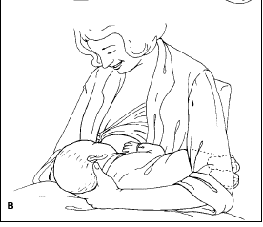
Football or clutch hold

Slide 35
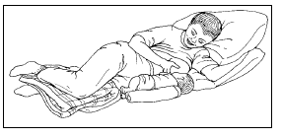
Side-lying position
Notes:
The mother lies on her side facing the infant who is also lying on his or her side
Infant faces the mother with the mouth at the level of the nipple
Caution-infant should not be surrounded by loose clothing or bedding and careful precautions should be made if the mother is drowsy to prevent entrapment or suffocation

Slide 36
Demonstrating correct position

Slide 37
Baby correct position
    baby’s nose at the level of the breast
    baby close to the mother
    head and the trunk in a straight line
    mom support child’s whole body

Slide 38
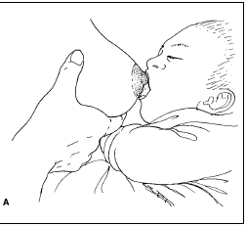
Importance of fatty acids in the perinatal period
Holding the breast
Opening the mouth
Introducing the breast into the infant mouth

Slide 39
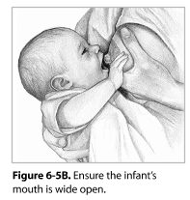
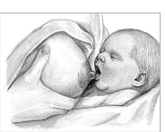
Attaching breast into the infant’s mouth
C- grip
Stimulating baby to open mouth wide
Introducing breast into the mouth

Slide 40
Attaching baby’s mouth to the breast
Holding the breast
Opening the mouth

Slide 42
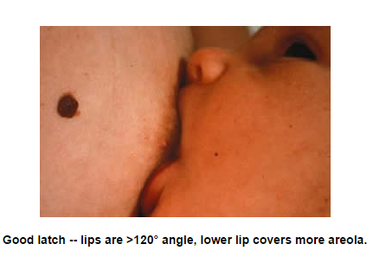
Signs of good attachment
chin touching breast,
mouth open,
more areola above nipple,
lower lip turned out,
Effective suckling.
baby takes slow deep suckles sometimes pausing and you may be able to see or hear baby swallowing.
Suckling is comfortable and pain free for mom.

Slide 43
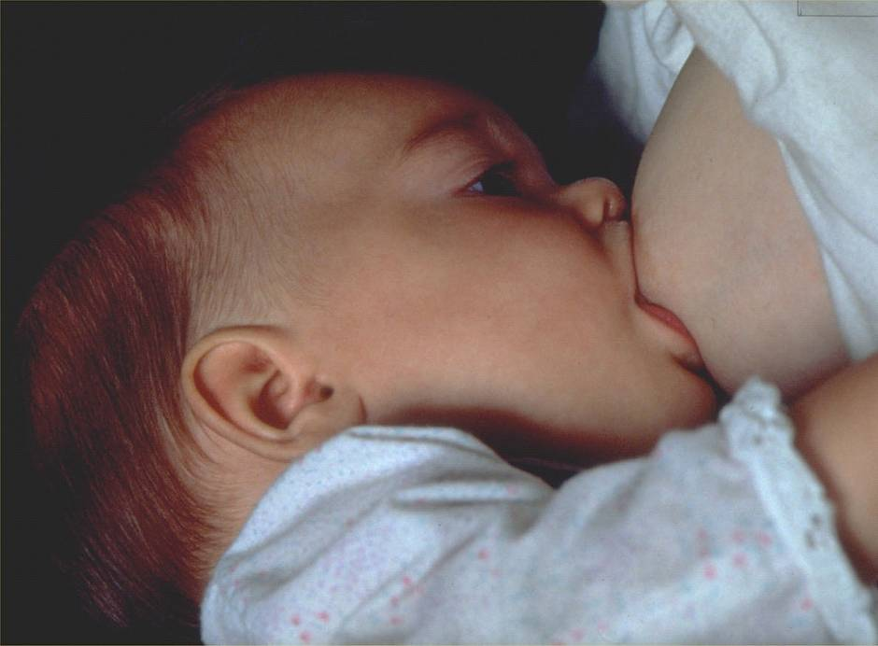
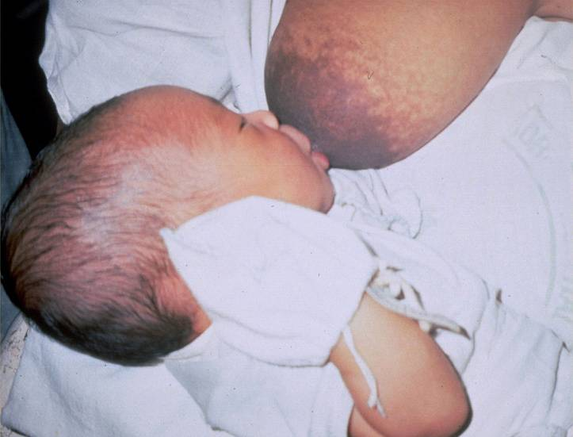
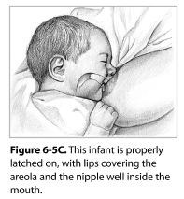
Correct attachment ?

Slide 44
Expressing breastmilk
Cup feeding
Takes 15minutes

Slide 45
Since ice o
Cooler Box – at 15ºC for 24hours
Source : ABM Clinical Protocol #8: Human Milk Storage Information for Home Use
for Full-Term Infants, Revised 2017
Notes:
ºc

Slide 46
Getting sufficient breastmilk
Correct breastfeeding technique
Relaxed mom
Frequent draining of the breastmilk
  Breastfeeding
  If not possible – express breastmilk
Not by drinking or eating excess fully
Help in weight reduction

Slide 47
Cues for feeding in baby watching:
Baby Cue
Wiggling, moving arms or legs
Rooting, fingers to mouth
Fussing, squeaky noises
Restless, crying intermittently
Full cry, aversive screaming pitch, color turns red
Stage of Readiness to Feed
Early
Early
Mid
Mid
Late

Slide 48
Breastfeeding for HIV mothers
Mother to make informed decision
Start on the ARVs early ( before 3 months gestation)
Fully supported for ARV adherence (mothers lifelong treatment and baby prophylaxis).
Baby prophylaxis to be continued for one week after stopping breastfeeding.
Transmission of HIV increases if mom stops ARVs abruptly

Slide 49
Breastfeeding for HIV mothers
4%
Overall transmission of HIV
3.5%
Breastfeeding duration for 6months
0.5-1.9%
ARVs started by 15weeks gestation
Breastfeeding duration for 12months
Transmission of HIV

Slide 50
10 steps of successful breastfeeding
Facilities policies : The International Code of Marketing of Breastmilk Substitutes and relevant World Health Assembly resolutions (1a,b,c)
Staff competency - Train all health care staff in skills necessary to support breastfeeding
Antenatal information : Inform all pregnant women about the benefits and management of breastfeeding.
Immediate post natal care - Help mothers to have immediate (or within 5 minutes after birth) and uninterrupted (for at least 60mintues) skin-to-skin contact and initiate breastfeeding as soon as possible after birth.
Support with breastfeeding – support mothers to initiate breastfeeding and manage common breastfeeding difficulties .
Supplementation : Do not give newborn infants food or drink other than breastmilk unless medically indicated.
Rooming in: Enable mothers and infants to remain together and to practice rooming-in 24hours a day.
Responsive feeding – support mothers to recognize and respond to their infants cues for feeding.
Feeding bottles, teat and pacifiers. Give guidance and counselling to enable family members make a informed decision on artificial teats or pacifiers(also called dummies or soothers) UNTIL successful breastfeeding is established. .
Care at discharge : coordinate discharge so that parents and their infants have timely access to on-going support and care.

Slide 54
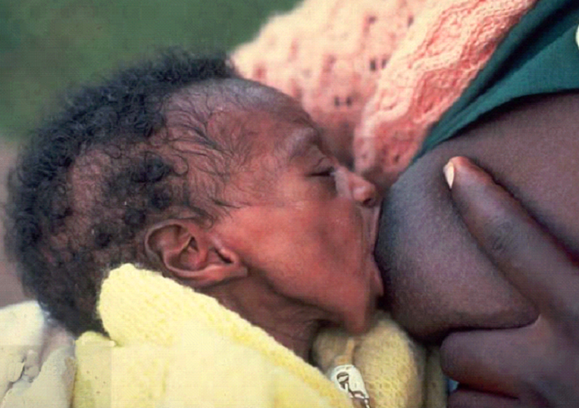
4/3

Slide 55
4/2

Slide 56
4/4

Slide 57
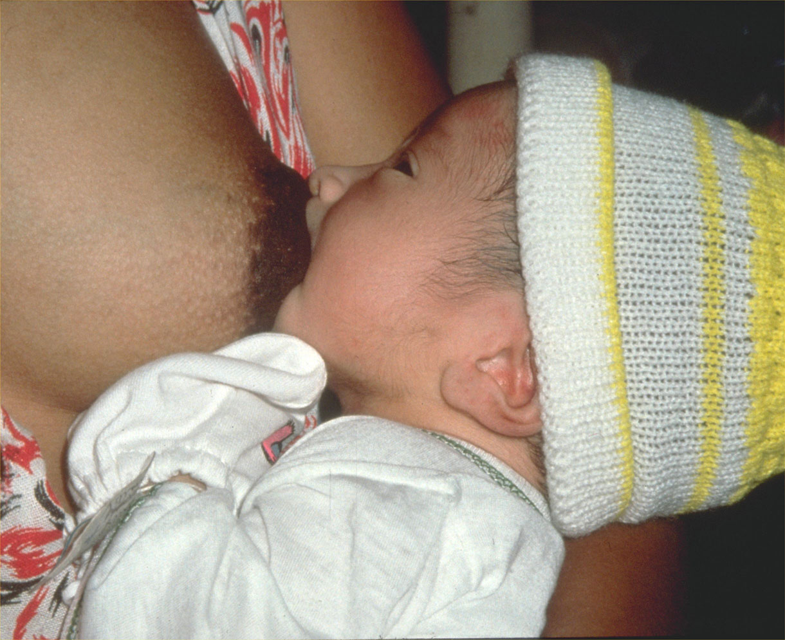
4/5

Slide 58
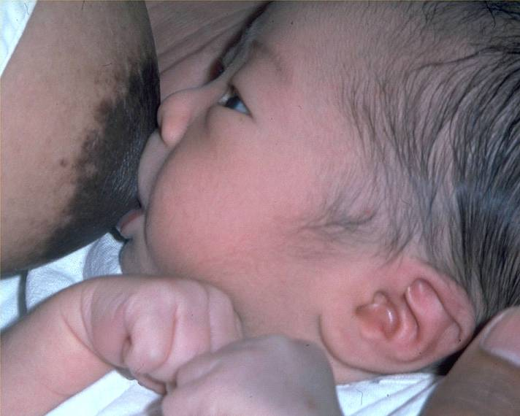
4/6

Slide 59
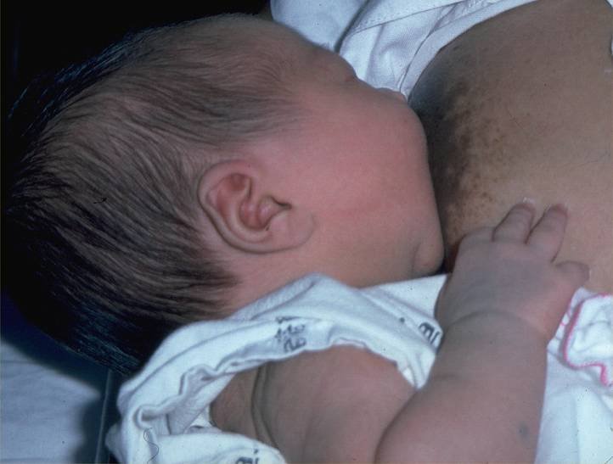
4/7

Slide 60
References
https://globalhealthmedia.org/videos/breastfeeding/ (MUST WATCH)
The Nursing Mother's Companion, 7th Edition – illustrates breastfeeding techniques.
Infant and young child feeding guidelines: 2010
Protecting, promoting and supporting Breastfeeding in facilities providing maternity and new-born services: the revised BABY-FRIENDLY HOSPITAL INITIATIVE (2018) - The role of facilities providing maternity and new-born services (page 18-28)

Slide 61
Questions

Slide 62
Summary
Breastfeeding is a learned process.
Support the mother by teaching her correct breastfeeding technique including :
      Mothers position
      Baby's position
      Holding the breast
      Latching on to the breast
      Technique of breastmilk expression by hand, explain storage of the breast milk
      Cup feeding.

