Slide 1
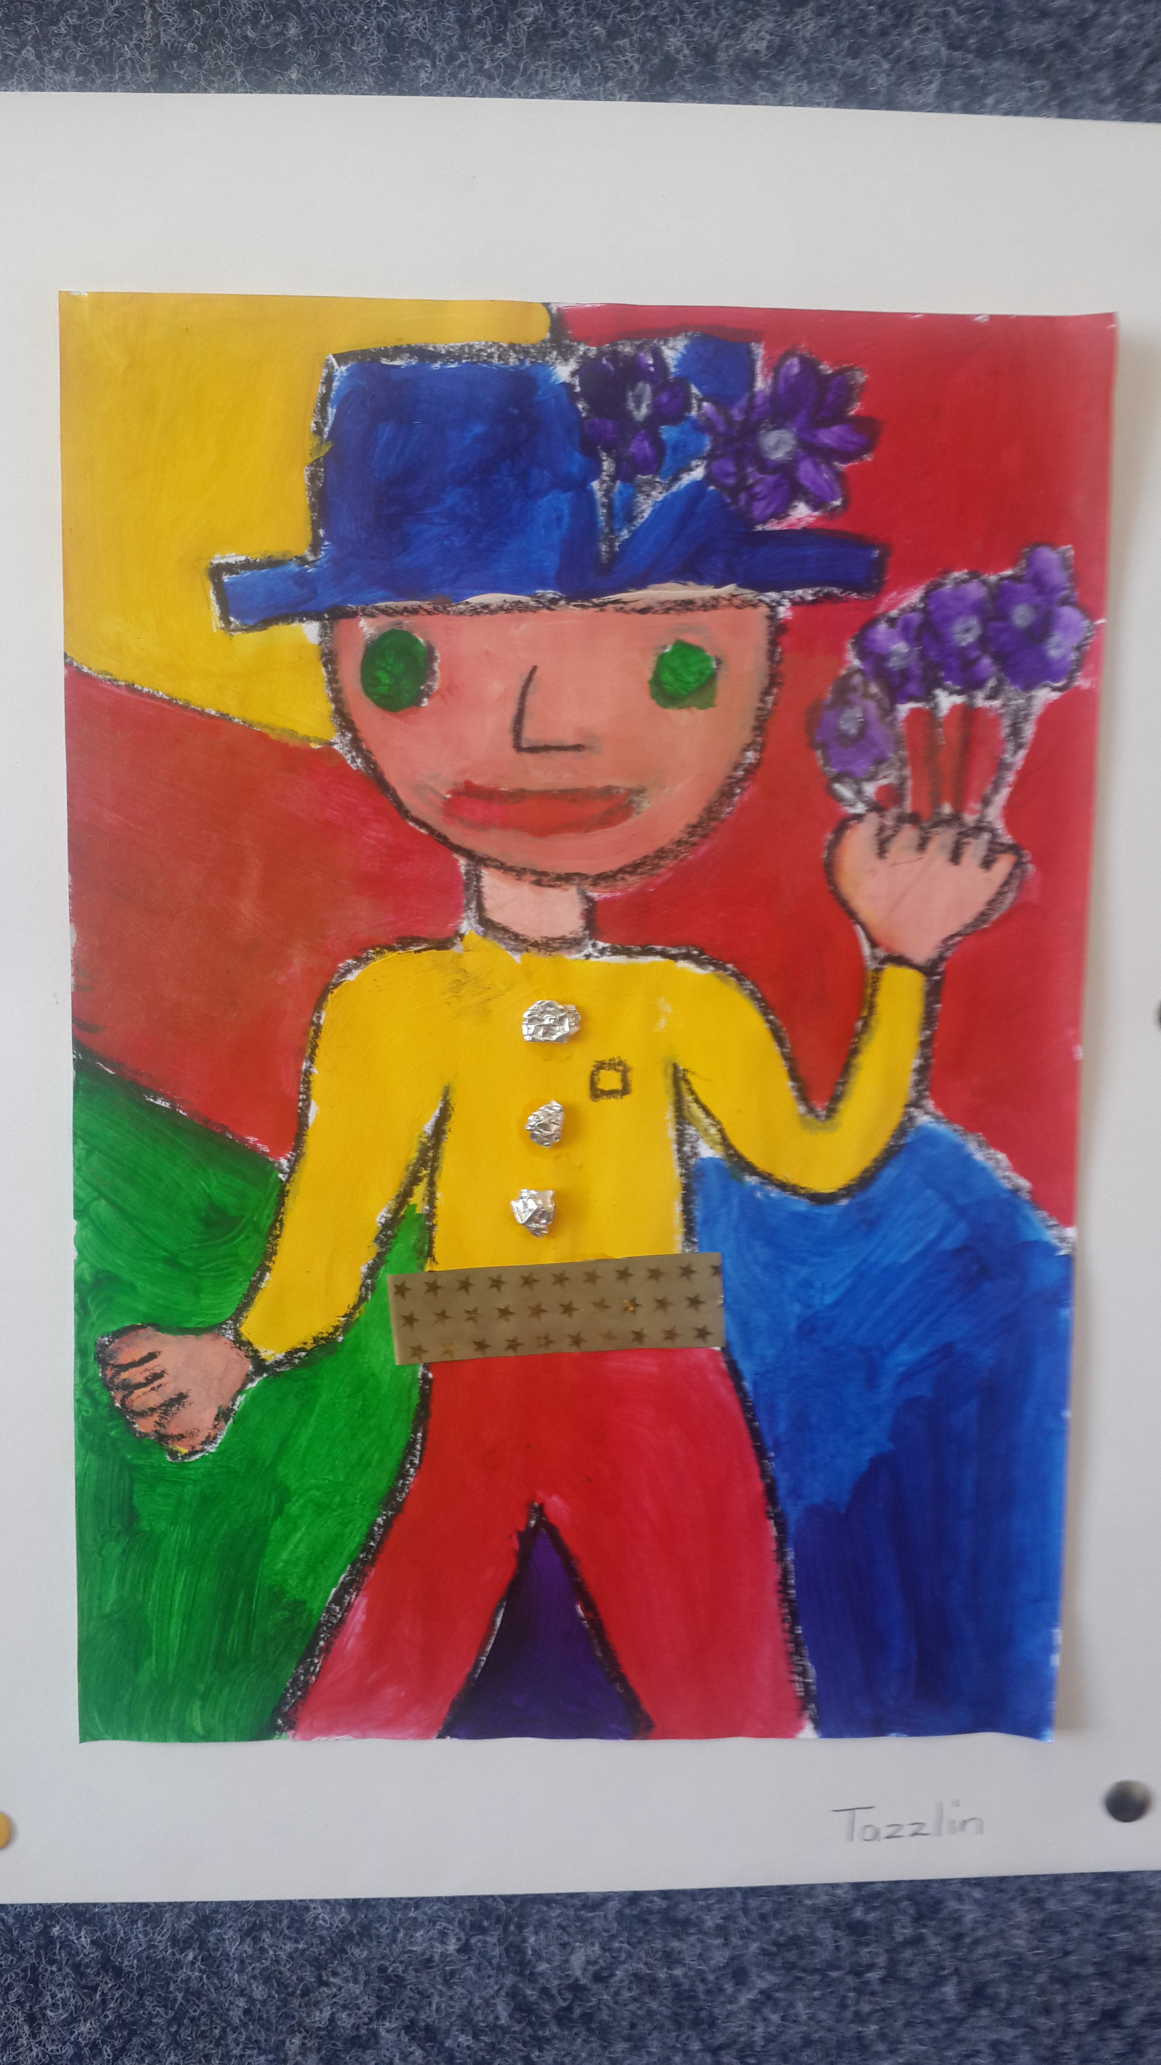
How to detect intrathoracic TB in children using the plain CXR.. & other imaging
Diana Marangu, MBChB-PhD
Undergraduate Lecture – Chest Radiograph
28th January 2020

Slide 2
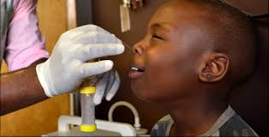
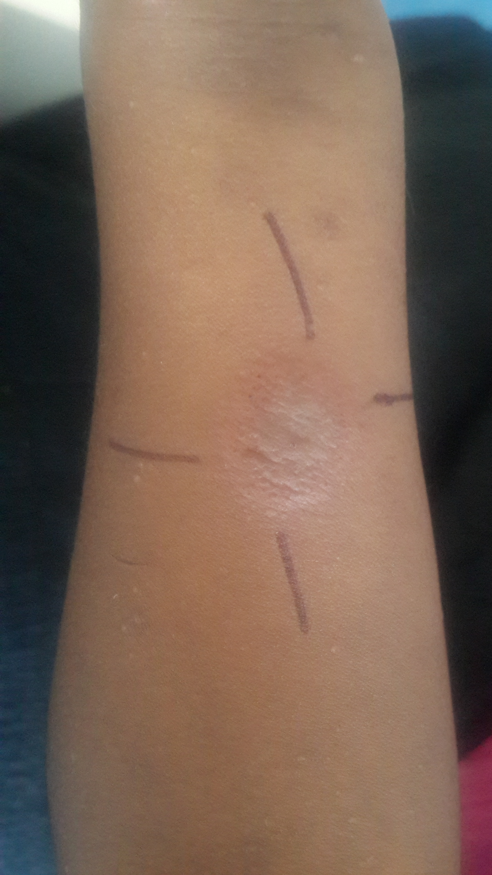
2017 Third Edition Kenya MOH National Guidelines on Management of Tuberculosis in Children.
https://www.google.com/url?sa=i&source=images&cd=&ved=2ahUKEwjY88-wnLrjAhWFz4UKHTOuAjQQjRx6BAgBEAQ&url=https%3A%2F%2Fchildhoodtb.theunion.org%2Fsystem%2Fresources%2Fattachments%2F000%2F000%2F031%2Foriginal%2FSW7_FINAL_NPA_Job_Aid.pdf%3F1493736400&psig=AOvVaw20YBbSzkLwsLf3D2ldNaFr&ust=1563393324790422

Slide 3
TB diagnosis in children
2017 Third Edition Kenya MOH National Guidelines on Management of Tuberculosis in Children.

Slide 4
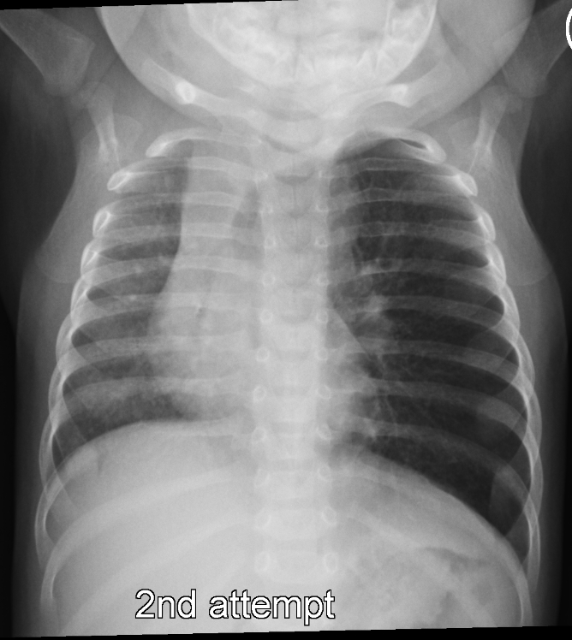
2017 Third Edition Kenya MOH National Guidelines on Management of Tuberculosis in Children.

Slide 5
Plain chest radiographs…
Biodata
Technical quality
Systematic approach (ABCD-EF)

Slide 6
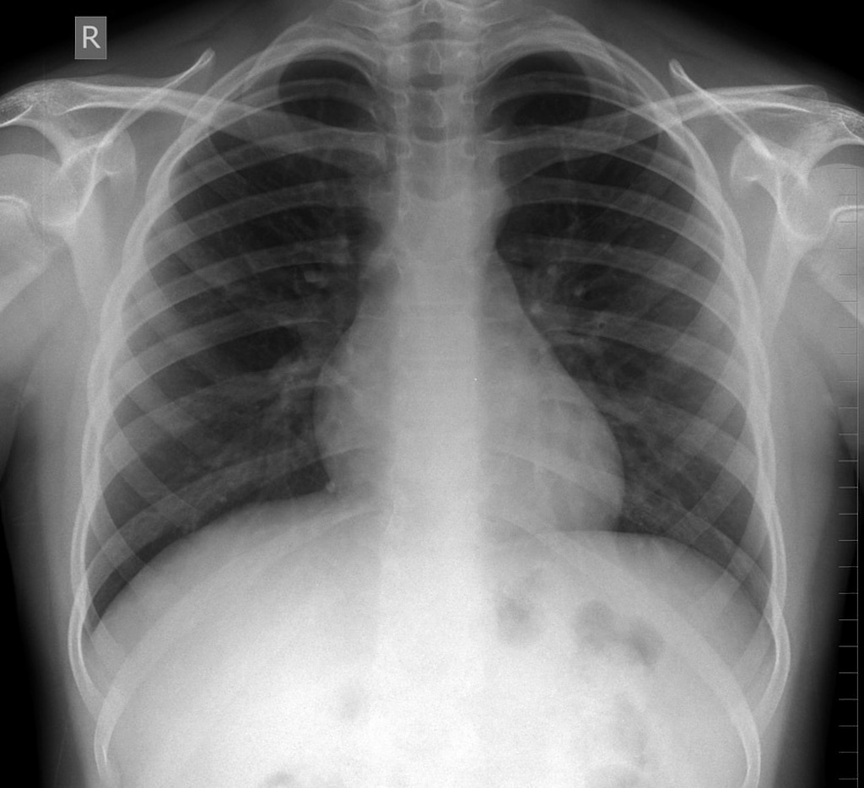
Approach to chest radiography
Biodata: Patient details, dates and time, any previous images View(AP/PA/Lateral), marker, collimation
Technical Quality: (RIP) Rotation, Inspiration, Penetration, Angulation
ABCDE-FGH
Notes:
Rotation: ends of the clavicle should be equidistant from the centre of the vertebral bodies;
Rotation may lead to misinterpretation of heart contours, tracheal position and lung appearances
Well penetrated: vertebrae are visible just behind the heart, lung tissue behind the heart can be visualized
Underpenetrated: ( white) the left hemidiaphragm is not visible to the spine. Lung tissue behind the heart cannot be assessed- overcall pathology
Over penetrated: vertebral bodies below the diaphragm: undercall pathology
Inspiration: 6 anterior ribs; 9 posterior ribs
When interpreting a chest X-ray it is important to recognise if there has been incomplete inspiration. If the image is acquired in the expiratory phase, the lungs are relatively airless and their density is increased. Also, the raised position of the diaphragm leads to exaggeration of heart size, and obscuration of the lung bases.
Angulation: lordotic
A- Airway: Trachea: central: Pulled vs pushed
: narrowing
B- Bones: Clavicles, anterior and posterior ribs, vertebral bodies: Fractures; Scoliosis; bone density
C- Cardiac- Cardiac site, size, shape and borders- borders of the heart and mediastinum should always be well defined and clear- Silhouette sign
Are the edges of the heart and diaphragm clear? Any opacities around those areas will cause a loss of the silhouette of these structures.
D- Diaphragm- Outline of the diaphragm on both sides should be clear and smooth. Rt hemidiaphragm should be slightly higher than the left. Cardiophrenic and costophrenic angles should be well defined. Pleural effusion: meniscus sign. No air under the diaphragm; Gastric bubble
E- Equal lung fields: scan from left to right all the way from top to bottom- equal radiolucency on both sides; Air bronchograms- visible air filled bronchi outlined by surrounding consolidation
Bat wing distribution : pulmonary edema
G: Gastric fundus: on the left side
H: Hilum and mediastinum: Hilum consists of main bronchus and pulmonary artery. Left side should be higher than the right; compare and see that one is not larger than the other. Mediastinum: silhouette sign should be clear

Slide 7
Structured approach! - ABCDE-FGH… etc.
A- Airway: Trachea: central; Pulled vs pushed; narrowing
B- Bones: Clavicles, anterior & posterior ribs, vertebral bodies: Fractures; Scoliosis; bone density
C- Cardiac- Cardiac site, size, shape and borders- borders of the heart and mediastinum should always be well defined and clear- Silhouette sign
D- Diaphragm- Outline of the diaphragm on both sides should be clear and smooth. Right hemidiaphragm should be slightly higher than the left. Cardiophrenic/costophrenic angles well defined. Pleural effusion: meniscus sign*. No air under the diaphragm; Gastric bubble
E- Equal lung fields: scan from left to right all the way from top to bottom- equal radiolucency on both sides; Air bronchograms- visible air filled bronchi outlined by surrounding consolidation. Bat wing distribution : pulmonary edema
G: Gastric fundus: on the left side
H: Hilum and mediastinum: Hilum consists of main bronchus and pulmonary artery. Left side should be higher than the right; compare and see that one is not larger than the other. Mediastinum: silhouette sign should be clear

Slide 8
Potential pitfalls…
POOR QUALITY -> can misinterpret hilar LN
NORMAL PULMONARY ARTERY –> mistaken for large LN
LARGE THYMUS –> common cause of widened mediastinum in a young child
Gie R. Diagnostic Atlas of Intrathoracic TB in Children.

Slide 9
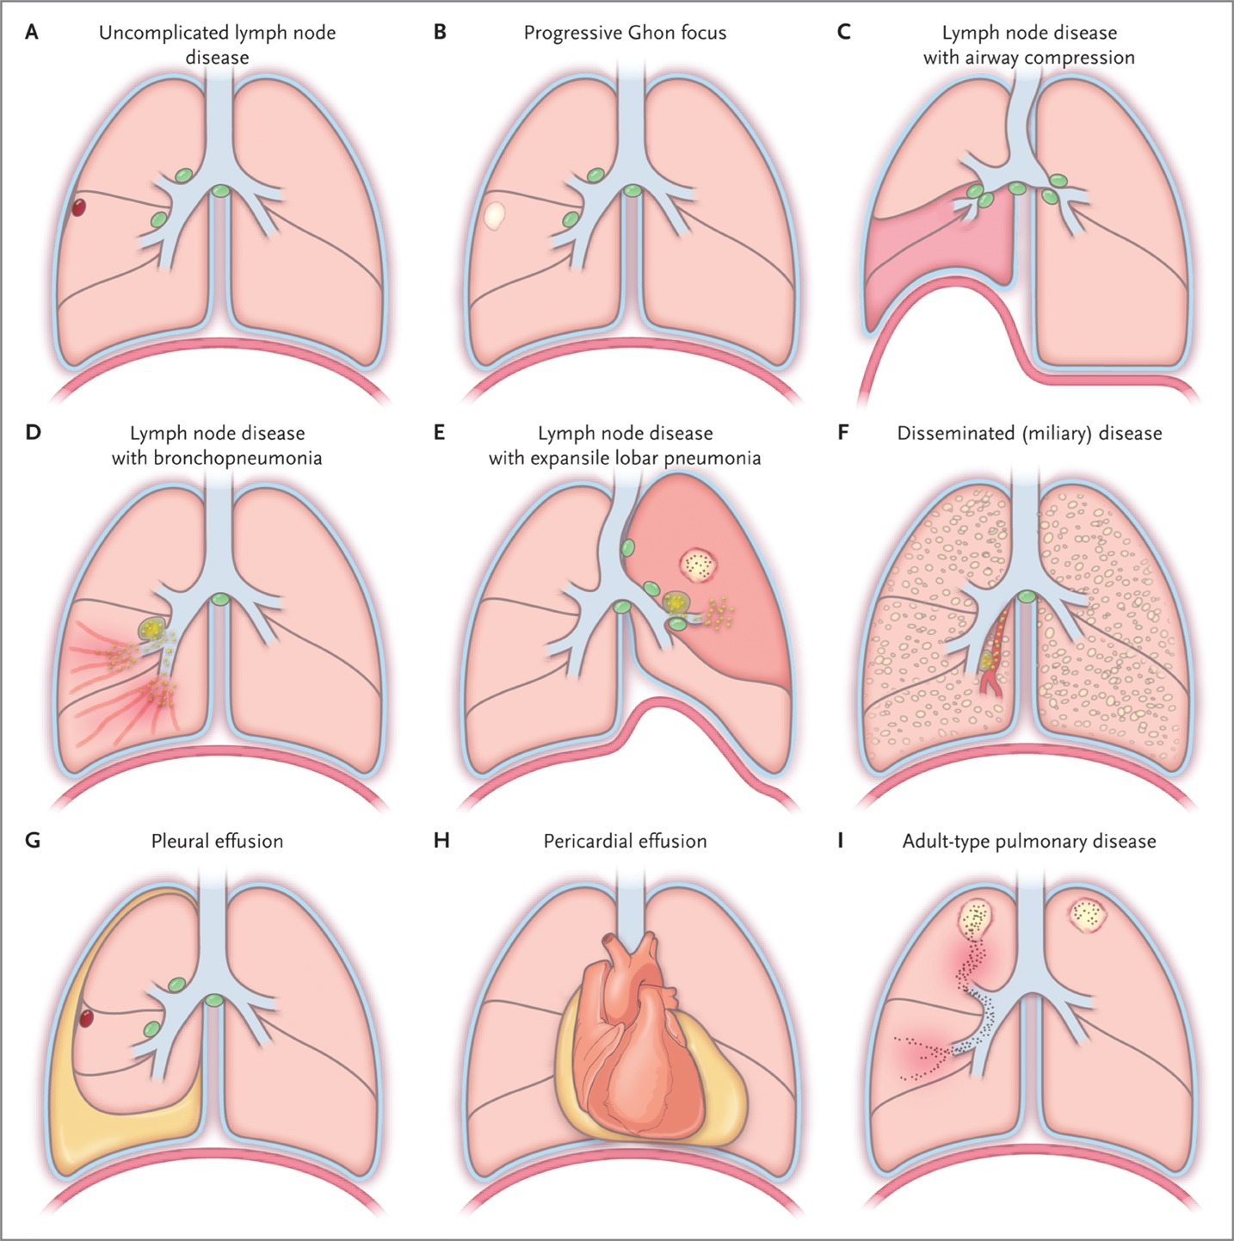
Clinical syndromes of intrathoracic TB in children
Immunopathogenesis, manifestation on imaging & diagnosis in children
Perez-Velez CM and Marais B. NEJM 2012; JID 2017

Slide 10
Uncomplicated lymph node disease
Uncomplicated R Hilar LN
Ghon focus NOT visible
Gie R. Diagnostic Atlas of Intrathoracic TB in Children.

Slide 11
Lateral CXR -> confirm Hilar Lymphadenopathy
? Paratracheal & Hilar LN
Massive Hilar LN
Gie R. Diagnostic Atlas of Intrathoracic TB in Children.

Slide 12
Previous calcified Ghon focus may simplify TB Dx
*Calcifications occur 1 year after infection
Left – mediastinal LN with lung infiltration
Calcified Ghon complex may indicate where the hilar & paratracheal LNs are situated
Calcified
Right Ghon Focus
Gie R. Diagnostic Atlas of Intrathoracic TB in Children.

Slide 13
Progressive Ghon focus
Ghon focus with cavitation (poorly contained) & bilateral bronchopneumonic consolidation.
Marais, B et al. Pediatr Radiol 2004.

Slide 14
Lymph node disease with airway compression
(a) Large Airway Obstruction –> both right and left main bronchi
CLINICAL PICTURE CAN BE CONFUSED FOR ASTHMA!
Gie R. Diagnostic Atlas of Intrathoracic TB in Children.

Slide 15
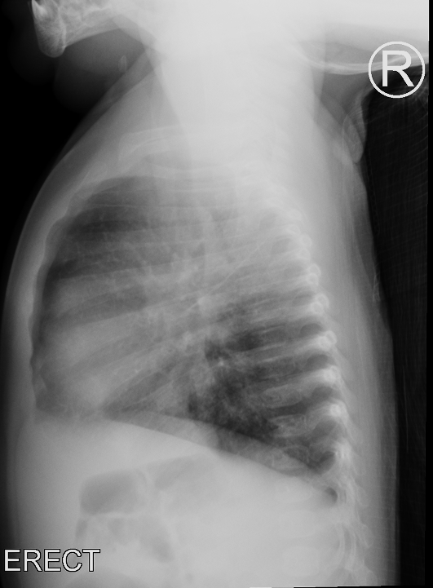
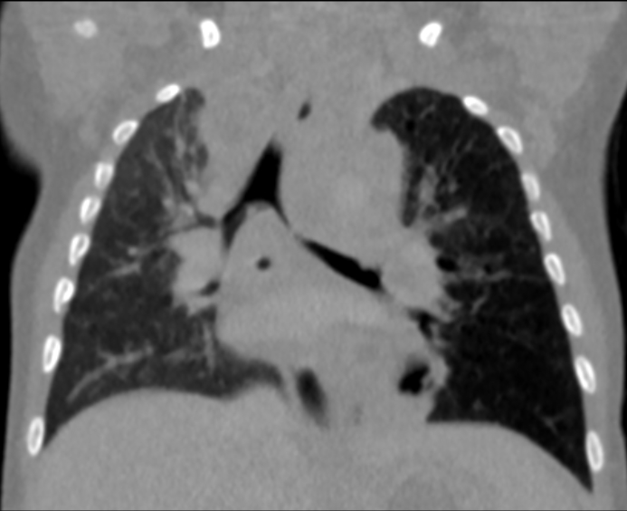
Lymph node disease with airway compression
(b) Unilateral Hyperinflation: Partial obstruction ->“Ball Valve effect”
Fellowship Training Case: L.B 2017

Slide 16
Lymph node disease with airway compression
(c) Lobar or segmental collapse –> due to complete obstruction
Lower lobe collapse
Gie R. Diagnostic Atlas of Intrathoracic TB in Children.

Slide 17
Lymph node disease with bronchopneumonia
Marais, B et al. Pediatr Radiol 2004.

Slide 18
Lymph node disease with expansile pneumonia
Lymph node ulcerates through the bronchus wall, causes occlusion of the bronchus as well as aspiration of infected material into the lobe. Continued immunological response in the lobe leads to the accumulation of infected material in the lobe. This process leads to expansion in the size of the lobe.
Marais, B et al. Pediatr Radiol 2004.

Slide 19
Disseminated (miliary) disease
Involvement of blood vessels by the primary complex -> large numbers of bacilli are then spread throughout the body and lead to the development of granulomas in all the involved organs.
Gie R. Diagnostic Atlas of Intrathoracic TB in Children.

Slide 20
Pleural effusion
Hypersensitive immune response to the tuberculoprotein in the pleural cavity. Occurs when the primary focus ruptures into the pleura cavity, releasing the tuberculoprotein and a small number of bacilli.
Marais, B et al. Pediatr Radiol 2004.

Slide 21
Pericardial effusion
Gie R. Diagnostic Atlas of Intrathoracic TB in Children.

Slide 22
Adult-type pulmonary disease
Alveolar consolidation and multiple cavities in the left upper lobe, leading to intrabronchial spread with segmental bronchopneumonia in the right upper lobe. Calcified mediastinal glands on the left suggest previous primary infection
*Overly aggressive innate immunity,
adaptive immunity, or both
Gie R. Diagnostic Atlas of Intrathoracic TB in Children.

Slide 23
Marais, B et al. Pediatr Radiol 2004.

Slide 24
Other chest imaging

Slide 25
CT Chest
To better characterize lesions: interstitial lung disease, lung tumors and metastases, hilar lymphadenopathy, congenital lesions
Lung window vs mediastinal window
High resolution CT: interstitial lung disease, bronchiectasis
CTA( CT angiography), reconstruction, virtual bronchoscopy
Notes:
Lung window: to assess parenchyma
Mediastinal window: hilar region and mediastinum
Bone window: bone
High resolution CT: narrow slice width 1-2mm; thin slices; skipped areas between the twin sections;
Standard CT: continuous images
Virtual bronchoscopy: fixed; doesn’t assess dynamic changes

Slide 26
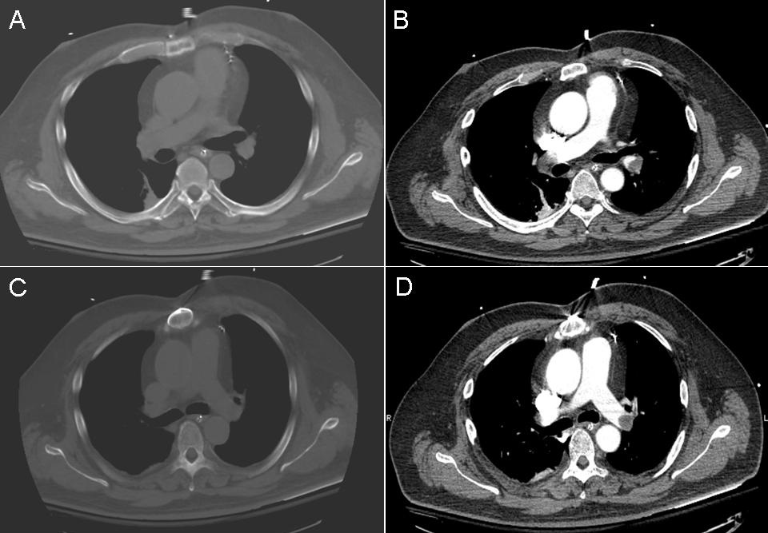

Slide 27
Chest Ultrasound:
Easy to use, portable
Characterize fluid collections-effusions, empyema, loculations;
Prenatal ultrasound : solid vs cystic lesions- CPAM
Point of care ultrasound: TB nodal disease
Air leaks- Pneumothorax: M mode bar code sign
Consolidation
Diaphragmatic paralysis: M mode bar code sign
Limitations: operator dependent; deeper structures not well visualized
Notes:
Bar code sign in pneumothorax

Slide 28
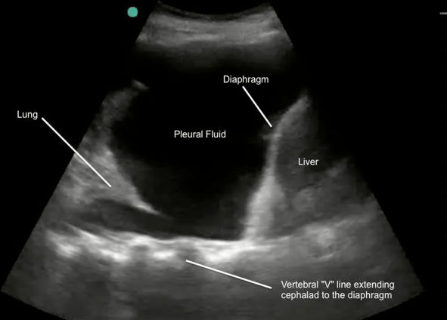
Notes:
How to perform pleural effusion EDE
Place the probe in the longitudinal plane on the posterior axillary line at the level of the xiphoid process
Find and centre the diaphragm
Identify the pleural cavity
Sweep the area for an effusion.

Slide 29
Fluoroscopy:
Evaluate for aspiration and swallowing using water soluble contrast
Evaluate for GERD
Evaluate for tracheooesophageal fistula H type
Diaphragmatic paralysis

Slide 30
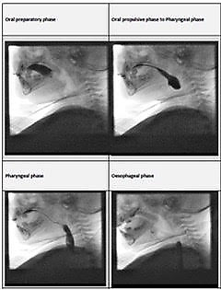
Phases of Swallowing in video fluoroscopy
Notes:
Oral phase
Oral propulsive phase
Pharyngeal
Esophageal phase

Slide 31
Scintigraphy
Milk scan to assess reflux
Shunts: AVM( pulmonary or extrapulmonary), hepatopulmonary syndrome
V/Q scan
Notes:
Milk mixed with radiocontrast then ingested.

Slide 32
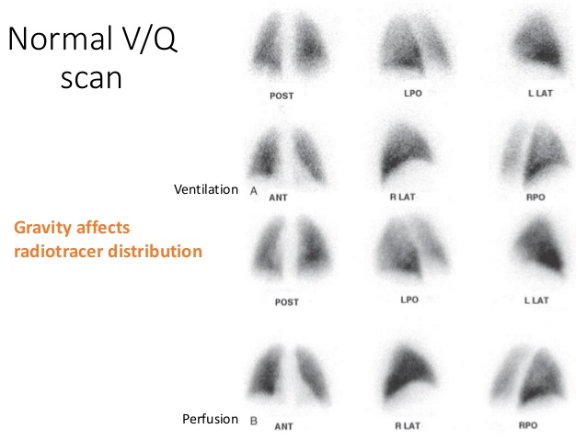
Notes:
A ventilation–perfusion (VQ) scan is a nuclear medicine scan that uses radioactive material (radiopharmaceutical) to examine airflow (ventilation) and blood flow (perfusion) in the lungs.
The aim of the scan is to look for evidence of any blood clot in the lungs, called pulmonary embolism (PE).
A VQ scan is carried out in two parts. In the first part, radioactive material is breathed in and pictures or images are taken to look at the airflow in the lungs. In the second part, a different radioactive material is injected into a vein in the arm, and more images taken to see the blood flow in the lungs.
This test is most commonly done in order to check for the presence of a blood clot or abnormal blood flow inside the lungs (such as a pulmonary embolism (PE) although computed tomography with radiocontrast is now more commonly used for this purpose.^{[2][3]} The V/Q scan may be used in some circumstances where radiocontrast would be inappropriate, as in renal failure.^{[4]}
A V/Q lung scan may be performed in the case of serious lung disorders such as chronic obstructive pulmonary disease (COPD) or pneumonia as well as a lung performance quantification tool pre- and post-lung lobectomy surgery.^{[5]}

Slide 33
Chest MRI
Follow up imaging- chronic lung disease; malignancy
Not commonly done in paediatrics: sedation; sensitive to motion

Slide 34

Ward E1 Mural: 2018
Red Cross Hospital

