Slide 1
PEDIATRIC AIRWAY
DR MACHARIA
23/10/2019

Slide 2
SCOPE OF THE LECTURE
Epiglottitis
Acute laryngotracheobronchitis (croup)
Retropharyngeal abscess
Tonsillar hypertrophy
Airway foreign body

Slide 3
1: EPIGLOTTITIS
Inflammation of the epiglottis and aryepiglottic folds
Commonly caused by Haemophilus influenzae type B and group A beta-hemolytic Streptococci
Can lead to acute airway obstruction
Is life-threatening hence requires urgent appropriate management

Slide 4
EPIGLOTTITIS
Clinical presentation:
Very rapid course of sore throat, difficulty swallowing and drooling
Others: Fever, difficulty speaking, muffling or changes in the voice, inspiratory stridor, severe dysphagia
Child sits upright with head held forward in severe respiratory distress
Notes:
Patients should be kept upright in a comfortable position
Airway management with oxygen therapy
Early tracheal intubation or emergency needle cricotracheostomy
IV fluids
IV steroids and antibiotics

Slide 5
EPIGLOTTITIS
Radiological features:
Soft tissue swelling of the epiglottis and aryepiglottic folds
Overdistension of the hypopharynx
*CT: Marked edema and thickening of the epiglottis and aryepiglottic folds, with narrowing of the airway

Slide 6
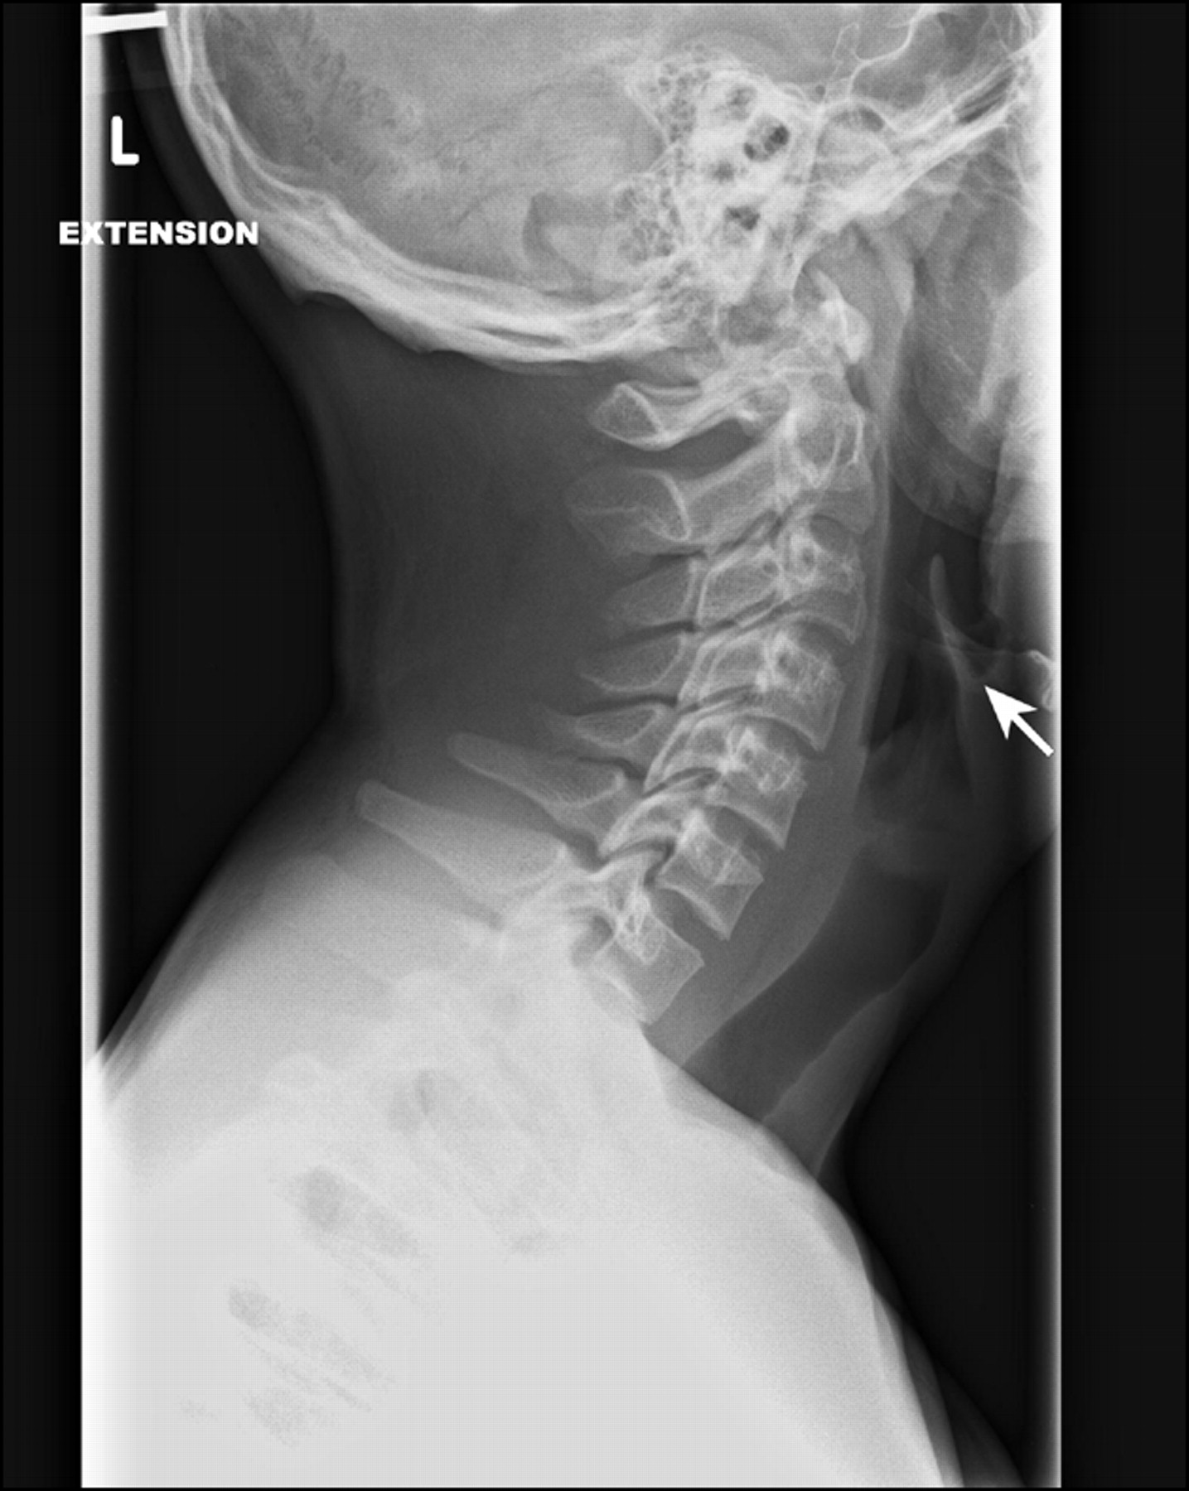
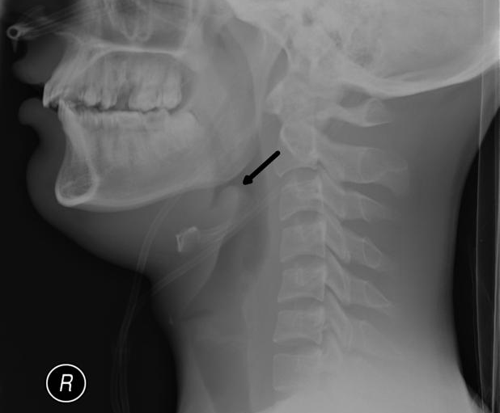
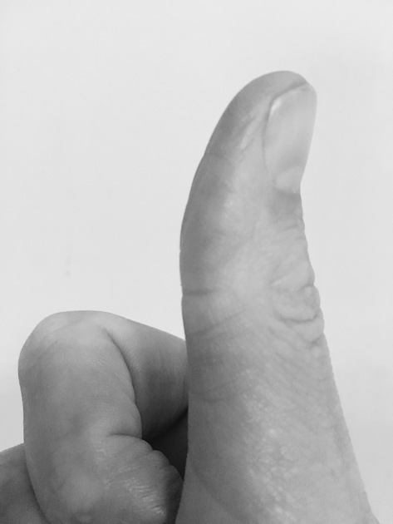
EPIGLOTTITIS
Radiological features:
Notes:
Intubation may be necessary to maintain the airway, so it is best not to take the patient out of the emergency department for imaging
A lateral soft tissue neck film should be taken in an upright position

Slide 7
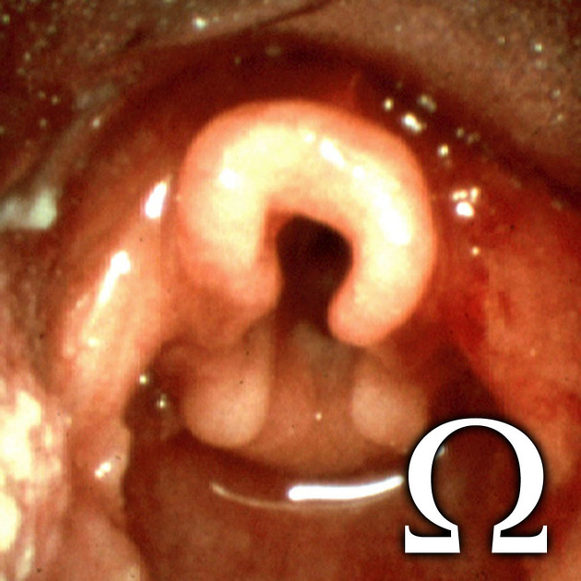
Imaging pitfall

Slide 8
2: ACUTE LARYNGOTRACHEOBRONCHITIS
A viral infection of the upper airway by parainfluenza virus or respiratory syncytial virus)
Clinical features:
Presents with protracted barking cough and inspiratory stridor due to mucosal edema resulting in tracheal narrowing
Imaging findings are not required for the diagnosis
Notes:
CROUP
Treatment is directed toward improving air exchange.
Conservative measures, including nebulised epinephrine (epinephrine) and corticosteroids, are commonly used

Slide 9
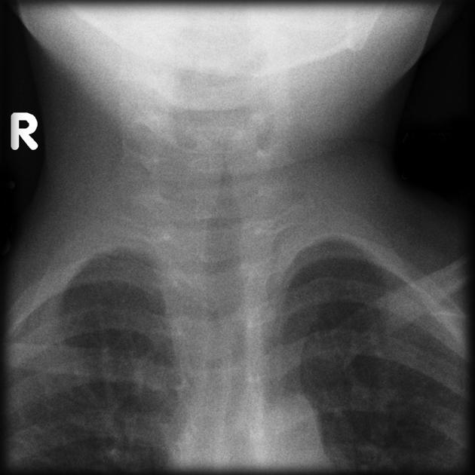
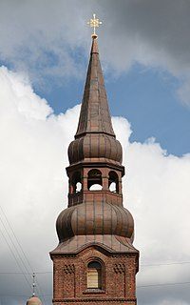
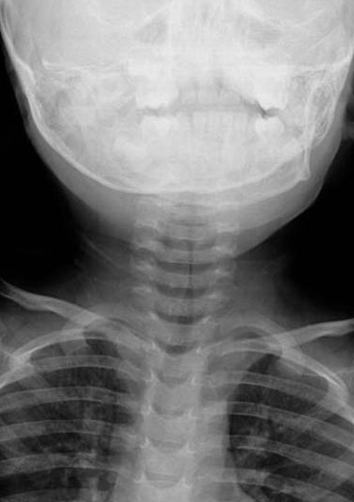
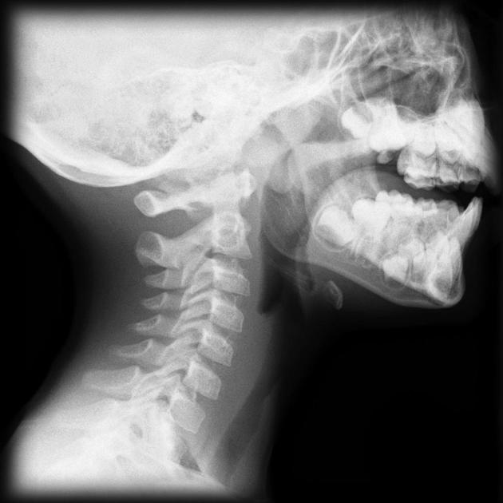
ACUTE LARYNGOTRACHEOBRONCHITIS
Radiological features:
Normal epiglottis & AP narrowing of subglottic trachea
Notes:
The steeple sign (wine bottle sign) refers to the tapering of the upper trachea on a frontal chest radiograph reminiscent of a church steeple
Ballooning of the hypopharynx.
Most importantly, the radiographic examination will also determine if there is a retropharyngeal abscess or an airway foreign body

Slide 10
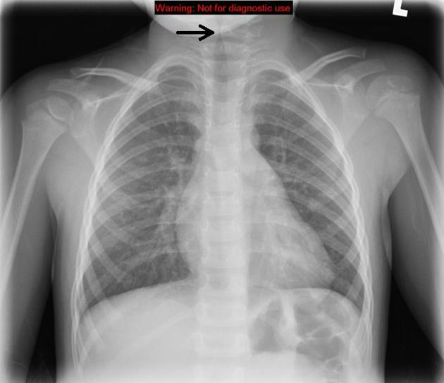
ACUTE LARYNGOTRACHEOBRONCHITIS
Radiological features:
Normal epiglottis & AP narrowing of subglottic trachea

Slide 11
3: RETROPHARYNGEAL ABSCESS
Results from infections of the retropharyngeal space mainly with streptococcal or staphylococcal organisms
Clinical features:
Fever, stiff neck, reticence to eat and cervical adenopathy
Potentially life-threatening hence requires prompt diagnosis and aggressive therapy
Notes:
May mimic epiglottitis

Slide 12
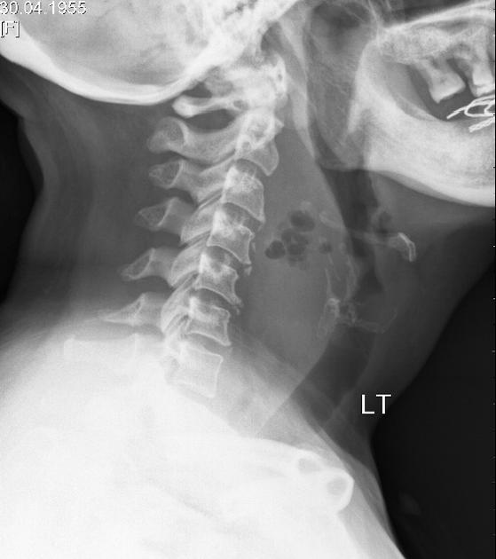
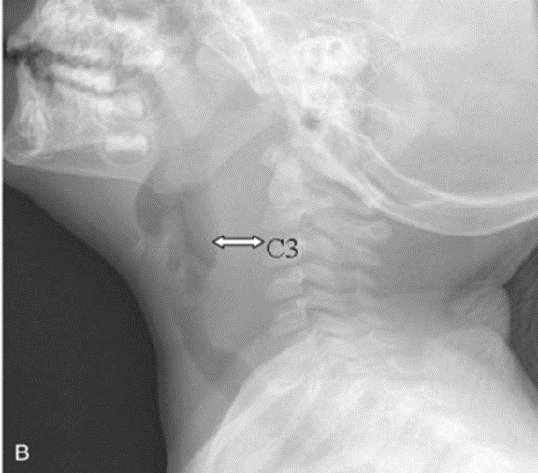
RETROPHARYNGEAL ABSCESS
Radiological features:
(a) Retropharyngeal soft tissue swelling; (b) widening of the prevertebral soft tissue stripe; (c) soft tissue gas

Slide 13
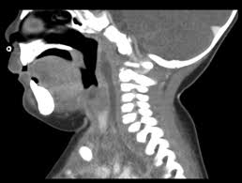
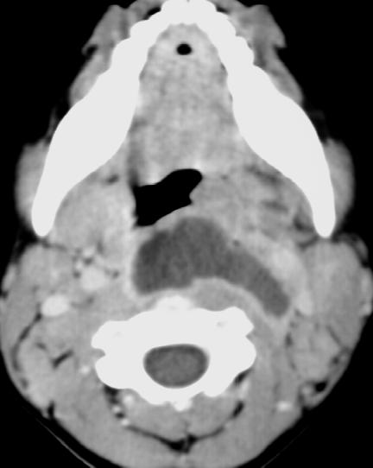
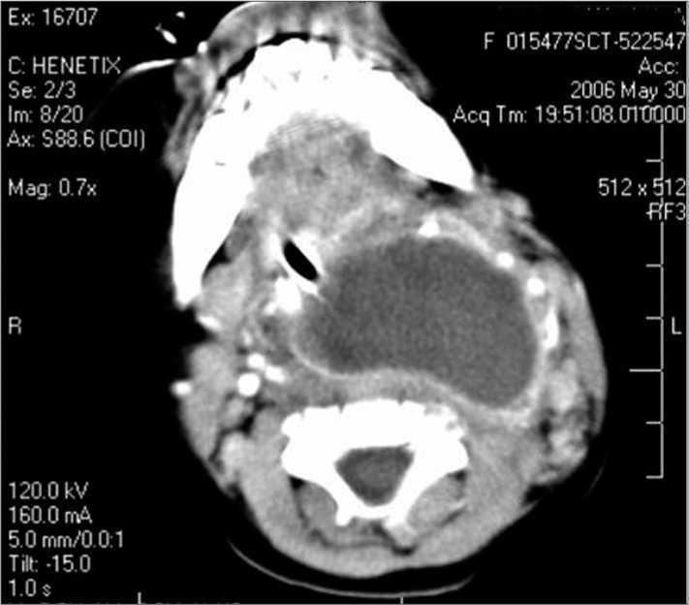
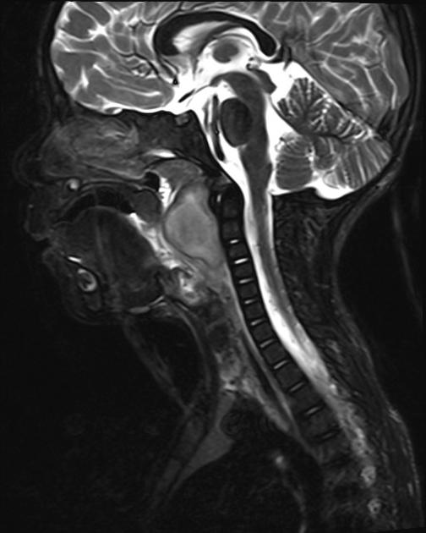
RETROPHARYNGEAL ABSCESS
Radiological features:
Neck CT is helpful to demonstrate the extent of the disease and to determine if there are drainable fluid collections

Slide 14
4: TONSILAR HYPERTROPHY
Enlargement of the lymphoid tissue that encircles the pharynx – mainly pharyngeal (adenoids), palatine and lingual tonsils
Enlarge secondary to infection and may obstruct nasopharynx and/or eustachian tubes
Sometimes bacterial pharyngitis can lead to a peritonsillar abscess (quinsy abscess)
Notes:
May mimic epiglottitis

Slide 15
TONSILAR HYPERTROPHY
Clinical features:
Painful throat, dysphagia, fevers, cervical lymphadenopathy, tonsillar exudate
Nasal congestion, adenoid facies, chronic or recurrent otitis media, swallowing difficulties, hyponasal speech, sleep-disordered breathing
Notes:
May mimic epiglottitis

Slide 16
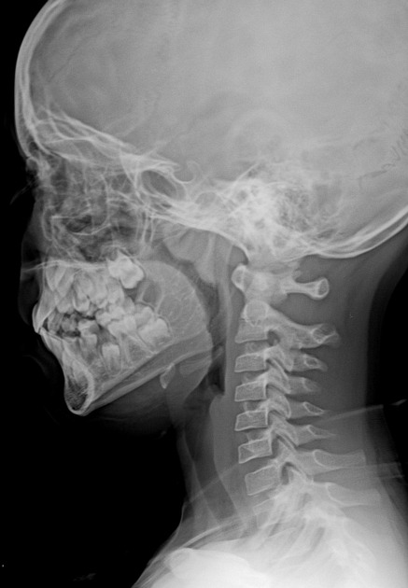
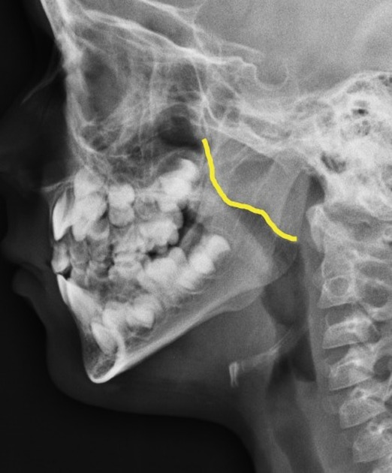
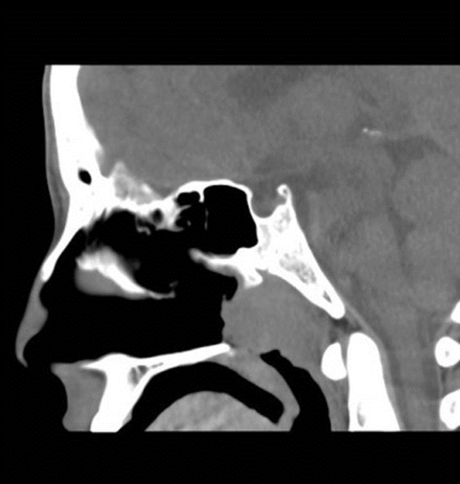
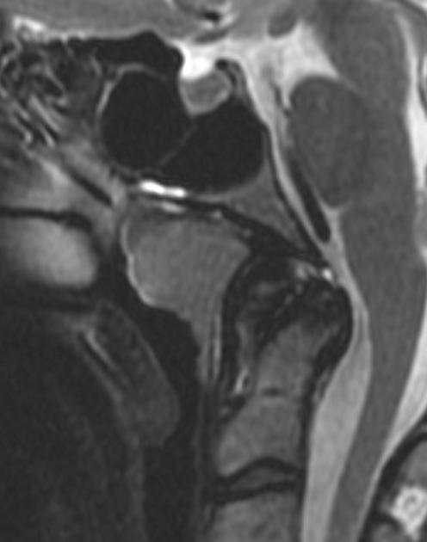
ADENOID HYPERTROPHY
Radiological features:
Mass in posterior nasopharynx (enlarged adenoids)
Notes:
May mimic epiglottitis

Slide 17
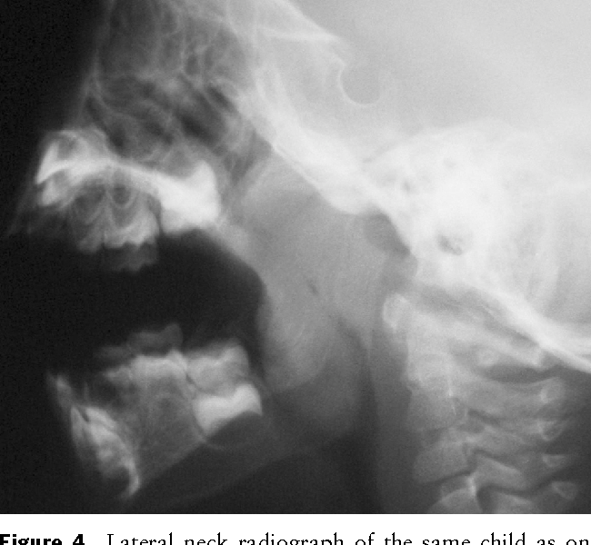
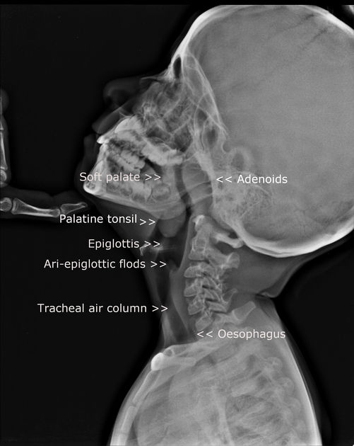
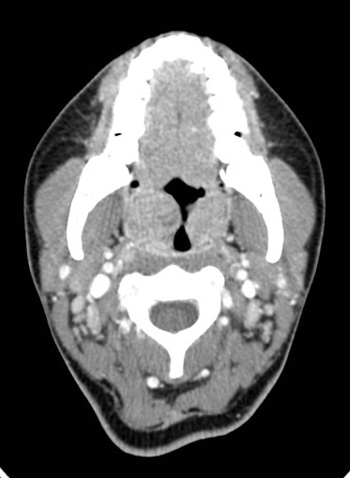
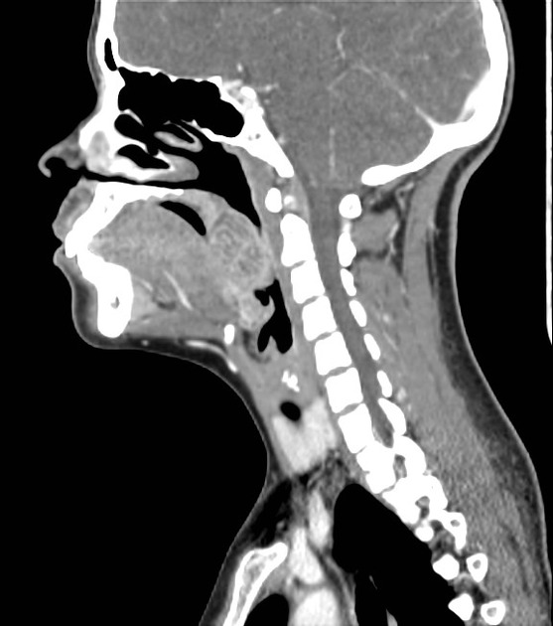
TONSILAR HYPERTROPHY
Radiological features:
Mass near end of uvula (palatine tonsils)
Notes:
May mimic epiglottitis

Slide 18
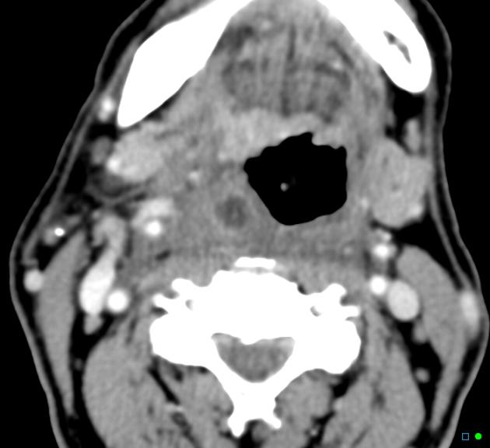
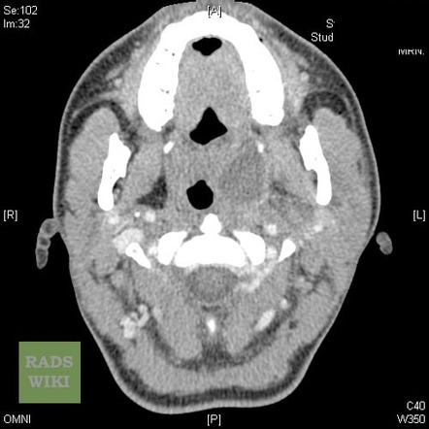
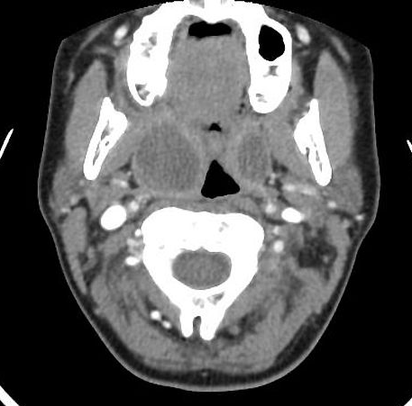
TONSILAR HYPERTROPHY
Radiological features:
CT is useful to determine the presence of a tonsillar abscess
Notes:
Peritonsilar (quinsy) abscess

Slide 19
5: AIRWAY FOREIGN BODY
Common cause of respiratory distress
Most children are witnessed to have had a choking event at the time of aspiration
Acute aspiration results in cough, stridor, wheezing
Chronic foreign body causes hemoptysis or recurrent pneumonia
Location: right bronchi > left bronchi > larynx, trachea
Notes:
Age: 6 months to 4 years.

Slide 20
AIRWAY FOREIGN BODY
Radiological features of bronchial foreign body:
Unilateral air tapping causing hyperlucent lung
Expiratory film or lateral decubitus makes air trapping more apparent
Lung collapse
Notes:
Atelectasis is uncommon, 10%
Only 10% of foreign bodies are radiopaque.

Slide 21
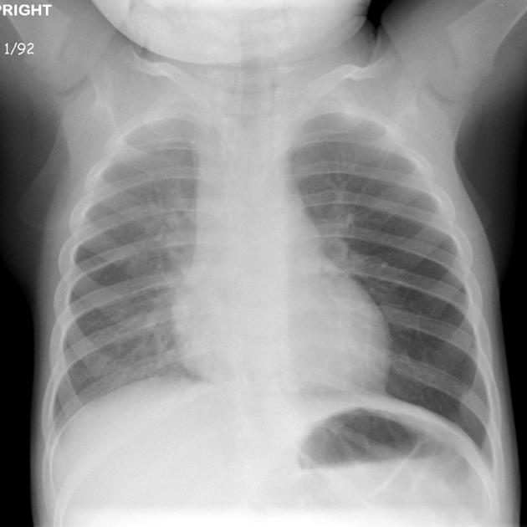
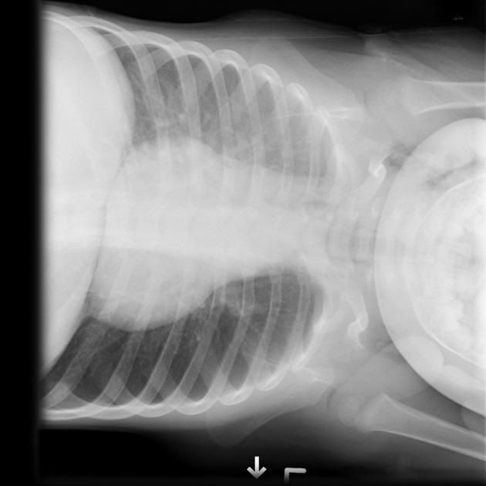
AIRWAY FOREIGN BODY
Radiological features of bronchial foreign body:
Notes:
Atelectasis is uncommon, 10%
Only 10% of foreign bodies are radiopaque.

Slide 22
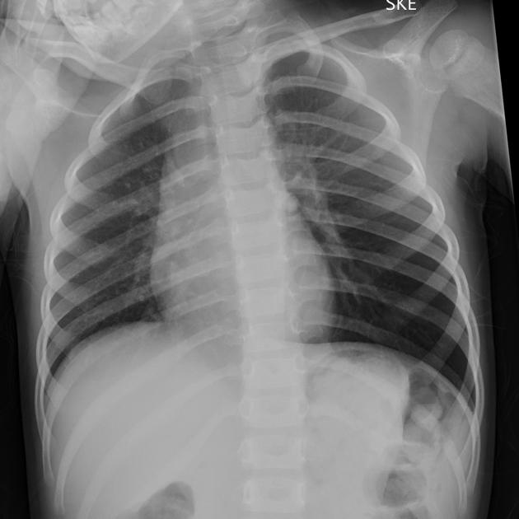
AIRWAY FOREIGN BODY
Bronchial foreign body:
The affected lung will usually appear overinflated and hyperlucent, with concomitant rib flaring and a depressed ipsilateral hemidiaphragm
Notes:
The patient should be radiographed on expiration: this will exaggerate the differences between the lungs
due to the check valve mechanism, where air enters the bronchus around the foreign body but cannot exit

Slide 23
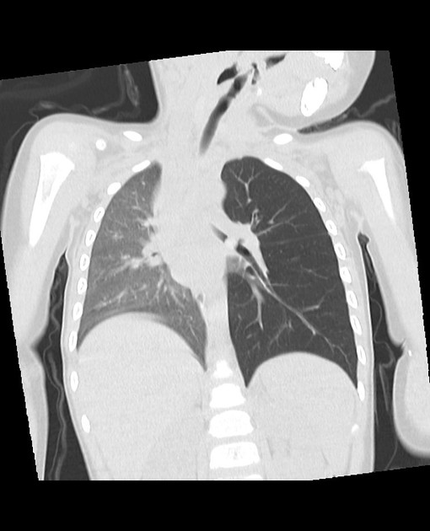
AIRWAY FOREIGN BODY
Bronchial foreign body:
The affected lung will usually appear overinflated and hyperlucent,
Depressed ipsilateral hemidiaphragm
Interrupted bronchus sign
Notes:
The patient should be radiographed on expiration: this will exaggerate the differences between the lungs
due to the check valve mechanism, where air enters the bronchus around the foreign body but cannot exit

Slide 24
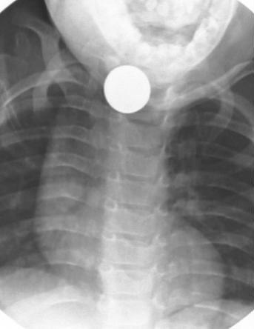
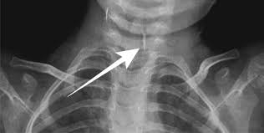
AIRWAY FOREIGN BODY
Tracheal and esophageal foreign body:
Notes:
Paint in a pipe

Slide 25
THE END

