Slide 1
Pneumonia in Children
Diana Marangu
Paediatrician & Pulmonologist
28th Jan 2020
*Updated Prof. Obimbo’s Slides

Slide 2
Pneumonia: Epidemiology, Diagnosis and Treatment
Epidemiology
Aetiology of pneumonia
Diagnosis & Classification
Investigations
Treatment
Prevention

Slide 3
Main Causes of Under-five mortality, African Region
1.2 million babies die in the first month
Almost 1 million children die from pneumonia
800,000 children die from malaria
763,000 children die from diarrhoea
30% of deaths associated
with MALNUTRITION
Source: WHO, World Health Statistics, 2009
Notes:
With the inclusion of neonatal pneumonia, respiratory disease is the number one cause of hospitalization and death in African children, with an estimated 35 million pneumonia cases and 1 million deaths every year. Out of every 2 children that die in the world from pneumonia, 1 is an African child.

Slide 4
Pneumonia kills more children than any other illness….
3.5
3.5
< 5 years old
> 5 years old
3.0
2.7
2.5
2.2
Deaths (millions)
2.0
1.7
1.5
1.1
0.9
1.0
0.5
0
Pneumonia
AIDS
Diarrhoea
TB
Malaria
Measles
Source: WHO
Notes:
4
Even among older children above the age of five years, as reflected in the red portion of the bars, pneumonia continues to be a significant cause of morbidity and mortality – ranking second only to HIV.

Slide 5
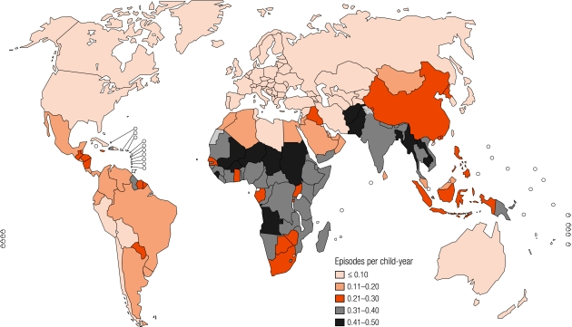
Incidence Childhood Clinical Pneumonia by Country 2007
Singh V et al, Paed Resp Reviews 2011. Rudan I et al, Bull WHO 2008. Wardlaw T et al, Lancet 2006
Notes:
This map graphically demonstrates the tragedy of high pneumonia incidence in Africa, with incidences as high as 0.5 per child year in some African countries, TEN TIMES higher than that of 0.05 per child year seen in developed countries.
Out of 15 countries in the world with the highest case-specific mortality rates for pneumonia, 11 are in Africa.
Rudan I, Boschi-Pinto C, Biloglav Z, et al. Epidemiology and etiology of
childhood pneumonia. Bull World Health Organ 2008; 86:408–416.
Wardlaw T, Salama P, Johansson EW, et al. Pneumonia: the leading killer of
children. Lancet 2006;368:1048–50.
Varinder Singh, Satinder Aneja. Pneumonia – Management in the Developing World.
Paediatric Respiratory Reviews 12 (2011) 52–59

Slide 6
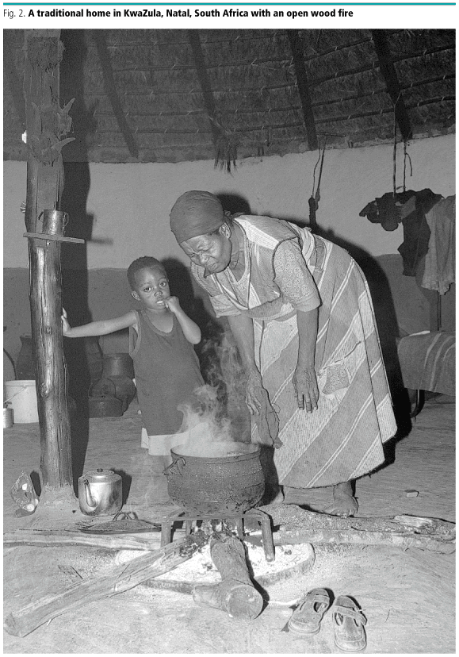
Factors contributing to High Pneumonia Morbidity & Mortality
Malnutrition:
  42% children moderate-severely stunted
  27% underweight
Indoor pollution: 78% use solid fuels for cooking, in rural areas 90%.
Poor access to health care
HIV / AIDS
Ref: UNICEF State of the World’s Children 2010. WHO World Health Statistics 2009. Rudan I, Bull WHO 2008.
Notes:
Why are African children so vulnerable to pneumonia? I will mention some of the major contributing factors:
The first is MALNUTRITION: 42% of African children have moderate to severe forms of malnutrition, therefore have weakened immunity and increased susceptibility to severe infections.
Another important factor is INDOOR POLLUTION: 90% of rural households in Sub-Saharan Africa use solid fuels for cooking, most cooking done indoors.
The third factor is - Poor access to health care, and the fourth is
HIV infection – We shall examine the latter two factors in greater detail in the next few slides.
Find pictures to illustrate: Evidence suggests that 30% of all under-five mortality is associated with malnutrition, (and that …..% of children hospitalized with pneumonia have HIV.)…MOVE TO HIV SECTION
UNICEF State of the World’s Children 2010.
WHO World Health Statistics 2009
UNAIDS Global Report 2010.
Rudan I, Bull WHO 2008.

Slide 7
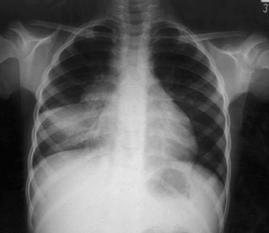
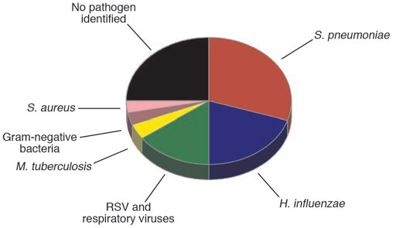
Causes of pneumonia in the developing world
Scott et al., J Clin Invest 2008;118:1291-1300

Slide 8
Important considerations, aetiology
African studies – children frequently have >1 infecting microbe: bacteria + TB, or bacteria + virus
After introduction of pneumococcal and HIB vaccines, other causes of pneumonia will assume increased importance....
  Staphylococcus aureus
  Klebsiella pneumoniae
  Mycoplasma pneumoniae
  Mycobacterium tuberculosis
  Pneumocystis jirovecii
  Respiratory syncitial virus (RSV), other viruses
HIV infected children may have...
  normal pathogens, but higher level of antibiotic resistance
  atypical, opportunistic microbes

Slide 9
WHO guidelines for diagnosis and management of pneumonia (WHO)

Slide 10
Diagnosis and Classification of Pneumonia
Presence of Cough PLUS
Oxygen saturations <90%
Cyanosed?
Unable to drink?
Reduced level of consciousness?
Grunting (infants)?
Y
Severe Pneumonia
RR ≥ 50 aged 2 –11 months?
RR ≥ 40 aged 12 – 59 months?
Lower chest wall indrawing?
Y
Pneumonia
Y
None of the above?
No Pneumonia
Notes:
As a result of this research the WHO proposes a classification of pneumonia based on key signs – this is part of the IMCI (and previously the ARI) programme.
Working from the severe end downwards one can check for only a few signs in a child with cough and difficulty breathing and classify into one of four categories that provide a measure of the severity of the child’s disease.
Once the severity is classified it becomes easier to decide who should be in hospital – only those with severe or very severe pneumonia.
There is evidence that this classification works to identify those at greatest risk of death and thus most in need of hospital care (see pneumonia severity of disease summary).

Slide 11
Clinical investigations
Pulse oximetry
Chest x-ray
  effusion, pneumothorax, LIP, pericardial effusion
Full blood count
Blood cultures
Other Ix guided by clinical presentation, e.g.
  Pleural aspiration for effusion/empyema
  Induced sputum for TB, PCP
  Nasal/oropharyngeal swab for respiratory viruses

Slide 12
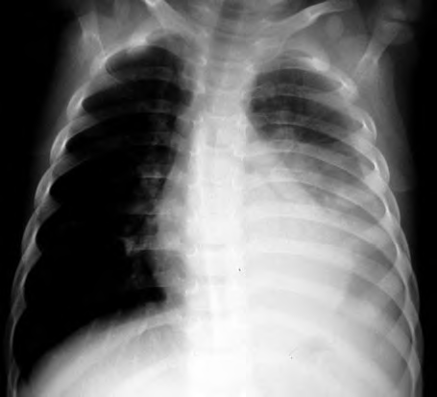
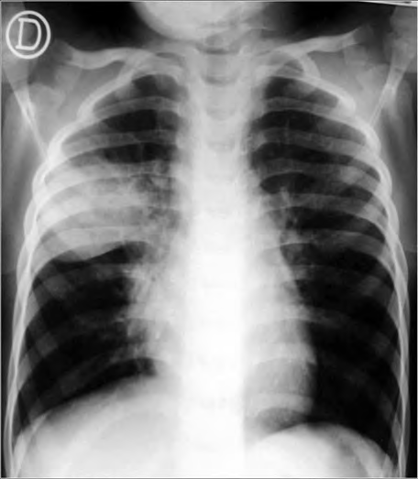
6 year old left pneumonia + effusion
Right upper lobe pneumonia

Slide 13
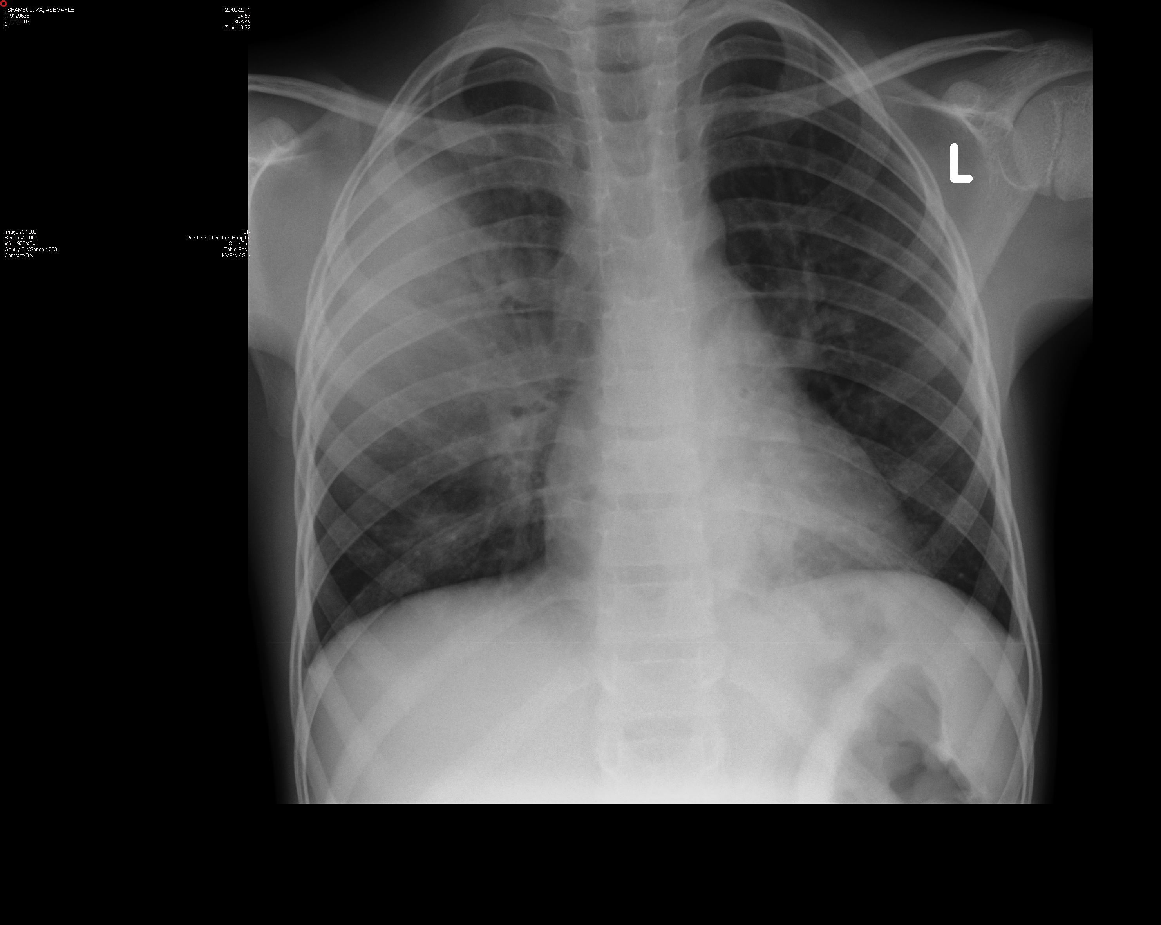
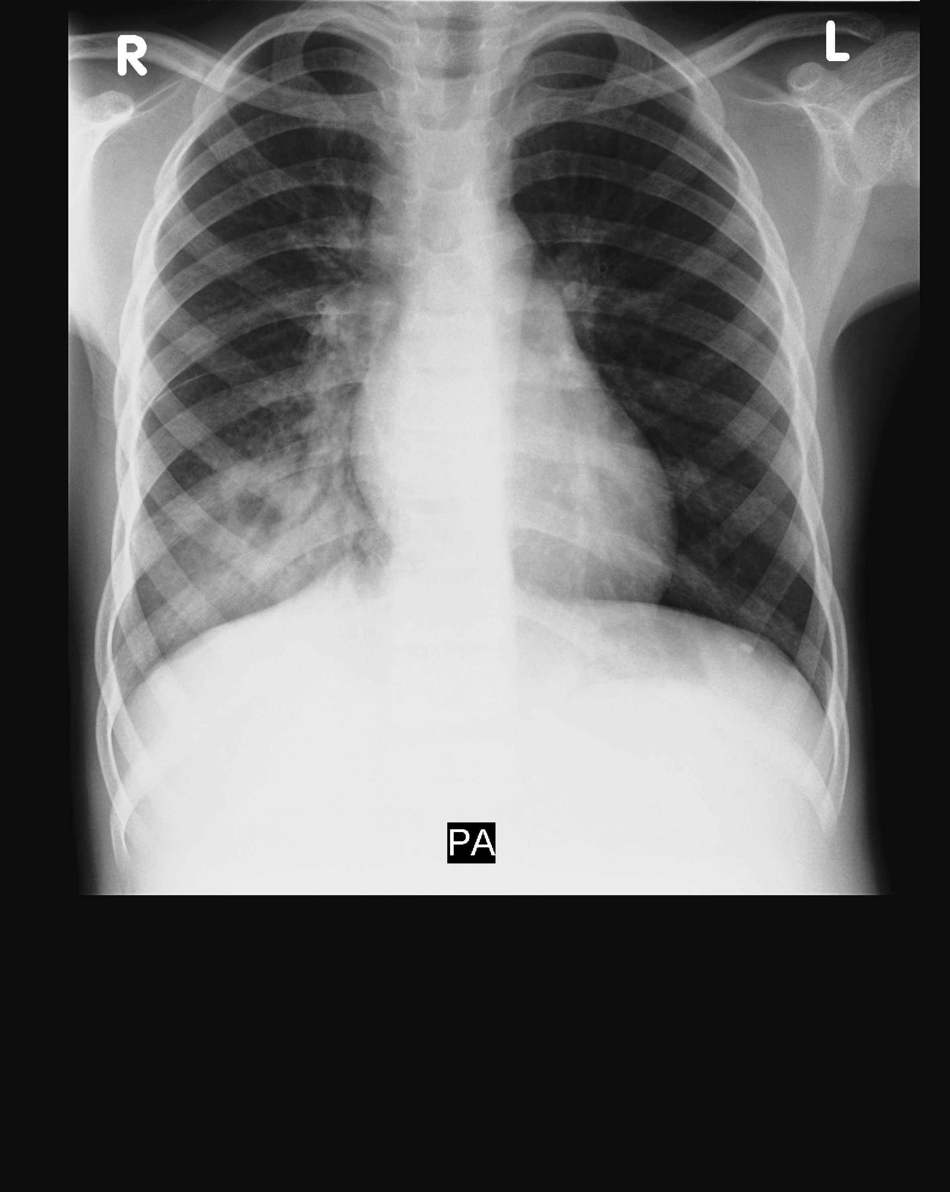
Right middle lobe pneumonia
Right lower lobe pneumonia

Slide 15
Antibiotic therapy for pneumonia: known or suspected HIV
Pneumonia severity | First line therapy | Second line therapy if not improving at 48 hours (first assess for complications)
Pneumonia | Amoxicillin (5 days) | 2nd line antibiotic
Severe Pneumonia | Ampicillin + Gentamicin 10 days Add 3w high dose cotrimoxazole if 2-11m old or features of PCP. | Ceftriaxone (or Cloxacillin + Gentamicin) plus high dose cotrimoxazole

Slide 16
Supportive therapy for pneumonia
Oxygen (esp. if SaO₂ <90%)
Bronchodilators (if significant wheeze)
Suction secretions as required
Ensure adequate hydration
Regular monitoring

Slide 17
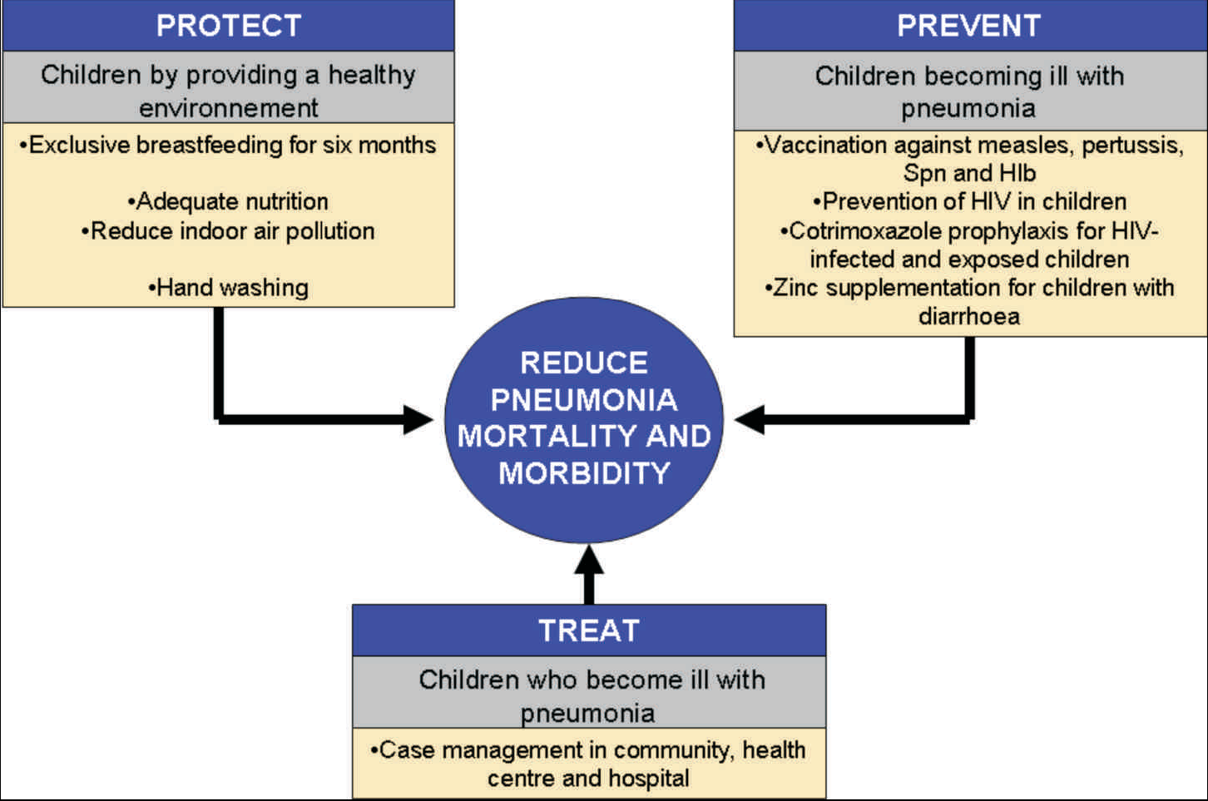
Framework for Prevention & Control of Pneumonia
Source: Global Action Plan for Prevention and Control of Pneumonia (GAPP), UNICEF/ WHO, November 2009
Notes:
Pneumonia is the second leading cause of child deaths, after neonatal conditions. Pneumococcus is the most important cause of pneumonia.
WHO estimates that in 2000 there were 824,000 deaths from pneumococcal diseases in children aged under-five years. Over 90% pneumococcal deaths in children are in Africa and Asia. Effective interventions exist for prevention and management of pneumonia. However, combined use of these interventions at country level is inadequate.
No single approach will fully address the problem of pneumonia, which requires prevention (vaccination: pertussis, measles, Hib and PCV), case management (at community and health facility levels) as well as risk factor modification (environmental pollution, nutrition, etc.). Implementation at scale of a package of interventions using integrated approach could reduce overall child mortality by up to 20% and be highly cost-effective[1].
The priority interventions for pneumonia control as determined by the global action plan for pneumonia control and prevention (GAPP) are as follows:
Main interventions
Immunization (increase coverage with measles and pertussis and introduce Hib and PCV)
Case management (particularly community case management) and promotion of care-seeking
Additional interventions
Zn supplementation, initially through treatment of diarrhoea
Promotion of exclusive breastfeeding up to six months
Interventions to reduce low birth weight
MTCT prevention and co-trimoxazole prophylaxis (in HIV endemic population)
Measures to reduce indoor air pollution (e.g. special stoves)
Hand washing
[1] Niessen L et al – Bull WHO in press

Slide 18
ASANTE!

