Slide 1
RESPIRATORY DISTRESS IN THE NEWBORN
UNIVERSITY OF NAIROBI
DR SEHDEVA
MMED RADIOLOGY
THIRD YEAR
09/10/2019

Slide 2
RESPIRATORY DISTRESS
Tachypnea >60bpm
Nasal flaring
Retraction
Grunting
Cyanosis
Desaturation
Decreased air entry

Slide 3
Neonatal Respiratory Distress
Medical Causes
Transient Tachypnea of the Newborn Meconium Aspiration Neonatal Pneumonia Respiratory Distress Syndrome (Surfactant Deficiency)
Surgical Causes
Congenital Diaphragmatic Hernia Congenital Lobar Emphysema Sequestration CPAM

Slide 4
TRANSIENT TACHYPNOEA OF THE NEW BORN (TTN)
Wet lung disease/ retained fetal fluid disease
Epidemiology: Usually near term or term babies. 1-2% of all neonates. M=F
Clinical presentation:
Tachypnea within 6 hrs. after birth.
Spontaneous improvement within 48hrs
Pathology: build up of fluid in the lungs due to reduced mechanical squeeze and removal of amniotic fluid
risk factors:
Treatment
supportive
Prognosis
good

Slide 5
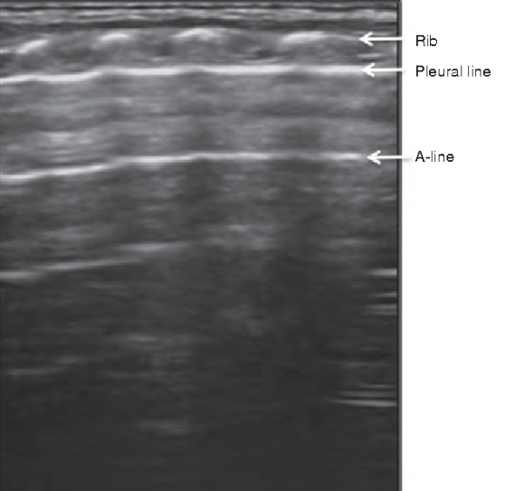
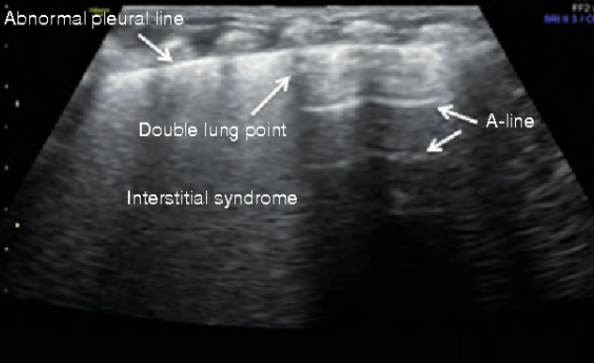
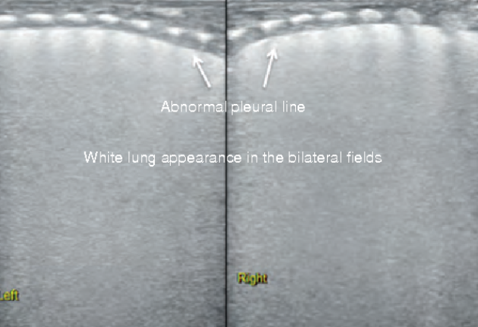
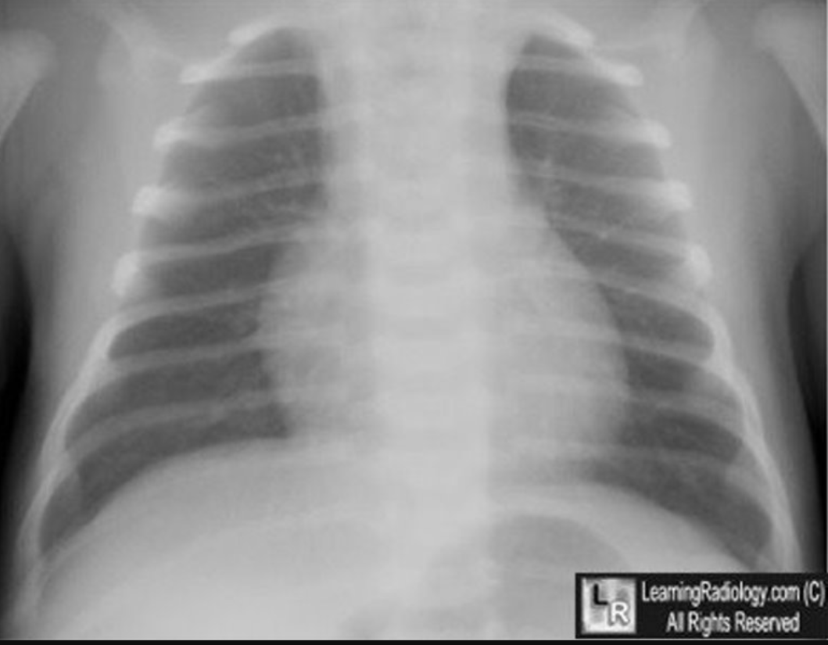
TTN
CXR
Normal to slightly hyperinflated
Prominent perihilar vascular markings
Pleural effusions
Fluid in the fissures
Pulmonary edema
1-Bob Jarman. Emergency point of care ultrasound.2017. ISBN : 9780470657577
Liu J, Chen XX, Li XW et al, lung ultrasonography to diagnose transient tachypnea of the newborn.2016.chest. 149 (5) 1269-75
Ultrasound images courtesy of jing liu, yan wang. Medicine. Volume 93, number 21, December 2014
Chest radiographs courtesy of learning radiology.com. 5 common causes of neonatal lung disease.
Notes:
Prominent perihilar streaking due to engorgement of perilymphatic
Fluid in the minor fissure
Prominent fuzzy pulmonary vascular markings
Hyperinflation of the lungs, depression of the diaphragm
Clearing by 12 to 18hrs. Complete resolution by 48 to 72 hrs.
Double lung point sign-sharp boundary btwn relatively aerated sup lung fields and coalescent b lines.

Slide 6
RESPIRATORY DISTRESS SYNDROME (RDS)/ Hyaline membrane disease
Epidemiology:
MCC of respiratory distress in premature
6 per 1000 neonates. M=F
Clinical presentation: Respiratory distress in first few hours of birth.
Pathology:
immature type II pneumocytes-insufficient surfactant-alveoli collapse.
Uncommon after 36 weeks of gestation
Risk factors-maternal diabetes, greater prematurity, perinatal asphyxia
Treatment
Supportive
Surfactant administration
Steroid in utero
Prognosis
Poor in kenya
2- Agrons GA, Courtney SE, Stocker JT et al, archives of AFIP: Lung disease in premature neonates : radiologic-pathologic correlation. Radiographics. 25 (4):1047-73
3-Liszwaki MC, Lee y. neonatal lung disorders/;pattern recognition approach to diagnosis. 2018. AJR. 210(5) 964-975.

Slide 7
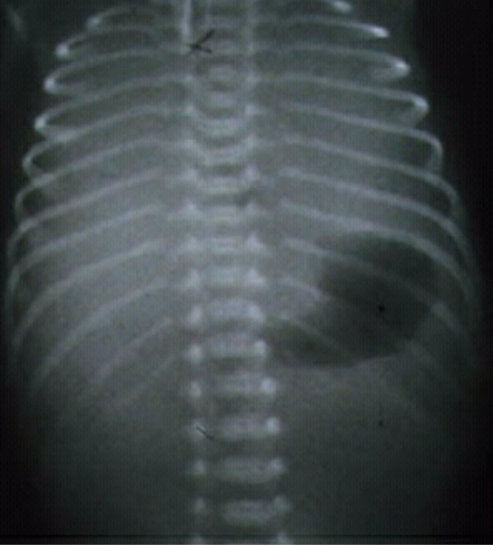
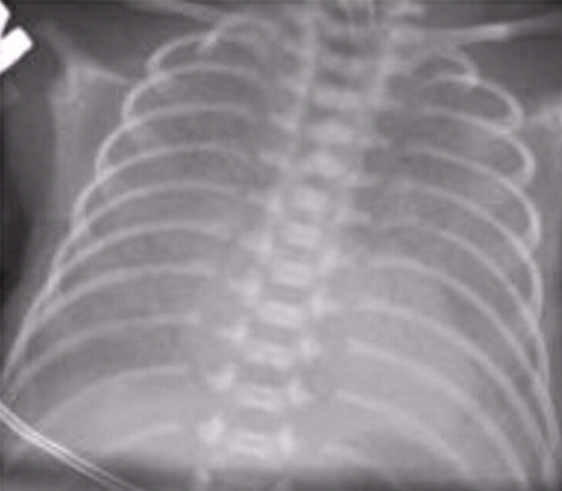
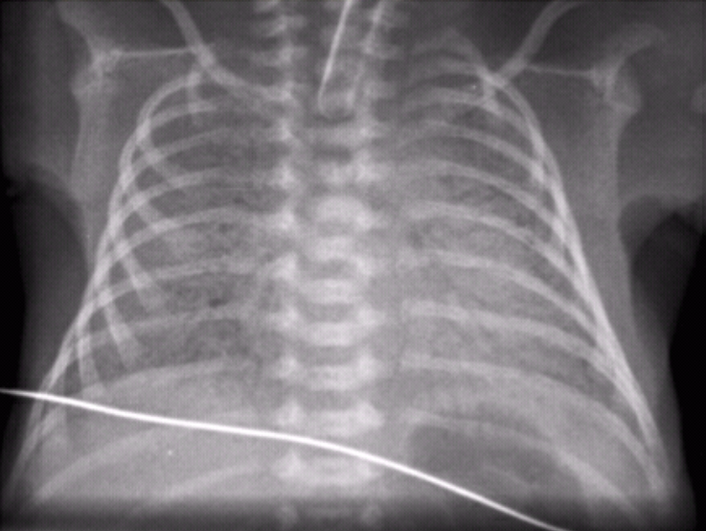
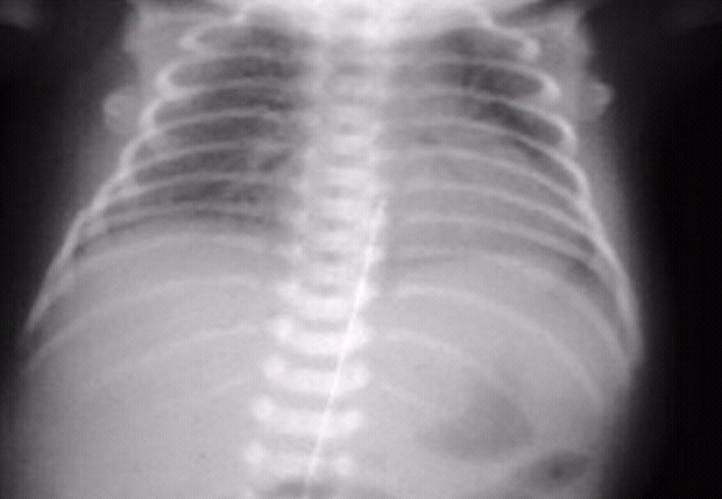
RDS
CXR
Low lung volumes
Bilateral and symmetrical disease
Grades
1- mild. Fine homogeneous GGO
2- widespread air Broncho grams
3- confluent alveolar shadowing/consolidation
4- lung white out, obscuring cardiac shadow
Notes:
Cxr- diffuse ggo low volumes bell shaped thorax, bilat .symmetry.
GGO- filling of air spaces by exudate/transudate. Increased attenuation.

Slide 8
MECONIUM ASPIRATION SYNDROME
Epidemiology:
In term or post term babies.
1-5% of all neonates. M=F
Clinical presentation:
Meconium stained fluid at birth
Respiratory distress in first few hours of birth.
Pathology:
intra partum or in utero aspiration of meconium that causes small airways obstruction and chemical pneumonitis
Risk factors:
Post term pregnancy
Obstructed labor
Treatment
suction of secretions and intubation
Prognosis
Mortality 10-20%

Slide 9
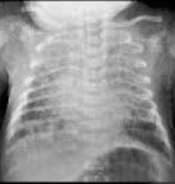
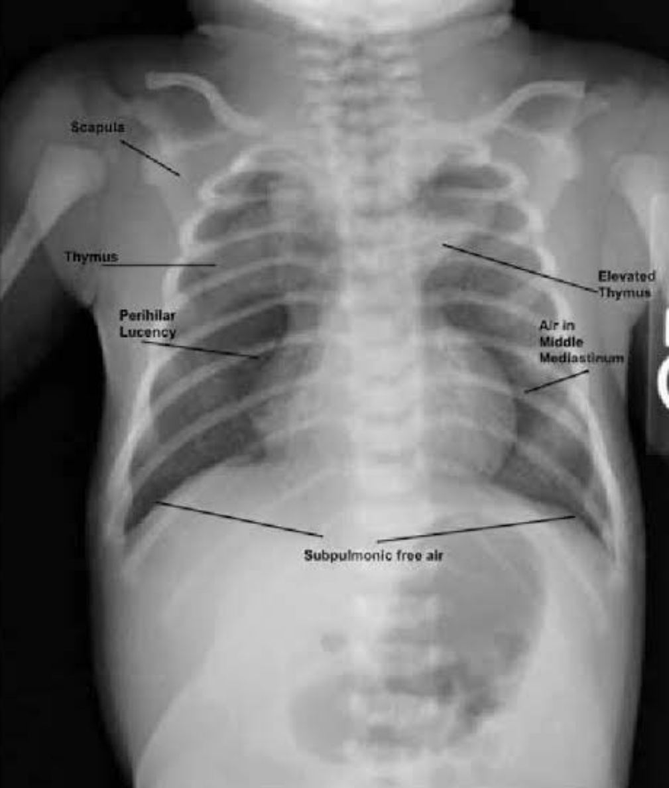
MAS
CXR
Increased lung volumes- flattened diaphragms
Asymmetric pulm opacities- subsegmental atelectasis
Pleural effusions
Chemical pneumonitis- Multifocal consolidation.
Pneumothorax/pneumomediastinum
.
Images courtesy of Cheny Yi Chan.spontaneous pneumomediastinum, a rare complication of vaginal delivery. Chin J Radiology 2008;33:277-280.

Slide 10
NEONATAL PULMONARY INFECTION/NP
Epidemiology:
In term or post term babies.
10% of a. M=F
Clinical presentation:
Temperature instability with neutropemia
Respiratory distress
Pathology:
transplacental spread of infection.
TORCH,Listeriosis,tuberculosis ,congenital syphilis
Aspiration on infected amniotic fluid after PROM
Hospital acquired
this occurs after the 1st week of life
Gram-negative organisms, Staphylococcus
Risk factors:
ROM >6HRS
Prolonged complicated labor
Premature infants
Treatment
Antimicrobial therapy
Prognosis
10% of global childhood mortality

Slide 11
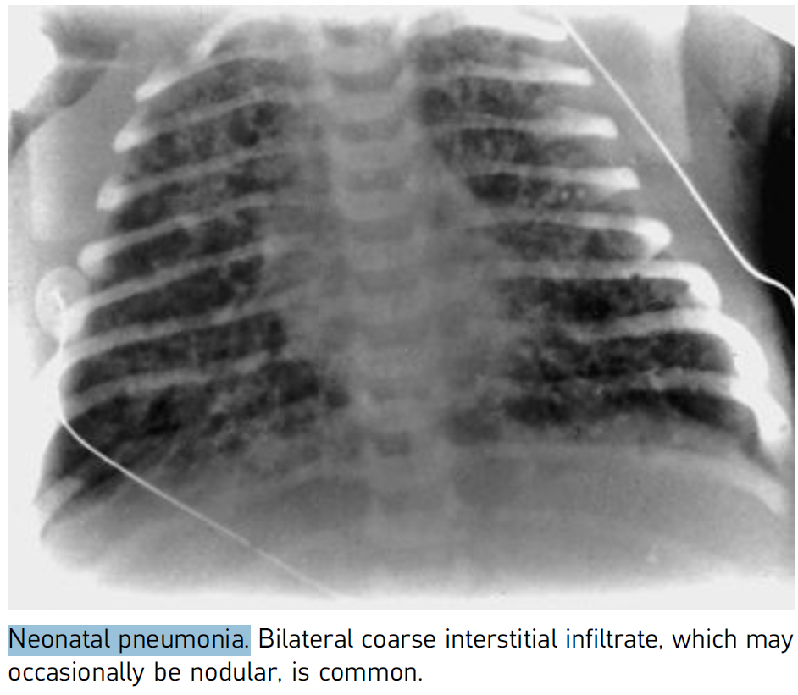
NP
CXR
Normal
Alveolar shadowing
Pleural effusion
Hyperinflated lungs
Air bronchograms

Slide 12
Complications of respiratory therapy
infants treated with positive pressure mechanical ventilation and oxygen therapy
Interstititial emphysema
Pneumomediastinum
Pneumothorax
Bronchopulmnar dysplasia

Slide 13
BRONCHOPULMONARY DYSPLASIA (BPD)
Def: chronic lung disease post prolonged oxygen therapy <1 month
Epidemiology:
M=F
Clinical presentation:
Temperature stability with normal CRP
Respiratory distress
1 month post oxygen therapy
Pathology: hypoxia and oxygen toxicity damages capillary walls- interstititial fluid seepage- epithelial damage and necrosis
Risk factors:
Prolonged complicated labor
Premature infants
Treatment
Antimicrobial therapy
Prognosis
Slow but continuous improvement
increased number of resp Infections

Slide 14
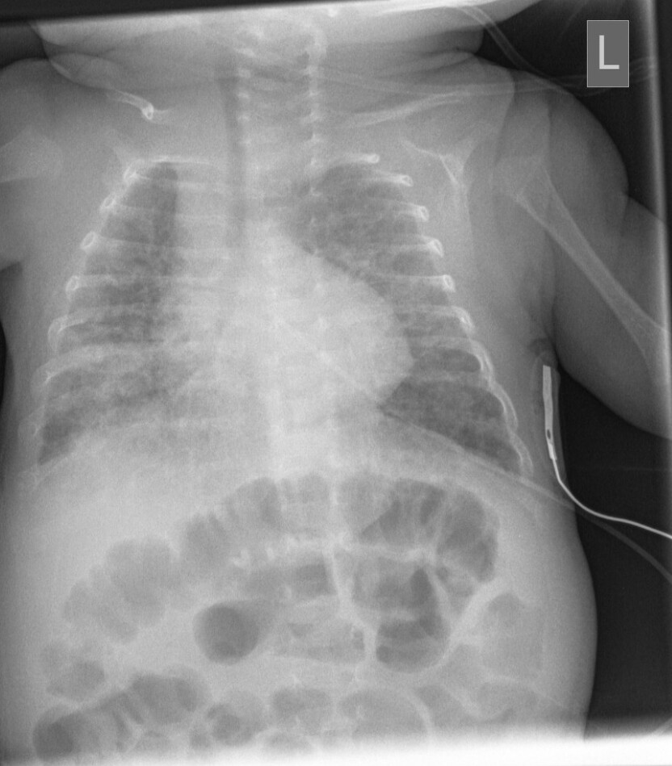
BPD
CXR
Normal lung volumes
Cardiomegaly- pulmonary HTN
areas of hyperexpansion and atelectasis are interspersed with patchy areas of fibrosis
severe hyperexpansion -moderate-sized pulmonary cysts
Notes:
A ‘bubbly’ appearance to the lungs (due to
alveolar distension and scarred acini) with alternating
cyst-like lucencies surrounded by curvilinear
stranding of soft tissue density

Slide 15
Surgical Causes
1. Congenital Diaphragmatic Hernia
2. Congenital Lobar Emphysema
3. Sequestration
4.CPAM

Slide 16
CONGENITAL DIAPHRAGMATIC HERNIA
Def: congenital defects of diaphragm where by abdominal contents herniate into the thorax and result into pulmonary hypoplasia
Epidemiology:
1 in 2000-4000
85% left sided.13% right sided.2% bilateral
M=F
Clinical presentation:
Antenatally on obs scan
Soon after birth with resp distress
Temperature stability with normal CRP
Pathology
congenital defects of diaphragm where by abdominal contents herniate into the thorax and result into pulmonary hypoplasia
Liver ,bowel, spleen etc
Treatment
Surgery

Slide 17
CONGENITAL DIAPHRAGMATIC HERNIA
BOCHDALEK
MORGAGNI
Most common
Left sided
Posterolateral
Presents earlier
Least common
Right anteromedial
Presents later

Slide 18
CONGENITAL DIAPHRAGMATIC HERNIA
BOCHDALEK
MORGAGNI
CXR
Hemithorax filled with cystic structures if bowel or solid if liver
Varying shift of mediastinum contralaterally

Slide 19
Pulmonary sequestration
Def:
lung tissue that is not connected to the tracheobronchial tree.
systemic arterial supply
instead of a pulmonary artery supply
venous drainage can be either systemic or pulmonary.
Epidemiology:
0.1%

Slide 20
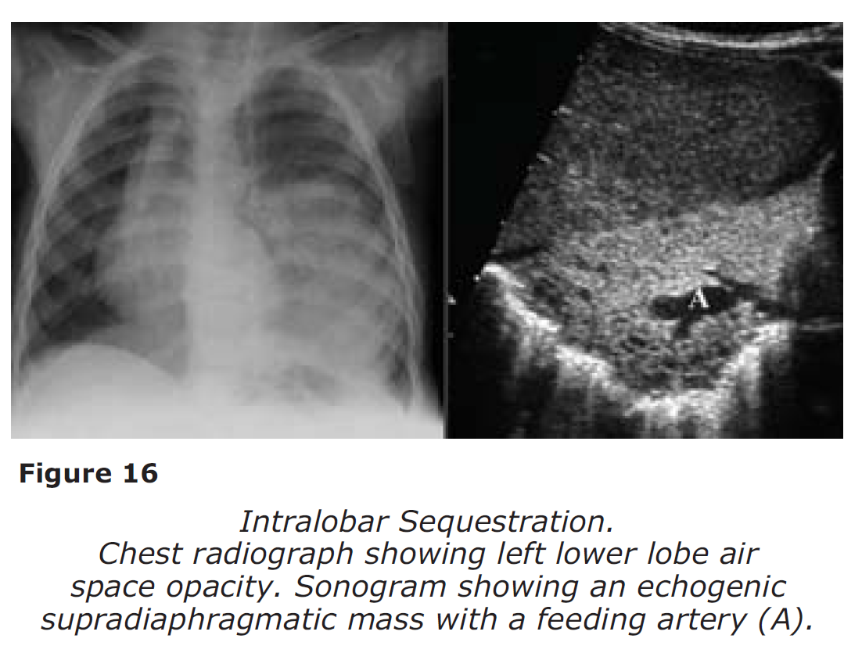
Intralobar sequestration
Epidemiology:
M=F
7-85%
Clinical presentation:
presents in late childhood/adolescence
recurrent infections.
Pathology
contained within the normal lung pleura
medial left lower lobe.
Pulmonary venous drainage
Treatment
Surgery

Slide 21
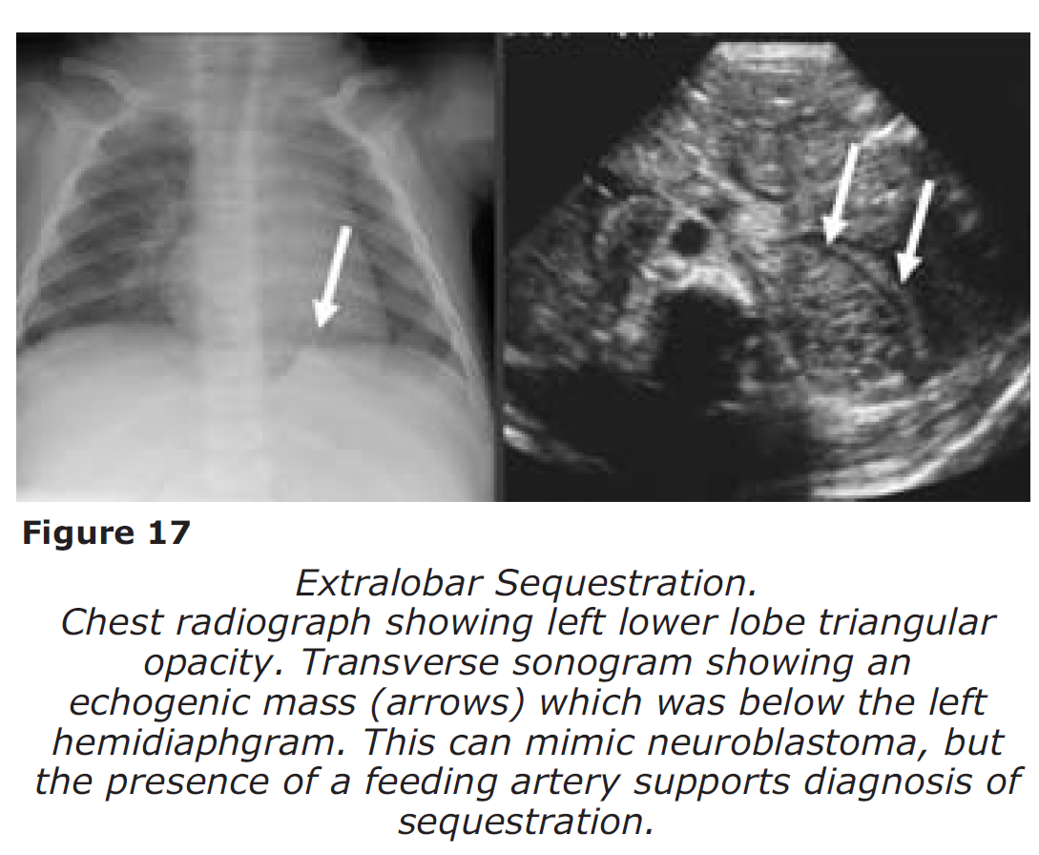
Extralobar sequestration
Epidemiology:
M:F=4:1
15-25%
Clinical presentation:
commonly presents in the neonatal period
recurrent infections.
Pathology
contained in its own separate pleura
medial left lower lobe
Systemic venous drainage in to the right atrium
Treatment
Surgery

Slide 22
CONGENITAL PULMONARY AIRWAY MALFORMATION/CPAM
Congenital cystic adenomatoid malformations
Def:
multicystic masses of segmental lung tissue with abnormal bronchial proliferation with intracystic communication and to tracheobronchial tree
Epidemiology:
25% of congenital lung lesions
1:1500-4000
M>F
Clinical presentation:
Neonate with resp distress
Recurrent infection
Pathology:
Proliferation of terminal resp units in a gland like pattern without proper alveolar formation
Unilateral
Less in the middle lobe
Treatment
surgery
Prognosis
Depends on severity

Slide 23
CPAM
TYPE 1
70%
Large cysts
1 or more dominant cyst, 2-10cm
TYPE 2
15-20%
Cysts <2cm
Other abn- renal agenesis, pulm sequestration
TYPE 3
10%
MICROCYST<5MM
Entire lobe
Poor prognosis
TYPE 4
Unlined cyst
Single lobe
Type 0
Very rare
Lethal global arrest of lung development

Slide 24
CPAM
Radiologic findings
Cystic mass
Single lobe
unilateral

Slide 25
CONGENITAL LOBAR EMPHYSEMA
1. Obstruction
2. Cartilage deficiency, dysplasia, immaturity

Slide 26
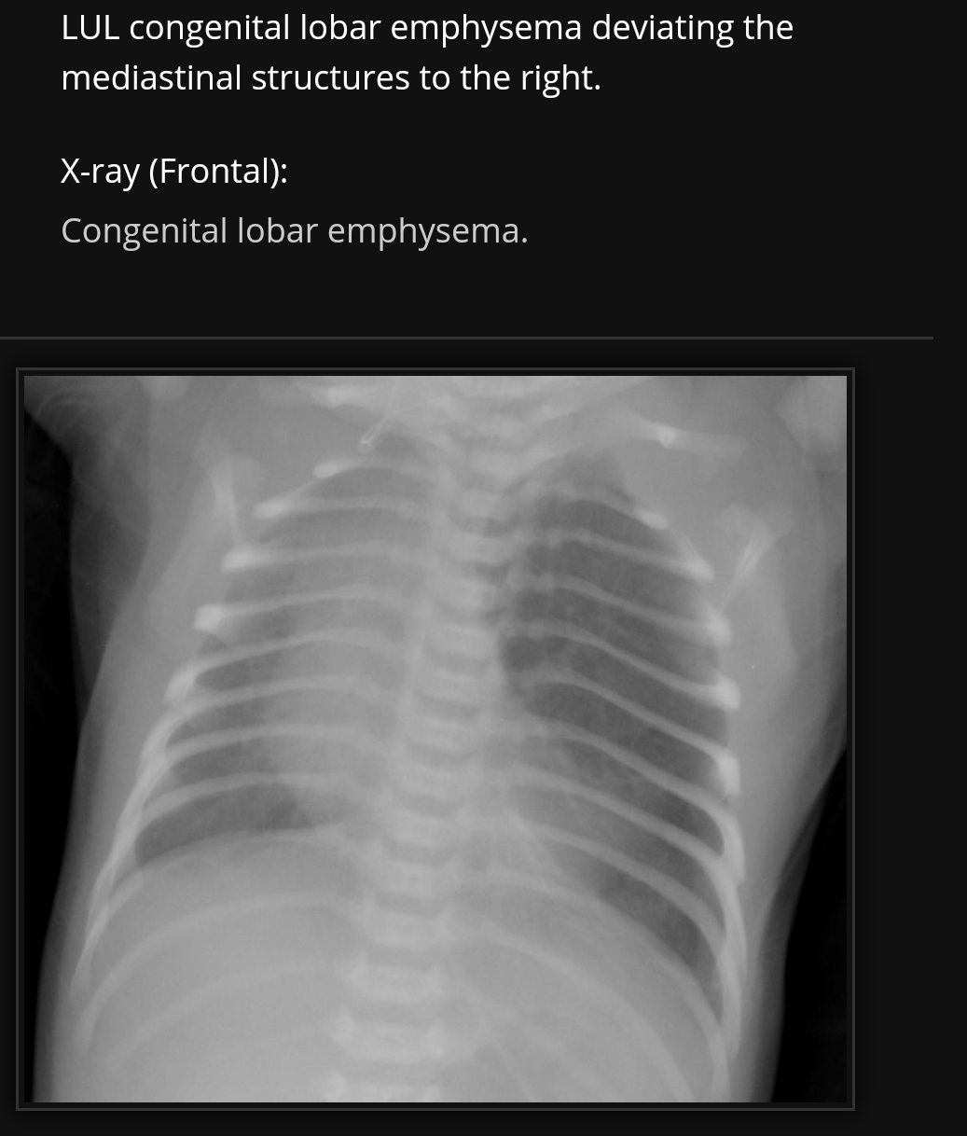

Slide 28
Life is air

