Slide 1
CRANIOFACIAL MALFORMATIONS
DR OSUNDWA TOM
SENIOR LECTURER AND CONSULTANT ORAL AND MAXILLOFACIAL SURGEON, UNIVERSITY OF NAIROBI

Slide 2
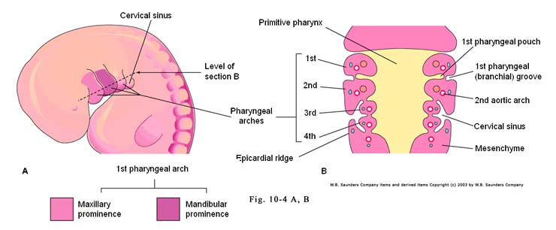
CRANIOFACIAL EMBRYOLOGY

Slide 3
PHARYNGEAL ARCHES
Pharyngeal Arch | Cranial Nerve | Muscle derivative | Skeletal Derivative
1 Mandibular | Trigeminal nerve | Muscle of mastication Tensor tympani | Incus, ant. Lig of malleus
2 Hyoid | Facial nerve | Muscles of facial expression | Stapes, Hyoid bone
3 | Glossopharyngeal nerve | Stylopharyngeas | Horns of hyoid
4 | Vagus nerve | Striated muscles of oesophagus
5 | None | None | None
6 | Merges with 4

Slide 4
PHARYNGEAL POUCHES
Pharyngeal Pouch | Derivative
1 | Epithelium of tympanic cavity and auditory tube
2 | Epithelium of tonsil
3 | Inferior parathyroid glands and epithelium of thymus
4 | Superior parathyroid glands.

Slide 5
CRANIOFACIAL EMBRYOLOGY

Slide 6
GENES: TRANSFORMING GROWTH FACTOR BETA 3
Studies of TGFB3 and cleft palate in knockout mice TGFB3-/-is promising and may in the near future result in the therapeutic use of TGFB3 in prevention and treatment of cleft lip and/or palate.
The TGFB3 gene has a CA repeat sequence, and polymorphism is dependent on the frequency of the CA repeats
Gene-Gene interaction, Foxe 1( associated with Bamforth-Lazarus syndrome-9q22) may control expression of TGFB3 during craniofacial development.

Slide 7
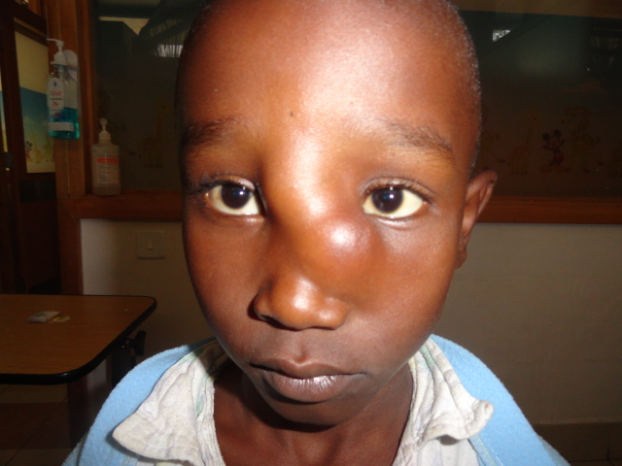
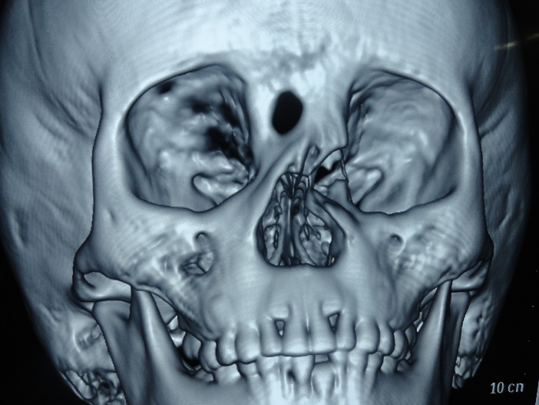
FRONTOETHMOIDAL ENCEPHALOCELE
Encephaloceles are anomalies characterized by herniation of variable degrees of cranial content through defects in the skull.
They may contain
  Meninges-meningocele,
  Brain matter and meninges -meningoencephalocele
  They may communicate with the ventricles-meningoencephalocystocele
Frontoethmoidal encephaloceles may be associated with;
  Varying degrees of grotesque facial deformity
  Varying degrees of Hypertelorism
  Decreased visual acuity
  Strabismus
  Lacrimal flow obstruction resulting in epiphora and dacryocystitis
  Increased risk of recurrent bacterial meningioencephalitis

Slide 8
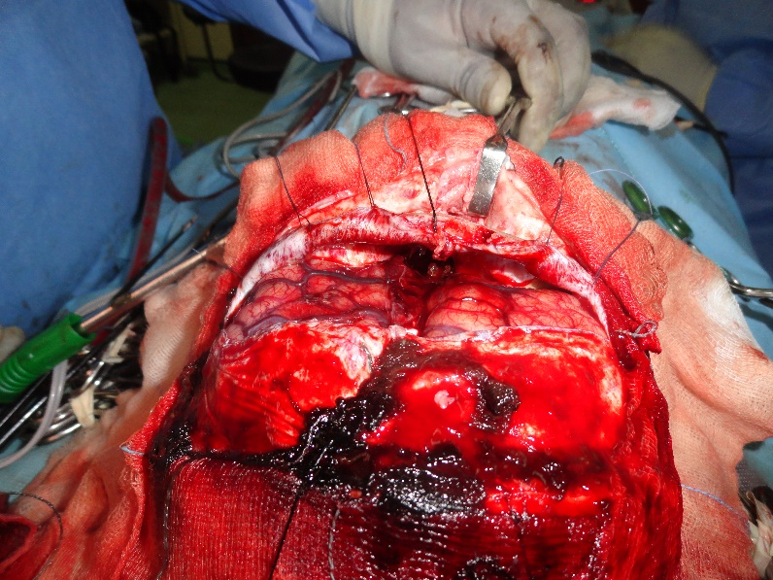
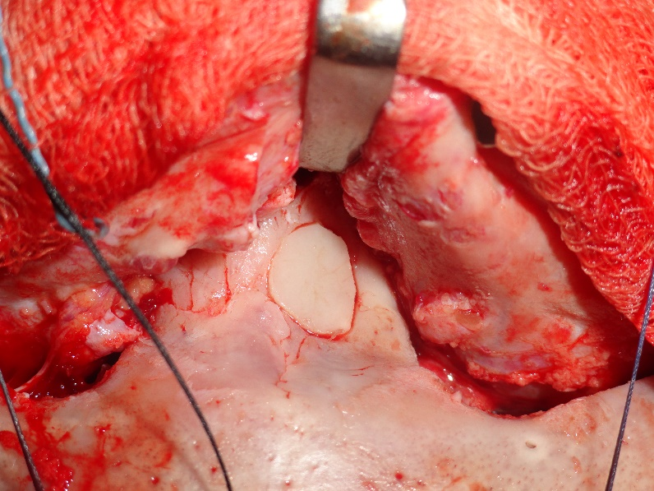
FRONTOETHMOIDAL ENCEPHALOCELE; SURGERY

Slide 9
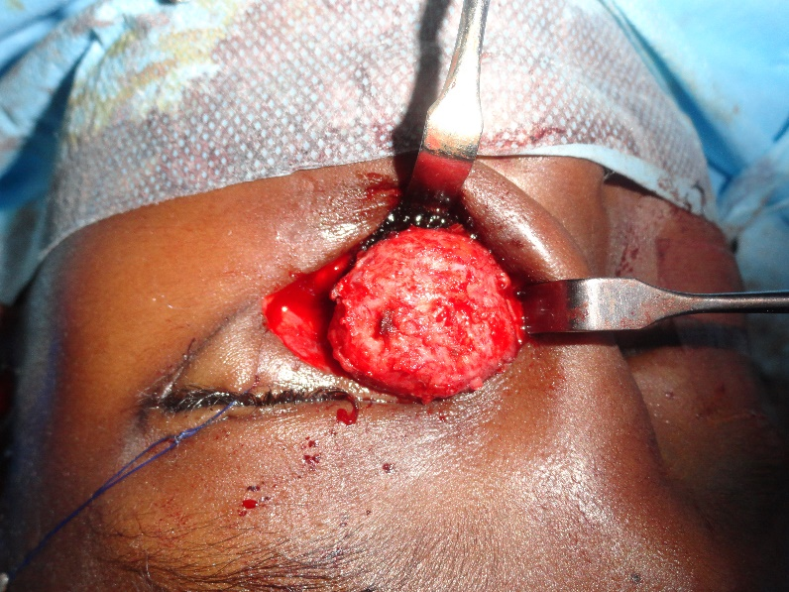
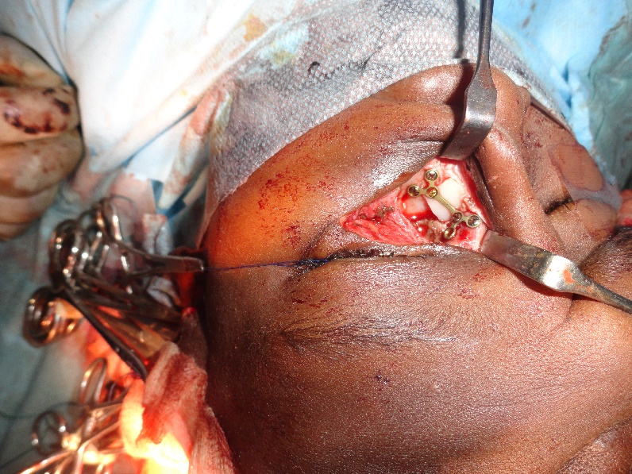
FRONTOETHMOIDAL ENCEPHALOCELE; SURGERY

Slide 10
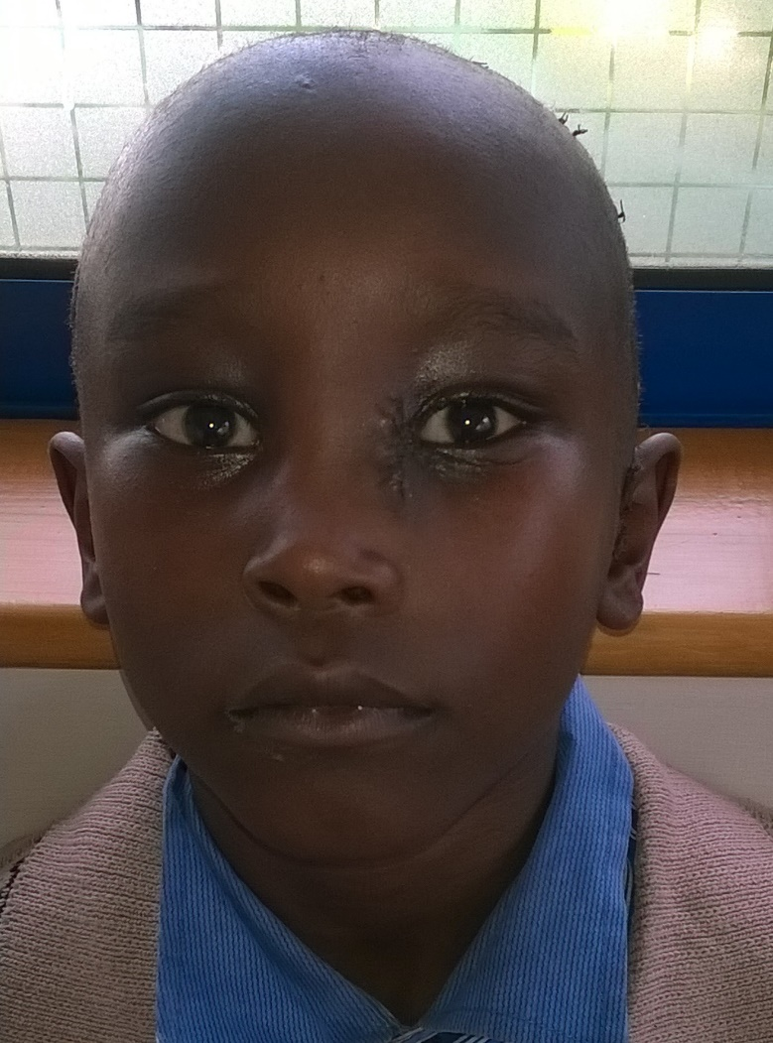
FRONTOETHMOIDAL ENCEPHALOCELE; SURGERY

Slide 11
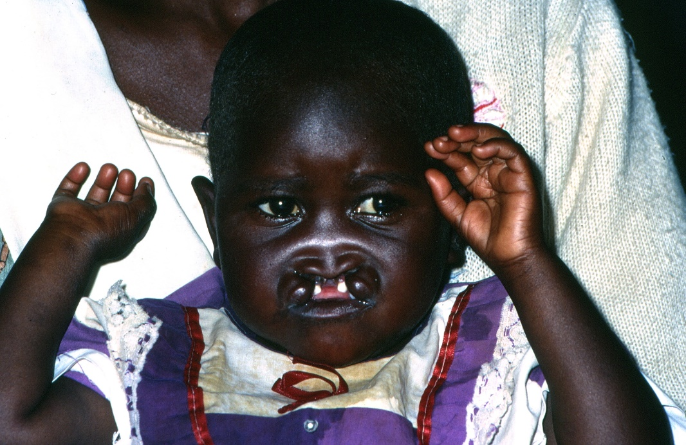
CLEFT LIP AND/OR PALATE
Cleft Lip and/or Palate is the most common craniofacial anomaly world wide.
It is a problem of immense global proportions with about 240,000 afflictions yearly. This translates to 700 cases daily.
Kenyan National Health and Strategic Plan 2002-2012 estimated that there were 30,000 untreated cleft lip and palate cases.
Over 350 cleft syndromes have been described (Cohen et al, 2000)
  Treacher-Collins syndrome
  Down’s syndrome
  Van der Woude syndrome
  Apert’s syndrome
  Kabuki make-up syndrome
  Pierre-Robin Syndrome
The aetiology of cleft lip and palate is multifactorial.
  Gene
  Environmental factors; Drugs, Folate and Zinc deficiency, alcohol, smoking etc.
Protocol used locally is the rule of ten
  HB >10
  10 Pounds wt. ( 4.5 Kg}
  Ten weeks

Slide 12
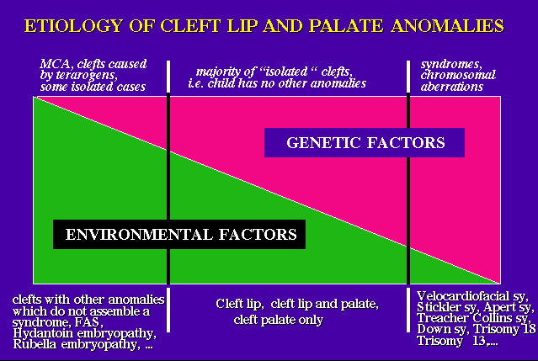
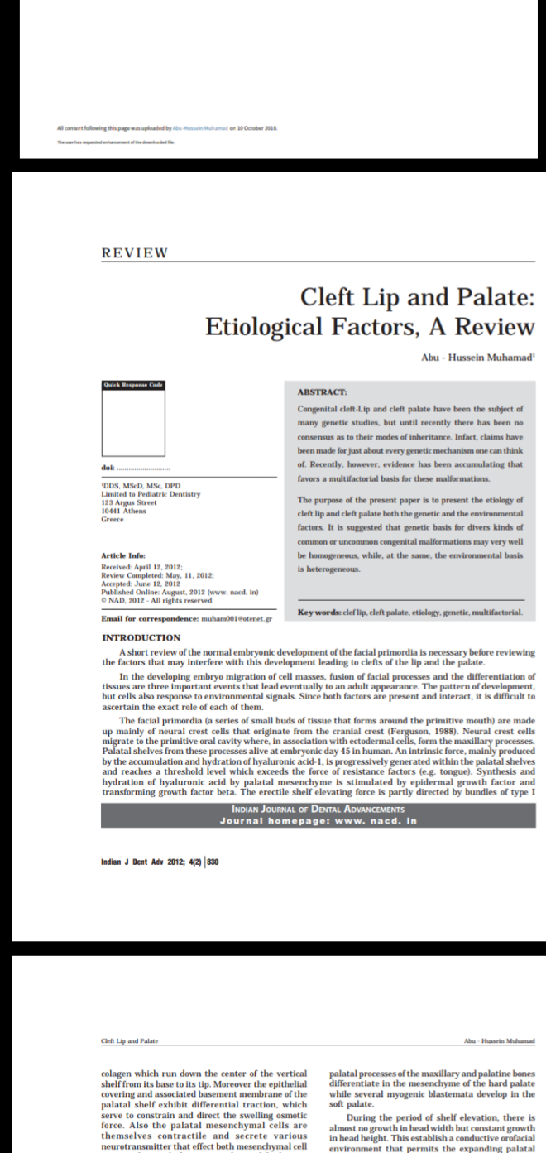
ETIOLOGY OF CLEFT LIP AND/OR PALATE

Slide 13
ETIOLOGY OF ORO-FACIAL CLEFTS: GENES IMPLICATED
Genes play a substantial role in facial embryogenesis with the role played by environmental factors in modulating genetic effects being equally critical.
Some of the genes that have been associated with cleft lip and or palate include
MSX1,
TGFA,
TGFB3,
IRF6,
MTHFR,
RARA,
PVRL-1,
TBX-22,
FGFR1, FGFR2, FGFR3,
FOXE 1
GLI2 and SUMO1.

Slide 14
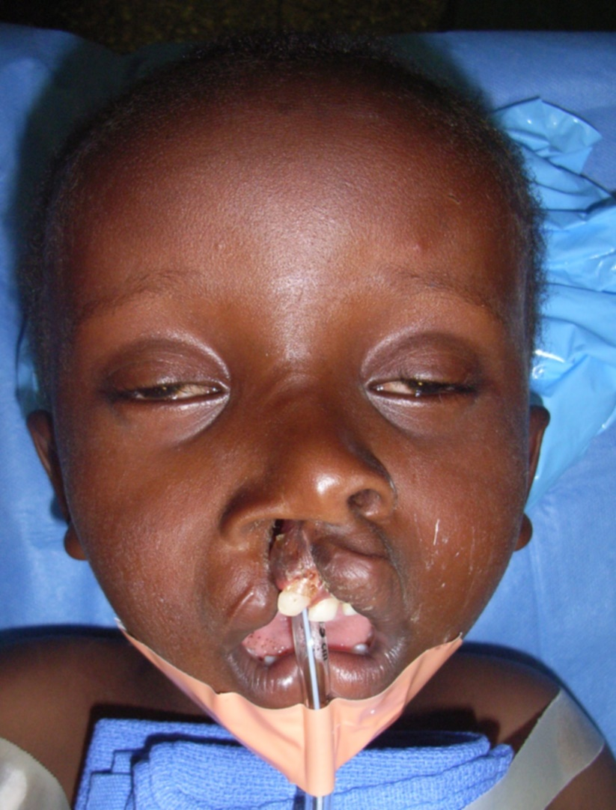
CLEFT LIP MANAGEMENT
Principals and goals include:
Preservation of lip length.
Functional repair of orbicularis oris.
Primary nasal correction.
Recreation of the wet and dry vermillion relationship.
Scars hidden in natural lines.
Rule of ten not rigid but guideline.
Millard’s rotation and advancement is the key for unilateral repairs with various modifications.

Slide 15
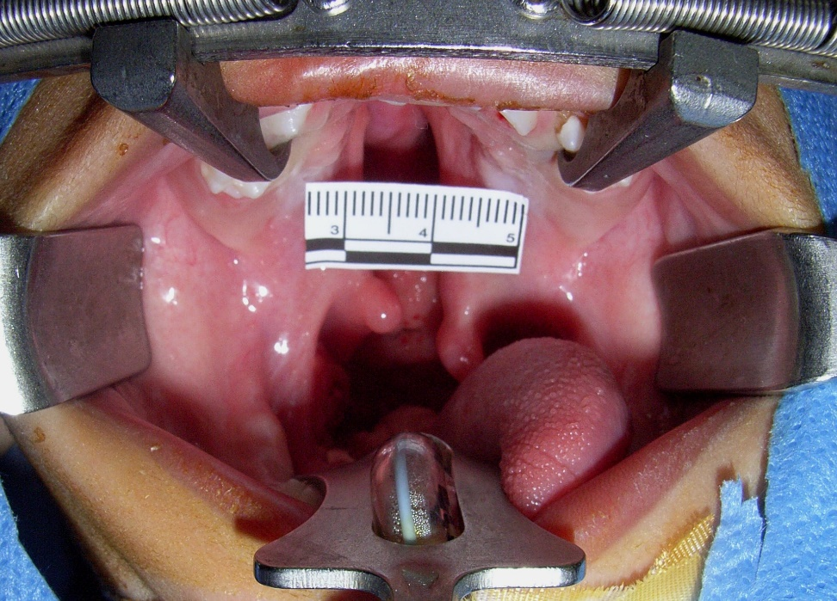
CLEFT PALATE MANAGEMENT
Cleft palate treatment is usually timed to correspond to the period before speech development (one and a half years).
The objective of palatal repair is to obtain a long mobile palate that can close the pharyngeal isthmus during speech and swallowing.

Slide 16
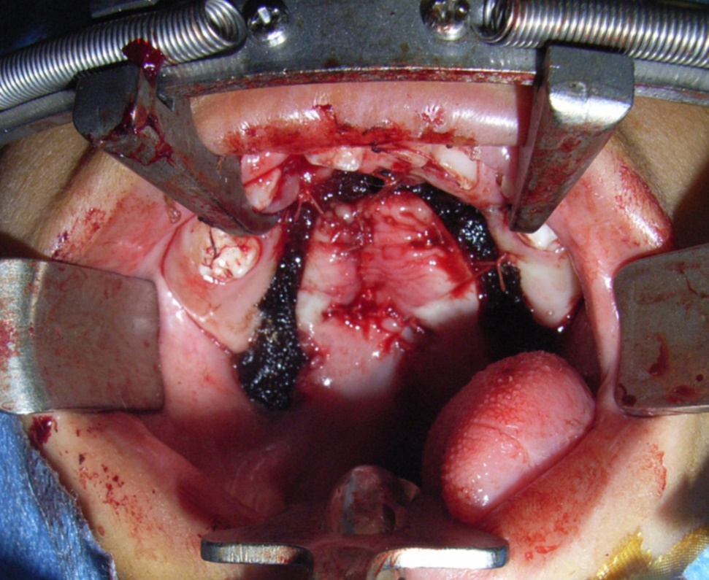
CLEFT PALATE
Cleft palate surgery VY pushback
Grafting to all cross arch stabilization and eruption of canine
Posterior pharyngeal wall flap may be used in case of inadequate oral tissue for surgical closure.
Other methods that have been used include the Fulow technique (Z-Plasty of the soft palate)

Slide 17
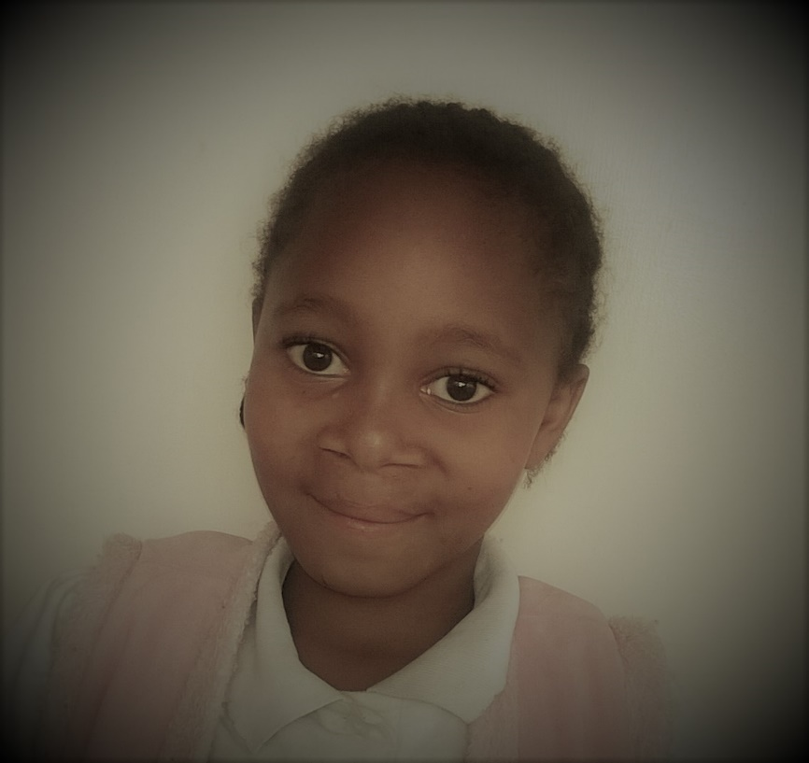
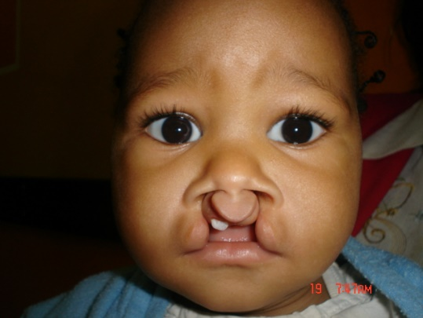
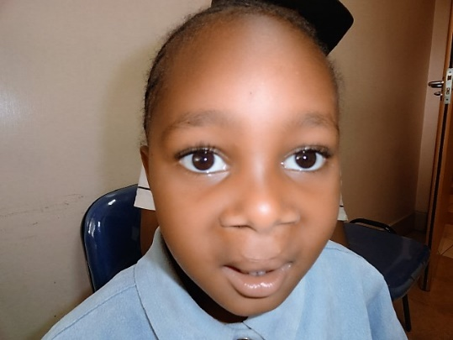
CLEFT LIP AND/OR PALATE

Slide 18
VAN DER WOUDE SYNDROME
VWS is the commonest orofacial clefting syndrome associated with 2% of cleft lip and/or palate cases (Shprintzen et al-1980).
Penetrance for VWS has been reported as high as 100% in some cases. Variable expressivity.
There is a 50% chance of inheriting the gene. Autosomal dominant.
No significant differences among the sexes (Rizos et al)
  Mutations in the interferon regulatory factor 6 gene (IRF6) located on chromosome 1q32.3-q41 are responsible for a majority of van der Woude syndrome (VWS) cases ( Micro-deletion)
Associated features of VWS:
  Hypodontia-USP,LSP,ULI
  MIH-Molar incisor Hypomineralization
  Ankyloglossia
  Syndactyly
  Symblepharon
  Associated with syndromes like Kabuki make-up, Popliteal Pterygium syndrome.
    Popliteal Pterygium thought to be allelic variants of the same gene (LOD=2.7).
  Oral synechiae

Slide 19
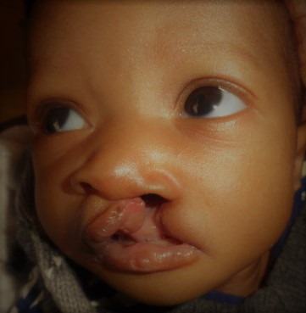
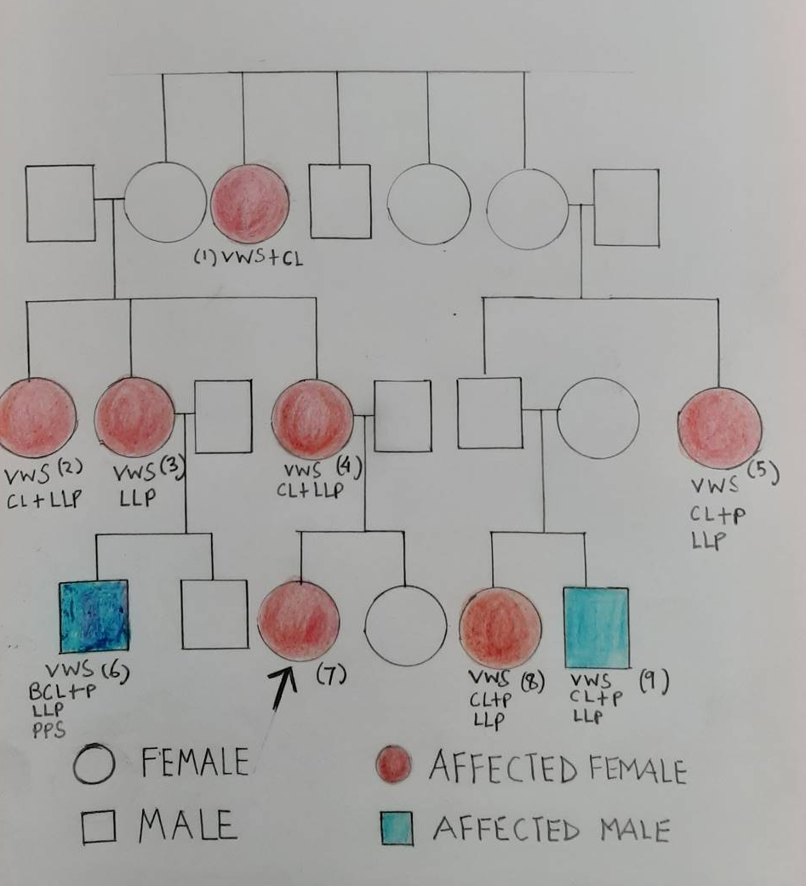
Van Der Woude-7 Proband

Slide 20
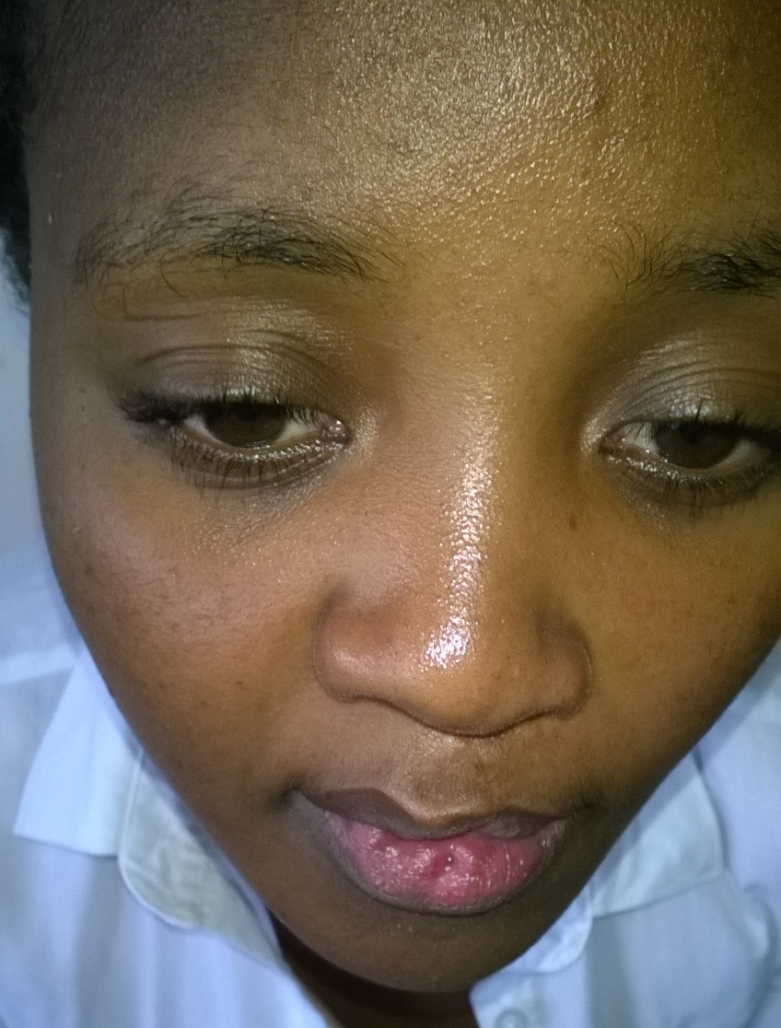

Van Der Woude Syndrome-4, Mother to proband

Slide 21
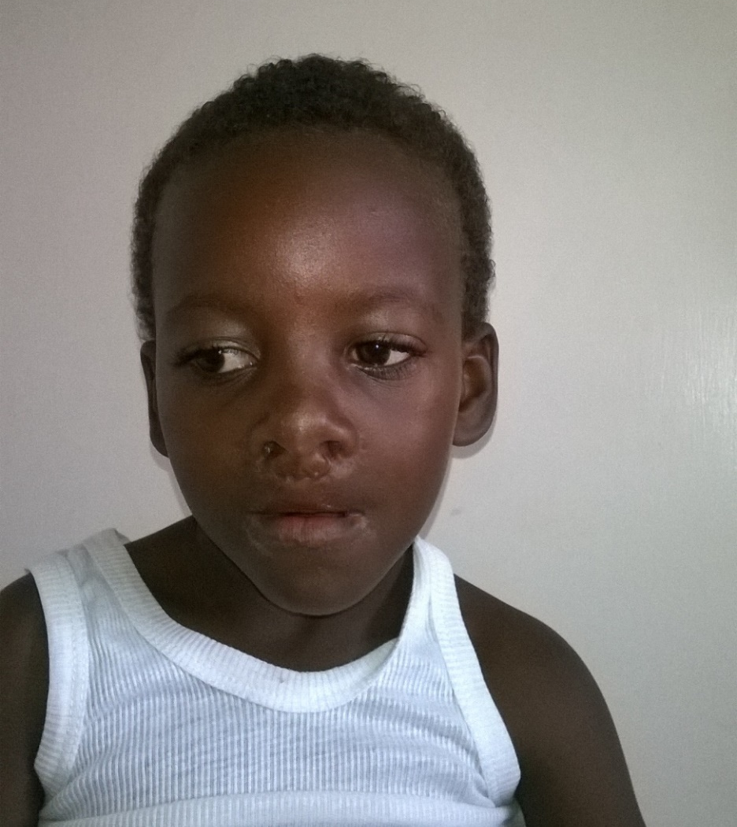

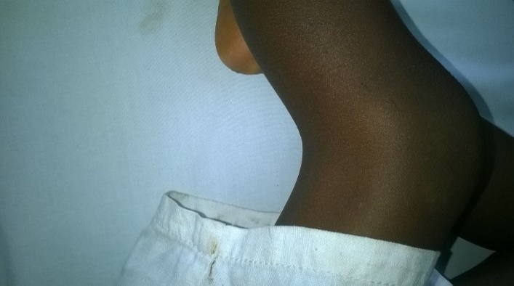
PROBANDS COUSIN-6 BCL+P/POPLITEAL PTERYGIUM AND CURLY HAIR

Slide 22
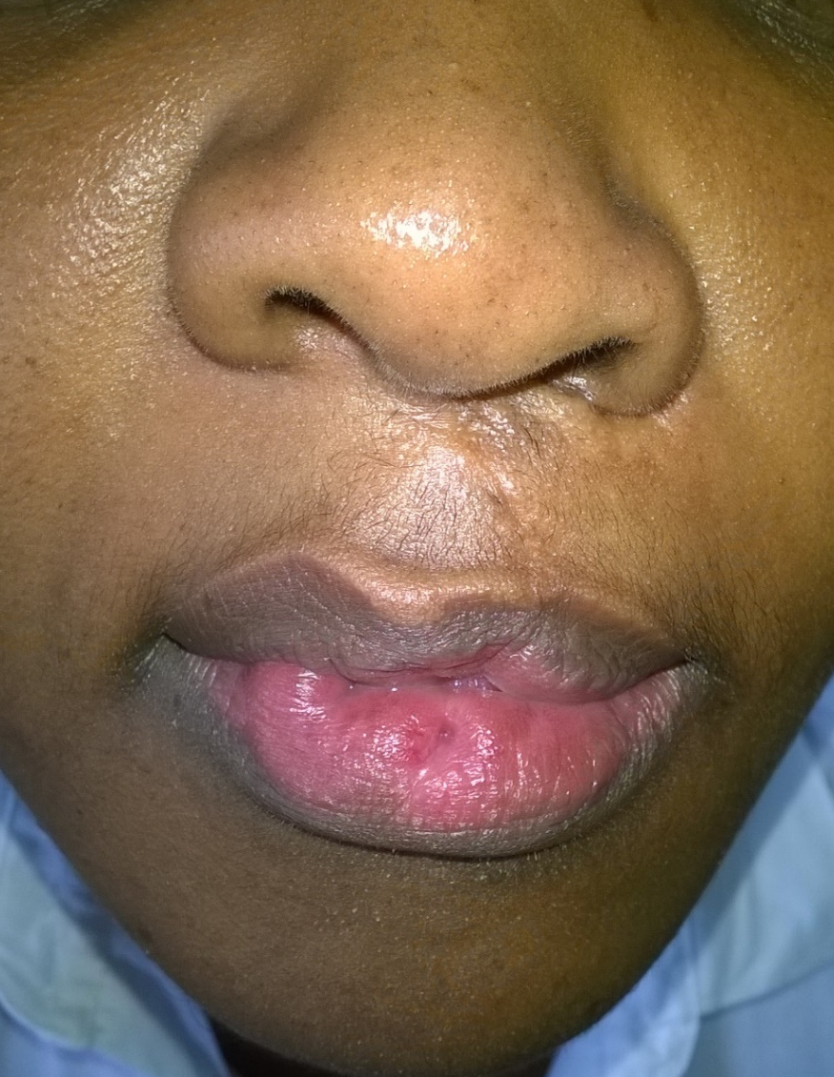


PROBANDS COUSIN’S MOTHER 3(AUNT)- UCL+P AND LLPS

Slide 23
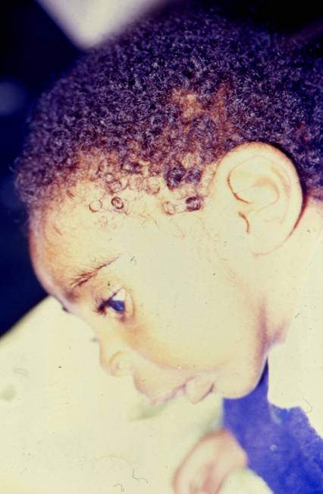
PIERRE-ROBIN ANOMALAD
Pierre Robin Syndrome, Pierre-Robin Sequence, Pierre-Robin Anomalad.
Associated with restriction of mandibular development in utero.
Associated with mutations in chromosomes 2, 11 and 17.
An affliction in the family increases the chance of another .
Associated with micrognathia, cleft palate (U-shaped) and glossoptosis.
Management includes airway management, allowing for catch up growth.
Residual deficit may be corrected by surgery/Distraction osteogenesis.

Slide 24
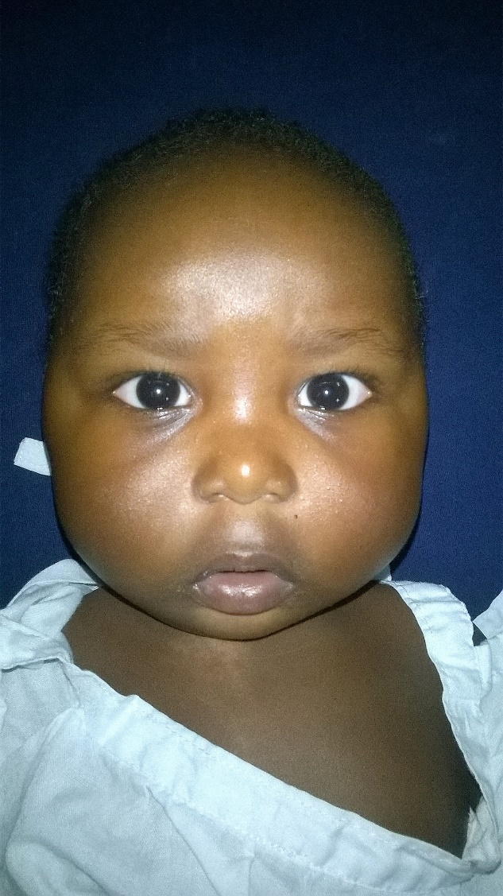
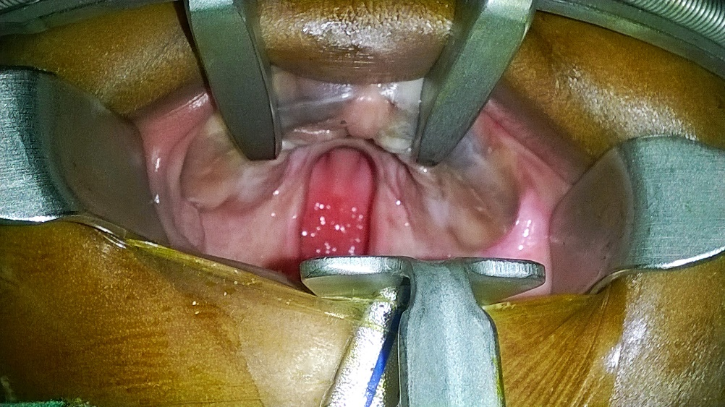
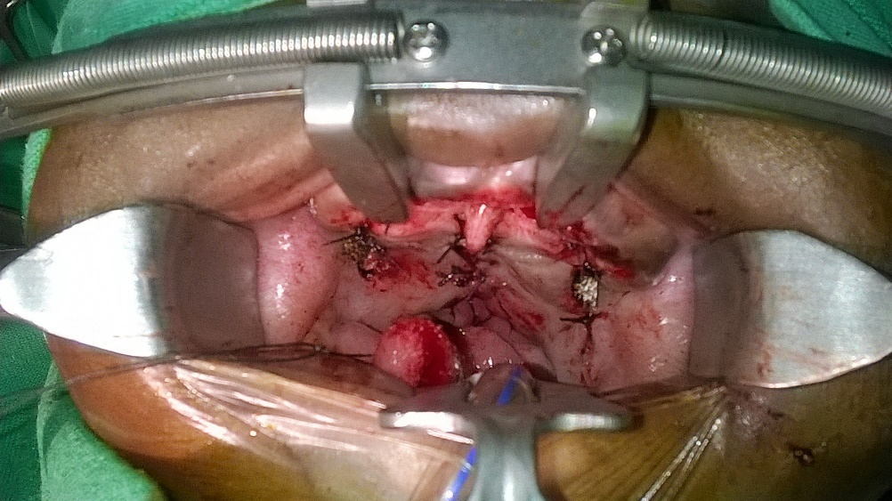
PIERRE-ROBIN SEQUENCE

Slide 25
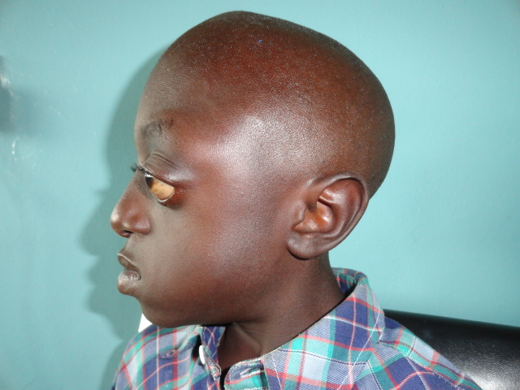
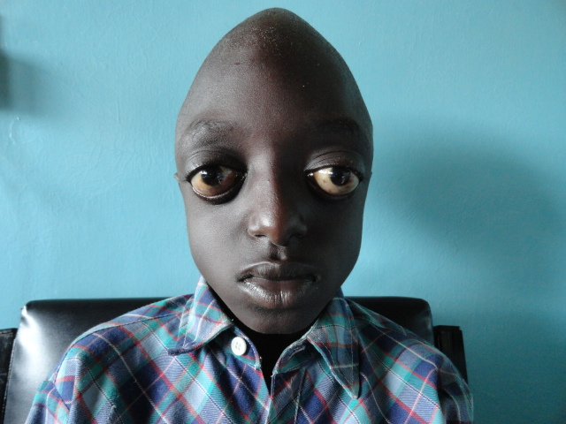
CRANIOSYNOSTOSIS: CROUZON’S SYNDROME
Crouzon Syndrome is an Autosomal Dominant craniosynostosis.
FGFR-2 gene whose locus is on Ch-10 is mutated. FGFR-3 involved to a lesser extent.
Clinical Features:
  Craniosynostosis
  Exophthalmos
  Cleft palate
  Hypoplastic maxilla, malocclusion
  PDA
Treatment is surgical

Slide 26
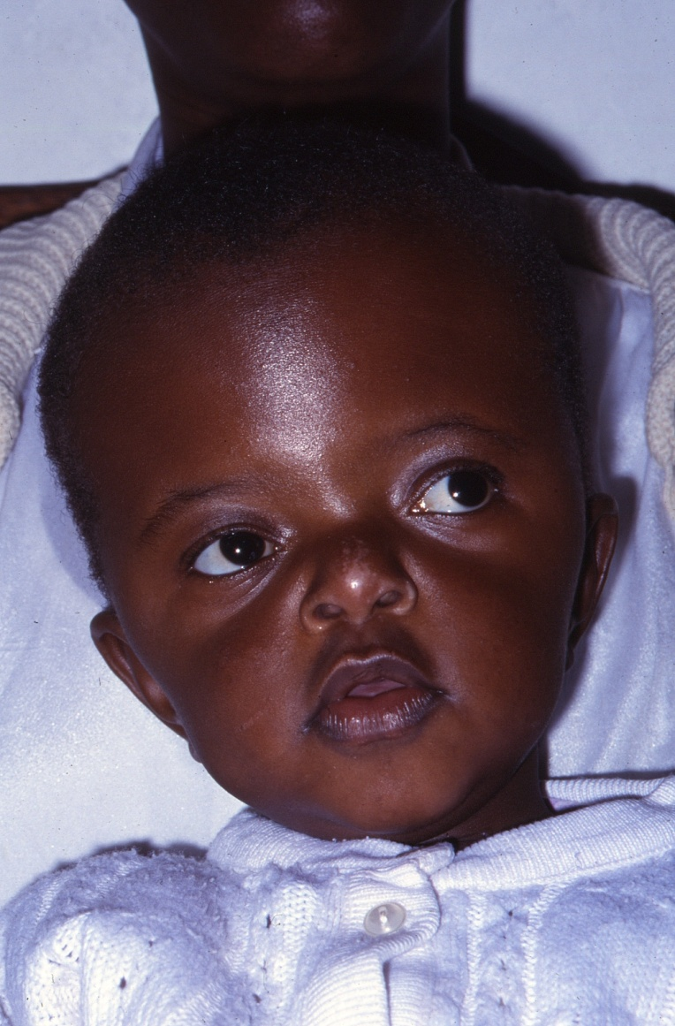
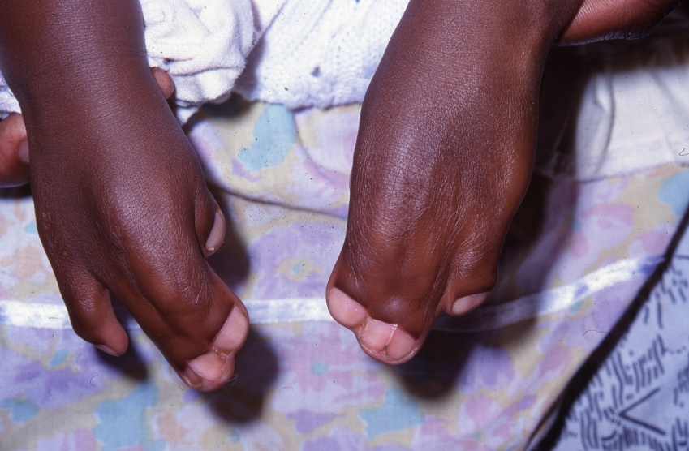
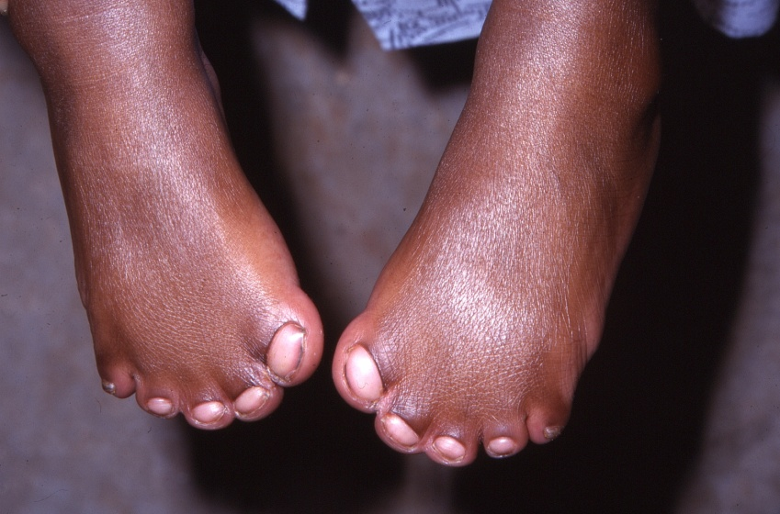
CRANIOSYNOSTOSIS: APERT’S

Slide 27
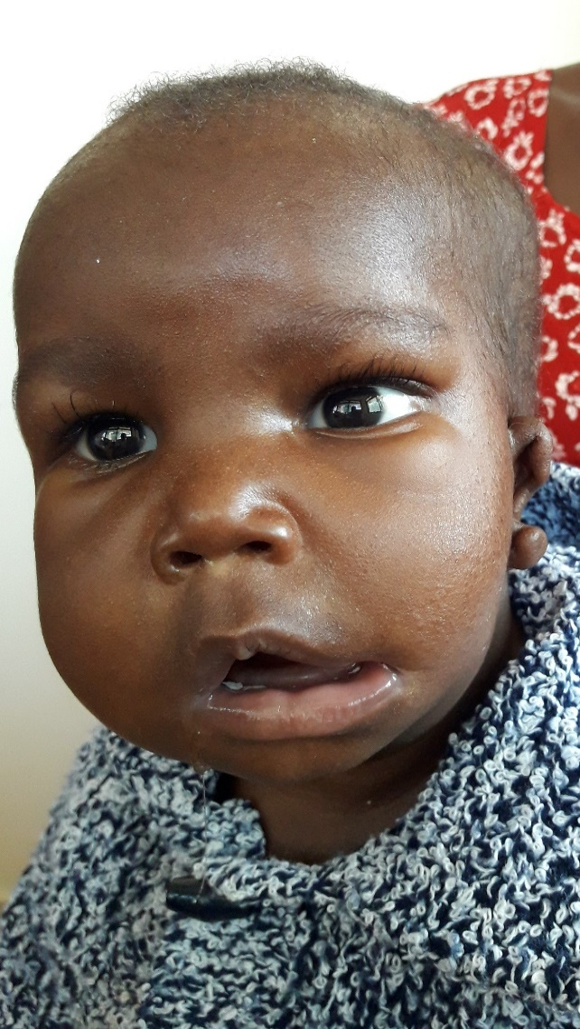
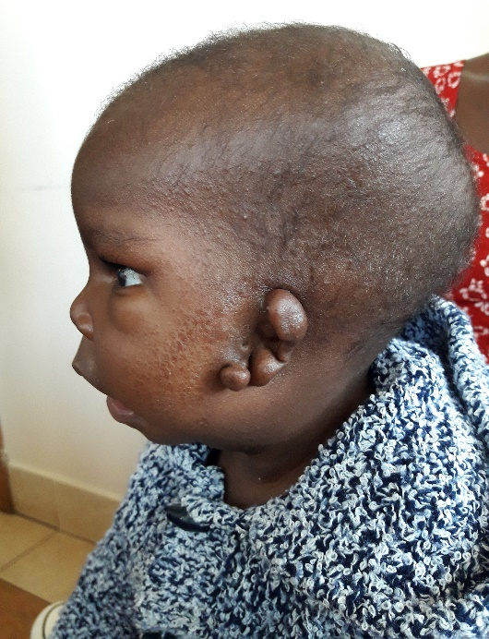
GOLDENHAR’S SYNDROME/ HEMIFACIAL MICROSOMIA
Goldenhar’s syndrome is a first and second arch syndrome.
Aetiology thought to be multifactorial but largely unknown
Affects the eyes, ears, mandible, soft palate, vertebrae and in some cases internal organs like the heart, lungs and kidneys.
Mostly unilateral although some cases (13%) have occurred bilaterally.
Early intervention for the hearing defect and distraction for the mandibular deficiency form part of the treatment

Slide 28
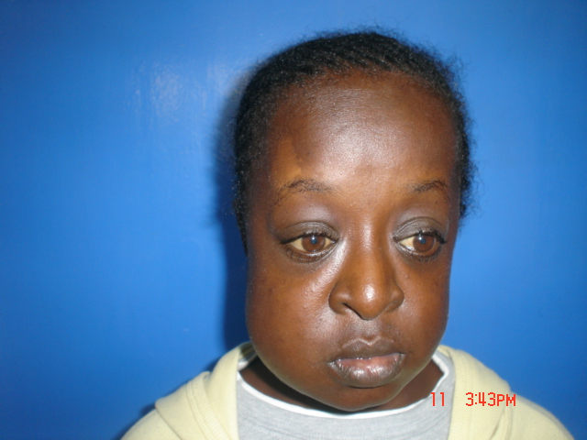
MC-CUNE ALBRIGHT SYNDROME

Slide 29
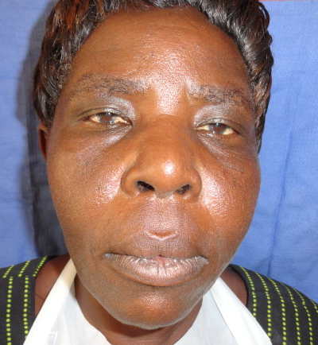
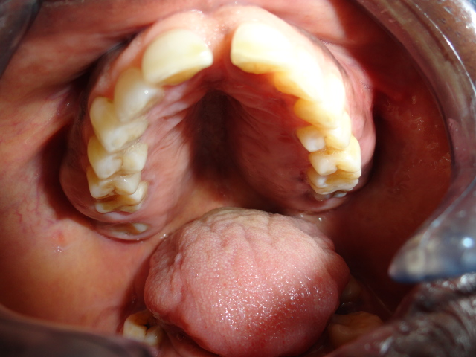
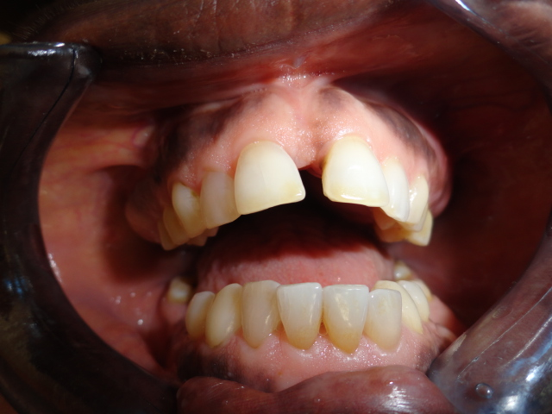
PAGET’S DISEASE OF BONE

Slide 30
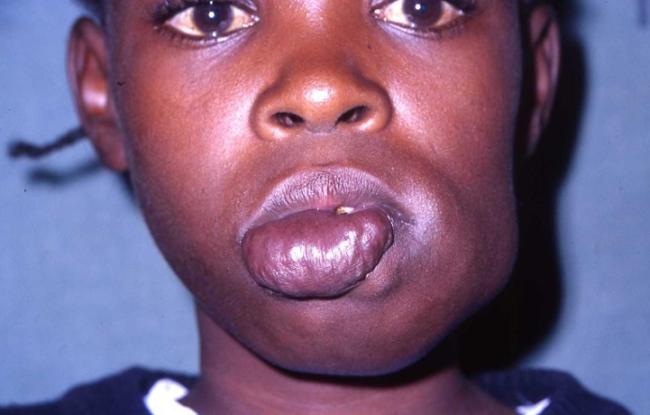
VASCULAR ANOMALIES
CLASSIFICATION OF VASCULAR ANOMALIES
  VASCULAR TUMORS
    HEMANGIOMA
    HEMANGIOENDOTHELIOMA
    ANGIOSARCOMA
  VASCULAR MALFORMATIONS
    SLOW FLOW
      CAPILLARY
      VENOUS
      LYMPHATIC
      COMINED
    HIGH FLOW
      ARTERIAL (AM, AVM)

Slide 31
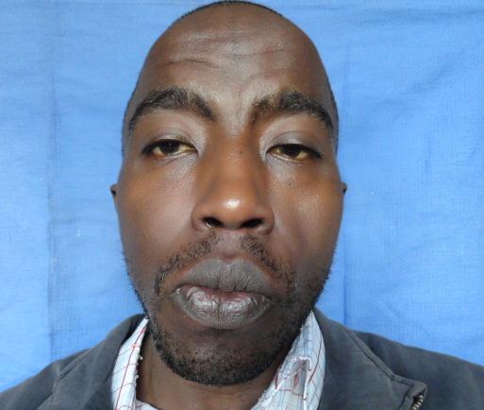
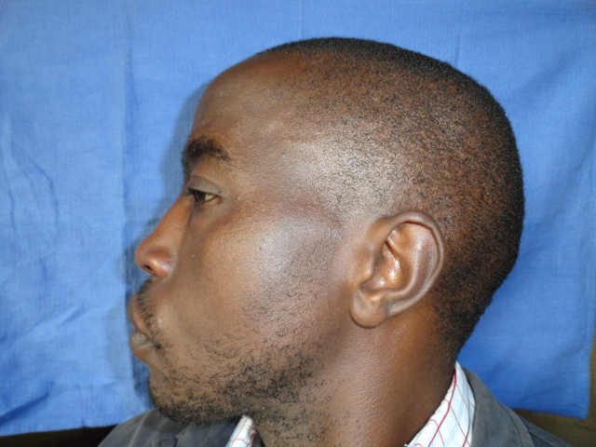
GORLIN-GORTZ SYNDROME

Slide 32
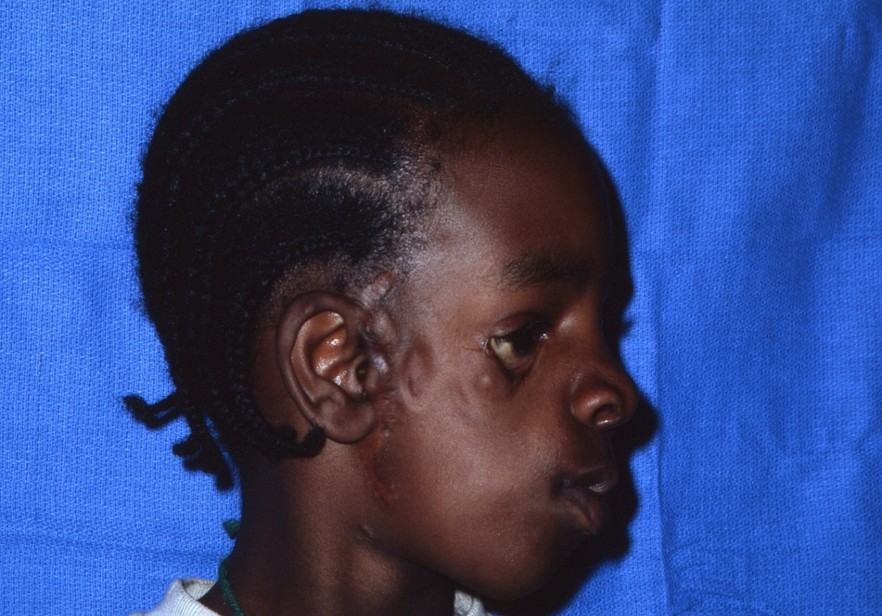
TREACHER COLLINS SYNDROME
Autosomal dominant inheritance.
1st-2nd Arch syndrome.
Associated with TCOF-1 gene [Treacle gene] Chromosome 5 mutation
Reverse S-craniofacial helix

