Slide 1
Antepartum Hemorrhage Year 3 lecture 2019
Prof. Zahida Qureshi

Slide 2
Definition:
APH is bleeding from or within the genital tract or
Per vaginum blood loss >15 ml
Cut off gestation varies
After 24 week and
28W used as the lower cut point in our set up
And prior to the birth of the baby.
prevalence
5% of all pregnancies
Accounts for 20 -25% of perinatal mortality
Causes:
Placenta previa
Abruptio placentae
Local causes: trauma, infection, tumors.
Vasa previa
Coaugulopathy
Ruptured uterus

Slide 3
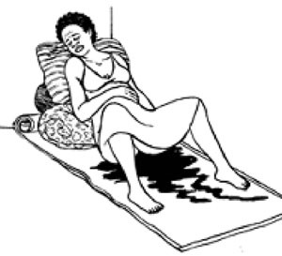

Slide 4
Different terminologies used
Spotting – staining, streaking or blood spotting noted on
underwear or sanitary protection
Minor haemorrhage – blood loss less than 50 ml that has
settled
Major haemorrhage – blood loss of 50–1000 ml, with no
signs of clinical shock
Massive haemorrhage – blood loss greater than 1000 ml
and/or signs of clinical shock.
Recurrent APH - > one episode

Slide 5
Danger sign in pregnancy
Emergency preparedness
Women should be informed during the antenatal clinic visits about vaginal bleeding being abnormal
Need to be prepared to come to a facility
Especially if the amount is excessive
Should be able to quantify the amount once they present to a health facility

Slide 6
Severity of bleeding
Volume Estimate | Percent of circularity volume | Type
500 ml or > | 10-15% | compensated
1000-1500 ml | 15-25% | mild
1500-2000 ml | 25-35% | moderate
2000-3000 ml | 35-50% | Severe (shock)
6

Slide 7
Placenta previa
Is the implantation of the placenta in the lower uterine segment
different grades of encroachment on the cervix.
Bleeding is: -painless
-causeless

Slide 8
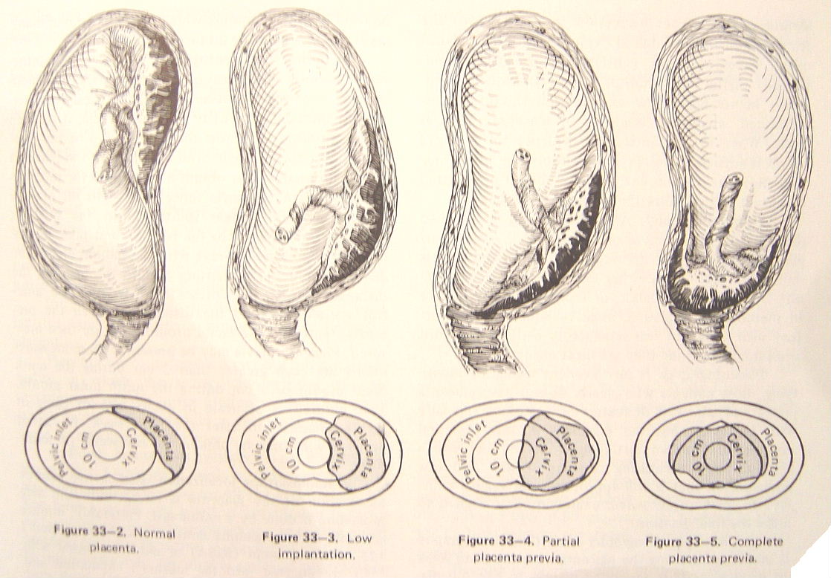
classification

Slide 10
Types of Placenta praevia I-IV

Slide 11
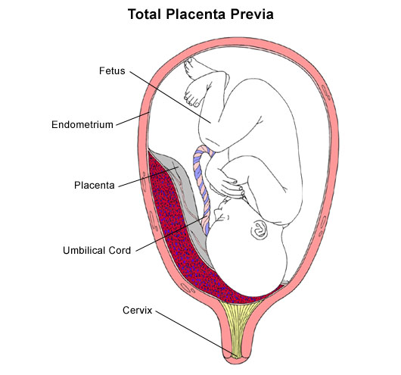
Placenta Previa

Slide 12
Abruptio Placentae
Is premature separation of a normally implanted placenta, may be precipitated by a sudden increase in blood pressure or trauma
Fetal parts are difficult to feel.
Feta heart sound may be absent
Signs of hypovolemia
Coagulopathies occur in 30% of cases

Slide 13
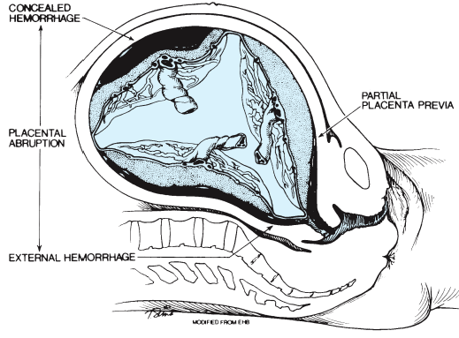

Slide 14
Sher’s Classification - Abruption
Grade I
Grade II
Grade III
III A
III B
Mild, often identified at delivery with retroplacental clot
Symptomatic, tender abdomen and live fetus
Severe, with fetal demise
- without coagulopathy (2/3)
- with coagulopathy (1/3)
Sher G, Statland BE. Abruptio placentae with coagulopathy: a rational basis for management. Clin Obstet Gynecol 1985;28(1):15-23.
22

Slide 15
Retro-placental clot

Slide 16
Diagnosis of APH
History
Physical examination
General examination
Vital signs
Speculum examination: contraindicated if PP is suspected
Ultrasound

Slide 17
Differences between PP and AP
PP
AP
Painless bleeding
Unprovoked usually
Clinical presentation corresponds with amount of blood loss
Baby usually alive
malpresentations
Painful bleeding
Trigger can be found eg PET, trauma
Clinical presentation not in keeping with amount of blood loss
Baby could be dead

Slide 18
Management
Supportive management
Two large bore intravenous cannulae
Draw blood for CBC, GXM, Coagulation profile
Fluid resuscitation
Blood transfusion if indicated
Definitive management
Depends on gestational age, fetal and maternal status
For Pp also depends on grade of praevia

Slide 19
If mother and or baby unstable, stabilise the mother then deliver as soon as possible through caesarean section
If mother and baby stable, do conservative management till term
Pp grade 1 and 2a…..can deliver vaginally
Pp grade 2b-4…deliver through caeserean section

Slide 20
Uterine Rupture
Occult dehiscence vs. symptomatic rupture
0.03-0.08% of all women
0.3-1.7% of women with uterine scar
Previous cesarean incision most common reason for scar disruption
Other causes: previous uterine curettage or perforation, inappropriate oxytocin usage, trauma
26

Slide 21
Risk Factors – Uterine Rupture
Previous uterine surgery
Uterine or fetal anomaly
Uterine over-distention or trauma
Placental factors
History of difficult placental removal
Placenta increta or percreta
Consider US or MRI to evaluate uterine wall
Gestational trophoblastic neoplasia
Adenomyosis
27

Slide 22
Clinical Findings – Uterine Rupture
Sudden deterioration of FHR pattern is most frequent finding
Vaginal bleeding
Pain
Cessation of contractions
Loss of station
Palpable fetal parts through maternal abdomen
Profound maternal tachycardia and hypotension
29

Slide 23
Complications of APH
Maternal complications
Anaemia
Maternal shock
Consumptive coagulopathy
Postpartum haemorrhage
Prolonged hospital stay
Psychological sequelae
Complications of blood transfusion
Renal tubular necrosis
Fetal complications
Fetal hypoxia
Infection Small for gestational age and fetal
growth restriction
Prematurity (iatrogenic and
spontaneous)
Fetal death

