Slide 1
LYMPHATIC FILARIASIS
KIMAIGA H.O
MBChB (University of Nairobi)

Slide 2
Filariasis
Species | Periodicity | Vector | Adult location | Micrifilaria location
Wuchereria bancrofti | Nocturnal | Culex sp. Anopheles sp. Aedes sp. | Lymph | Blood
Brugia malayi | Nocturnal | Mansonella sp. Anopheles sp. | Lymph | Blood
Loa loa | Diurnal | Chrysops sp. (Deer fly) | Sub-cutaneous | Blood
Onchocerca volvulus | None | Simulium sp. (Black fly) | Sub-cutaneous | Skin
Mansonella pertsans | None | Culicoides sp. (Biting midge) | Body cavity | Blood
Mansonella streptocercus | None | Culicoides sp. (Biting midge | Body cavity | Blood

Slide 3
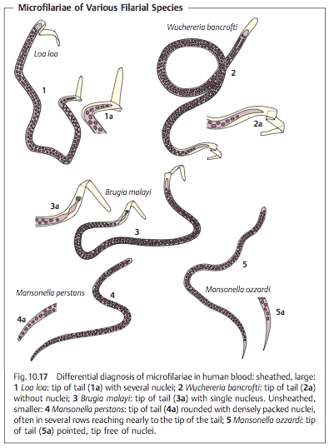

Slide 4
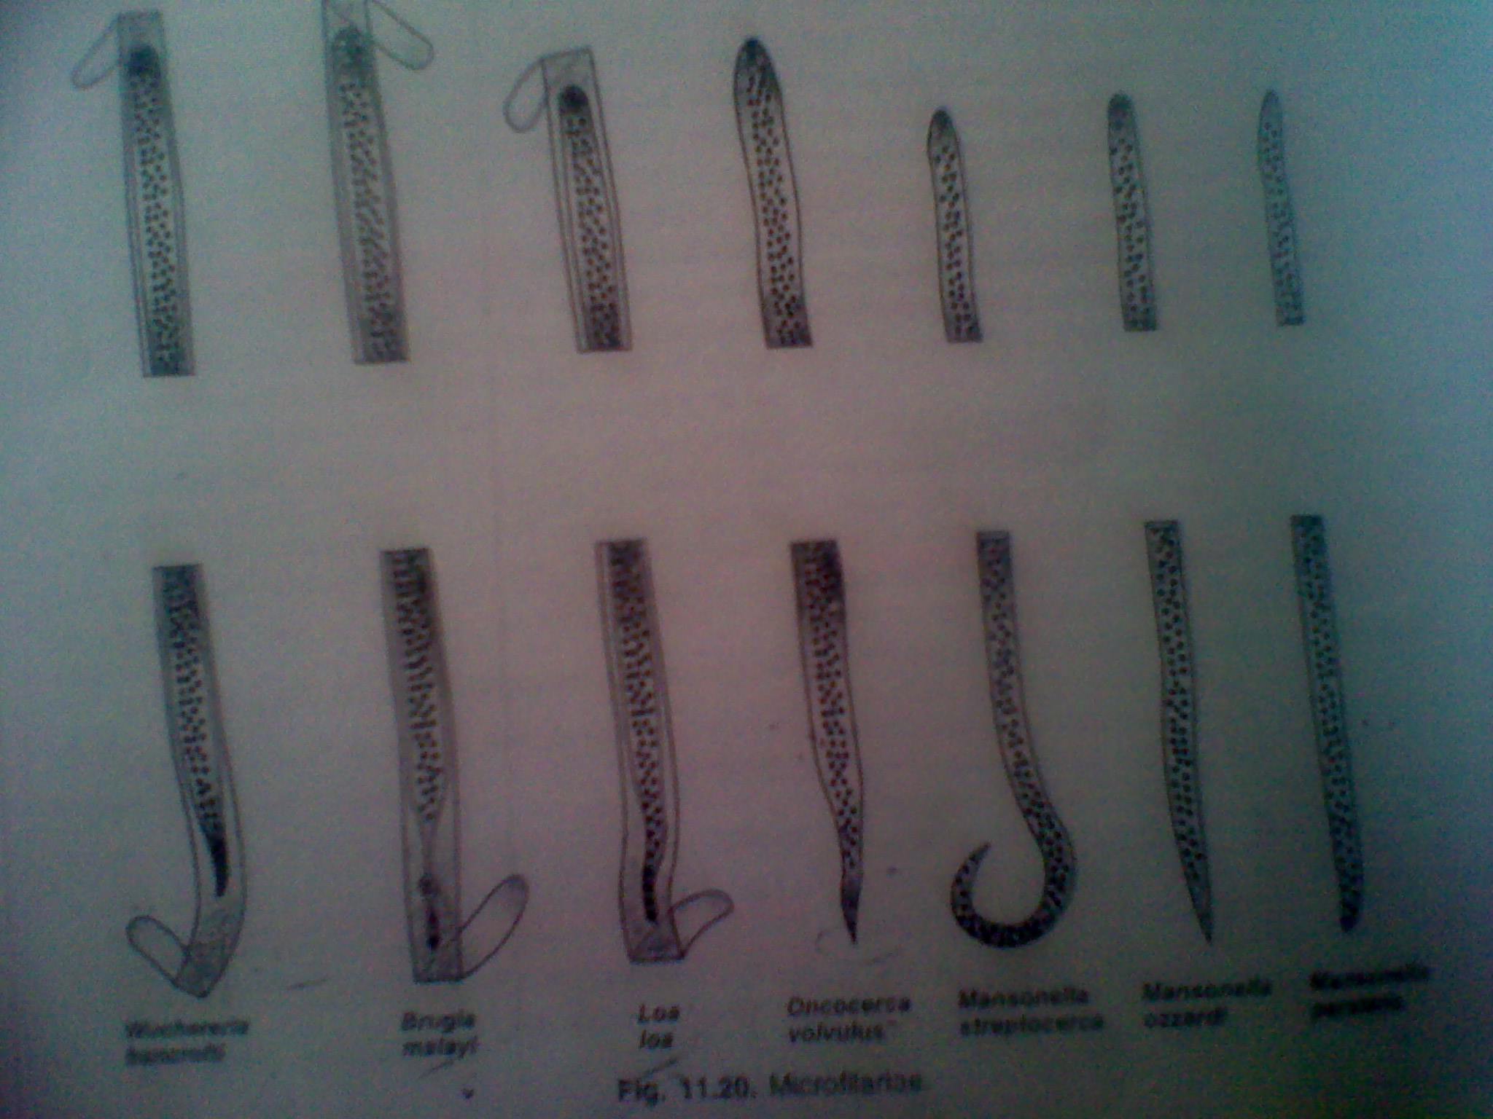

Slide 5
PATHOGENIC PARASITES
LYMPHATIC FILARIASIS
Causative agent
Filariasis is caused by the Wuchereria bancrofti, a tissue nematode worm that infects about 115 million people globally especially Africa.
It is the most widely distributed filarial parasite.
Other nematodes are Brugia timori and Brugia malayi.
The disease is more disfiguring than dangerous

Slide 6
Distribution
120 million infected, >40 million with clinical disease
In Africa, filariasis is most frequent in the tropical coast belts and lake regions. Since the disease is transmitted by mosquitoes, it is rare in high altitudes and dry regions.
Geographical distribution:
  Asia - china, india, indonesia, japan,malaysia, Phillippines e.t.c
  Africa: East Africa coasts from Ethiopia to Mozambique, West Africa coasts – Nigeria, Ghana, Ivory Coast e.t.c
  Central and South America
  Pacific Islands
Filariasis is frequent in coastal regions and the lake regions.
In the coastal regions, 30% of adult males have hydroceles, a late manifestation of the infection.
Associated with worm humid climates (Kwale, tana, malindi, coast in Kenya)
Found both in rural and urban communities
Has Age- specific prevalence; rises with age
Gender differences associated with cultural practices resulting in differential exposure to infections btw sexes in different communities

Slide 7
Geographical distribution

Slide 8
Morphology
Adults:
  Whitish, threadlike
  Female longer than male
  Male: 2.5- 4 cm, Female: 5-10 cm
Microfilariae (Wurchereria bancrofti)
  Sheathed
  nuclei clearly separated, do not extend to the tip of the tail
Microfilariae (Brugia malayi/ brugia timori)
  sheathed,
  nuclei, appear matted, 3 nuclei extend to the tail

Slide 9
Agent’s reservoir
The adult worm lives in the human lymph vessels, mates and produces millions of microscopic larvae known as microfilariae in blood

Slide 10
Route of exit from the reservoir
Microfilariae circulates in the person’s blood and infects the mosquito when it bites an infected host.
Microfilariae have nocturnal periodicity i.e They are scarce in peripheral blood by day and increase at night.

Slide 11
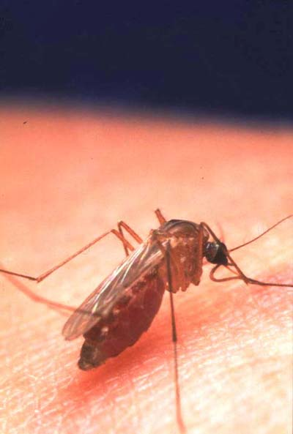
Mode of transmission
Vector borne: transmitted by different mosquito spp depending on the geographical area.
In Africa ,the commonest vector is Anopheles and in the America , it is Culex quinquefasciatus. Aedes and Mansonia can transmit the infection in the Pacific and in Asia.
Route of entry into the susceptible host- When mosquito carrying microfilarial larvae bites a new host, it deposits larvae into the subcutaneous tissues of the host.

Slide 12
Microfilariae develop to infective stage filariform (L3) after 10 days
L3 deposited in bites, gets into blood then to lymphatics
They grow into adult worms , a process that takes 6 months or more. The adult worms lives for about 5-7 years.
Adults mate and produce microfilariae which gets into blood again.

Slide 13
Life Cycle of Wuchereria bancrofti
Adults mate, fertilized female produces microfilariae
Microfilariae in blood is taken up by the mosquito when it sucks blood of an infected person.
Microfilariae have nocturnal periodicity (more likely to be in blood at night btw 10 pm and 2 am) but diurnal strains occur in some parts of the world
In the mosquito microfilariae penetrates stomach wall, migrate to flight muscles then through the hemocoel to proboscis

Slide 14
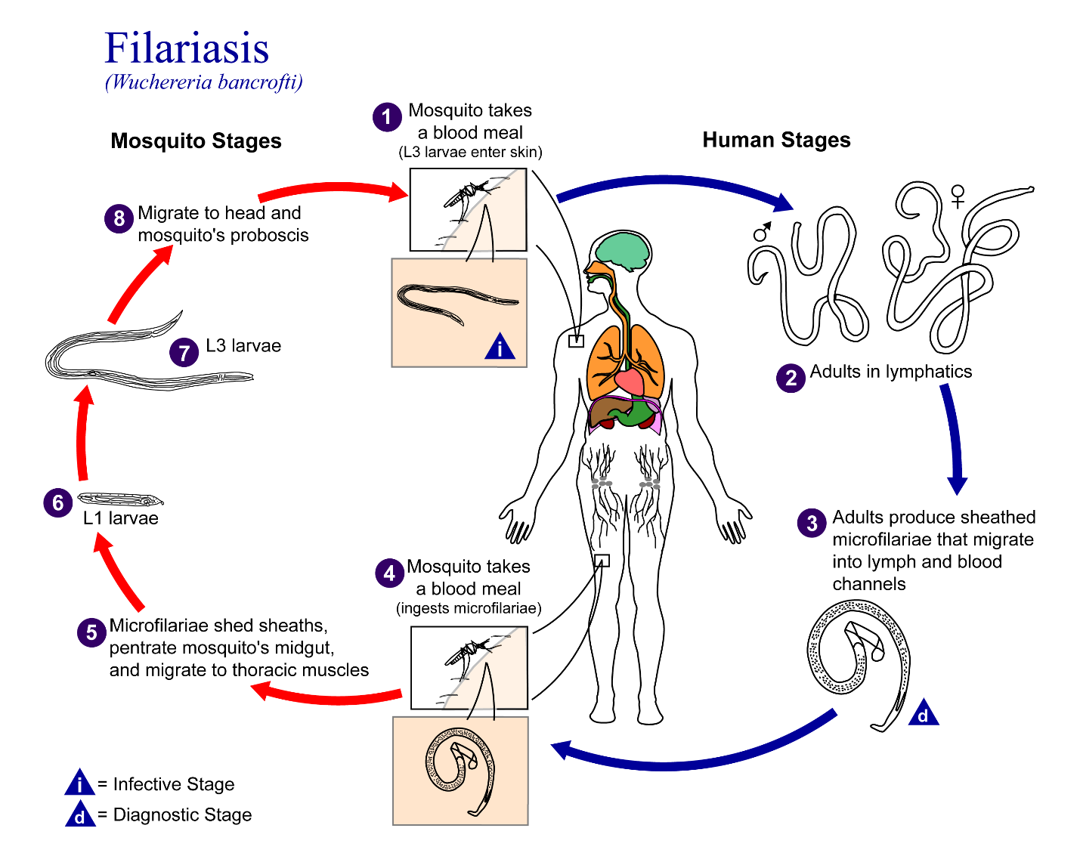

Slide 15
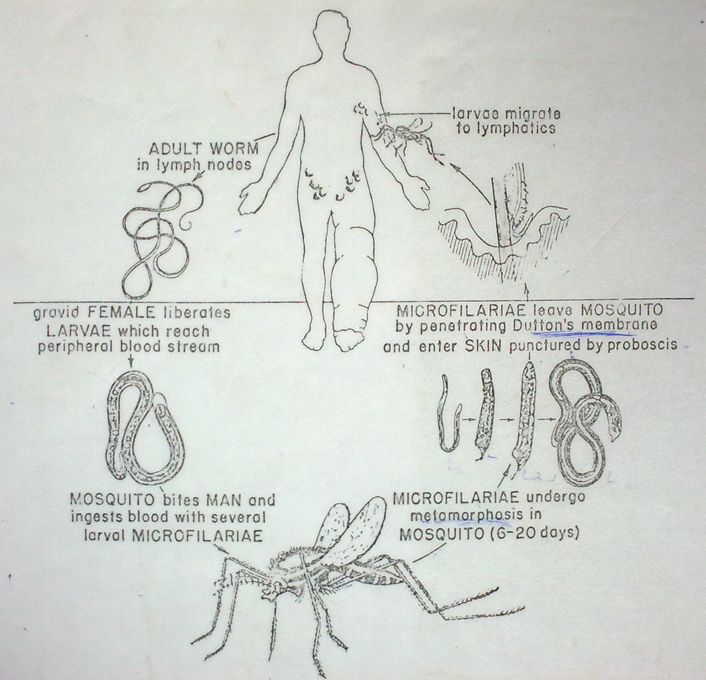

Slide 16
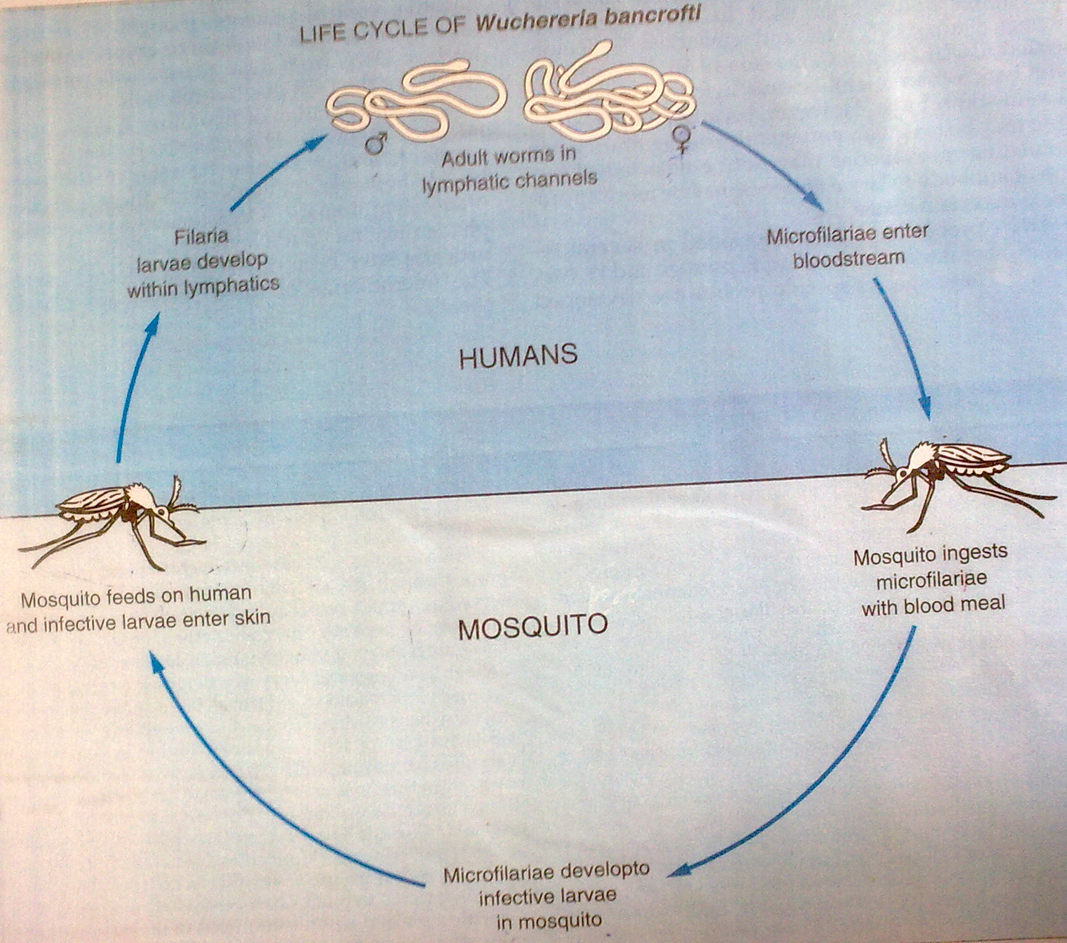

Slide 17
Response to the agent or its toxins
The presence of worms in the lymph vessels give rise to a foreign-body reaction.
When the worms die, more foreign proteins are released causing an even more severe reaction.

Slide 18
Description of the CD incl. Signs and symptoms
Although the parasite damages the lymph system, most infected people have no symptoms and will never develop clinical symptoms. Unless tested, one can’t know whether they are infected.
Three phases may be distinguished;

Slide 19
Bancroftian filariasis | Main Signs and Symptoms | Blood smear
Acute phase (first months) / Early stages (Acute manifestation) | Fever Chills Lymphadenitis Lymphangitis Orchitis Epididimytis Eosinophilia | Negative
Subacute phase / Late stage (chronic manifestation) – block lymph flow | Adult worms cause: -Fever -Lymphadenitis -Funiculitis -Epididymitis -Hydrocele Microfilariae cause: -Hypereosinophilia -Asthma-like attack - Fliarial/ elephantoid fever | Positive
Chronic phase | Lymphoedema of legs, arms or breast Elephantiasis Chyluria Hydrocele Tropical pulmonary eosinophillia.- associated with autoimmune rxn – difficulty in breathing, wheezing, cough, fever. | Negative

Slide 20
Occult filariasis (Meyers-Kouwenar syndrome) (microfilariae)
  Occult – can’t be seen coz it’s caused by microfilariae
  Massive eosinophilia
  Generalized lymph node enlargement
  Hepatosplenomegaly
  Pulmonary symptoms
  Absence of microfilaremia
Tropical pulmonary eosinophilia (eosinophilic lung, Weingarlen’s syndrome)
  Low fever
  Weight loss
  Paroxysmal coughs with scanty (blood-stained) sputum
  Dyspnoea (not expiratory)
  Splenomegaly
  Chest radiography – bronchovascular markings or diffuse mottling in the lung fields

Slide 21
Inflammation
Dilation of lymphatics – lymphangiovarix
Rupture of lymphangiovarix
  Lymphorrhagia – lymph scrotum, lymphocele, lymphuria
  Chylorrhagia – chylocele, chyluria or haematochyluria, chylous diarrhoea, chylous ascites & chylothorax
Hyperplasia of skin and connective tissue
Secondary bacterial infections (Strep pyogenes, Staph aureus)
Septic lymphangitis, abscesses & septicaemia
NB: when lymph leaks out into tissues, it causes hyperplasia of surrounding tissues coz it’s rich in proteins. Usually bone & *** are not affected. Mostly affected tissues are subcutaneous.

Slide 22
Lymphangitis
  May involve lymphatics of
    Testicle & epididymis (epididymo orchitis)
    Spermatic cord (funicular varices)
    Abdomen (retroperitoneal lymphangitis)
    Upper and lower extremities
  Lymphadenitis
    Groin & axilla (soft, more or less lobulated masses)
Hydrocele (E. Africa, Japan & China, less common in India & Pacifics)
  Recurrent orchitis & epididymis
  W/without scrotal elephantiasis
  Thickening of spermatic cord – lymphatic varicoceles (funicular lymphangiovarices)

Slide 23
Elephantiasis (East Africa, China, India and Pacific, rare in W. Africa)
  (legs, arms, breast, scrotum)
  Enormous enlargement tumour-like solidity
  Due to fibrotic constriction of all afferent lymphatics draining the part e.g.
    Legs – obstruction of inguinal and ileac lymph nodes, scrotum
    Obs of superficial inguinal lymph nodes
  Hypertrophy & hyperplasia
  Commonly affected organs
    Legs, scrotum, penis, labia, clitoris, & vulva, breast & forearm
  Podoconiosis is not the same as elephantiasis! In areas of high altitudes with loam soil, walking bare foot one abs silicates from soil through skin thus provoking granuloma and development of filariasis which is not due to filari worms.
Chyluria (China, Japan & S. India, rare in Africa & Pacific)
  Rupture of varicose lymphatic chyle vessels through urinary tract mucosa into the urinary tract)
  Escape of chyle through urine hence whitish urine

Slide 24
Occult & classical filariasis differences
 | Classical filariasis | Occult filariasis
Cause | Developing worms and adults | Microfilariae
Basic lesions | Acute inflammation followed by an epitheloid granuloma surrounding the adult worm and a fibrosis scar | Eosinophilic granuloma
Organ induced | Lymphatic system | Lymphatic system, lungs, liver & spleen
Microfilaria | Present in blood | Present in affected tissues, but not in blood
Therapeutic response | No response to any drug | Responds to microfilarial drug, diethylcarbomarzine
Serological test | Complement fixation | Complement fixation test highly sensitive to***

Slide 25
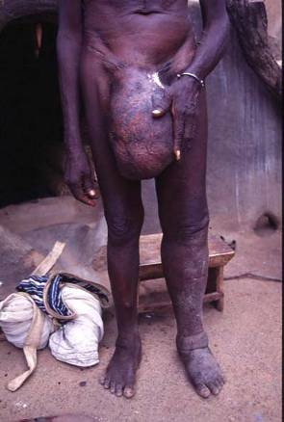
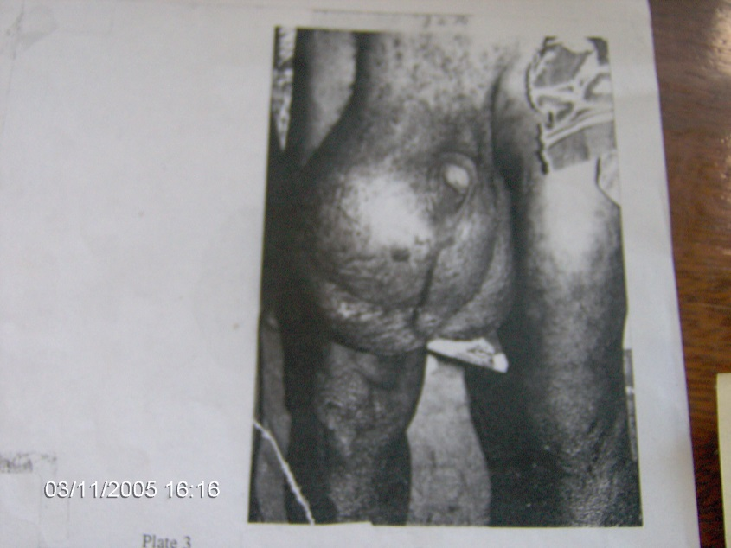
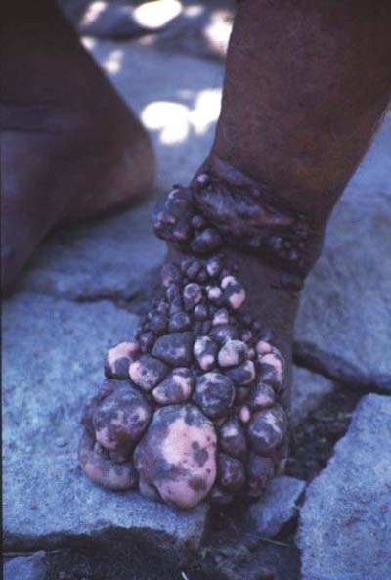
filariasis - hydrocele - most common
manifestation in bancroftian filariasis in East Africa
The foot of an elderly man who had to give up his job due to to his elephantiasis

Slide 26
Diagnosis
History of living in the endemic areas for years
Physical examination findings
Blood examination (night samples) for microfilariae
  Thick blood smears staining (Giemsa/Wrights)
  Bapillary tube examination
  Blood filter (nucleopore)
DEC (Diethyl carbamazine) provocation test (DEC 50mg then blood after 30 min)
Ultrasound of the scrotum – filarial dance sign (adults seen, appear to be dancing)
Serological tests – filarial specific antibodies e.g IgG; circulating filarial antigens (CFA)

Slide 27
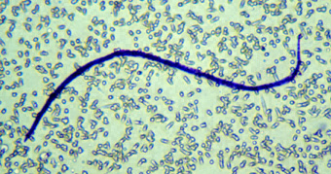
The microfilaria of Wuchereria bancrofti are sheathed and measure 240-300 µm in stained blood smears and 275-320 µm in 2% formalin. They have a gently curved body, and a tail that is tapered to a point. The nuclear column (the cells that constitute the body of the microfilaria) is loosely packed; the cells can be visualized individually and do not extend to the tip of the tail. Microfilariae circulate in the blood.

Slide 28
Microfilariae of Brugia malayi are sheathed and in stained blood smears measure 175-230 µm. In 2% formalin they are longer, measuring 240-300 µm. The tail is tapered, with a significant gap between the terminal and subterminal nuclei. Microfilaria circulate in the blood.

Slide 29
Microfilaria of Brugia timori are sheathed and measure on average 310 µm in stained blood smears and 340 µm in 2% formalin. Microfilaria of B. timori differ from B. malayi by a having a longer cephalic space, a sheath that does not stain with Giemsa, and a larger number of single-file nuclei towards the tail. Microfilariae circulate in the blood.

Slide 31
NB: comparisons
W. bancrofti - The posterior end of the worm is devoid of nucleus, and it is sheathed. Pointed end.
Loa loa – nuclei go all the way to the bottom. Ensheathed,
M. malayi – sheathed, posterior end has single nucleus.

Slide 32
Treatment
The DOC is Diethylcarbamazine [Hetrazane or Banocide].
  This kills the microfilariae and also has some effect on the adult worm. It should not be given during the acute phase but afterwards.
  The dose is 150mg[3 tablets] 3 times a day for an average adult. Treatment should be given for 12 days.
  Should not be used in places with onchocerciasis occuring together with lymphatic filariasis
Another treatment option is Ivermectin
  These drugs are used either alone or in combinations
  The 2 drugs are only effective against microfilariae
  No effect on adult worm
  Given during the acute phase
Albendazole

Slide 33
Management cont...
To avoid reactions , antihistamine drugs and /or steroids can be given during the first days of treatment.
Hydrocelectomy - Surgical treatment is indicated for hydrocele and is sometimes possible for elephantiasis of the legs and scrotum .Refer patients for whom surgery might be indicated.

Slide 34
Others
  Daily foot-washing with soap, water & antiseptic
  Use of emollient due to hardening. Used to soften tissue
  Bandaging in selected px
  Elevation of the leg
  Controlled exercises
  Compression bandaging

Slide 35
Prevention and Control
Vector control by treating septic tanks and pit latrines regularly by insecticides and larvicides e.g polystyrene powder
The human reservoir can be reduced through organised mass campaigns e.g annual mass treatment using DEC or ivermectin to reducing the level of microfilariae in the blood and thus, diminishes transmission of infection.
Personal protection to reducing exposure to the infection can be achieved by screening houses , closing eavesusing mosquito bed net and insect repellants

Slide 36
Bancroftian filariasis and Elephantiasis

Slide 37
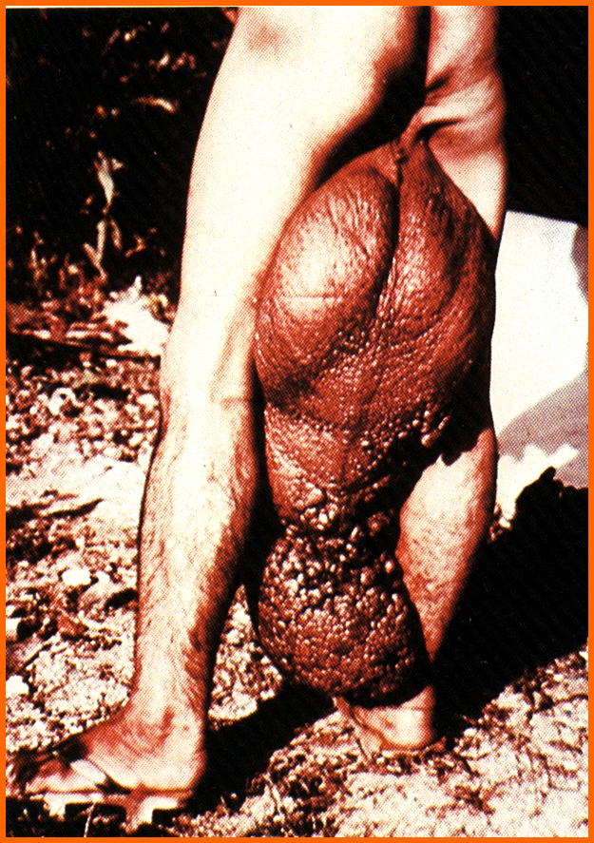
Bancroftian filariasis
Bancroftian filariasis:Elephantiasis of scrotum

Slide 38
Life Cycle of Brugia malayi
The typical vector for Brugia malayi filariasis are mosquito species from the genera Mansonia and Aedes. During a blood meal, an infected mosquito introduces third-stage filarial larvae onto the skin of the human host, where they penetrate into the bite wound . They develop into adults that commonly reside in the lymphatics . The adult worms resemble those of Wuchereria bancrofti but are smaller. Female worms measure 43 to 55 mm in length by 130 to 170 μm in width, and males measure 13 to 23 mm in length by 70 to 80 μm in width. Adults produce microfilariae, measuring 177 to 230 μm in length and 5 to 7 μm in width, which are sheathed and have nocturnal periodicity. The microfilariae migrate into lymph and enter the blood stream reaching the peripheral blood . A mosquito ingests the microfilariae during a blood meal . After ingestion, the microfilariae lose their sheaths and work their way through the wall of the proventriculus and cardiac portion of the midgut to reach the thoracic muscles . There the microfilariae develop into first-stage larvae and subsequently into third-stage larvae . The third-stage larvae migrate through the hemocoel to the mosquito's prosbocis and can infect another human when the mosquito takes a blood meal .

Slide 39
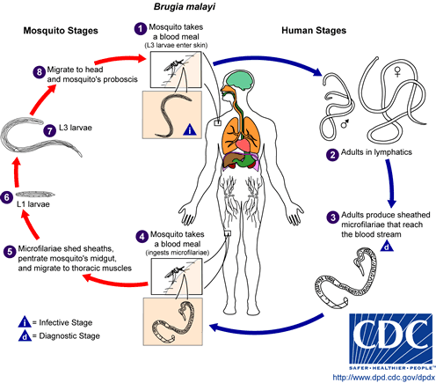

Slide 40
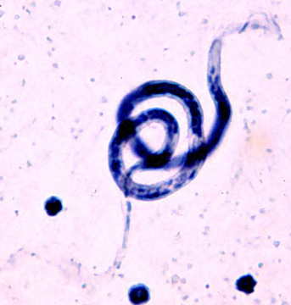
B. Malayi
(microfilaria)

