Slide 1
ONCHOCERCA VOLVULUS
KIMAIGA H.O
MBChB (University of Nairobi)

Slide 2
ONCHOCERCA VOLVULUS
Tissue nematode, helminth worm found in subcutaneous tissue
Found in West and central Africa, parts of east Africa (not Kenya), the Middle east, Central and South America
Adults found in subcutaneous nodules
Microfilariae found in the skin, but do sometimes appear in blood, in the eye in heavy infections
May be found in urine, sputum and CSF especially after rx
Causes onchocerciasis (river blindness) the world’s 2nd leading cause of blindness.

Slide 3
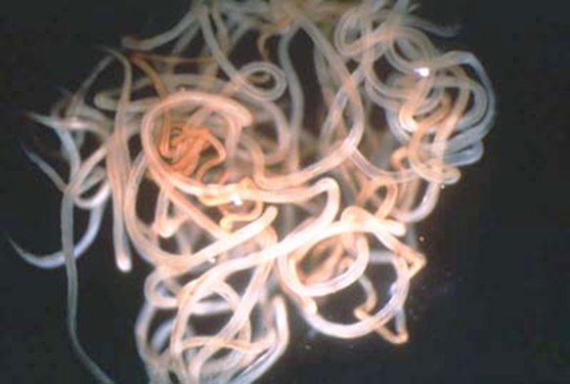
Morphology
Adults – cylindrical worms. Females are 30- 50 cm; males are 20 -40 cm long
Can live in a human body for up to 15 years.
Microfilariae – unsheathed, 300- 320 micrometers in length, tail tapes to a point, nucleus does not extend to the tail end

Slide 4
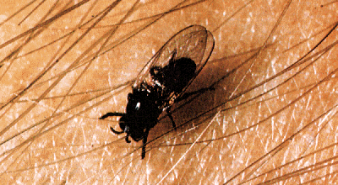
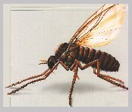
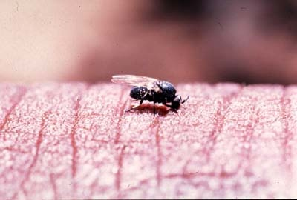
It’s Vector: Simulium damnosum (black fly) spreads Onchocerca volvulus which causes onchocerciasis.
Black fly of genus : Simulium : damnosum, neavei, ethiopiense and woodi.

Slide 5
Life cycle
Adults mate, fertilized females produce microfilariae
Microfilariae in skin is taken up by Simulium flies (S.domnosum)
  Blackfly lay eggs on fast flowing waters/well oxygenated water where the larvae develop (larvae require high oxygen) (thus found in rivers – river blindness); phoretic relationship with crabs
In the mosquito - microfilariae penetrates stomach wall, migrate to flight muscles then to proboscis, development to infective stage ~ 10 days

Slide 6
When the mosquito feeds again, Microfilariae deposited in bite and develop to adults in subcutaneous nodules
Worms mature and produce microfilariae; about 9-12 months, adults 10 – 15 yrs
Man is the only definitive host of the parasite.
Other possible modes of transmission – congenital
  1:20 newborns babies in heavily infected areas have mf in their skin soon after birth
  Microfilariae in blood transplacental e.g after rx
  Adults cross placenta and establish in babies.

Slide 7
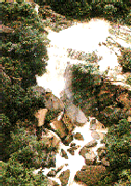
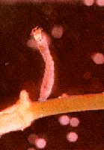
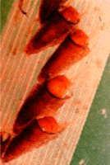

Slide 8
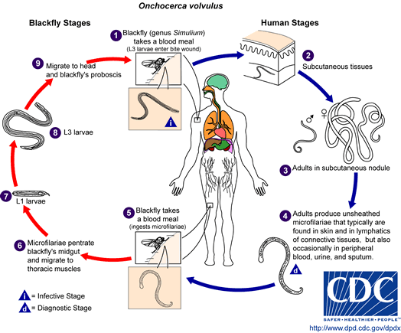

Slide 9
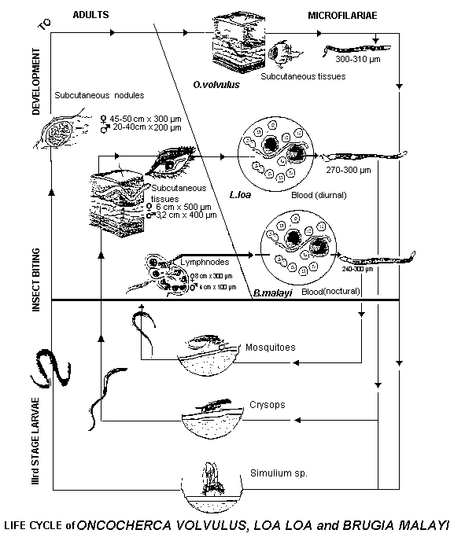

Slide 10
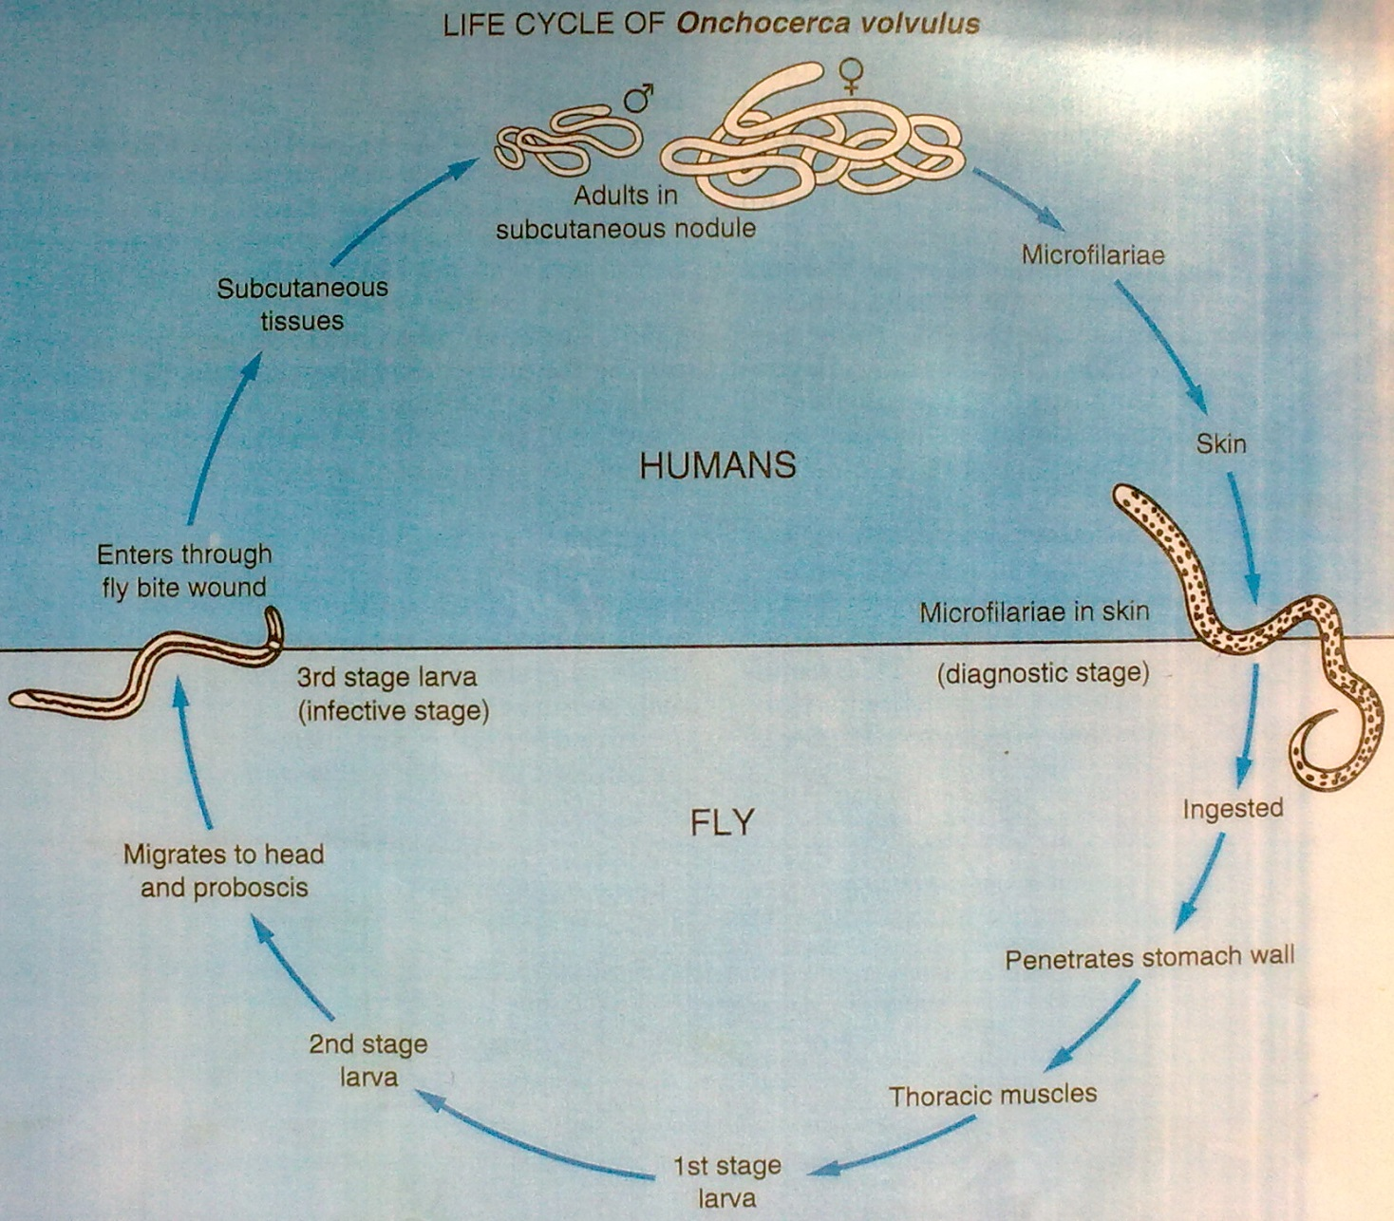

Slide 11
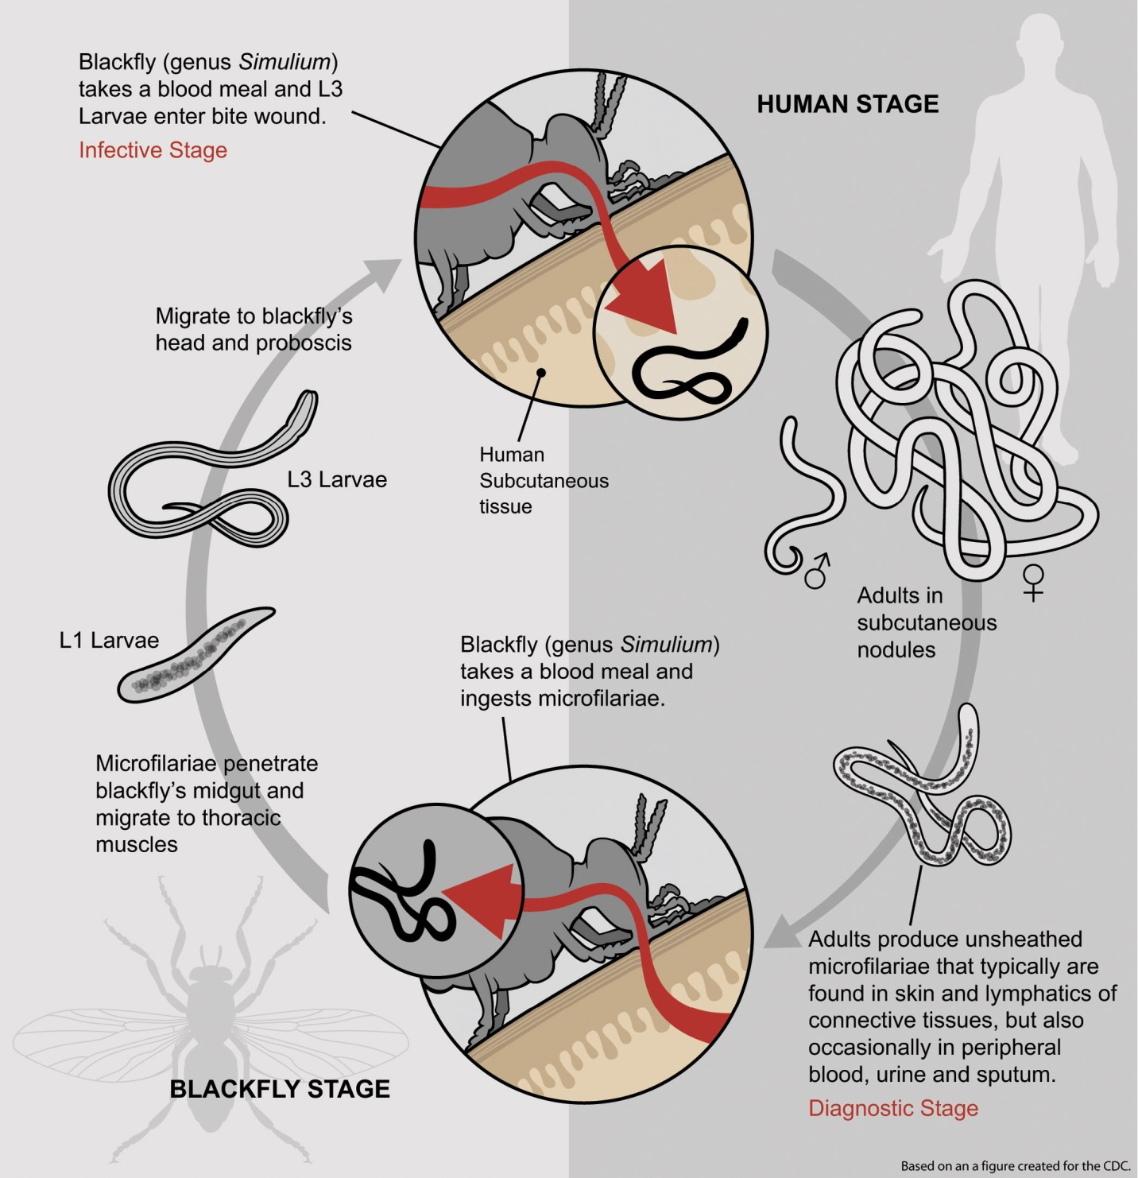

Slide 12
Clinical presentation
Incubation period 15 – 18 months, may be asymptomatic
Pruritis of the skin, skin rash, intense itching and lesions
Subcutaneous nodules (onchocercomas) in bony prominences. In Africa normally around the hips, in South & Central America on the head
Lymphadenitis resulting in hanging groins (loss of skin elasticity)
Elephantiasis of the scrotum in males

Slide 13
Serious visual impairment and blindness
Pathological lesions
  Subcutaneous fibrous nodules (onchocereomas)
    Can be as large as 6 cm
    Single or multiple nodules
    Painless and non-suppurating
    Concentric mass of fibrous tissue with a honeycomb central area
  Ocular lesions
    In person with nodules on head or face
    Due to microfilariae – may be found moving through substantia propria of cornea and in anterior chamber
    Manifestations – simple conjunctivitis, small round opacities, pannus in anterior quadrant of cornea, iridocylitis, secondary glaucoma, optic atrophy, blindness
SOWDA – arabic for dark, results from strong immune response by the host; Cells involve upper dermis usually localized to one limb, itchy, swelling, dark with scaling papules, enlarged regional lymph nodes.

Slide 14
Lizard skin –Xeroderma due to lichenification and thickening of skin
Presbyderma – loss of skin elasticity, premature aging
Leopard skin – skin depigmentation in patches
Hanging groin (loss of skin elasticity)
Arthritis – may be monoarthritis affecting the large joints e.g hip, pain disappears rapidly on rx

Slide 15
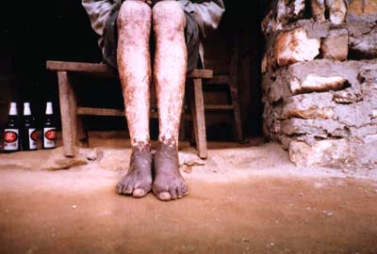
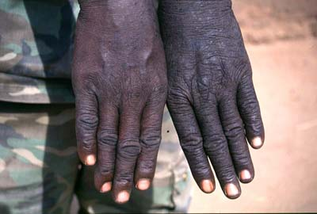
Maddening itching, depigmentation (leopard skin), and thickened skin

Slide 16
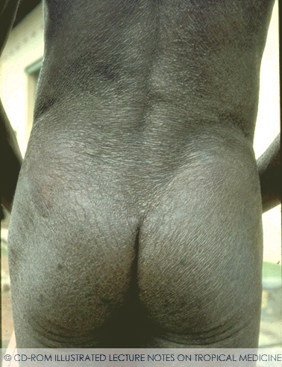

Slide 17
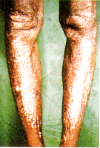
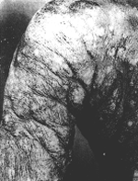
Destruction of elastic tissue, formation of redundant folds and loss of pigmentation

Slide 18
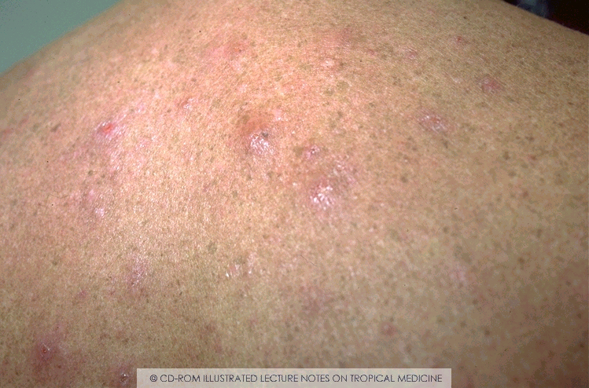

Slide 19
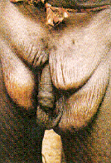
Lymph glands in pockets of skin : ‘hanging groin’ , in severe cases ‘minor elephantiasis’

Slide 20
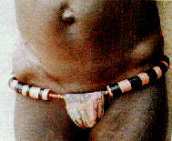
Nodules over bony prominences

Slide 21
Pathophysiology:
Inflammatory cells comprising : Eosinophils, Neutrophils and Macrophages surround the dead microfilariae
IgG antibodies, immune complex formation and complement activation on the surface of microfilariae attract cells, killing of mf. And inf. larvae ( Greene B.M. et. al.,1981; J. Immunology ). Does not confer protective imm.
Microfilariae : antibody dependent cell mediated cytotoxicity reaction (ADCC).
Humoral response is marked in endemic areas ( Greene B.M. et. al.,1985; Rev. Infect Dis ).
Nodules : with thick fibrous wall with cellular infiltrate, formed by granulomatous reaction around adult worm. Calcification of nodules and dead worms can occur.
Macrophages : filled with lipid are found.( Gatrill A.J. et. al., 1987; Histochem J.)

Slide 22
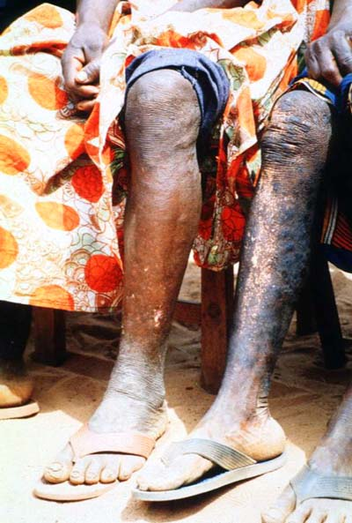
  Lichenified dermatitis (sowda, i.e., a localized form of chronic papular dermatitis usually confined to one extremity) involves edema, hyperpigmented papules and plaques, and intense pruritus that is usually limited to a single limb and associated with regional lymphadenopathy.

Slide 23
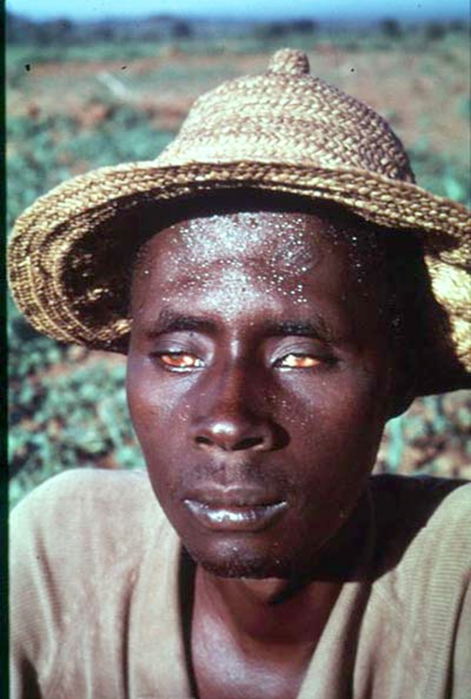
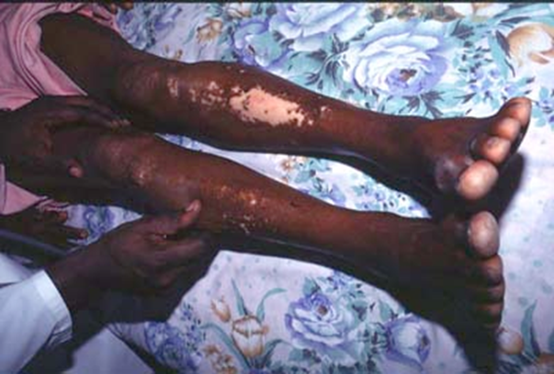
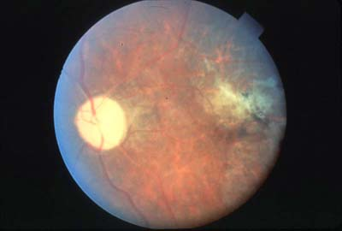

Slide 24
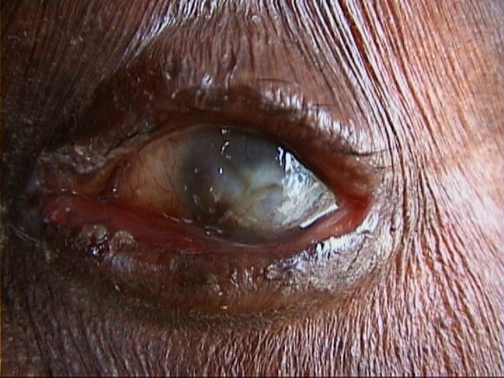
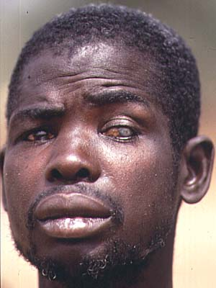

Slide 25
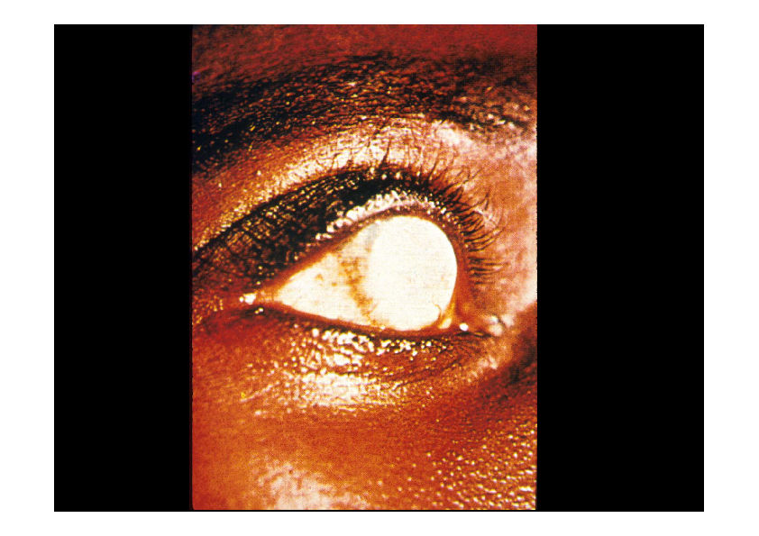

Slide 26
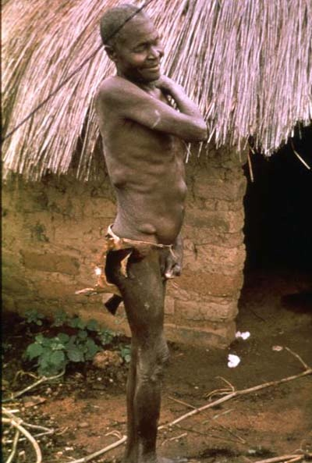
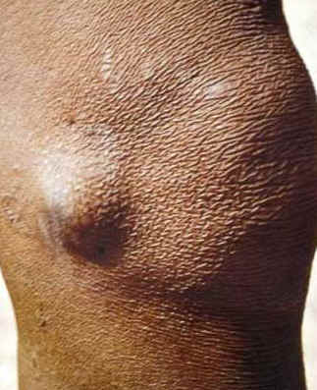
Oncocercomata (onchocercal nodule)

Slide 27

Nodules containing O.Volvulus on the head.

Slide 28
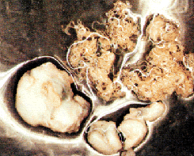
Cross section of worms in Subcutaneous nodules.

Slide 29
Diagnosis
Search for the presence of microfilariae in blood, urine and eyes.
  Detection of microfilariae of O. volvulus in the cornea or anterior chamber of the eye using slit-lamp examination.
Search for adult worms (macrofilariae)
Skin snips (thighs, buttocks, scapula, iliac crest), place in normal saline to allow m.f to migrate; examine after 12 – 24 hrs for microfilariae in wet preparations then stain (e.g Giemsa) and examine for features (unsheathed, nucleus not reaching tip of tail)
Microfilariae - negative form skin snips in SOWDA

Slide 30
Mazzotti skin tests
  Administer a single small dose of DEC (50-100 mg).
  After 2 -24 hrs intense pruritus with or without erythema is elicited over involved areas, which indicate the death of microfilariae in the skin
  Steroids may be necessary to control this inflammatory reaction
  The test must be used with caution in individuals who may be heavily infected because a severe systemic reaction can be provoked. A DEC patch test that causes a localized skin reaction may be used in such patients.
Immunodiagnosis/ Serological tests for detection of filarial antigen: – ELISA, FAT
  Commercial kits are available to test venous blood and can be quantitative (enzyme-linked immunoassay [ELISA]) Og4C3 monoclonal antibody–based assay or qualitative immunochromatographic test (ICT).
Eosinophilia (non-specific)

Slide 31




1 & 2 ) Blood free skin snip. 3) Skin biopsy. 4) Skin fragment.

Slide 32
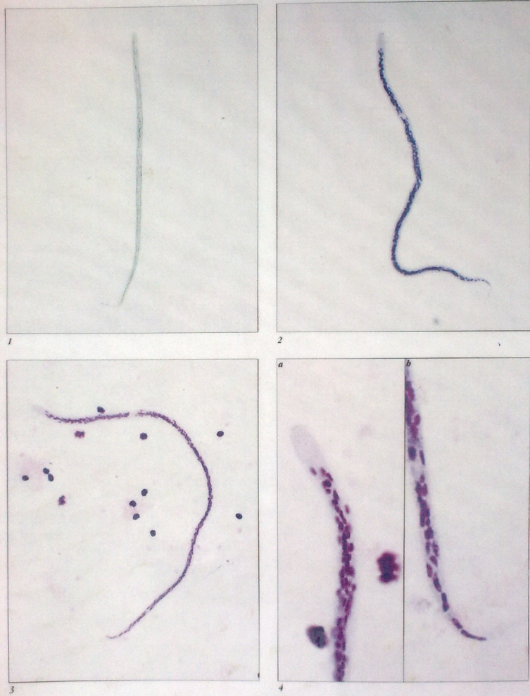
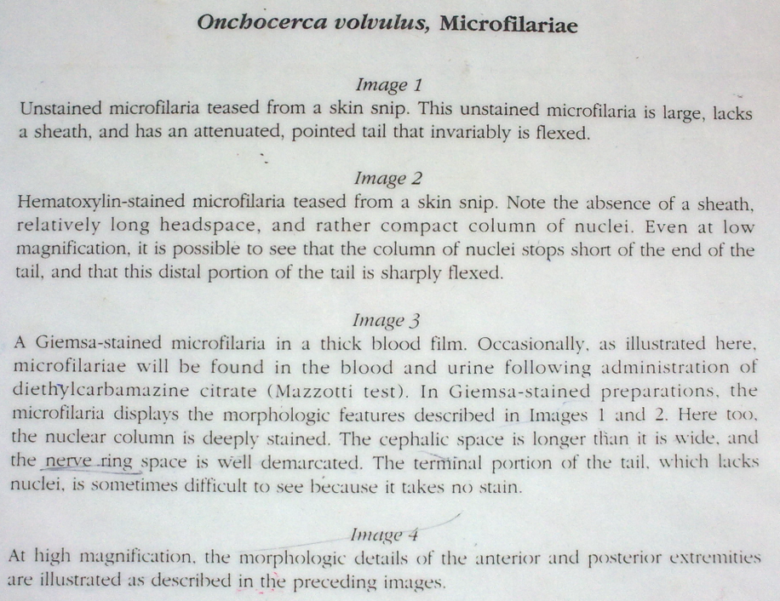

Slide 33
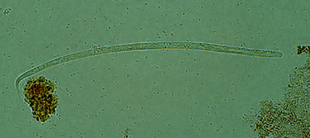
O. volvulus
(microfilaria)

Slide 34
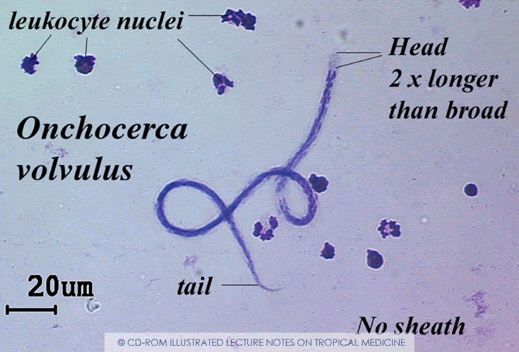
Cephalic space
Microfilariae of O.Volvulus are longer and do not have nuclei to the end of tail. sheath less, sharply pointed and curved tail.
(Giemsa stain).

Slide 35
Microfilariae of Onchocerca volvulus are unsheathed and measure 300-315 µm in length. The tail tapers to a point and is often sharply bent. The nuclei do not extend to the tip of the tail. Microfilariae typically reside in skin but may be found in blood or urine during heavy infections, or invade the eye and cause a condition known as river blindness.
Adult males of Onchocerca volvulus measure 15-45 mm in length; females are 30-50 cm. Adults usually reside in nodules (onchocercomas) in subcutaneous tissue.

Slide 36
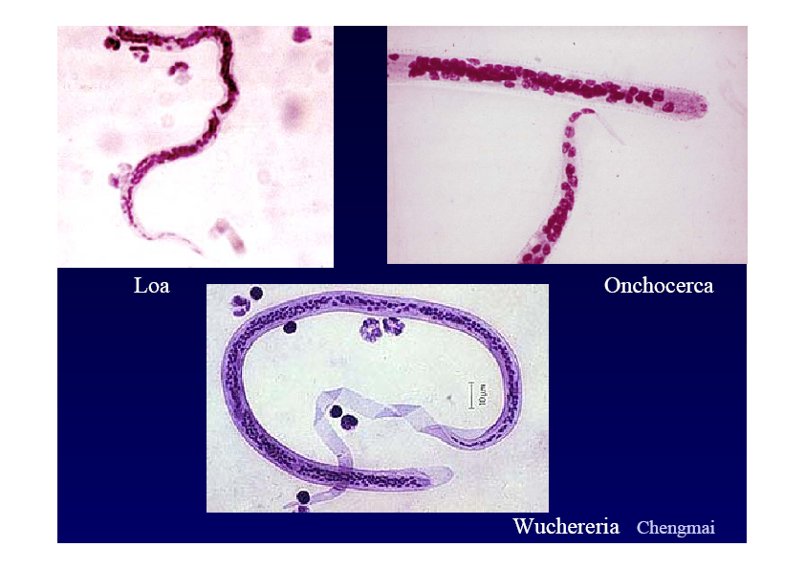

Slide 38

Treatment
Diethylcarbamazine (DEC) only kills microfilaria. Causes hyperpolarization of nerve membrane and flaccid paralysis of the nematode, worms are removed by normal peristalsis
Ivermectin (Mectizan®)- (150 microgram/kg single dose) only kills microfilaria. Binds to glutamate gated chloride channels in the parasites’ nervous system, causing them to open.
Suramin only kills macrofilaria should be used in extreme cases because of toxicity.

Slide 39
Use of Doxycycline has irreversibly eliminated skin microfilaria through direct effect on endosymbiont. But not suitable for mass treatment (too long
Both benzodiazepines Diazepam and Midazolam had a synergistic effect on the activity of ivermectin
Nodulectomy (surgical removal of nodules)
The blindness is irreversible due to fibrosis.

Slide 40
Wolbachia and onchocerciasis
Wolbachia bacteria are endosymbionts of Onchcerca
Wolbachia thrive in the filarial worms responsible for river blindness
Wolbachia are killed by antibiotics
Antibiotics interfere with the life cycle of Onchcerca
Wolbachi protein extracts seem to be responsible for keratitis
Antibiotic treatment leads to cure

Slide 41
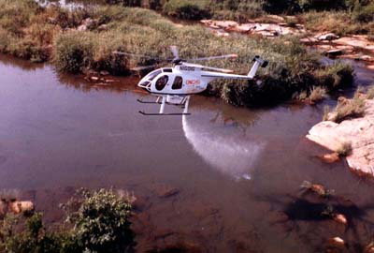
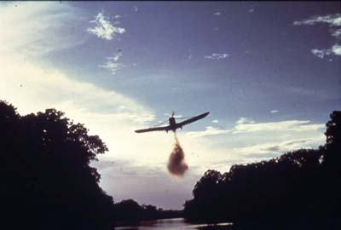
Prevention and control
Vector control: Tememphos as larvicide is effective but resistance develops. Aerial spraying of insecticides over breeding sites in fast flowing rivers.

Slide 42
Personal prophylaxis: yearly ivermectin
Nodulectomy : been useful in reducing incidence of blindness in Mexico and Guatemala
Migration of communities from endemic areas

