Slide 1
LOA LOA
KIMAIGA H.O
MBChB (University of Nairobi)

Slide 2
LOA LOA
Tissue nematode, found in the subcutaneous tissues
Found in West and central Africa
Adults in subcutaneous nodules, connective tissue & sub-conjuctival tissue of the eye
Transmitted by flies Microfilariae found in peripheral blood
Causes loiasis
The vector for Loa loa filariasis are Mango deer flies (Chrysops spp.)
  C. silacea and C. dimidiata. (day-biting flies)

Slide 3
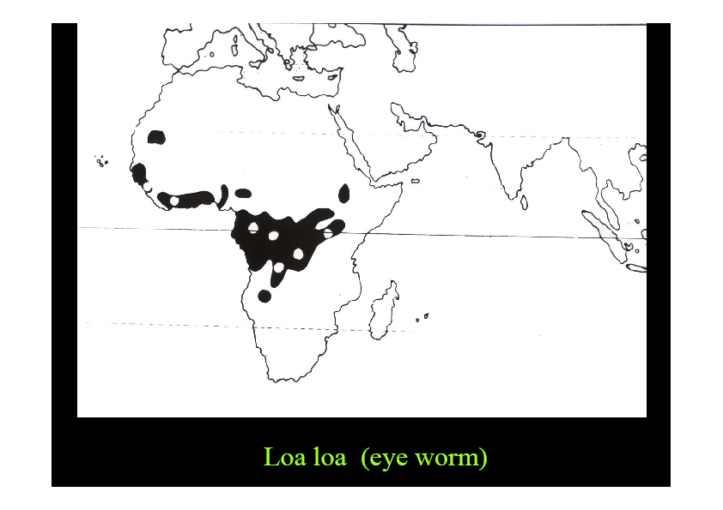

Slide 4
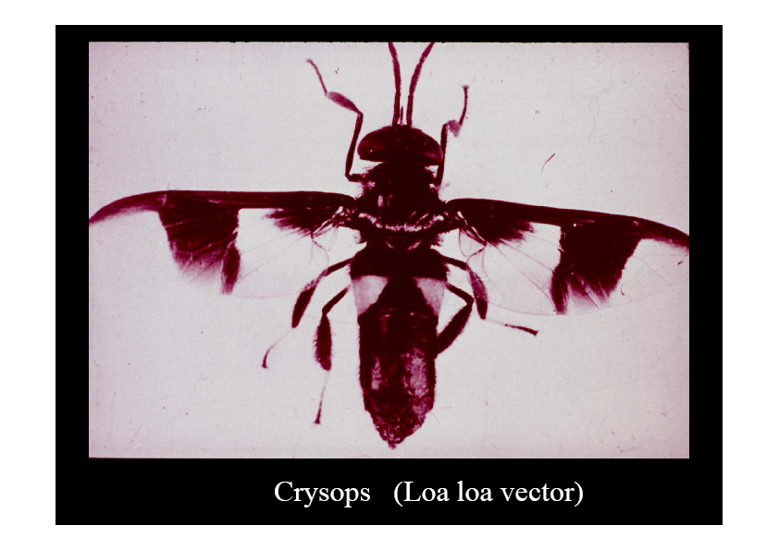

Slide 5
Morphology
Adults :- Threadlike. Females 5 -7 cm; males 3- 4 cm long
Microfilariae – sheathed, 200 – 250 micrometers long
The tail is tapered and nucleus extend to the tip of the tail.

Slide 6

Sheath does not stain , space around the larvae

Slide 7


Nuclei form a continuous row to tip of tail, unstained sheath is visible

Slide 8

Microfilaria , Mayer’ haematoxyline

Slide 9
Life cycle
Adults mate, fertilized females produces microfilariae
Microfilariae in blood taken up by Chrysops flies during a blood meal
Microfilariae have diurnal periodicity (8 am – 8 pm)
Microfilariae have been recovered from spinal fluids, urine, and sputum. During the day they are found in peripheral blood, but during the noncirculation phase, they are found in the lungs

Slide 10
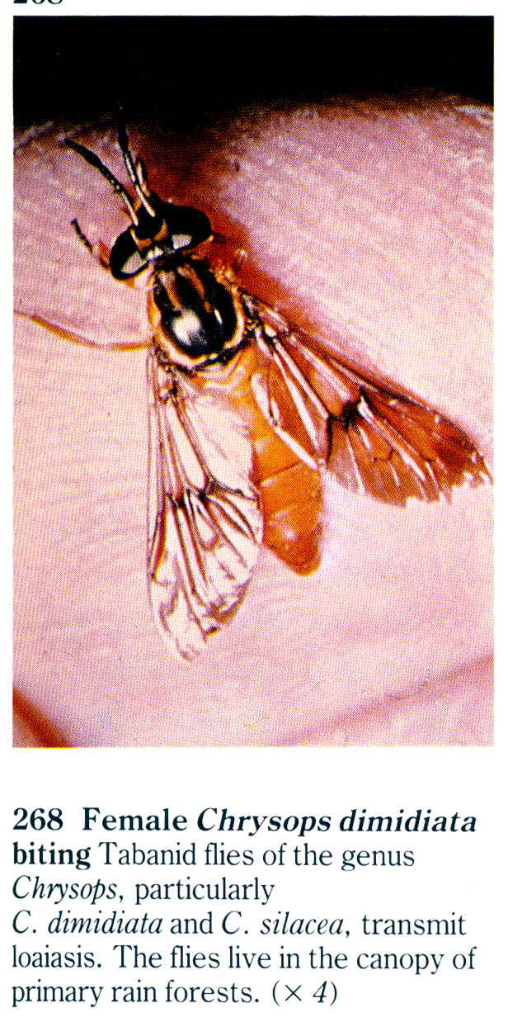
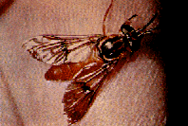
Microfilariae lose their sheaths and penetrate stomach wall, migrate to flight muscles then to proboscis (in mosquito)
In flies development to infective stage takes ~ 10 days
Microfilariae deposited in bite, develop to adults in subcutaneous nodules
Takes 5 -6 months to mature and produce mf; adults live up to 17 yrs.

Slide 11
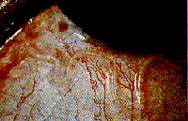
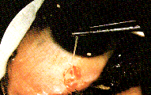

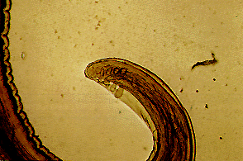
Adult Loa loa moving under the conjunctiva

Slide 12
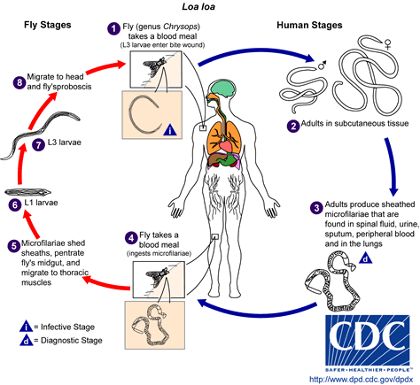

Slide 13
Clinical presentation
Incubation period may be several years
Usually asymptomatic
Worm migrates rapidly through the skin to different parts (e.g. eyes)
Migration of adults worm across conjunctiva (seen by patient!)
Pruritus of the skin
Calabar swelling – transient, migratory, painless, body swellings. May occur at regular intervals, more frequent in hot weather
Others: rare, in heavy infections - meningoencephalitis ( e.g after DEC rx), choroidoretinitis, arthritis

Slide 14
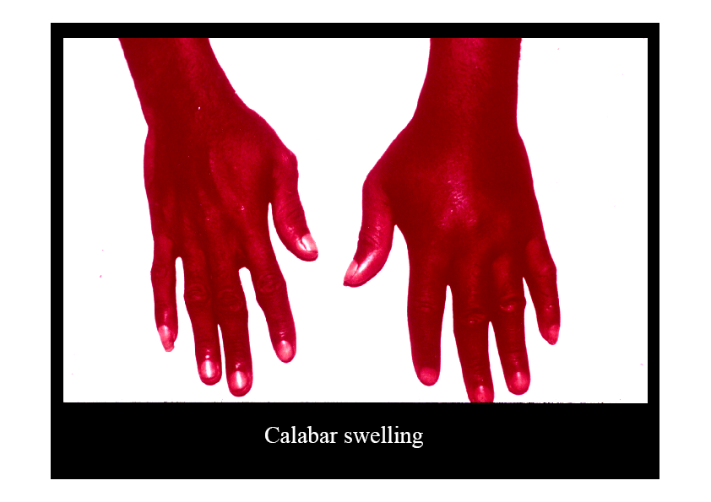

Slide 15
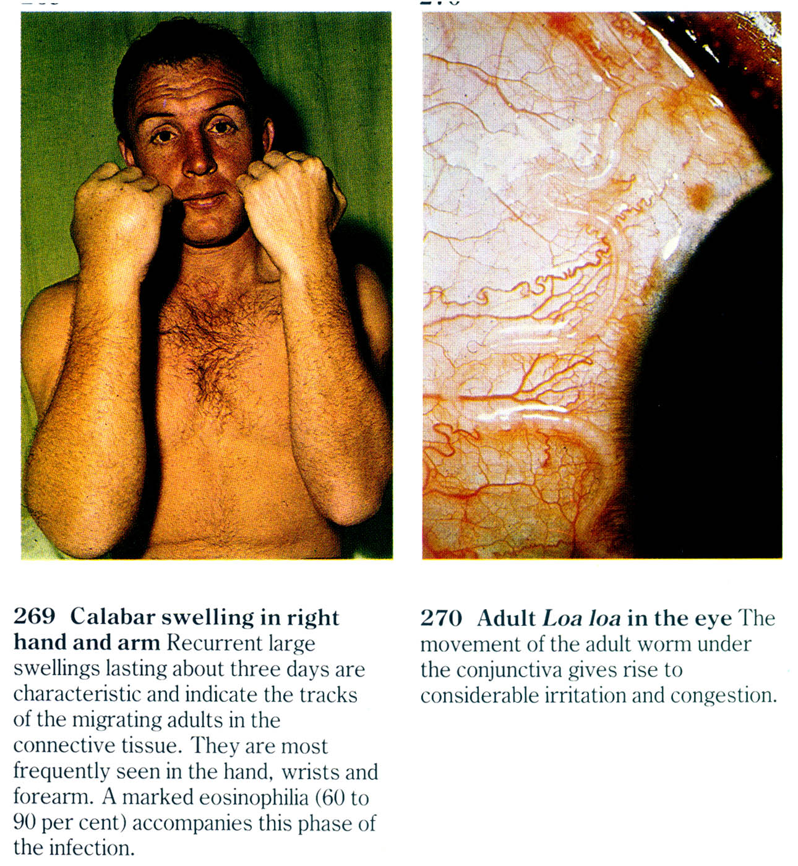

Slide 16
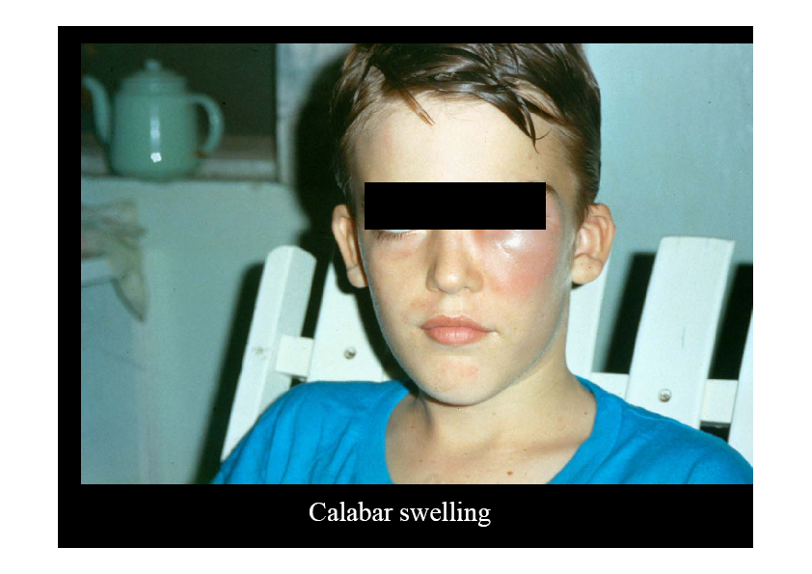

Slide 17
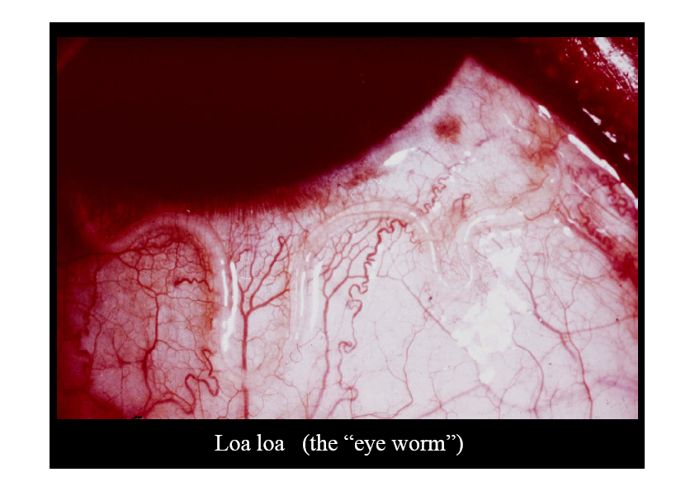

Slide 18
Diagnosis
History of migratory worm in the eye, or of calabar swellings
Microfilariae in blood smears
Serological tests – IFAT, ELISA, PCR
Adult worm extraction from conjuctiva
Eosinophilia, non specific

Slide 19
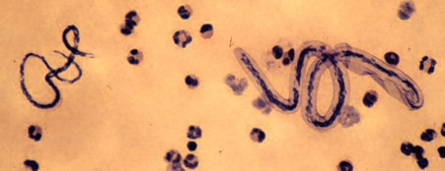
Loa loa/M. perstans
(microfilaria)
Loa loa
M. pertsans

Slide 20
Treatment
DEC- careful as may cause meningoencephalitis in heavy infections
Ivermectin

Slide 21
Control and prevention
Environmental – homes far from forest edges, swamps
Vector control- larvicides & insecticides
Personal control – insect repellants

