Slide 1
NON PATHOGENIC FILARIA PARASITES
Mansonella ozzardi
Mansonella perstans
Mansonella strepocerca.
Vector:- culicoides (flies)

Slide 2
Life Cycle of Mansonella ozzardi:
During a blood meal, an infected arthropod (midges, genus Culicoides, or blackflies, genus Simulium) introduces third-stage filarial larvae onto the skin of the human host, where they penetrate into the bite wound
They develop into adults that commonly reside in subcutaneous tissue
Adult worms are rarely found in humans. The size range for females worms is 65 to 81 mm in length and 0.21 to 0.25 mm in diameter but unknown for males.
Adults worms recovered from experimentally infected Patas monkeys measured 24 to 28 mm in length and 70 to 80 μm in diameter (males) and 32 to 62 mm in length and .130 to .160 mm in diameter (females).
Adults produce unsheathed and non-periodic microfilariae that reach the blood stream . The arthropod ingests microfilariae during a blood meal. After ingestion, the microfilariae migrate from the arthropod's midgut through the hemocoel to the thoracic muscles . There the microfilariae develop into first-stage larvae and subsequently into third-stage infective larvae . The third-stage infective larvae migrate to arthropod's proboscis and can infect another human when the arthropod takes a blood meal .

Slide 3
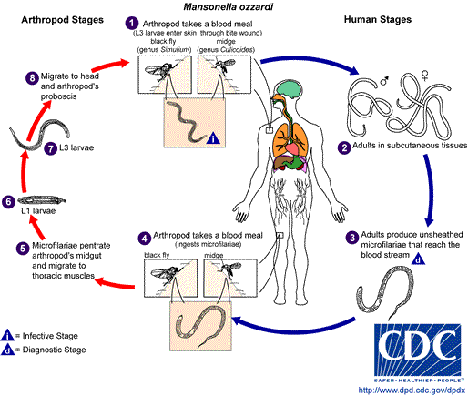

Slide 4
Mansonella ozzardi

Slide 5
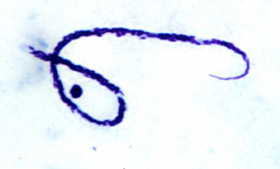
Microfilariae of Mansonella ozzardi are unsheathed and measure 160-205 µm in stained blood smears and 200-255 µm in 2% formalin. The tail tapers to a point and the nuclei end well before the end of the tail. The end of the tail is also bent in a small hook-like shape. Microfilariae circulate in blood.

Slide 6
Life Cycle :
M. ozzardi consists of two biological forms. One is transmitted by black flies of the Simulium family and is mainly found in the Amazon and parts of the South American mainland. The other form is transmitted by midges of the Culicoides family and is endemic to beach areas in the Caribbean where these pests are common. Once in the human host the larvae move into the peritoneal cavities. The adults then mate and produce unsheathed microfilariae about 207-232 x 3-4 micrometers in size. The microfilaria closely resemble those of M. perstans except they have a sharp tail. They are nonperiodic like their vectors and can be found in the blood and skin at all times.

Slide 7
After a blood meal , larvae migrate within 24 hrs to the muscle of the thorax, third stage larvae ( 0.7 mm) emerge after 8 days.
Mf : unsheathed, non-periodic, sharp pointed.

Slide 8
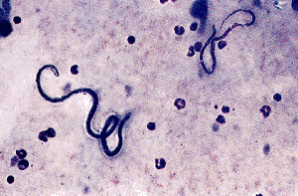

Slide 9
Clinical features---- joint pain, headache,fever, pruritus.
Investigation--------
Treatment ---Ivermectin

Slide 10
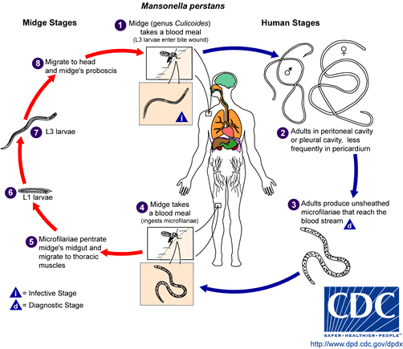
Mansonella pertsans

Slide 11
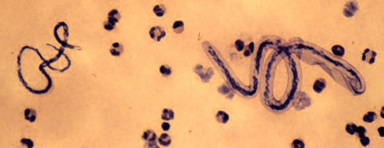
Loa loa/M. perstans microfilaria
Loa loa
M. pertsans

Slide 12
Microfilariae of Mansonella perstans are unsheathed and measure 190-200 µm in stained blood smears and 180-225 µm in 2% formalin. The tail is blunt and nuclei extend to the tip of the tail. Microfilariae circulate in the blood.

Slide 13
Life Cycle:
M. perstans is transmitted to humans by the midges Culicoides grahami and C. austeni. Once inside the body the infective larvae move to serous cavities (pleural and peritoneal), mesentery, peri-renal spaces, retroperitoneal spaces or the pericardium and mature into adults. Because of their habits the adults are rarely seen but they have been found to be cylindrical in shape with lengths and diameters of 4-5 cm x 0.06 mm in males and 7.8 cm x 0.12 mm in the females. The mated adults produce microfilariae which are unsheathed with lengths and diameters of 200 x 4.5 micrometers. They possess the power of elongation and contraction so they can vary in measurement and form

Slide 14
Pathology
The vast majority of infections with M. perstans are asymptomatic. Some individuals do show symptomless eosinophilia, pleuritis, abdominal pain, and transient skin swellings. However, to date most studies have not found any serious conditions connected with perstanian infection.

Slide 15
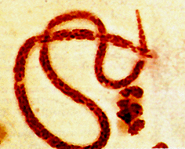
The microfilariae of M. perstans are smaller than those of W. bancrofti and the caudal end is blunt with a terminal nucleus. They are nonperiodic and circulate in the blood in equal amounts through out the day and night. The microfilariae can also often be found in the cerebrospinal fluids.

Slide 16
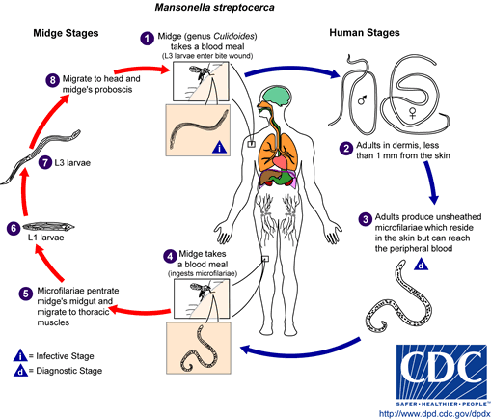
Mansonella streptocerca

Slide 17
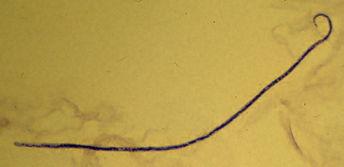
Microfilariae of Mansonella streptocerca are unsheathed and measure 180-240 µm. The tail is been into a hook-like shape and the nuclei extend to the end of the tail. Microfilariae are found in skin and do not circulate in the blood.

Slide 18
The life cycle of M. Streptocerca is similar to that of other filarial nematodes in that it goes through six life stages. The third-stage infective larva are transmitted by the midge Culicoides grahami and once inside a human host the larvae move to the upper thorax and shoulders where they mature in the dermis.

Slide 19
Adult streptocercae are thin sinuous worms, the males averaging 17x0.05mm and the females 27x0.075 mm. Once the adults have mated they produce microfilaria which average 180-240 x 2.5-5 micrometers in size and they also inhabit the dermis.

Slide 20
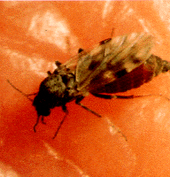

Slide 21
Pathology
In many cases there are no clinical or pathological features of streptocercian infection. IgE mediated immune responses to filarial antigens can occur against dead worms and microfilariae. They are similar but usually less severe than those caused by onchocerciasis and the eye is never affected. The incubation and maturation time of the third-stage infective larvae is three to four months.

Slide 22
Persons with symptoms often have an itching dermatitis over the thorax and shoulders. The skin is thickened and there are hypopigmented macules. The axillary lymph glands can also be enlarged.
D/D: Oncho and Leprosy.

Slide 23
The microfilaria are unsheathed and have a characteristic pattern of nuclei posterior to the clear cephalic space with four oval nuclei followed by seven to ten smaller, more rounded nuclei and an oval rounded terminal nucleus in a characteristic curved posterior portion of the worm producing the 'walking stick' or 'shepherd’s crook' tail. These features distinguish them from M. ozzardi and perstans.

Slide 24
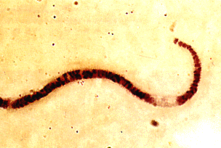

Slide 25
Treatment :
DEC : eliminates both Adult and mf.
2-6 mg/kg. for 21 days.

